Slide 1
Project 2 Summary
Project 3 Intro
Cs195g Computational Photography
James Hays, Brown University

Slide 2
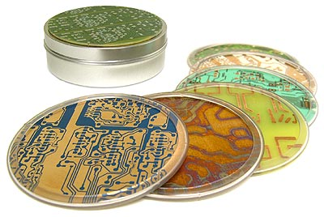
Project 2 Class Choice Award
Evan Wallace
Prize:
Circuitboard Coasters

Slide 3
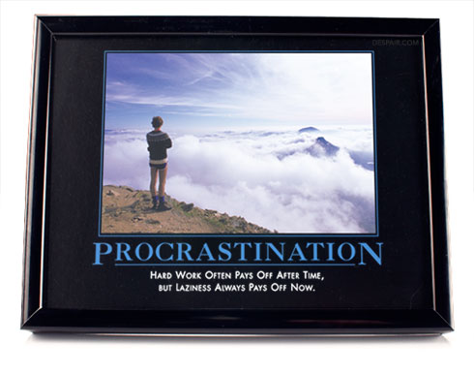
Project 2 TA Choice Award
Steven Gomez
Prize:
Demotivational
Desktopper

Slide 4
Also Presenting
Rudy Sandoval
David Dufresne
Ben Cohen
Evan Donahue

Slide 5
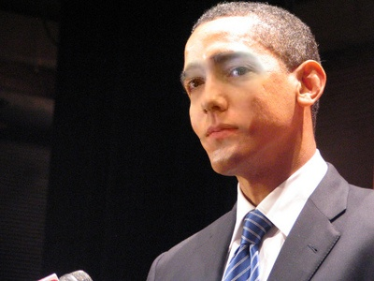
More Highlights
Image by Tristan Hale

Slide 6
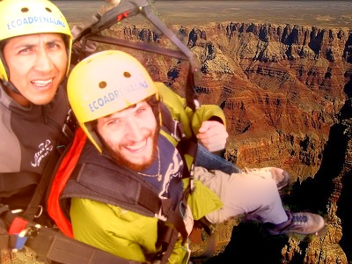
More Highlights
Image by Sam Potasznik

Slide 7
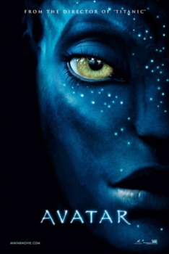
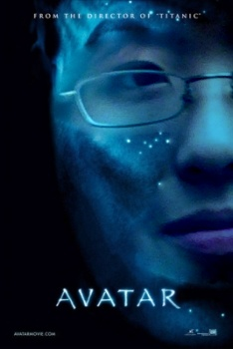
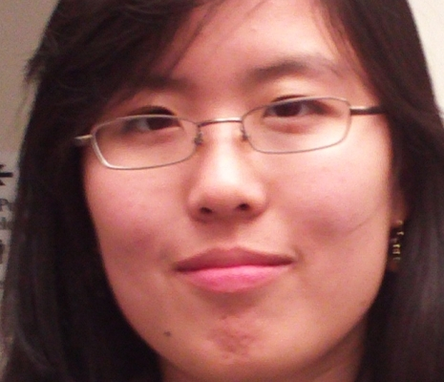

More Highlights
Images by Pat Doran

Slide 8
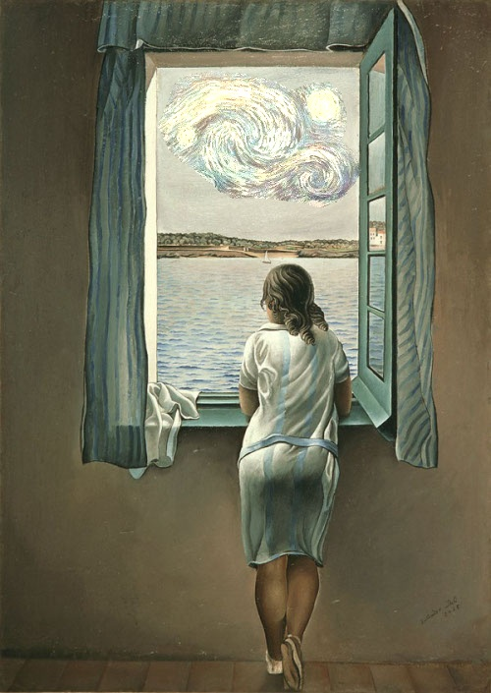
More Highlights
Image by Jason Pacheco

Slide 9
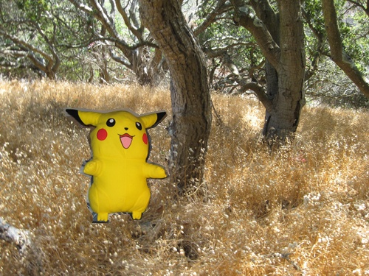
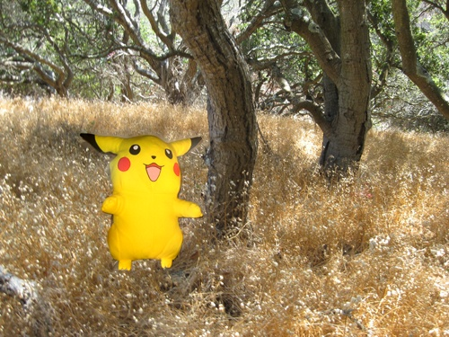
More Highlights
Images by Lyn Fong

Slide 10



More Highlights
Images by Travis Web

Slide 11
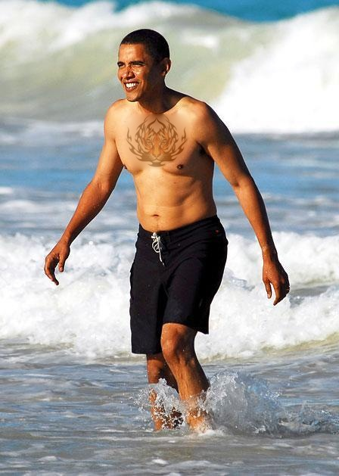
More Highlights
Image by Eli Bosworth

Slide 12
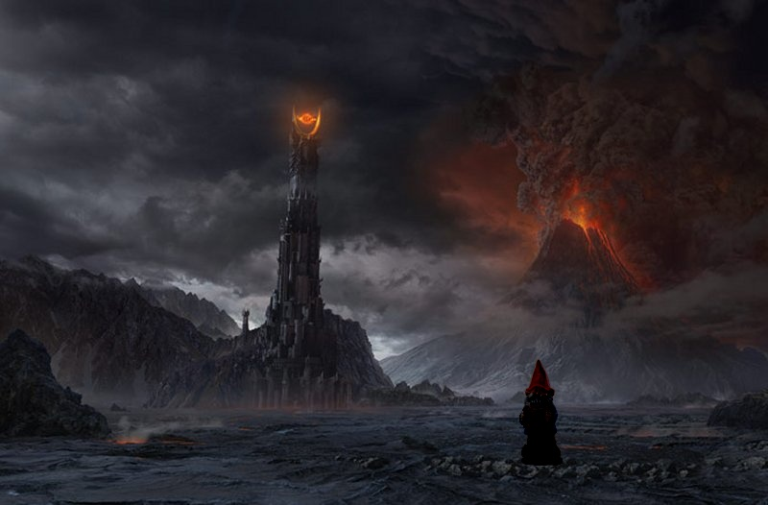
More Highlights
Image by Diane Huang

Slide 13
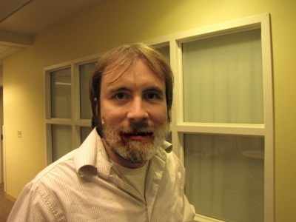
More Highlights
Image by Ben Swanson

Slide 14
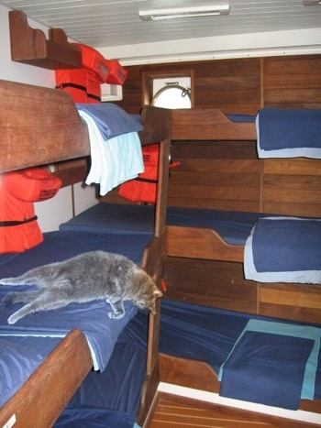
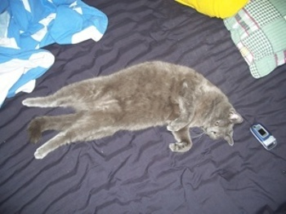
More Highlights
Images by Basia Korel

Slide 15
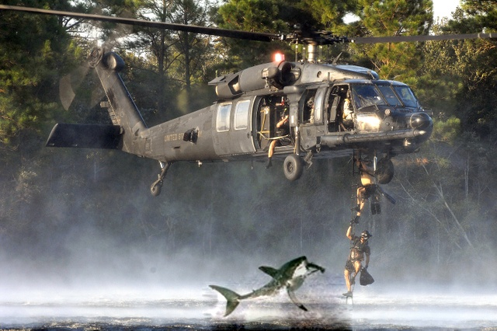
More Highlights
Image by Alex Collins

Slide 16
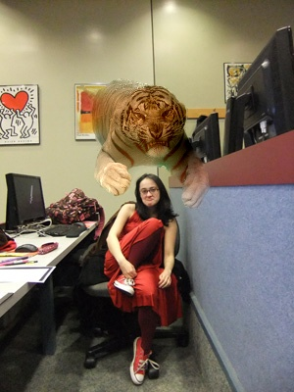
More Highlights
Image by Ben Cohen

Slide 17
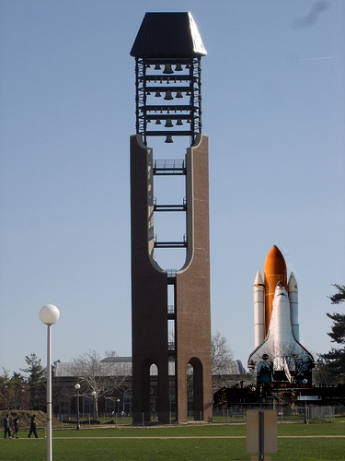
More Highlights
Image by Steven Gomez

Slide 18
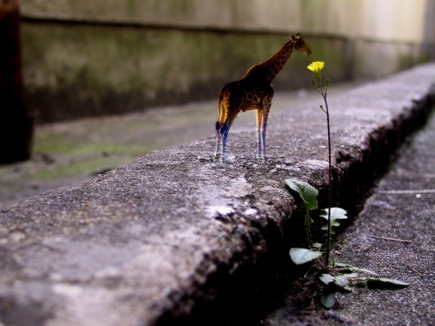
More Highlights
Image by Rudy Sandoval

Slide 19
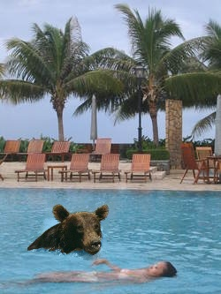
More Highlights
Image by Evan Donahue

Slide 20
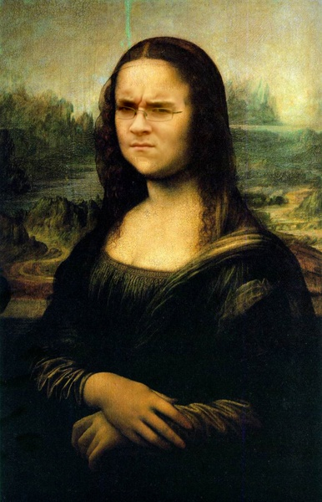
More Highlights
Image by Evan Wallace

Slide 21
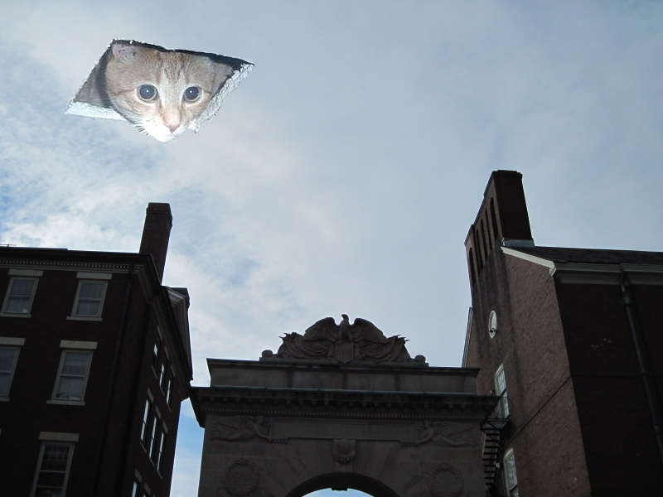
More Highlights
Image by David Dufresne

Slide 22
What did we learn about blending?

Slide 23
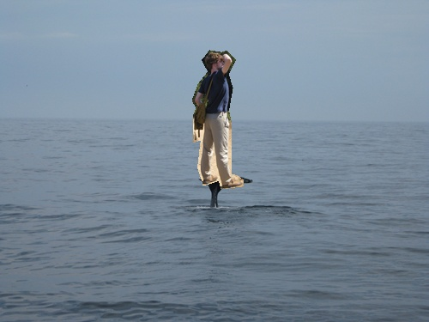
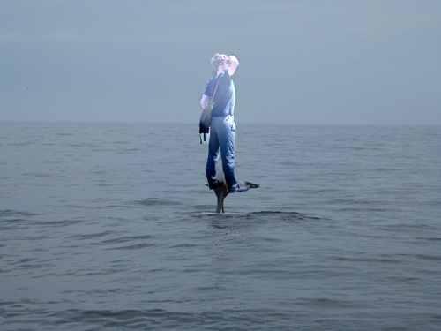
What did we learn about blending?
The colors along the boundaries cannot be drastically different:
Images by Lyn Fong

Slide 24
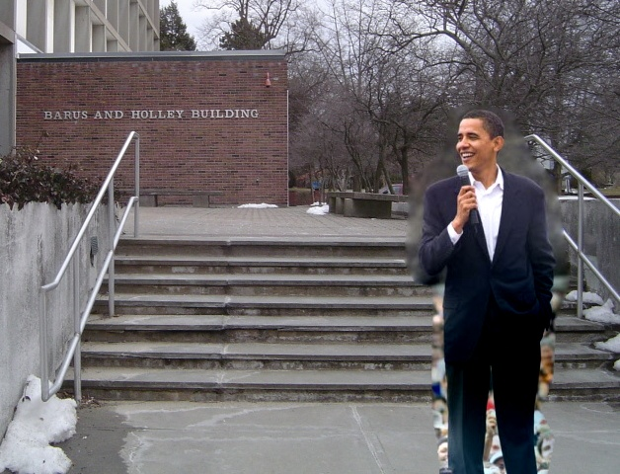
What did we learn about blending?
Texture differences still show through
Image by Diane Huang

Slide 25
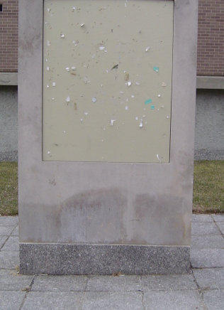
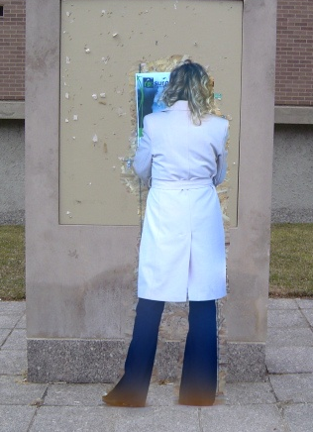
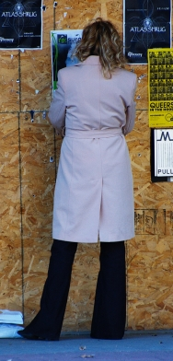
What did we learn about blending?
Although sometimes blending still nearly works
Images by Diane Huang

Slide 26
Project 3: Don’t Blend, Cut!

Slide 27
Final Reminder
Read Szeliski’s book!

