Slide 1
Project 3 Summary
Project 4 Intro
Cs195g Computational Photography
James Hays, Brown University

Slide 2
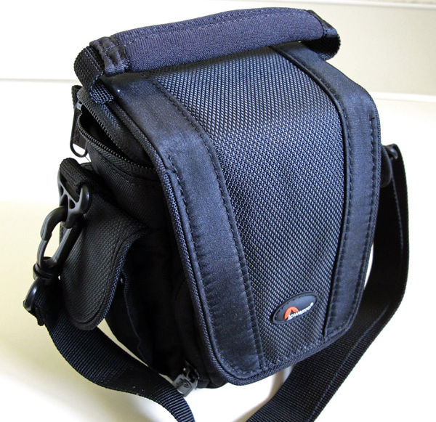
Prizes!
Camera bags

Slide 3
Winning Projects
Evan Wallace
Jason Pacheco

Slide 4
Also Presenting
Steve Gomez
Jarrell Travis Webb
Eli Bosworth

Slide 5
Additional results

Slide 6
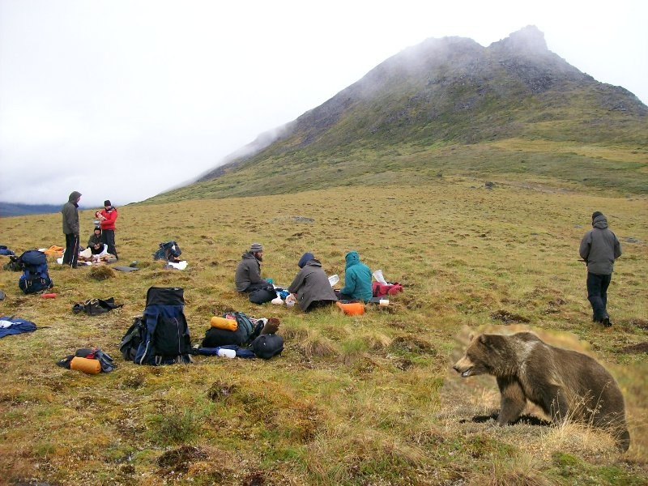
Image Tim St. Clair

Slide 7
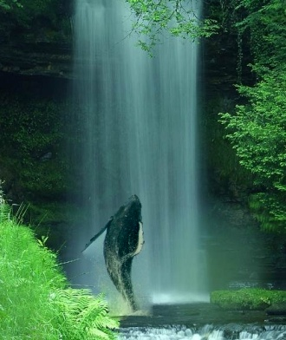
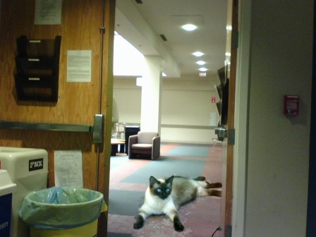
Images by Tristan Hale

Slide 8
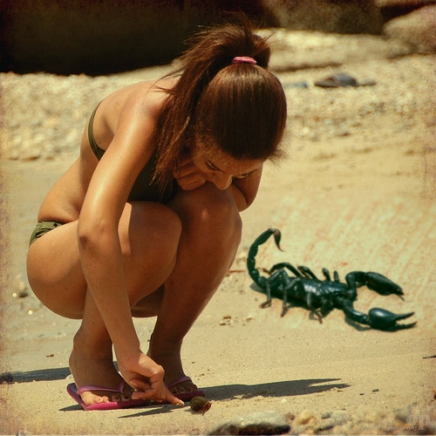
Image by Steve Gomez

Slide 9
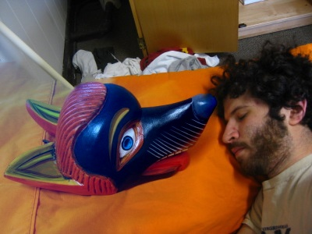
Image Sam Potasznik

Slide 10
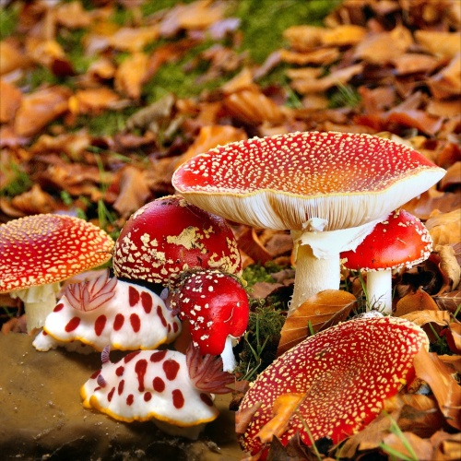
Image Rudy Sandoval

Slide 11
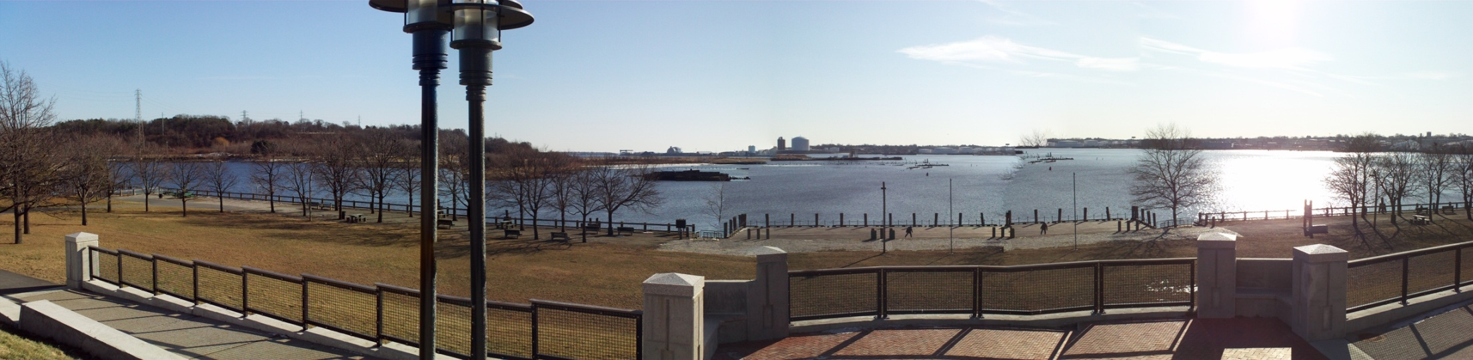
Image by Pat Doran

Slide 12
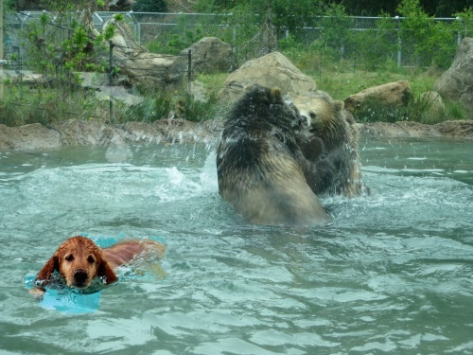
Image by Linda Fong

Slide 13
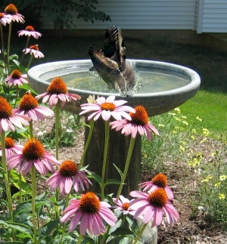
Image Evan Donahue

Slide 14
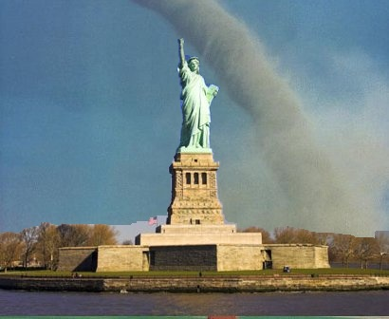
Image David Dufresne

Slide 15
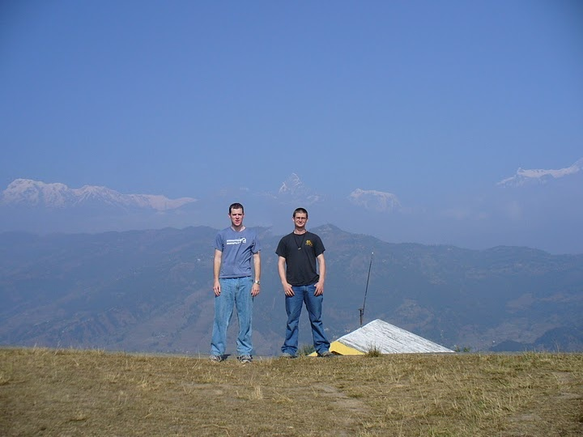
Image by Ben Swanson

Slide 16
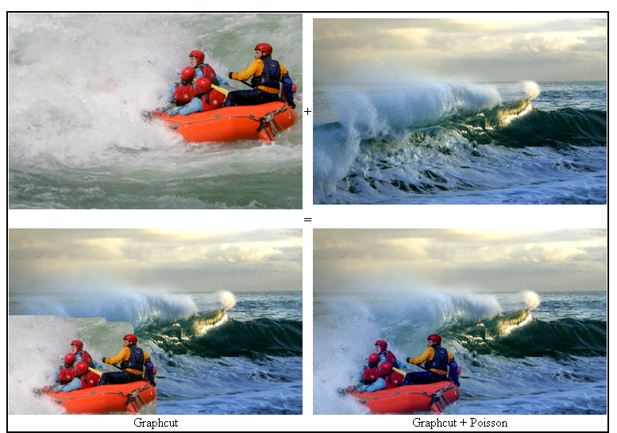
Images by Ben Cohen

Slide 17
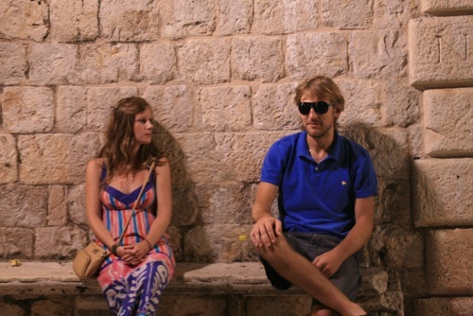
Image by Basia Korel

Slide 18
Texture Synthesis Results

Slide 19
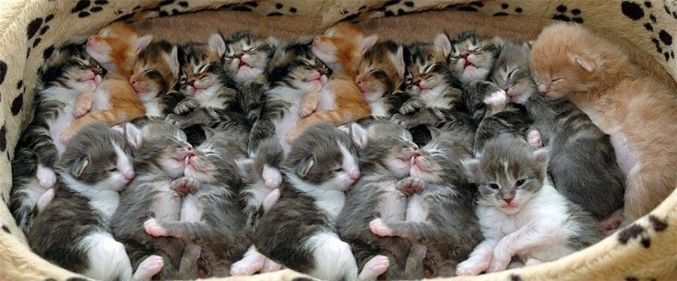
Image by Evan Wallace

Slide 20
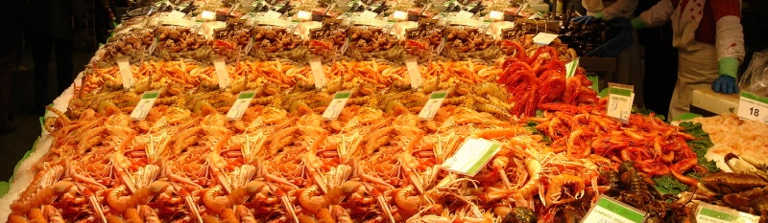
Image by Jason Pacheco

Slide 21
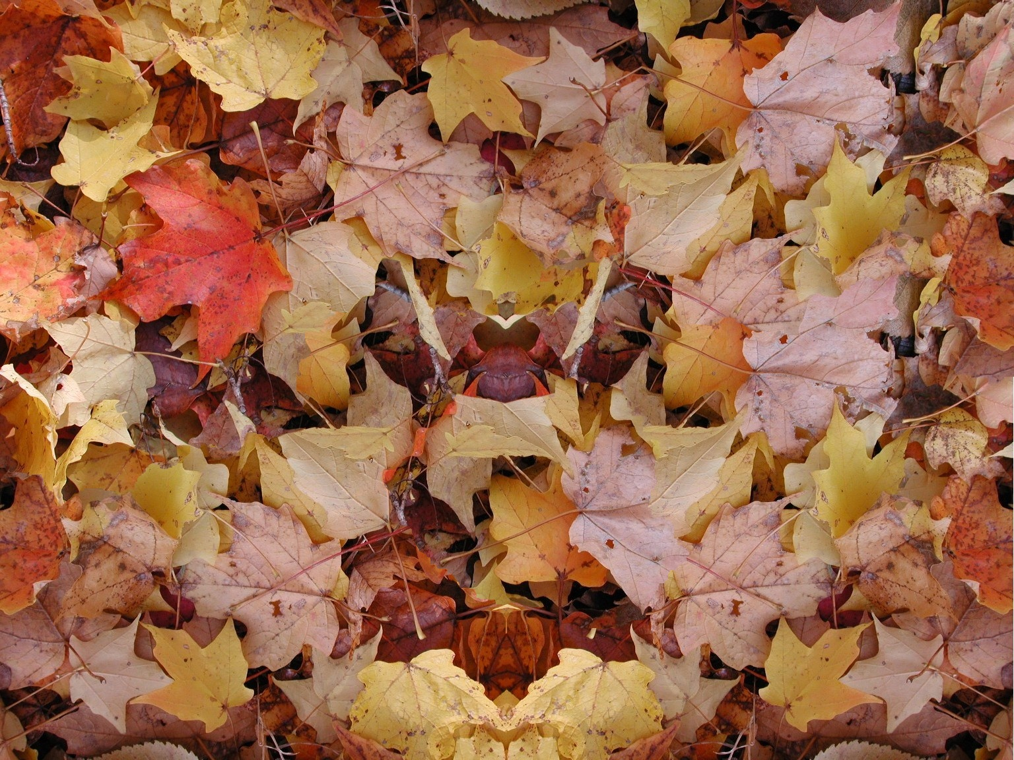
Image by Rudy Sandoval

Slide 22
Project 4: Image Completion

