Slide 1
Internet-scale Imagery for Graphics and Vision
James Hays
cs195g Computational Photography
Brown University, Spring 2010

Slide 2
Big issues
What is out there on the Internet? How do we get it? What can we do with it?
How do we compute distances between images?

Slide 3
The Internet as a Data Source
Social Networking Sites (e.g. Facebook, MySpace)
Image Search Engines (e.g. Google, Bing)
Photo Sharing Sites (e.g. Flickr, Picasa, Panoramio, photo.net, dpchallenge.com)
Computer Vision Databases (e.g. CalTech 256, PASCAL VOC, LabelMe, Tiny Images, image-net.org, ESP game, Squigl, Matchin)
Notes:
Social network images are largely inaccessible.
Search engine results are perhaps inaccurate and you don’t get much metadata with the images
Photo sharing sites are large, higher quality photographs, more metadata (text and geo tags)
Computer vision databases are smaller, but higher quality usually and with more annotation.

Slide 4
How Big is Flickr?
As of June 19th, 2009
Total content:
  3.6 billion photographs
  100+ million geotagged images
Public content:
  1.3 billion photographs
  74 million geotagged images

Slide 5
How Annotated is Flickr? (tag search)
Party – 7,355,998
Paris – 4,139,927
Chair – 232,885
Violin – 55,015
Trashcan – 9,818

Slide 6
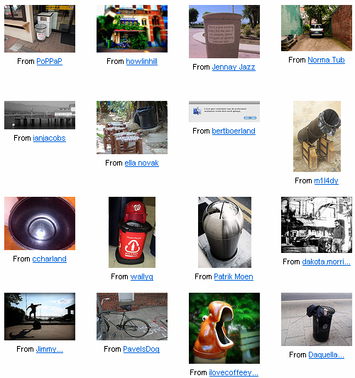
Trashcan Results
http://www.flickr.com/search/?q=trashcan+NOT+party&m=tags&z=t&page=5

Slide 7
Different ways to leverage Internet Data
Aggregate Statistics (e.g. Photo collection priors, Image sequence geolocation)
Text keywords, other metadata (e.g. Phototourism, Photo Clip Art, sketch2photo)
Visual similarity (e.g. Tiny Images, Scene Completion, im2gps, cg2real, DB photo enhancement, Virtual Photoreal Space, Total Recall)
  Scene level similarity
  Instance level similarity

Slide 8
Statistics from Large Photo Collections

Slide 9
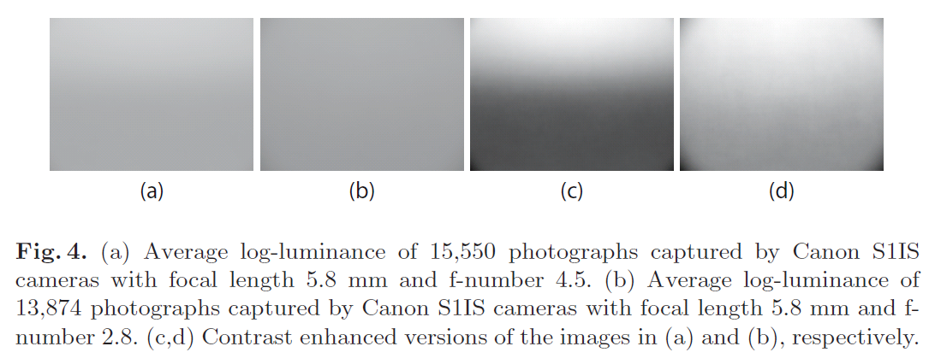
Priors for Large Photo Collections and What They Reveal about Cameras.
Sujit Kuthirummal, Aseem Agarwala, Dan B Goldman, and Shree K. Nayar
ECCV 2008

Slide 10
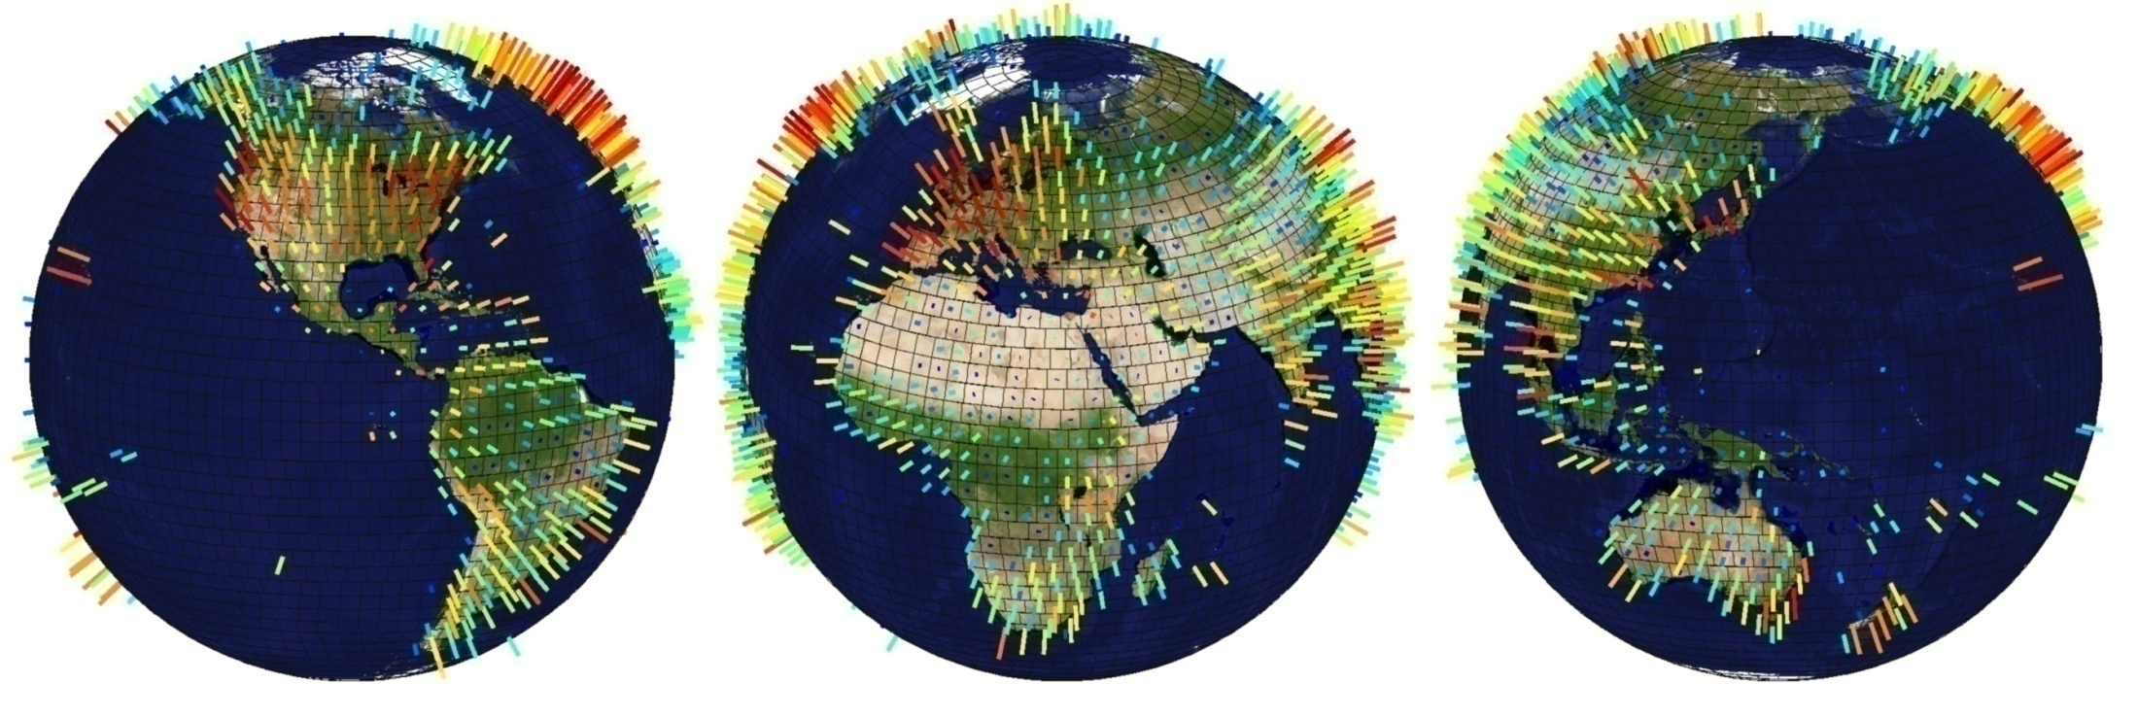
im2gps Geographic Photo Density
Notes:
All photographs had at least one geographic place name.

Slide 11
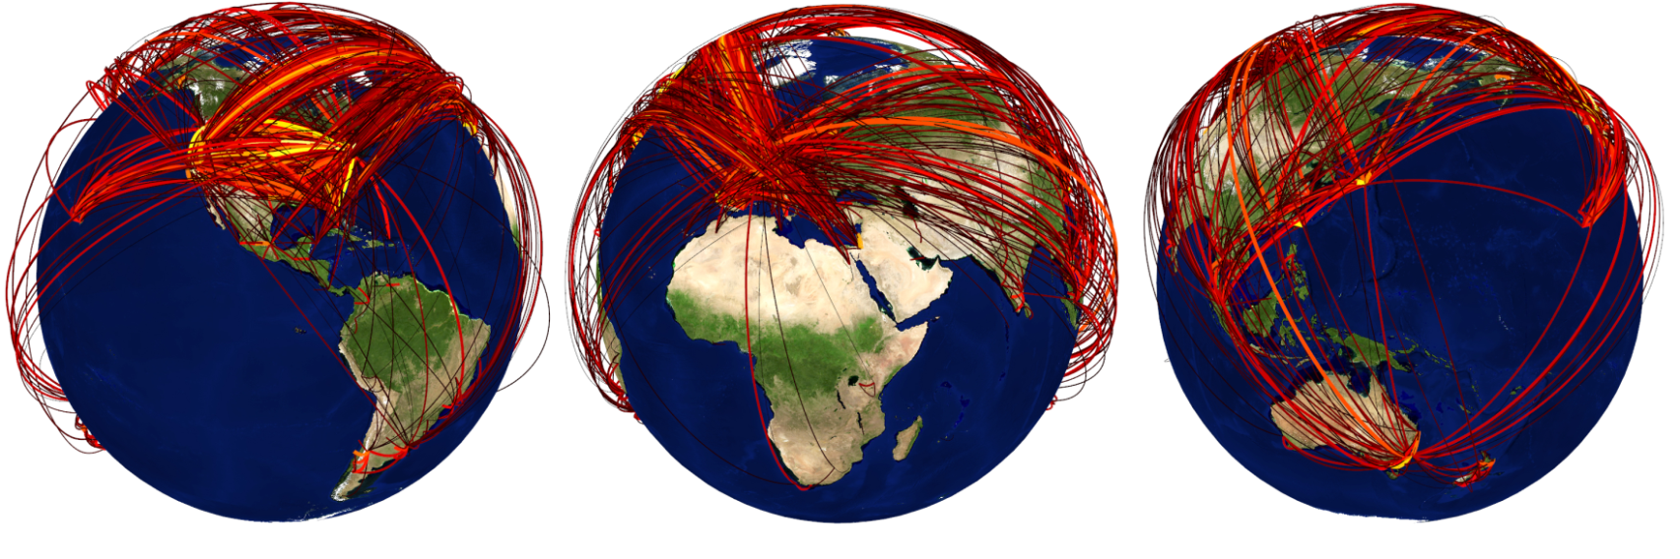
Image Sequence Geolocation with Human Travel Priors
Kalogerakis, Vesselova, Hays, Efros, Hertzmann.
Image Sequence Geolocation with Human Travel Priors. ICCV 2009
Notes:
Interesting note, landmarks alone don’t account for the performance.

Slide 12
Internet Imagery from metadata search

Slide 13
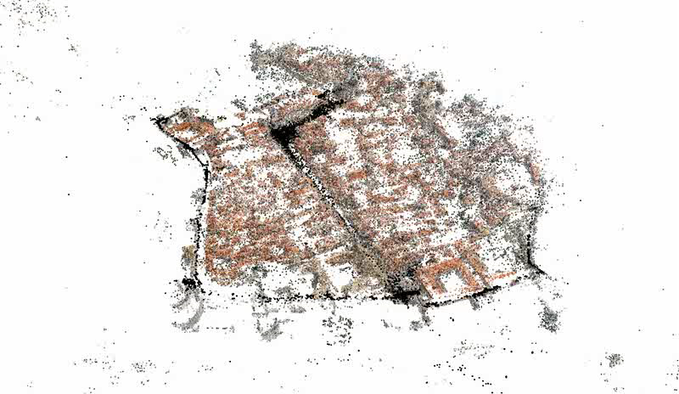
Building Rome in a Day
Sameer Agarwal, University of Washington
Yasutaka Furukawa, University of Washington
Noah Snavely, Cornell University
Ian Simon, University of Washington
Steve Seitz, University of Washington
Richard Szeliski, Microsoft Research

Slide 14
Sketch2photo

Slide 15
Internet Imagery from visual search

Slide 16








Distance Metrics
y
y
x
-
x
= Euclidian distance of 5 units
-
= Grayvalue distance of 50 values
-
= ?

Slide 17
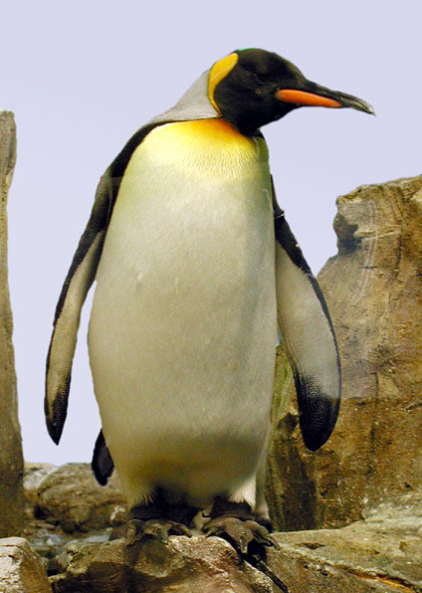
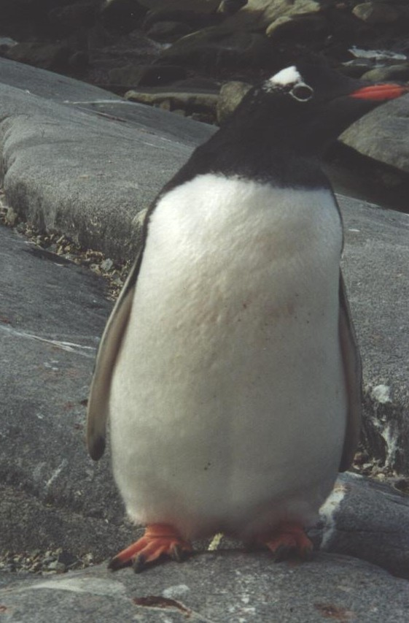

SSD says these are not similar
?

Slide 18
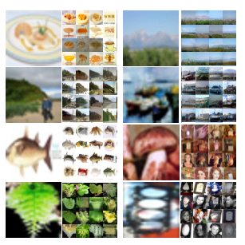
Tiny Images
80 million tiny images: a large dataset for non-parametric object and scene recognition Antonio Torralba, Rob Fergus and William T. Freeman. PAMI 2008.

Slide 19
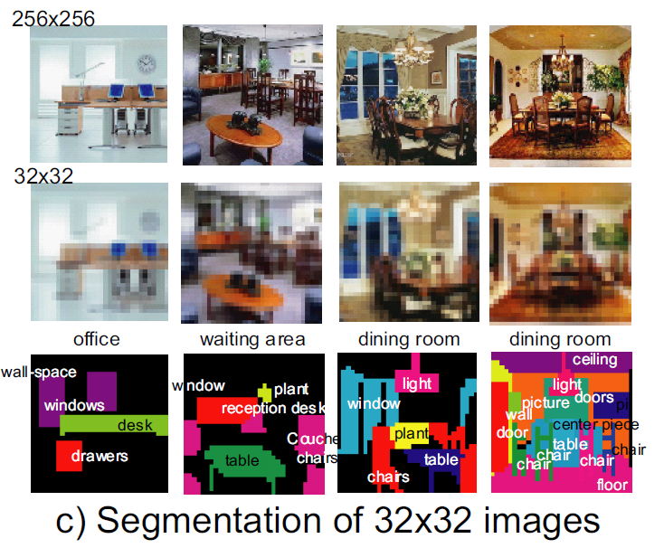

Slide 20
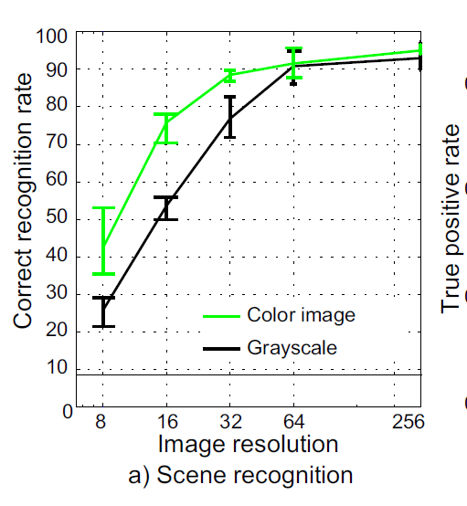
Human Scene Recognition

Slide 21
Tiny Images Project Page
http://groups.csail.mit.edu/vision/TinyImages/

Slide 22

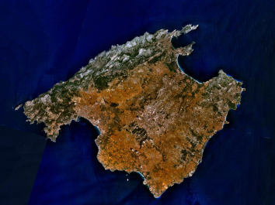
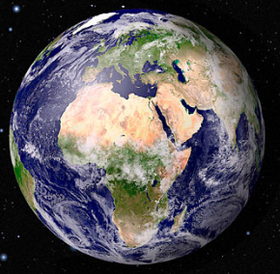
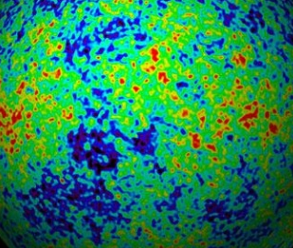

Powers of 10
Number of images on my hard drive: 10⁴
Number of images seen during my first 10 years: 10⁸
(3 images/second * 60 * 60 * 16 * 365 * 10 = 630720000)
Number of images seen by all humanity: 10²⁰
106,456,367,669 humans¹ * 60 years * 3 images/second * 60 * 60 * 16 * 365 =
1 from http://www.prb.org/Articles/2002/HowManyPeopleHaveEverLivedonEarth.aspx
Number of photons in the universe: 10⁸⁸
Number of all 32x32 images: 10⁷³⁷³
256 ^{32*32*3} ~ 10⁷³⁷³
Notes:
so don’t listen to anyone claiming to brute force image space
But most of image space is empty, never observed

Slide 23
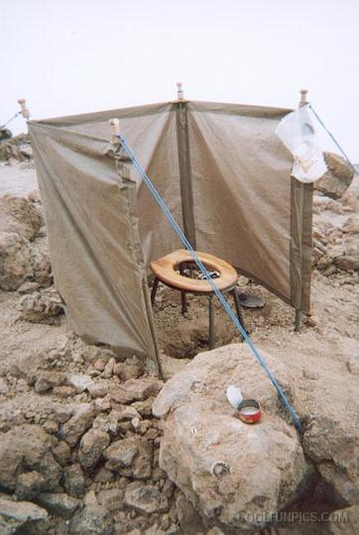
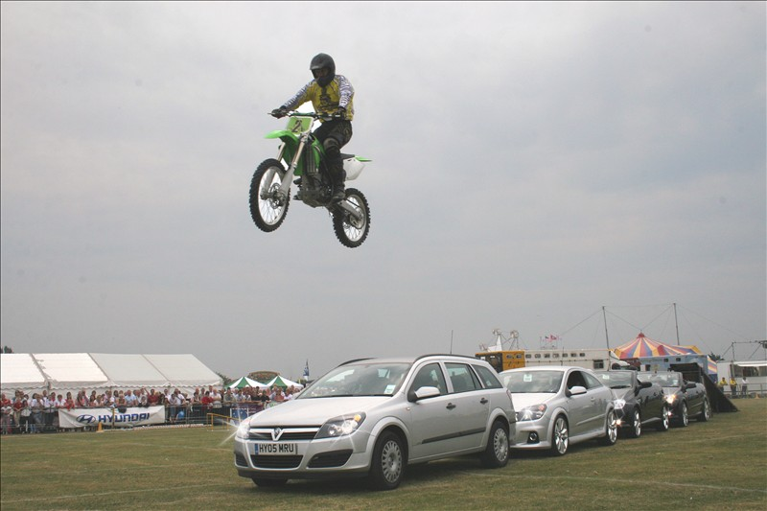
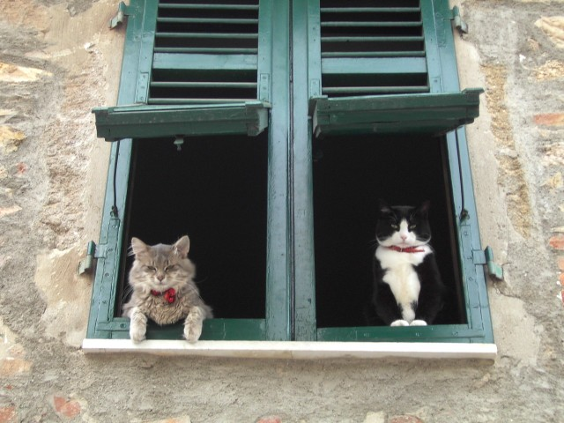
Scenes are unique
Notes:
Scene and object recognition at human performance is very hard because we are able to deal with so many different kinds of scenes…
Scenes are so unique.

Slide 24
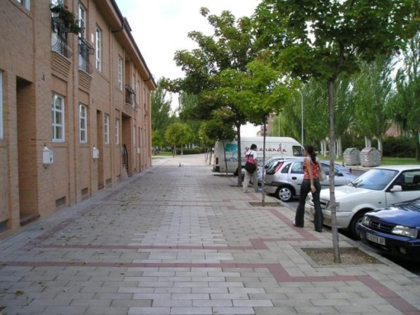
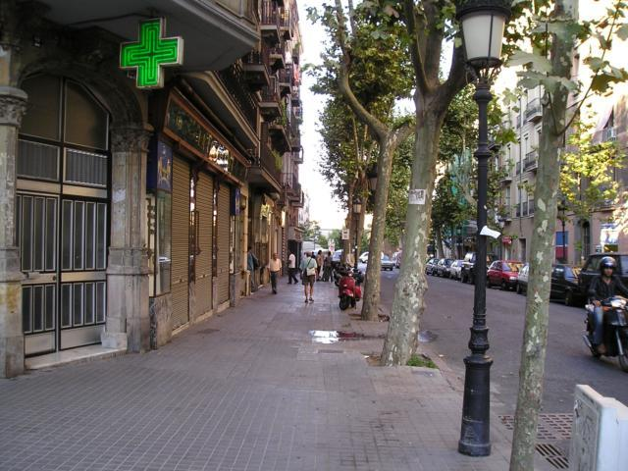
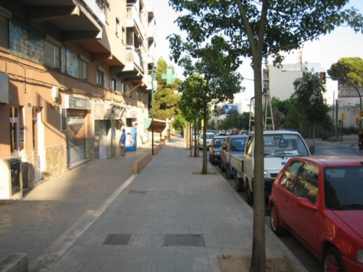
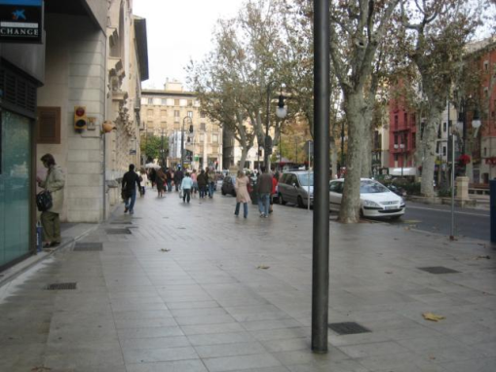
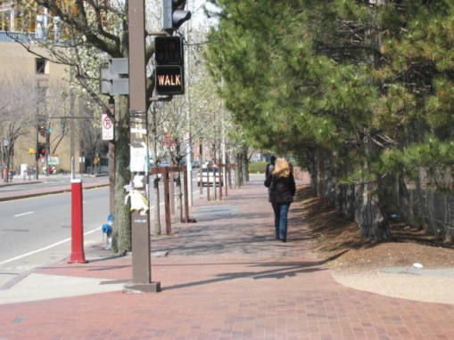
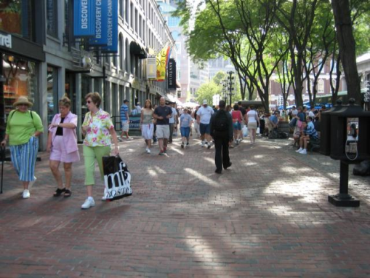
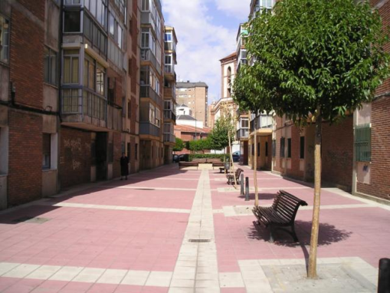
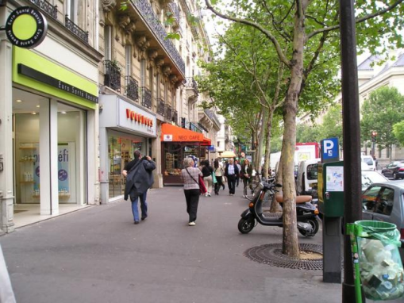
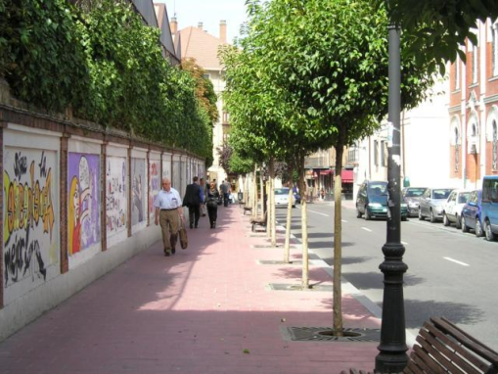
But not all scenes are so original
Notes:
But most scenes are not really like that. Most of the time, scenes are boring places in which nothing really surprising happens. For instance, this street… there is nothing really special about it. In fact, I can easily find thousands of other street pictures that look just like this. Of course, these scenes are different in the details, just as two faces are different, but at a coarser level they are form by similar objects arranged in a similar spatial configuration.

Slide 25
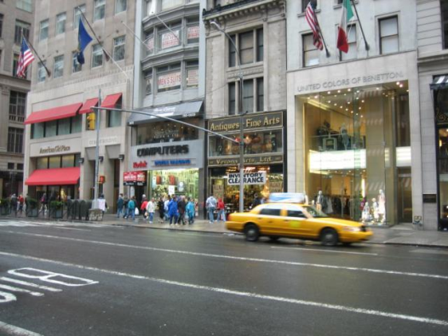
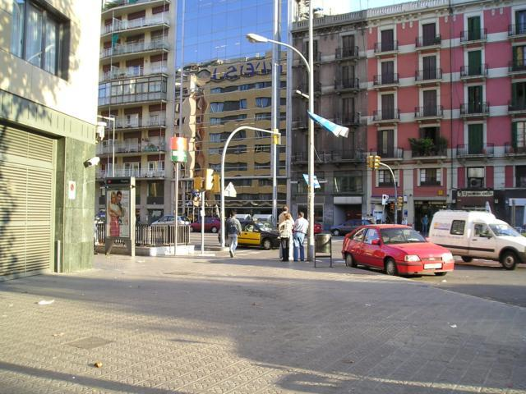
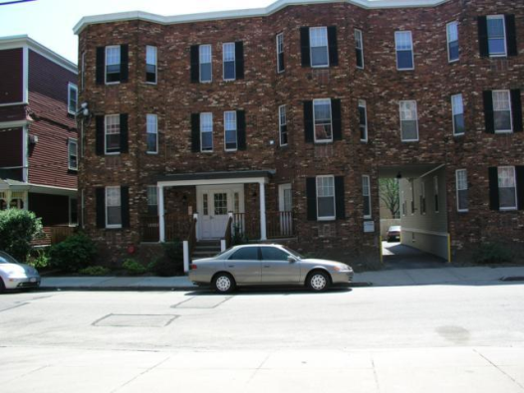
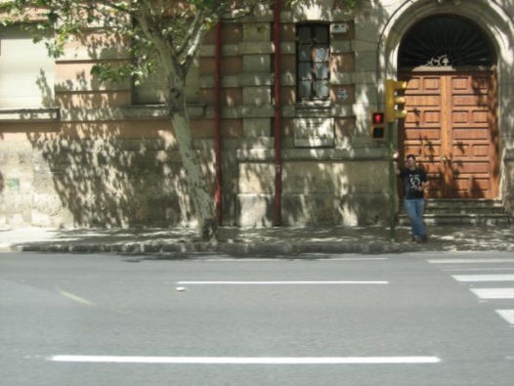
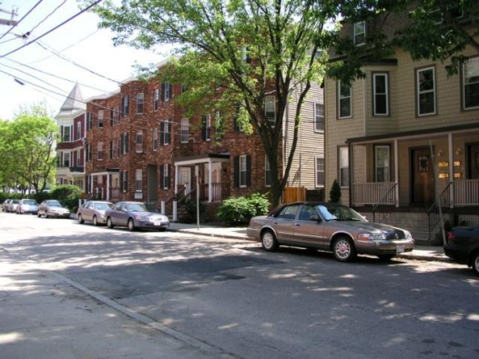
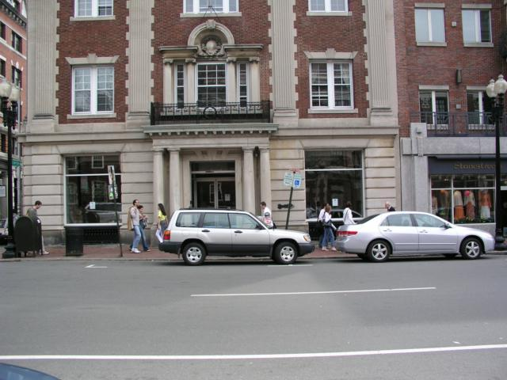
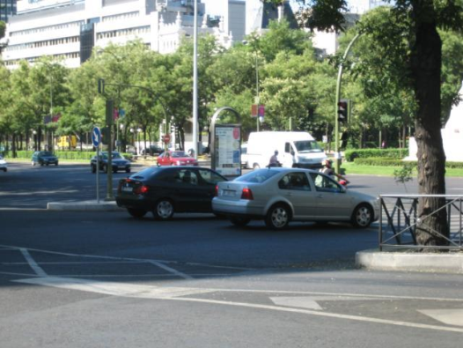
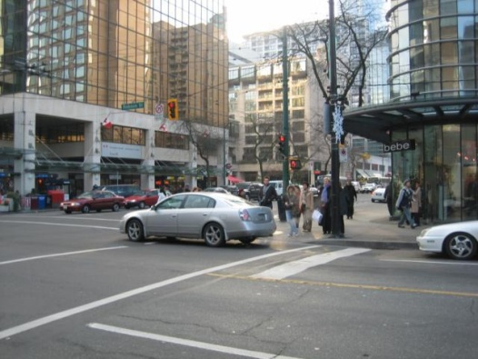
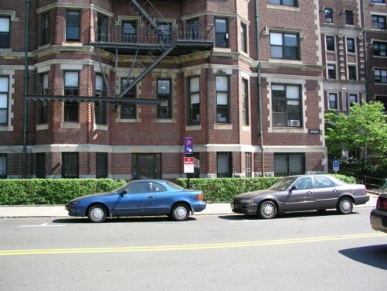
But not all scenes are so original
Notes:
But most scenes are not really like that. Most of the time, scenes are boring places in which nothing really surprising happens. For instance, this street… there is nothing really special about it. In fact, I can easily find thousands of other street pictures that look just like this. Of course, these scenes are different in the details, just as two faces are different, but at a coarser level they are form by similar objects arranged in a similar spatial configuration.

Slide 26
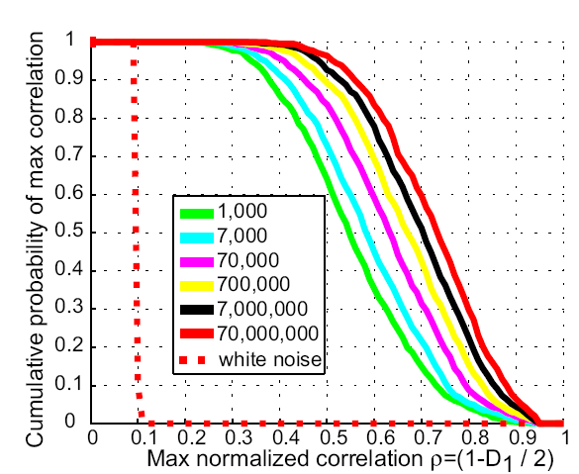
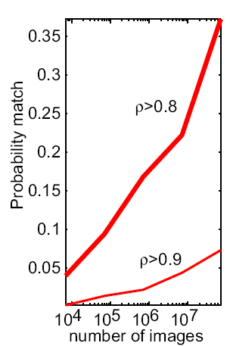
How many images are there?
Torralba, Fergus, Freeman. PAMI 2008

