Slide 1
Internet-scale Imagery for Graphics and Vision
James Hays
cs195g Computational Photography
Brown University, Spring 2010

Slide 2
Recap from Monday
What imagery is available on the Internet
What different ways can we use that imagery
  aggregate statistics
  sort by keyword
  visual search
    category / scene recognition
    instance / landmark recognition

Slide 3
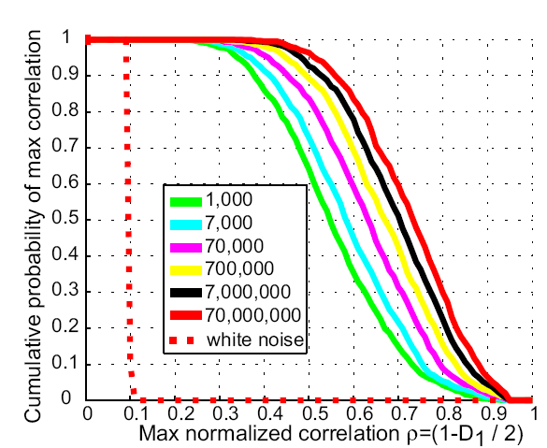
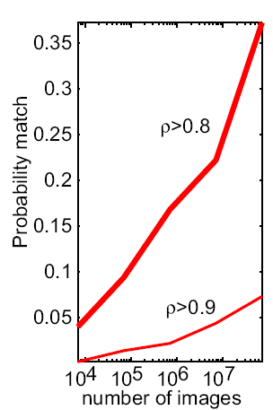
How many images are there?
Torralba, Fergus, Freeman. PAMI 2008

Slide 4
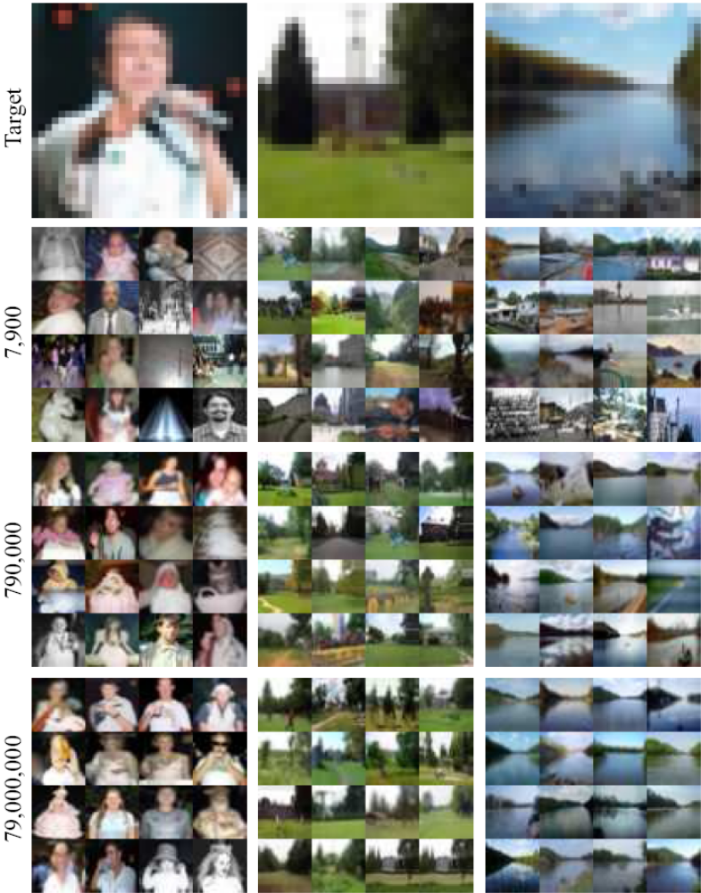
Lots
Of
Images
A. Torralba, R. Fergus, W.T.Freeman. PAMI 2008

Slide 5
Lots
Of
Images
A. Torralba, R. Fergus, W.T.Freeman. PAMI 2008

Slide 6
Lots
Of
Images

Slide 7
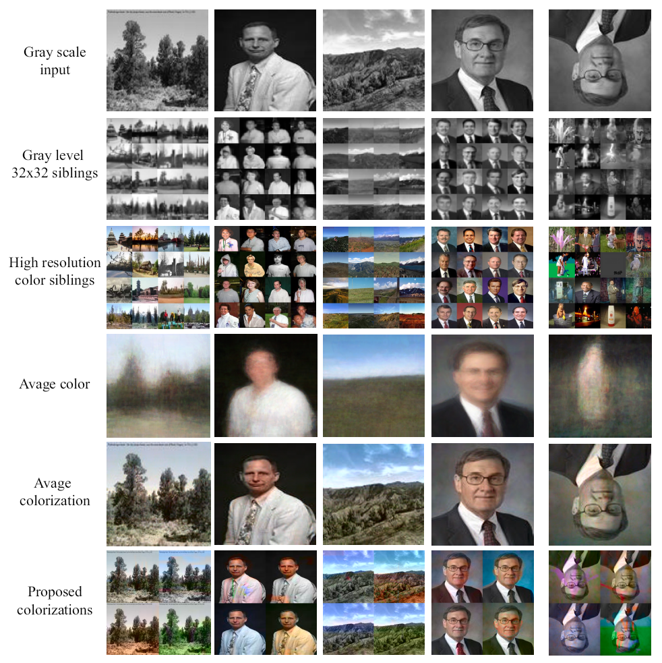
Automatic Colorization Result
Grayscale input High resolution
Colorization of input using average
A. Torralba, R. Fergus, W.T.Freeman. 2008

Slide 8
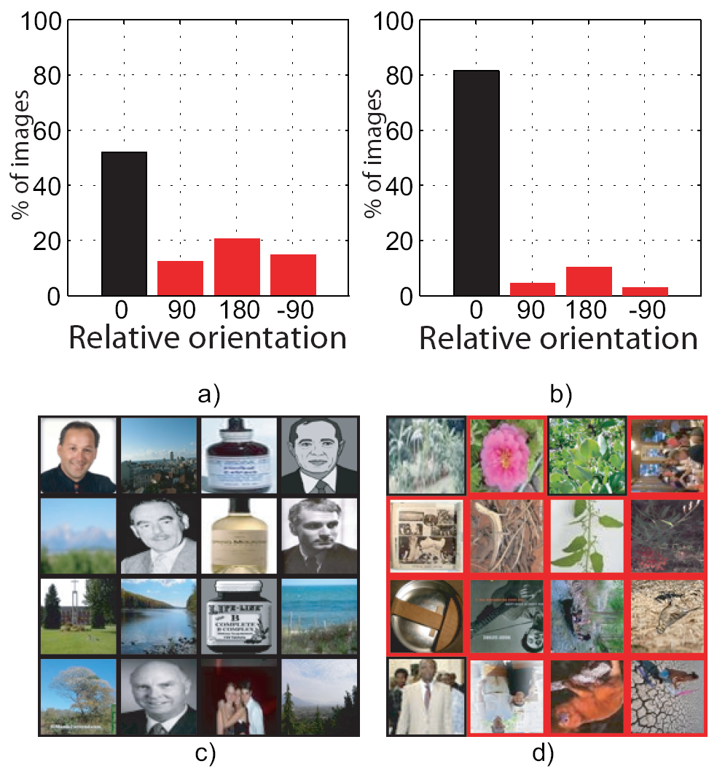
Automatic Orientation
Many images have
ambiguous orientation
Look at top 25%
by confidence:
Examples of high and low confidence images:

Slide 9
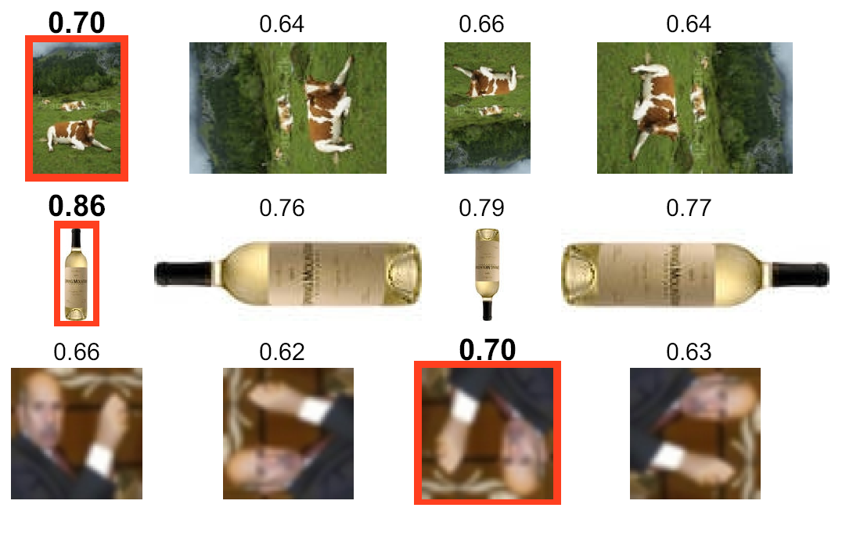
Automatic Orientation Examples
A. Torralba, R. Fergus, W.T.Freeman. 2008
Notes:
Images change size as rotated
9

Slide 10
Tiny Images Discussion
Why SSD?
Can we build a better image descriptor?

Slide 11
Gist Scene Descriptor
Better than SSD, why?

Slide 12
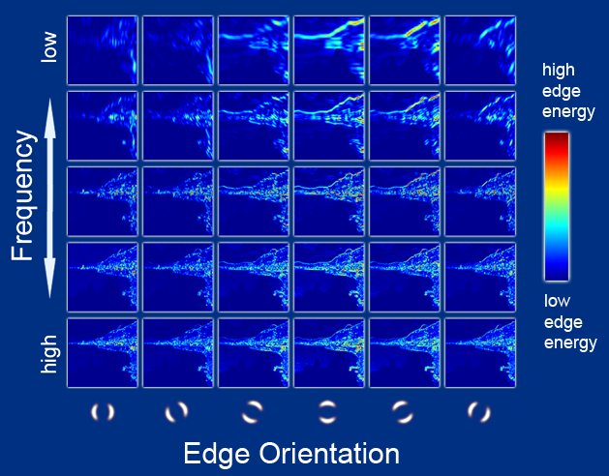
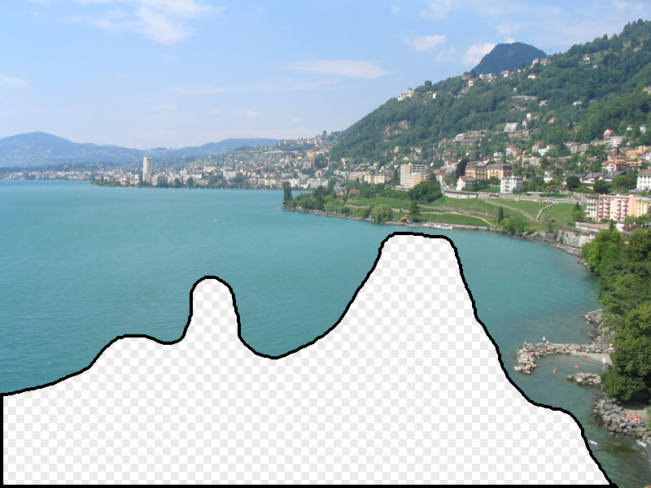
Gist Scene Descriptor
Hays and Efros, SIGGRAPH 2007

Slide 13
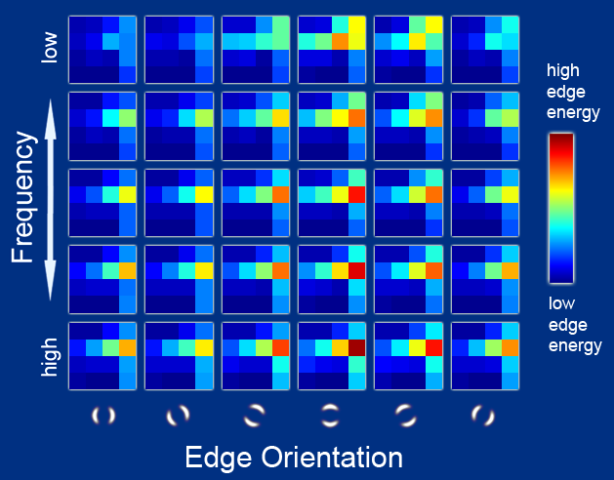
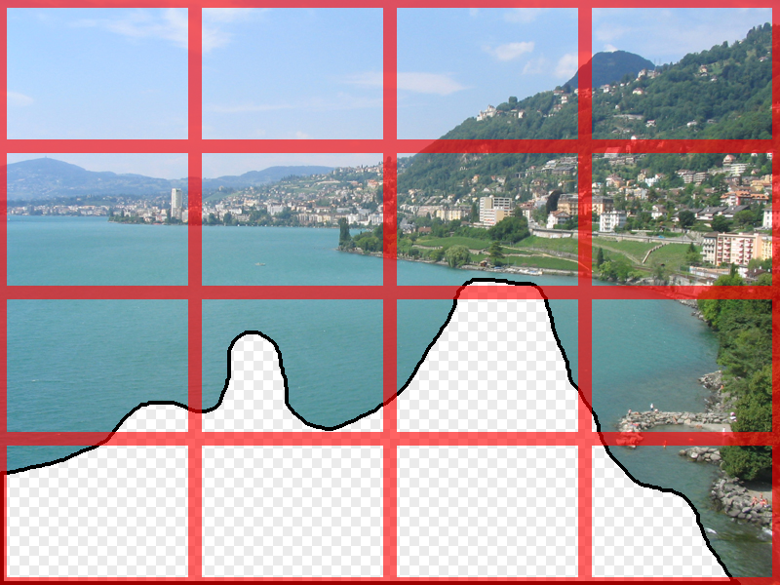
Gist Scene Descriptor
Gist scene descriptor
(Oliva and Torralba 2001)
Hays and Efros, SIGGRAPH 2007

Slide 14
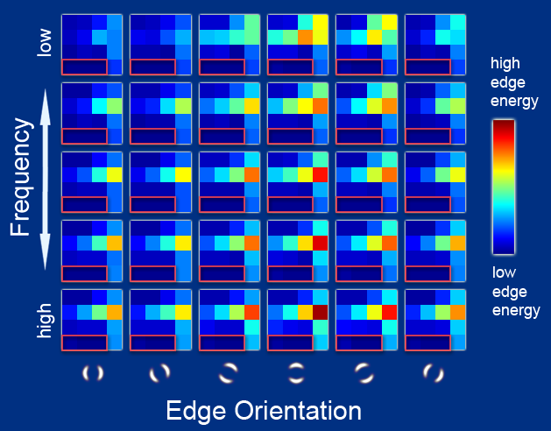
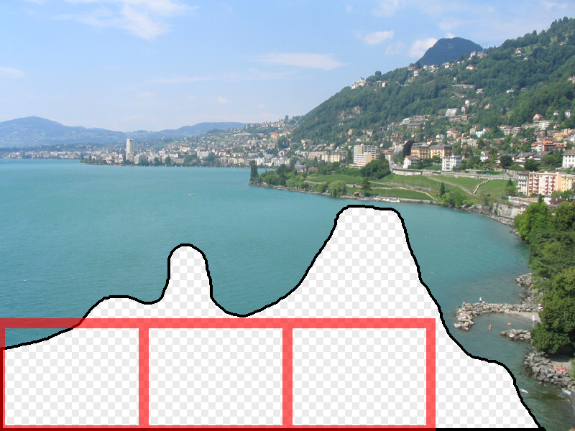
Gist Scene Descriptor
Gist scene descriptor
(Oliva and Torralba 2001)
Hays and Efros, SIGGRAPH 2007

Slide 15
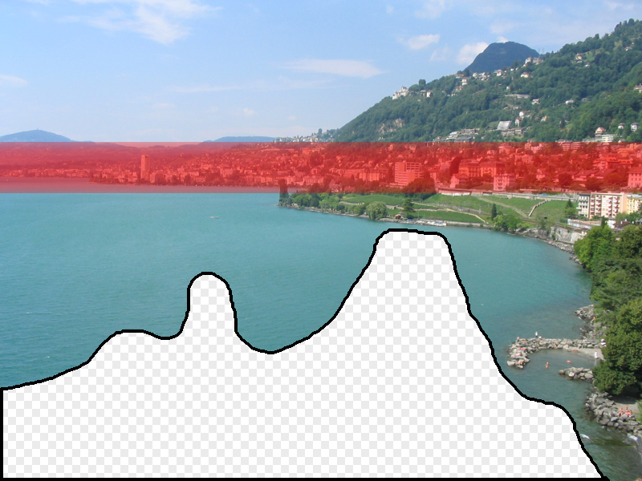
Gist Scene Descriptor
Gist scene descriptor
(Oliva and Torralba 2001)
Hays and Efros, SIGGRAPH 2007

Slide 16

Gist Scene Descriptor
+
Gist scene descriptor
(Oliva and Torralba 2001)
Hays and Efros, SIGGRAPH 2007

Slide 17
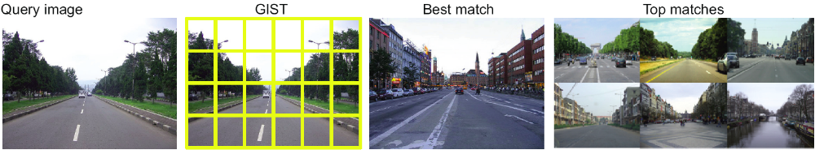
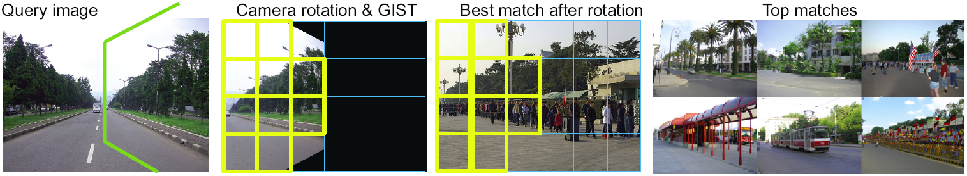
Scene matching with camera transformations

Slide 18
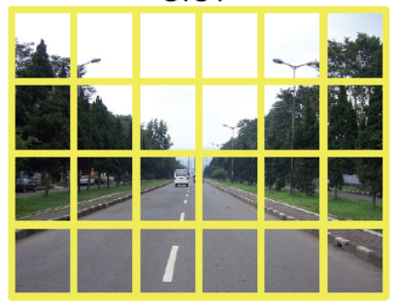
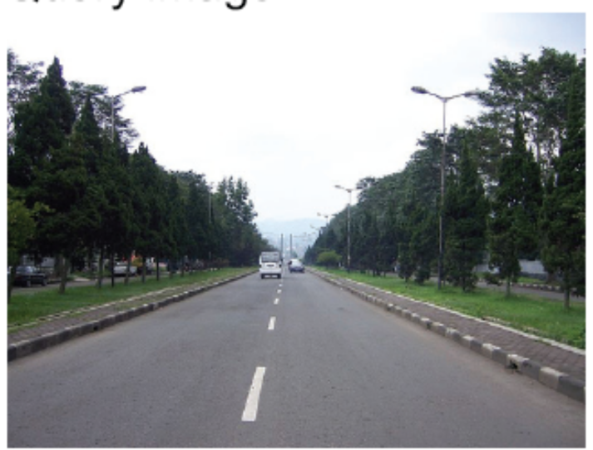

Image representation
GIST [Oliva and Torralba’01]
Original image
Color layout

Slide 19
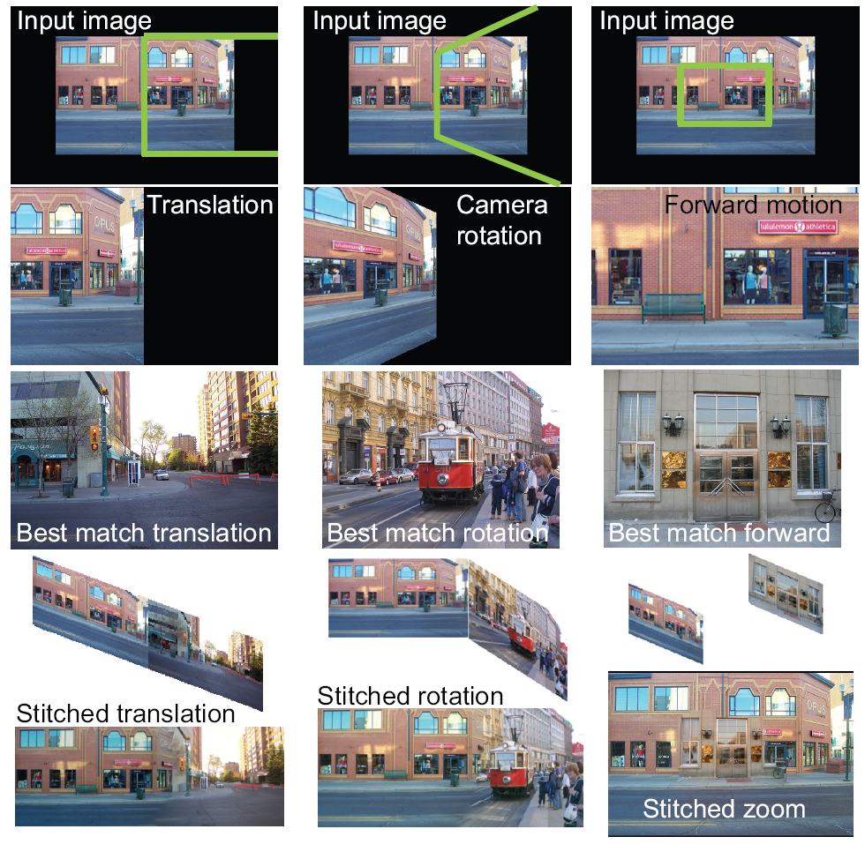
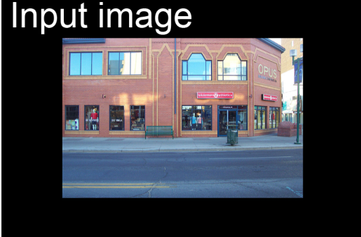
Scene matching with camera view transformations: Translation
1. Move camera
4. Locally align images
5. Find a seam
2. View from the virtual camera
6. Blend in the gradient domain
3. Find a match to fill the missing pixels

Slide 20
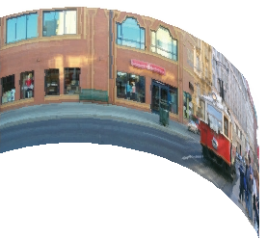
Scene matching with camera view transformations: Camera rotation
1. Rotate camera
4. Stitched rotation
2. View from the virtual camera
3. Find a match to fill-in the missing pixels
5. Display on a cylinder

Slide 21
Scene matching with camera view transformations: Forward motion
1. Move camera
2. View from the virtual camera
3. Find a match to replace pixels

Slide 22
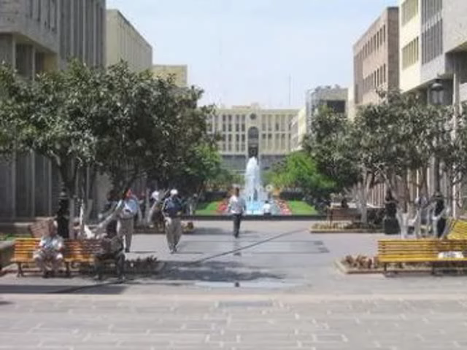
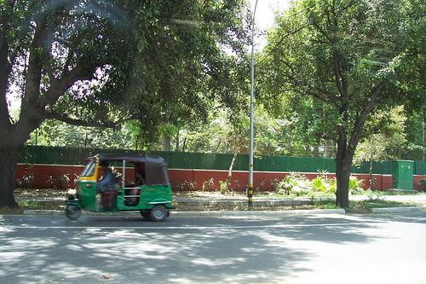
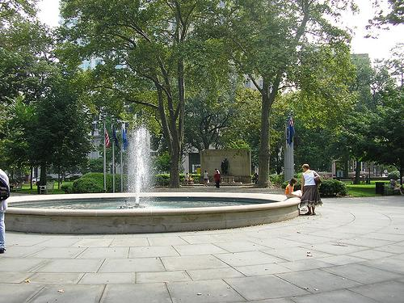
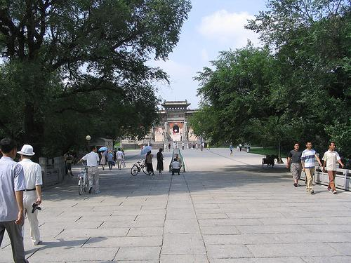
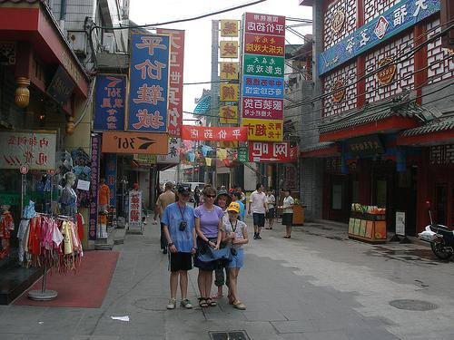
Tour from a single image
Navigate the virtual space using intuitive motion controls

Slide 23
Video

Slide 24
Distinctive Image Features from Scale-Invariant Keypoints
David Lowe
Slides from Derek Hoiem and Gang Wang

Slide 25
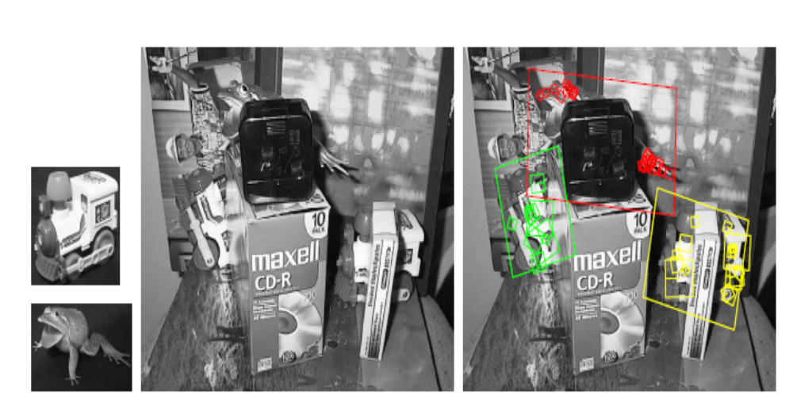
object instance recognition (matching)

Slide 26
Challenges
Scale change
Rotation
Occlusion
Illumination
……

Slide 27
Strategy
Matching by stable, robust and distinctive local features.
SIFT: Scale Invariant Feature Transform; transform image data into scale-invariant coordinates relative to local features

Slide 28
SIFT
Scale-space extrema detection
Keypoint localization
Orientation assignment
Keypoint descriptor

Slide 29
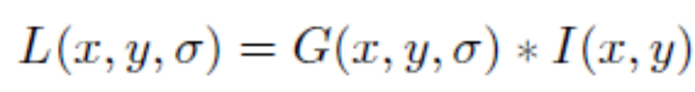
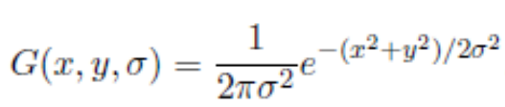
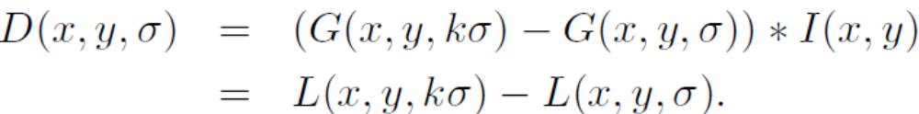
Scale-space extrema detection
Find the points, whose surrounding patches (with some scale) are distinctive
An approximation to the scale-normalized Laplacian of Gaussian

Slide 30
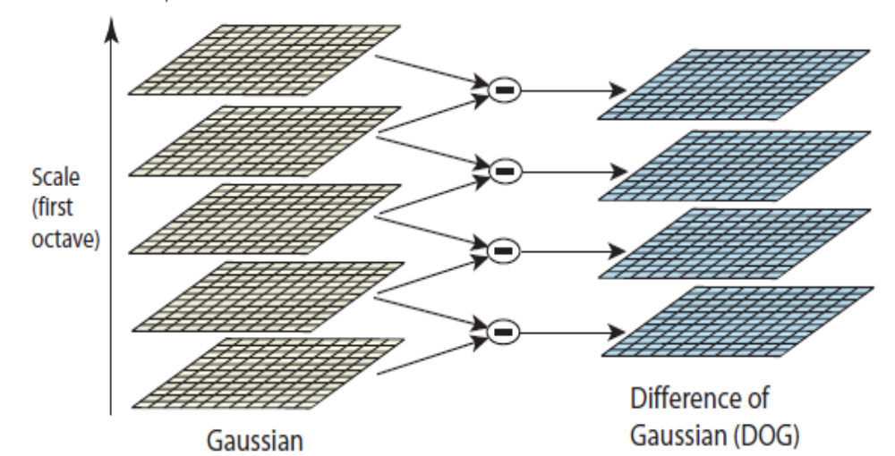
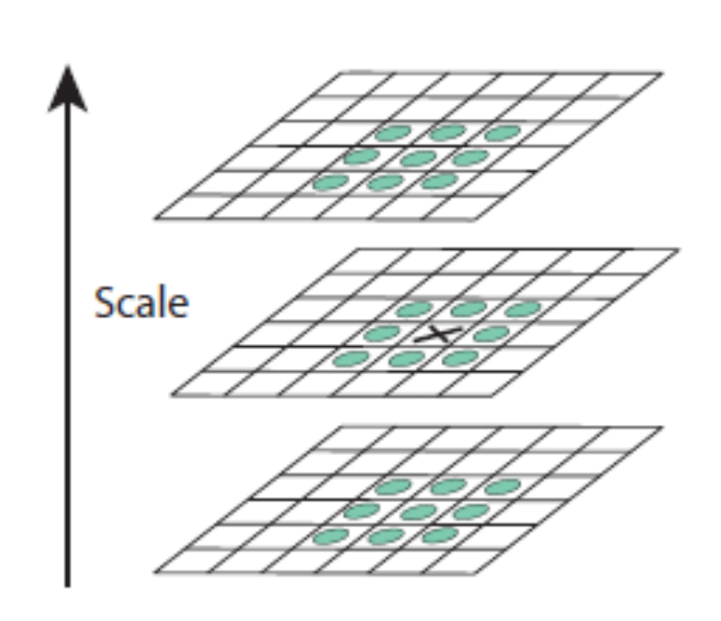
Maxima and minima in a
3*3*3 neighborhood

Slide 31
Keypoint localization
There are still a lot of points, some of them are not good enough.
The locations of keypoints may be not accurate.
Eliminating edge points.

Slide 32
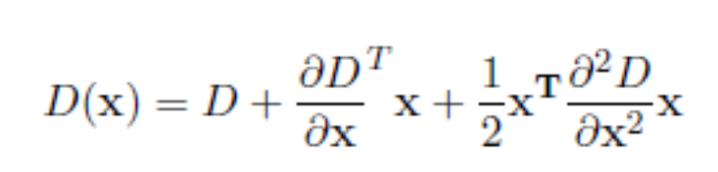
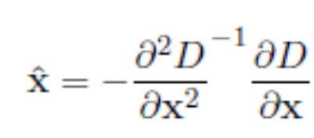

(1)
(2)
(3)

Slide 33

Eliminating edge points
Such a point has large principal curvature across the edge but a small one in the perpendicular direction
The principal curvatures can be calculated from a Hessian function
The eigenvalues of H are proportional to the principal curvatures, so two eigenvalues shouldn’t diff too much

Slide 34
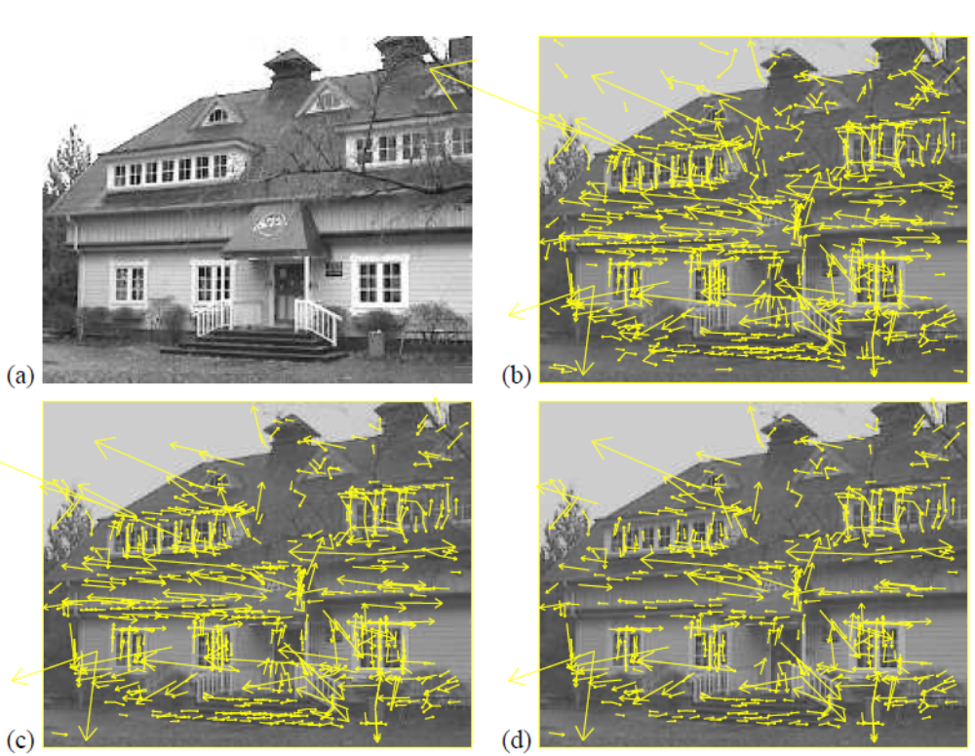

Slide 35
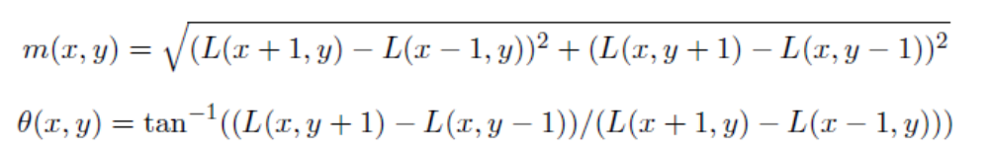
Orientation assignment
Assign an orientation to each keypoint, the keypoint descriptor can be represented relative to this orientation and therefore achieve invariance to image rotation
Compute magnitude and orientation on the Gaussian smoothed images

Slide 36
Orientation assignment
A histogram is formed by quantizing the orientations into 36 bins;
Peaks in the histogram correspond to the orientations of the patch;
For the same scale and location, there could be multiple keypoints with different orientations;

Slide 37
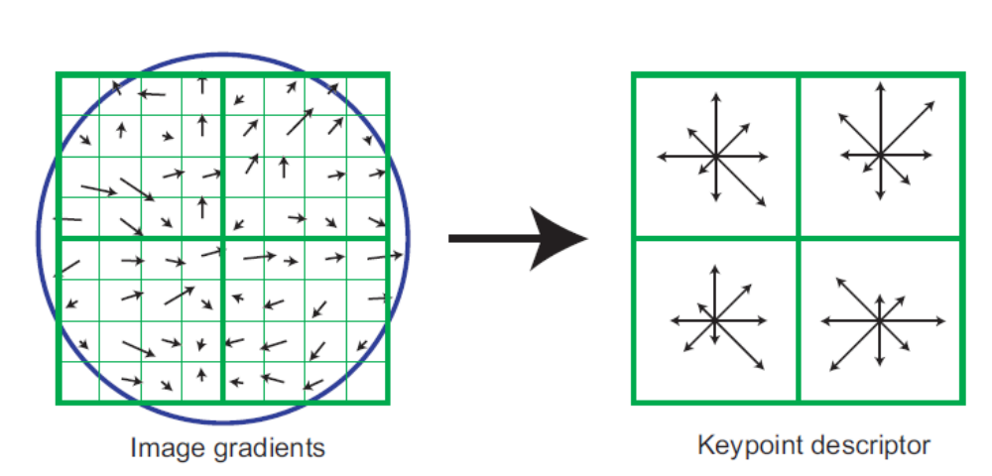
Feature descriptor

Slide 38
Feature descriptor
Based on 16*16 patches
4*4 subregions
8 bins in each subregion
4*4*8=128 dimensions in total

Slide 39
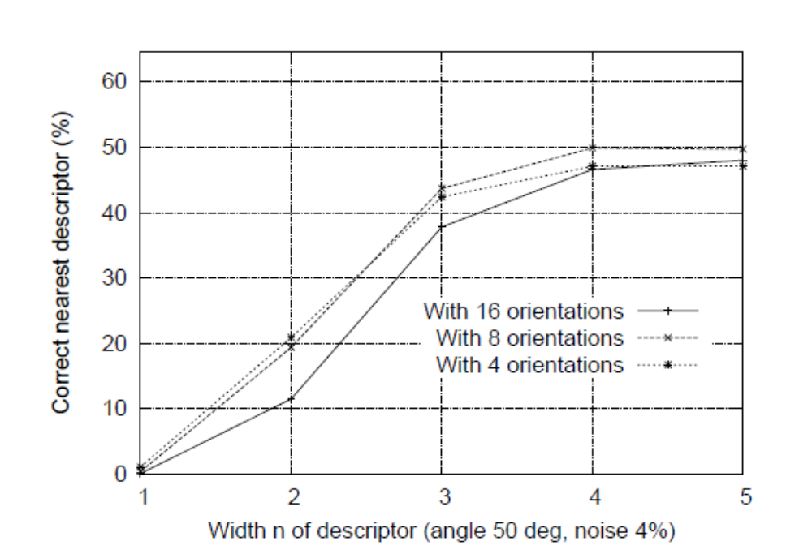

Slide 40
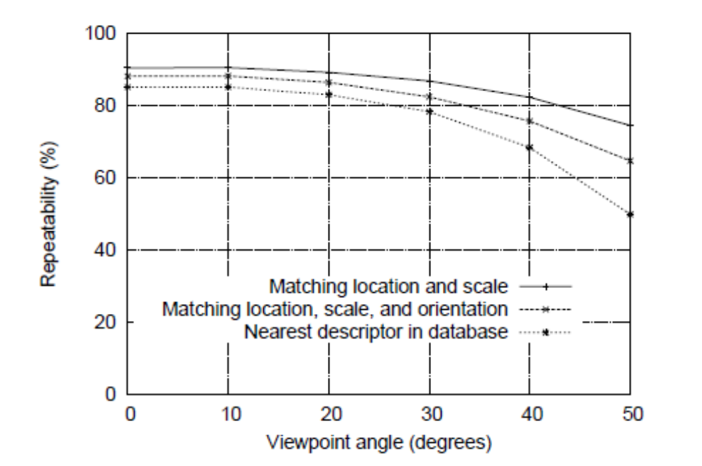

Slide 41
Application: object recognition
The SIFT features of training images are extracted and stored
For a query image
Extract SIFT feature
Efficient nearest neighbor indexing
3 keypoints, Geometry verification

Slide 42
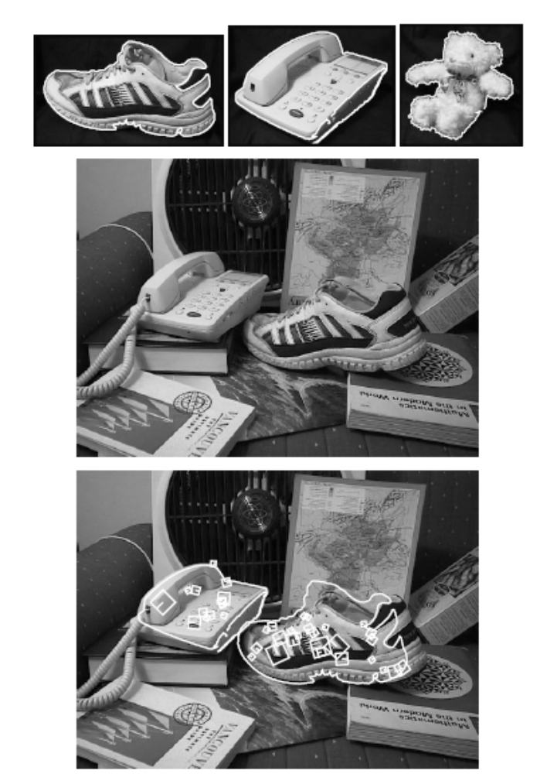

Slide 43
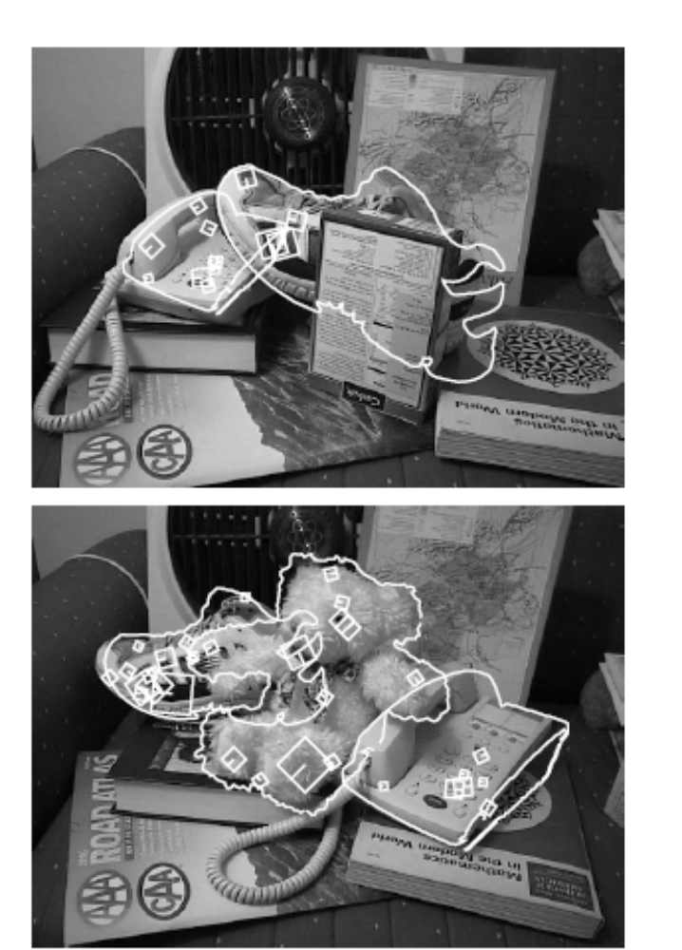

Slide 44
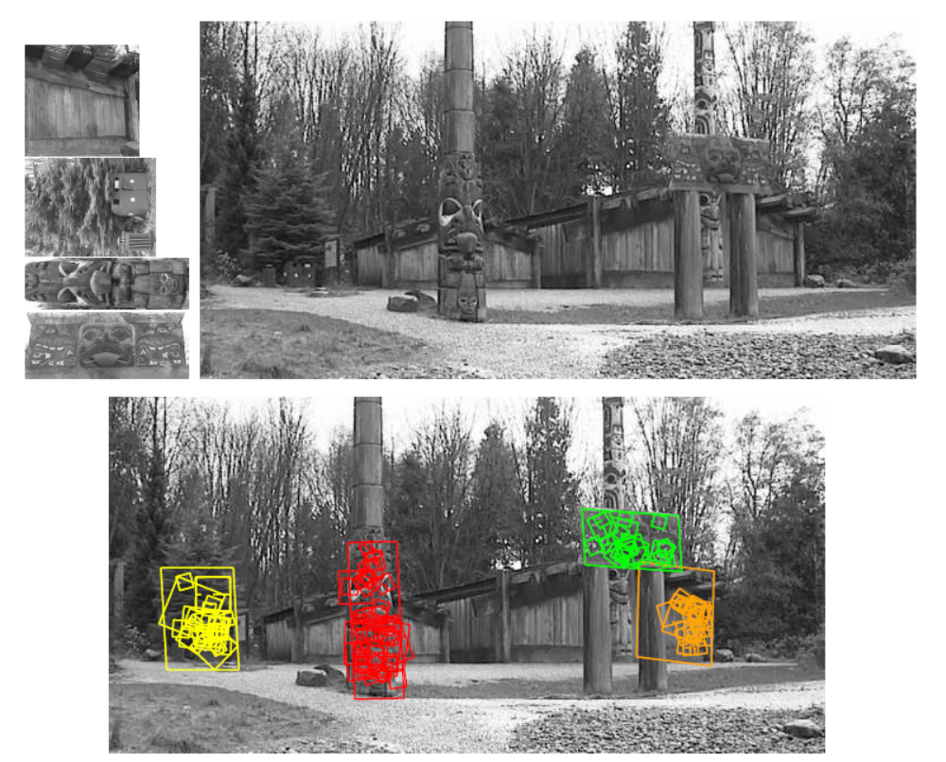

Slide 45
Extensions
PCA-SIFT
Working on 41*41 patches
2*39*39 dimensions
Using PCA to project it to 20 dimensions

Slide 46
Surf
Approximate SIFT
Works almost equally well
Very fast

Slide 47
Conclusions
The most successful feature (probably the most successful paper in computer vision)
A lot of heuristics, the parameters are optimized based on a small and specific dataset. Different tasks should have different parameter settings.
Learning local image descriptors (Winder et al 2007): tuning parameters given their dataset.
We need a universal objective function.

