Slide 1
Internet-scale Imagery for Graphics and Vision
James Hays
cs195g Computational Photography
Brown University, Spring 2010

Slide 2
Recap from Wednesday
Finished discussing “tiny images”
Covered “gist” and “SIFT”
Today we’ll look at additional image features, motivated by the problem of global image geolocation

Slide 3
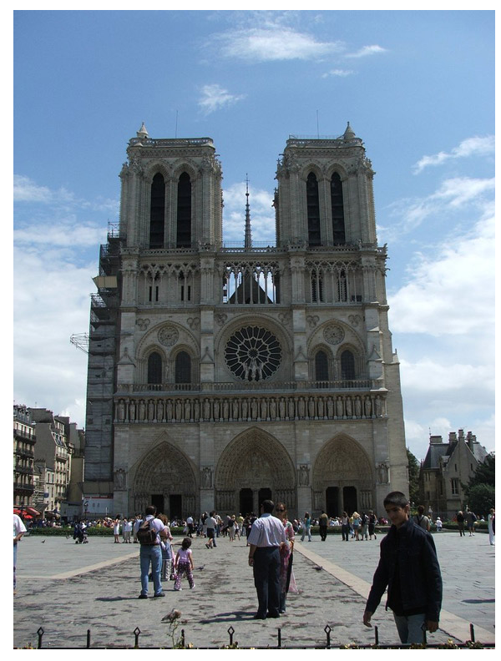
Where in the World?
[Hays and Efros. im2gps: Estimating Geographic Information from a Single Image. CVPR 2008.]
Notes:
New problem I proposed. Only possible with large scale data.
Consider changing title to something more sciency, like “Does appearance correlate with geography”

Slide 4
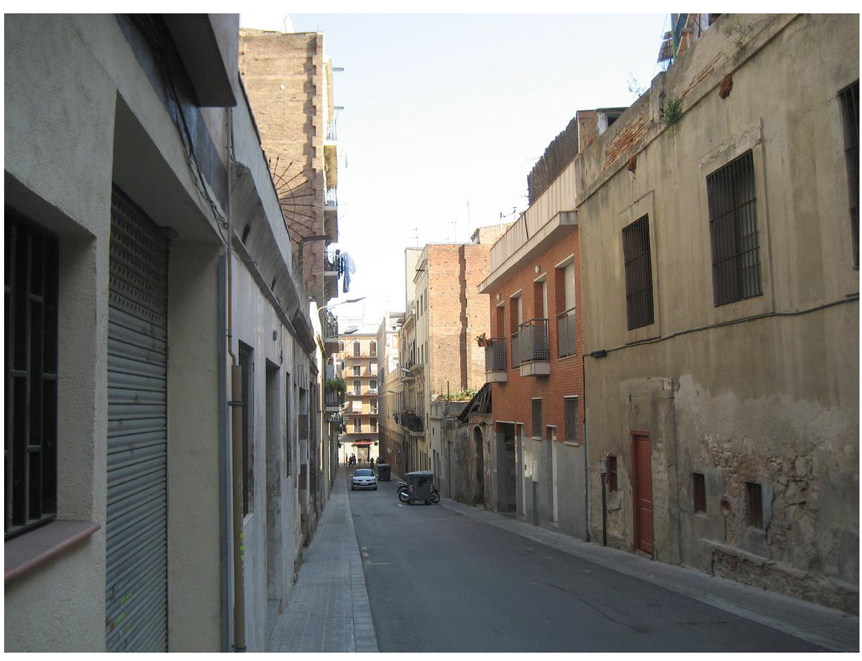
Where in the World?
Notes:
Google street view data + sparse visual words (SIFTS), efficient matching with geometric verification might work.

Slide 5
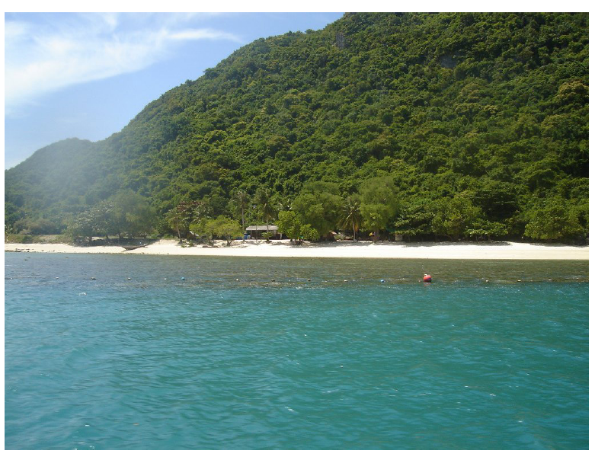
Where in the World?
Notes:
Have you seen this exact scene? Of course not. Are you reasoning about its location based on what you know about vegetation distribution, etc?
We’re going to try and locate images like this through data association, not the semantic reasoning that a human like yourself could employ

Slide 6
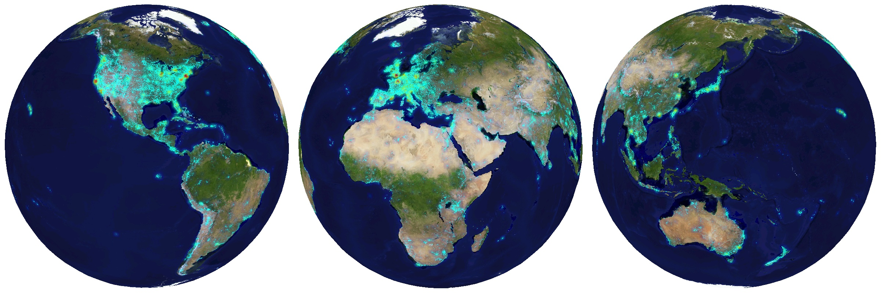
6+ million geotagged photos by 109,788 photographers
Annotated by Flickr users
Notes:
Don’t say “log scale” because it’s not, it’s actually sqrt scale or something, so exponential scale?

Slide 7
6+ million geotagged photos by 109,788 photographers
Annotated by Flickr users
Notes:
Not a sampling of locations, it’s a sample of PHOTOGRAPHS that people actually take

Slide 8
Which scene properties are relevant?
Gist + Color – as in Scene Completion, but 5x5.
Color Histograms - L*A*B* 4x14x14 histograms
Texton Histograms – 512 entry, filter bank based
Line Features – Histograms of straight line stats
Notes:
We also included standard features such as color histograms (popular in CBIR), texture measures, line statistics… they were largely discredited, but it turns out that using them in unison is best.
Maybe add some visualizations of the features, intermediate images, for the barcelona image even.
Mention the 3 cpu years thing

Slide 9
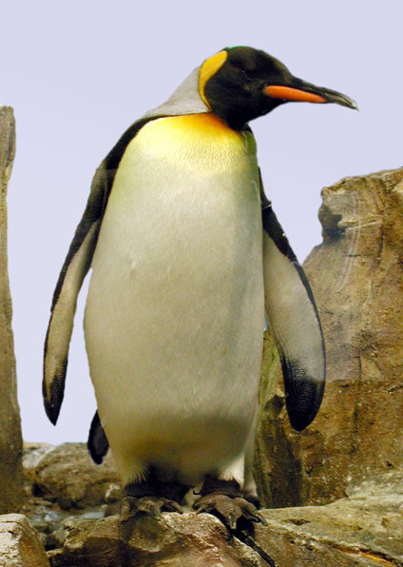
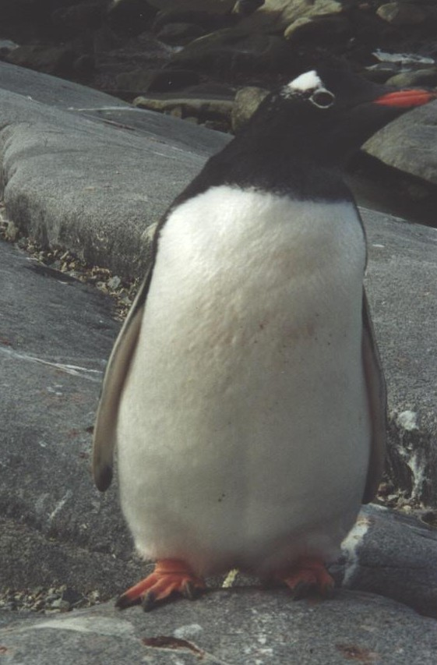
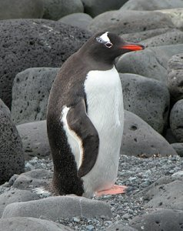
Comparing Images
15-463: Computational Photography
Alexei Efros, CMU, Fall 2008
Adopted from Frederic Heger

Slide 10








Distance Metrics
y
y
x
-
x
= Euclidian distance of 5 units
-
= Grayvalue distance of 50 values
-
= ?

Slide 11

Beyond SSD…
?

Slide 12
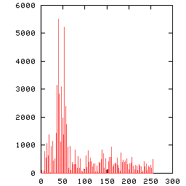
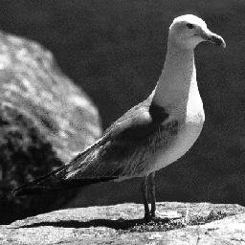
Image Representations: Histograms
Images from Dave Kauchak
global histogram
  Represent distribution of features
    Color, texture, depth, …
Space Shuttle Cargo Bay

Slide 13
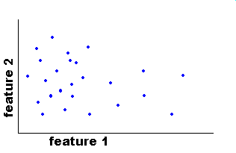
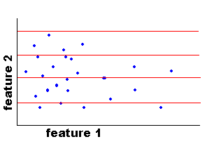
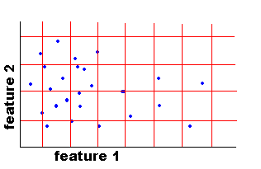
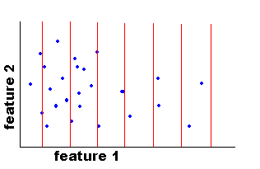
Image Representations: Histograms
Images from Dave Kauchak
Joint histogram
  Requires lots of data
  Loss of resolution to
  avoid empty bins
Marginal histogram
  Requires independent features
  More data/bin than
  joint histogram

Slide 14
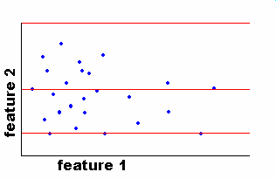
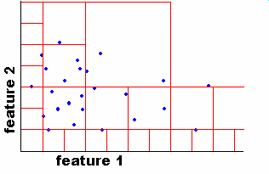
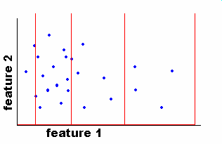
Image Representations: Histograms
Images from Dave Kauchak
Adaptive binning
  Better data/bin distribution, fewer empty bins
  Can adapt available resolution to relative feature importance
Space Shuttle Cargo Bay

Slide 15
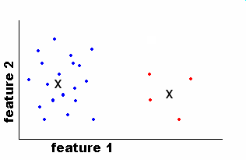
Image Representations: Histograms
Images from Dave Kauchak
EASE Truss
Assembly
Clusters / Signatures
  “super-adaptive” binning
  Does not require discretization along any fixed axis
Space Shuttle Cargo Bay

Slide 16
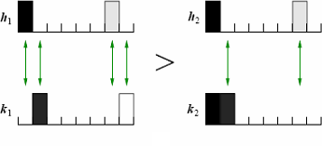
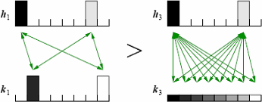
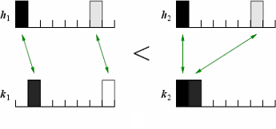
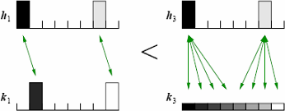
Issue: How to Compare Histograms?
Bin-by-bin comparison
Sensitive to bin size.
Could use wider bins …
… but at a loss of resolution
Cross-bin comparison
How much cross-bin influence is necessary/sufficient?

Slide 17
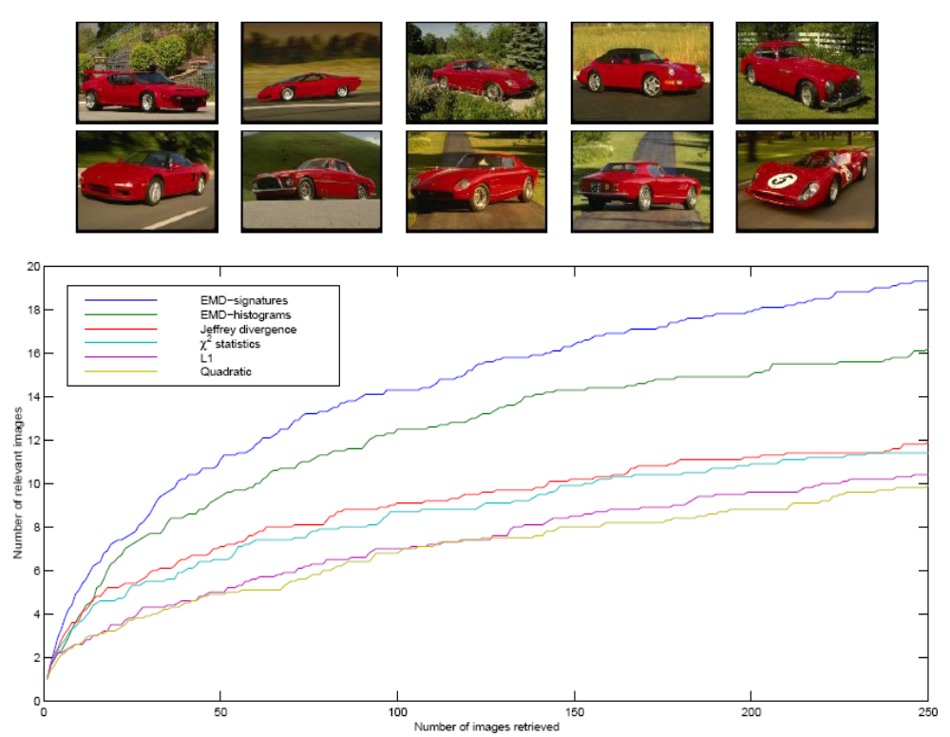
Red Car Retrievals (Color histograms)
Histogram matching distance

Slide 18
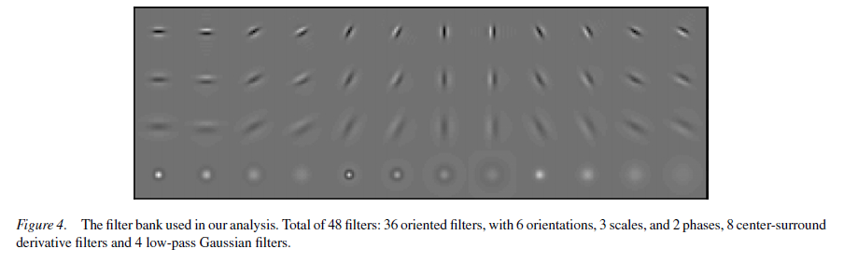
Texton Histograms
Convolve images with multiple filters
Cluster responses into “universal” dictionary
For new image, filter and assign to nearest neighbors in dictionary
Image from Leung and Malik, IJCV, 2001

Slide 19
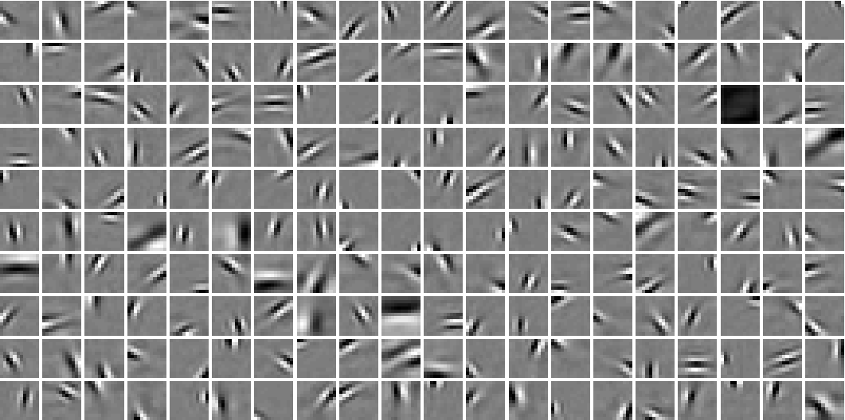
Example Texton Dictionary
Image from Olshausen and Field 1997

Slide 20
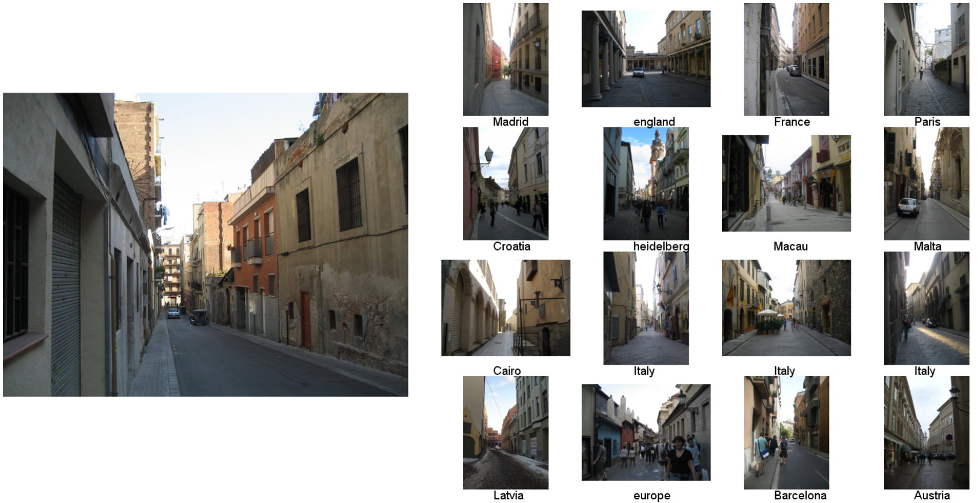
Scene Matches

Slide 21
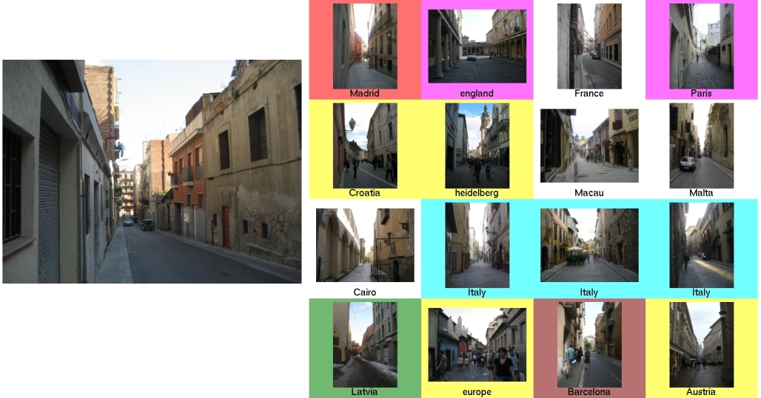

Notes:
The colors correspond to geographic clusters

Slide 22
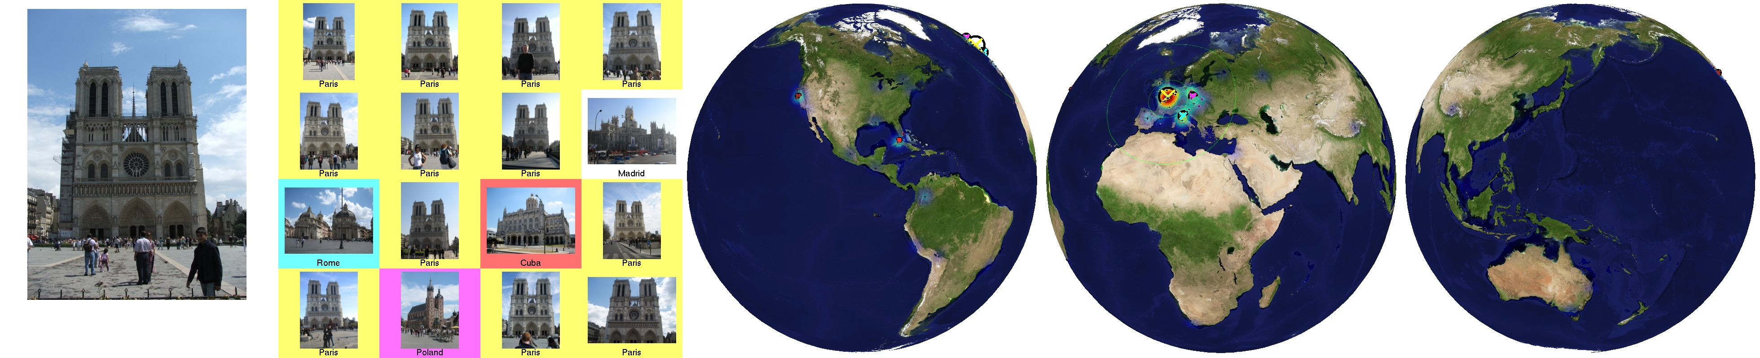
Scene Matches

Slide 23


Slide 24
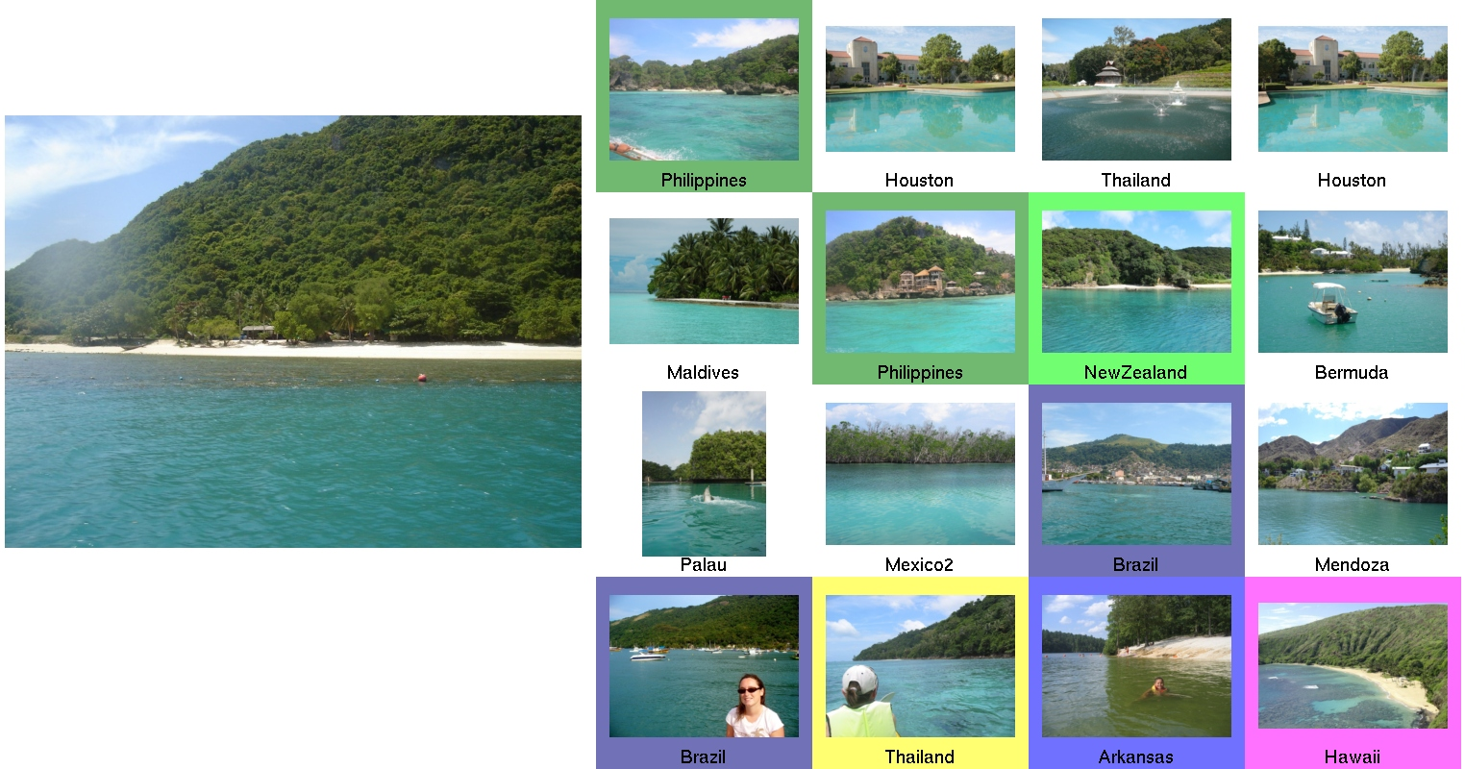
Scene Matches

Slide 25



Slide 26
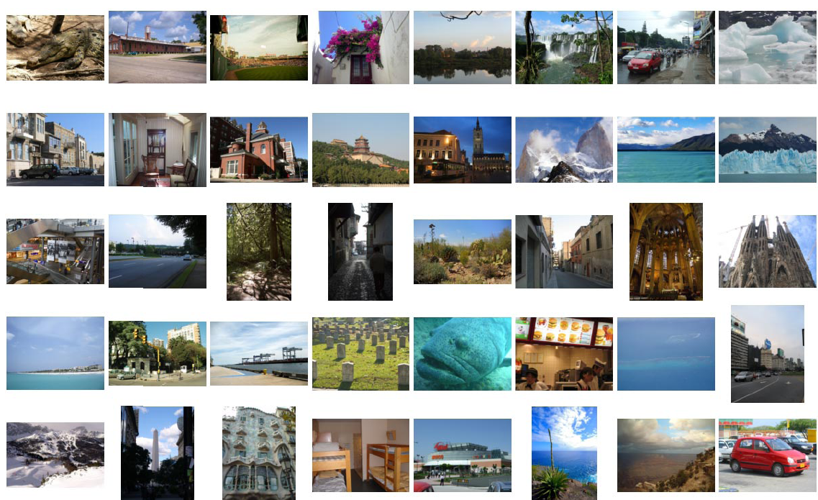
Quantitative Evaluation Test Set
…
Notes:
Make the images a little bigger, fewer of them

Slide 27
The Importance of Data
Notes:
Need to report more than a number here, need to say it’s a surprising scientific result.

Slide 28
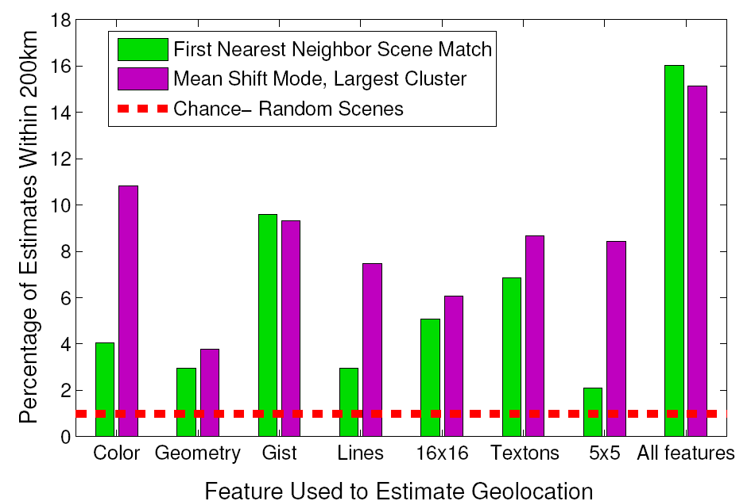
Feature Performance

Slide 29
Performance Analysis
Is im2gps just landmark recognition?
Is im2gps just scene categorization?
Does im2gps performance depend on the peakiness of the test set and data base?

Slide 30
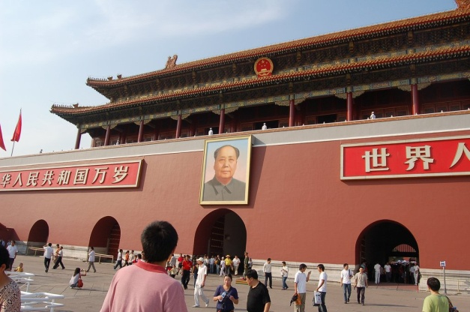
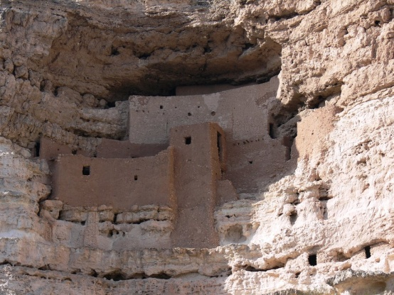


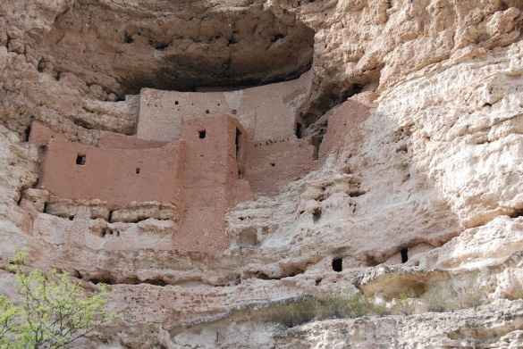

Landmark Recognition
Of the 16% that im2gps gets right (1NN),
58% of those are landmarks
Match Query
Notes:
As defined by first nearest neighbor being the same physical scene

Slide 31
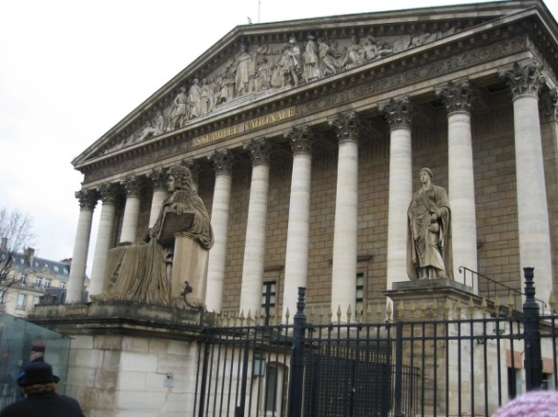

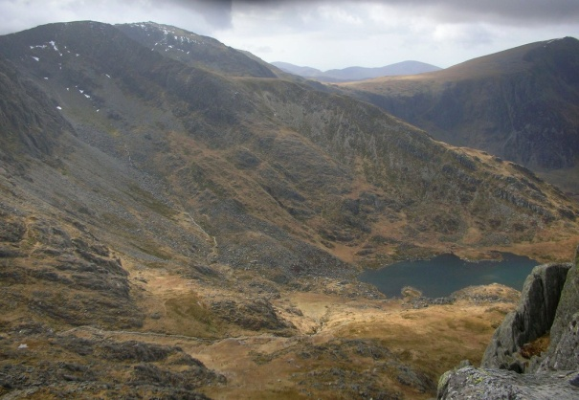
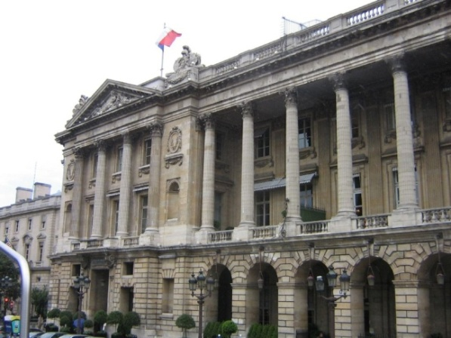

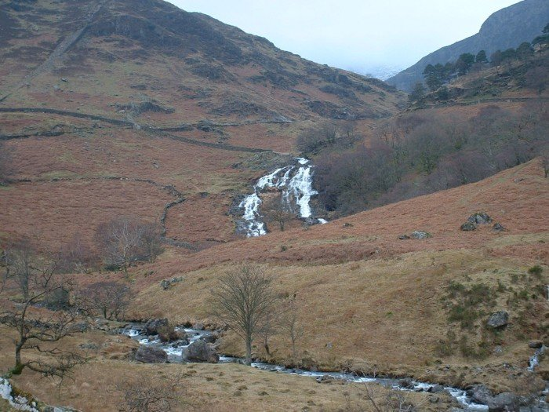
Landmark Recognition
Correct, non-landmark 1NN
Match Query
Notes:
For the learning and larger test set, this ratio actually drops a bit. Our performance is about half due to instance level recognition.

Slide 32
Additional Features
Two shortcomings of our existing scene matching features:
  lack of invariance to scene layout.
  poor performance at instance-level recognition.
To address these problems we add additional geometry derived and SIFT derived features

Slide 33

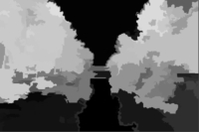
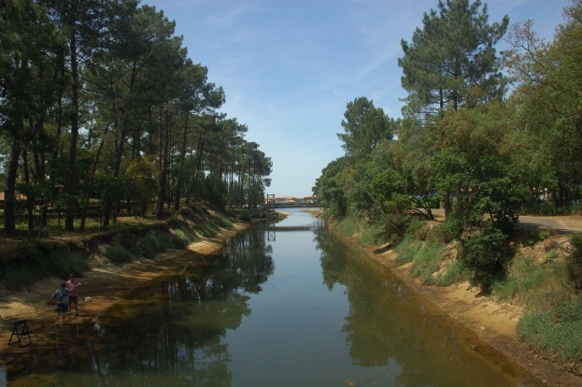
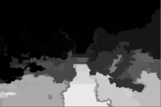
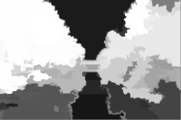
Geometry Specific
Color and Texture Histograms
P(Sky)
P(Vegetation)
Sky Color Hist.
Sky Texture Hist.
Ground Color Hist.
Ground Texture Hist.
Vegetation Color Hist.
Vegetation Texture Hist.
Vertical Color Hist.
Vegetation Texture Hist.
P(Ground)
P(Vertical)
Build color and texture histograms for each geometric class. Also, use geometric context map as a feature.

Slide 34
Bags of SIFT
SIFT features are built at Hessian-affine and MSER interest points.
SIFTs are quantized into histograms with
  1,000 entries (similar to SIFT Flow)
  50,000 entries (similar to Video Google)
Histograms are built with k-means. Assignments are “Soft”.
Notes:
NO contribution here

Slide 35
Combining Features
Histograms use Chi squared distance.
Image features (gist, geom) use L1 distance.
We use a hierarchical search
  2000NN from “base” im2gps features.
  Re-ranked with geometry and SIFT features added.

Slide 36
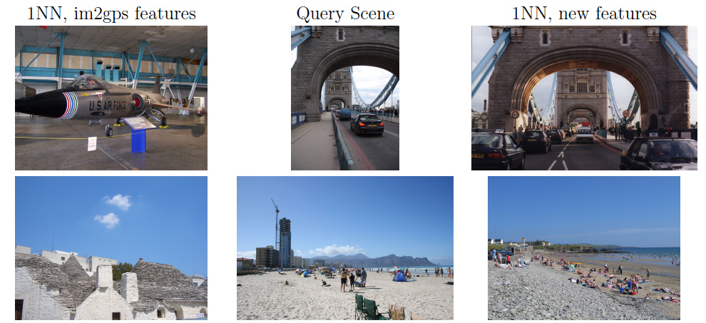
Additional Features Results

Slide 37
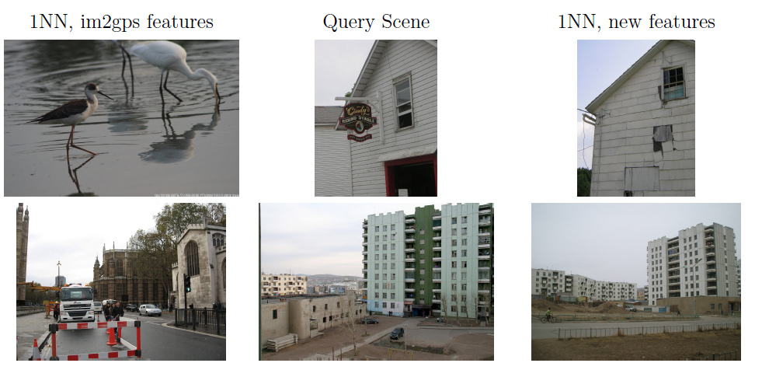
Additional Features Results

Slide 38

Learning Results

Slide 39
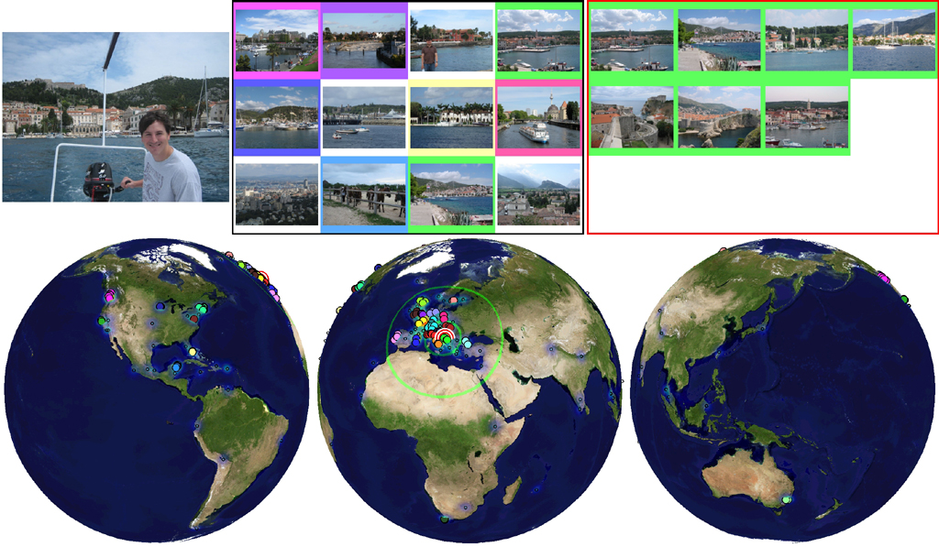
Learning Results

Slide 40
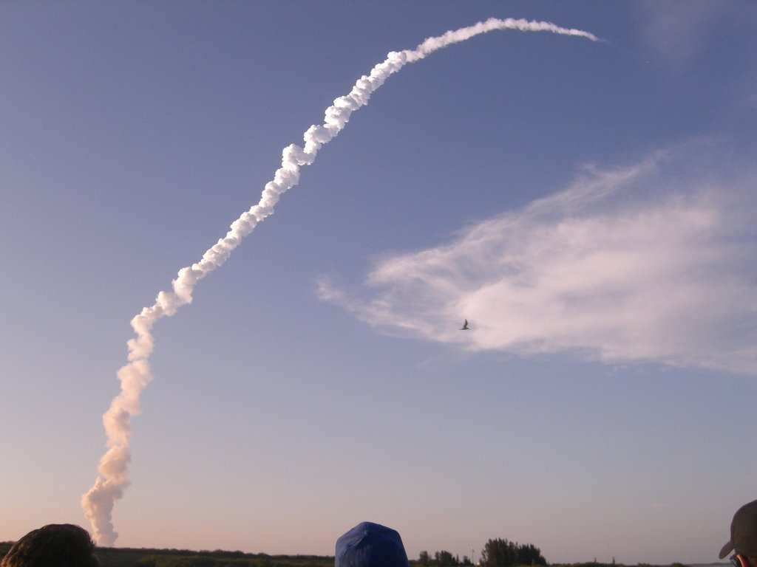
Learning Results

Slide 41
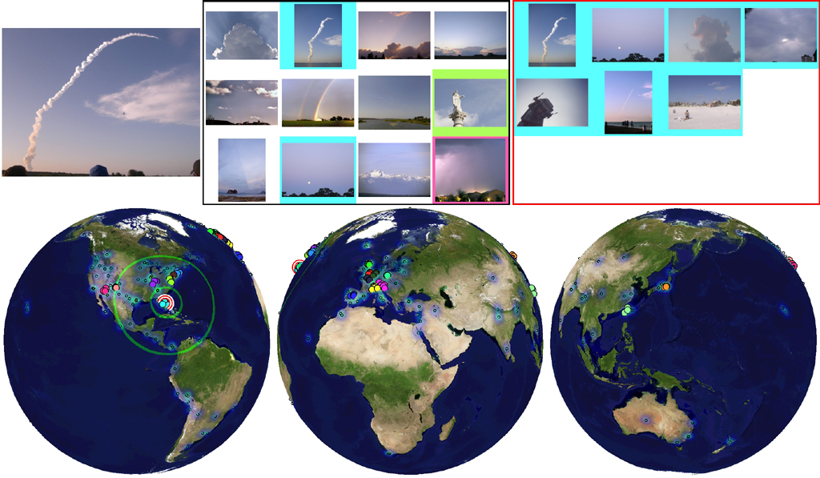
Learning Results

Slide 42
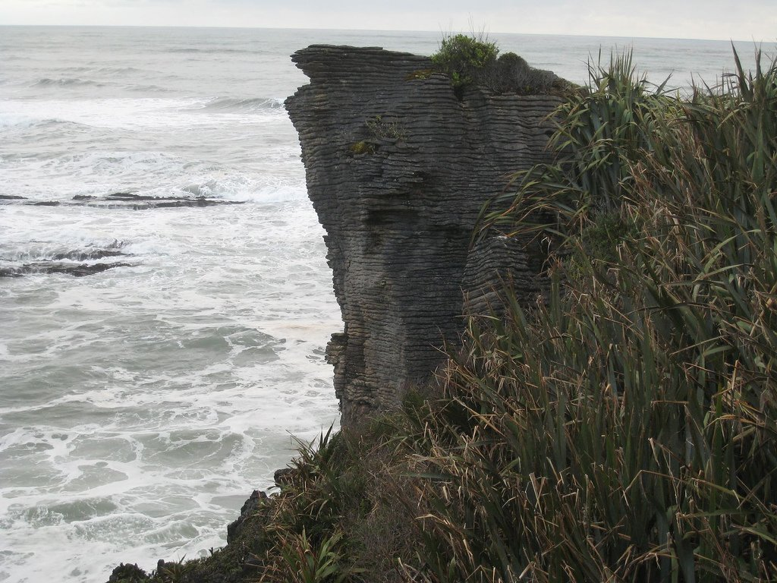
Learning Results

Slide 43
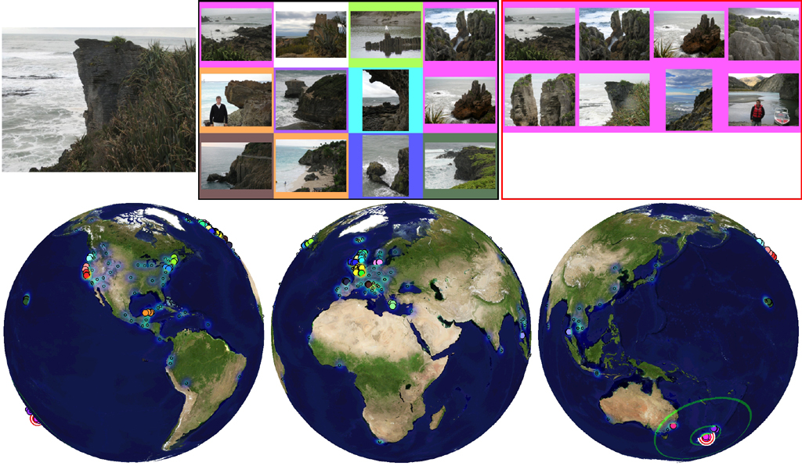
Learning Results

Slide 44
Learning Results, im2gps Test Set
Im2gps test set
  Im2gps: 16.5% accuracy
  Learning: 31% accuracy
Geographically uniform test set
  Im2gps: 2.30% accuracy
  Learning: 2.93% accuracy

Slide 45
Discussion
There’s no “magic” to the learning. For 95% of the correctly geolocated images, one of these is true:
  The first nearest neighbor is correct.
  The largest mean shift cluster is correct.
  There is an instance level match among the NN.
  The query is from a very popular location.
In general, performance is quite intuitive and predictable.
Notes:
By far the most popular failure case is “that’s really hard!”
It can’t really pick up on super subtle landscape features that a human wouldn’t. It beats humans by having a better memory, not better scene comparison methods.

Slide 46
Discussion
It is somewhat difficult to interpret the learning – the SVM decision boundary does not directly map to a feature weighting, as it would with a linear SVM.
Linear SVMs perform very poorly.
This learning should benefit other scene matching problems with labeled data.

