Slide 1
Summary of Friday
A homography transforms one 3d plane to another 3d plane, under perspective projections. Those planes can be camera imaging planes or planes in the scene.
If a camera is stationary, a homography can perfectly relate two photos taken at different rotations and focal lengths.
We covered how to capture and build a panorama.

Slide 2
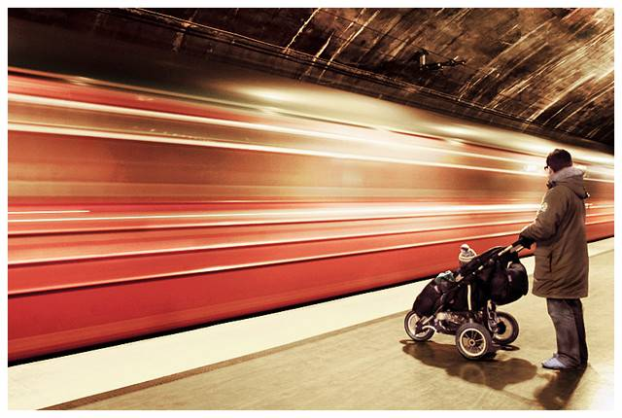
Automatic Image Alignment
© Mike Nese
cs195g: Computational Photography
James Hays, Brown, Spring 2010
Slides from Alexei Efros,
Steve Seitz, and Rick Szeliski

Slide 3
Live Homography DEMO
Check out panoramio.com “Look Around” feature!
Also see OpenPhoto VR: http://openphotovr.org/

Slide 4
Image Alignment
How do we align two images automatically?
Two broad approaches:
  Feature-based alignment
    Find a few matching features in both images
    compute alignment
  Direct (pixel-based) alignment
    Search for alignment where most pixels agree

Slide 5
Direct Alignment
The simplest approach is a brute force search (hw1)
  Need to define image matching function
    SSD, Normalized Correlation, edge matching, etc.
  Search over all parameters within a reasonable range:
e.g. for translation:
for tx=x0:step:x1,
for ty=y0:step:y1,
compare image1(x,y) to image2(x+tx,y+ty)
end;
end;
Need to pick correct x0,x1 and step
  What happens if step is too large?

Slide 6
Direct Alignment (brute force)
What if we want to search for more complicated transformation, e.g. homography?
for a=a0:astep:a1,
for b=b0:bstep:b1,
for c=c0:cstep:c1,
for d=d0:dstep:d1,
for e=e0:estep:e1,
for f=f0:fstep:f1,
for g=g0:gstep:g1,
for h=h0:hstep:h1,
compare image1 to H(image2)
end; end; end; end; end; end; end; end;

Slide 7
Problems with brute force
Not realistic
  Search in O(N⁸) is problematic
  Not clear how to set starting/stopping value and step
What can we do?
  Use pyramid search to limit starting/stopping/step values
  For special cases (rotational panoramas), can reduce search slightly to O(N⁴):
    H = K₁R₁R₂⁻¹K₂⁻¹ (4 DOF: f and rotation)
Alternative: gradient descent on the error function
  i.e. how do I tweak my current estimate to make the SSD error go down?
  Can do sub-pixel accuracy
  BIG assumption?
    Images are already almost aligned (<2 pixels difference!)
    Can improve with pyramid
  Same tool as in motion estimation

Slide 8
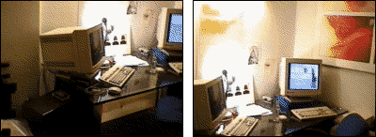
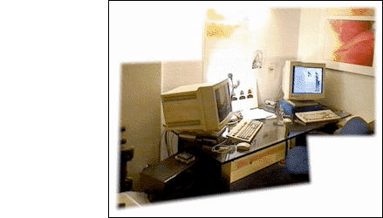
Image alignment

Slide 9
Feature-based alignment
Find a few important features (aka Interest Points)
Match them across two images
Compute image transformation (first parts of Project 6)
How do we choose good features?
  They must prominent in both images
  Easy to localize
  Think how you would do it by hand
  Corners!

Slide 10
Feature Detection

Slide 11
Feature Matching
How do we match the features between the images?
  Need a way to describe a region around each feature
    e.g. image patch around each feature
  Use successful matches to estimate homography
    Need to do something to get rid of outliers
Issues:
  What if the image patches for several interest points look similar?
    Make patch size bigger
  What if the image patches for the same feature look different due to scale, rotation, etc.
    Need an invariant descriptor

Slide 12




Invariant Feature Descriptors
Schmid & Mohr 1997, Lowe 1999, Baumberg 2000, Tuytelaars & Van Gool 2000, Mikolajczyk & Schmid 2001, Brown & Lowe 2002, Matas et. al. 2002, Schaffalitzky & Zisserman 2002

Slide 13
Today’s lecture
1 Feature detector
  scale invariant Harris corners
1 Feature descriptor
  patches, oriented patches
Reading:
Brown, Szeliski, and Winder. Multi-image Matching using Multi-scale image patches, CVPR 2005
(linked from Project 6 already)

Slide 14
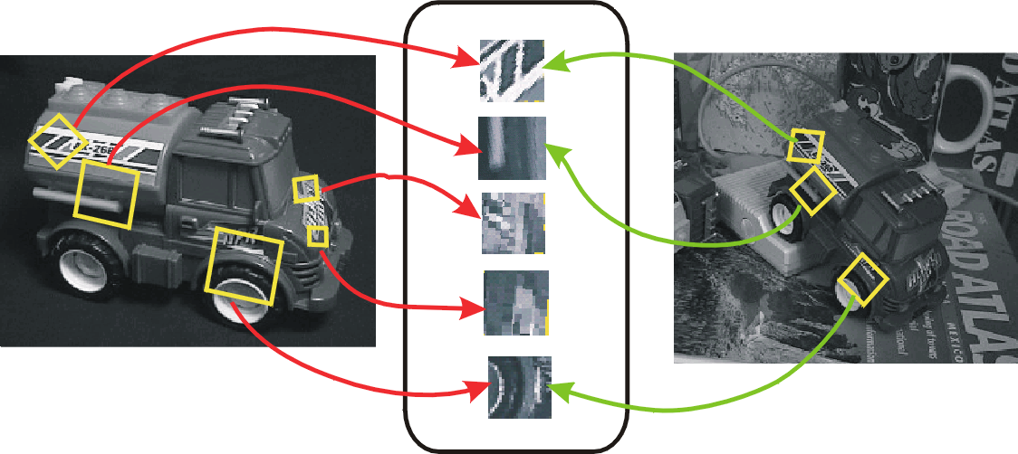
Invariant Local Features
Image content is transformed into local feature coordinates that are invariant to translation, rotation, scale, and other imaging parameters
Features Descriptors

Slide 15
Applications
Feature points are used for:
  Image alignment (homography, fundamental matrix)
  3D reconstruction
  Motion tracking
  Object recognition
  Scene categorization
  Indexing and database retrieval
  Robot navigation
  … other

Slide 16
Harris corner detector
C.Harris, M.Stephens. “A Combined Corner and Edge Detector”. 1988

Slide 17
The Basic Idea
We should easily recognize the point by looking through a small window
Shifting a window in any direction should give a large change in intensity

Slide 18
Harris Detector: Basic Idea
“flat” region:
no change in all directions
“edge”:
no change along the edge direction
“corner”:
significant change in all directions

Slide 19
Harris Detector: Mathematics
Change of intensity for the shift [u,v]:
Window function
Shifted intensity
Intensity
Window function w(x,y) =
or
1 in window, 0 outside
Gaussian

Slide 20
Harris Detector: Mathematics
For small shifts [u,v] we have a bilinear approximation:
where M is a 2×2 matrix computed from image derivatives:

Slide 21
Harris Detector: Mathematics
Classification of image points using eigenvalues of M:
λ₂
“Edge”
λ₂ >> λ₁
“Corner”
λ₁ and λ₂ are large,
λ₁ ~ λ₂;
E increases in all directions
λ₁ and λ₂ are small;
E is almost constant in all directions
“Flat” region
“Edge”
λ₁ >> λ₂
λ₁
But eigenvalues are expensive to compute

Slide 22
Harris Detector: Mathematics
Measure of corner response:

Slide 23
Harris Detector
The Algorithm:
  Find points with large corner response function R (R > threshold)
  Take the points of local maxima of R

Slide 24
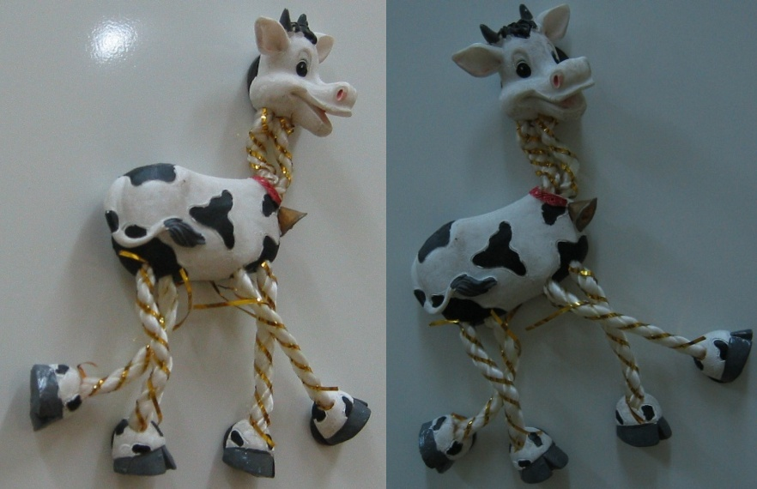
Harris Detector: Workflow

Slide 25
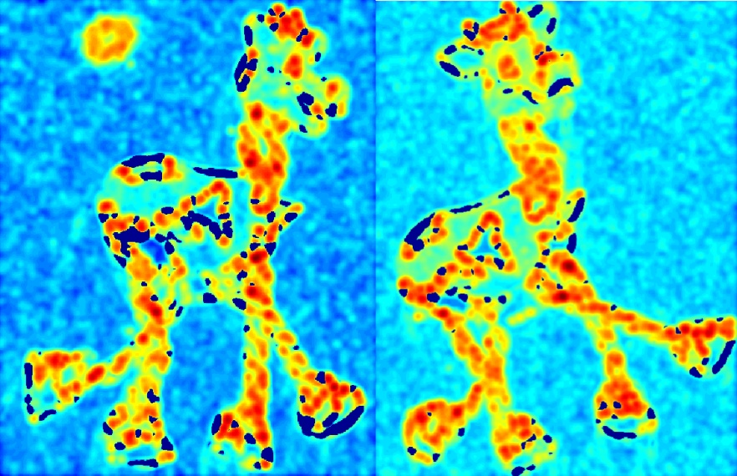
Harris Detector: Workflow
Compute corner response R

Slide 26
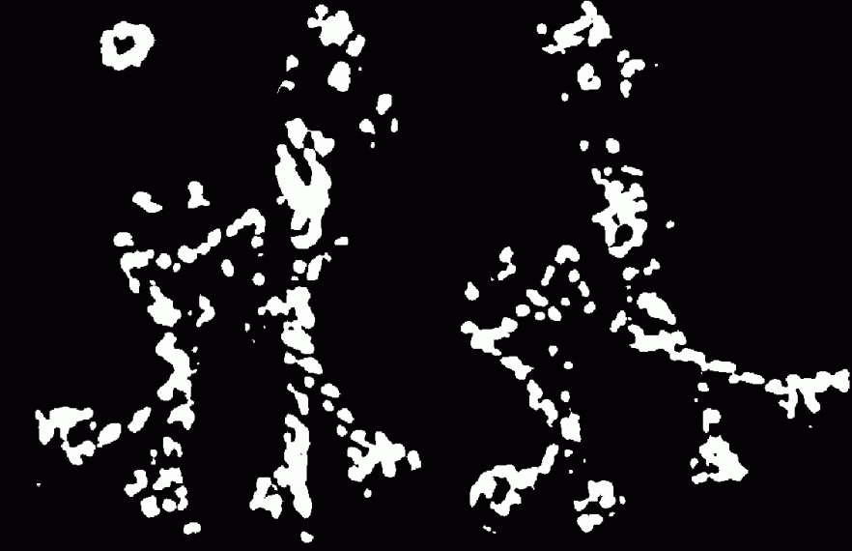
Harris Detector: Workflow
Find points with large corner response: R>threshold

Slide 27
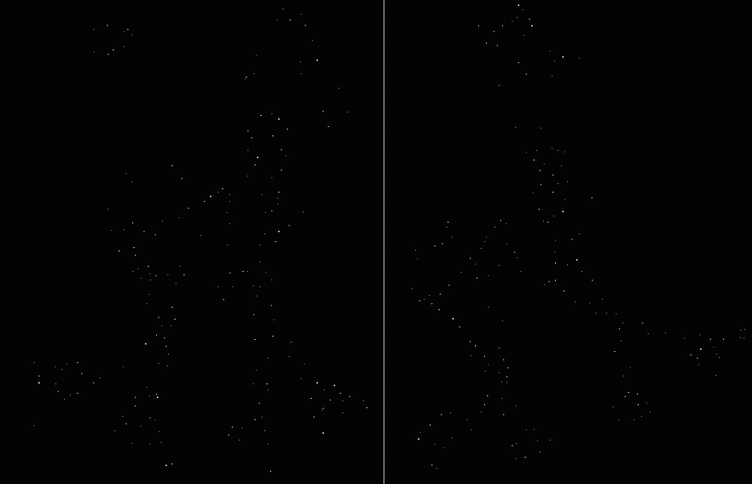
Harris Detector: Workflow
Take only the points of local maxima of R

Slide 28

Harris Detector: Workflow

Slide 29
Harris Detector: Some Properties
Rotation invariance
Ellipse rotates but its shape (i.e. eigenvalues) remains the same
Corner response R is invariant to image rotation

Slide 30
Harris Detector: Some Properties
Partial invariance to affine intensity change
Only derivatives are used => invariance to intensity shift I → I + b
Intensity scale: I → a I
R
R
threshold
x (image coordinate)
x (image coordinate)

Slide 31
Harris Detector: Some Properties
But: non-invariant to image scale!
All points will be classified as edges
Corner !

Slide 32
Scale Invariant Detection
Consider regions (e.g. circles) of different sizes around a point
Regions of corresponding sizes will look the same in both images

Slide 33
Scale Invariant Detection
The problem: how do we choose corresponding circles independently in each image?
Choose the scale of the “best” corner

Slide 34
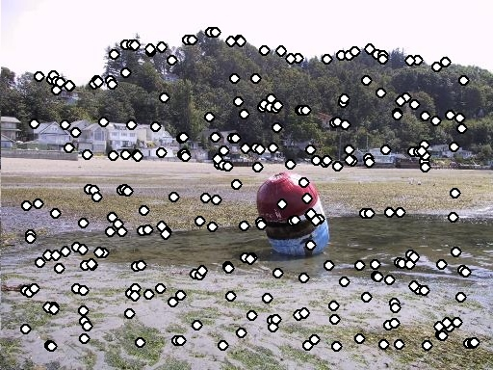
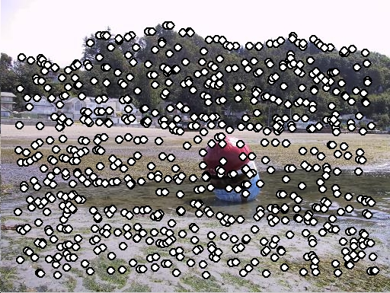
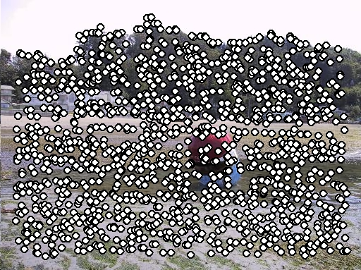
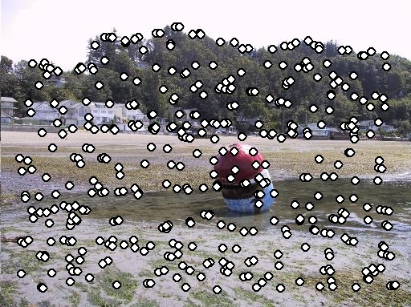
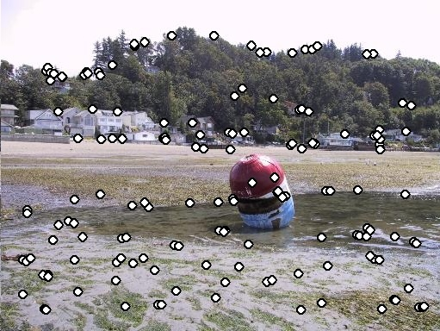
Feature selection
Distribute points evenly over the image

Slide 35
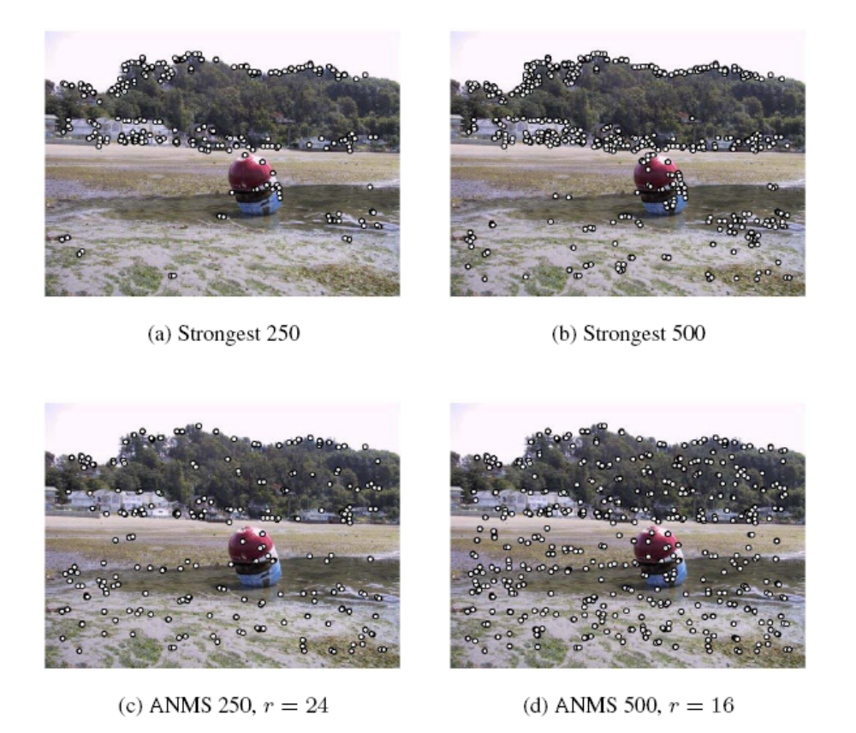
Adaptive Non-maximal Suppression
Desired: Fixed # of features per image
  Want evenly distributed spatially…
  Sort points by non-maximal suppression radius
  [Brown, Szeliski, Winder, CVPR’05]

Slide 36
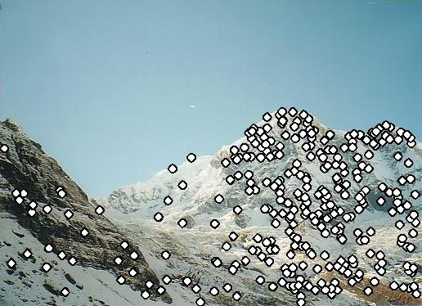
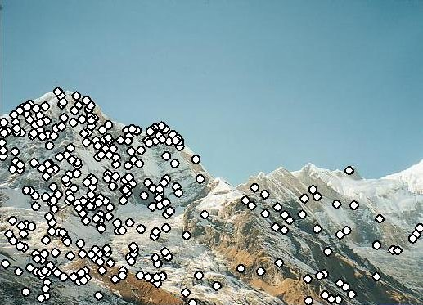
Feature descriptors
We know how to detect points
Next question: How to match them?
?
Point descriptor should be:
  Invariant 2. Distinctive

Slide 37
Descriptors Invariant to Rotation
Find local orientation
Dominant direction of gradient
Extract image patches relative to this orientation

Slide 38
Multi-Scale Oriented Patches
Interest points
  Multi-scale Harris corners
  Orientation from blurred gradient
  Geometrically invariant to rotation
Descriptor vector
  Bias/gain normalized sampling of local patch (8x8)
  Photometrically invariant to affine changes in intensity
[Brown, Szeliski, Winder, CVPR’2005]

Slide 39
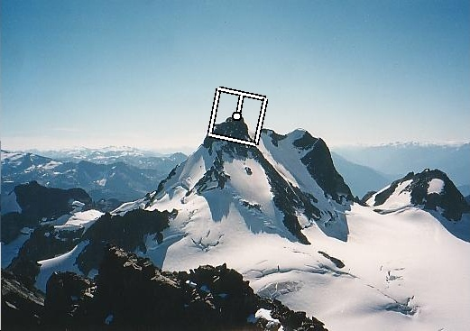
Descriptor Vector
Orientation = blurred gradient
Rotation Invariant Frame
  Scale-space position (x, y, s) + orientation (θ)

Slide 40
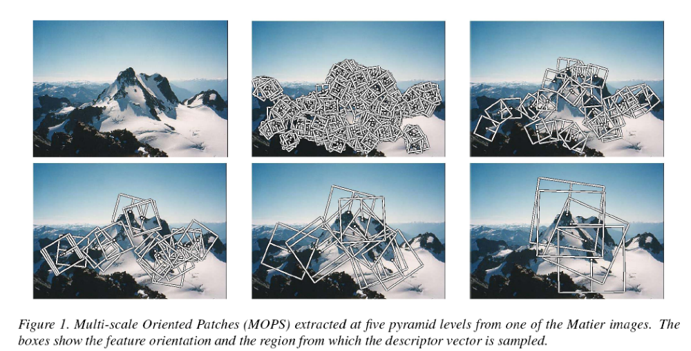
Detections at multiple scales

Slide 41
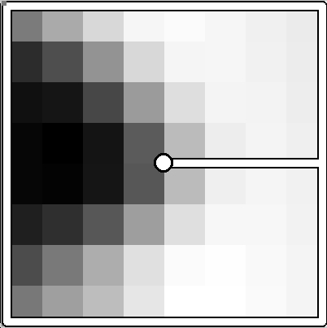
MOPS descriptor vector
8x8 oriented patch
  Sampled at 5 x scale
Bias/gain normalisation: I’ = (I – μ)/σ
40 pixels
8 pixels

Slide 42
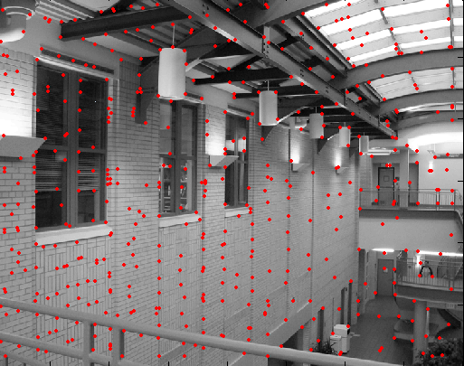
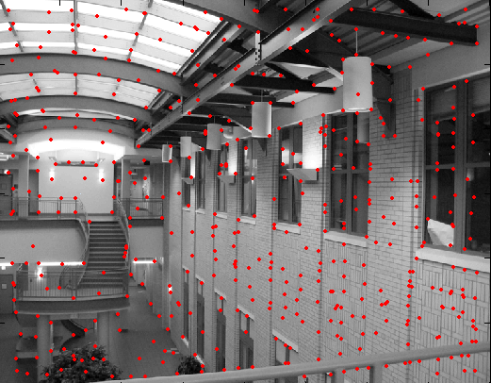
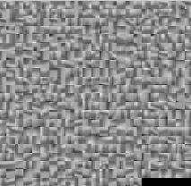
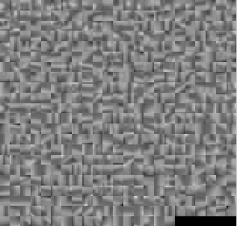
Feature matching
?

Slide 43
Feature matching
Exhaustive search
  for each feature in one image, look at all the other features in the other image(s)
Hashing
  compute a short descriptor from each feature vector, or hash longer descriptors (randomly)
Nearest neighbor techniques
  kd-trees and their variants

Slide 44
What about outliers?
?

Slide 45
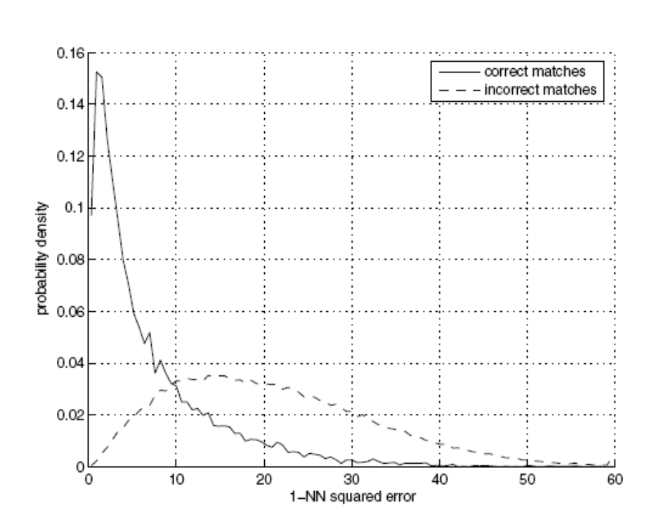
Feature-space outlier rejection
Let’s not match all features, but only these that have “similar enough” matches?
How can we do it?
  SSD(patch1,patch2) < threshold
  How to set threshold?

Slide 46
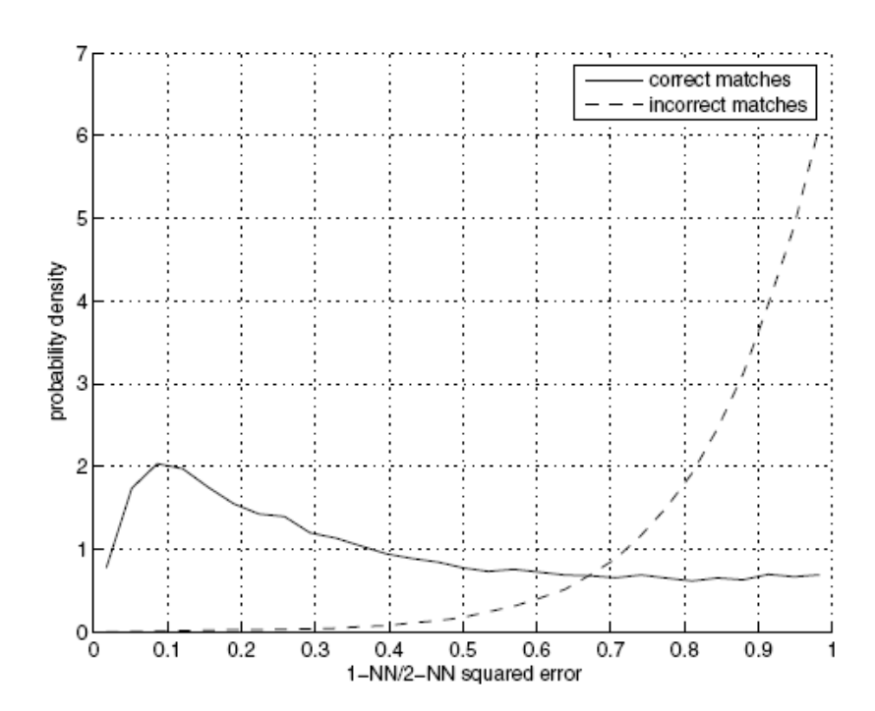
Feature-space outlier rejection
A better way [Lowe, 1999]:
  1-NN: SSD of the closest match
  2-NN: SSD of the second-closest match
  Look at how much better 1-NN is than 2-NN, e.g. 1-NN/2-NN
  That is, is our best match so much better than the rest?

Slide 47
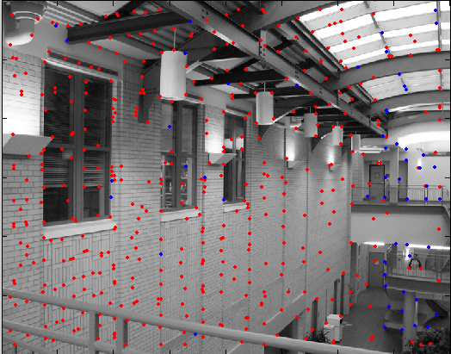
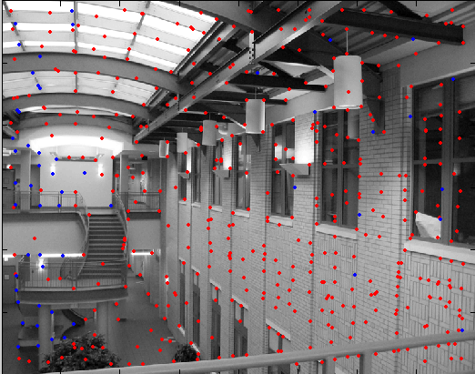
Feature-space outliner rejection
Can we now compute H from the blue points?
  No! Still too many outliers…
  What can we do?

Slide 48
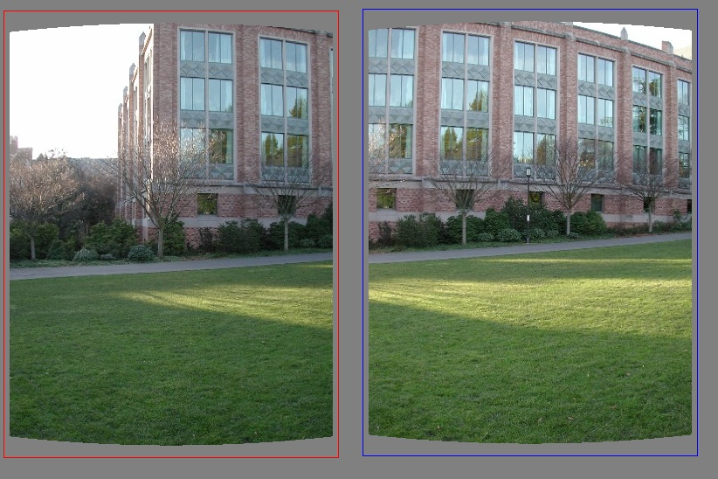
Matching features
What do we do about the “bad” matches?

Slide 49
RANdom SAmple Consensus
Select one match, count inliers

Slide 50
RANdom SAmple Consensus
Select one match, count inliers

Slide 51
Least squares fit
Find “average” translation vector

Slide 52
RANSAC for estimating homography
RANSAC loop:
Select four feature pairs (at random)
Compute homography H (exact)
Compute inliers where SSD(p_{i}’, H p_{i)} < ε
Keep largest set of inliers
Re-compute least-squares H estimate on all of the inliers

Slide 53
RANSAC
The key idea is not just that there are more inliers than outliers, but that the outliers are wrong in different ways.

Slide 54
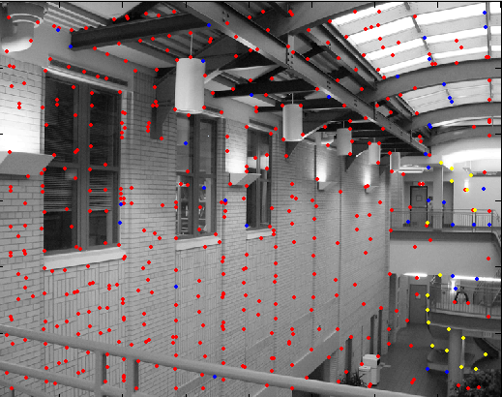
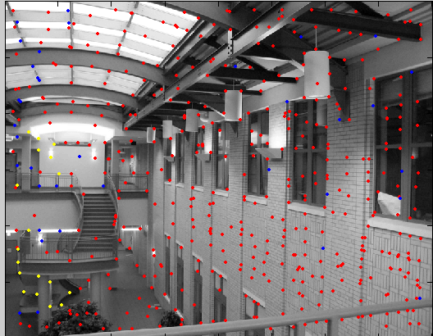
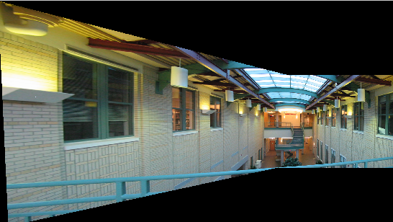
RANSAC

Slide 56
Example: Recognising Panoramas
M. Brown and D. Lowe,
University of British Columbia

Slide 57
Why “Recognising Panoramas”?

Slide 58
Why “Recognising Panoramas”?
1D Rotations (θ)
  Ordering ⇒ matching images

Slide 59
Why “Recognising Panoramas”?
1D Rotations (θ)
  Ordering ⇒ matching images

Slide 60
Why “Recognising Panoramas”?
1D Rotations (θ)
  Ordering ⇒ matching images

Slide 61
Why “Recognising Panoramas”?
1D Rotations (θ)
  Ordering ⇒ matching images
2D Rotations (θ, φ)
  Ordering ⇒ matching images

Slide 62












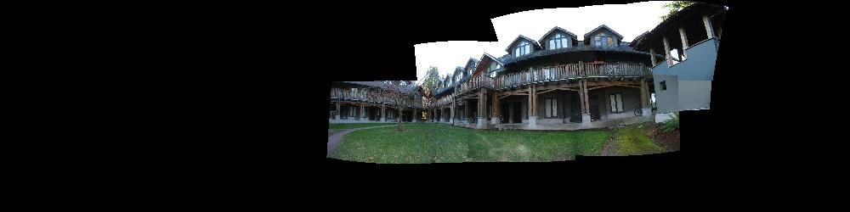
Why “Recognising Panoramas”?
1D Rotations (θ)
  Ordering ⇒ matching images
2D Rotations (θ, φ)
  Ordering ⇒ matching images

Slide 63
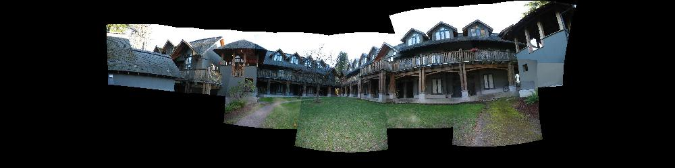
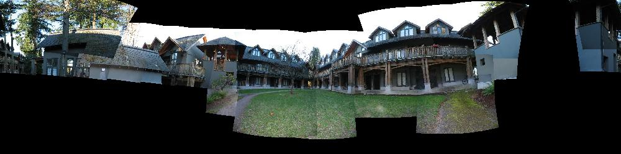
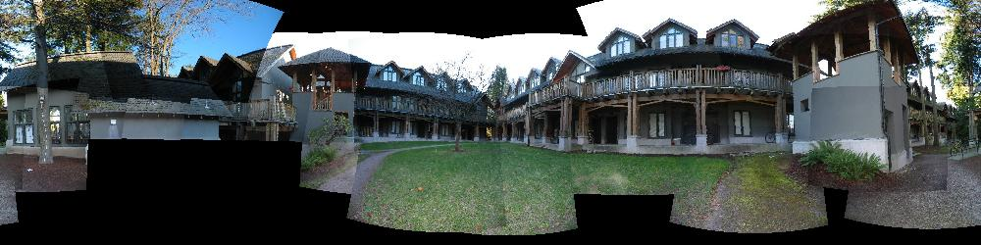
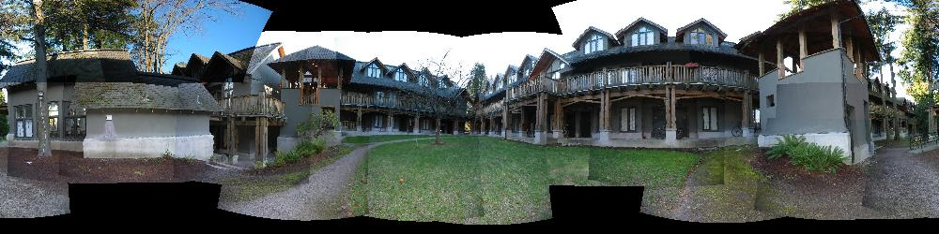
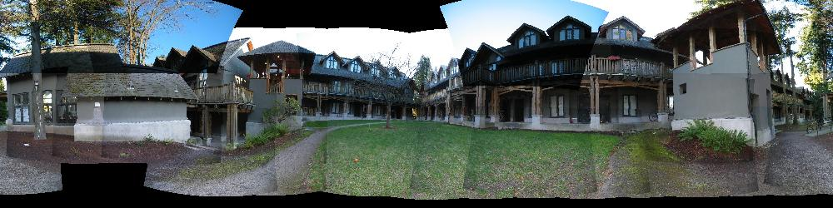
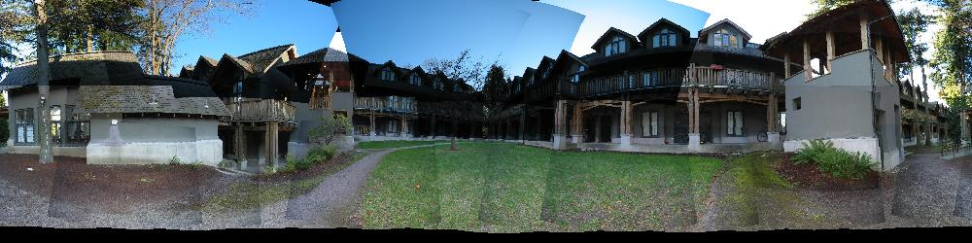
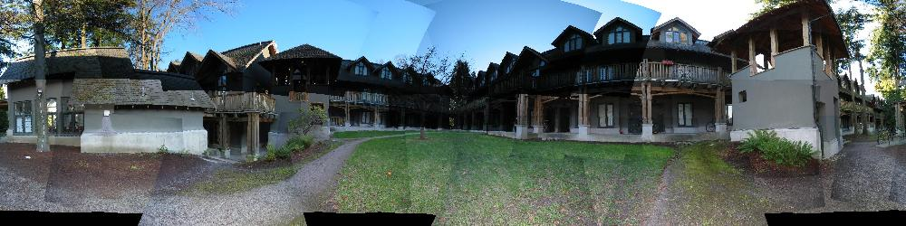
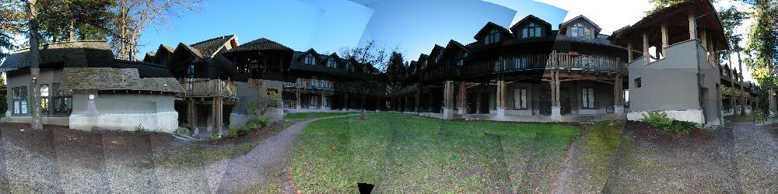

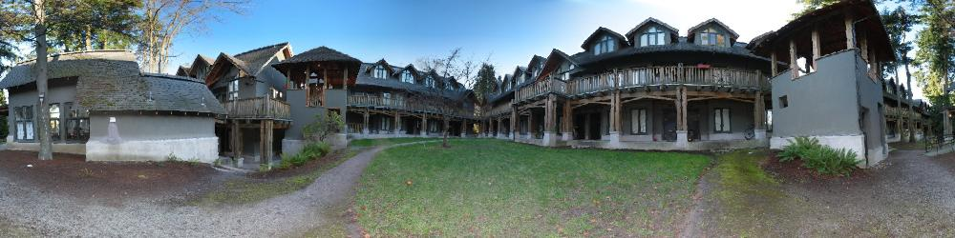
Why “Recognising Panoramas”?
1D Rotations (θ)
  Ordering ⇒ matching images
2D Rotations (θ, φ)
  Ordering ⇒ matching images

Slide 64
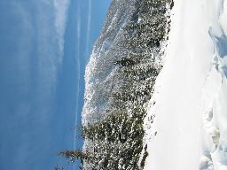
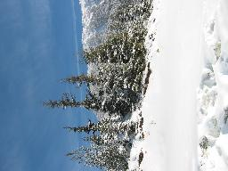
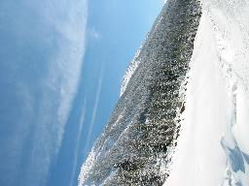
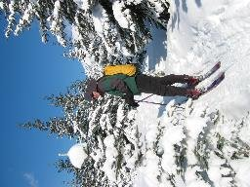
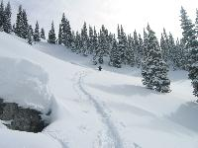
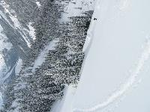
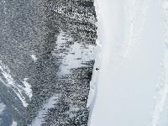
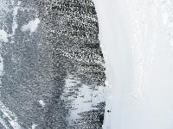
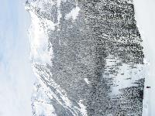



















Why “Recognising Panoramas”?

Slide 65
Overview
Feature Matching
Image Matching
Bundle Adjustment
Multi-band Blending
Results
Conclusions

Slide 66


RANSAC for Homography

Slide 67


RANSAC for Homography

Slide 68

RANSAC for Homography

Slide 69


Probabilistic model for verification

Slide 70
Finding the panoramas

Slide 71
Finding the panoramas

Slide 72
Finding the panoramas

Slide 73
Finding the panoramas

Slide 74



Homography for Rotation
Parameterise each camera by rotation and focal length
This gives pairwise homographies

Slide 75





































Bundle Adjustment
New images initialised with rotation, focal length of best matching image

Slide 76

Bundle Adjustment
New images initialised with rotation, focal length of best matching image

Slide 77

Multi-band Blending
Burt & Adelson 1983
  Blend frequency bands over range ∝ λ

Slide 78


























Results

