Slide 1
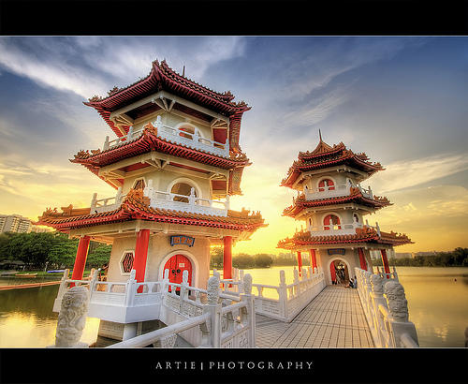
High Dynamic Range Images
cs195g: Computational Photography
James Hays, Brown, Spring 2010
slides from Alexei A. Efros
and Paul Debevec
Notes:
http://www.flickr.com/photos/artiephotography/3513060620/

Slide 2
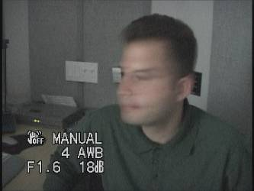
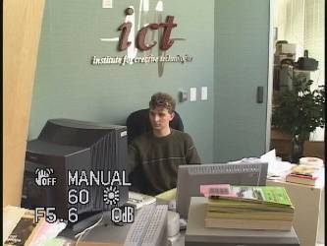
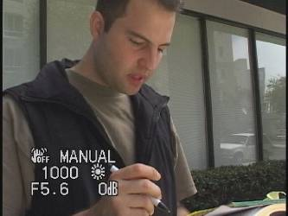
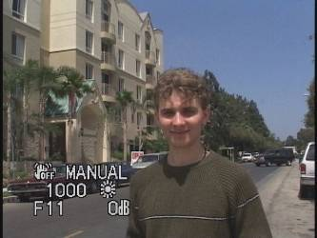
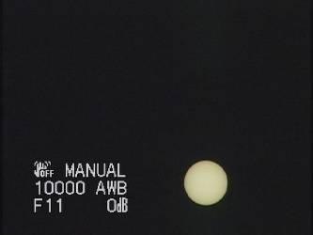
Problem: Dynamic Range
1
The real world is
high dynamic range.
1500
25,000
400,000
2,000,000,000

Slide 3
Long Exposure
10⁻⁶
High dynamic range
10⁶
Real world
10⁻⁶
10⁶
Picture
^{0 to 255}

Slide 4
Short Exposure
10⁻⁶
High dynamic range
10⁶
Real world
10⁻⁶
10⁶
Picture
^{0 to 255}

Slide 5
Image
pixel (312, 284) = 42
42 photons?
Notes:
2

Slide 6
Camera Calibration
Geometric
  How pixel coordinates relate to directions in the world
Photometric
  How pixel values relate to radiance amounts in the world

Slide 7
Camera Calibration
Geometric
  How pixel coordinates relate to directions in the world in other images.
Photometric
  How pixel values relate to radiance amounts in the world in other images.

Slide 8
The Image
Acquisition Pipeline
Lens
Shutter
scene
radiance
(W/sr/m )
sensor
irradiance
∫
sensor
exposure
2
Δt
CCD
ADC
Remapping
analog
voltages
digital
values
pixel
values
Raw
Image
JPEG
Image
Notes:
3

Slide 9
Imaging system response function
255
Pixel
value
0
log Exposure = log (Radiance * Δt)
(CCD photon count)
Notes:
1

Slide 10
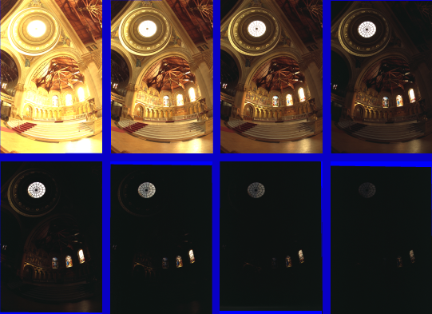
Varying Exposure
Notes:
memorial church, Stanford.

Slide 11
Camera is not a photometer!
Limited dynamic range
  Perhaps use multiple exposures?
Unknown, nonlinear response
  Not possible to convert pixel values to radiance
Solution:
  Recover response curve from multiple exposures, then reconstruct the radiance map
Notes:
4

Slide 12

Recovering High Dynamic Range
Radiance Maps from Photographs
Paul Debevec
Jitendra Malik
Computer Science Division
University of California at Berkeley
August 1997
Notes:
1

Slide 13
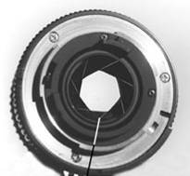
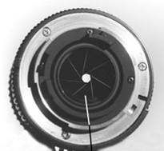
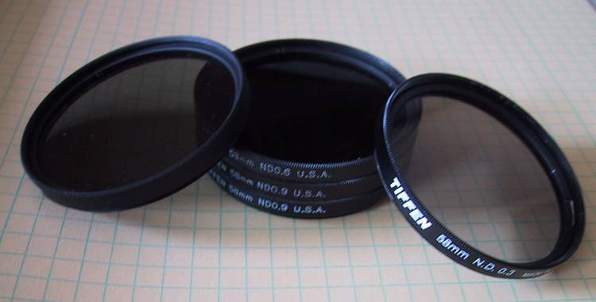
Ways to vary exposure
Shutter Speed (*)
F/stop (aperture, iris)
Neutral Density (ND) Filters

Slide 14
Shutter Speed
Ranges: Canon D30: 30 to 1/4,000 sec.
Sony VX2000: ¼ to 1/10,000 sec.
Pros:
Directly varies the exposure
Usually accurate and repeatable
Issues:
Noise in long exposures

Slide 15
Shutter Speed
Note: shutter times usually obey a power series – each “stop” is a factor of 2
¼, 1/8, 1/15, 1/30, 1/60, 1/125, 1/250, 1/500, 1/1000 sec
Usually really is:
¼, 1/8, 1/16, 1/32, 1/64, 1/128, 1/256, 1/512, 1/1024 sec

Slide 16
The Algorithm
Image series
• 1
• 1
• 1
• 1
• 1
• 2
• 2
• 2
• 2
•
2
• 3
• 3
• 3
• 3
• 3
Δt =
1/64 sec
Δt =
1/16 sec
Δt =
1/4 sec
Δt =
1 sec
Δt =
4 sec
Pixel Value Z = f(Exposure)
Exposure = Radiance ∗ Δt
log Exposure = log Radiance + log Δt
Notes:
10

Slide 17
Response Curve
Assuming unit radiance
for each pixel
After adjusting radiances to obtain a smooth response curve
3
2
Pixel value
Pixel value
1
ln Exposure
ln Exposure

Slide 18
The Math
Let g(z) be the discrete inverse response function
For each pixel site i in each image j, want:
Solve the overdetermined linear system:
fitting term
smoothness term

Slide 19
Matlab
Code
function [g,lE]=gsolve(Z,B,l,w)
n = 256;
A = zeros(size(Z,1)*size(Z,2)+n+1,n+size(Z,1));
b = zeros(size(A,1),1);
k = 1; %% Include the data-fitting equations
for i=1:size(Z,1)
for j=1:size(Z,2)
wij = w(Z(i,j)+1);
A(k,Z(i,j)+1) = wij; A(k,n+i) = -wij; b(k,1) = wij * B(i,j);
k=k+1;
end
end
A(k,129) = 1; %% Fix the curve by setting its middle value to 0
k=k+1;
for i=1:n-2 %% Include the smoothness equations
A(k,i)=l*w(i+1); A(k,i+1)=-2*l*w(i+1); A(k,i+2)=l*w(i+1);
k=k+1;
end
x = A\b; %% Solve the system using SVD
g = x(1:n);
lE = x(n+1:size(x,1));

Slide 20
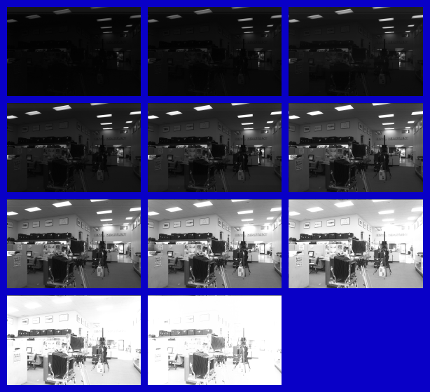
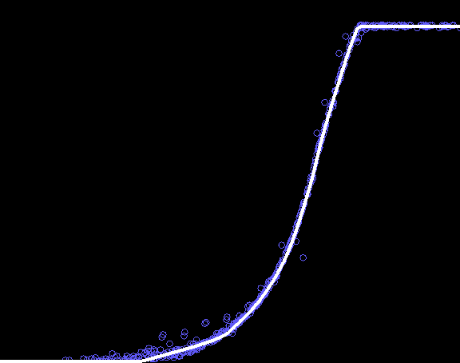
Results: Digital Camera
Kodak DCS460
1/30 to 30 sec
Recovered response curve
Pixel value
log Exposure
Notes:
13

Slide 21
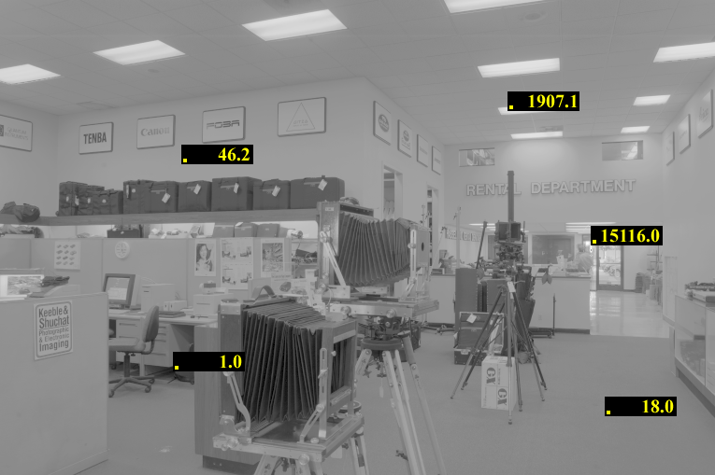
Reconstructed radiance map

Slide 22
Results: Color Film
Kodak Gold ASA 100, PhotoCD
Notes:
14

Slide 23
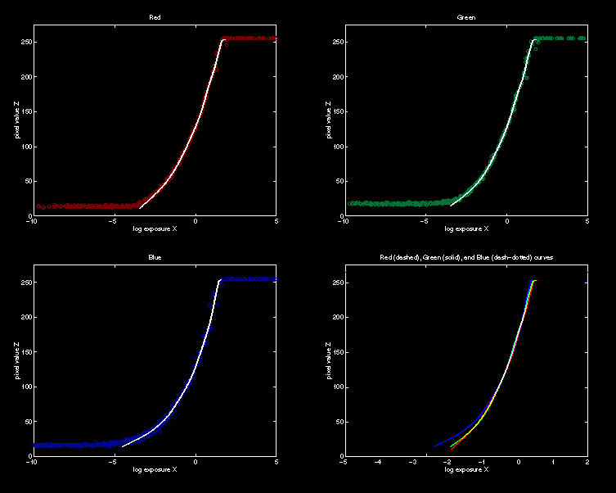
Recovered Response Curves
Red
Green
Blue
RGB
Notes:
15

Slide 24
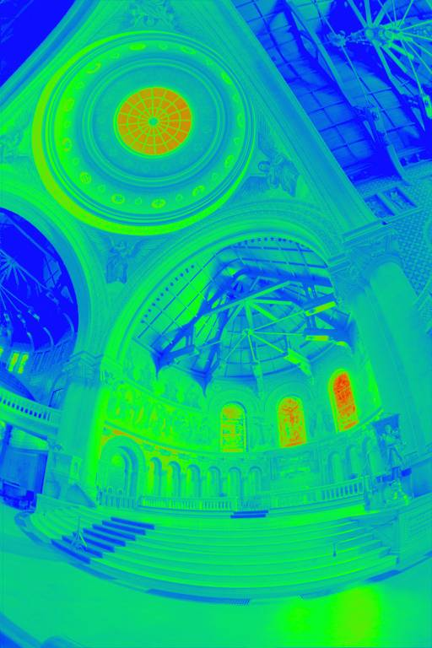
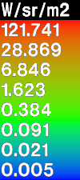
The Radiance Map
Notes:
17

Slide 25
How do we store this?

Slide 26
Portable FloatMap (.pfm)
12 bytes per pixel, 4 for each channel
sign
exponent
mantissa
Text header similar to Jeff Poskanzer’s .ppm
image format:
PF
768 512
1
<binary image data>
Floating Point TIFF similar

Slide 27
Radiance Format
(.pic, .hdr)
32 bits / pixel
Red Green Blue Exponent
(145, 215, 87, 149) =
(145, 215, 87) * 2^(149-128) =
(1190000, 1760000, 713000)
(145, 215, 87, 103) =
(145, 215, 87) * 2^(103-128) =
(0.00000432, 0.00000641, 0.00000259)
Ward, Greg. "Real Pixels," in Graphics Gems IV, edited by James Arvo, Academic Press, 1994

Slide 28
ILM’s OpenEXR (.exr)
6 bytes per pixel, 2 for each channel, compressed
sign
exponent
mantissa
Several lossless compression options, 2:1 typical
Compatible with the “half” datatype in NVidia's Cg
Supported natively on GeForce FX and Quadro FX
Available at http://www.openexr.net/

Slide 29
Now What?
Notes:
17

Slide 30
Tone Mapping
How can we do this?
  Linear scaling?, thresholding? Suggestions?
10⁻⁶
High dynamic range
10⁶
Real World
Ray Traced
World (Radiance)
10⁻⁶
10⁶
Display/
Printer
^{0 to 255}

Slide 31
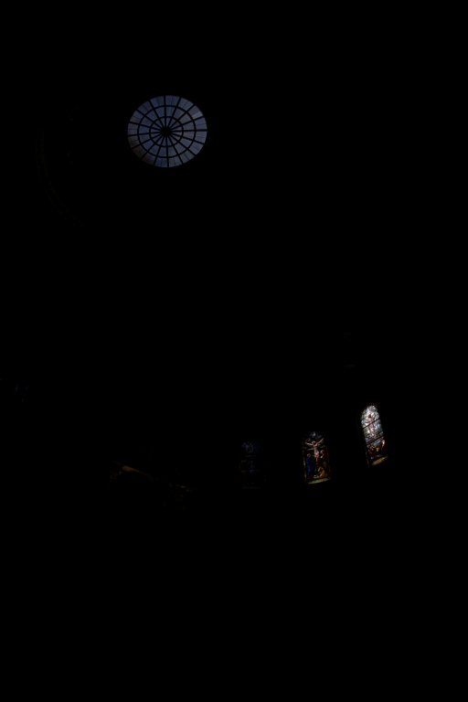
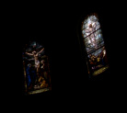
The
Radiance
Map
Linearly scaled to
display device
Notes:
16

Slide 32
Simple Global Operator
Compression curve needs to
  Bring everything within range
  Leave dark areas alone
In other words
  Asymptote at 255
  Derivative of 1 at 0

Slide 33
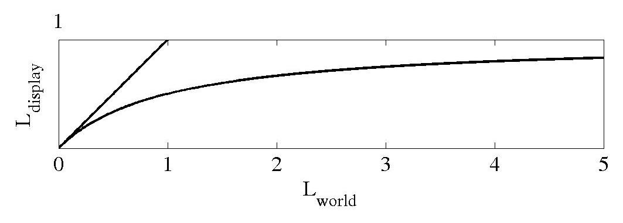
Global Operator (Reinhart et al)

Slide 34
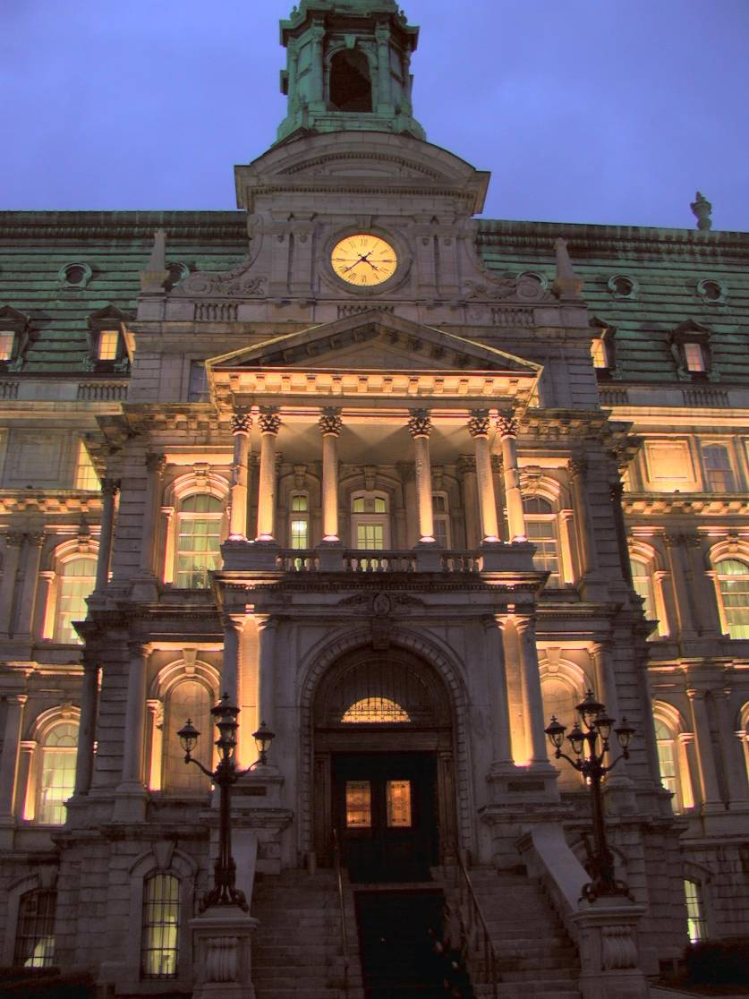
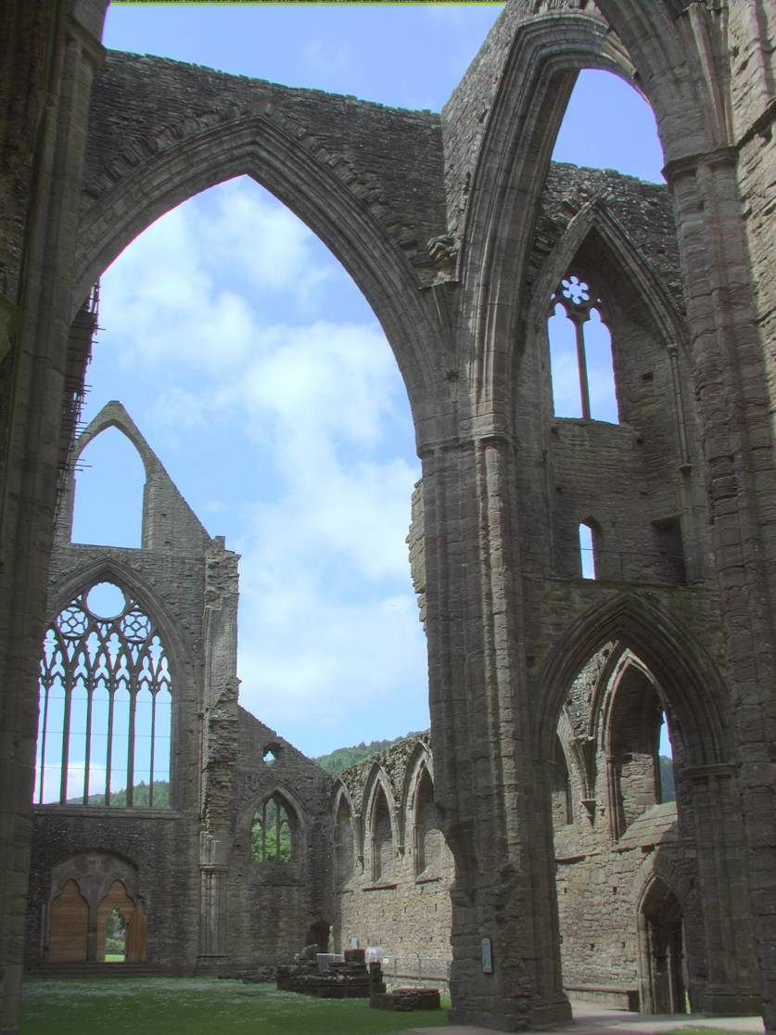
Global Operator Results

Slide 35
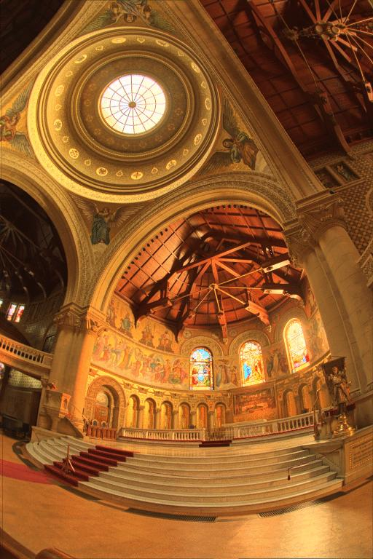
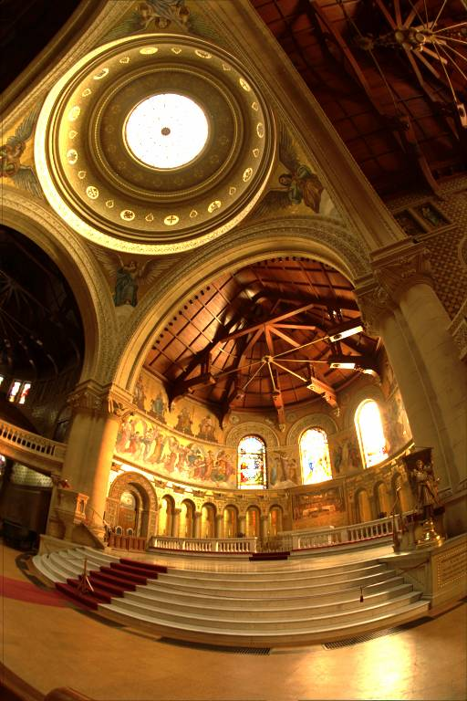
Reinhart Operator
Darkest 0.1% scaled
to display device

Slide 36
What do we see?
Vs.

Slide 37
Issues with multi-exposure HDR
Scene and camera need to be static
Camera sensors are getting better and better
Display devices are fairly limited anyway (although getting better).

Slide 38
What about local tone mapping?

