Slide 1
Photo Quality Assessment
CS195g Computational Photography
James Hays, Brown University, Spring 2010

Slide 2
Agenda
Movie
What makes a good photo?
No class on Wednesday
Assigned reading for Friday
Course summary
CS2951b, Data-driven Graphics and Vision
Course evaluation

Slide 3
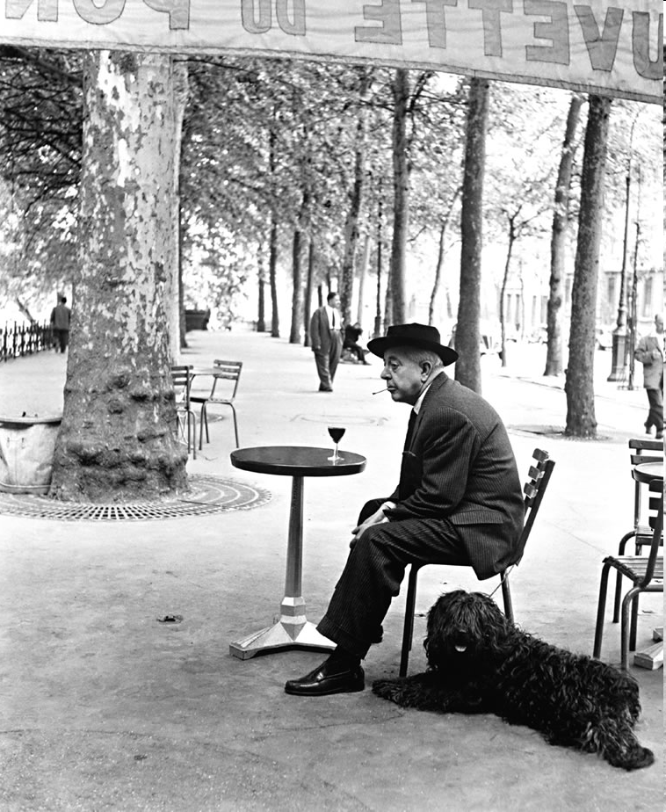
What Makes a Great Picture?
© Robert Doisneau, 1955
With many slides from Alyosha Efros,
Yan Ke, as annotated by Tamara Berg

Slide 4
Photography 101
Composition
  Framing
  Rule of Thirds
  Leading Lines
  Textures and Patterns
Lighting
  Direction
  Color coordination / balance

Slide 5
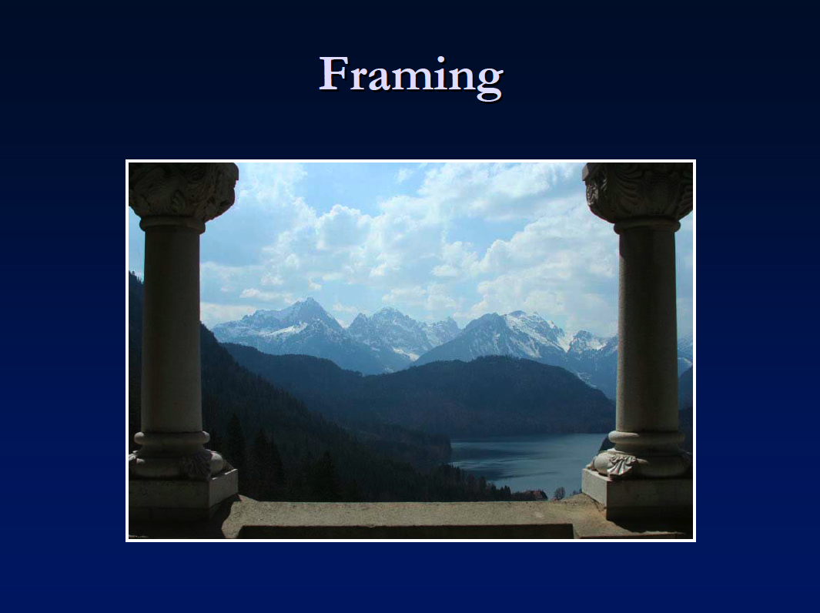
Framing
“Photography is all about framing. We see a subject -- and we put a frame around it. Essentially, that is photography when all is said and done.”
-- from photo.blorge.com

Slide 6
Frame serves several purpouses:
1. It gives the image depth
2. Use correctly, framing can draw the eye of the viewer of an interest to a particular part of the scene.
3. Framing can bring a sense of organization or containment to an image.
4. Framing can add context to a shot.
http://digital-photography-school.com/blog/frame-your-images/

Slide 7
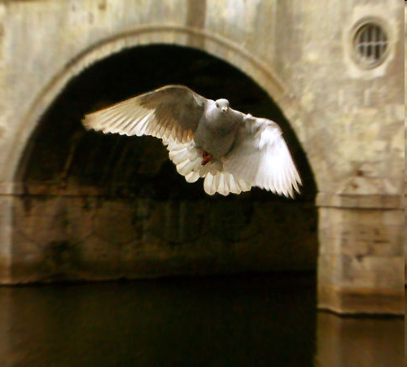
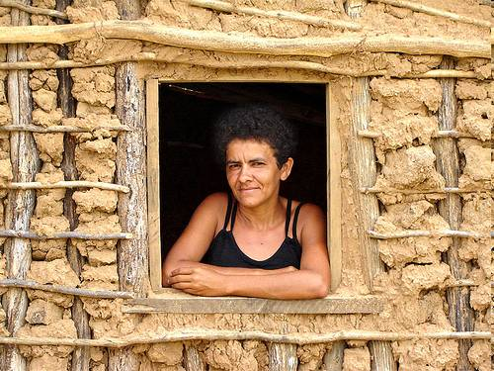
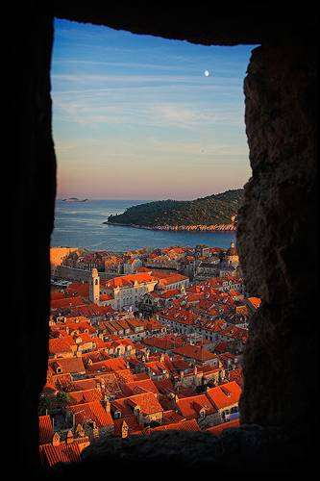
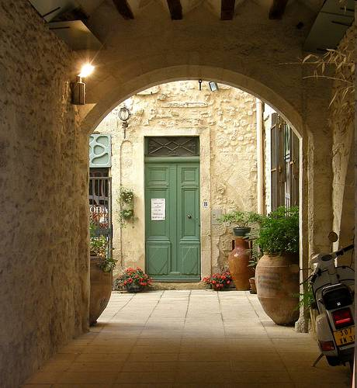
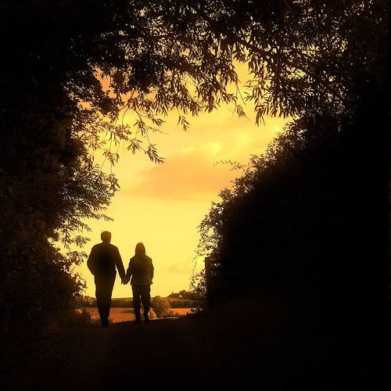
Examples of nice framing
http://flickr.com/photos/paulosacramento/226545698/
http://flickr.com/photos/chrisbeach/13868545/
http://flickr.com/photos/74531485@N00/929270814/
http://flickr.com/photos/freakdog/223117229/
http://flickr.com/photos/cdm/253805482/

Slide 8
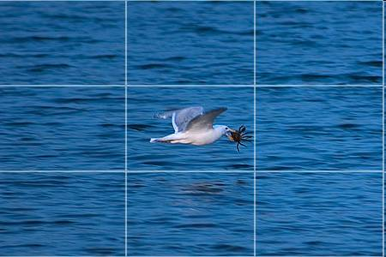
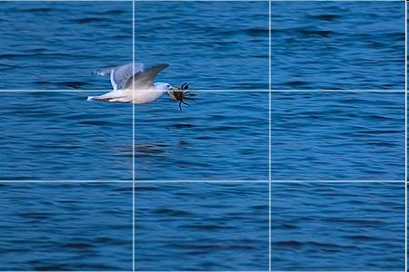
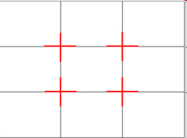
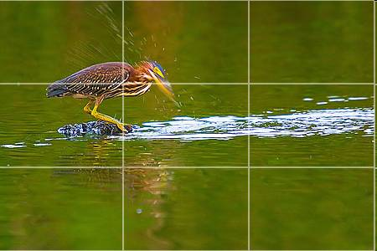
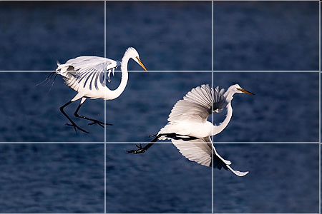
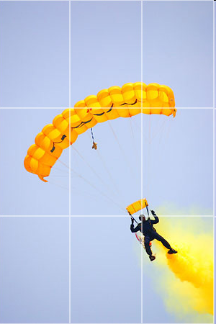
Rules of Thirds
http://www.photo96.com/blog/?p=371

Slide 9
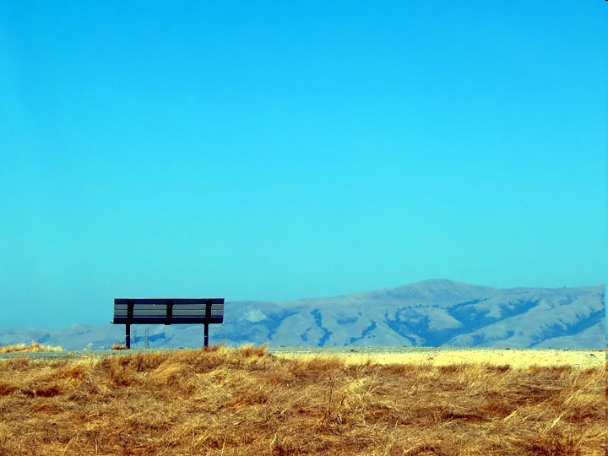
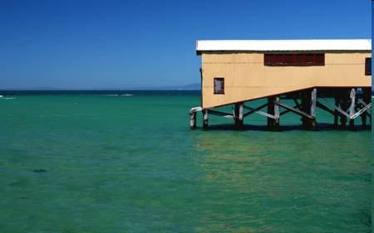
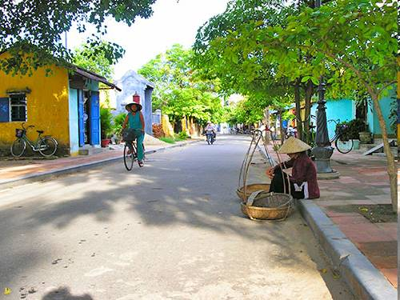

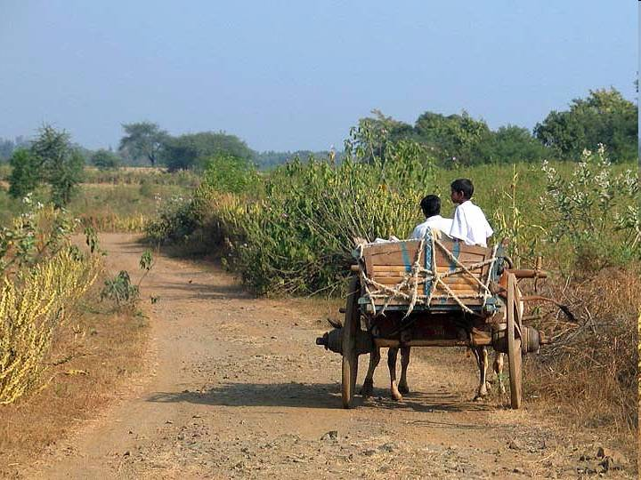
Other examples

Slide 10
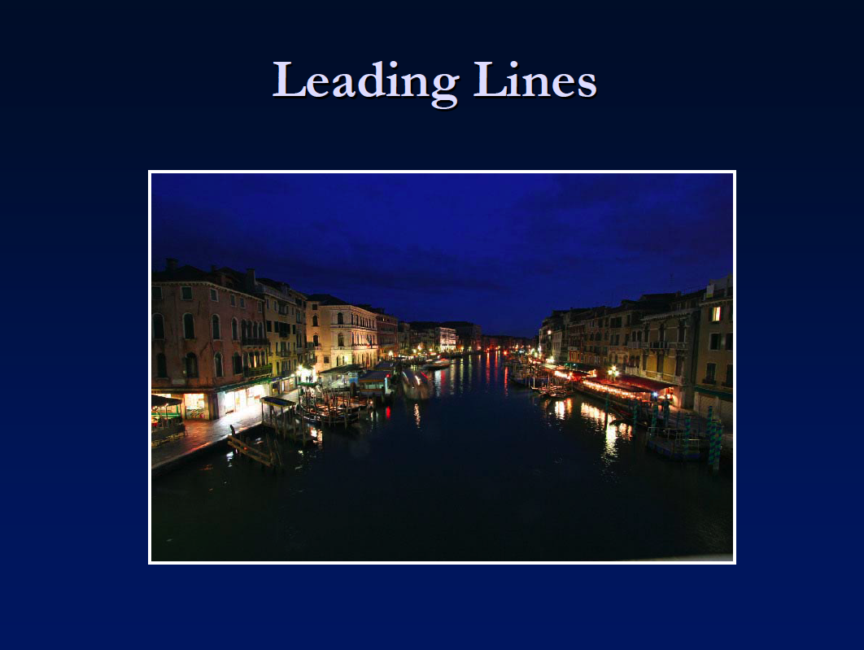

Slide 11
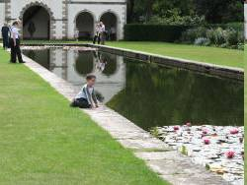
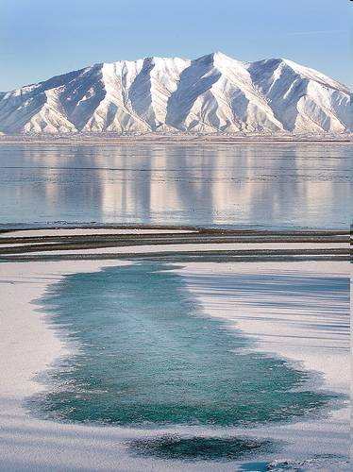
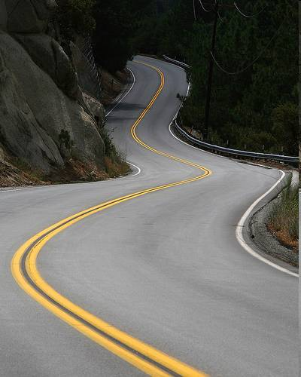
More examples

Slide 12
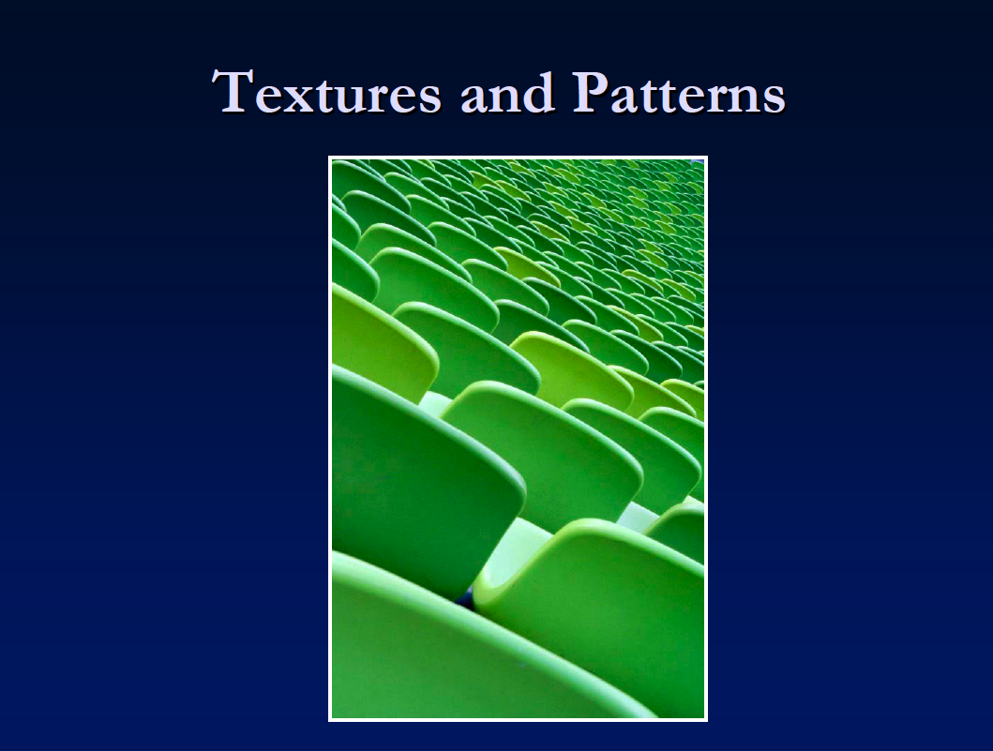

Slide 13
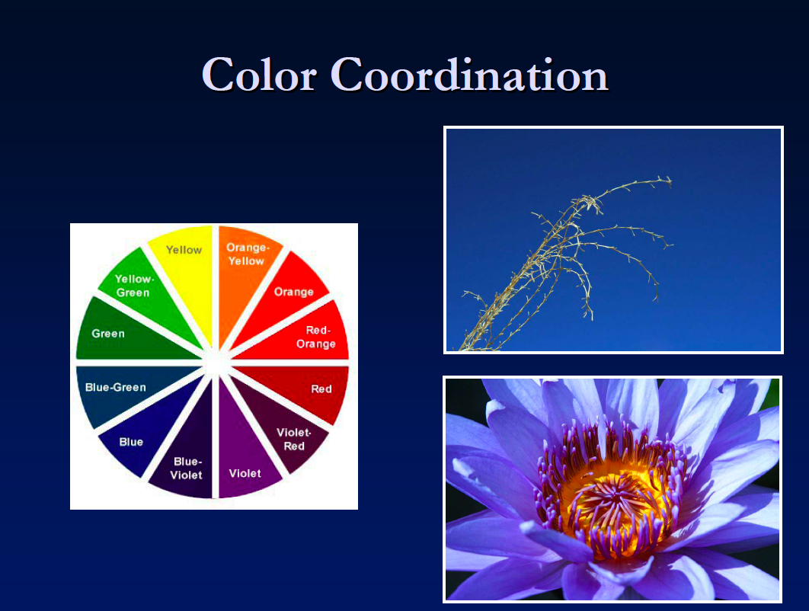
Complementary colors (of opposite hue on color wheel)

Slide 14
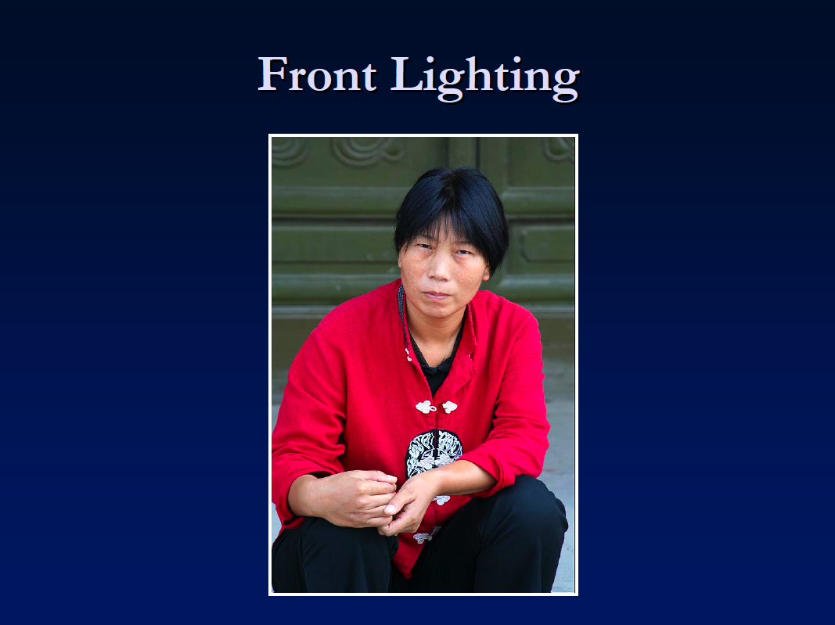

Slide 15
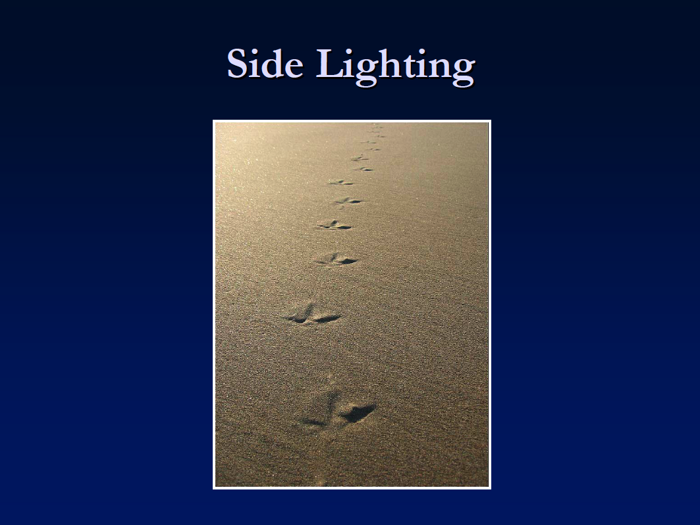

Slide 16
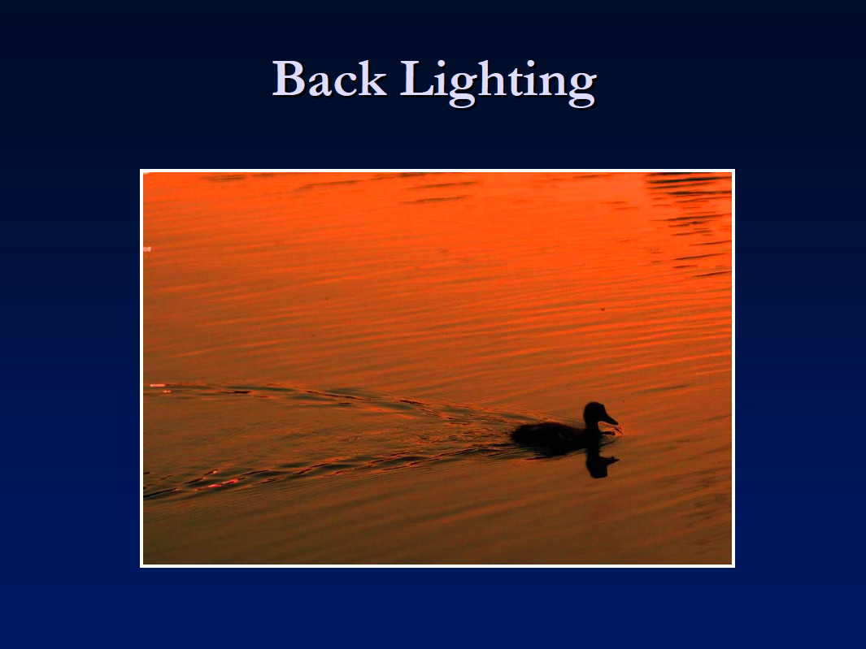

Slide 17
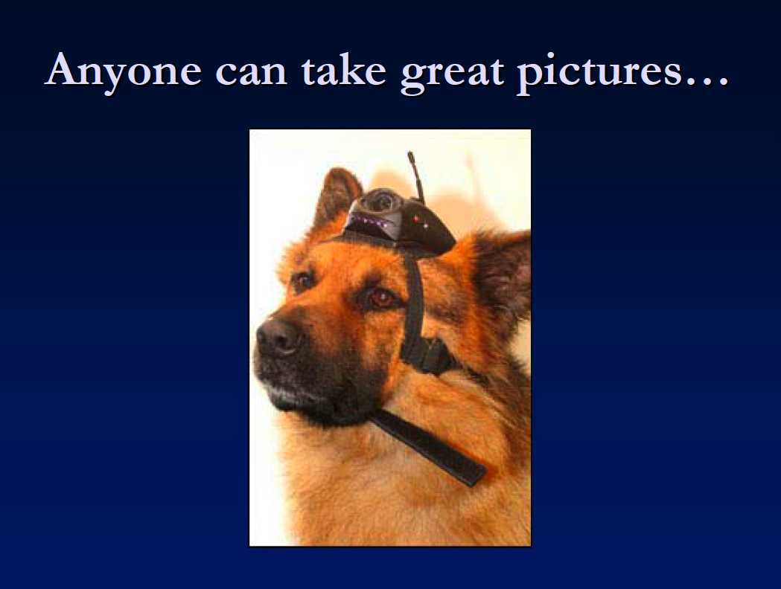

Slide 18
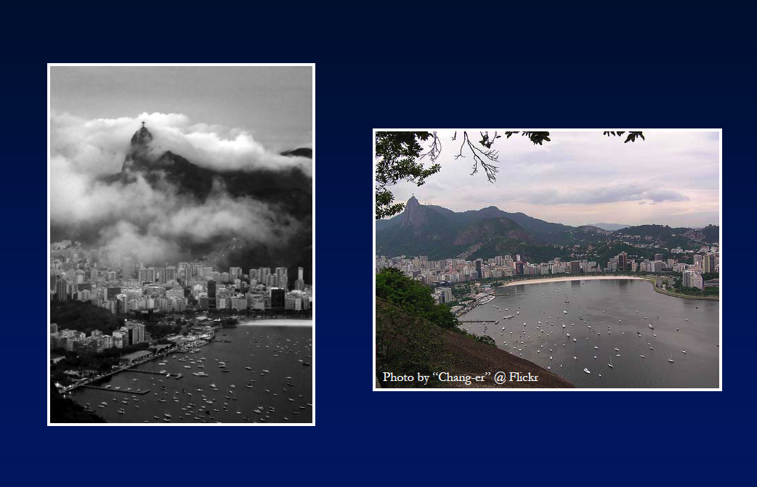
If we can recognize the good photos

Slide 19
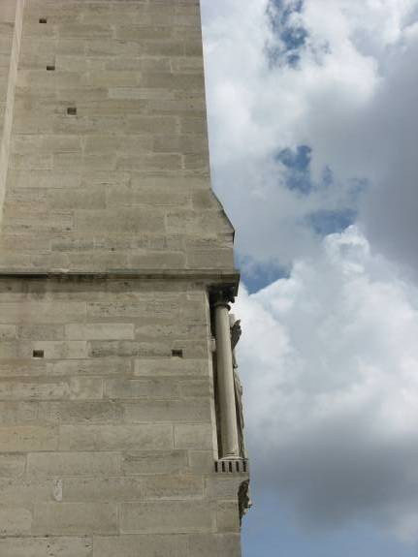
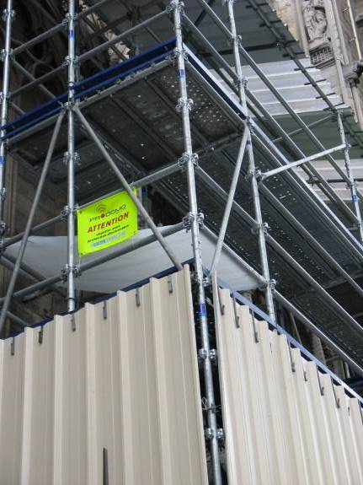
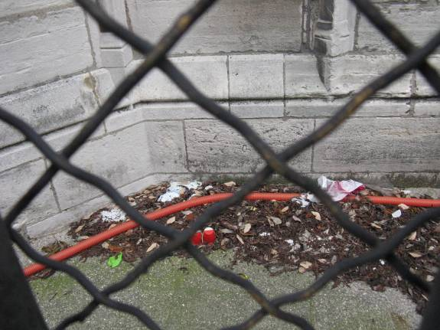
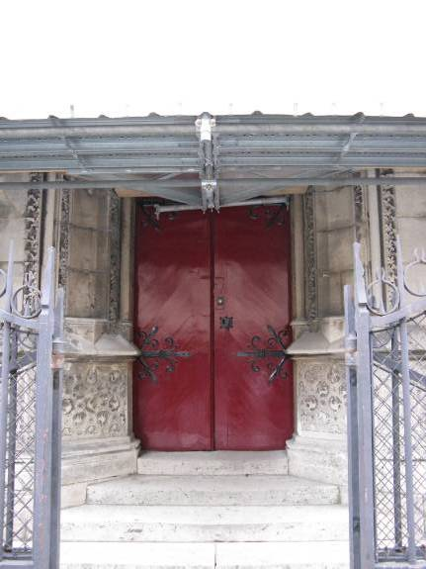
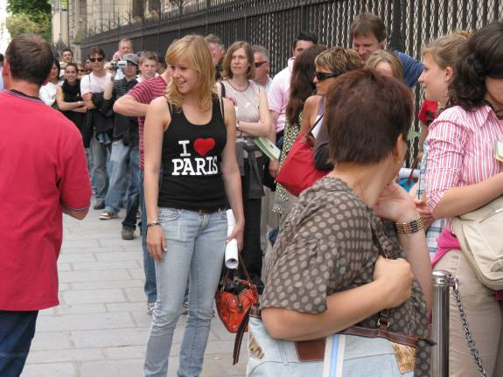
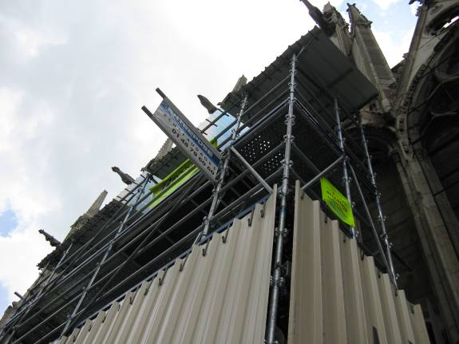
Alyosha claims to be a bad photographer…

Slide 20
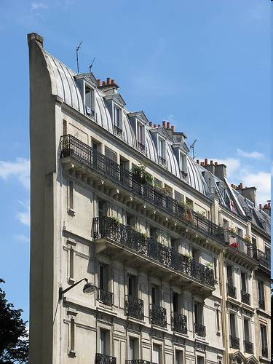
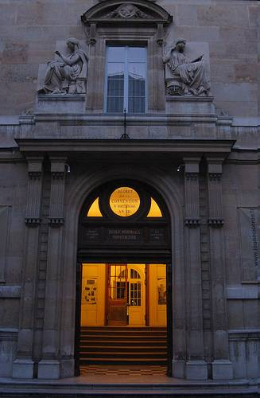
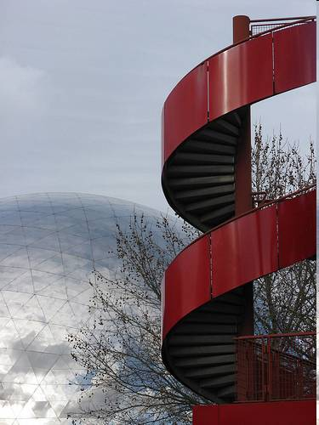
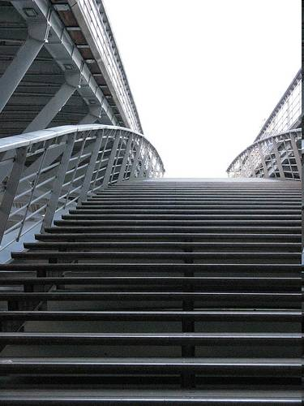
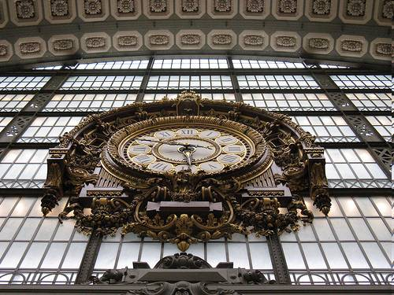
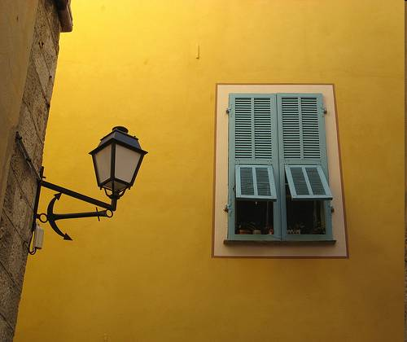
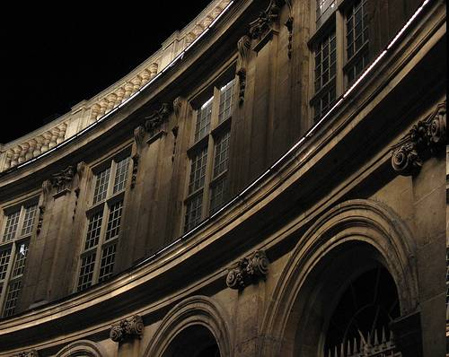
…but a pretty good photo critic!
http://flickr.com/photos/aaefros/
# of my Paris photos on Flickr: 32
Total # of my Paris photos: ~1250
~2%

Slide 21
The Postmodern Photographer
The Old Days: a pre-process
  Load film
  Find subject
  Position camera
  Set all the settings “just right”
  Take a deep breath…
  ...Press buttom!
The New Digital Days: a post-process
  Get a 2 GB memory cartridge
  Take pictures like there is no tomorrow!!!
  …
  Back home, spend hours of agony trying to find 1-2 good ones

Slide 22
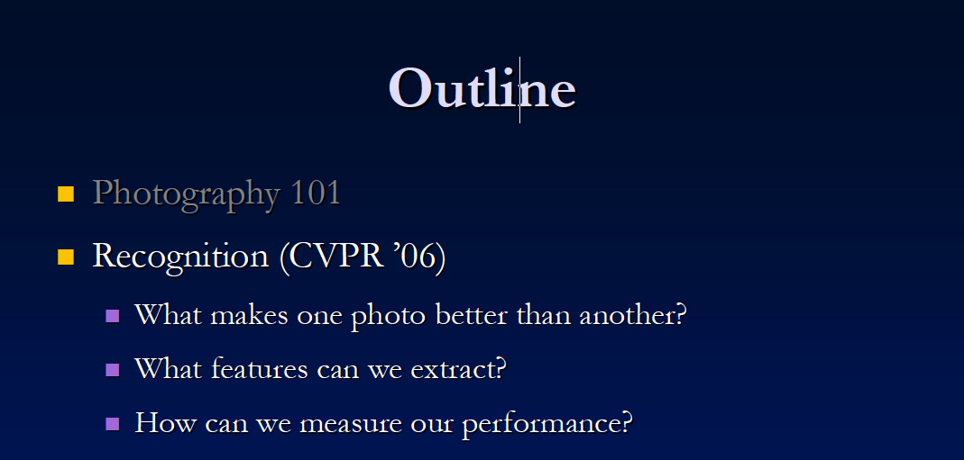
Y. Ke, X. Tang, and F. Jing. The Design of High-Level Features
for Photo Quality Assessment. CVPR 2006.

Slide 23
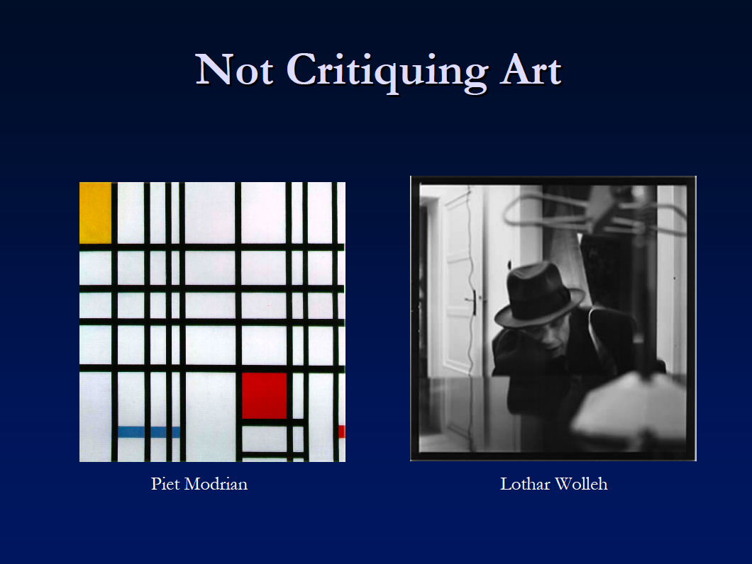
Not considering semantic measures of what makes a photo good (subject matter, humor, etc). Professional = those you would frame, snapshot = those that would stay in photo album.

Slide 24
Applications
Image search for improved quality along with relevance.
Automatically select the best photos from a set of vacation pictures to choose the best ones to show.
See if computer can perform well on a traditionally human task.

Slide 25
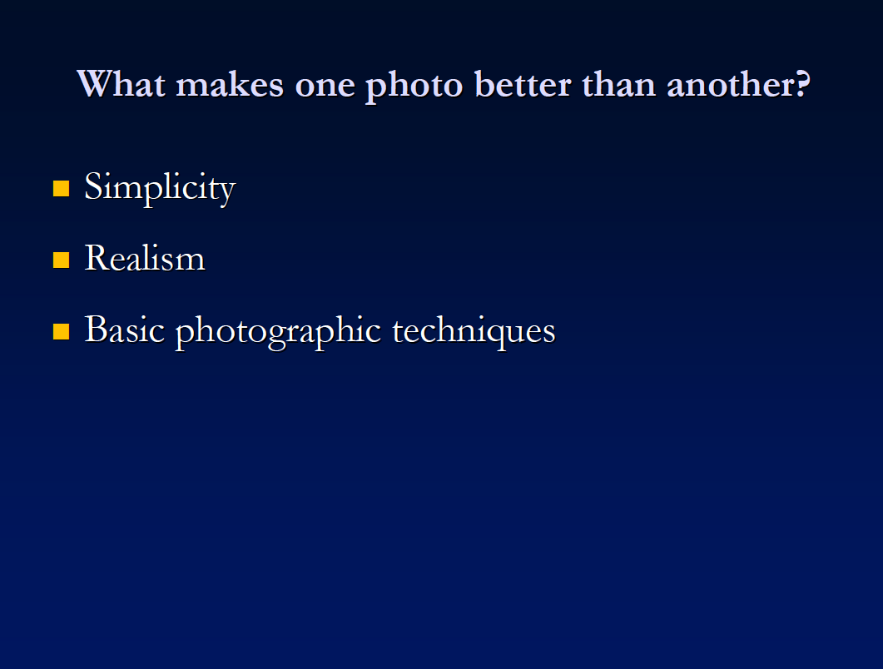

Slide 26
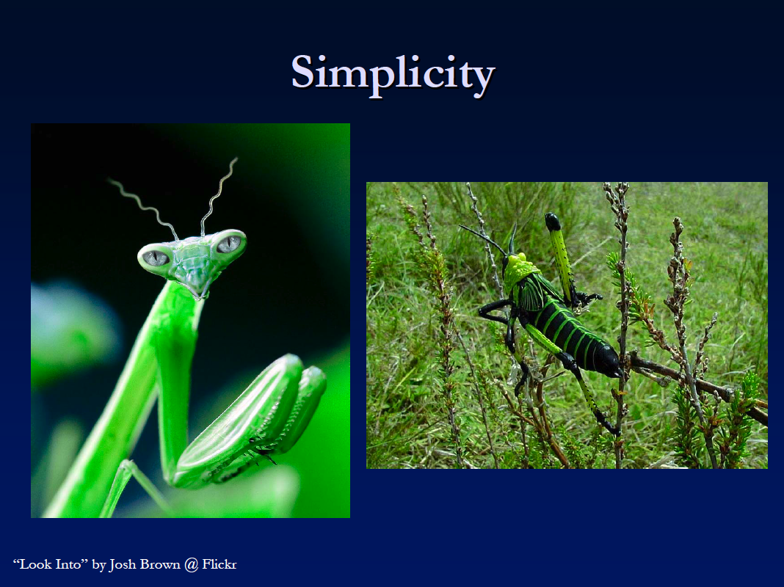
Prof - Obvious what one should be looking at ie easy to separate subject from the background. Snap – unstructured, busy, filled with clutter.

Slide 27
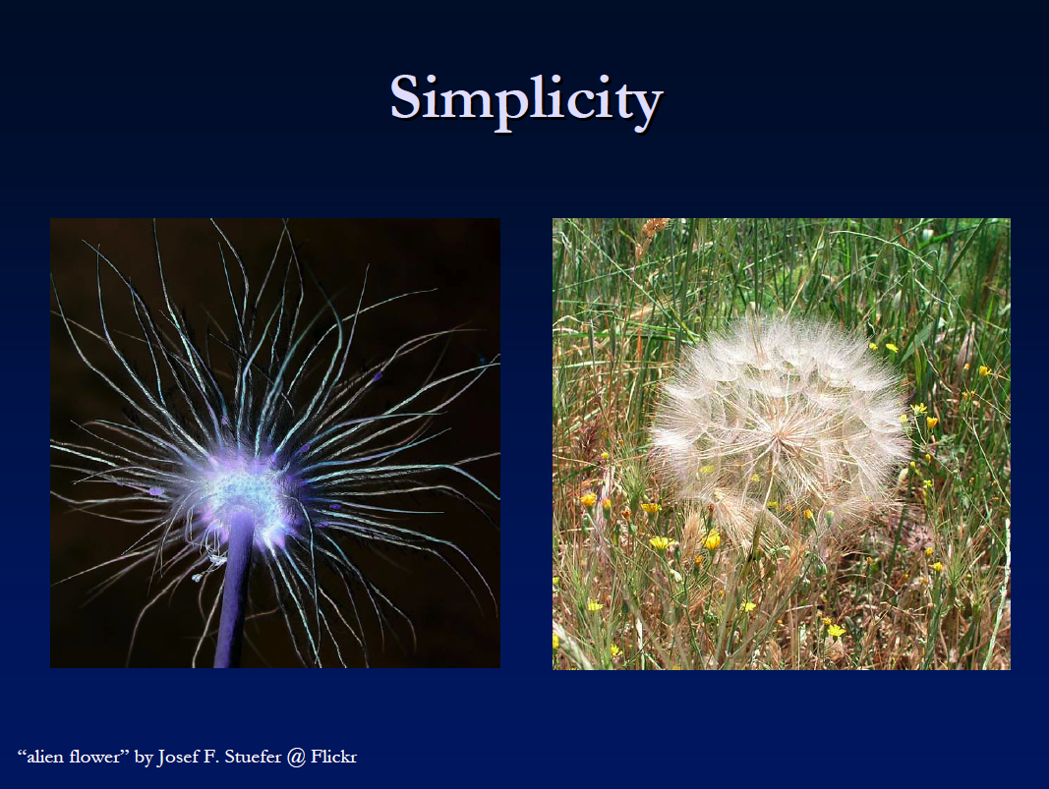

Slide 28
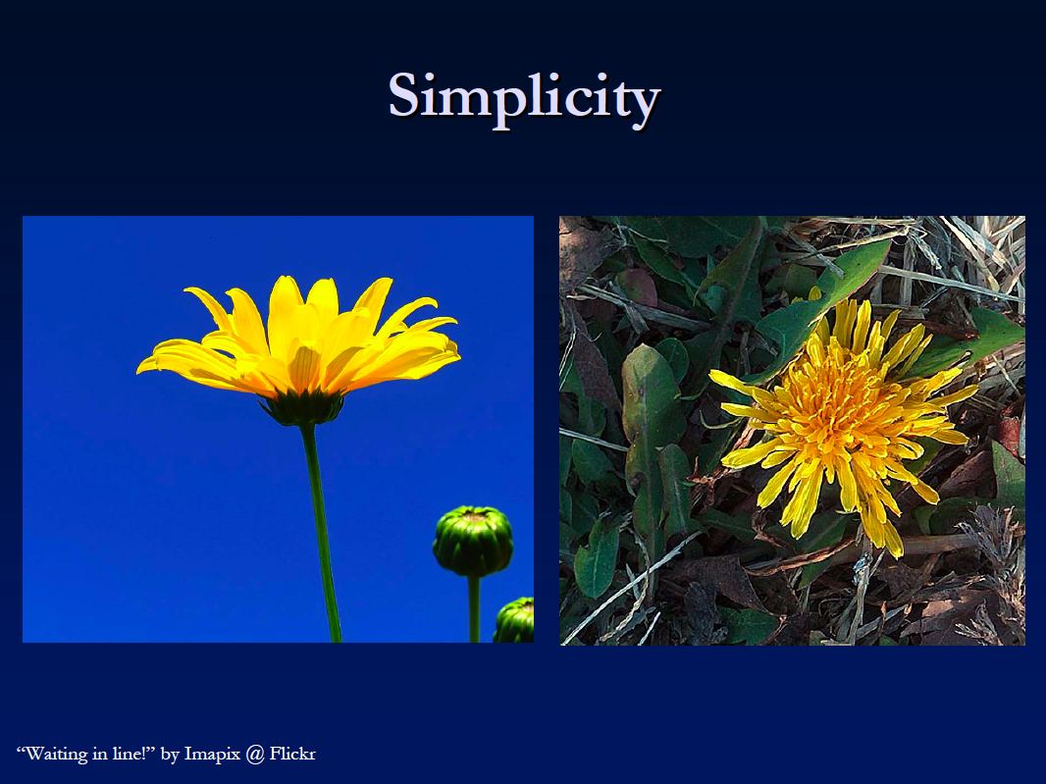

Slide 29
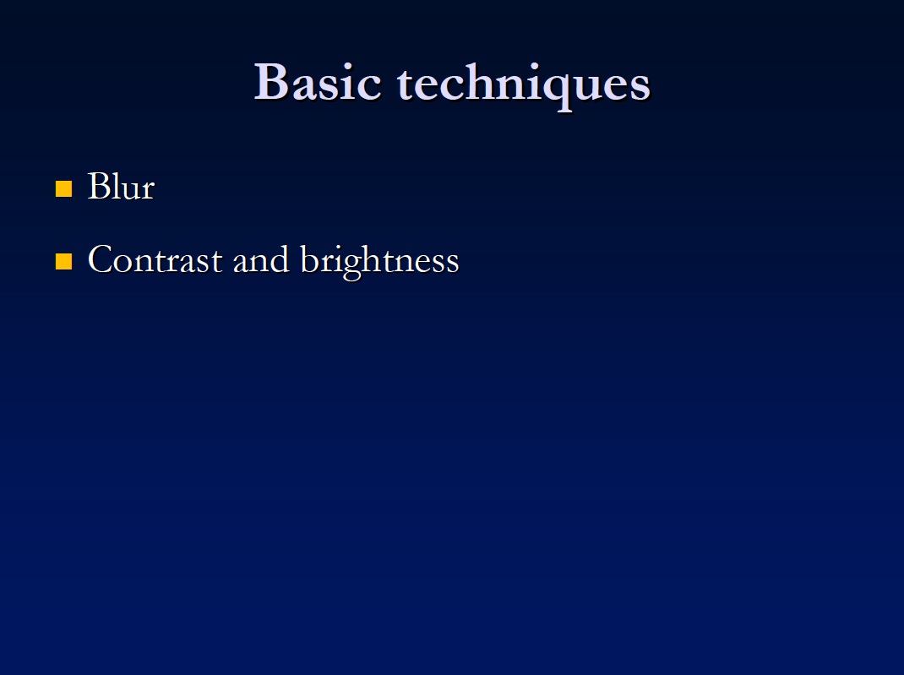
- Snaps – entire photo blurry indicates poor technique. Prof - background out of focus by widening the lens aperture, but foreground in sharp focus.
Make the subject pop out by choosing complementary colors for subject & background. Isolate the subject by increasing lighting contrast between subject & background.
Abstract concepts - “Good composition, color & lighting”

Slide 30
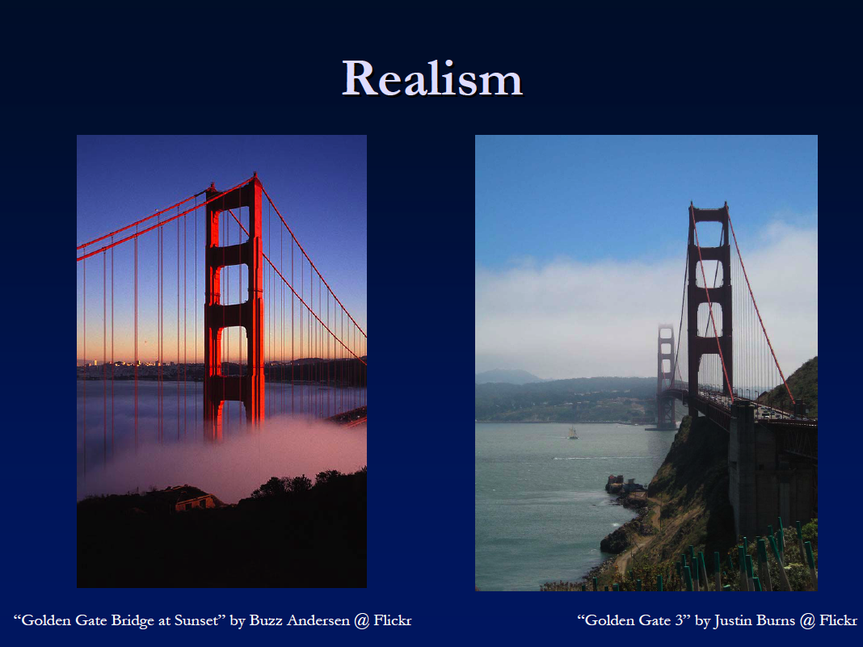
(Sur)
Snaps look real, while prof photos look surreal.

Slide 31
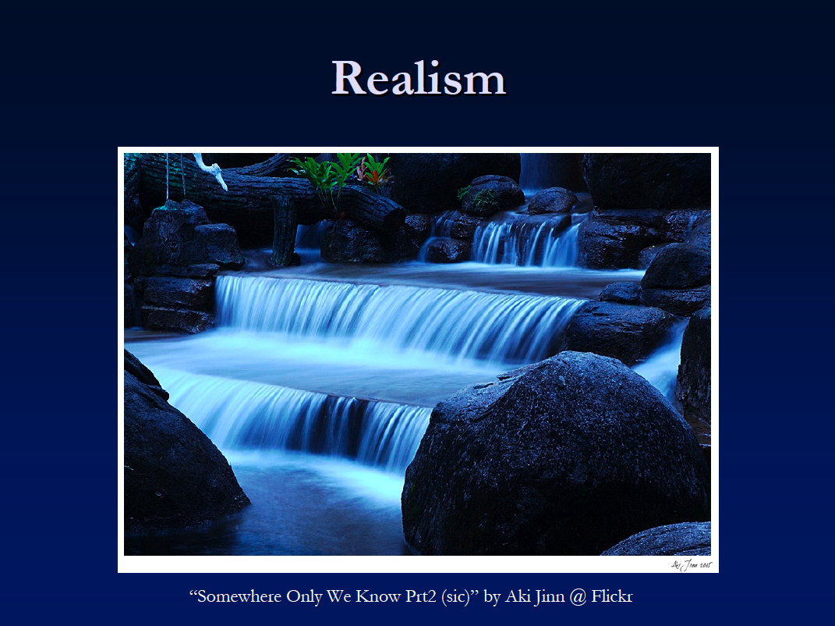
(Sur)

Slide 32


Slide 33

More edges near border due to background clutter
More edges near center of img
Trying to capture a photo’s “simplicity”

Slide 34

Mean Laplacian of snapshots
Mean Laplacian of professional
More uniformly distributed
More concentrated
Expect high quality photos to have high spatial frequency edges nearer to center than snapshots

Slide 35

Edge width
.94
.56
Calculate area that edges occupy – width of bounding box covering 96% of edge energy
Cluttered regions should tend to produce a larger bounding box, and well defined subjects should produce a smaller one.

Slide 36

For query image find k nearest neighbors in training set. Quality = number of prof neighbors in top 5.

Slide 37

20 bin histogram defining possible unique hues
# unique hues smaller for prof photos even though they tend to look more vibrant and colorful (S,V may vary more) – another measure related to “simplicity”

Slide 38

Prof photos should have some part of photo in sharp focus

Slide 39

Prof photos usually have higher contrast
Contrast = width of middle 98% mass of hist

Slide 40

Contrast

Slide 41

Professional photographers may adjust exposure to be correct on subject only so subj pops from bkd. Cameras tend to adjust brightness to average at 50% gray, but prof photos might deviate significantly. Use ave brightness as feature.

Slide 42


Slide 43


Slide 44

Use photos average rating as ground truth quality measure
Use only top 10%, bottom 10% as dataset.
Use half for training/half for testing.
Photo contest website, user rated

Slide 45


Slide 46


Slide 47


Slide 48

72% classification rate

Slide 49


Slide 50


Slide 51


Slide 52
Photo Quality Summary
Yan Ke’s method and several closely related publications tend to answer the question
“Is this photo well composed?” and not
“Is this photo interesting?”.
They focus on hand-formulated, mid-level cues and not high level considerations

Slide 53

Why is this photo awesome?

Slide 54

Why did this photo win a Pulitzer prize?
Omaha Beach, Normandy, France. Robert Capa, 1944

Slide 55
No class on Wednesday
Because it is reading period, you can do some reading for the final (invited) lecture on Friday
I’ll send email after class.

Slide 56
Course Wrap-up

Slide 57
From the course intro…
Two strategies for realistic rendering
  capture real world data
  synthesize from bottom up
Both strategies have existed for 500 years. Both are successful. Attempts to take the best of both world have been successful. We’re going to take it further.

Slide 58


Creating Realistic Imagery
Computational
Photography
Computer Graphics
Photography
Realism
Manipulation
Ease of capture
+ great creative possibilities
+ easy to manipulate objects/viewpoint
Tremendous expertise and work for realism
+ instantly realistic
+ easy to aquire
- very hard to manipulate objects/viewpoint

Slide 59
Course Wrap-up
You should have a broad understanding of research at the intersection of computer vision and computer graphics. Should be comfortable attending an “imaging” session at SIGGRAPH.
Achieved deeper understanding of some areas (projects).

Slide 60
CS2951b, Data-driven Graphics and Vision
Seminar course focused on recent research aimed at active researchers

Slide 61
Course evaluations

