Slide 1

ASTERIX:
Towards a Scalable, Semistructured Data Platform for Evolving World Models
Michael Carey
Information Systems Group
CS Department
UC Irvine

Slide 2
Today’s Presentation
Overview of UCI’s ASTERIX project
  What and why?
  A few technical details
  ASTERIX research agenda
Overview of UCI’s Hyracks sub-project
  Runtime plan executor for ASTERIX
  Data-intensive computing substrate in its own right
  Early open source release
Project status, next steps, and Q & A

Slide 3
Context: Information-Rich Times
Databases have long been central to our existence, but now digital info, transactions, and connectedness are everywhere…
  E-commerce: > $100B annually in retail sales in the US
  In 2009, average # of e-mails per person was 110 (biz) and 45 (avg user)
  Print media is suffering, while news portals and blogs are thriving
Social networks have truly exploded in popularity
  End of 2009 Facebook statistics:
    > 350 million active users with > 55 million status updates per day
    > 3.5 billion pieces of content per week and > 3.5 million events per month
  Facebook only 9 months later:
    > 500 million active users, more than half using the site on a given day (!)
    > 30 billion pieces of new content per month now
Twitter and similar services are also quite popular
  Used by about 1 in 5 Internet users to share status updates
  Early 2010 Twitter statistic: ~50 million Tweets per day

Slide 4

Context: Cloud DB Bandwagons
MapReduce and Hadoop
  “Parallel programming for dummies”
  But now Pig, Scope, Jaql, Hive, …
  MapReduce is the new runtime!
GFS and HDFS
  Scalable, self-managed, Really Big Files
  But now BigTable, HBase, …
  HDFS is the new file storage!
Key-value stores
  All charter members of the “NoSQL movement”
  Includes S3, Dynamo, BigTable, HBase, Cassandra, …
  These are the new record managers!

Slide 5
Let’s Approach This Stuff “Right”!
In my opinion…
  The OS/DS folks out-scaled the (napping) DB folks
  But, it’d be “crazy” to build on their foundations
Instead, identify key lessons and do it “right”
  Cheap open-source S/W on commodity H/W
  Non-monolithic software components
  Equal opportunity data access (external sources)
  Tolerant of flexible / nested / absent schemas
  Little pre-planning or DBA-type work required
  Fault-tolerant long query execution
  Types and declarative languages (aha…!)

Slide 6

So What If We’d Meant To Do This?
What is the “right” basis for analyzing and managing the data of the future?
  Runtime layer (and division of labor)?
  Storage and data distribution layers?
Explore how to build new information management systems for the cloud that…
  Seamlessly support external data access
  Execute queries in the face of partial failures
  Scale to thousands of nodes (and beyond)
  Don’t require five-star wizard administrators
  ….

Slide 7
ASTERIX Project Overview
Data loads & feeds from external sources (XML, JSON, …)
AQL queries & scripting requests and programs
Data publishing to external sources and apps
ASTERIX Goal: To ingest, digest, persist, index, manage, query, analyze, and publish massive quantities of semistructured information…
Hi-Speed Interconnect
CPU(s)
CPU(s)
CPU(s)
Main
Memory
Main
Memory
Main
Memory
(ADM = ASTERIX Data Model;
AQL = ASTERIX Query Language)
Disk
Disk
Disk
ADM
Data
ADM
Data
ADM
Data

Slide 8

The ASTERIX Project
Semistructured
Data Management
Semistructured data management
  Core work exists
  XML & XQuery, JSON, …
  Time to parallelize and scale out
Parallel database systems
  Research quiesced in mid-1990’s
  Renewed industrial interest
  Time to scale up and de-schema-tize
Data-intensive computing
  MapReduce and Hadoop quite popular
  Language efforts even more popular (Pig, Hive, Jaql, …)
  Ripe for parallel DB ideas (e.g., for query processing) and support for stored, indexed data sets
Parallel Database Systems
Data-Intensive
Computing

Slide 9
ASTERIX Project Objectives
Build a scalable information management platform
  Targeting large commodity computing clusters
  Handling mass quantities of semistructured information
Conduct timely information systems research
  Large-scale query processing and workload management
  Highly scalable storage and index management
  Fuzzy matching in a highly parallel world
  Apply parallel DB know-how to data intensive computing
Train a new generation of information systems R&D researchers and software engineers
  “If we build it, they will learn…”(☺)

Slide 10
“Mass Quantities”? Really??
Traditional databases store an enterprise model
  Entities, relationships, and attributes
  Current snapshot of the enterprise’s actual state
  I know, yawn….! (☺)
The Web contains an unstructured world model
  Scrape it/monitor it and extract (semi)structure
  Then we’ll have a (semistructured) world model
Now simply stop throwing stuff away
  Then we’ll get an evolving world model that we can analyze to study past events, responses, etc.!

Slide 11


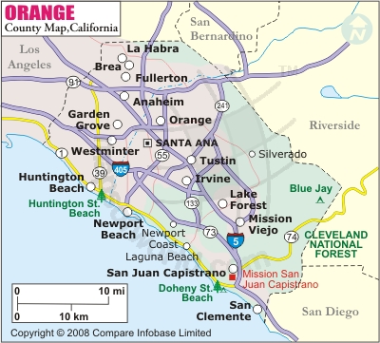

Use Case: OC “Event Warehouse”
Traditional Information
  Map data
  Business listings
  Scheduled events
  Population data
  Traffic data
  …
Additional Information
  Online news stories
  Blogs
  Geo-coded or OC- tagged tweets
  Status updates and wall posts
  Geo-coded or tagged photos
  …
NowLedger project in ISG @ UCI

Slide 12

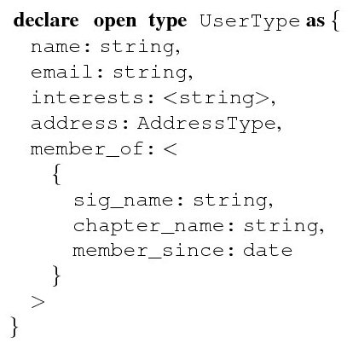
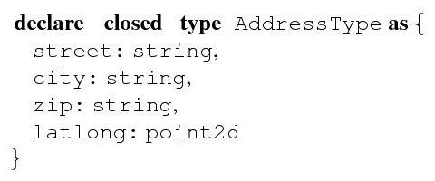
ASTERIX Data Model (ADM)
Loosely: JSON + (ODMG – methods) ≠ XML

Slide 13
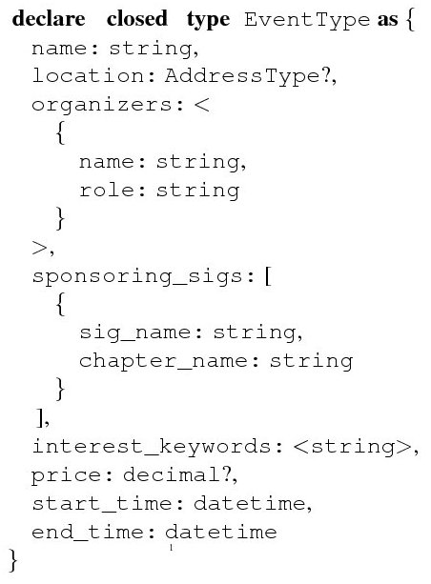
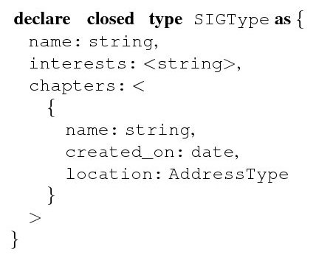
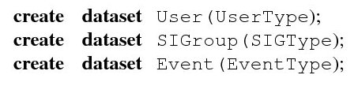
ADM (cont.)
(Plus equal opportunity support for both stored and external datasets)

Slide 14
Note: ADM Spans the Full Range!
  declare closed type SoldierType as {
  name: string,
  rank: string,
  serialNumber: int32
  }
  create dataset MyArmy(SoldierType);
  -versus-
  declare open type StuffType as { }
  create dataset MyStuff(StuffType);

Slide 15
ASTERIX Query Language (AQL)
Q1: Find the names of all users who are interested in movies:
  for $user in dataset('User') where some $i in $user.interests satisfies $i = "movies“ return { "name": $user.name };
Note: A group of extremely smart and experienced researchers and practitioners designed XQuery to handle complex, semistructured data – so we may as well start by standing on their shoulders…!

Slide 16
AQL (cont.)
Q2: Out of SIGroups sponsoring events, find the top 5, along with the numbers of events they’ve sponsored, total and by chapter:
  for $event in dataset('Event') for $sponsor in $event.sponsoring_sigs let $es := { "event": $event, "sponsor": $sponsor } group by $sig_name := $sponsor.sig_name with $es let $sig_sponsorship_count := count($es) let $by_chapter := for $e in $es group by $chapter_name := $e.sponsor.chapter_name with $es return { "chapter_name": $chapter_name, "count": count($es) } order by $sig_sponsorship_count desc limit 5 return { "sig_name": $sig_name,
  "total_count": $sig_sponsorship_count,
  "chapter_breakdown": $by_chapter };
{"sig_name": "Photography", "total_count": 63, "chapter_breakdown": [{"chapter_name": ”San Clemente", "count": 7},
{"chapter_name": "Laguna Beach", "count": 12}, ...] }
{"sig_name": "Scuba Diving", "total_count": 46, "chapter_breakdown": [ {"chapter_name": "Irvine", "count": 9},
{"chapter_name": "Newport Beach", "count": 17}, ...] }
{"sig_name": "Baroque Music", "total_count": 21, "chapter_breakdown": [ {"chapter_name": "Long Beach", "count": 10}, ...] }
{"sig_name": "Robotics", "total_count": 12, "chapter_breakdown": [ {"chapter_name": "Irvine", "count": 12} ] }
{"sig_name": "Pottery", "total_count": 8, "chapter_breakdown": [ {"chapter_name": "Santa Ana", "count": 5}, ...] }

Slide 17
AQL (cont.)
Q3: For each user, find similar users based on interests:
set simfunction ‘Jaccard’;
set simthreshold .75;
for $user in dataset('User')
let $similar_users :=
for $similar_user in dataset('User')
where $user != $similar_user
and $user.interests ~= $similar_user.interests
return { "user_name" : $similar_user.name}
return { "user_name" : $user.name, "similar_users" : $similar_users };

Slide 18
AQL (cont.)
Q3': For each user, find the 10 most similar users based on interests:
for $user in dataset('User')
let $similar_users :=
for $similar_user in dataset('User')
where $user != $similar_user
let [$match, $sim] :=
$user.interests ~= $similar_user.interests
with simfunction 'jaccard', simthreshold '.75‘
where $match
order by $sim
limit 10
return { "user_name" : $similar_user.name,
"similarity" : $sim }
return { "user_name" : $user.name, "similar_users" : $similar_users };

Slide 19
AQL (cont.)
Q4: Update the user named John Smith to contain a field named favorite-movies with a list of his favorite movies:
  replace $user in dataset('User')
  where $user.name = "John Smith"
  with ( add-field($user, "favorite-movies", ["Avatar"])
  );

Slide 20
AQL (cont.)
Q5: List the SIGroup records added in the last 24 hours:
  for $curr_sig in dataset('SIGroup') where every $yester_sig in dataset('SIGroup',
  getCurrentDateTime( ) - dtduration(0,24,0,0))
  satisfies $yester_sig.name != $curr_sig.name
  return $curr_sig;

Slide 21
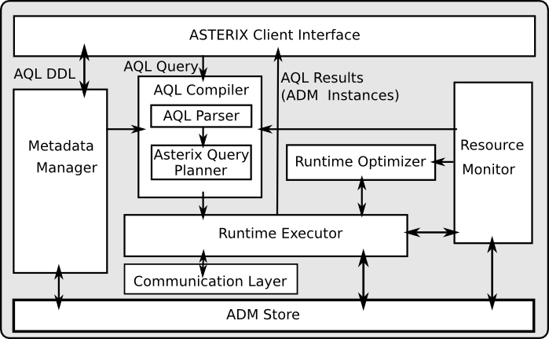
ASTERIX System Architecture

Slide 22
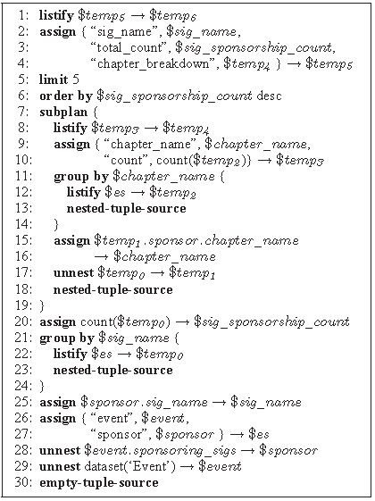
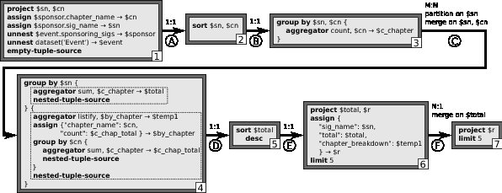
AQL Query Processing
  for $event in dataset('Event') for $sponsor in $event.sponsoring_sigs let $es := { "event": $event, "sponsor": $sponsor } group by $sig_name := $sponsor.sig_name with $es let $sig_sponsorship_count := count($es) let $by_chapter := for $e in $es group by $chapter_name := $e.sponsor.chapter_name with $es return { "chapter_name": $chapter_name, "count": count($es) } order by $sig_sponsorship_count desc limit 5 return { "sig_name": $sig_name,
  "total_count": $sig_sponsorship_count,
  "chapter_breakdown": $by_chapter };

Slide 23
ASTERIX Research Issue Sampler
Semistructured data modeling
  Open/closed types, type evolution, relationships, ….
  Efficient physical storage scheme(s)
Scalable storage and indexing
  Self-managing scalable partitioned datasets
  Ditto for indexes (hash, range, spatial, fuzzy; combos)
Large scale parallel query processing
  Division of labor between compiler and runtime
  Decision-making timing and basis
  Model-independent complex object algebra (AQUA)
  Fuzzy matching as well as exact-match queries
Multiuser workload management (scheduling)
  Uniformly cited: Facebook, Yahoo!, eBay, Teradata, ….

Slide 24

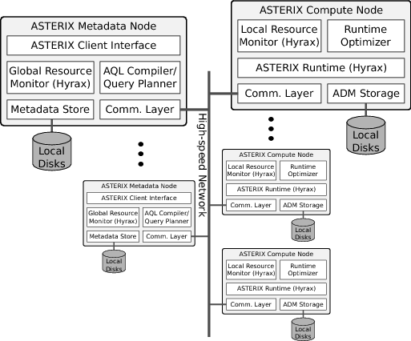
ASTERIX and Hyracks

Slide 25
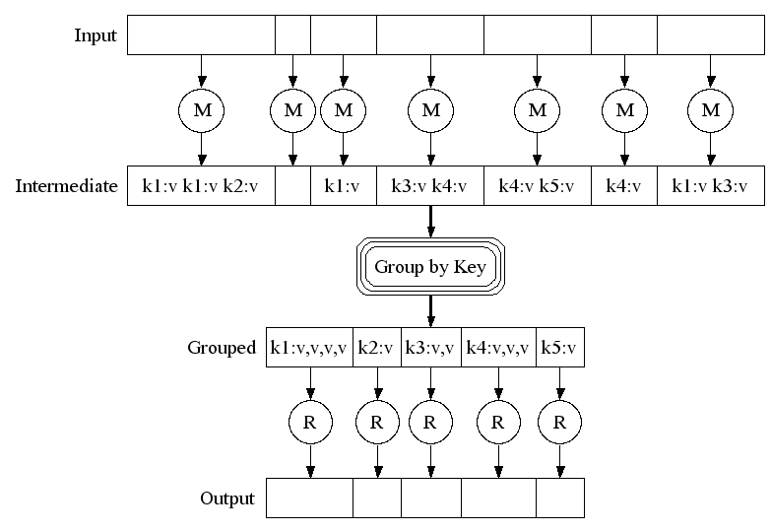
First some optional background (if needed)…
MapReduce in a Nutshell
Map (k1, v1) → list(k2, v2)
Processes one input key/value pair
Produces a set of intermediate
key/value pairs
Reduce (k2, list(v2)→ list(v3)
Combines intermediate
values for one particular key
Produces a set of merged
output values (usually one)

Slide 26
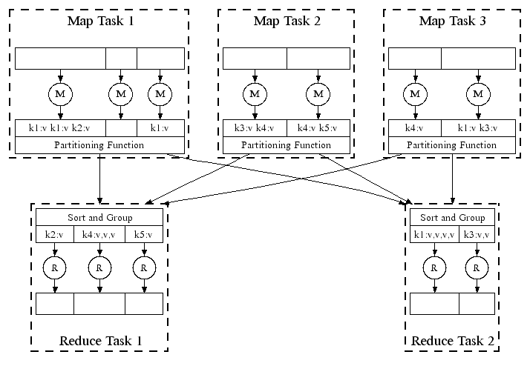
MapReduce Parallelism
← Hash Partitioning
(Looks suspiciously like
the inside of a shared-
nothing parallel DBMS…!)

Slide 27
Joins in MapReduce
Equi-joins expressed as an aggregation over the (tagged) union of their two join inputs
Steps to perform R join S on R.x = S.y:
  Map each <r> in R to <r.x, [“R”, r]> -> stream R'
  Map each <s> in S to <s.y, [“S”, s]> -> stream S'
  Reduce (R' concat S') as follows:
    foreach $rt in $values such that $rt[0] == “R” {
      foreach $st in $values such that $st[0] == “S” {
        output.collect(<$key, [$rt[1], $st[1]]>)
      }
    }

Slide 28
Hyracks: ASTERIX’s Underbelly
MapReduce and Hadoop excel at providing support for “Parallel Programming for Dummies”
  Map(), reduce(), and (for extra credit) combine()
  Massive scalability through partitioned parallelism
  Fault-tolerance as well, via persistence and replication
  Networks of MapReduce tasks for complex problems
Widely recognized need for higher-level languages
  Numerous examples: Sawzall, Pig, Jaql, Hive (SQL), …
  Currently popular approach: Compile to execute on Hadoop
  But again: What if we’d “meant to do this” in the first place…?

Slide 29
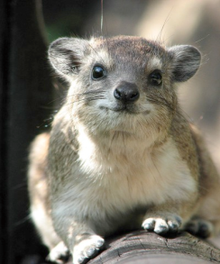
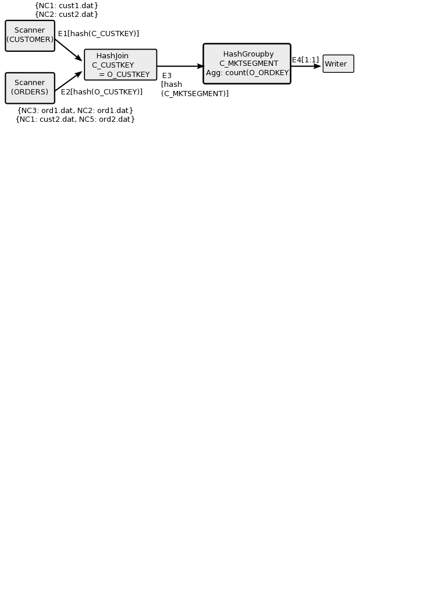
Hyracks In a Nutshell
Partitioned-parallel platform for data-intensive computing
Job = dataflow DAG of operators and connectors
  Operators consume/produce partitions of data
  Connectors repartition/route data between operators
Hyracks vs. the “competition”
  Based on time-tested parallel database principles
  vs. Hadoop: More flexible model and less “pessimistic”
  vs. Dryad: Supports data as a first-class citizen

Slide 30
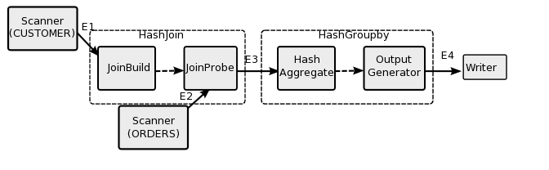
Hyracks: Operator Activities

Slide 31
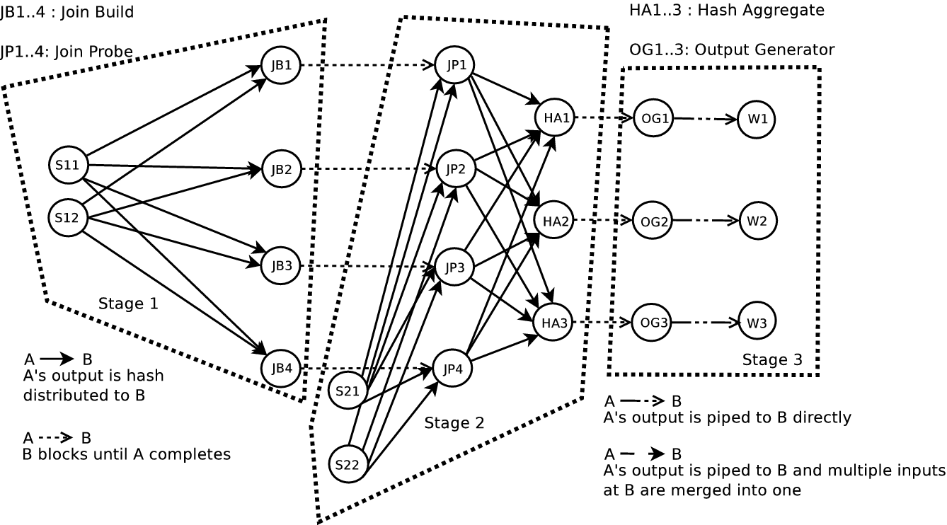
Hyracks: Runtime Task Graph

Slide 32
Hyracks Library (Growing…)
Operators
  File readers/writers: line files, delimited files, HDFS files
  Mappers: native mapper, Hadoop mapper
  Sorters: in-memory, external
  Joiners: in-memory hash, hybrid hash
  Aggregators: hash-based, preclustered
Connectors
  M:N hash-partitioner
  M:N hash-partitioning merger
  M:N range-partitioner
  M:N replicator
  1:1

Slide 33
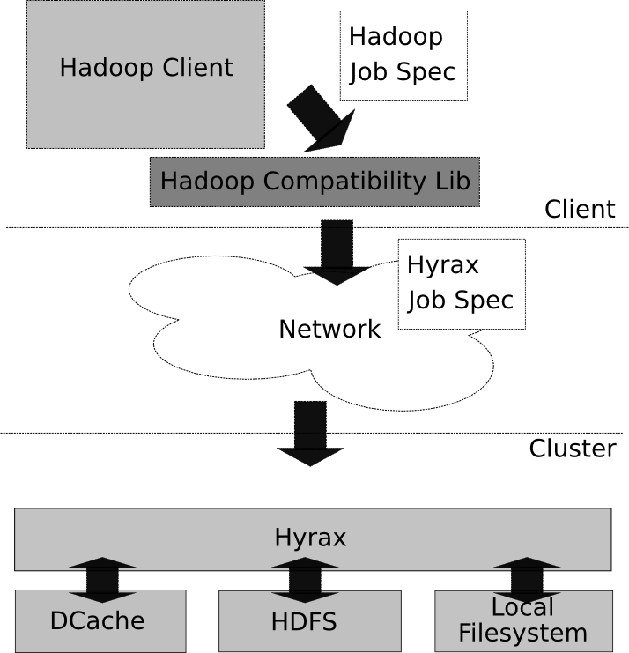
Hadoop Compatibility Layer
Goal:
  Run Hadoop jobs unchanged on top of Hyracks
How:
  Client-side library converts a Hadoop job spec into an equivalent Hyracks job spec
  Hyracks has operators to interact with HDFS
  Dcache provides distributed cache functionality

Slide 34
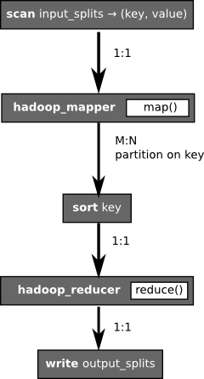
Hadoop Compatibility Layer (cont.)
Equivalent job specification
  Same user code (map, reduce, combine) plugs into Hyracks
Also able to cascade jobs
  Saves on HDFS I/O between M/R jobs

Slide 35
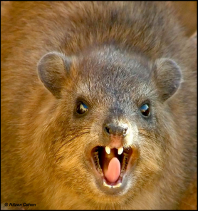
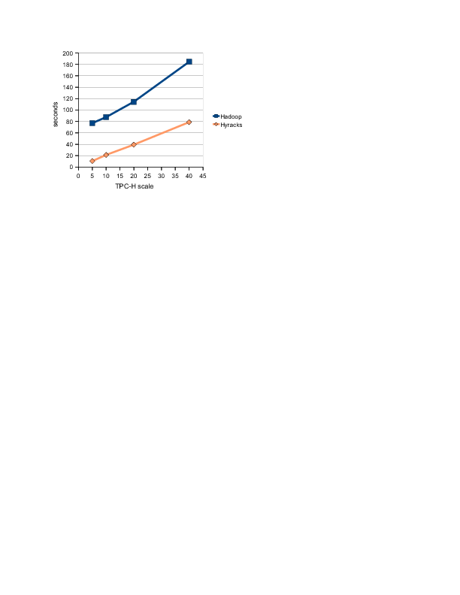
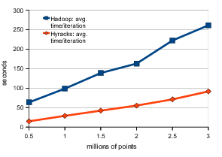
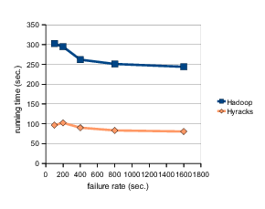
Hyracks Performance
(On a cluster with 40 cores & 40 disks)
K-means (on Hadoop compatibility layer)
DSS-style query execution (TPC-H-based example)
(Faster ☺)
Fault-tolerant query execution (TPC-H-based example)

Slide 36
Hyracks Performance Gains
K-Means (on compatibility layer)
  Push-based (eager) job activation
  Default sorting/hashing on serialized (i.e., binary) data
  Pipelining (w/o disk I/O) between Mapper and Reducer
  Relaxed connector semantics exploited at network level
TPC-H Query (in addition to the above gains)
  Hash-based join strategy doesn’t require sorting or involve artificial data multiplexing/demultiplexing
  Hash-based aggregation is more efficient as well
Fault-Tolerant TPC-H Experiment (just a POC)
  Faster → smaller failure target, more affordable retries
  Do need incremental recovery, but not w/blind pessimism

Slide 37
Hyracks – Next Steps
Fine-grained fault tolerance/recovery
  Restart failed jobs in a more fine-grained manner
  Exploit operator properties (natural blocking points) to obtain fault-tolerance at marginal (or no) extra cost
Automatic scheduling
  Use operator constraints and resource needs to decide on parallelism level and locations for operator evaluation
    Memory requirements
    CPU and I/O consumption (or at least balance)
Protocol for interacting with HLL query planners
  Interleaving of compilation and execution, sources of decision-making information, etc.

Slide 38
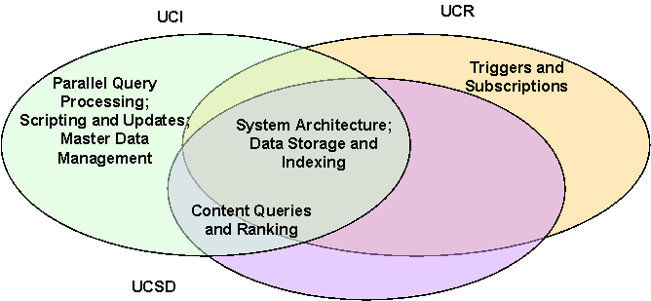
Large NSF project for 3 SoCal UCs
(Funding started flowing in Fall 2009.)

Slide 39


In Summary
Semistructured
Data Management
Parallel Database Systems
Data-Intensive
Computing
Our approach: Ask not what cloud software can do for us, but what we can do for cloud software…!
We’re asking exactly that in our current work at UCI:
  ASTERIX: Parallel semistructured data management platform
  Hyracks: Partitioned-parallel data-intensive computing runtime
Current status (early 2011):
  Lessons from a fuzzy join case study (Student Rares V. scarred for life)
  Hyracks 0.1.4 was “released” (In open source, at Google Code)
  AQL is up and limping – in parallel (Both DDL(ish) and DML)
  Also working on Hivesterix (Model-neutral QP: AQUA)
  Storage work underway (ADM, B+ trees, R* trees, text, …)

Slide 40
Partial Cast List
Semistructured
Data Management
Parallel Database Systems
Data-Intensive
Computing
Faculty and research scientists
  UCI: Michael Carey, Chen Li; Vinayak Borkar, Nicola Onose
  UCSD/UCR: Alin Deutsch, Yannis Papakonstantinou, Vassilis Tsotras
PhD students
  UCI: Rares Vernica, Alex Behm, Raman Grover, Yingyi Bu, Yassar Altowim, Hotham Altwaijry, Sattam Alsubaiee
  UCSD/UCR: Nathan Bales, Jarod Wen
MS students
  UCI: Guangqiang Li, Sadek Noureddine, Vandana Ayyalasomayajula, Siripen Pongpaichet , Ching-Wei Huang
BS students
  UCI: Roman Vorobyov, Dustin Lakin

