Slide 1


User Interfaces:
Evolution and Revolution
Part One
Andy van Dam
Brown University
April 25, 2011
Notes:
Berra: predicting is hard
Techno-optimist
Too opt on hypertext and e-books
Didn’t see personal comp, games, GPUs
FEEL FREE TO INTERRUPT

Slide 2
My background
1964
  epiphany seeing Sketchpad movie
1966
  “Computer-Driven Displays and their Use in Man-Machine Interaction”
1971- 86
  work on graphics standards (SIGGRAPH Core, ISO PHIGS++); my group invented in logical (abstract) interaction devices: tasks such as inputting text strings, scalars, positions, picking/selection with pick path
Early 90s on:
  desktop 3D widgets, post-WIMP UI’s, VR (BOOM, CAVE™) – interaction with wands, gloves, trackers on body parts (feet), speech, pens on tablets, etc.. Also haptics for 3D GUI’s
1996
  3D sketching w/ inferencing, mouse, then bi-mannual pen + “puck”
  tabletPC apps for 2D visual languages: music, math, chem, 2D sketching
Current - Surface apps as driving apps, primarily in educational space: students and scholars. Useful apps, interesting new interaction techniques

Slide 3
Roadmap
1 - Current context – developments underway
2 - Importance and brief history of UI/UX
3 – WIMP post-WIMP/NUI
4 – Invariants
5 – Aspects of NUIs
6 – Research Issues (a preview)
7 – Bottom line
Notes:
Someone implemented some of these using the Kinect
Tom Cruise in Minority report

Slide 4
1 - Current context – developments underway
Evolution of desktop to mobile to ubiquitous computing
“Unreasonable effectiveness of data”
Search
Augmented reality/mixed reality
Social computing
Notes:
Alon Halevy, Peter Norvig, and Fernando Pereira. "The Unreasonable Effectiveness of Data," Intelligent Systems, IEEE , vol.24, no.2, pp.8-12, March-April 2009
doi: 10.1109/MIS.2009.36
URL: http://ieeexplore.ieee.org/stamp/stamp.jsp?tp=&arnumber=4804817&isnumber=4804812
How Billions of Trivial Data Points can Lead to Understanding Peter Norvig (Director of Research, Google) presents as part of the UBC Department of Computer Science's Distinguished Lecture Series, September 23, 2010. In decades past, models of human language were wrought from the sweat and pencils of linguists. In the modern day, it is more common to think of language modeling as an exercise in probabilistic inference from data: we observe how words and combinations of words are used, and from that build computer models of what the phrases mean. This approach is hopeless with a small amount of data, but somewhere in the range of millions or billions of examples, we pass a threshold, and the hopeless suddenly becomes effective, and computer models sometimes meet or exceed human performance. This talk gives examples of the data available in large repositories of text, images, and videos, and shows some tasks that can be accomplished with the resulting models.
http://www.youtube.com/watch?v=9vR8Vddf7-s
(homage to Wigner and Hamming)
"The Unreasonable Effectiveness of Mathematics in the Natural Sciences," in Communications in Pure
and Applied Mathematics, vol. 13, No. I (February 1960). New York: John Wiley & Sons, Inc.
Copyright © 1960 by John Wiley & Sons, Inc.
"The Unreasonable Effectiveness of Mathematics" by R. W. HAMMING, The American Mathematical Monthly Volume 87 Number 2 February 1980
Mark Weiser

Slide 5

Evolution of desktop: to mobile and ubiquitous computing
Continuation of "Moore's law" even by other means
  multicore implies more CPUs, integrated GPUs and controllers
Notes:
Mark Weiser as father of Ubicomp
Very influential paper in 1981 knew where you were when you approached a whiteboard.
*******
evolution of desktop to mobile (iPhone /smartphone, iPad, , ...); embedded computing in devices, appliances, vehicles, and buildings
-o all online
o especially wrt UI/UX
o cloud
o game controllers, Kinect
o iPhones/smartphones and iPads
o sensors (RFID chips) - smart environment
- cloud computing
o monolithic apps in shrink-wrapped suites -> cloud, lightweight apps -> AJAX and Web 2.0 tech -> mashups

Slide 6
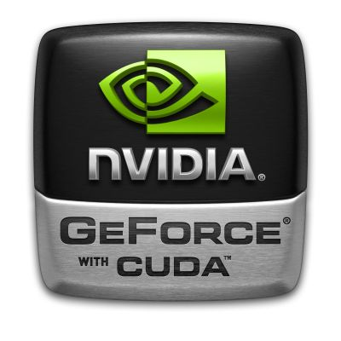
Evolution of desktop: to mobile and ubiquitous computing
Continuation of "Moore's law" even by other means
  multicore implies more CPUs, integrated GPUs and controllers
  GPUs are game-changing
Notes:
Mark Weiser as father of Ubicomp
Very influential paper in 1981 knew where you were when you approached a whiteboard.
*******
evolution of desktop to mobile (iPhone /smartphone, iPad, , ...); embedded computing in devices, appliances, vehicles, and buildings
-o all online
o especially wrt UI/UX
o cloud
o game controllers, Kinect
o iPhones/smartphones and iPads
o sensors (RFID chips) - smart environment
- cloud computing
o monolithic apps in shrink-wrapped suites -> cloud, lightweight apps -> AJAX and Web 2.0 tech -> mashups

Slide 7
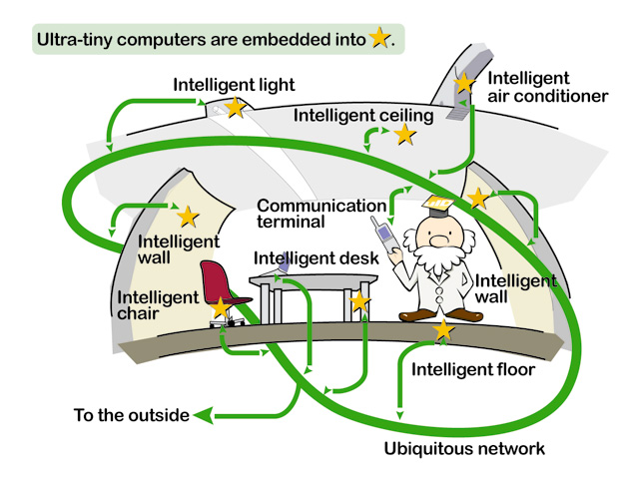
Evolution of desktop: to mobile and ubiquitous computing
Continuation of "Moore's law" even by other means
  multicore implies more CPUs, integrated GPUs and controllers
  GPUs are game-changing
  proliferation of platforms
Ubicomp – ecology of devices (society of appliances) and people
Notes:
Mark Weiser as father of Ubicomp
Very influential paper in 1981 knew where you were when you approached a whiteboard.
*******
evolution of desktop to mobile (iPhone /smartphone, iPad, , ...); embedded computing in devices, appliances, vehicles, and buildings
-o all online
o especially wrt UI/UX
o cloud
o game controllers, Kinect
o iPhones/smartphones and iPads
o sensors (RFID chips) - smart environment
- cloud computing
o monolithic apps in shrink-wrapped suites -> cloud, lightweight apps -> AJAX and Web 2.0 tech -> mashups

Slide 8
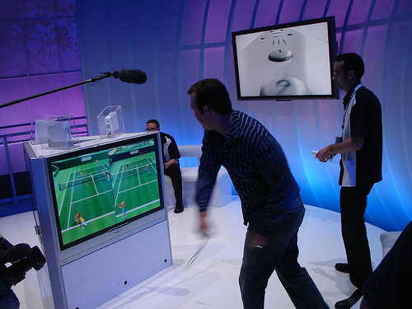
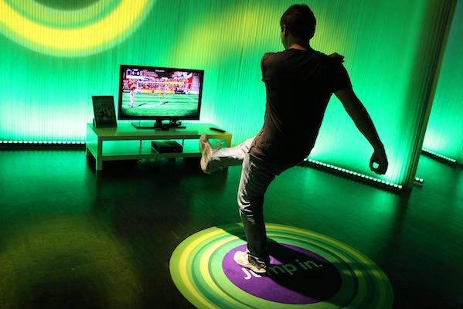
Evolution of desktop: to mobile and ubiquitous computing
Continuation of "Moore's law" even by other means
  multicore implies more CPUs, integrated GPUs and controllers
  GPUs are game-changing
  proliferation of platforms
Ubicomp – ecology of devices (society of appliances) and people
  iPhones/smartphones and iPads
  game controllers, e.g., Wii and Kinect
Notes:
Mark Weiser as father of Ubicomp
Very influential paper in 1981 knew where you were when you approached a whiteboard.
*******
evolution of desktop to mobile (iPhone /smartphone, iPad, , ...); embedded computing in devices, appliances, vehicles, and buildings
-o all online
o especially wrt UI/UX
o cloud
o game controllers, Kinect
o iPhones/smartphones and iPads
o sensors (RFID chips) - smart environment
- cloud computing
o monolithic apps in shrink-wrapped suites -> cloud, lightweight apps -> AJAX and Web 2.0 tech -> mashups

Slide 9
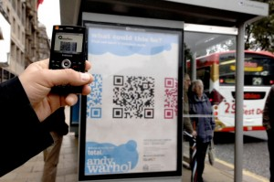
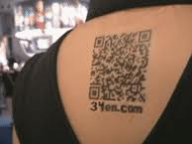
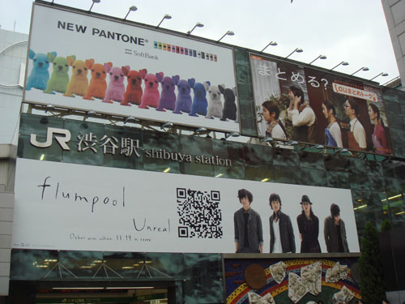
Evolution of desktop: to mobile and ubiquitous computing
Continuation of "Moore's law" even by other means
  multicore implies more CPUs, integrated GPUs and controllers
  GPUs are game-changing
  proliferation of platforms
Ubicomp – ecology of devices (society of appliances) and people
  iPhones/smartphones and iPads
  game controllers, e.g., Wii and Kinect
  embedded computing in devices, appliances, vehicles, and buildings, including sensors (RFID chips), QR (quick response) codes, ...
Notes:
Mark Weiser as father of Ubicomp
Very influential paper in 1981 knew where you were when you approached a whiteboard.
*******
evolution of desktop to mobile (iPhone /smartphone, iPad, , ...); embedded computing in devices, appliances, vehicles, and buildings
-o all online
o especially wrt UI/UX
o cloud
o game controllers, Kinect
o iPhones/smartphones and iPads
o sensors (RFID chips) - smart environment
- cloud computing
o monolithic apps in shrink-wrapped suites -> cloud, lightweight apps -> AJAX and Web 2.0 tech -> mashups

Slide 10
Evolution of desktop: to mobile and ubiquitous computing
Continuation of "Moore's law" even by other means
  multicore implies more CPUs, integrated GPUs and controllers
  GPUs are game-changing
  proliferation of platforms
Ubicomp – ecology of devices (society of appliances) and people
  iPhones/smartphones and iPads
  game controllers, e.g., Wii and Kinect
  embedded computing in devices, appliances, vehicles, and buildings, including sensors (RFID chips), QR (quick response) codes, ...
Browser-based and cloud computing
  monolithic shrink-wrapped apps cloud, with lightweight apps
  AJAX and Web 2.0 mashups
Notes:
Mark Weiser as father of Ubicomp
Very influential paper in 1981 knew where you were when you approached a whiteboard.
*******
evolution of desktop to mobile (iPhone /smartphone, iPad, , ...); embedded computing in devices, appliances, vehicles, and buildings
-o all online
o especially wrt UI/UX
o cloud
o game controllers, Kinect
o iPhones/smartphones and iPads
o sensors (RFID chips) - smart environment
- cloud computing
o monolithic apps in shrink-wrapped suites -> cloud, lightweight apps -> AJAX and Web 2.0 tech -> mashups

Slide 11
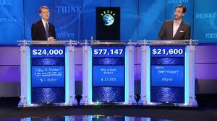
Unreasonable effectiveness of data
Core technologies (many worked on for decades)
  voice recognition
  hand writing recognition
  machine learning
  agents, e.g., e-commerce
Applications
  data mining, visual analytics
  machine translation
  pattern detection and recognition
  question answering
    Jeopardy/Watson
Notes:
Many of these are classified as AI, but hard to define.
They
(homage to Wigner and Hamming) – put papers in notes
**************
* unreasonable effectiveness of large data (homage to Wigner and Hamming)
- data mining, machine learning, pattern detection and recognition, e.g., fraud detection
o voice reco
o hand writing reco
o machine translation
o question answering and Jeopardy/Watson: great progress, yet a beginning
o Wolfram Alpha
o agents, e.g., e-commerce

Slide 12

Unreasonable effectiveness of data
Core technologies (many worked on for decades)
  voice recognition
  hand writing recognition
  machine learning
  agents, e.g., e-commerce
Applications
  data mining, visual analytics
  machine translation
  pattern detection and recognition
  question answering
    Jeopardy/Watson
    Wolfram Alpha
Notes:
Many of these are classified as AI, but hard to define.
They
(homage to Wigner and Hamming) – put papers in notes
**************
* unreasonable effectiveness of large data (homage to Wigner and Hamming)
- data mining, machine learning, pattern detection and recognition, e.g., fraud detection
o voice reco
o hand writing reco
o machine translation
o question answering and Jeopardy/Watson: great progress, yet a beginning
o Wolfram Alpha
o agents, e.g., e-commerce

Slide 13
Unreasonable effectiveness of data
Core technologies (many worked on for decades)
  voice recognition
  hand writing recognition
  machine learning
  agents, e.g., e-commerce
Applications
  data mining, visual analytics
  machine translation
  pattern detection and recognition
  question answering
    Jeopardy/Watson
    Wolfram Alpha
Is this AI?
  when it is in the research lab …
Notes:
Many of these are classified as AI, but hard to define.
They
(homage to Wigner and Hamming) – put papers in notes
**************
* unreasonable effectiveness of large data (homage to Wigner and Hamming)
- data mining, machine learning, pattern detection and recognition, e.g., fraud detection
o voice reco
o hand writing reco
o machine translation
o question answering and Jeopardy/Watson: great progress, yet a beginning
o Wolfram Alpha
o agents, e.g., e-commerce

Slide 14
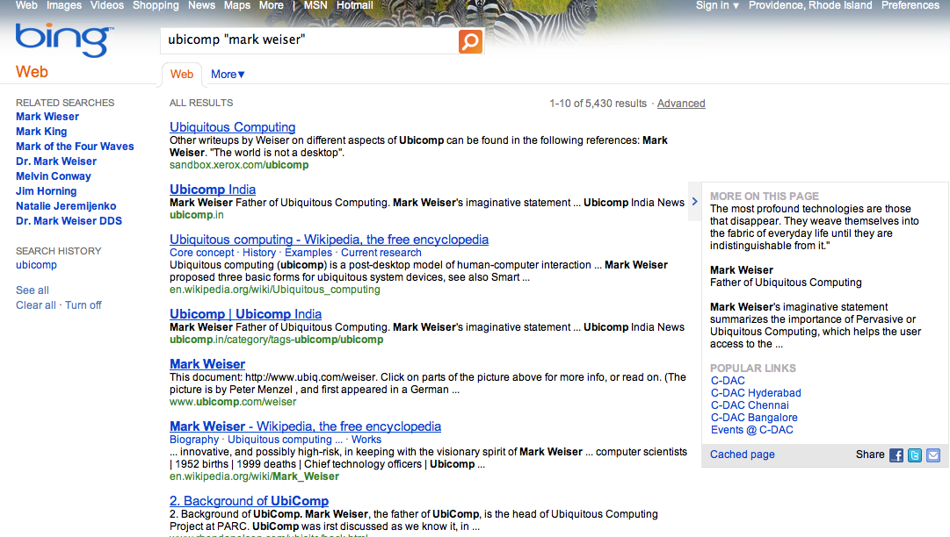
Search
Better output
  Bing vs. Google
Notes:
search and browsing
relate to pattern recognize
corner of the eye seeing
spatial work
QR codes
fuzzy search
context-driven search
recall vs. recognize
James Fogarty, Desney Tan, Ashish Kapoor, and Simon Winder. "CueFlik: interactive concept learning in image search" in ACM CHI '08, pp. 29-38. 2008
ABSTRACT
Web image search is difficult in part because a handful of keywords are generally insufficient for characterizing the visual properties of an image.
Popular engines have begun to provide tags based on simple characteristics of images (such as tags for black and white images or images
that contain a face), but such approaches are limited by the fact that it is unclear what tags end-users want to be able to use
in examining Web image search results. This paper presents CueFlik, a Web image search application that allows
end-users to quickly create their own rules for re-ranking images based on their visual characteristics. End-users can
then re-rank any future Web image search results according to their rule. In an experiment we present in this paper,
end-users quickly create effective rules for such concepts as “product photos”, “portraits of people”, and “clipart”.
When asked to conceive of and create their own rules, participants create such rules as “sports action shot” with images from queries for “basketball” and “football”.
CueFlik represents both a promising new approach to Web image search and an important study in end-user interactive machine learning.

Slide 15
Search
Better output
  Bing vs. Google
Contextualized search
  history
  geospatial location
  social network
  …
Image and video search
  James Fogarty, Desney Tan, Ashish Kapoor, and Simon Winder. "CueFlik: interactive concept learning in image search" in ACM CHI '08, pp. 29-38. 2008.
Voice search
Notes:
search and browsing
relate to pattern recognize
corner of the eye seeing
spatial work
QR codes
fuzzy search
context-driven search
recall vs. recognize
James Fogarty, Desney Tan, Ashish Kapoor, and Simon Winder. "CueFlik: interactive concept learning in image search" in ACM CHI '08, pp. 29-38. 2008
ABSTRACT
Web image search is difficult in part because a handful of keywords are generally insufficient for characterizing the visual properties of an image.
Popular engines have begun to provide tags based on simple characteristics of images (such as tags for black and white images or images
that contain a face), but such approaches are limited by the fact that it is unclear what tags end-users want to be able to use
in examining Web image search results. This paper presents CueFlik, a Web image search application that allows
end-users to quickly create their own rules for re-ranking images based on their visual characteristics. End-users can
then re-rank any future Web image search results according to their rule. In an experiment we present in this paper,
end-users quickly create effective rules for such concepts as “product photos”, “portraits of people”, and “clipart”.
When asked to conceive of and create their own rules, participants create such rules as “sports action shot” with images from queries for “basketball” and “football”.
CueFlik represents both a promising new approach to Web image search and an important study in end-user interactive machine learning.

Slide 16
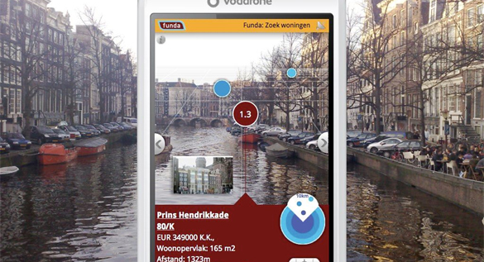
Augmented reality/mixed reality
Mechanisms
  superposition of computer-generated information and real world
Examples
  Smartphone cameras (Layar’s Amsterdam)

Slide 17
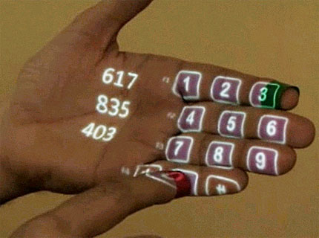
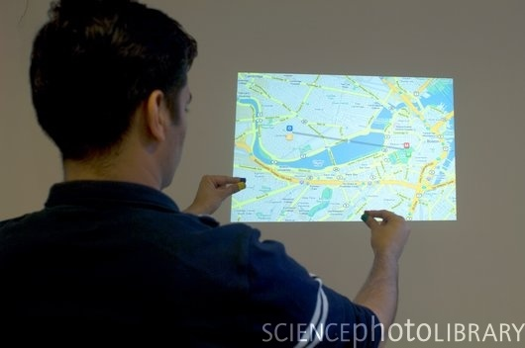
Augmented reality/mixed reality
Mechanisms
  superposition of computer-generated information and real world
Examples
  Smartphone cameras (Layar’s Amsterdam)
  SixthSense (MIT)
    http://www.cs.brown.edu/~avd/UI/SixthSense-PranavMistry-part1Clip.mov

Slide 18
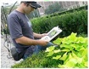
Augmented reality/mixed reality
Mechanisms
  superposition of computer-generated information and real world
Examples
  Smartphone cameras (Layar’s Amsterdam)
  Sixthsense (MIT)
  LeafView (Columbia & Smithsonian)

Slide 19
Augmented reality/mixed reality
Mechanisms
  superposition of computer-generated information and real world
Examples
  Smartphone cameras (Layar’s Amsterdam)
  Sixthsense (MIT)
  LeafView (Columbia & Smithsonian)
  UNC visions –

Slide 20
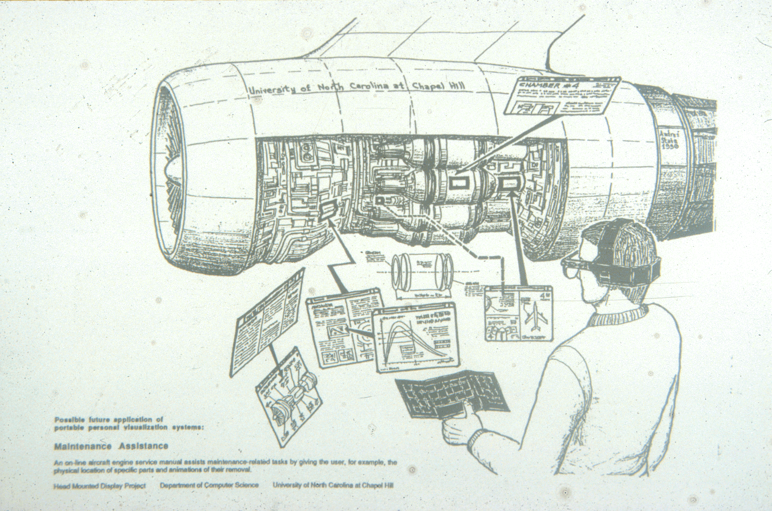
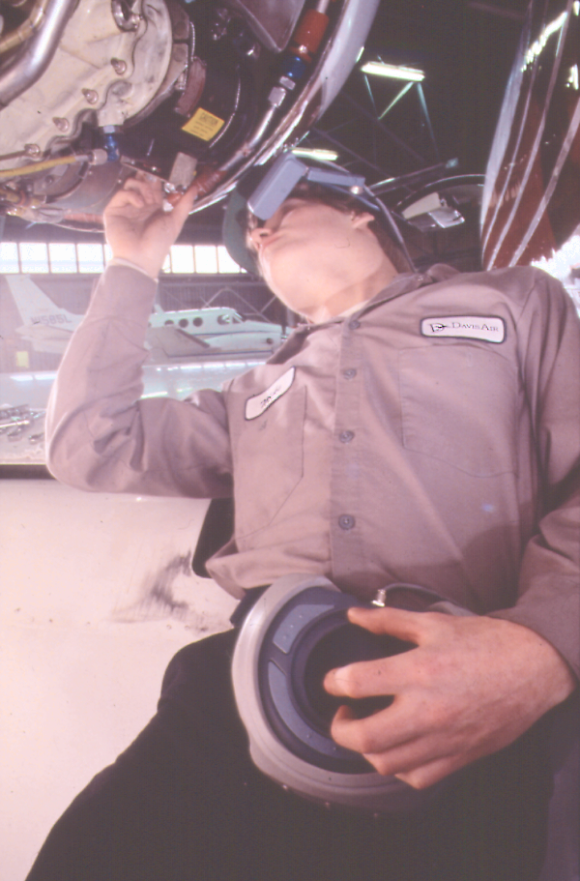
Mechanisms
  superposition of computer-generated information and real world
Examples
  Smartphone cameras (Layar’s Amsterdam)
  Sixthsense (MIT)
  LeafView (Columbia & Smithsonian)
  UNC visions –
    airplane repair

Slide 21
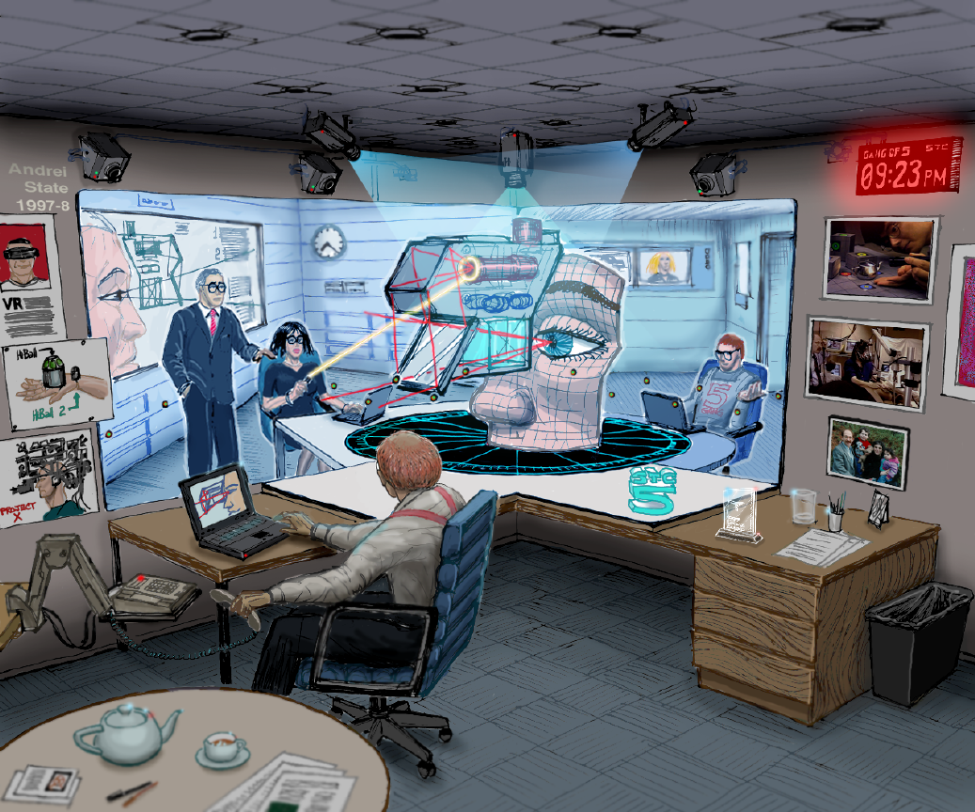
Augmented reality/mixed reality
Mechanisms
  superposition of computer-generated information and real world
Examples
  Smartphone cameras (Layar’s Amsterdam)
  Sixthsense (MIT)
  LeafView (Columbia & Smithsonian)
  UNC visions –
    airplane repair
    Office of the Future – tele-presence, tele-immersion

Slide 22
Social computing
Social networking
Teams
  spectrum from single user to small team to large team to crowdsourcing
Social agents/avatars (Clippy!?!)
  observing and mediating your interaction
Multiple demographics
  digital natives and their expectations vs. aging boomer population
  one size does not fit all
Notes:
Digital natives have a totally different notion of platform, e.g., not the PC and its OS and the traditional apps such as email and office suites.
Instead Facebook is the platform from within which they do all their activities.
Even Google and Web browsers are not necessarily the platform of choice for the next generations.
Affective computing, social agents/avatars (Clippy!) observing your interaction.

Slide 23
Roadmap
1 - Current context – developments underway
2 - Importance and brief history of UI/UX
3 – WIMP post-WIMP/NUI
4 – Invariants
5 – Aspects of NUIs
6 – Issues
7 – Bottom line
Notes:
leverage full human sensorium

Slide 24
2 - Importance and brief history of UI/UX
Distinctions between UI and UX
Is there an ideal user interface?
Historical trends
Projects and their legacies
Notes:
Does anyone other than ms use the term NUI? Yes – see wikipedia article
Post-WIMP – perhaps equate post-WIMP and NUI
*********
Affective computing,
Importance and Brief History of UI/UX
* Importance of UI/UX
- key to productivity and differentiator
o often the bulk of an app's code
- "Moore's law" for CPUs vs. constant for human compute power
o use UI to increase bandwidth to the brain
- UI's much too hard (to create and to use) -
- controlled environment of MacApp - > wild wild west, where every app has a different UI.
* Is there an ideal user interface?
- why not
- the importance of context in the: user, task, platform, environment, history, social, ...
- even in a simple situation there will be a combination of direct control and indirect control through agents i.e. Jeeves.
* Punctuated equilibrium
- batch cards
- alpha-numeric terminals
- WIMP GUIs - PARC Alto, commercialization via Mac and PC, Windows
- post-wimp -
o Google's April fools clip.
o Corning clip
o Apple's Knowledge Navigator
* Projects and their legacies (Choose zero, one, or two)
- Memex -> annotation, hypertext
- Engelbart demo -> GUI, teleconferencing
- Video Place -> Kinect
- PLATO –> touch screens
- *Put That There (MIT 1979)–> multimodal UI: gesture, voice commands, graphical and audio feedback
- Anderson –> pen, math
- SketchPad -> interactive graphics
- DynaBook -> tablet
* NUI (natural user interface)
- focus on bi-directional, intuitive control
- multi-model human interaction combined with intelligent machine responsiveness
- shared machine initiative and human initiative
- smart environment becomes an extension of the human mind-body system

Slide 25
Importance of UI/UX (1/2)
Distinctions between UI and UX
  UX is more inclusive while UI is often restricted to “look and feel”
Key to productivity and differentiator
  often the bulk of an app's code

Slide 26
CPU power vs. brain power
Compute
Graphics
Computing Capacity
“Moore’s Law”
Human Capacity
t
t
  Use compute power in UI to increase b/w to the brain
Notes:
Just the diagram – no title – merging
To a first approximation, we have enough computing for most productivity applications.
Its human performance, not computer performance that now matters most.
Therefore, throw most of the extra computing power at the user interface.
In fact, GUIs already are major consumers of both code and computing power.
Need to go way beyond today’s GUIs. That’s what this talk is about! * Punctuated equilibrium
- batch cards
- alpha-numeric terminals
- WIMP GUIs - PARC Alto, commercialization via Mac and PC, Windows
- post-wimp -
o Google's April fools clip.
o Corning clip
o Apple's Knowledge Navigator

Slide 27
Importance of UI/UX (2/2)
UIs much too hard to create and to use
Style changes
  controlled environment of 1980s MacApp - > wild wild west, where every app has a different UI

Slide 28
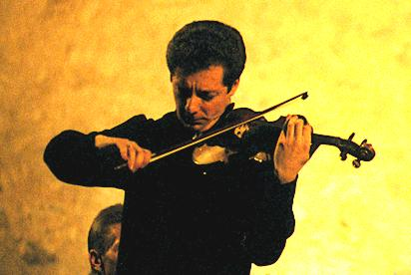

Is there an ideal user interface?
None! Uis are a necessary evil
Counterpoint: aesthetics of a good UI
Want to communicate and control as we do in and with the real world
  objects
  tasks
  other participants (real and software agents)
Model: perfect Butler (Jeeves), but not HAL-9000
Future
  ultimately: brain-machine interfaces,“cogito ergo fac”

Slide 29
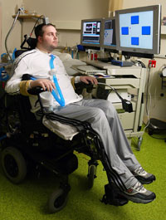
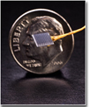
Brown University’s BrainGate neural implant interface
Prof. John Donoghue et al
  http://www.braingate2.org/
Deep brain implant
  tapping about 100 neurons
  cursor control for people who have NO physical control
Others working on non-invasive technology (brain wave monitors)
Notes:
Leigh R. Hochberg, Mijail D. Serruya, Gerhard M. Friehs, Jon A. Mukand, Maryam Saleh, Abraham H. Caplan, Almut Branner, David Chen, Richard D. Penn, and John P. Donoghue. " Neuronal ensemble control of prosthetic devices by a human with tetraplegia" in Nature 442, 164-171, 13 July 2006.
http://www.guardian.co.uk/science/2011/apr/17/brain-implant-paralysis-movement
http://news.brown.edu/pressreleases/2011/03/braingate
http://iopscience.iop.org/1741-2552/8/2/025027

Slide 30
Is there an ideal user interface?
None! Uis are a necessary evil
Counterpoint: aesthetics of a good UI
Want to communicate and control as we do in and with the real world
  objects
  tasks
  other participants (real and software agents)
Models: Jeeves, HAL-9000
Future
  ultimately: brain-machine interfaces,“cogito ergo fac”
Today: transparent, fluid UIs -> automaticity

Slide 31
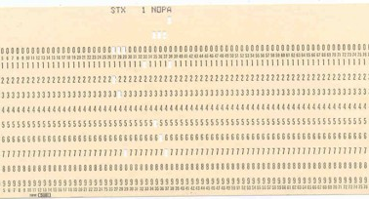
History of UI: Punctuated Equilibrium
1960s… Batch
Notes:
NUI/post-WIMPwill be expanced on
gesture, speech, eg not invovling mice and keyboard
all these continue to exist. but
Timeline progressive disclosure of time line points with images from 1999 and
then the left-hand bullet points.
just images from page 3 of 1999 talk.
dos after glass tty
wimp gui
and the three gui images, left of the timeline
post wimp
andy in cave holding pda
then bullets

Slide 32
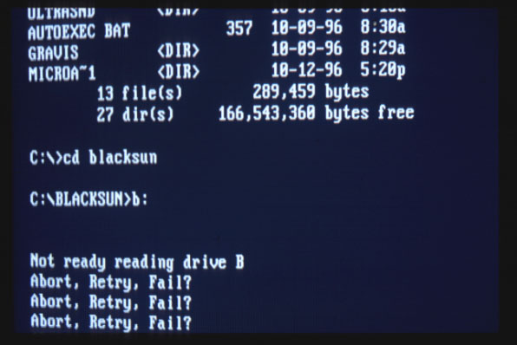
History of UI: Punctuated Equilibrium
1960s… Batch
1970s… Command Line on “Glass TTY”
Notes:
NUI/post-WIMPwill be expanced on
gesture, speech, eg not invovling mice and keyboard
all these continue to exist. but
Timeline progressive disclosure of time line points with images from 1999 and
then the left-hand bullet points.
just images from page 3 of 1999 talk.
dos after glass tty
wimp gui
and the three gui images, left of the timeline
post wimp
andy in cave holding pda
then bullets

Slide 33
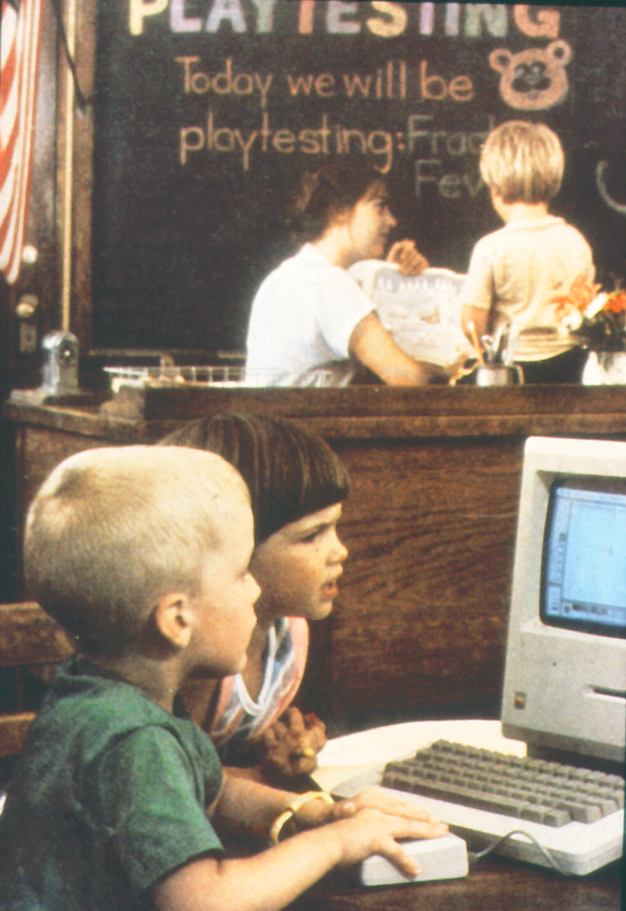
History of UI: Punctuated Equilibrium
1960s… Batch
1970s… Command Line on “Glass TTY”
1980s… WIMP GUI
Notes:
NUI/post-WIMPwill be expanced on
gesture, speech, eg not invovling mice and keyboard
all these continue to exist. but
Timeline progressive disclosure of time line points with images from 1999 and
then the left-hand bullet points.
just images from page 3 of 1999 talk.
dos after glass tty
wimp gui
and the three gui images, left of the timeline
post wimp
andy in cave holding pda
then bullets

Slide 34
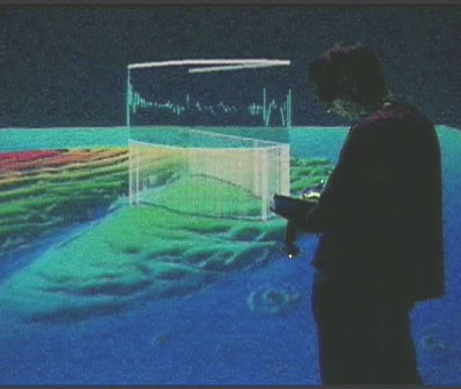
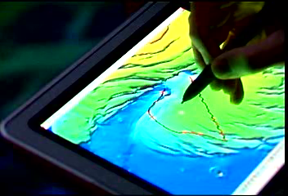
History of UI: Punctuated Equilibrium
1960s… Batch
1970s… Command Line on “Glass TTY”
1980s… WIMP GUI
1990s… Post-WIMP
NUI
Notes:
NUI/post-WIMPwill be expanced on
gesture, speech, eg not invovling mice and keyboard
all these continue to exist. but
Timeline progressive disclosure of time line points with images from 1999 and
then the left-hand bullet points.
just images from page 3 of 1999 talk.
dos after glass tty
wimp gui
and the three gui images, left of the timeline
post wimp
andy in cave holding pda
then bullets

Slide 35
History of UI: Punctuated Equilibrium
1960s… Batch
1970s… Command Line on “Glass TTY”
1980s… WIMP GUI
1990s… Post-WIMP
NUI
Each paradigm shift led to a large increase in user base
Each paradigm persists
Notes:
NUI/post-WIMPwill be expanced on
gesture, speech, eg not invovling mice and keyboard
all these continue to exist. but
Timeline progressive disclosure of time line points with images from 1999 and
then the left-hand bullet points.
just images from page 3 of 1999 talk.
dos after glass tty
wimp gui
and the three gui images, left of the timeline
post wimp
andy in cave holding pda
then bullets

Slide 36
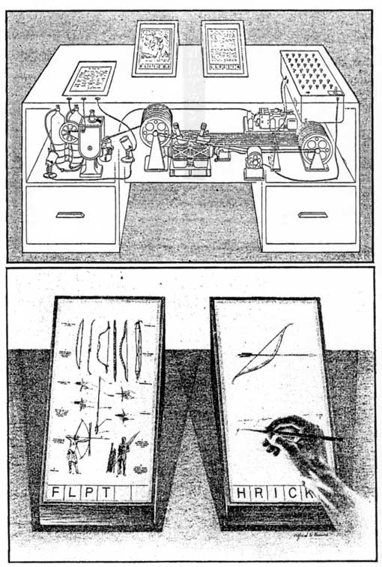
Projects and their legacies (1/3)
Vannevar Bush’s Memex (1945) annotation, hypertext

Slide 37
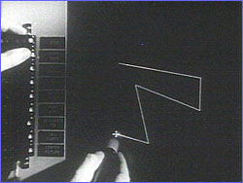
Projects and their legacies (1/3)
Vannevar Bush’s Memex (1945) annotation, hypertext
Ivan Sutherland’s SketchPad (1963) interactive graphics
  http://www.cs.brown.edu/~avd/UI/SketchpadEdited-avd-4.20.11.avi

Slide 38
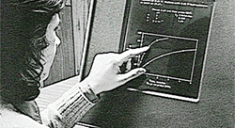
Projects and their legacies (1/3)
Vannevar Bush’s Memex (1945) annotation, hypertext
Ivan Sutherland’s SketchPad (1963) interactive graphics
Donald Bitzer’s PLATO (1967) touch screens

Slide 39
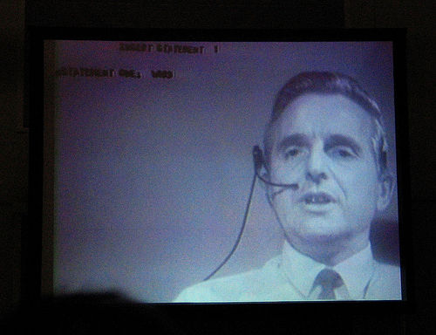
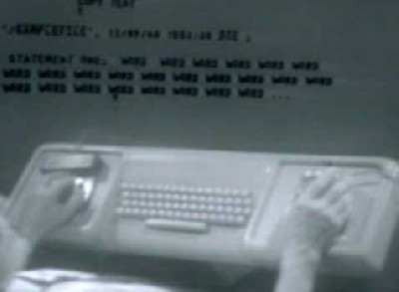
Projects and their legacies (1/3)
Vannevar Bush’s Memex (1945) annotation, hypertext
Ivan Sutherland’s SketchPad (1963) interactive graphics
Donald Bitzer’s PLATO (1967) touch screens
Doug Engelbart’s NLS (1968) bi-manual interaction with mouse, keyboard, and chord; integrated audio/video telecollaboration

Slide 40
Projects and their legacies (1/3)
Vannevar Bush’s Memex (1945) annotation, hypertext
Ivan Sutherland’s SketchPad (1963) interactive graphics
Donald Bitzer’s PLATO (1967) touch screens
Doug Engelbart’s NLS (1968) bi-manual interaction with mouse, keyboard, and chord; integrated audio/video telecollaboration
Robert Anderson’s Math Recognizer(1968) pen-based, gesture recognition personal laptop/tablet
  http://www.cs.brown.edu/~avd/UI/Anderson.mov

Slide 41
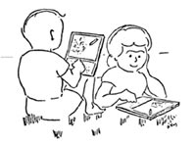
Projects and their legacies (2/3)
Alan Kay’s DynaBook (1972) personal laptop/tablet

Slide 42
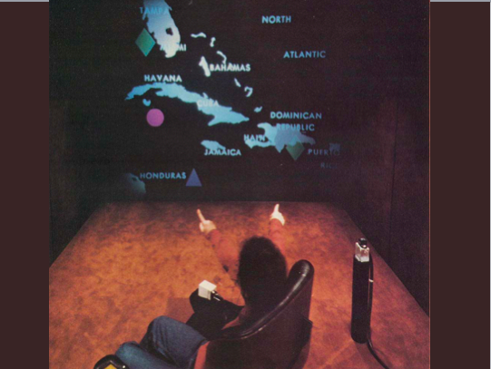
Projects and their legacies (2/3)
Alan Kay’s DynaBook (1972) personal laptop/tablet
Bolt’s Put That There (1979) multi-modal UI: gesture, voice commands, graphical and audio feedback
  http://www.cs.brown.edu/~avd/UI/Put-That-There-TwoPeopleClip.mov

Slide 43
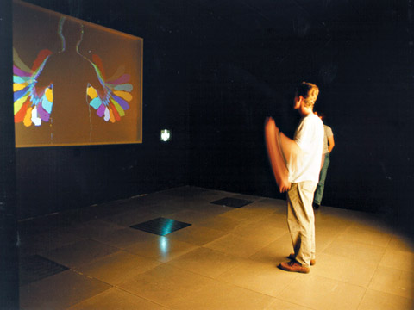
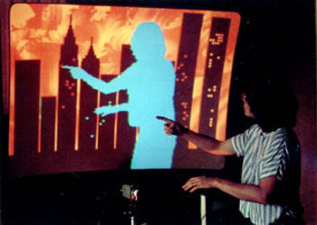
Projects and their legacies (2/3)
Alan Kay’s DynaBook (1972) personal laptop/tablet
Bolt’s Put That There (1979) multi-modal UI: gesture, voice commands, graphical and audio feedback
  http://www.cs.brown.edu/~avd/UI/Put-That-There-TwoPeopleClip.mov
Myron Kruger’s Video Place (1986) body-centric interaction using video and sensors
  http://www.cs.brown.edu/~avd/UI/MyronKruegerCritterClip.mov

Slide 44
Roadmap
1 - Current context – developments underway
2 - Importance and brief history of UI/UX
3 – WIMP post-WIMP/NUI
4 – Invariants
5 – Aspects of NUIs
6 – Issues
7 – Bottom line
Notes:
leverage full human sensorium

Slide 45
Advantages of WIMP GUIs
Xerox PARC’s legacy provides a “standard”
  ease of X for users (learning, remembering, using…)
Layers of support software
  ease of implementation, maintainability
    toolkits
    GUI builders
    UIMS
  much more support for “look” (visual design) than for “feel” (interaction design)
    “feel” involves domain-specific application semantics

Slide 46

Limitations of WIMP GUIs (1/2)
Limited vision (flat, 2D)
No speech
No gestures
Limited audio and tactile feedback
One-handed interaction
Limited movement
System unaware of user
System has no model of user

Slide 47
Limitations of WIMP GUIs (2/2)
Imposes sequential “ping-pong” dialog model: mouse and keyboard input, 2D graphics (sound?) output
  deterministic and discrete
  difficult to handle simultaneous input, even two mice
  pure WIMP doesn’t use other senses: hearing, touch, ...
  >50% of our neurons in visual cortex, but as humans it is very difficult for us to communicate without speech, sound...
Not usable in many environments
  while walking or driving, in the shower,…
  in immersive VR (e.g., head-mounted display or CAVE™) where you are “in” the 3D scene: no keyboard, mouse…

Slide 48
Characteristics of post-WIMP user interfaces
Usually multiple simultaneous devices, sensory channels, users
  multi-modal UIs
High bandwidth, continuous input
  body part tracking (head, gaze, hand...)
  gesture and speech recognition, often interlaced (“Put That There”)
Typically non-deterministic, probabilistic decoding and disambiguation (many issues, e.g., spatio-temporal resolution)
  back-tracking to refine maximum-likelihood decoding
  similar to differential diagnosis
  in multi-modal UIs best done via mutual reinforcement
    (Phil Cohen et al’s “unification”)

Slide 49
WIMP GUIs Will Be Augmented, Not Replaced
UI Spectrum
  direct control
    direct manipulation
    by-example...
  indirect control
    agents
    social interfaces (avatars)
WIMP enhanced by
  speech & gesture recognition
    pens and multi-touch
    body tracking and scene extraction via computer vision technology, e.g., Kinect

Slide 50
NUI (Natural User Interface)
Context-sensitive spectrum – “natural” refers to making the user “a natural” and the interface “invisible”
Goals
  leverage full human sensorium, perceptual and cognitive ability, even emotional state (affect)
  minimize cognitive load by shifting from cognitive to perceptual and motor skills
Strategies
  multi-modal human interaction combined with intelligent computer collaboration
  shared human and machine initiative
Notes:
relative notion – what is natural to one is not to another. spectrum.
as usual a context-sensitive spectrum
Motor-sensory - cognitive - social
One-handed pan/zoom on real camera vs pan-zoom with one hand holding and
the other either panning or pinch-zooming, and no ability to use muscle
memory to get back to a previous view
Panning/zooming + marking + voice together to give map directions via
mail.
Can send it to car and its nav system - combine nav voice and your voice
Society of appliances work together to reduce complexity for users
Sensor networks, ambient intelligence

Slide 51
NUI (Natural User Interface) Examples
A movie NUI: Minority Report
John Underkoffler of Oblong at TED 2010
  http://www.cs.brown.edu/~avd/UI/UnderkofflerClip.mov
Apple’s vision “Knowledge Navigator”: 1989
  http://www.cs.brown.edu/~avd/UI/KnowledgeNavigator.mp4
MSR’s Bill Buxton on NUIs
  http://www.cs.brown.edu/~avd/UI/Buxton2.mp4

Slide 52
Agents: inferring user intent
Hierarchy of capabilities
  helper /clerk
    explicit instruction, e.g., commands, hi-level parameterized spec
  concierge
    higher level specification
    learn by example
Examples
  Siri – iPhone Virtual Personal Assistant app
    http://www.cs.brown.edu/~avd/UI/Siri.mp4
  MSR’s Bohus & Horvitz’ Virtual Receptionist 2009 situated interaction
    http://www.cs.brown.edu/~avd/UI/Bohus-Horvitz-VirtualReceptionistClip.mov

Slide 53
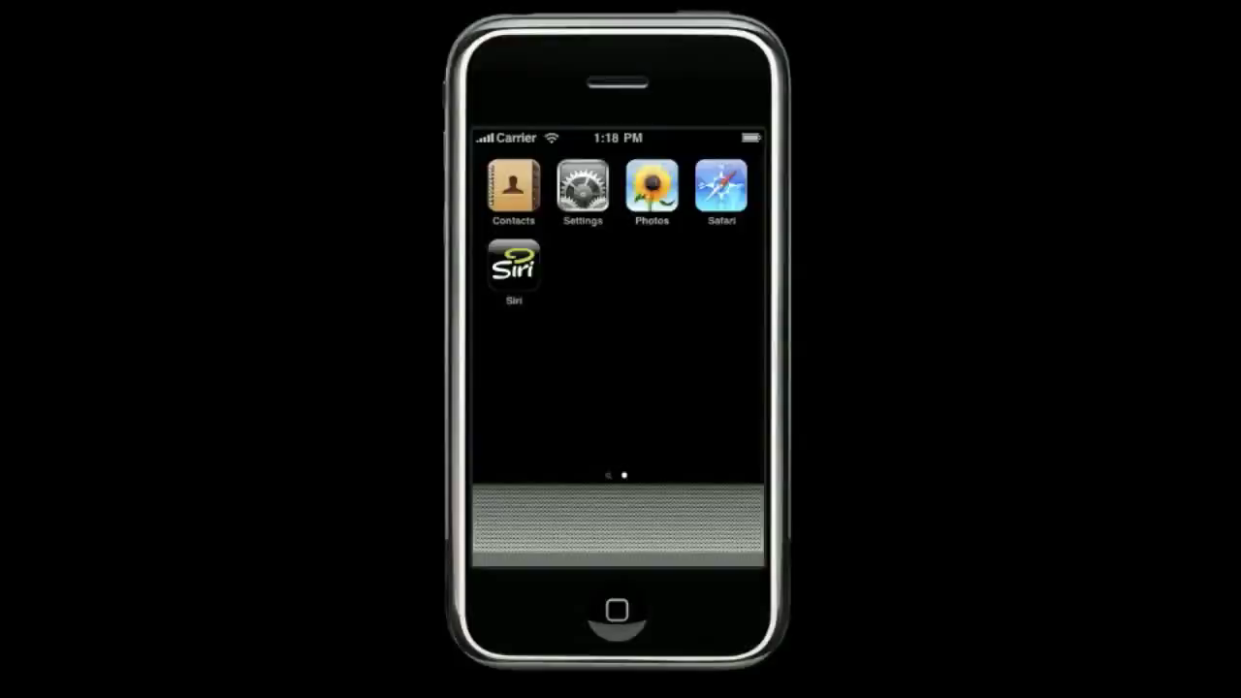
Siri – iPhone Virtual Personal Assistant app

Slide 54
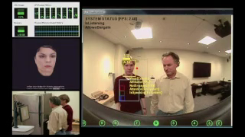
MSR’s Bohus & Horvitz’ Virtual Receptionist 2009 situated interaction

Slide 55
Agents: inferring user intent
Hierarchy of capabilities
  helper /clerk
    explicit instruction, e.g., commands, hi-level parameterized spec
  concierge
    higher level specification
    learn by example
  personal assistant
    reason based on observation of past activity
    unlike concierge, the assistant has a model of your context
      therefore much higher level of reasoning and inferencing of intent
  perfect partner
    anticipation of intent
NUIs some combination of
  direct manipulation plus indirect control via agents
  some under explicit control, e.g., avatars, some autonomous

Slide 56
Roadmap
1 - Current context – developments underway
2 - Importance and brief history of UI/UX
3 – WIMP post-WIMP/NUI
4 – Invariants
5 – Aspects of NUIs
6 – Research issues
7 – Bottom line

Slide 57
4 – Reflect: NUI’s evolve, what are some invariants?
Humans in the loop
NUIs will augment GUIs
  iPhone and its SmartPhone equivalents, Pads are hybrids
Multiple media and formats
  must co-exist and play well together
Rapid context-switching between tasks
  system should help user manage and manipulate complexity, e.g., contexts/”working sets”
Notes:
humans have to be part of it. agents can’t do it all.
need for postwimp uis

Slide 58
Roadmap
1 - Current context – developments underway
2 - Importance and brief history of UI/UX
3 – WIMP post-WIMP/NUI
4 – Invariants
5 – Aspects of NUIs
6 – Research Issues
7 – Bottom line

Slide 59
5 – Aspects of NUIs
WIMP was the last one-size-fits-all UI
UIs need to be much more adaptive and take into account
  context
  tasks
  time
  user roles
  input and output
Notes:
context
o home
~ shower with one whole wall of shower fog-resistant mirror-like voice-activated glass.
~ study
~ kitchen
~ bedroom
o mobile
o vehicle
o office
o solo vs. small team vs. crowd
o co-located vs. telecollaboration
- tasks
o type of task and data that is involved
o dedicated or shifting
~ searching
~ scholarly work
~ analysis vs. synthesis
~ level of abstraction, moving from data to interpretation to knowledge
o size (measure of complexity, duration, degree of having to save and restore state, ...)
o structured/formal/well-defined vs. exploratory/unstructured
o examples
~ data entry and form-filling
~ data mining
~ brainstorming
~ pattern searching
~ problem solving
~ document composition
- time
o frequency of interaction
o synchronous vs. asynchronous
o defining, capturing, restoring, forking state/context
- roles
o occasional vs. expert
o research vs. ad-hoc
o dynamically changing within session
- input and output, i.e., what do you need and why
o data formats
o lossage of data, structures, semantics

Slide 60
Context as aspect of UI/UX (1/2)
Importance of context for
  user
  task
  platform
  environment
  history
  social network
Group structures
  solo vs. small team vs. crowd
  co-located vs. telecollaboration, both synchronous and asynchronous
Notes:
importance of context in the: user, task, platform, environment, history, social, …

Slide 61
Context as aspect of UI/UX (2/2)
Locales
  Home
    shower
    study
    kitchen
    living room and den
    bedroom
  Mobile
    walking
    driving
  Office
Notes:
importance of context in the: user, task, platform, environment, history, social, …
with one whole wall of shower fog-resistant touch mirror and voice-activated glass

Slide 62
Tasks (1/2)
Type of task and data that is involved
Structure
  well-defined/structured/formal vs. exploratory/unstructured
Dedicated or shifting
  get/supply information
  browsing, searching
  analysis vs. synthesis
  level of abstraction and complexity
    need to move from data to interpretation to knowledge

Slide 63
Tasks (2/2)
Size
  measure of complexity
    Landay’s Activity-Centered Design: Yang Li and James A. Landay. "Activity-based prototyping of ubicomp applications for long-lived, everyday human activities" in proceedings of ACM CHI '08
Time duration (e.g., “delete file” vs. “shuttle to building 8”vs. “getting fit”)
  degree of having to save and restore state ...
Examples
  data entry and form-filling
  document composition
  data mining
  brainstorming
  pattern searching
  problem solving

Slide 64
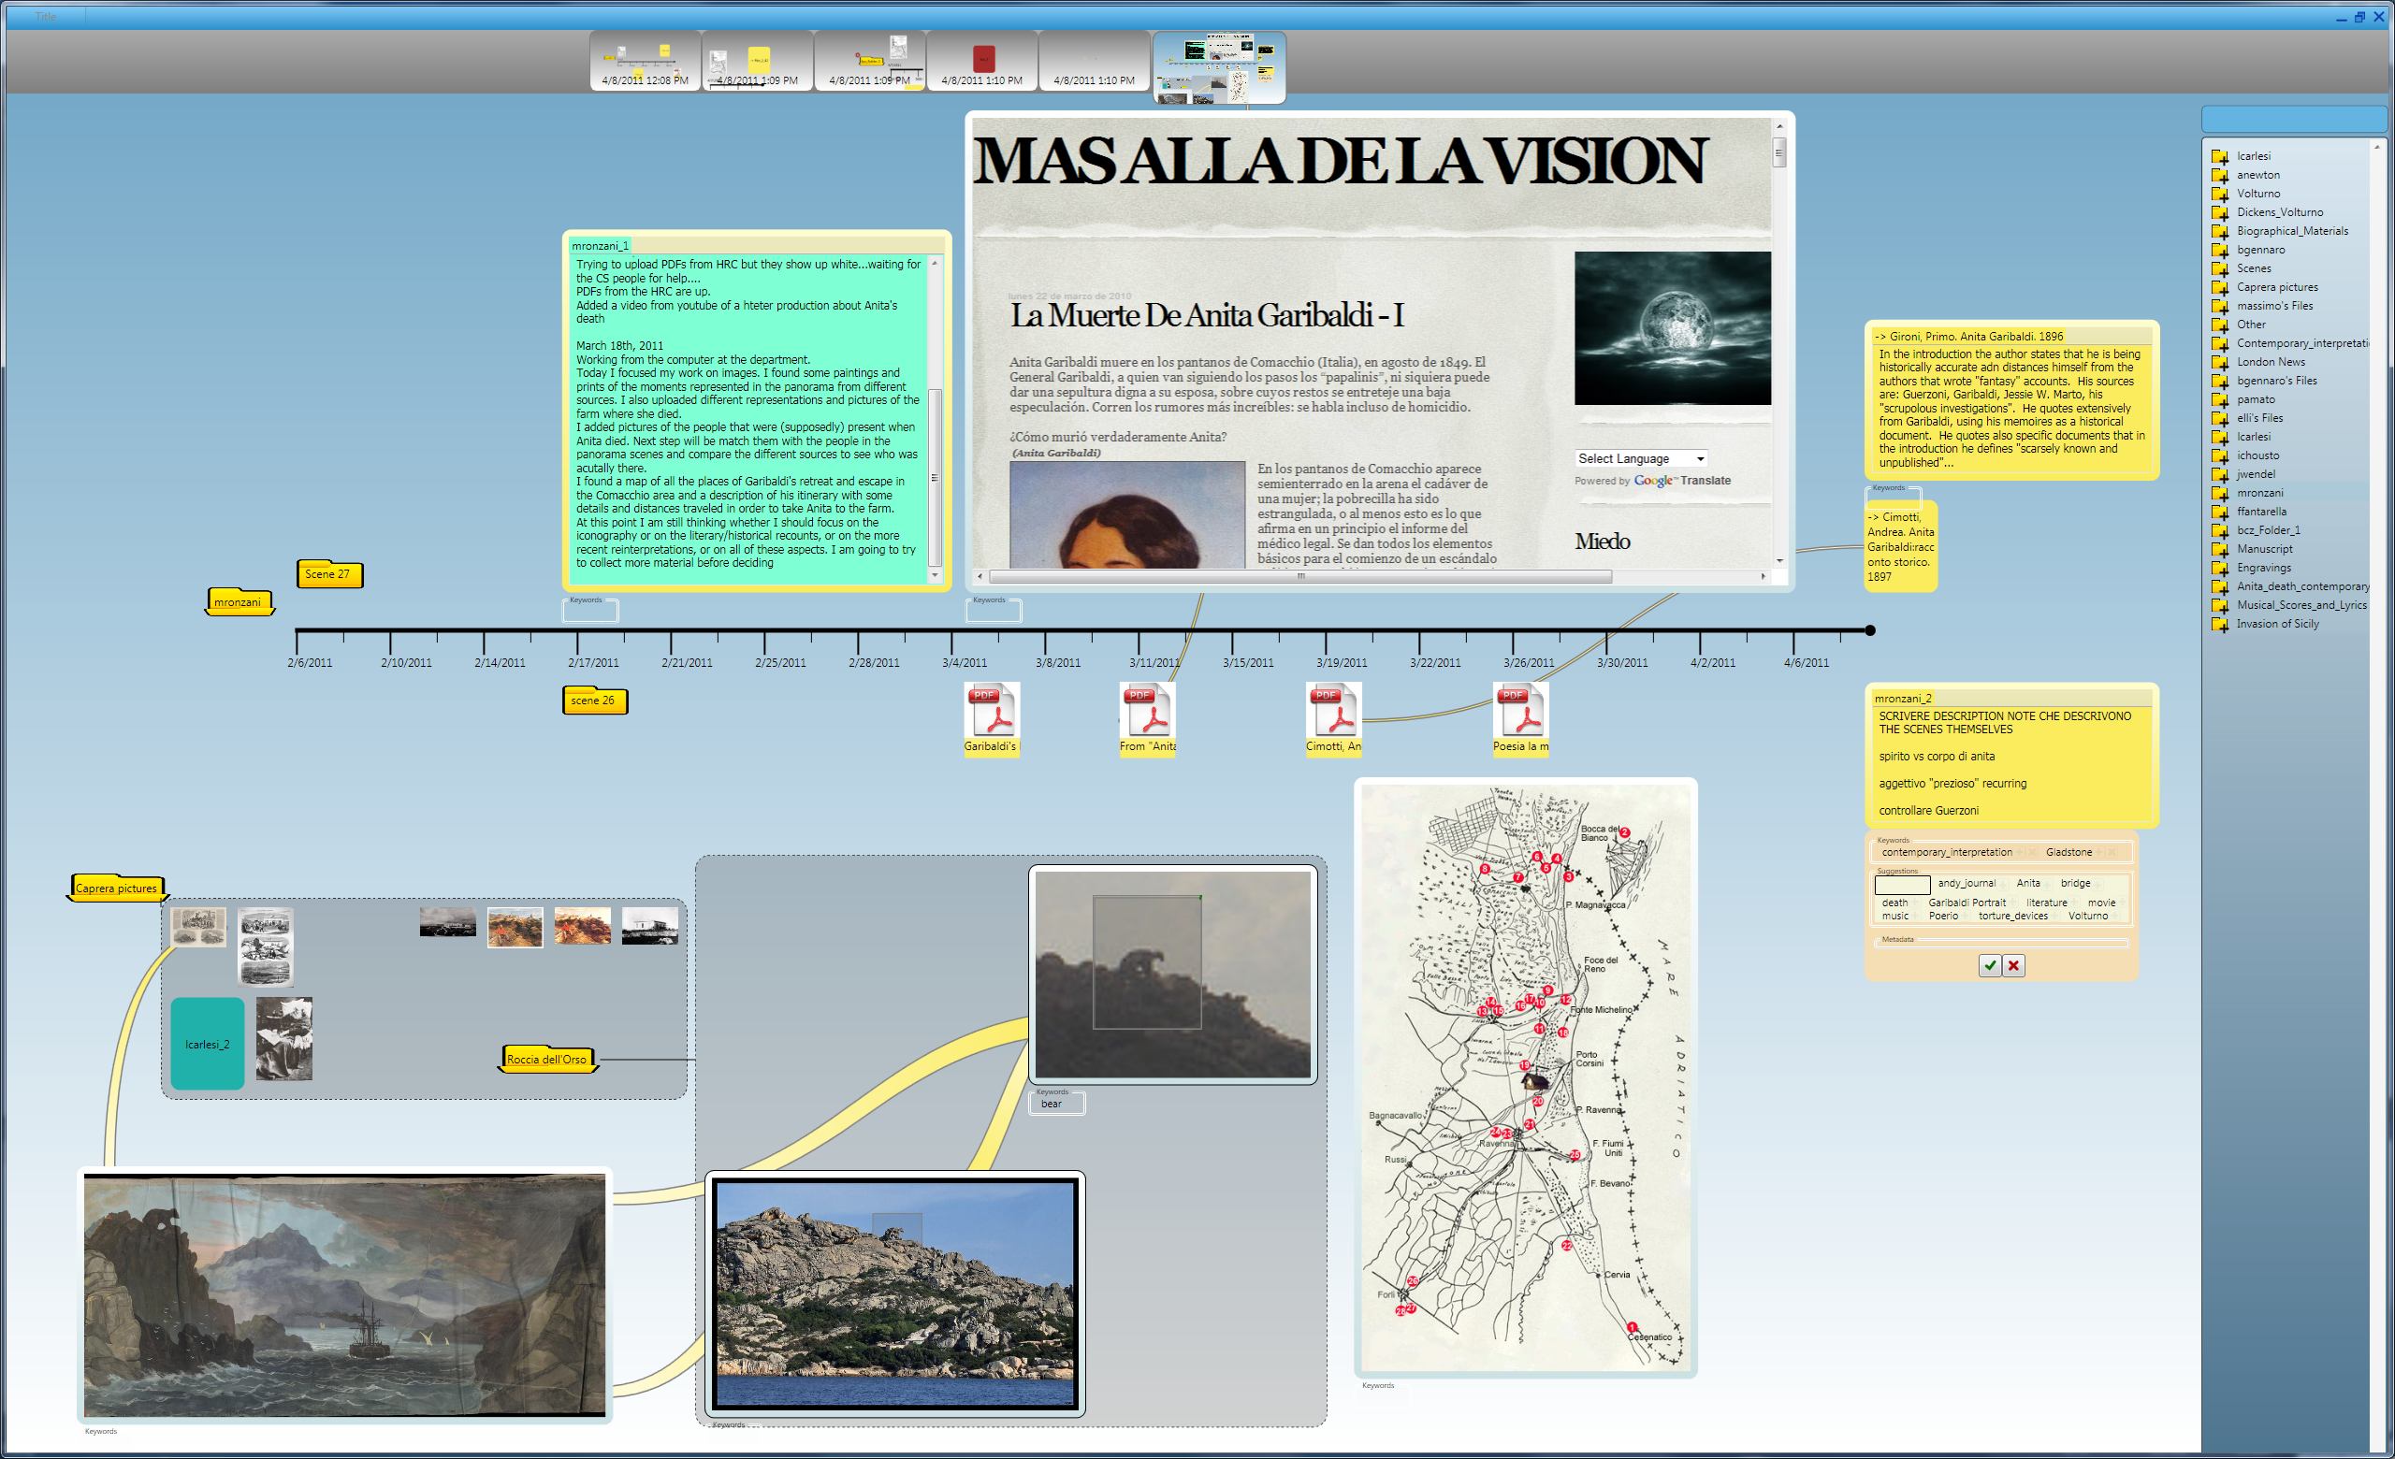
Time as a first-class notion
Frequency of interaction
Synchronous vs. asynchronous
Defining, capturing, restoring, forking state/context

Slide 65
Time as a first-class notion
Frequency of interaction
Synchronous vs. asynchronous
Defining, capturing, restoring, forking state/context

Slide 66
User Roles
Occasional/casual vs. expert
Research vs. ad-hoc
Dynamically changing within session
  learner
  expert
  explorer
  communicator
  manager/leader
  critic
  …
Notes:
o Visioneer
Trainee
Customer service rep
Manager/leader
Marketeer

Slide 67
Input and Output
What do you need and why
  data formats
  lossage transfer issues
    data
    structures
    semantics

Slide 68
Roadmap
1 - Current context – developments underway
2 - Importance and brief history of UI/UX
3 – WIMP post-WIMP/NUI
4 – Invariants
5 – Aspects of NUIs
6 – Research Issues
7 – Bottom line

Slide 69
6 – Research issues – a preview
Component technology
  making speech and gesture recognition more robust; addressing discoverability, learnability…
Ecosystem of devices and users
  moving from single user/device to multi-user/device/agent
Complexity management
Situated interaction
  situated interaction task focus with situational awareness
Acquiring knowledge of user intent, user modeling
“Transparent movement” of context/state between environments
  environment-independent notion of context/state (>= “desktop”)
Modeling NUI interaction
  building a NUI design discipline and NUI IDEs
Notes:
conceirge –
personal assistant – infers intent.
see notes from drive – the exact wording

Slide 70
Roadmap
1 - Current context – developments underway
2 - Importance and brief history of UI/UX
3 – WIMP post-WIMP/NUI
4 – Invariants
5 – Aspects of UIs
6 – Issues
7 – Bottom line

Slide 71
7 – Bottom line
NUIs
  will augment and expand, not replace existing Uis
  much more multi-modal (especially bi-manual) interaction
Computer-human interaction
  increasingly seamless and invisible: automaticity
Focus shift
  from limited single user/computer UI to multi-everything UX
    “smart offices, homes, …” with large interactive display surfaces, seamlessly interoperating with a host of portable devices
Notes:
Note – simplifying for naïve user by removing power user capabilities
is a bad design decision

Slide 72
References
Upcoming NUI book:
  Daniel Wigdor and Dennis Wixon. “Brave NUI World: Designing Natural User Interfaces for Touch and Gesture”. Morgan Kaufmann, to be published in April 2011.
Conferences:
  TEI (Tangible, Embedded, and Embodied Interaction)
    http://www.tei-conf.org/11/hm/
    NSF, ACM, SIGCHI, and Microsoft among the sponsors
  ICMI (International Conference on Multimodal Interaction)
    http://www.acm.org/icmi/2011/
    ACM, SIGCHI, and Microsoft among the sponsors
Website repository: User Interfaces: Evolution and Revolution
  http://www.cs.brown.edu/~avd/UI/
Notes:
TEI, the conference on Tangible, Embedded, and Embodied Interaction, is about
creating compelling experiences that bridge bits and atoms through research in HCI, design, interactive arts, tools and technologies.
http://www.acm.org/icmi/2011/

Slide 73
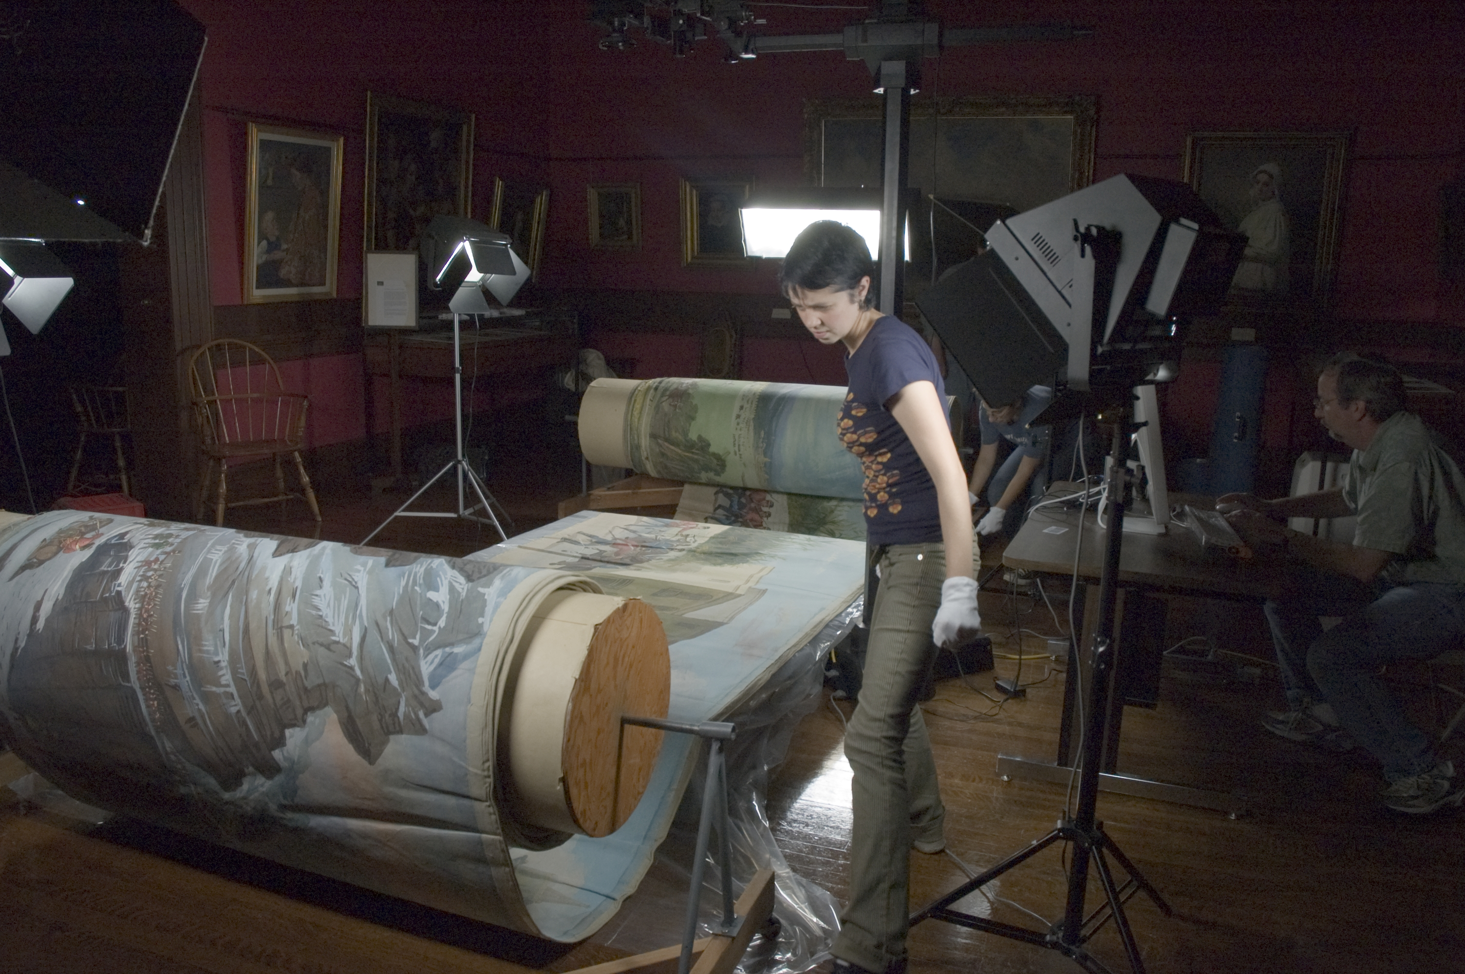

Garibaldi Panorama – 1860’s

Slide 74
Garibaldi Panorama – 1860’s
Size
  scroll approximately 90 meters long, and 1.5 meters tall, painted on both sides
Medium
  watercolor on thin paper similar to wallpaper
Kept in a climate-controlled vault
  panorama essentially inaccessible.
  scanned at high resolution, best displayed on the Surface for interactive viewing (like the famous Along the River During the Qingming Festival scroll)

Slide 75
LADS (Large Art Displayed on Surface)
Generalization of "Garibaldi on the Surface” application
Any artwork, but especially meant for large artworks
  currently 2D only
Modes
  catalog with filters
  artwork viewing (with metadata and other documents) and manipulation
Will run on any Windows 7 Touch platform

Slide 76
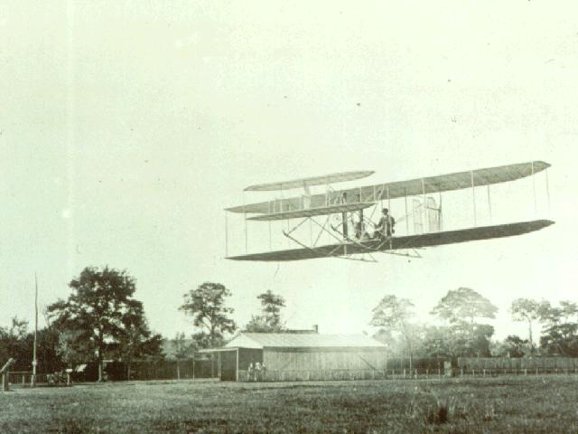
“To Infinity and Beyond…”
Notes:
Where - Ktty Hawk, NC
When – December 17, 1903
Plane name – Flyer
Who – Orville Wright
Almost beat him:
Samuel Pierpont Langley in his Aerodrome – October, 1903 – failed to lift off.
Santos Dumont in his Canard at Paris – October, 1906 – flew 197 feet to become the first flyer to cover 25 meters.
Louis Bleriot was the first to fly an aircraft across the English channel – in 1909.

