Slide 1


User Interfaces:
Evolution and Revolution
Part Two
Andy van Dam
Brown University
April 26, 2011
Notes:
Berra: predicting is hard
Techno-optimist
Too opt on hypertext and e-books
Didn’t see personal comp, games, GPUs
FEEL FREE TO INTERRUPT

Slide 2
Roadmap
Part 1: Streamlining interaction for WIMP UI’s
  Brown’s and MSR’s Code Bubbles
  Brown’s Humanities Bubbles (HumBub)
Part 2: NUI’s (Natural User Interfaces)
  recap of WIMP vs. Post-WIMP/NUI
  bi-manual pen + (multi-)touch
    MSR’s Buxton et al; Fluidity’s FluidMath, Brown’s HandsOnMath
Long-term research issues – a (partial) research agenda
  component technology improvement
  ecosystem of devices, users and avatars
  complexity management
  situated interaction
  acquiring knowledge of user intent
  transparency of state and data
  modeling NUI interaction
Notes:
Not covering:
Brain
Robots
Semantic web
Social networking

Slide 3
Code Bubbles: streamlining user interaction
Problem
  with messy desktop metaphor, users spend as much as 30% of their time manipulating windows containing files to see their targets (reshuffling, resizing)
    files are too heavyweight and take up too much screen real estate
    windows take up too much screen real estate
Goal
  present the user’s “working set” (context) by displaying only selected fragments in lightweight bubbles that don’t overlap
Solution
  visual front-end to Eclipse (@Brown by Bragdon and Reiss) and Visual Studio (@MSR by Rob DeLine and Kael Rowan)
  power tool version for Visual Studio to be released soon
NUI version using Kinect and large screen display submitted for publication (Bragdon and DeLine)
  Video - http://www.cs.brown.edu/~avd/UI/Brown-CodeBubblesClip.mov

Slide 4
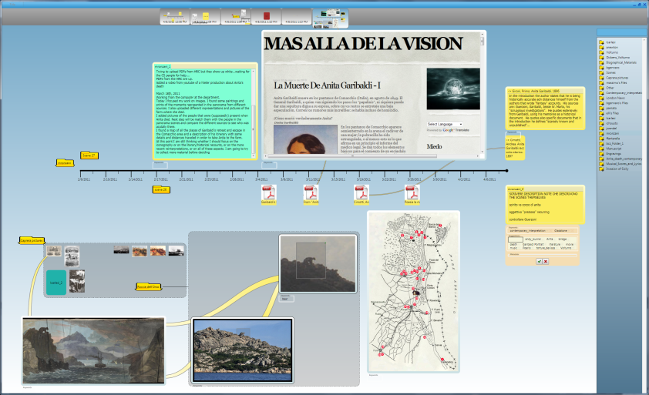
HumBub: IDE for Humanities Research

Slide 5
HumBub: IDE for Humanities Research
Support small-group humanities workflow, borrows from Code Bubbles
  integrated lifecycle of:
    browse, search, annotate, arrange, present, publish
  multi-user repository for all work products
Facilitate visual interaction on unbounded “messy desktop”
  spread heterogeneous documents across an expansive tableau
  save, browse and restore previous desktops
  provide structured layouts (timelines, pivot views)

Slide 6
HumBub: IDE for Humanities Research
Leverage workspace layout for presentation/publication
  presentations as a guided tour of a “messy desktop panorama”
  apply export templates to publish to Web, Surface, etc.
Treat annotation as a first class notion
  bi-directional, find-grained links (“anchors” are regions, pages, time-codes)
  keywords/metadata and typed annotations
  stored in Brown Digital Repository (OAC-compliant)
Provide multiple ways to search and browse
  text, faceted metadata, and contextual
  automatic categorized clustering of results
  traditional and “smart” folders (aggregate content based on filters)

Slide 7
HumBub: IDE for Humanities Research
Context-capture (time)
  capture a time-stamped context (state and data)
  preserve as icon for access on the time bar
  possible uses
    returning to and further editing the saved context
    having different contexts for different people from same time frame
    creating animations of the development of a concept
    educational use for teaching critical thinking
Been continuously rapid-prototyped with faculty and student users in a course on the Risorgimento (150th anniversary this year) focused on the Garibaldi Panorama – all work done within the system
Will be NUI-ized to take advantage of the Surface and absorb some LADS functionality
See also SketchStorm and SketchComm (Xiang Cao)
  Tools to support designers to find inspirations and communicate early design ideas

Slide 8
WIMP vs. Post-WIMP/NUI - recap
Single user:single device vs. ecosystem of multi-everything: users, devices, sensors, agents, …
Better matching of human capability natural user interaction and user experience
Typically non-deterministic probabilistic recognition of interaction (multi-modal) sequences, with backtracking
Most NUIs explore one or a few component modalities deeply
  speech
  pen, touch, and in-air gestures on Kinect
  agents
  sensors and tangible objects, e.g., phicons, smart environments (ubicomp)
  telepresence

Slide 9
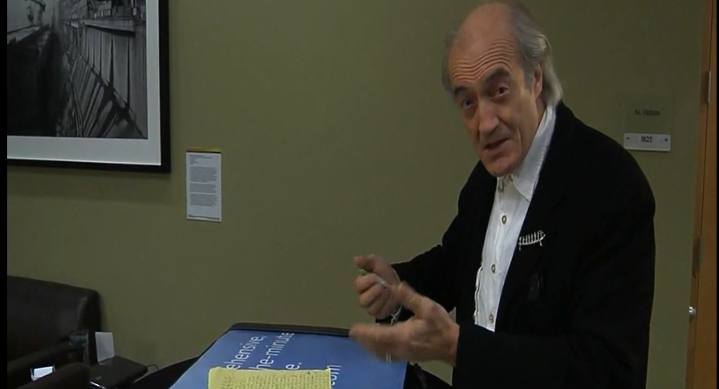
Buxton: making user interfaces natural
  Video: http://www.cs.brown.edu/~avd/UI/Buxton1.mp4

Slide 10
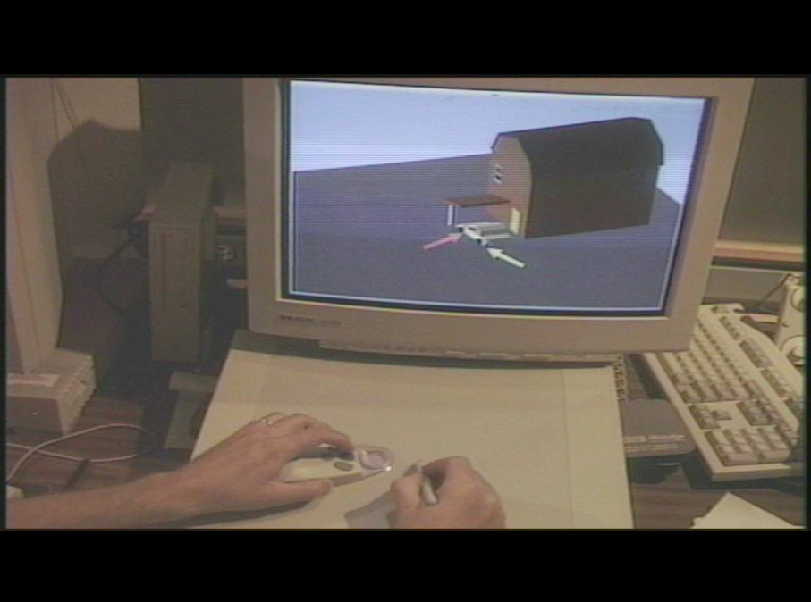
Two-handed Sketch - 1997
Robert C. Zeleznik, Andrew S. Forsberg, and Paul S. Strauss. "Two pointer input for 3D interaction" in ACM I3D '97. Predates Google’s Sketchup by a decade

Slide 11
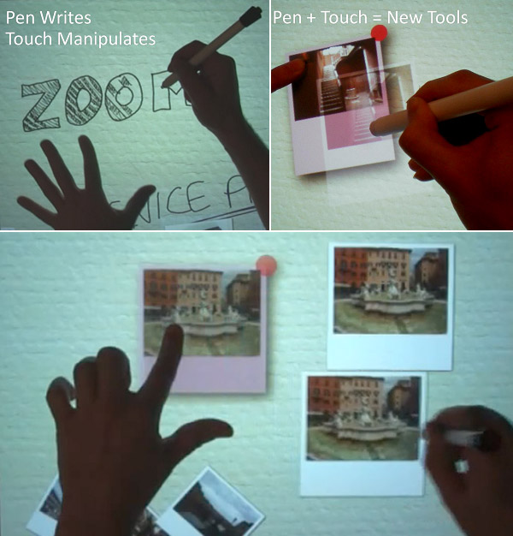
MSR’s experiments with pen+touch
Publication
  Ken Hinckley, Koji Yatani, Michel Pahud, Nicole Coddington, Jenny Rodenhouse, Andy Wilson, Hrvoje Benko, and Bill Buxton. "Pen + touch = new tools”, in proceedings of ACM UIST '10
Observations
  each tool is best for something, worst for something else
  pen writes
  touch manipulates
  pen + touch yields new tools/vocabulary
Touch
  unifies object selection with mode-switching of pen
  holding touch generates a unitary multimodal gesture
Notes:
Ken Hinckley, Koji Yatani, Michel Pahud, Nicole Coddington, Jenny Rodenhouse, Andy Wilson, Hrvoje Benko, and Bill Buxton. "Pen + touch = new tools" in proceedings of ACM UIST '10, pp. 27-36, 2010.

Slide 12
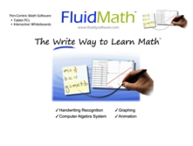
Fluidity Software’s FluidMath forTabletPC’s
Commercial reimplementation and refinement of basic ideas of Joe LaViola’s Ph.D. work on MathPad (MSR-sponsored)
Targeted at high-school math
  pre-Algebra through pre-Calculus currently
  calculus, geometry coming soon
Many benefits, some examples given here
  FluidMath is engaging – interaction is exciting for students
  let’s teacher stay in “primary workspace” where pen is used
  fluid interface allows students to see more examples than otherwise possible
  More information, videos, and free trial at http://www.fluiditysoftware.com
  Free-form notepaper metaphor for math and diagrams anywhere versus Microsoft Math

Slide 13
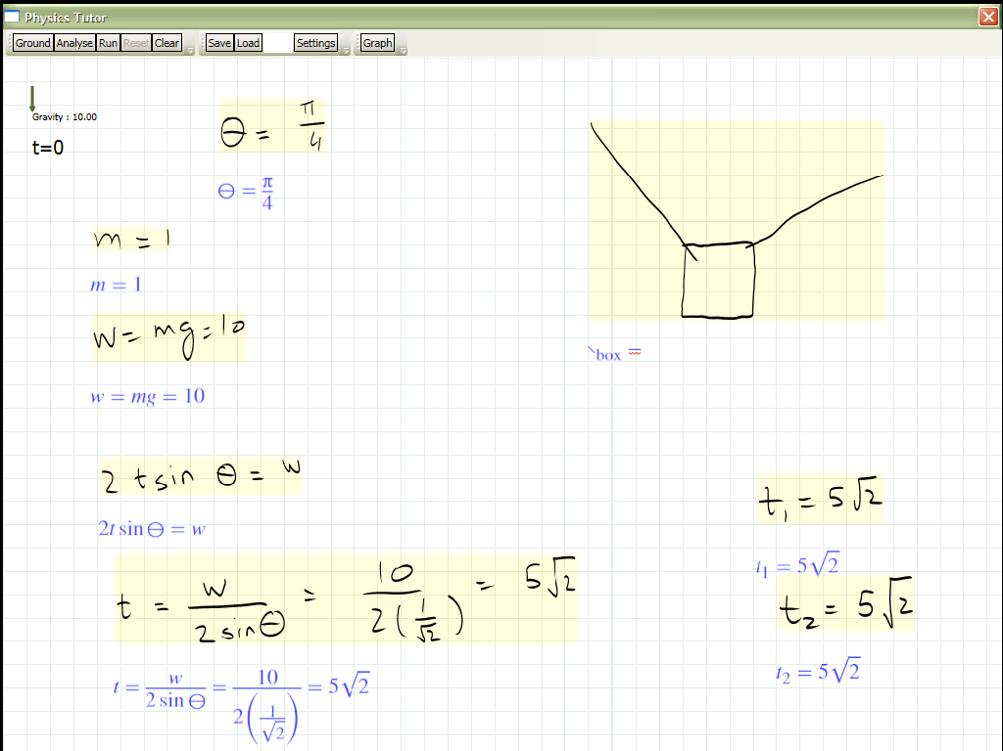
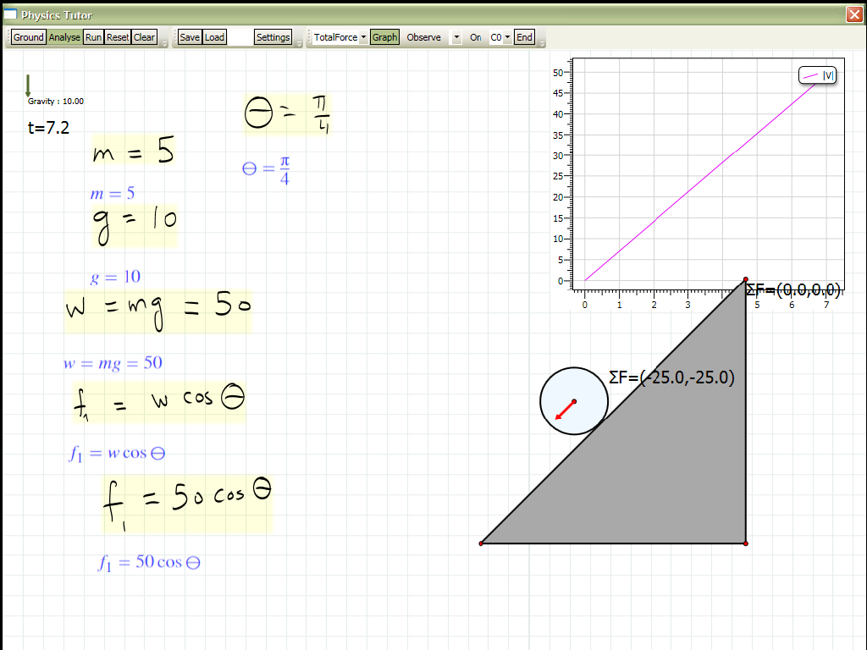
MathPad² – Next Steps (Cheema and LaViola, 2010)
Moving towards intelligent physics tutoring
Integrated physics engine
Supporting animation of physics problems where answers are a value (not a function of time)
High level semantic knowledge
  understanding what type of problem from problem description, math and diagram

Slide 14
Hands-On Math
CAS (Computer Algebra Systems) tools are underutilized for problem solving
  too rigid and formal
  need transparent explanations of computations
  must support free-form 2D input
  [Andrea Bunt, Michael Terry, and Edward Lank. “Friend or foe?: examining CAS use in mathematics research” in ACM CHI '09 229-238. ]
Hands-On Math
  combine best aspects of physical paper and CAS
  hypothesis: physical manipulation enhances cognitive processing, both for learners and practitioners
  disclose reasoning chains through interactivity
  pen and touch gestures make CAS as accessible as doodling

Slide 15
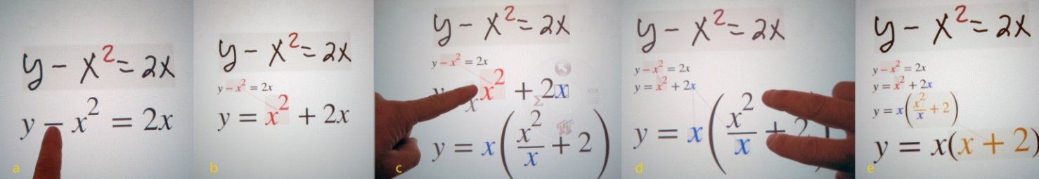
Math Interaction
Write math anywhere
  calculate with extended notations
  create graphs with a gesture
Manipulate recognized math with multi-touch
  http://www.cs.brown.edu/~avd/UI/ Brown-HandsOnMath.wmv
Drag -x²
Annotated
result
Drag x (from 2x)
Interactively factors
Updating results
below
Squeezing x²/x
simplifies it
Final expression

Slide 16
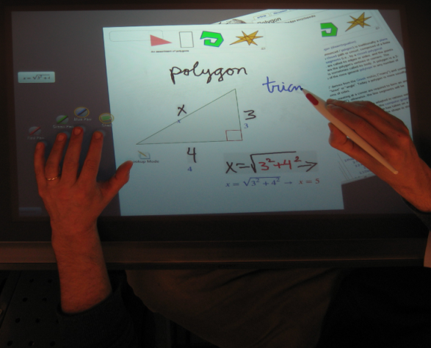
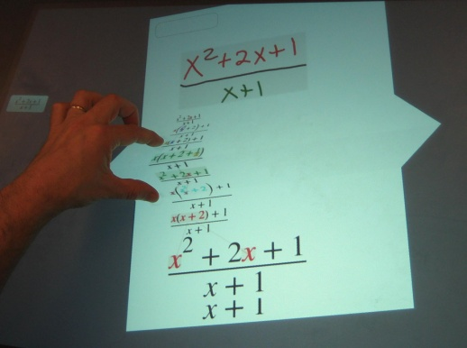
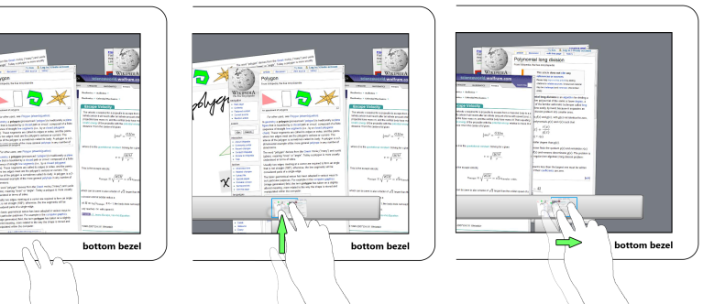
Hands-On Math UI
Page-based metaphor
  Virtual “pages”
    Used for organization
    Provide a “scope”
    Facilitate multi-user scenarios
    Foldable to make space
    Web page integration
  Large pannable
  desktop
    Pannable workspace
    Reference docs

Slide 17
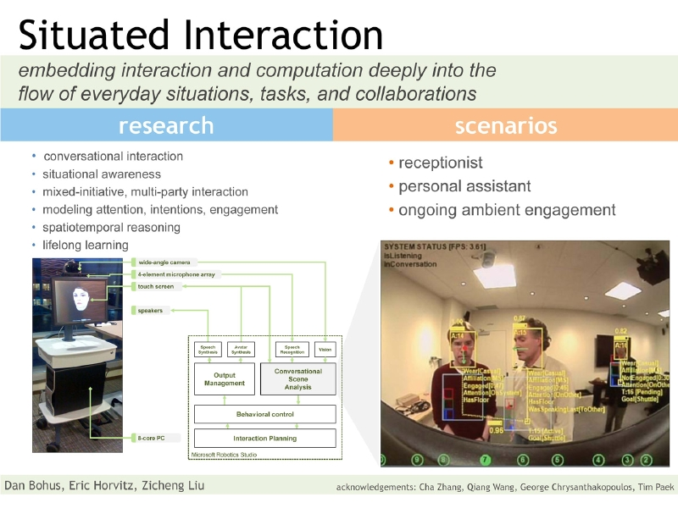
Ubicomp approaches - situated Interaction

Slide 18
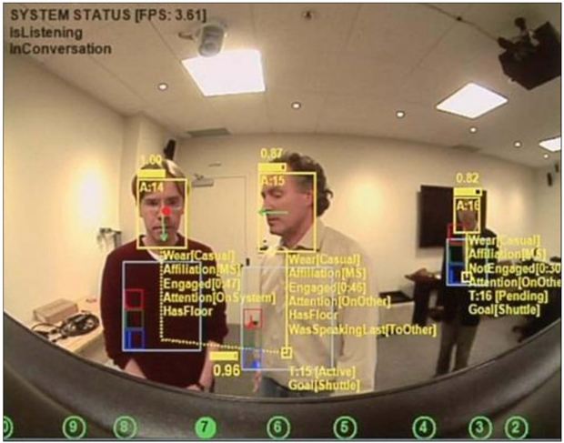
Ubicomp approaches - situated Interaction

Slide 19
Ubicomp approaches - situated Interaction
Goals
  interactive systems that embed interaction and computation into natural human activities and contexts
Core research areas
  situational awareness (e.g. conversational scene analysis, multimodal
  sensing and fusion, etc.)
  engagement, attention, floor in multi-participant interaction
  mixed-initiative, multi-participant interaction and dialog control
  situated grounding, robustness and error handling
  life-long learning and adaptation
  spatio-temporal reasoning, behavior and intention recognition
  high-resolution, coordinated behavioral models for embodied agents
Courtesy of Dan Bohus’ research overview description

Slide 20
Ubicomp approaches – smart environments
Legacy
  Weiser’s Ubiquitous Computing, Xerox PARC 1988
  Bolt’s Put That There
  Kruger’s VideoPlace
  Ishii’s phicons
  Streitz’ Ambiente/Agora and Roomware

Slide 21
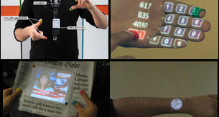
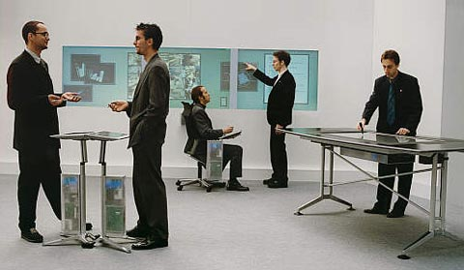
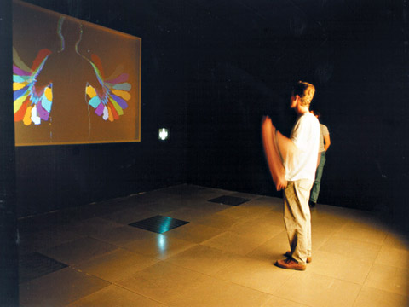
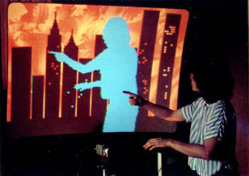
Smart environments

Slide 22
Ubicomp approaches – smart environments
Legacy
  Weiser’s Ubiquitous Computing, Xerox PARC 1988
  Bolt’s Put That There
  Kruger’s VideoPlace
  Ishii’s phicons
  Streitz’ Ambiente/Agora and Roomware
Characteristics
  integrating bits and atoms into a cohesive whole
  human in the loop
  bi-directional manipulation of sensor-based objects
  disappearing computer
    smart rooms and cities
      Norbert Streitz. "Ambient Intelligence Landscapes for Realizing the Cities of the Future” in proceedings of AmI-09 - 3rd European Conference on Ambient Intelligence, pp. 18 – 21, 2009.
    sensor-based environments
      Jon E. Froehlich, Eric Larson, Tim Campbell, Conor Haggerty, James Fogarty, and Shwetak N. Patel. "HydroSense: infrastructure-mediated single-point sensing of whole-home water activity" in proceedings of ACM Ubicomp '09, pp 235-244, 2009.
  transparent movement of state and data in both time and space

Slide 23
Ubicomp approaches – smart environments
Research conferences
  ICMI (International Conference on Multimodal Interaction)
    http://www.acm.org/icmi/2011/
    ACM, SIGCHI, and Microsoft among the sponsors
  TEI (Tangible, Embedded, and Embodied Interaction)
    http://www.tei-conf.org/11/hm/
    NSF, ACM, SIGCHI, and Microsoft among the sponsors
  UBICOMP (Ubiquitous Computing)
    http://www.ubicomp.org/ubicomp2011/
    ACM, SIGCHI, and Microsoft among the sponsors
    Ubicomp 2011 to be held in Beijing, China on September 17-21, 2011 General Chairs James Landay and Yuanchun Shi, Tsinghua University

Slide 24
Roadmap
Part 1: Streamlining interaction for WIMP UI’s
  Brown’s and MSR’s Code Bubbles
  Brown’s Humanities Bubbles
Part 2: NUI’s (Natural User Interfaces)
  recap of WIMP vs. Post-WIMP/NUI
  bi-manual pen + (multi-)touch
    MSR’s Buxton et al; Fluidity’s FluidMath, Brown’s HandsOnMath
Long-term research issues – a (partial) research agenda
  component technology improvement
  ecosystem of devices and users
  complexity management
  situated interaction
  acquiring knowledge of user intent
  transparency of state and data
  modeling NUI interaction
Notes:
Not covering:
Brain
Robots
Semantic web
Social networking

Slide 25
Improving component technologies (1/3)
Robustness of speech and of gesture recognition of all types (decrease error rates and increase adaptability to variability in user, language, environment…)
How to disambiguate gesture from content (e.g., punctuation/reserved gestures)
Discoverability and learnability
  minimal use of small set of gestures – common belief is that people can learn only a few – wrong!
  must try to systematically discover a common subset, some natural, some learned (beyond pan and pinch-zoom)
  need better disclosure and teaching strategies

Slide 26
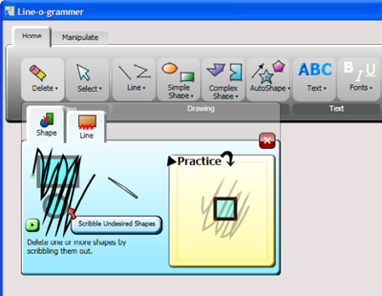
Improving component technologies (2/3)
Brown’s Gesture Bar (Andrew Bragdon)
Andrew Bragdon, Robert Zeleznik, Brian Williamson, Timothy Miller, and Joseph J. LaViola, Jr.."GestureBar: improving the approachability of gesture-based interfaces" in proceedings of ACM CHI '09

Slide 27
Improving Component Technologies (3/3)
Haptics has special problems
  need very high sampling rates
  more difficult problem: how to go from 2 point forces to distributed forces as we have in the real world
  even more difficult problem: mobile haptics – people want to be unencumbered…
For many purposes having the haptic feedback of a tool (such as a pen, marker or wand is preferred by many over in-air gesturing)

Slide 28
UX: Ecosystem of users, devices, agents…
Moving (finally) into ubicomp world of
  cheap, flexible bi-directional displays (e.g., pixel-sense),
  sensors in everything and everywhere, and
  progress on all component fronts, including agents with sensory awareness
  too few projects combine multiple modalities – most of us work on one or a few component technologies
But our models and practices have scarcely evolved from one user : one desktop/laptop
How to control complexity of n : n interactions without sensory overload?
  multi-player Kinect is a good special case

Slide 29
Management of complexity
Synchronous/asynchronous interaction, version control of shared objects, states/contexts
Scaling (in size of data sets, tasks, devices, people, agents…)
Time duration: from atomic task common in HCI literature to short-term domain-specific higher-level task to long-term task a la Landay’s Activity Theory
Task focus within situational awareness
…
Solutions
    move tasks from cognitive to perceptual and motor skill level
    use visualization, audio cues,…(learn from cockpit design)
Notes:
conceirge –
personal assistant – infers intent.
see notes from drive – the exact wording

Slide 30
Transparent movement of state and data
Move transparently from shower to kitchen table to car to hallway to office –
  Corning glass and MSFT’s Vision 2019 videos shows nice devices and interactions but that’s the easy part!
    Corning’s “A Day Made of Glass”
      http://www.cs.brown.edu/~avd/UI/Corning-ADayMadeofGlassClip.mov
Requires
  rich notion of state/context, much of it gathered by monitoring user behavior
  zoomable interfaces (ZUI’s that adapt to form factor)
  mapping of modalities (e.g., target selection by touch to speech, , simulations of natural devices onto less natural ones (pen to finger for sketching/writing),…
  some tasks may not be executable in some environments – how does user learn that?

Slide 31
Acquiring knowledge of user intent, user modeling
Types of user processes
    executing tasks
    learning
    exploring
    problem solving
    communicating
    collaborating
    ...
Moving from being instructed by user re intent to inferring it from analysis of interaction histories
  can learn patterns from data mining of GUI interactions

Slide 32
Modeling NUI interaction – separation of concerns
Separation of UI from application semantics?
  relationship among different concerns
    Xerox PARC's MVC (Model-View-Controller) categorization
    -architectural/semantic design vs. interaction design vs. visual design
    UIMS (User Interface Management System), e.g., VB, Visual Studio
    HCI and UI design are separate fields, but not first-class in CS, alas
  cannot separate in post-WIMP non-deterministic UIs – gesture recognition is domain-dependent (especially for specialized languages, e.g., 2D visual languages)
  MUST have integrated design teams and design process covering domain and user expertise through design of functionality and UX – rapid prototyping early and often!
Notes:
* management of complexity
- of all these diff kinds of sync and async interaction, scaling,
* acquiring knowledge of user intent
- (being instructed, learning, exploring, problem solving, ...)
* how to provide simultaneous focus on task plus situational awareness without overloading
- move as much as possible from cognitive to perceptual level through good visualization
* transparent movement of context/state
- from shower to car to office to..
* move from single user/single platform to multi/everything
- platforms, sensors, people, avatars, ..
* collaboration across space and time using
- telecollaboration
- avatars
- indirect agents
* separation of UI from application semantics.
- relationships among concerns
PARC's MVC
UMIS
- cannot separate in post-WIMP non-deterministic UIs

Slide 33
Modeling NUI Interaction - formalisms
What formalisms, especially for mixed-mode interactions?
  rapid prototyping has replaced most formal specifications (Finite State Machines, Augmented Transition Networks…) – used sometimes for individual interactions
  ACM CHI ’08 workshop on “User Interface Description Languages for Next Generation User Interfaces”
    section on UIDLs for multimodal and ubiquitous computing
      Robert Jacob’s http://www.eecs.tufts.edu/~oshaer/workshop/CHI08_ws_proc.pdf
Some design prototyping tools such as
    Li and Landay’s Activity Designer
      Yang Li and James A. Landay. "Activity-based prototyping of ubicomp applications for long-lived, everyday human activities" in proceedings of ACM CHI '08
    Horneckers’ Tangible Interaction Framework and Cards
      Eva Hornecker and Jacob Buur. "Getting a grip on tangible interaction: a framework on physical space and social interaction" in proceedings of ACM CHI '06
      Eva Hornecker. "Creative idea exploration within the structure of a guiding framework: the card brainstorming game" in proceedings of ACM TEI '10
Notes:
* management of complexity
- of all these diff kinds of sync and async interaction, scaling,
* acquiring knowledge of user intent
- (being instructed, learning, exploring, problem solving, ...)
* how to provide simultaneous focus on task plus situational awareness without overloading
- move as much as possible from cognitive to perceptual level through good visualization
* transparent movement of context/state
- from shower to car to office to..
* move from single user/single platform to multi/everything
- platforms, sensors, people, avatars, ..
* collaboration across space and time using
- telecollaboration
- avatars
- indirect agents
* separation of UI from application semantics.
- relationships among concerns
PARC's MVC
UMIS
- cannot separate in post-WIMP non-deterministic UIs

Slide 34
Need a NUI design discipline
Sophisticated NUI’s (beyond the multi-point pan and pinch-zoom added to WIMP GUI’s) are designed in an ad-hoc manner, using low-level SDK’s for each component technology – developers must integrate somehow
Wigdor & Wixon’s “Brave NUI World” (2011) is a good start for designing for multi-touch (+ pen) and in-air gestures
Need multi-disciplinary teams and especially UX designers, User Experience design studio
    needs to be infused by perceptual, cognitive and social psychology, cultural anthropology
Need NUI IDE’s/builders

Slide 35
Bottom line
NUIs
  will augment and expand, not replace existing UI’s
  much more multi-modal (esp. bi-manual) interaction
Computer-human interaction
  increasingly seamless and invisible: automaticity
Focus shift
  from limited single user/computer UI to multi-everything UX - Ubicomp will finally become a reality
    “smart offices, homes, …” with large interactive display surfaces, seamlessly interoperating with a host of portable devices
“Exercise for the reader:” implement a more sophisticated version of “Put That There” using, e.g., Kinect
Notes:
Note – simplifying for naïve user by removing power user capabilities
is a bad design decision

Slide 36
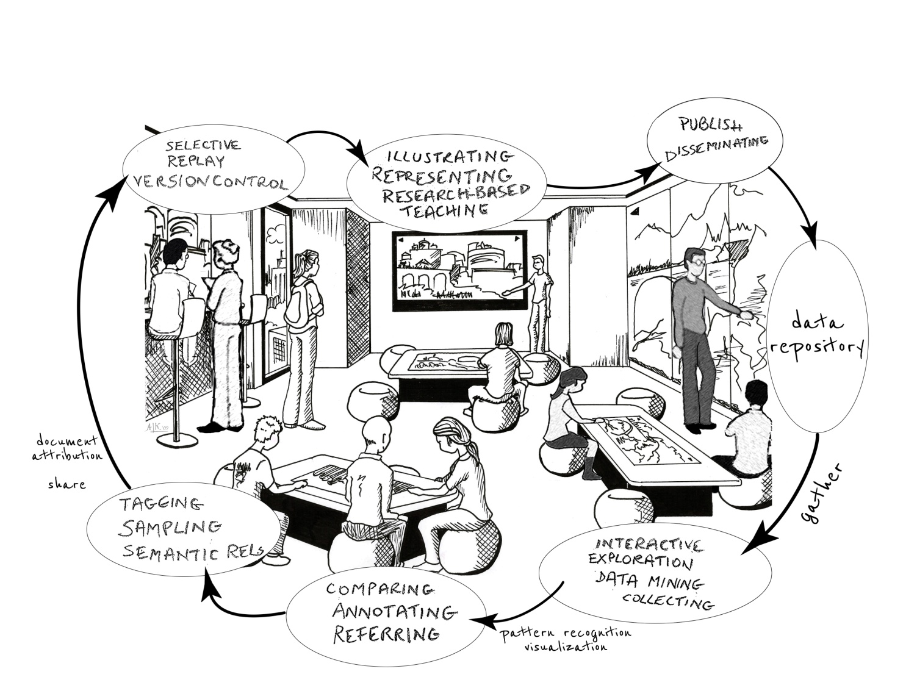
Digital Scholarship Lab

Slide 37
References
NUI book:
  Daniel Wigdor and Dennis Wixon. “Brave NUI World: Designing Natural User Interfaces for Touch and Gesture”. Morgan Kaufmann, 2011.
Conferences:
  ICMI (International Conference on Multimodal Interaction)
    http://www.acm.org/icmi/2011/
    ACM, SIGCHI, and Microsoft among the sponsors
  TEI (Tangible, Embedded, and Embodied Interaction)
    http://www.tei-conf.org/11/hm/
    NSF, ACM, SIGCHI, and Microsoft among the sponsors
  UBICOMP (Ubiquitous Computing)
    http://www.ubicomp.org/ubicomp2011/
    ACM, SIGCHI, and Microsoft among the sponsors
    Ubicomp 2011 to be held in Beijing, China on September 17-21, 2011
  ACM ITS (Interactive Tabletops and Surfaces) 2011, General Chair Daniel Wigdor, Kobe, Japan
Website for this talk: http://www.cs.brown.edu/~avd/UI/
Notes:
TEI, the conference on Tangible, Embedded, and Embodied Interaction, is about
creating compelling experiences that bridge bits and atoms through research in HCI, design, interactive arts, tools and technologies.
http://www.acm.org/icmi/2011/

Slide 38
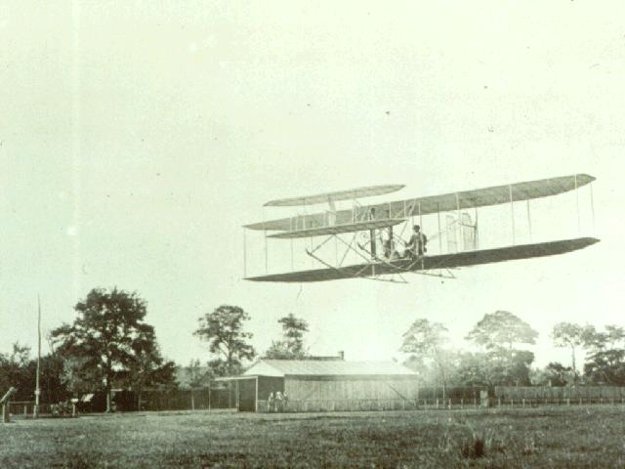
“To Infinity and Beyond…”
Notes:
Where - Ktty Hawk, NC
When – December 17, 1903
Plane name – Flyer
Who – Orville Wright
Almost beat him:
Samuel Pierpont Langley in his Aerodrome – October, 1903 – failed to lift off.
Santos Dumont in his Canard at Paris – October, 1906 – flew 197 feet to become the first flyer to cover 25 meters.
Louis Bleriot was the first to fly an aircraft across the English channel – in 1909.

