Slide 1
Approximation Schemes for Dense Variants of Feedback Arc Set,
Correlation Clustering, and Other Fragile Min Constraint Satisfaction Problems
Warren Schudy
Brown University
Computer Science
Joint work with Claire Mathieu, Marek Karpinski, and others

Slide 2
Outline
Overview
  Approximation algorithms
  No-regret learning
Approximate 2-coloring
  Algorithm
  Analysis
Open problems

Slide 3



Optimization and Approximation
Combinatorial optimization problems are ubiquitous
Many are NP-complete
Settle for e.g. 1.1-approximation:
Cost(Output) ≤ 1.1 Cost(Optimum)
A polynomial-time approximation scheme (PTAS) provides a 1+ε approximation for any ε >0.

Slide 4
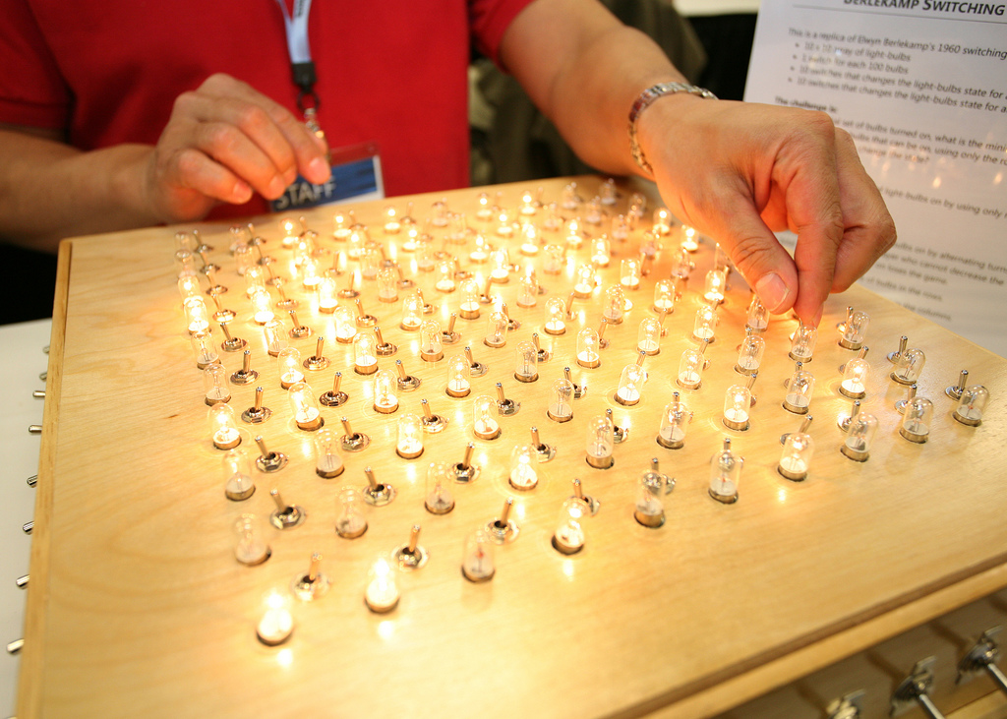
At Microsoft Research Techfest 2009:
http://www.flickr.com/photos/msr_redmond/3309009259/

Slide 5


Gale-Berlekamp Game
Invented by Any Gleason (1958)
n/2
Minimize number of lit light bulbs
NP hard [RV ’08]
PTAS runtime n^{O(1/ε²)} [BFK ’03]
  We give PTAS linear runtime O(n²)+2^{O(1/ε²)} [KS ‘09]
Animating…
Notes:
Andy Gleason – test problem for local search 1958
Berlekamp: built physical model in 1960s

Slide 6
Approximate 2-coloring
Cost 1
Minimize number of monochromatic edges
“Pessimist’s MAX CUT” or “MIN UNCUT”
General case:
  O(√ log n) approx is best known [ACMM ‘05]
  no PTAS unless P=NP [PY ‘91]
Everywhere-dense case (all degrees Θ(n))
  Previous best PTAS: n^{O(1/ε²)} [AKK ’95]
  We give PTAS with linear runtime O(n²)+2^{O(1/ε²)} [KS ‘09]
Animating…

Slide 7
Generalization: Fragile dense MIN-2CSP
Min Constraint Satisfaction Problem (CSP):
n variables, taking values from constant-sized domain
Soft constraints, which each depend on 2 variables
Objective: minimize number of unsatisfied constraints
Assumptions:
Everywhere-dense, i.e. each variable appears in Ω(n) constraints
These constraints are fragile, i.e. changing value of a variable makes all satisfied constraints it participates in unsatisfied. (For all assignments.)
  We give first PTAS for all fragile everywhere-dense MIN-kCSPs. Its runtime is O(input size)+2^{O(1/ε²)} [KS ‘09]
GB Game
Approx. 2-coloring
Notes:
Ask audience to explain how GB game is CSP

Slide 8
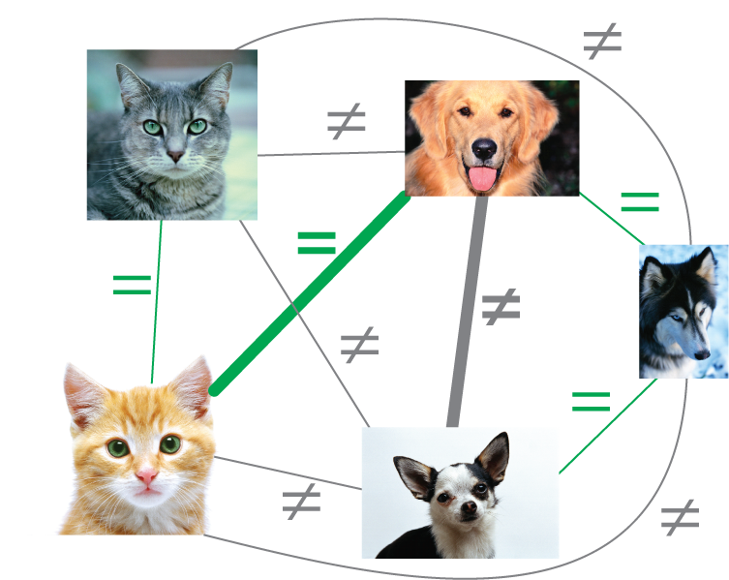
Correlation Clustering
Minimize number of disagreements
2.5 approximation [ACN ‘05]
No PTAS (in adversarial model) unless P=NP [CGW ‘05]
If number of clusters is limited to a constant d:
  Previous best PTAS runtime n^{O(1/ε²)} [GG ’06]
  We give PTAS with runtime O(n²)+2^{O(1/ε²)} (linear time) [KS ‘09]
  Not fragile but rigid [KS ‘09]

Slide 9
More correlation clustering
Additional results:
  Various approximation results in an online model [MSS ‘10]
  Suppose input is generated by adding noise to a base clustering. If all base clusters are size Ω(√n) then the semi-definite program reconstructs the base clustering [MS ‘10]
  Experiments with this SDP [ES ‘09]

Slide 10
Fully dense feedback arc set
A
B
C
D
Minimize number of backwards edges
Applications
  Ranking by pairwise comparisons [Slater ‘61]
  Learning to order objects [CSS ‘97]
  Kemeny rank aggregation
NP-hard [ACN ’05, A ’06, CTY ‘07]
  We give first PTAS [MS ‘07]
Notes:
Cohen Schapire Singer ‘97

Slide 11

Generalization
Example: betweenness. Minimize number of violated constraints
B between A, C
B between A, D
A between C, D
C between B, D
A, B, C, D
Generalize to soft constraints depending on k objects
Assumptions
  Complete, i.e. every set of k objects has a soft constraint
  The constraints are fragile, i.e. a satisfied constraint becomes unsatisfied if any single object is moved
We give first PTAS for all complete fragile min ranking CSPs [KS ‘09]
Animating…

Slide 12
Summary of PTASs
 |  | Previous work | This work
Every.-dense | Fragile Min k-CSP | - | O(input)+2^{O(1/ε²)} [KS ‘09] (Essentially optimal)
 | Approx. 2-color, Gale-Berlekamp Game | n^{O(1/ε²)} [AKK ‘95, BFK ‘03]
Complete | Correlation clustering with O(1) clusters | n^{O(1/ε²)} [GG ‘06]
 | Fragile Min Ranking k-CSP | - | Poly(n) 2^{Poly(1/ε)} [MS ‘07, KS ‘09]
 | Feedback arc set | -
 | Betweenness | -

Slide 13
Outline
Overview
  Approximation algorithms
  No-regret learning
Approximate 2-coloring
  Algorithm
  Analysis
Open problems

Slide 14
External regret
Rock-paper scissors history:
Exist algorithms with regret O(√t) after t rounds [FS ‘97]
 | 1 | 2 | 3 | 4 | 5 | Score
Them | R | S | P | R | P
Us | S | R | P | S | R | 1-3=-2
Us’ | P | P | P | P | P | 2-1=1
[External] P Regret: 1 − (-2) = 3

Slide 15
Internal regret
Regret O(√t) after t rounds using matrix inversion [FV ‘99]
… using matrix-vector multiplication [MS ‘10]
Currently investigating another no-regret learning problem related to dark pools with Jenn Wortman Vaughan [SV]
 | 1 | 2 | 3 | 4 | 5 | Score
Them | R | S | P | R | P
Us | S | R | P | S | R | 1-3=-2
Us’: S→P | P | R | P | P | R | 3-1=2
[Internal] S→P Regret: 2 − (-2) = 4

Slide 16
Outline
Overview
  Approximation algorithms
  No-regret learning
Approximate 2-coloring
  Algorithm
  Analysis
Open problems

Slide 17
Reminder: approximate 2-coloring
Minimize number of monochromatic edges
Assume all degrees Ω(n)

Slide 18
Some Instances are easy
Previously known additive error algorithms: Cost(Output) ≤ Cost(Optimum) + O(ε n²)
  [Arora, Karger, Karpinski ‘95]
  [Fernandez de la Vega ‘96]
  [Goldreich, Goldwasser, Ron ‘98]
  [Alon, Fernandez de la Vega, Kannan, Karpinski. ‘99]
  [Freize, Kannan ‘99]
  [Mathieu, Schudy ‘08]
Which instances are easy?
When OPT = Ω(n²)
Animating…

Slide 19


Previous algorithm (1/3)
– analysis version
Assumes OPT ≤ ε κ₀ n² where κ₀ is a constant
“exhaustive sampling”
x⁰ |  | x³
G
S
Return best
V
G
S
S
Return
…
…
…
Random sample S
G
S
Let S be random sample of V of size O(1/ε²)·log n
For each coloring x⁰ of S
  Compute coloring x³ of V somehow…
Return the best coloring x³ found
Let x⁰ = x* restricted to S
Animating…

Slide 20
Previous algorithm (2/3)
x⁰ |  | partial coloring x² ← if margin of v w.r.t. x⁰ is large then color v greedily w.r.t. x⁰ else label v “ambiguous” |  | x³
2 to 1
G
S
G
3 to 0
Etc.
Define the margin of vertex v w.r.t. coloring x to be
|(number of blue neighbors of v in x) - (number of red neighbors of v in x)|.

Slide 21
Previous algorithm (3/3)
x⁰ |  | x² |  | x³ extends x² greedily
G
G
S

Slide 22
Previous algorithm
Our
Intermediate
Assume OPT ≤ ε κ₀ n²
κ₁ n²
κ₂
Let S be random sample of V of size O(1/ε²)·log n
For each coloring x⁰ of S
  partial coloring x² ←
  if margin of v w.r.t. x⁰ is large
  then color v greedily w.r.t. x⁰
  else label v “ambiguous”
  Extend x² to a complete coloring x³ greedily
Return the best coloring x³ found
  x¹ ← greedy w.r.t. x⁰
Idea: two greedy phases before assigning ambiguity allows constant sample size
Idea: use additive error algorithm to color ambiguous vertices.
¹
¹
  using an existing additive error algorithm
Animating…

Slide 23
Outline
Overview
  Approximation algorithms
  No-regret learning
Approximate 2-coloring
  Algorithm
  Analysis
Open problems

Slide 24
Plan of analysis
Main Lemma:
    Coloring x² agrees with the optimal coloring x*
    Few mistakes are made when coloring the ambiguous vertices

Slide 25
Relating x¹ to OPT coloring
Lemma 2: with probability at least 90% all vertices have margin w.r.t. x* within O(δ n) of
margin w.r.t. x¹.
Proof plan: bound num. miscolored vertices by O(δ n)
Proof:
D
Optimum assignment x*:
C
B
A
E
F
1
3
Case 1: |1-3| > δ n / 3
“F unbalanced”
Chernoff and
Markov bounds
Case 2: |1-3| ≤ δ n / 3
“F balanced”
Fragility & density
Few miscolored
because:

Slide 26
    Proof that x² agrees with the optimal coloring x*
1. Assume F colored by x²
x¹
x*
D
D
C
B
C
B
A
E
A
E
F
F
4
1
3
0
2. 4>>0 and F blue
by def’n x²
3. 4-0 ≈ 3-1
by Lemma 2
4. F blue by
optimality of x*

Slide 27
    Proof that x² agrees with the optimal coloring x*
1. Assume F colored by x²
x¹
x*
D
D
C
B
C
B
A
E
A
E
F
F
4
1
3
0
2. 4>>0 and F blue
by def’n x²
3. 4-0 ≈ 3-1
by Lemma 2
4. F blue by
optimality of x*

Slide 28
Proof ideas: few mistakes are made when coloring the ambiguous vertices
Similar techniques imply every ambiguous vertex is balanced
Few such vertices

Slide 29
Outline
Overview
  Approximation algorithms
  No-regret learning
Approximate 2-coloring
  Algorithm
  Analysis
Open problems

Slide 30

Impossible extensions
Our results:
Fragile everywhere-dense Min CSP
Fragile fully-dense Min Rank CSP
Impossible extensions unless P=NP:
Fragile everywhere-dense Min CSP
Fragile fully-dense Min Rank CSP
Fragile average-dense Min CSP
Fragile everywhere-dense Min Rank CSP
everywhere-dense Correlation Clustering

Slide 31

Kemeny Rank Aggregation (1959)
Voters submit rankings of candidates
Translate rankings into graphs
Add those graphs together
Find feedback arc set of resulting weighted graph
A>B>C
C>A>B
A>C>B
A
C
A
C
A
C
B
B
B
1
A
2
C
3
0
1
2
B
0
1
1
A
C
B
2
2
3
  Nice properties, e.g. Condorcet [YL ’78, Y ‘95]
  We give first PTAS [MS ‘07]

Slide 32
An Open Question
Real rankings often have ties, e.g. restaurant guides with ratings 1-5
Exists 1.5-approx [A ‘07]
Interesting but difficult open question: Is there a PTAS?
A: 5 C: 4
B: 5 D: 3
A
C
D
B

Slide 33
Summary of PTASs
 |  | Previous work | This work
Everywhere-dense | Fragile Min k-CSP | - | O(input)+2^{O(1/ε²)} [KS ‘09] (Essentially optimal)
 | Approx. 2-color, Multiway cut, Gale-Berlekamp Game, Nearest codeword, MIN-kSAT | n^{O(1/ε²)} [AKK ‘95, BFK ‘03]
 | Unique Games | -
Fully-dense | Rigid Min 2-CSP | -
 | Correlation clustering with O(1) clusters | n^{O(1/ε²)} [GG ‘06]
 | Consensus clust. with O(1) cl. | n^{O(1/ε²)} [BDD ‘09]
 | Hierarchical clust. with O(1) cl. | -
Fully-dense | Fragile Min Ranking k-CSP | - | Poly(n) 2^{Poly(1/ε)} [MS ‘07, KS ‘09]
 | Feedback arc set | -
 | Betweenness | -

Slide 34
Questions?

Slide 35
My publications (not the real titles)
Correlation clustering and generalizations:
K and S. PTAS for everywhere-dense fragile CSPs. In STOC 2009.
Elsner and S. Correlation clustering experiments. In ILP for NLP 2009.
M and S. Correlation clustering with noisy input. In SODA 2010.
M, Sankur, and S. Online correlation clustering. To appear in STACS 2010.
Feedback arc set and generalizations:
M and S. PTAS for fully dense feedback arc set. In STOC 2007.
K and S. PTAS for fully dense fragile Min Rank CSP. Arxiv preprint 2009.
Additive error:
M and S. Yet Another Algorithm for Dense Max Cut. In SODA 2008.
No-regret learning:
Greenwald, Li, and S. More efficient internal-regret-minimizing algorithms. In COLT 2008.
S and Vaughan. Regret bounds for the dark pools problem. In preparation.
Other:
S. Finding strongly connected components in parallel using O(log²n) reachability queries. In SPAA 2008.
S. Optimal restart strategies for tree search. In preparation.
K. = Karpinski, M. = Mathieu, S. = Schudy

Slide 36
References
[A ‘06] = Alon. SIAM J. Discrete Math, 2006.
[ACMM ’05] = Agarwal, Charikar, and Makarychev (x2). STOC 2005.
[ACN ‘05] = Ailon, Charikar and Newman. STOC 2005.
[AFKK ‘03] = Alon, Fernandez de la Vega, Kannan, and Karpinski. JCSS, 2003.
[AKK ‘95] = Arora, Karger and Karpinski. STOC 1995.
[BFK ‘03] = Bazgan, Fernandez de la Vega and Karpinski. Random Structures and Algorithms, 2003.
[CGW ‘05] = Charikar, Guruswami and Wirth. JCSS, 2005.
[CS ‘98] = Chor and Sudan. SIAM J. Discrete Math, 1998.
[CTY ‘06] = Charbit, Thomassé and Yeo. Comb., Prob. and Comp., 2007.
[GG ‘06] = Giotis and Guruswami. Theory of Computing, 2006.
[F ‘96] = Fernandez de la Vega. Random Structures and Algorithms, 1996.
[FK ‘99] = Frieze and Kannan. Combinatorica, 1999.
[FS ‘97] = Freund and Schapire. JCSS, 1997.
[FV ‘99] = Foster Vohra. Games and Economic Behavior, 1999.
[GGR ‘98] = Goldreich, Goldwasser and Ron. JACM 1998.
[O ‘79] = Opatrny. SIAM J. Computing, 1979.
[PY ‘91] =Papadimitriou and Yannakakis. JCSS, 2001
[RV ‘08] = Roth and Viswanathan. IEEE Trans. Info Thoery, 2008.

Slide 37
Appendix

Slide 38
Approximate 3-coloring (MIN-3-UNCUT)
Uncut (monochromatic)
edge
Not fragile
Dense MIN-3-UNCUT is at least as hard as general MIN-2-UNCUT so no PTAS unless P=NP
General
MIN-2-UNCUT instance
Dense MIN-3-UNCUT instance
10n² vert.
Reduction
10n² vert.
n vertices
n vertices
10n² vert.
Complete tripartite graph

