Slide 1
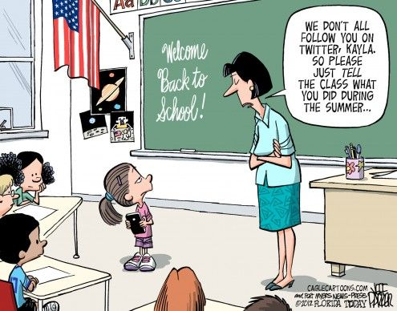
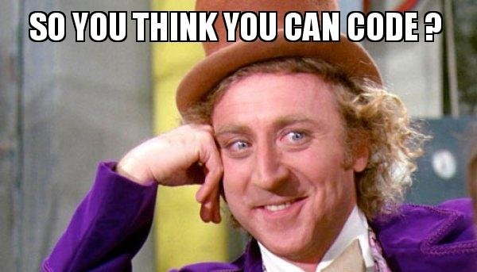
Course Introduction
CSCI2340: (Graduate) Software Engineering
Steven P. Reiss

Slide 2
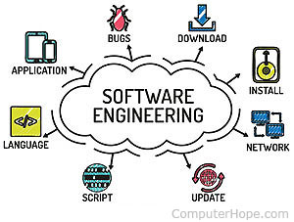
What is Software Engineering
The systematic application of engineering approaches to the development of large software systems.
The application of a systematic, disciplined, computable approach for the development, operation, and maintenance of large software systems.
A process of analyzing user requirements and then designing, building, and testing a software application which will satisfy those requirements.

Slide 3
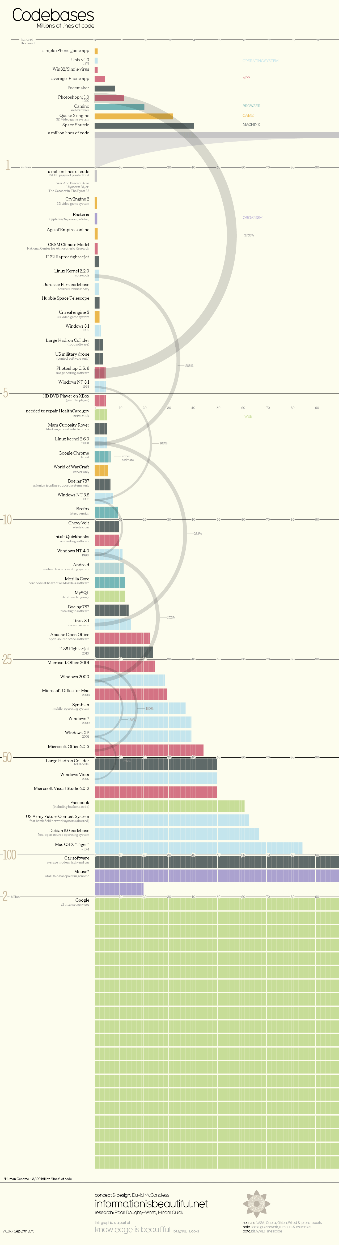
What Has It Accomplished
Size of software systems has increased
  By about a factor of 10 each decade
History
  1970: Box of punch cards (2000), large program: 10,000 LOS
    Compile time in lines per minute (10-1000)
  1980: 5M disk was large, large program: 100,000
  1990: 40M disk was std, large program: 1,000,000
  2000: 10G disk was std, large program: 10,000,000
  2010: 1T disk is std, large program: 50,000,000 (windows)
  2020: 10T disk is std, large program: 2,000,000,000 (google web)
    100,000,000 in a car

Slide 4
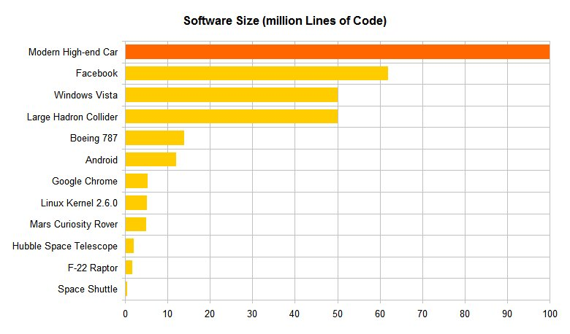
Question: What is YOUR Largest System
1,000 - 2,000 lines (CS15/18)
  You shouldn’t be here
10,000 - 20,000 lines (CS32)
  Probably a bit less, but designed for
200,000 lines (Internship)
2,000,000 lines
Larger
  How much of this did you understand

Slide 5
Software Engineering
Has focused on how to build large software systems
  How to build software at scale
Has developed tools, techniques & frameworks
  For building software at scale
Attempts to address the various problems
  When building software at scale
Let’s get an overview of what all this means

Slide 6
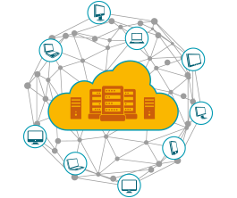
What is a Large Software System
Could be measured in lines of code or source
  But this varies over time, language, etc.
  Still the only meaningful measure
A system that is too complex for one person to understand
A system that takes more than K man-years to build
  K = 10?
  Mythical Man Month

Slide 7
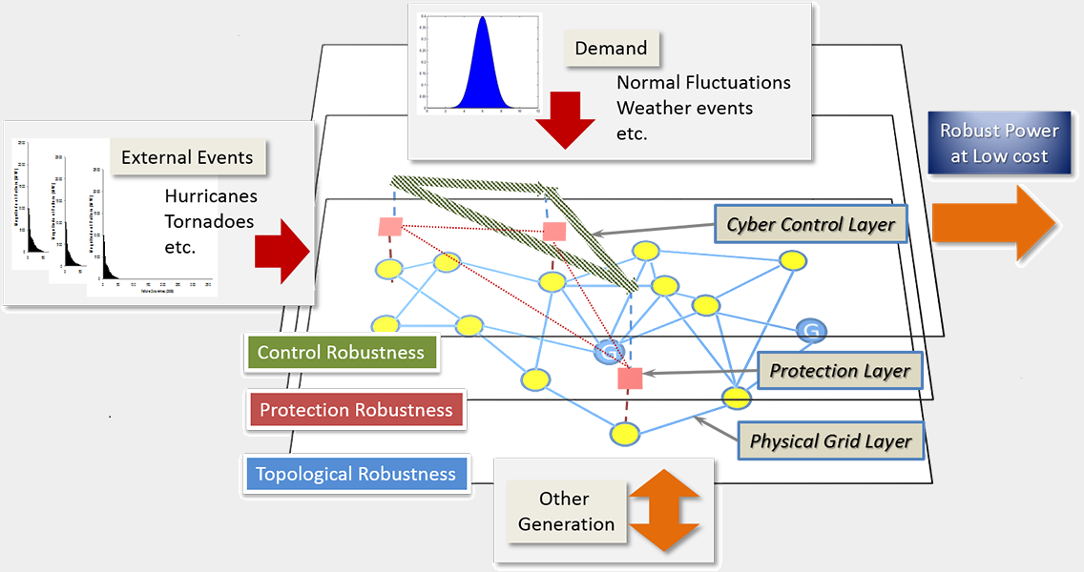
Large Software System Characteristics
Require multiple developers
Long-lived
Evolve, not built all at once
Distributed (client-server, web-based, multiple servers)
Concurrent (multithreaded, multiprocess)
Multiple languages
Prone to failure
  Guaranteed to have bugs
  Often 1000’s
Notes:
So how does software engineering address this.

Slide 8

Software Engineering at Scale
How to build large systems
  Multiple person development
  Long-lived
  Evolve, not build at once
  Distributed
  Concurrent
  Avoiding failure
Notes:
Software engineering address how to build large systems. It tells us how to organize the systems and the people for multiple person development. It tells us how to design a system so it can be maintained and so that it can be built in stages rather than all at once. …

Slide 9
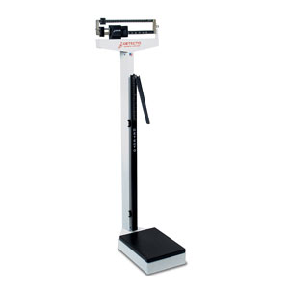
Software Engineering at Scale
Importance of Maintenance
  Multiple person development
  Long-lived
  Evolve, not build at once
  Distributed
  Concurrent
  Avoiding failure
Notes:
Software engineering stresses the importance of maintenance and provides ways for doing so.

Slide 10
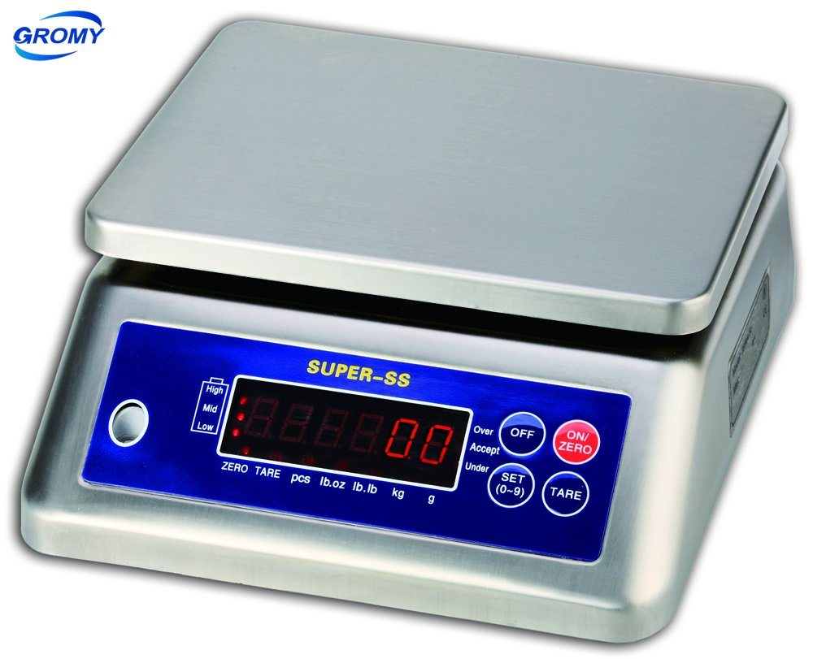
Software Engineering at Scale
Importance of Managing Risk
  Multiple person development
  Long-lived
  Evolve, not build at once
  Distributed
  Concurrent
  Avoiding failure
Notes:
It also stresses the importance of managing risk and provides ways for doing so.

Slide 11
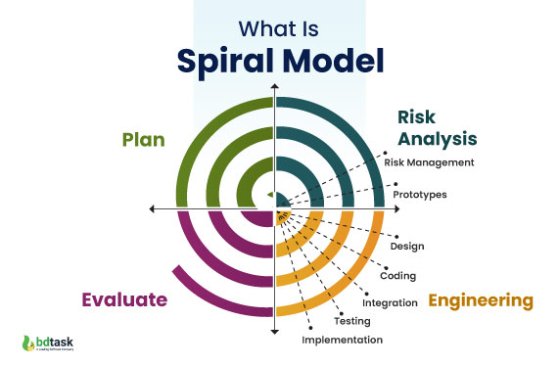
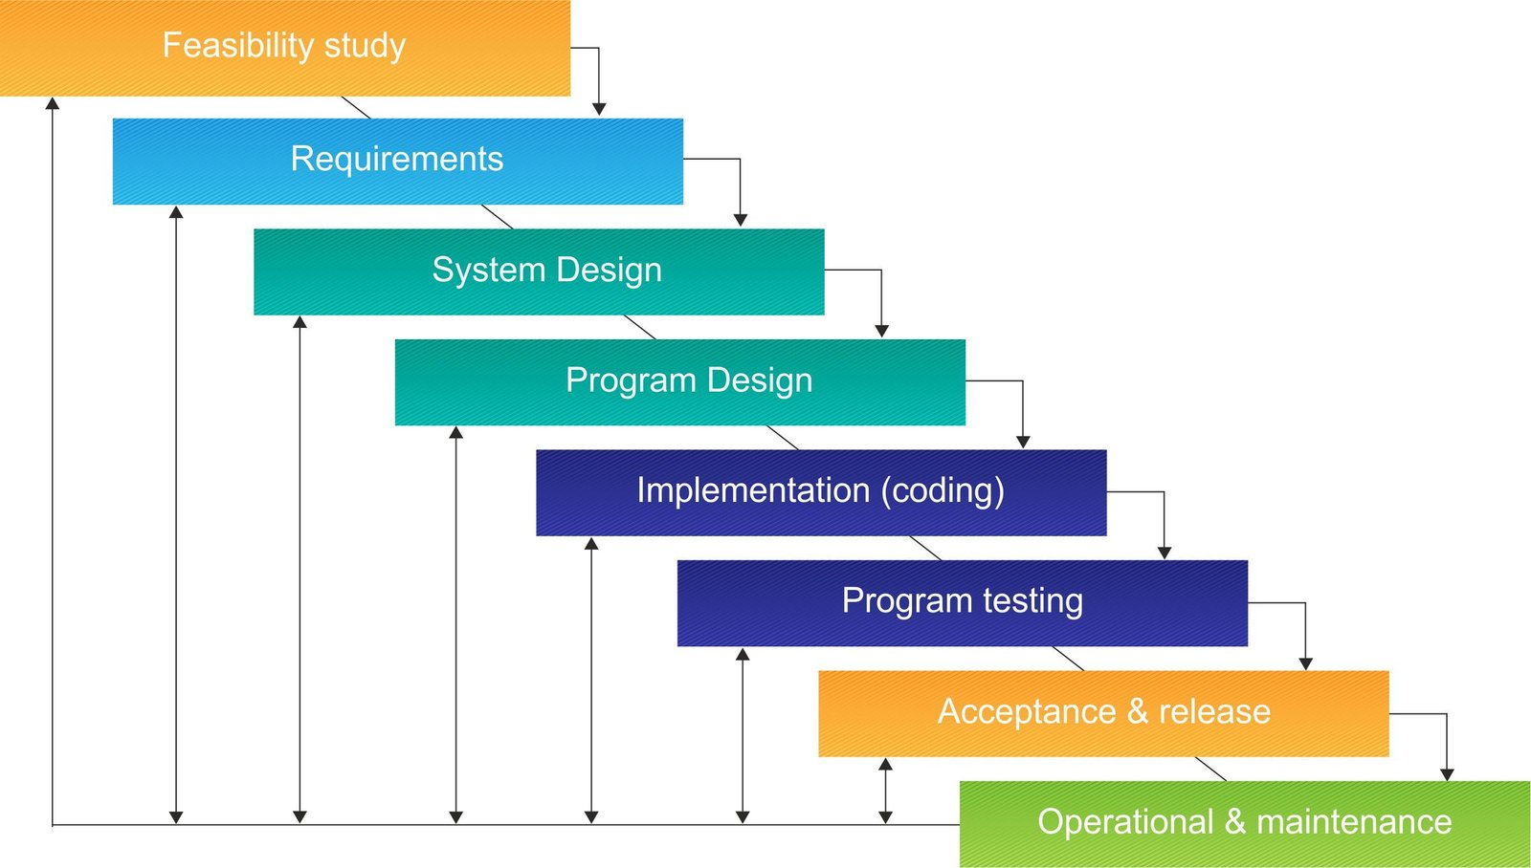
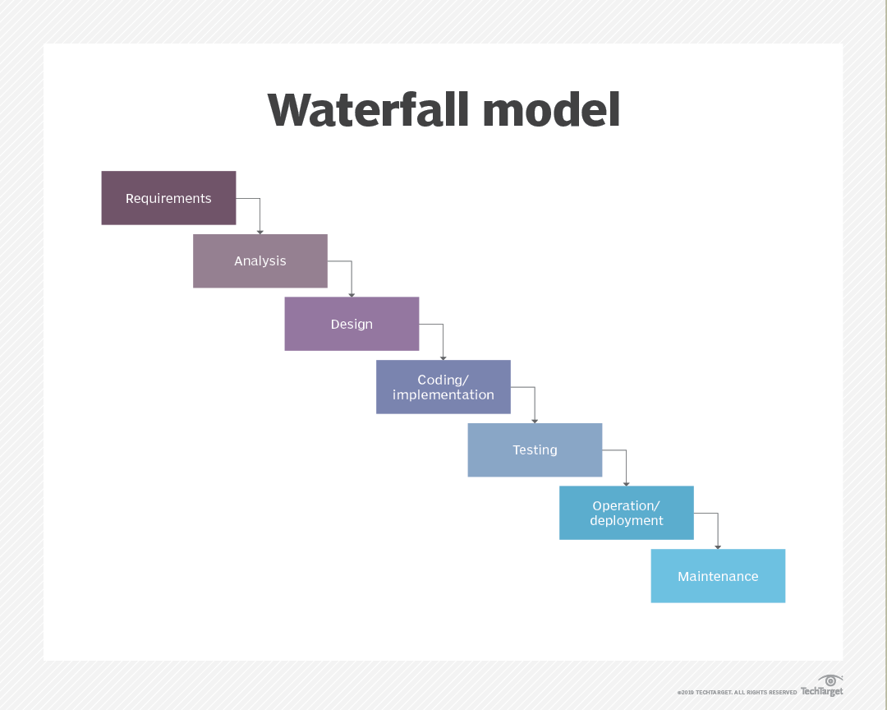
Traditional Software Engineering
Notes:
Introduction to the various phases
This worked for relatively small large systems (40 years ago), not today’s.
Modified waterfall models.

Slide 12
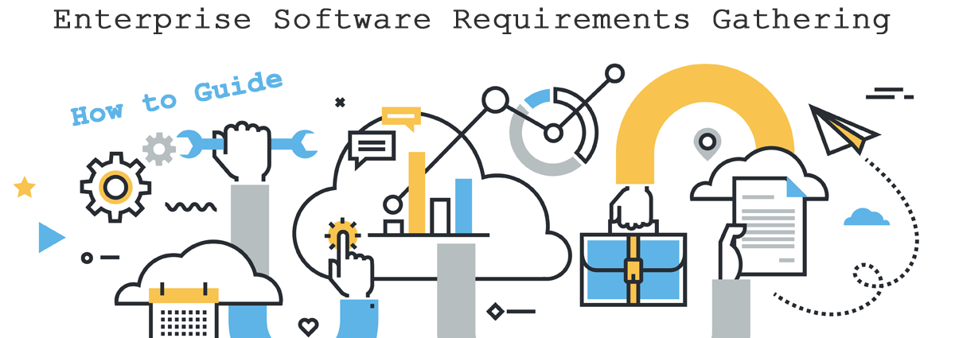
Software Engineering at Scale: Requirements
Determine what the user needs
Define the problem to be solved
Done over time
Evolving
More user-oriented
Notes:
Today, we still have these phases, but we don’t have the waterfall model, or even a modified waterfall model. These are things we will talk about in this course.

Slide 13
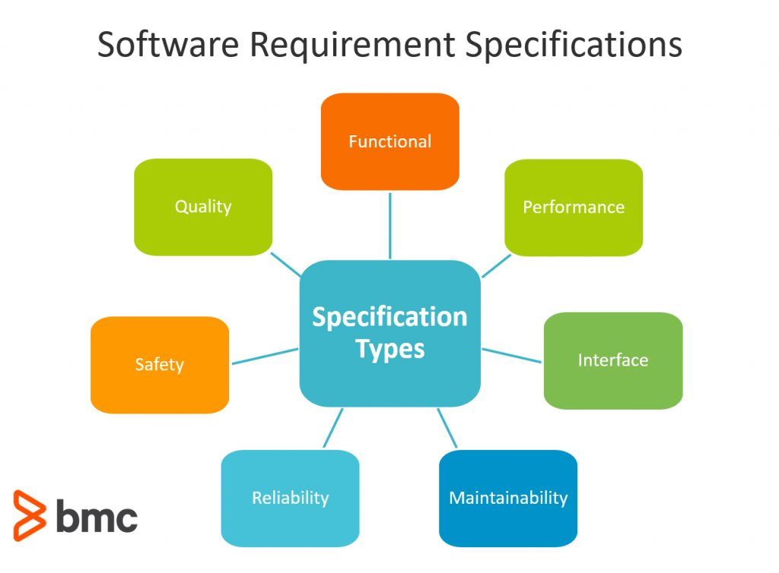
Software Engineering at Scale: Specifications
Determine what should be built
Feature-based specification
Risk-based specification
Minimal Viable Product concept
Include more than just functionality
  Safety, performance, reliability
  Quality, maintainability
  Documentation

Slide 14

Software Engineering at Scale: Design
Design what will be built
Software Architectures
High-level design using interfaces
Object-oriented design
Risk-based design
Team-based design
Design for maintenance
User interface design
Distributed/concurrent system design

Slide 15

Software Engineering at Scale: Coding
Coding for risk
Coding for maintenance
Coding for teams
Coding user interfaces
Coding for security
Coding for privacy

Slide 16
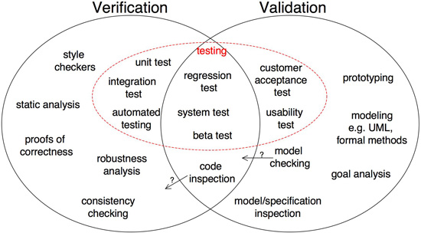
Software Engineering at Scale:
Verification and Validation
Debugging
Testing Strategies
Static Analysis
Contracts
Type Safety
Model Checking

Slide 17
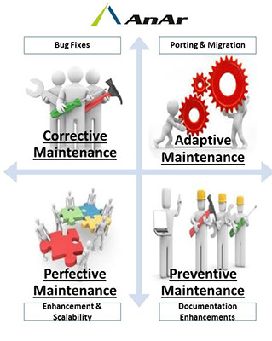
Software Engineering at Scale: Maintenance
Keeping the system running
  As hardware and languages evolve
  Minimizing down time
Fixing problems (bugs)
Adding features (evolution)
Making the system more robust
Making the system more secure
Making the system …

Slide 18
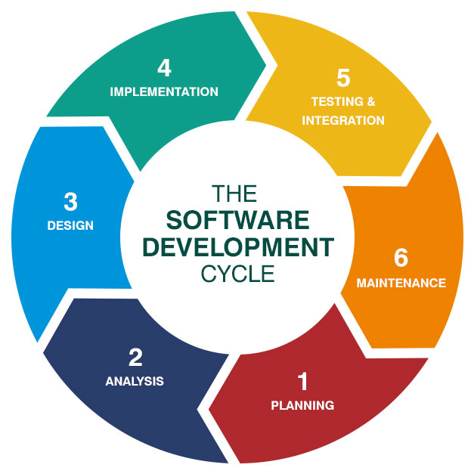
All Software Development is Maintenance
Systems are too big to write all at once
  Requirements will have changed by the time it is done
  Systems evolve rather than being created
Too much demand for change
  Competing products, upgraded OS, platforms
User’s expectations are high
  Expect software to be perfect
  Expect software to evolve
  Expect a better user interface
  Expect new features and UIs continually

Slide 19
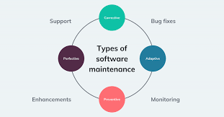
All Software Development is Maintenance
Many software projects start with existing code
  Convert that code to a new purpose
  Extend that code for new functionality
  Rewrite the code so it remains usable
Most software is developed from an existing base
  Templates or skeletons for various purposes
  Based on prior systems
  As extensions of existing systems
Most software makes extensive use of libraries & frameworks
  Don’t write something that has been written before
  In-house, open-source, purchased
  And existing systems

Slide 20
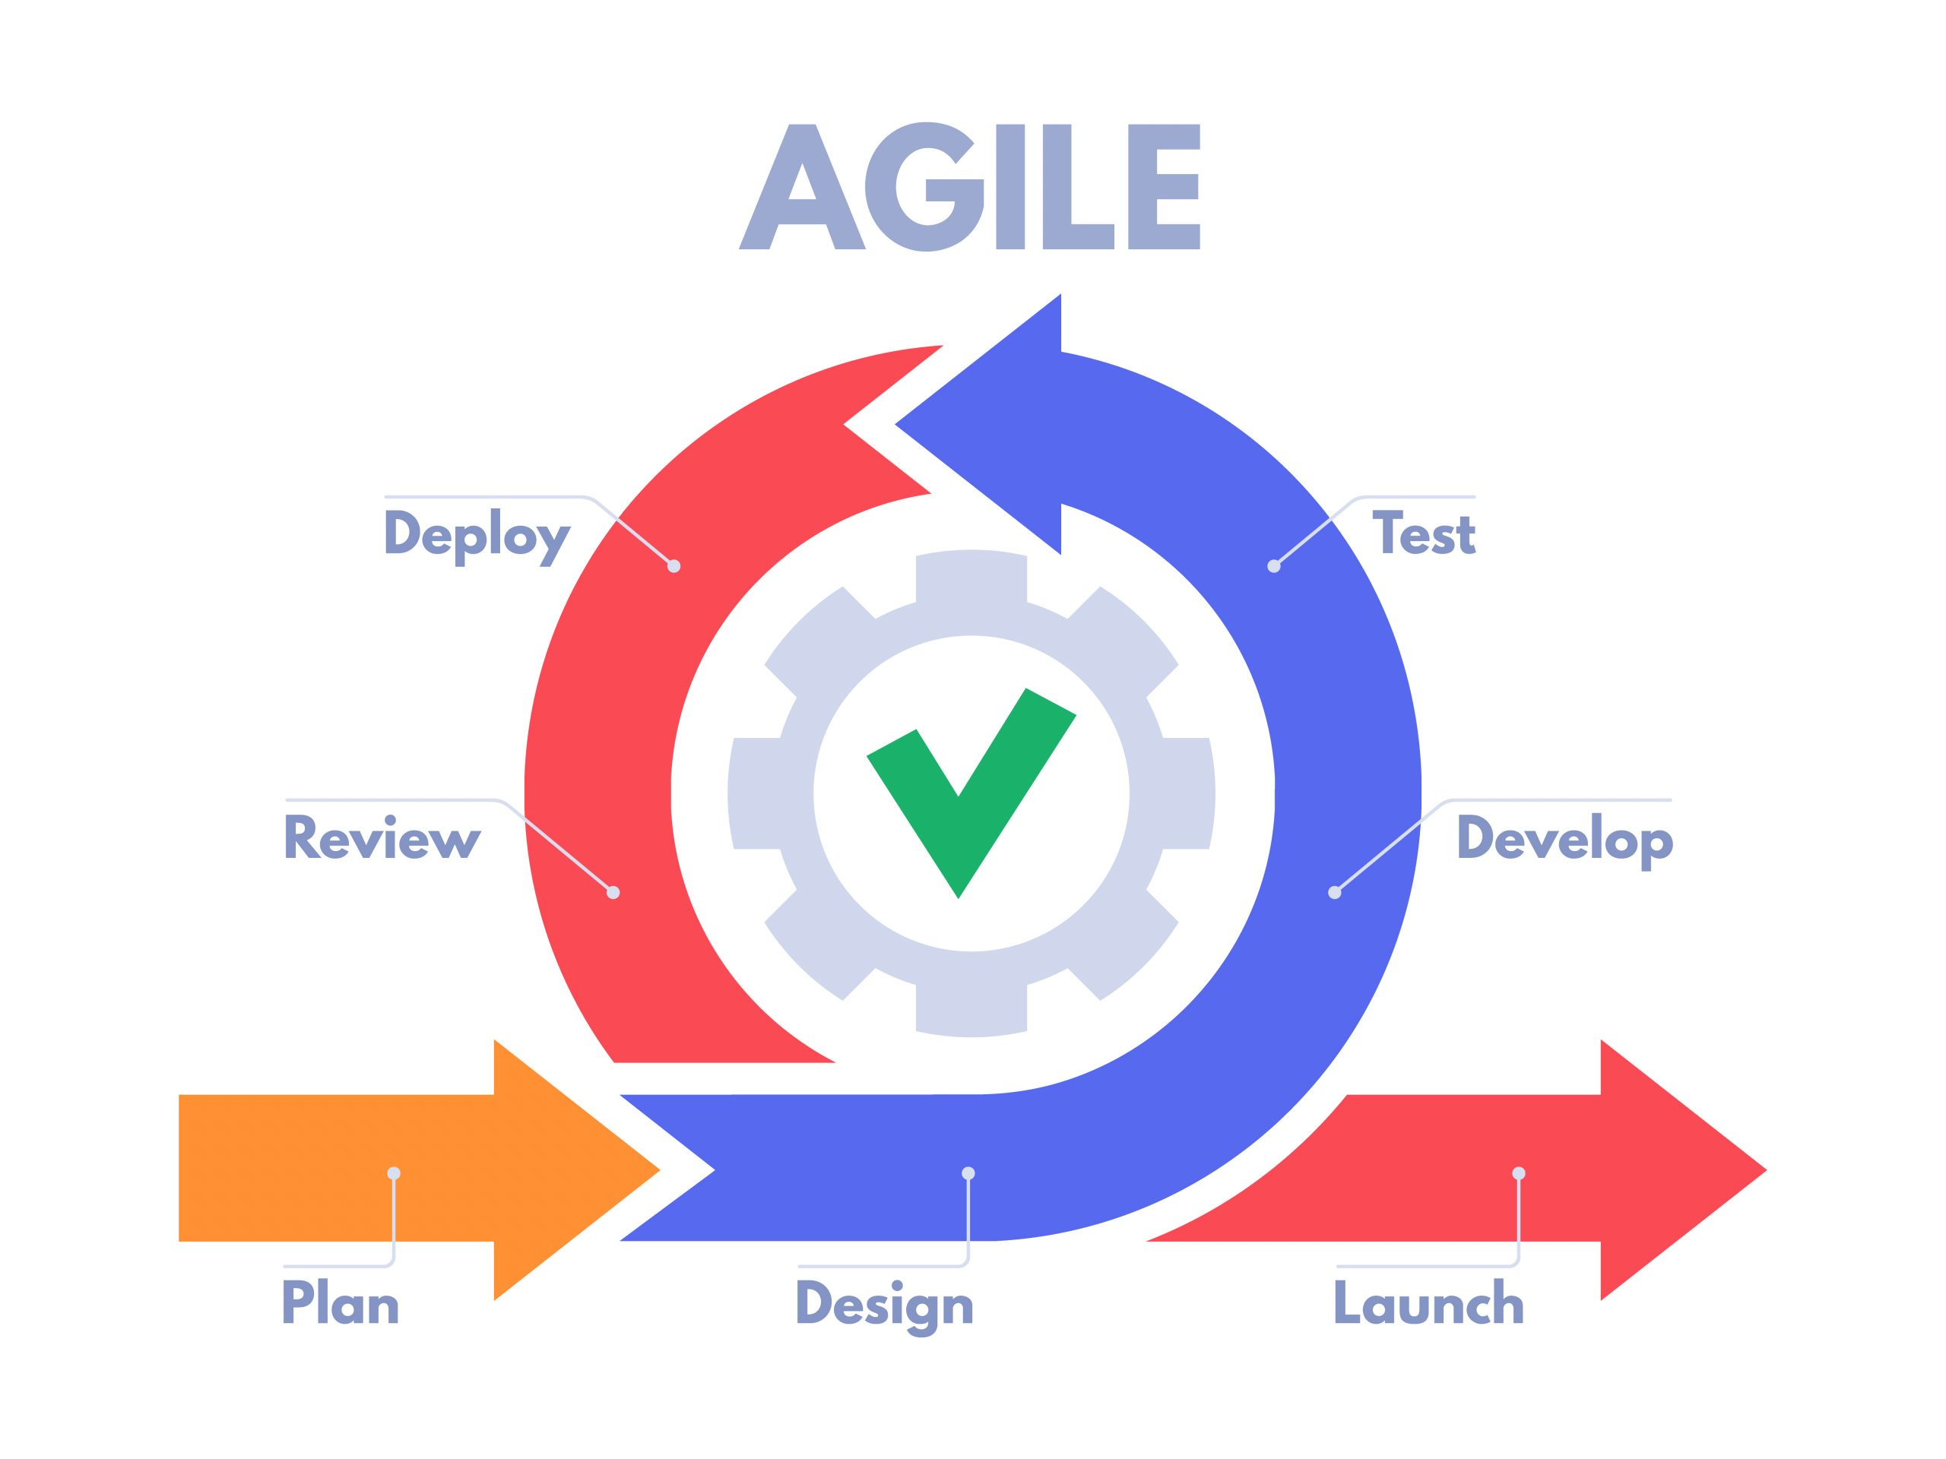
Agile Development
Realize that most development is maintenance
  Develop a software process to take this into account
Goal is to provide an early working system
  To get feedback from users to direct future development
  To test the system to ensure it is robust
  To provide satisfaction to the developers
  And then extend that early system into a complete system
Attempted to completely redo software development
  But more evolutionary then revolutionary

Slide 21
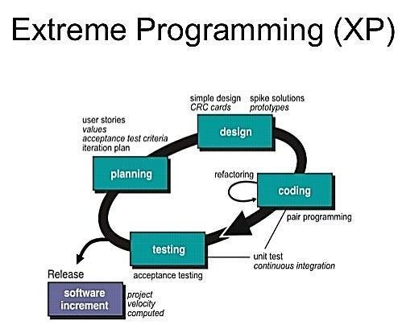
Extreme Programming
Agile development derived from Extreme Programming (XP)
  Develop in short bursts
  Test-first development
  Do specifications and requirements in terms of stories
  Pair programming
  Refactor the system as needed to add new features
Lots of “new” ideas
  That can be viewed separately

Slide 22
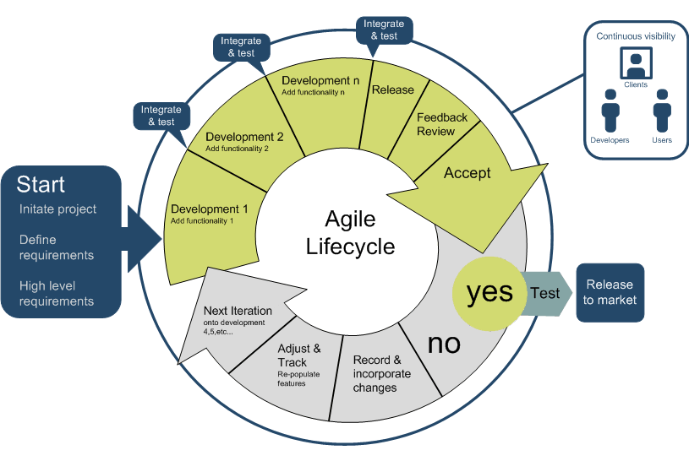
Agile Development Methodology
Work in terms of sprints
  Each sprint in 1-2 week of work
  Each sprint adds features to the code
Meet frequently to discuss progress
  Weekly meeting after a sprint
  SCRUM extension => daily meetings
  Continuous integration
Each sprint is its own cycle
  Requirements, specifications, design, coding, testing

Slide 23
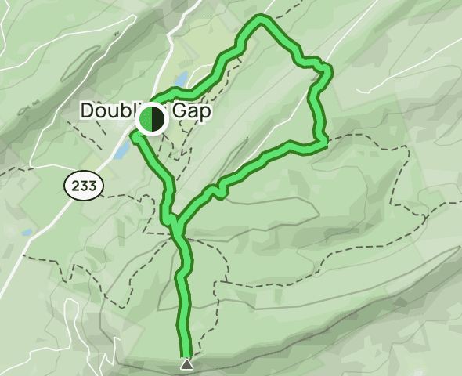
Lollipop (Balloon) Model of Development
Agile development has its advantages
  BUT it can require frequent refactoring of the overall system
  AND it assumes the software is done at some point
We prefer a hybrid or compromise model
  Do complete requirements and specifications
  Decide on a software architecture
  Do a high-level design for that architecture
  Then do agile development
  But assume that development never stops
We call this the lollipop or balloon model

Slide 24
Lollipop Development Model
Coding
Requirements
Specifications
High-Level Design
Design
Testing
Feature Analysis

Slide 25

Software Tools
Tools have been created to assist the developer
  To support underlying techniques that work
  This is a large part of what software engineering has done
Tools have been developed for all phases and needs
  With different degrees of success
Wide and expanding variety of tools out there
  Each developer/company has their favorites
  We will cover a subset

Slide 26

Course Overview
This course will cover much of software engineering
  How to build large systems
  Techniques that have been developed
It will cover the various phases
It will teach you how to create large systems
  By example and by doing
It will give you experience with software tools
  And working in teams
It will provide a foundation for research in the field

Slide 27
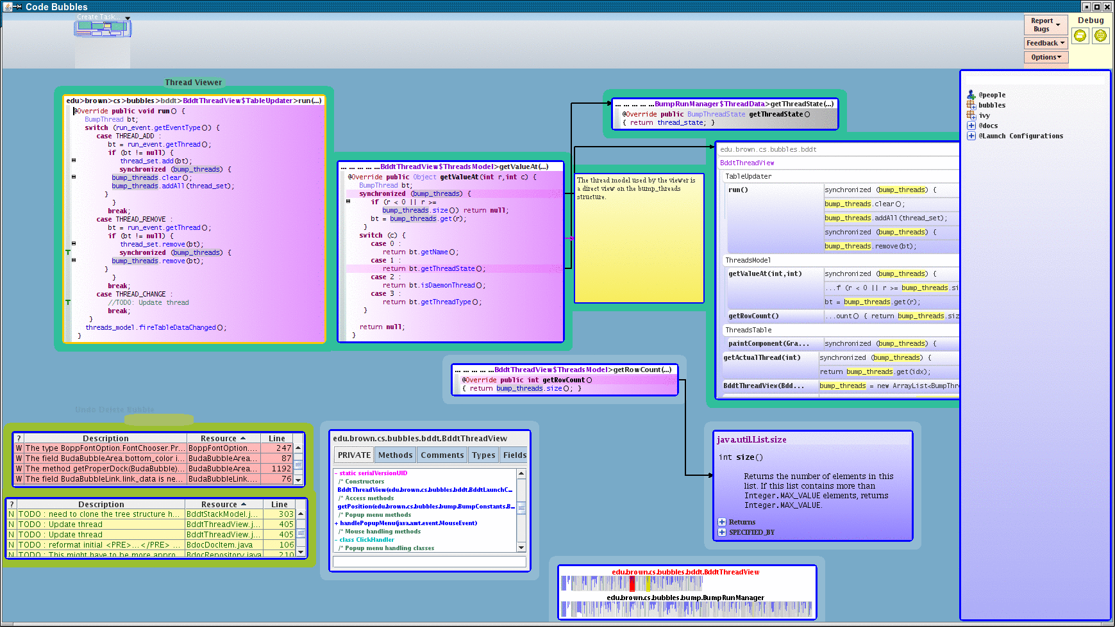
Tools We Will Use
IDE: Code Bubbles, VS Code, Eclipse, IntelliJ, …
Teamwork: ZOOM, GIT, SLACK, GITHUB
Team Organization: GITHUB
Design: UML editor
Coding: ant, maven, Gradle
Testing: Junit
Bug databases: GITHUB
Deployment: Docker
Visualization and understanding
Notes:
Subject to change

Slide 28
QUESTION: Why are you taking this course?
To learn how to build large software systems
To become a better programmer
To become acquainted with modern software techniques
To prepare to do research in software engineering
Because it sounds like fun?

Slide 29

Course Mechanics
Web site kept up to date
  More or less
  Canvas for turning in assignments
    But little else
Programming assignment
  Handed in and possibly graded
  Evolving: done multiple times (requirements will change)
  Should be coded as if it were a large, long-lived system
  Should be coded to evolve as the course progresses
  Will tolerate some lateness
Class participation
  Group activities, feedback, questions
  Will tolerate some absences
Team project

Slide 30
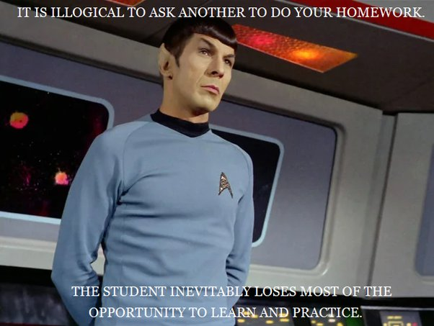
Collaboration
This course is highly collaborative
  Project teams work together
  Programming is better when done collaboratively
  You don’t have to invent everything from scratch
  But you should still do your own work
All collaboration must be identified and cited
  Outside sources, libraries, AI, web pages
  Collaborators
  Citations should be part of the code
Missing citations are a violation of academic integrity

Slide 31
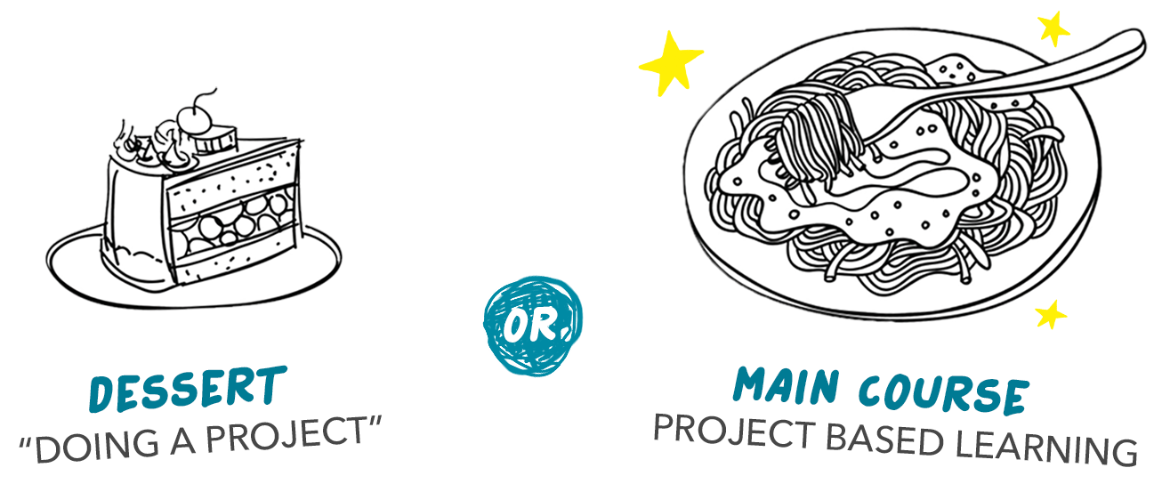
Course Project
List of potential projects on the web site
  Google doc for commenting, expressing interest, asking questions
    Feel free to add comments, questions, express interest, …
  Projects have different emphases
    Development, testing, feasibility, augmenting existing systems, …
  Software-engineering research oriented
Soliciting new ideas through the weekend
  Google form for submitting on the web site
    What software would benefit society
    What software would you or your research lab like to have
    What software could be used to start a company
    What software do you want to modify or adapt
  Earlier is better (will probably require a back and forth)
    And I’m not around 24/7 on weekends
Form for project preferences
  Available Monday, due Tuesday

Slide 32

Course Project
Project team selection next week
  I will choose project teams based on preferences
    Probably won’t satisfy everyone, but I will do my best
  Each team responsible for project from start to finish
  Initial team meeting in class next Thursday
  Target team size 6-10
Weekly deadlines for project
  Include hand-ins, presentations, demo videos
  Or just where the project should be
Weekly meetings of project teams
  I’ll try to attend occasionally if during the day
Should be coded as if it were a large, long-lived system
  Grading based on code quality and extensibility

Slide 33


Research in Software Engineering
Software engineering is an evolving field
  Much has been done
  Much remains to be done
This course will offer starting points for potential research
  New research directions
  What is currently going on in the field
  What I’ve been doing over the past 10 years
Projects can be research oriented if you want
  Most of the suggested projects have a research feel
  But other projects are still welcome

Slide 34
Do You Belong Here?
If I asked you to write a system on your own that could:
  Simulate 100,000 objects interacting via gravity
  With an XML file giving the initial configuration
  Use a complex data structure (Oct-Trees) [NlogN vs N²]
  Handling collisions; using a separate package to do 3D output
  Using multiple threads
Would it be easy for you?
  Oh, give me a week or two
Would you feel confident that you could do it in time?
  You can identify the classes needed and define a high-level design quickly
  Have everything working in 3-4 weeks
Would you feel overwhelmed?

Slide 35

Alternative Problem (for Web developers)
I have a large collection geolocated tweets from USA
  Each with zip code, district, state, author, tweet, time, …
Create an application to let users query & visualize these
  Query by keyword, time range, …
  Sample the results
  Refine the queries to get better results
  View the data on a map over time
  Download CSV result for further analysis
Would this be in your current skill set?
  Front end and back end
  How long would it take you?

Slide 36
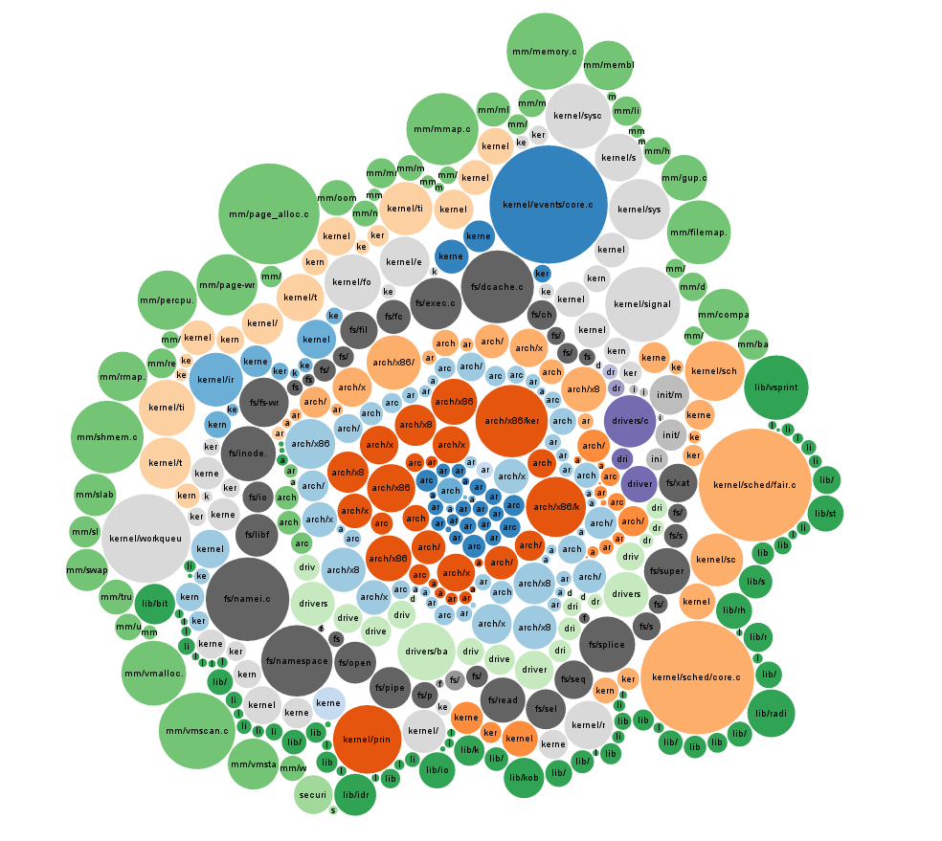
Why Do We Consider These Problems
We will cover high-level design
We will cover detailed design only briefly
  Selecting classes, methods, fields, …
  How to code methods
  Class design (OO patterns, …)
  We assume you know this (32/134)
If writing the detailed stuff is difficult
  You should learn this first (take 32/134)
We don’t want to drag down the project teams

Slide 37
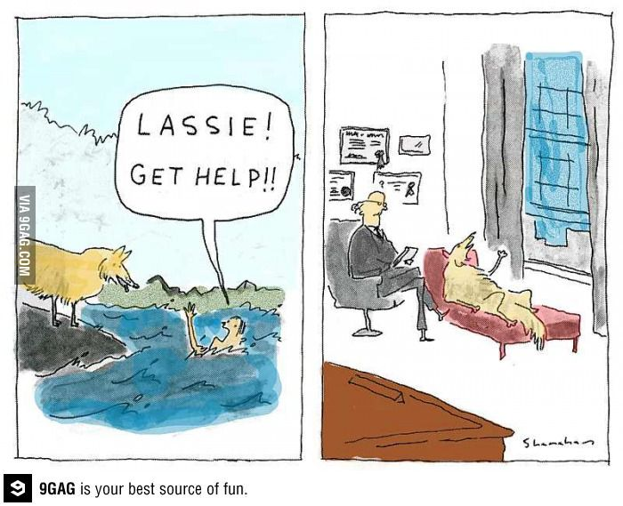
Getting Help
Office Hours
  Monday 1-3
    ZOOM: 781-445-5513
    Exceptions should be noted in calendar
  Thursday 11-12:30
    CIT 403
  Open-office (8-3 via Zoom or in my office)
    Probably tell from my status (sign or web page)
Note there are no TAs for this course
  Use your project teams for project help
  There will be minimal grading (this is a graduate course)

Slide 38

Questions on the Course

Slide 39

Exercise: Project discussion
Project Discussion
  Questions
    What types of projects are you interested in
    What would you like to get out of the project
    What do you see as your role in the project
  Let's go round the room and get feedback
Notes:
Put link in chat window. If time, have people try it.

Slide 40
Homework
Download and install Code Bubbles
  Need to install Eclipse first if not already there
Run Code Bubbles on a project
  Existing Eclipse workspace
  Existing Java project
  New code (hello world, nim)
Relate experiences in a canvas hand-in
Due 9/12 (one week)

Slide 41

Recap
Project ideas due by the end of the day Saturday
  Will be vetted, might ask follow-up questions
  Projects should be approved by Sunday
  Review project discussion document
Project preference forms out on Monday
  Due by the 5:00 pm on Tuesday
Further Reading
  Sommerville's Software Engineering
    Look at Chapter one.
  Textbook chapters 1 and 2

