Slide 1
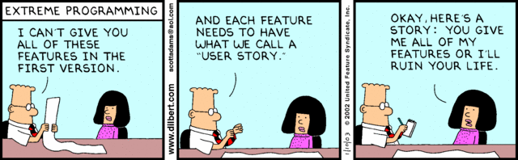
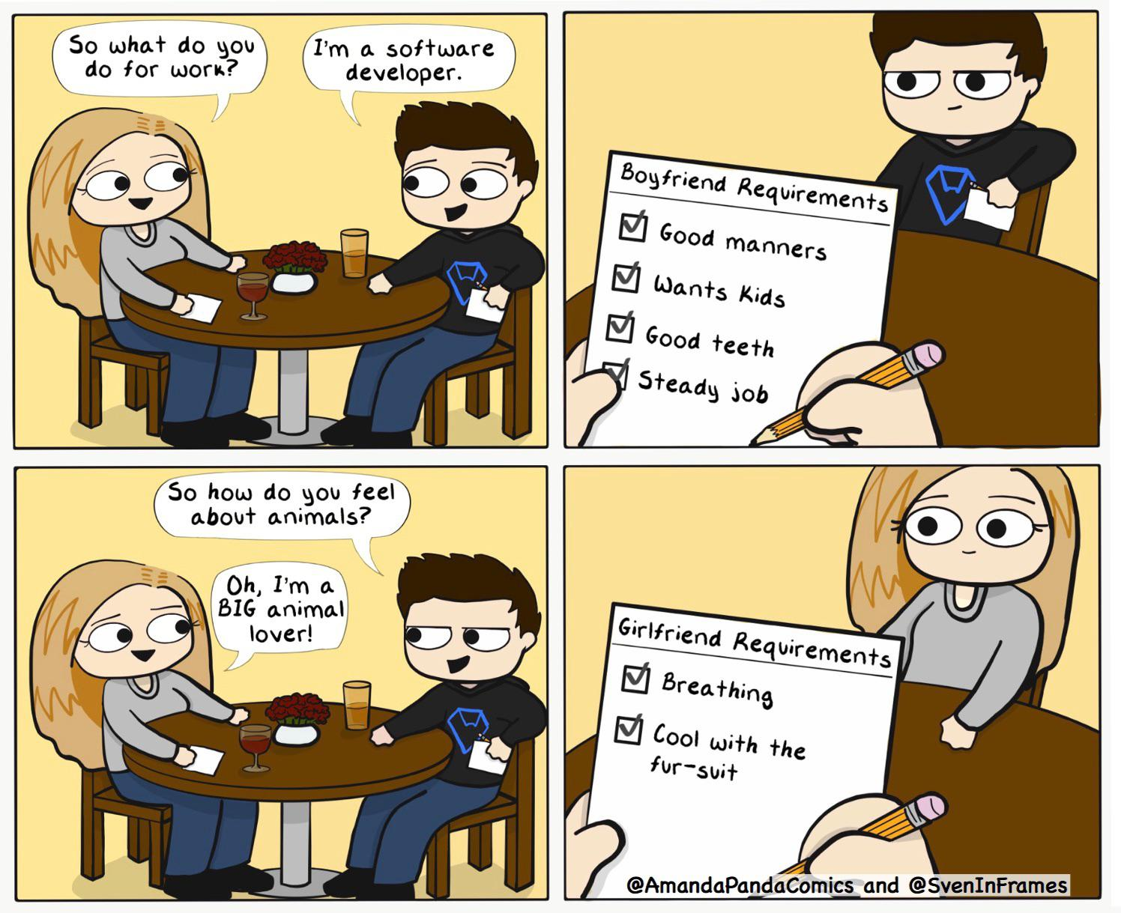
Requirements
CSCI2340: (Graduate) Software Engineering
Steven P. Reiss
ANY QUESTIONS???
Notes:
\

Slide 2
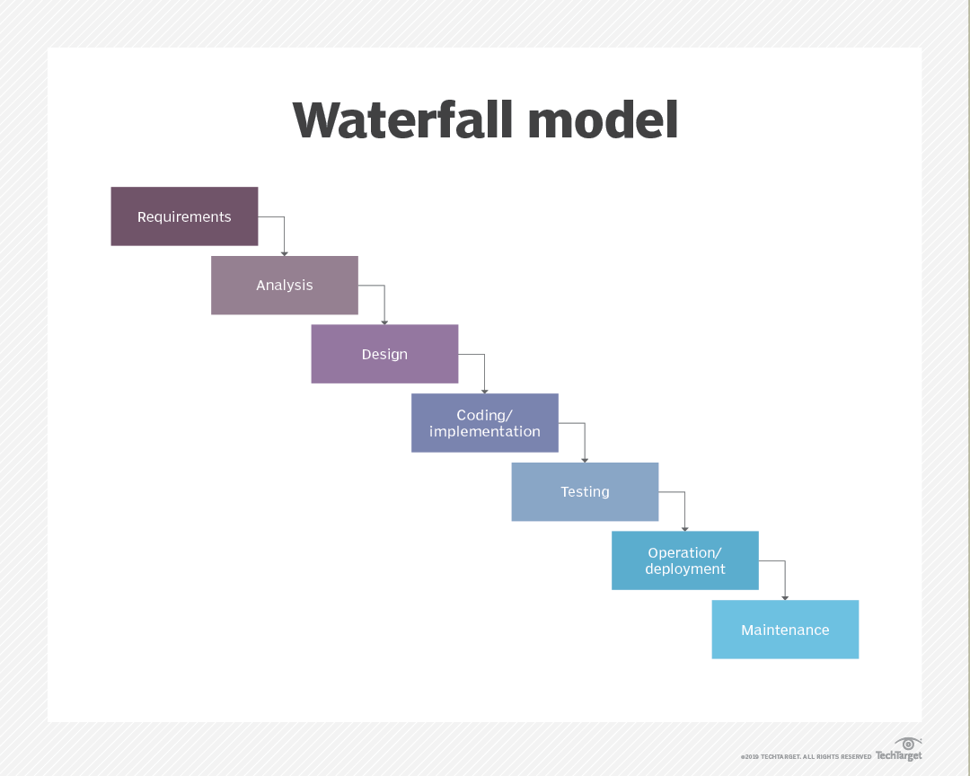
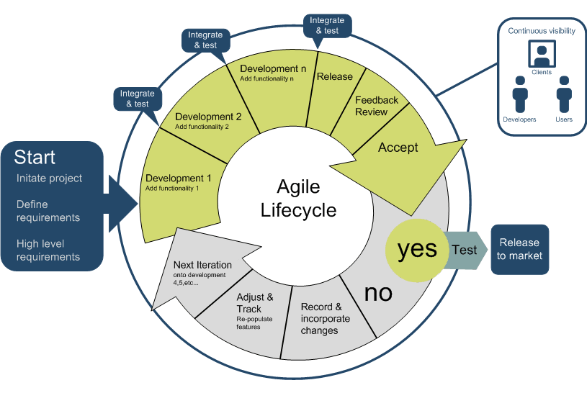
Requirements and the Life-Cycle

Slide 3
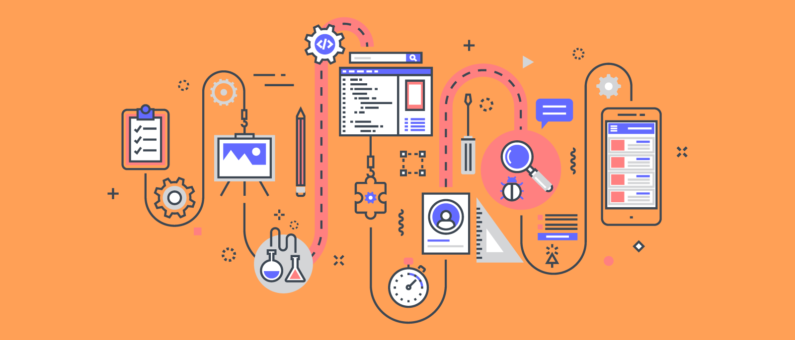
What Are Requirements
The process of establishing the needs of stakeholders to be solved by the software
Requirements are a definition of the PROBLEM
  What users (stakeholders) want and need
  Not a definition of the system
  Or a definition of what will be built
  Or a definition of how the system is built
  Or a definition of what technologies to use
  These come later

Slide 4
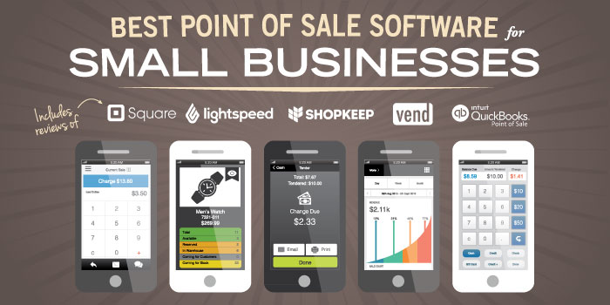
Stakeholders
Anyone who will care about the eventual product
  Those who will be using the system
  Managers
  Those paying for the software
  Those interacting with users
Consider a point-of-sale application
  Users: check out personal
  Others: customers, managers, company management

Slide 5
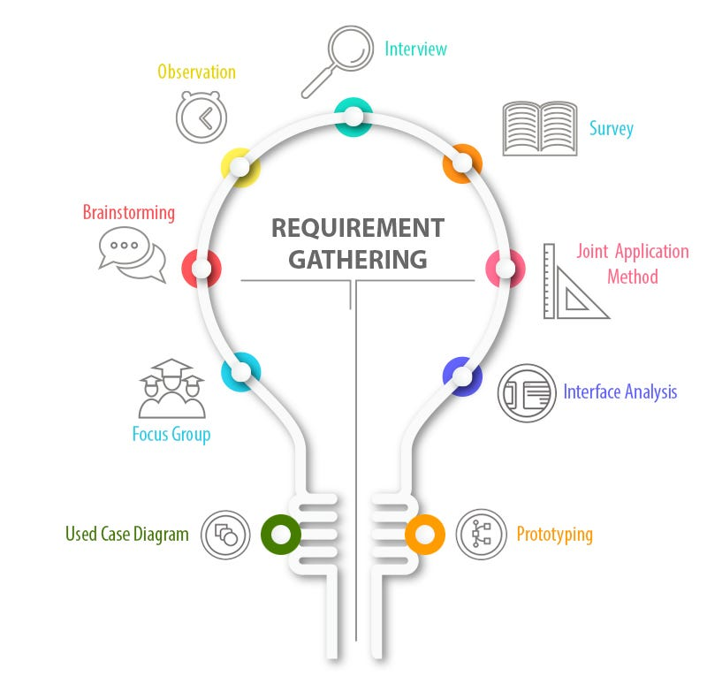
What are Requirements
Requirements define the system from the user’s perspective
  Specify the problem
  Specify what is needed in the solution
  Do not define the implementation
Requirements constrain the system
  Constrain specification & design & code
Requirements provide motivation
  For specifications and design decisions
Requirements require users

Slide 6
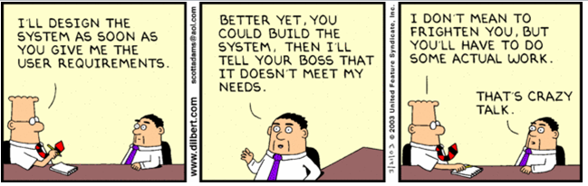
Importance of Requirements
Many software projects fail
  FAFSA; healthcare.gov; …
Poor requirements cause over half of these failures
  13% fail due to incomplete requirements
  12% fail due to lack of user involvement
  10% fail due to unrealistic expectations
  9% fail due to changing requirements
  7% fail because the system is no longer needed
Notes:
heathcare.gov; fasfa

Slide 7
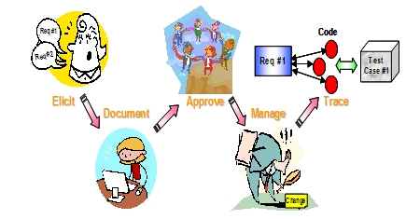
Requirements in the Practice
Initial Requirements
  Imagine a complete system that would to everything needed
  Include all the bells and whistles
  Include all far-reaching goals and ideas
  Set priorities
Practical Requirements
  Then narrow this down to a practical initial product
  With the important features emphasized
Keep initial overall requirements in mind
  Throughout specification, design, coding, maintenance

Slide 8
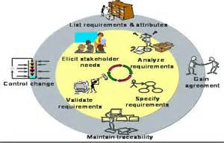
Requirements Process
Requirements Analysis is an on-going process
  You need a good first approximation
  Think of it as a dialog with the stakeholders
  Understand what they want
  Their understanding what you can do
Things are going to change
  People change their minds
  Markets change
  New opportunities arise
Notes:
Getting the first approximation is our first task

Slide 9
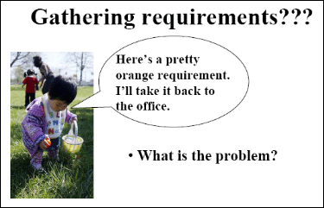
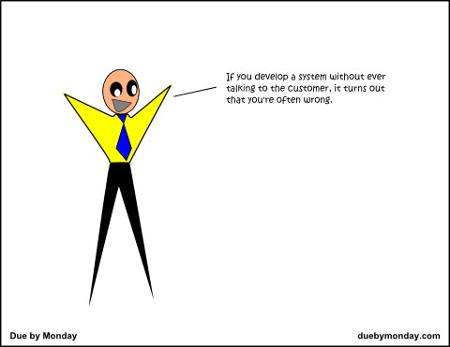
Requirements are Difficult to Obtain
Talking to users is problematic
  Communications difficulties
    Cultural differences, different vocabularies
  Can’t anticipate all questions or issues
  You won’t understand the user’s needs and desires
  Your biases will get in the way
  Designing & building the system creates opportunities
  Users are fickle (don’t know what they really want)
Users don’t understand what is possible/difficult
Users are NECESSARY
  Without them you will build the wrong system
Notes:
What is a contract for vocabulary
What is a transaction?
Monkey game and food

Slide 10
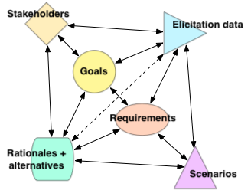
Requirements Goals
Define the problem from the user’s point of view
Assess the need for a solution
Determine the outlines of the ideal solution
Determine what is required and what is optional
Determine what is feasible (resource limitations)
Determine acceptance criteria
DO NOT WORRY ABOUT IMPLEMENTATION

Slide 11

Twitter Data Access
A data science course wants to have easy access to relevant data. We have a collecting geolocated tweets for a while. Suppose a student in the course wants to analyze how and when the flu becomes prevalent. They should be able to look for tweets containing ’flu’ (or similar) over some time period and then view the number of occurrences by state during that time. We want a web app that would let students query, view, and process that data.

Slide 12
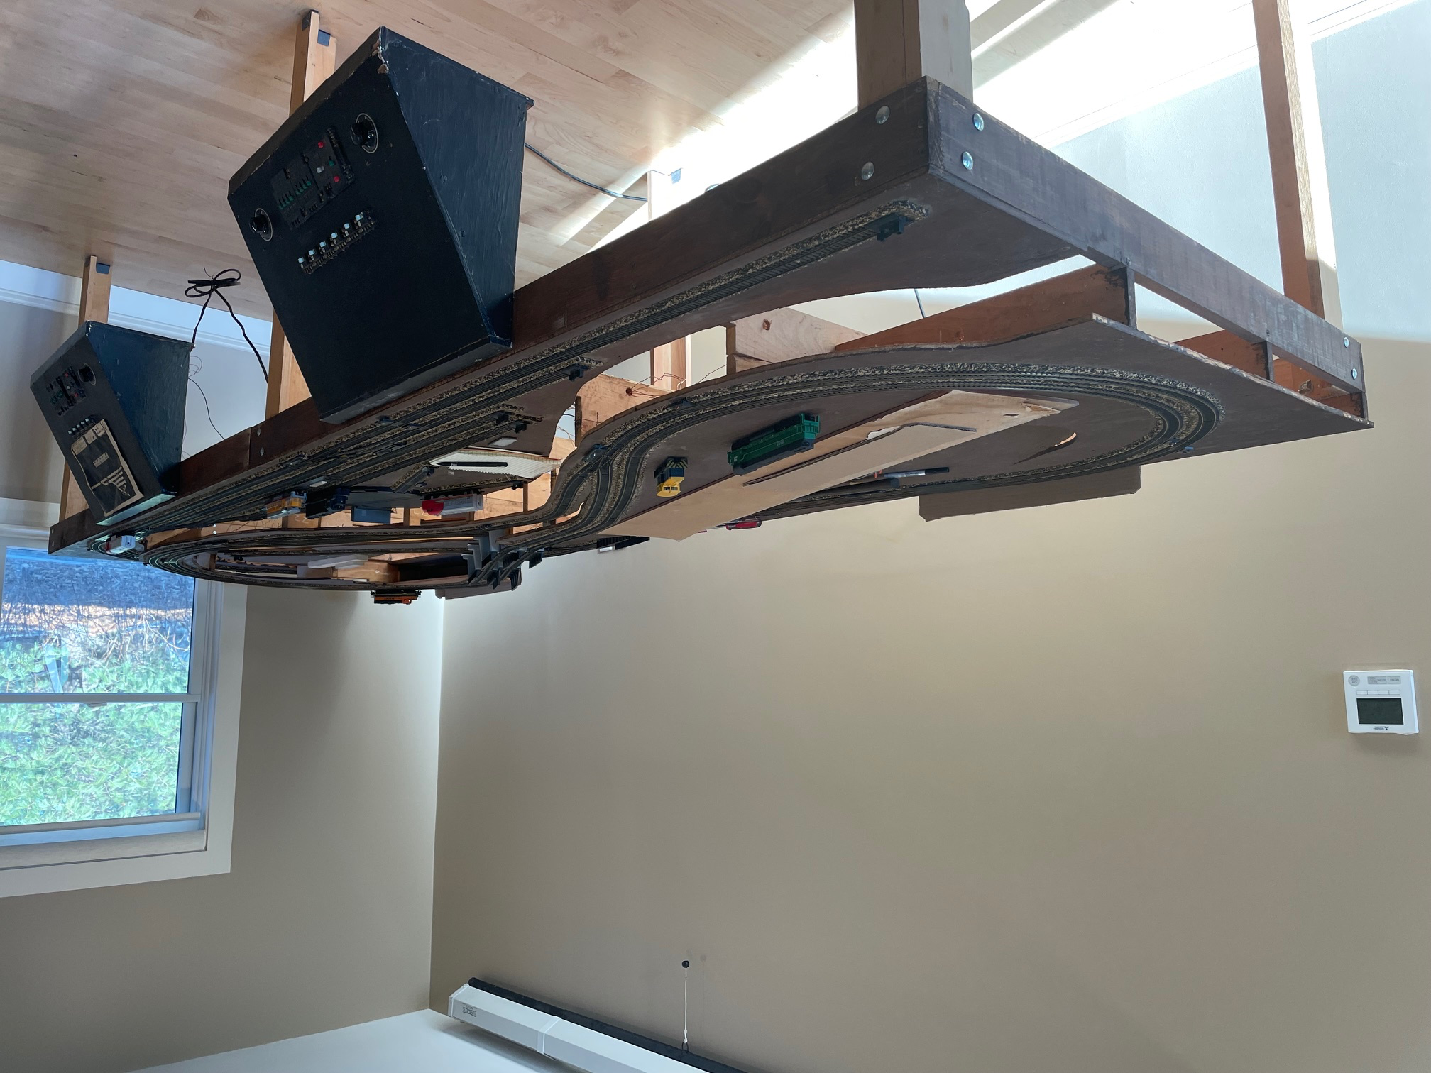
SHORE
I have a HO railroad set up that I put together 25-30 years ago. I want to control this setup from my computer. Moreover, I want to have a high-level control so I can say things like "Take train A out of the yard, go around the outer loop 3 times, then around the inner loop twice, then reverse directions and go around the outer loop twice more before bringing the train back into the yard." At the same time, I want to ensure that the trains do not crash or derail.

Slide 13
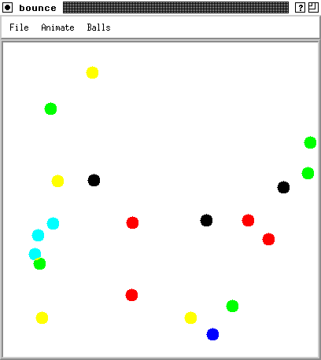
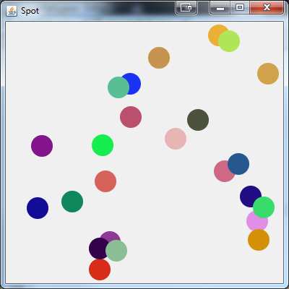
Programming Assignment
I like to be amused while I am waiting for my programs to compile or to run. What I would like you to write is a program that displays a set of balls that bounce around in a window in an entertaining way that the user can control.

Slide 14
In-Class EXERCISE
Task
  I like to be amused while I am waiting for my programs to compile or to run. What I would like you to write is a program that displays a set of balls that bounce around in a window in an entertaining way that the user can control.
Develop requirements for this
  This is a concept, not requirements
  Questions you might want to consider:
    What do “ball”, “bounce”, “entertaining”, “control” mean
    What type of interaction is appropriate
    What might happen in the future
    What might you want it to look like
We will split into groups (rows?)
  Introduce yourselves
  Decide who will be ”users” and who will be “developers”
  Develop at least 5 basic requirements
  You will have ~5 minutes

Slide 15
Exercise Summary
What requirements did you produce?

Slide 16
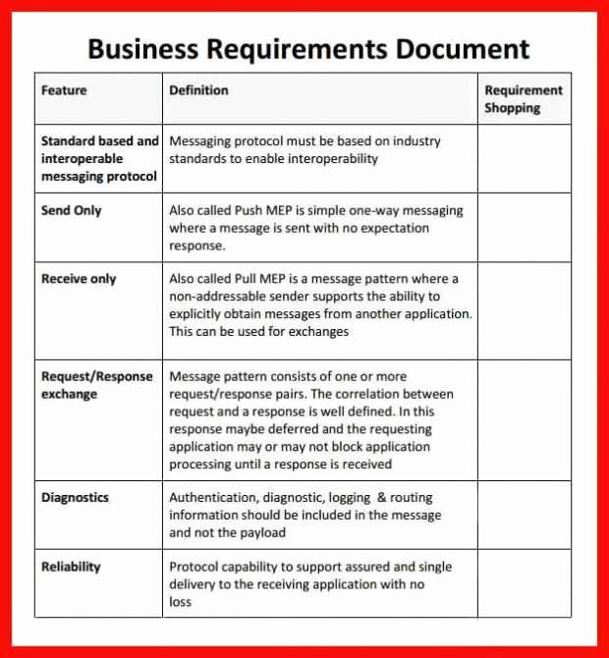
Representing Requirements
Typically done using Formalized Natural Language
  Organized as an outline (hierarchical, numbered)
  With detailed descriptions of what is needed
  With cross-referencing as appropriate
Good for following requirements through development
  Requirements traceability
    Why is this feature or code or specification or design here
    What is the importance of this feature
  How do requirements relate to one another
Good for formal definition of what is needed
  Government contracts
Difficult for the user
  Can be repetitive, hard to understand
  Hard to get the overall sense of the proposed application
  Difficult to ensure completeness, correctness, consistency

Slide 17
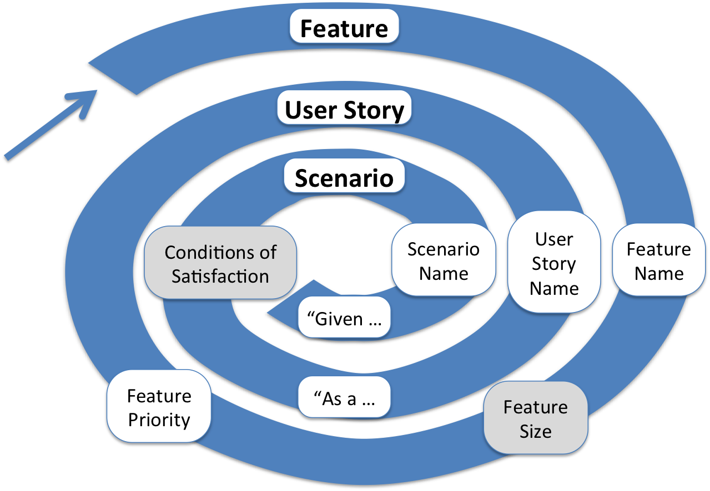
Agile Requirements
Agile Requirements are done as use cases
  Stories or scenarios
  Descriptions of common ways the system will be used
  A story describing a common use of the system
    From start to end
  In addition to some standard requirements
Agile Requirements are done incrementally
  Basis for sprints, features

Slide 18
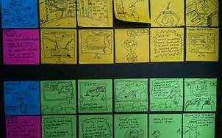
Use Cases / Stories / Scenarios
Detailed description of task
  Use actual names
  Be specific
  Include motivation
  Be complete
It is a story
  Think of a novel
  Write it as such

Slide 19
User Story
Professor Reiss needs to compile Code Bubbles. This takes 2-3 minutes. This is too short a time to get work done and too long to do nothing. While he compiles, he wants to move the mouse into a distraction window that shows a set of balls moving around in an interesting manner. To be interesting the balls can eat each other (and grow) and exhibit gravity. He can control the balls to achieve a particular goal, say ending with only the blue ball alive or achieving a stable solution with 2 balls orbiting each other. The program starts when he moves the mouse in and suspends when the mouse is out. The goal should be achieved before the compilation is finished.

Slide 20


Stories and Scenarios
Form a basis for getting user feedback
  Give you a sense of what the user wants to do
  Give the user a sense of what your app can/will do
  Give the user a context for providing input
  Give the user a chance to change the story
    What happens if …
Let the developer give the user feedback
  What is too complex
  What is vague or not well understood
Are a basis for specifications
  Defining what the system will do

Slide 21
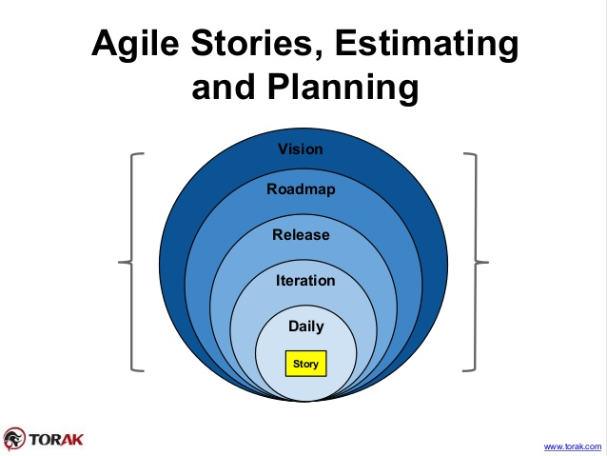
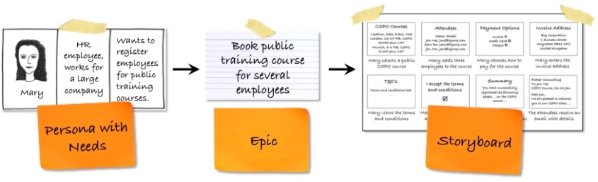
Stories and Scenarios
Create a set of stories
Cover the principal uses
Cover a diverse set of tasks
  With a diverse set of users
Should give you a sense of
  What you will need to do
  How the application will be used
  What problem is being solved

Slide 22
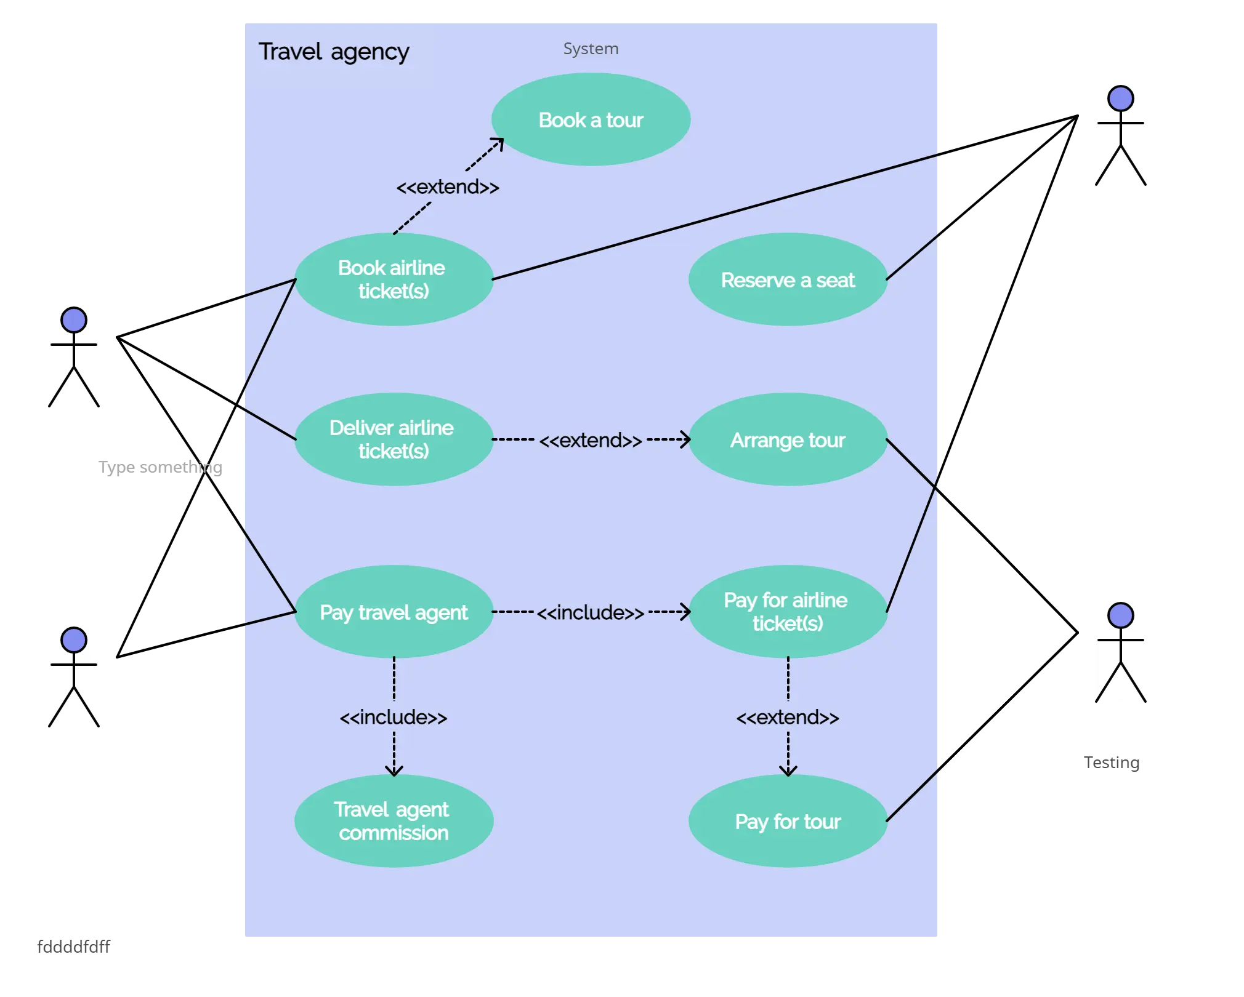
Representing Use Cases
Can use plain English
  Possibly with pictures
UML notation
  Use-Case Diagrams
  Actors (people or other systems)
  Use cases (functionality)
  Communication links
    Direct, directed or 2-way
    Include/exclude other use cases
  System boundaries

Slide 23
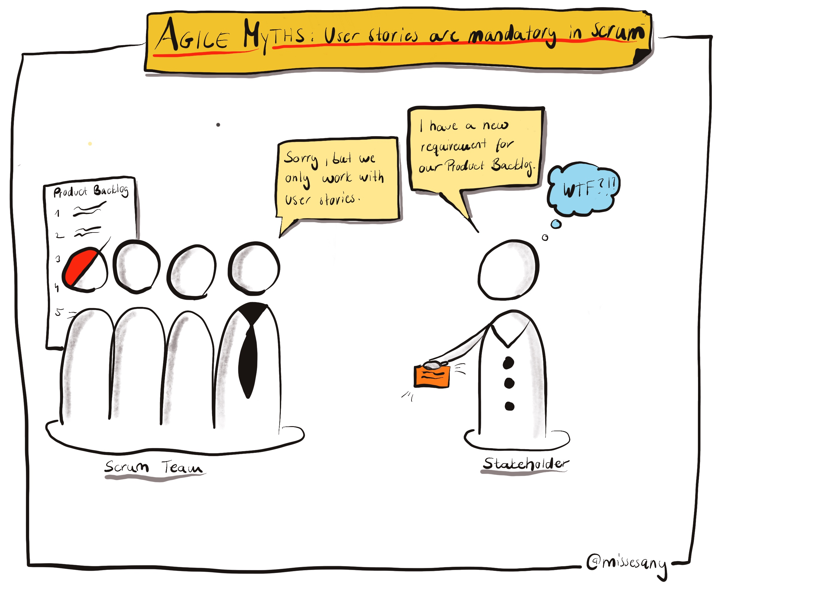
Agile Requirements
Are easier for the user
  Just tell a story
Are more difficult for the developer
  Harder to achieve requirements traceability
  Not organized in a meaningful manner
  Don’t really constrain design or implementation
Are easily made inconsistent
  Different stories can easily point in opposite directions
Use a combination of outline requirements & stories

Slide 24
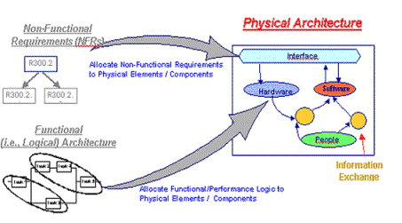
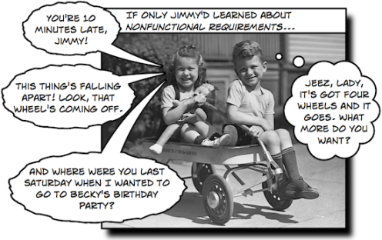
Non-Functional Requirements
Security constraints
Privacy constraints
Anticipated average and maximum loads
  What should happen if these are exceeded
Universal Access: Internationalization and accessibility
Legal issues (money, privacy, children, health, accessibility …)
Reliability (up time, data safety)
Performance
Time and cost limits
Fairness

Slide 25
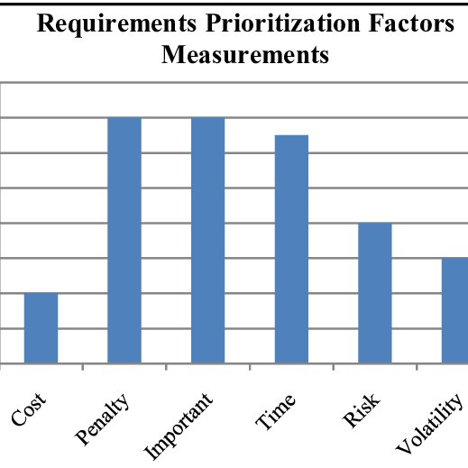
Prioritizing Requirements
Required vs Optional vs Long-Term
Minimal viable product
  MVP
  What is required to have something that can be used
  Basis for future development
  Useful to demonstrate utility of the system
  Often the basis for start-up development
Minimal core system
  What is essential to experiment with requirements
  What needs to be done before anything else

Slide 26
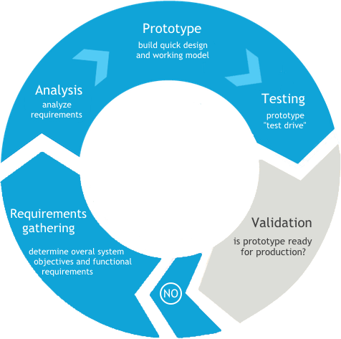
Prototyping
You might need something concrete to understand
  What will work, what can work, what will users want, …
  Stories give some sense of this, but more might be needed
You might want to create a prototype
  Dummy version of the system
  Can be paper rather than code
  Just enough to give a sense of possibilities
Prototypes should be throw-away
  If you’re not willing to throw it away, don’t prototype
  Create a minimal system instead

Slide 27
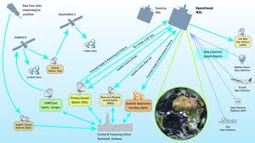
Getting USER (Stakeholder) Information
Talking to users
  Interviews
  Focus Groups
  Questionnaires (Qualtrics, Gforms)
  Facebook, Mechanical Turk
Observing users
Look at competing products

Slide 28
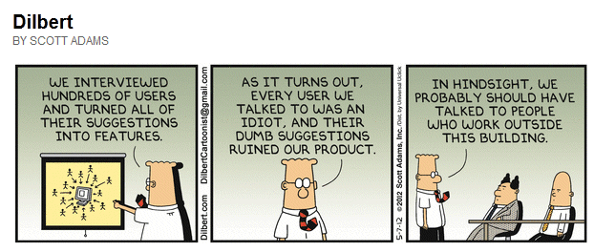
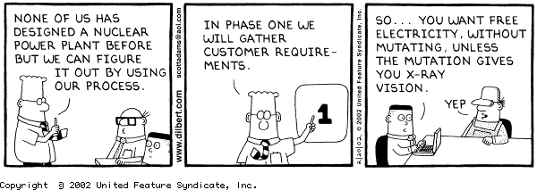
Talking to Users
Understanding what they want
  And why they think they want it
Understanding what is important to them
  Features, performance, …
Vocabulary
  Don’t be afraid to ask questions
Who is in charge

Slide 29
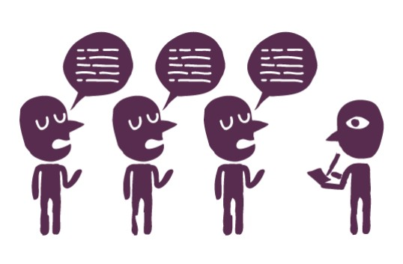
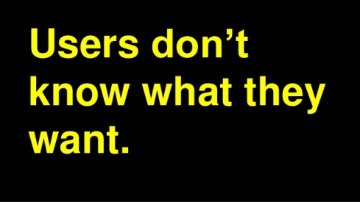
Interviewing Potential Users
Structured versus unstructured interviews
Interviews require considerable preparation
  DO YOUR HOMEWORK
  Determine what information is needed
  Find out about the interviewees
  Decide on questions and organization
  Otherwise, it will be a waste of time
  Experiment beforehand
Process
  Move from general to specific to general (open) questions
  Summarize the interview
    In terms of stories, use-cases, scenarios
      Examples of the use of the system
    To feed back to the client
  Follow up
Notes:
Can skip this slide

Slide 30
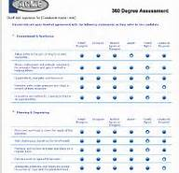

Questionnaires and Surveys
Who is your target audience (stakeholders)
  Particular users or the general public
  Others that may be affected by the system
  Avoiding bias in audience selection
Needs a lot of thought
  What information is needed
  Phrasing questions so as not to bias the outcomes
  Determining how to interpret the results
  Experiment beforehand
Likert scales
  Range of 1-7 (or 1-5) where … rate X
  Provides a means of compiling results
End with open questions (won’t be answered by everyone)

Slide 31
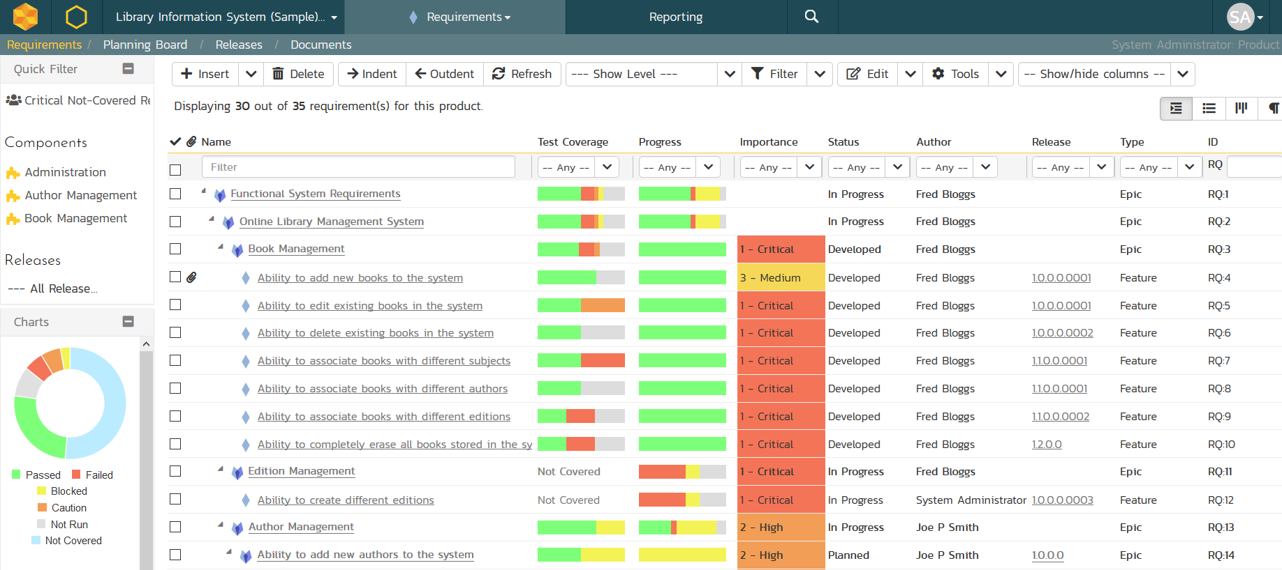
Requirements Tools
Provide a means for organizing requirements
  Geared toward standard requirements
  Easy to add, change, etc. requirements
  Ensure requirements are always available
JAMA, IBM Doors, CaseComplete

Slide 32

Requirements Research
Using AI (NLP) techniques
  For obtaining natural-language requirements
  For analyzing natural-language requirements
Other means of eliciting requirements
  App-store based techniques
Defining fairness
Cross-domain requirements linking
Analyzing privacy policy of third-party libraries

Slide 33
PROJECT
Project teams will be assigned tomorrow
  You will be notified via e-mail
  Next class we will have an initial team meeting
  Form for providing project preferences
Current Popular Projects
  DJ Mix, LLAMA, Speech
  UI Generation, IoT, Accessibility, Agentic

Slide 34
PROJECT Homework
Once projects are assigned
  Create a shared requirements document for your project
  Start adding requirements for your project
  Start thinking of who to interview or poll or work with
    Identify and start talking to potential users
  Add (individually) to the requirements document
For next class’s project meeting
  Think about your role in the project
  Think about how you want the project to go

Slide 35
Homework (from last time)
Download and install Code Bubbles
  Need to install Eclipse first if not already there
Run Code Bubbles on a project
  Existing Eclipse workspace
  Existing Java project
  New code (hello world)
Relate experiences (pro and con) in a canvas hand-in
Due 9/12 (Thursday)

Slide 36
Homework (Requirements)
Develop requirements for the programming assignment
  For what you want to build, not in general
  Use input from our earlier exercise if desired
  Hand in via canvas. Due 9/12 (Thursday)
  We will use this in the next class
Requirements Quality Assistant Game
  https://www.ibm.com/internet-of-things/learn/RQA-interactive/#/

Slide 37
Further Reading
Text Book: Chapter 3
(Optional) View the IBM Doors preview video
  https://www.ibm.com/products/ibm-engineering-requirements-management-doors-next
(Optional) View the CaseComplete preview video
  https://casecomplete.com/learn
  Look at the follow-ups (CaseComplete 101)

