Slide 1
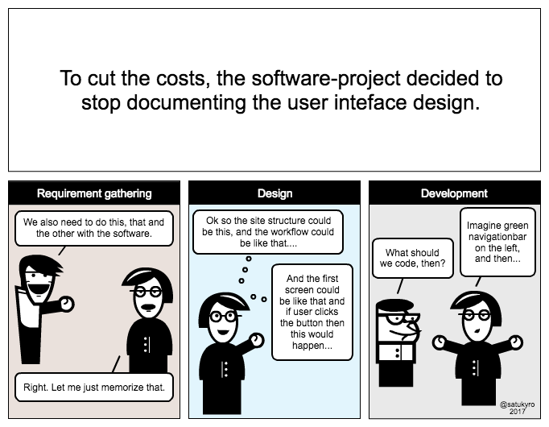
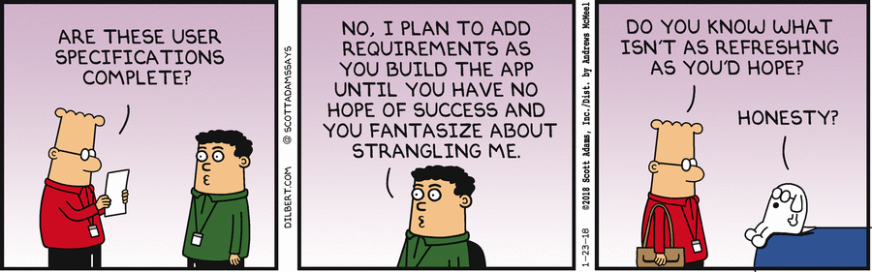
Specifications
CSCI2340: (Graduate) Software Engineering
Steven P. Reiss
Thanks for your flexibility
I will entertain project change requests
If you drop the course and have a project, please tell me.
If you weren’t assigned a project, please tell me.
ANY QUESTIONS???

Slide 2
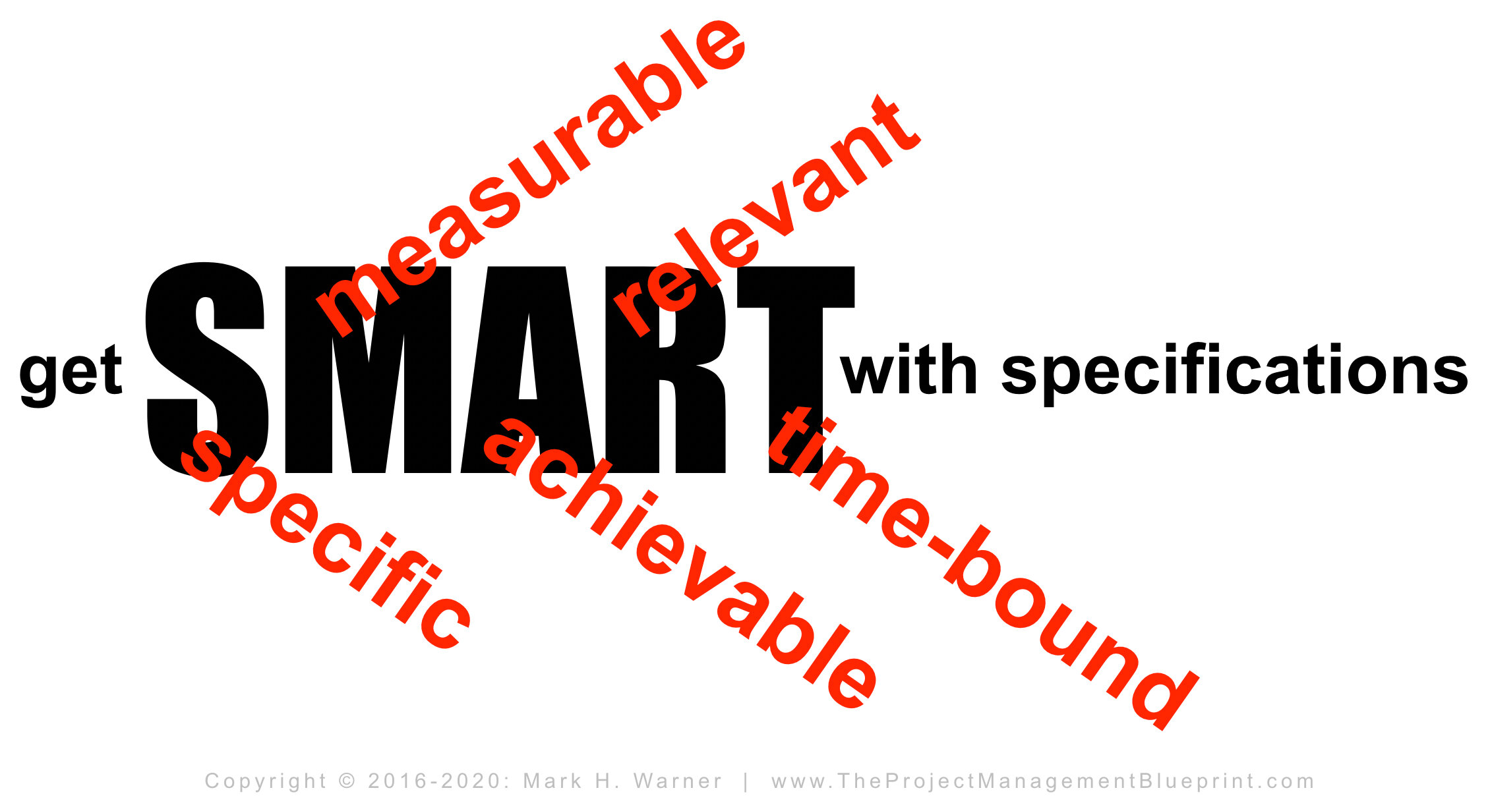
Goals for Specifications
Outline the solution
  Requirements define the problem
  Specifications define the solution
    What needs to be done to solve the problem
Provide a basis for better requirements
Provide a basis for designing the system
  You must know what you are building to build it
Provide a basis for understanding what the costs
  Team size, work & cost estimation, time estimation, …
Provide a basis for understanding if the solution works
  Will it meet the users’ needs
  Will it solve the problem for the users
Provide a basis for prioritization

Slide 3
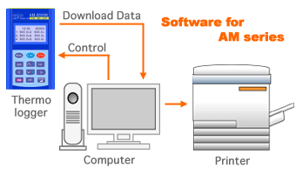
Specifications
Detail what the application will do
  From the programmer’s point of view
  Concentrate on commands, inputs, outputs
    What commands are needed
  Not how the commands are implemented
Define the data the application will use
  What information is needed
  What information is used
  Where does this information come from
  Where does this information go
  How the user interacts with the system
  How the system interacts with other systems

Slide 4
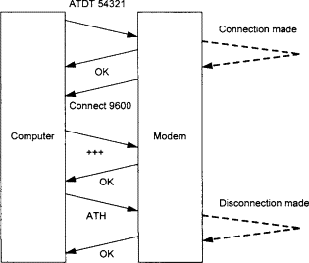
Define the Actions or Commands
Define each command
  What are the inputs (what data is needed)
    What data is provided by the user
    What data is provided by the system
  What are their outputs (what data is produced)
  What is the mapping from input to output (what do they do)
Commands should cover the requirements
  Actions required by the system in the stories or use cases
  Actions required by specific requirements
  Have a complete (and extensible) set of commands

Slide 5
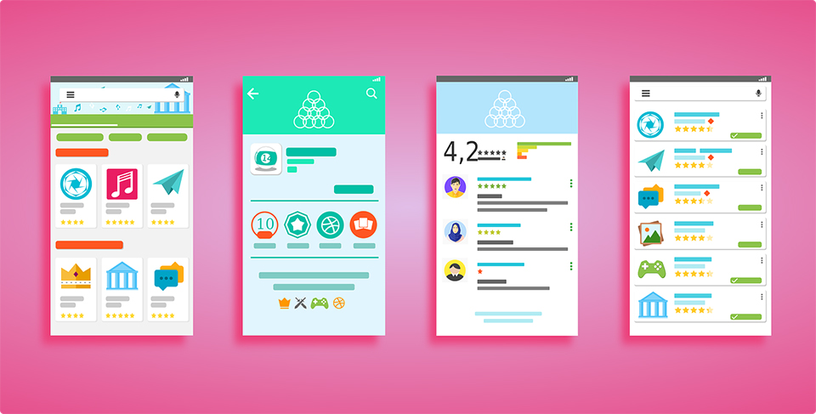
User Interface Specifications
Commands can be invoked in many ways
  Based on user requirements
  Alternatives
    Commands, drag and drop, menus, typing, external events, …
  Exactly how is UI design; specifications can provide hints
Commands can produce output in many ways
  Based on user requirements
  Alternatives
    Text files, graphics, CSV, pdf, html pages, searchable lists, text output, …
  Exactly how it is presented is UI design
    Specifications can provide hints

Slide 6
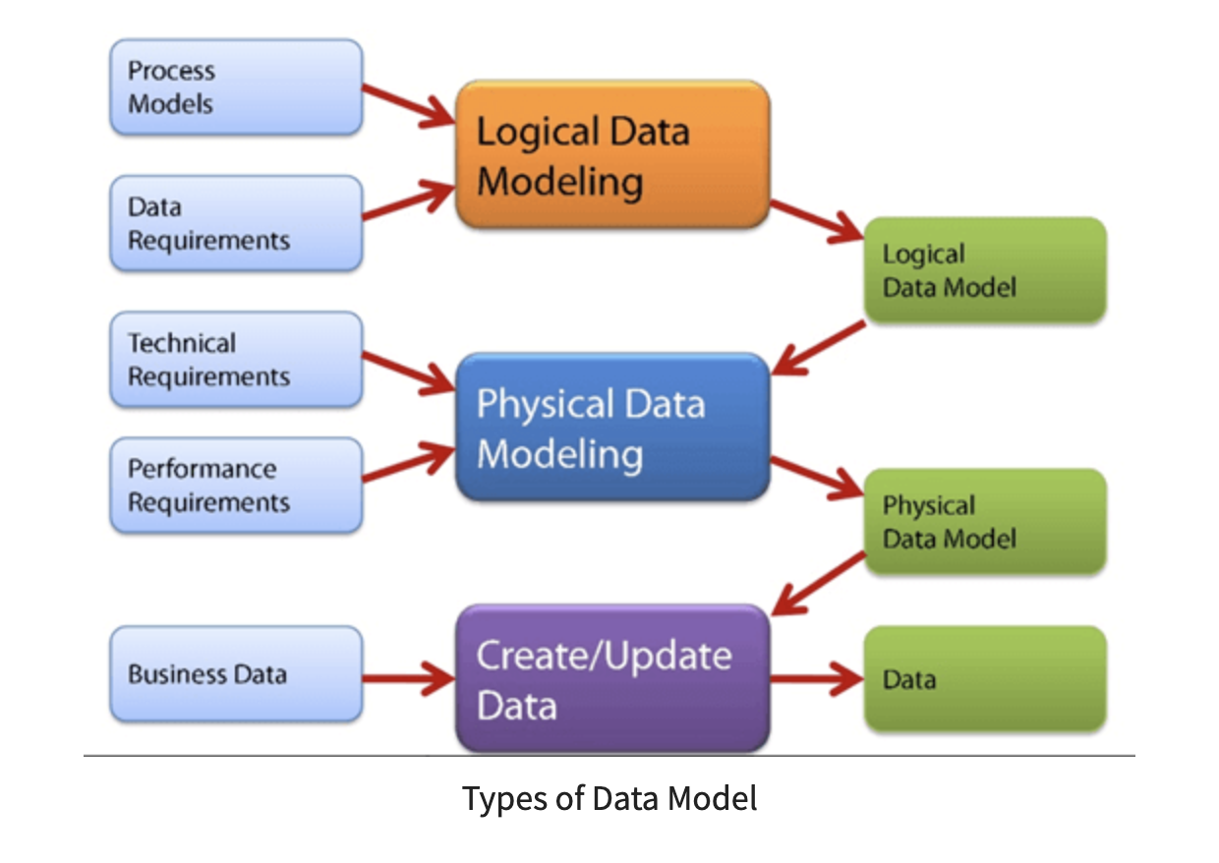
Define the Underlying Data
What data does the system need to operate
  Where does this data come from
  How are you going to obtain this data
  How are you going to store this data
  Are there legal or other restrictions on this data
  How are you going to bootstrap this data
  How are you going to keep the data up-to-date
What data does the system produce
  Is the data to be used by other systems
  Where does the data go (permanent, ephemeral, …)

Slide 7
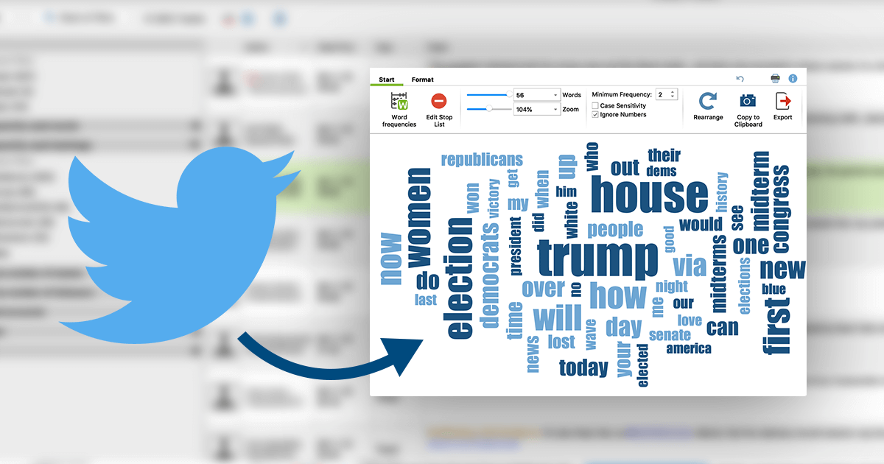
Example: Twitter Data
Problem:
  I have about 3 billion geolocated US tweets over 10 years
  Want to let user query these and see results
    Motivation: track election, flu, covid, affluence, discrimination, …
    Query by keywords (and, or), dates
    Display results on a map, using color and other highlighting
    Dynamic display of results over time
    Output the results for further analysis
  Should have a web interface
  Should be easy to use (for cs0931)

Slide 8

Twitter Data
Data was collected from twitter stream
  Processed, cleaned and stored to be accessible
    Missing a bit due to quirks in the feed (could be redone)
  Twitter shut down the collection mechanism last summer
    geo-located queries no longer work; no longer free
Data Specifications:
  What was gathered from the stream (CSV format with X fields)
  How it is stored initially (CSV files with ~1M entries) (6000)
  How it is updated (separate program)
  Data is somewhat clean before it is used by the program
    Duplicates eliminated; US only; Lat & long; zip; district; state; …

Slide 9
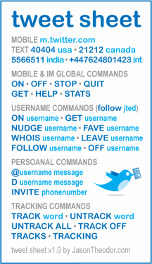
Twitter Commands
Search
  Inputs: time range, keywords, logic
  Outputs: list of tweets
Refine Search
  Inputs: list of tweets, time range, keywords, negative words
  Outputs: refined list of tweets
Display
  Inputs: list of tweets, type of region, map, range transformations
  Outputs: interactive web page
Restrict Display
  Inputs: display, time range, change transformations
  Outputs: updated web page
Load Data from raw twitter CSV files
Export Data to CSV or other formats

Slide 10

Specifications Are Not Designs
WHAT not HOW
Do not identify specific technologies to use
  Unless mandated by outside requirements (e.g., CSV files)
Do not determine how or where tasks are done
  Client, server, cloud, browser …
  Languages or technologies to be used (unless required)
  Algorithms or processing (unless required)
Do not provide detailed user interface designs
You do not want to overcommit at this point
  Understand the full specs before design
  Specifications will change as requirements change

Slide 11
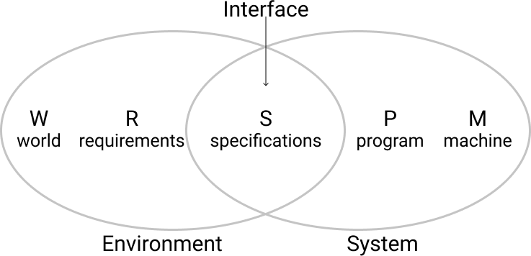
Specifications versus Requirements
Fine line between the two
  Requirements are from the user point of view (problem)
  Specifications are from the programmer’s point of view (solution)
  But both describe the problem and how it may be solved
Additional information in the specifications
  User and external interfaces
  Commands with their inputs and outputs
  Data used and generated by the system

Slide 12
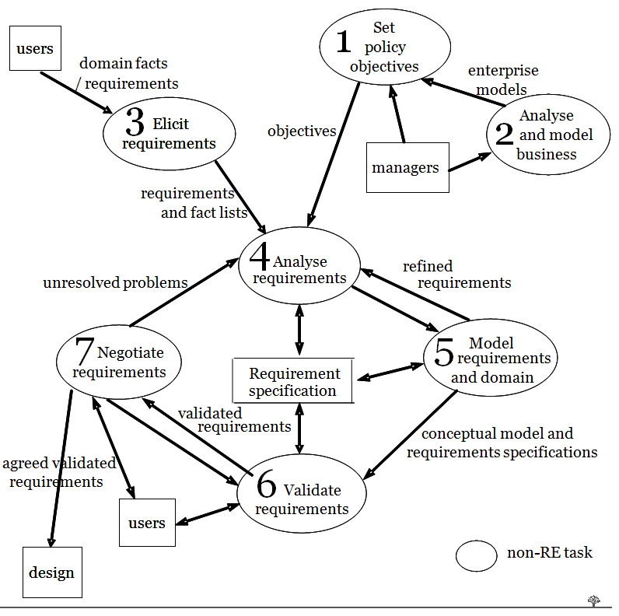
Requirements Traceability
Motivation
  Want to understand WHY for each command
  Importance or priority of each command
  Resolve conflicts between specifications
  Understand what needs to change
    As requirements change
Relate specifications to requirements
  Each specification should be based on 1 or more requirements
  Should be able to go both ways

Slide 13
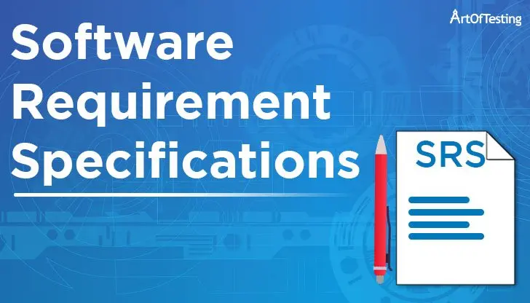
Requirements Specifications
These are often viewed as a single phase
  Talking with both users and the developers
  Agreeing on a problem and a potential solution
  Automatic traceability
Sometimes the results are merged
  Requirements Specifications Document
  Tends to lose the user influence and problem understanding
    Specifications emphasized; requirements deemphasized
  But it is easier to maintain one set of documents rather than two
Do requirements first
  Then merge the specifications into the requirements document
  Have an on-going dialog with the stakeholders

Slide 14
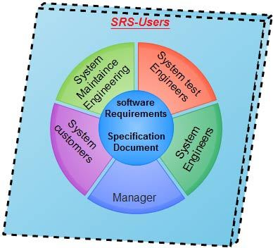
Representing Specifications
Natural language
  Akin to requirements document
Organized outline
  Organized by topic, component, purpose
  Numbered points (for reference)
Links to corresponding requirements
Description of the what it does
  Commands or Actions
  Effects on outside entities
  How the user might invoke them

Slide 15
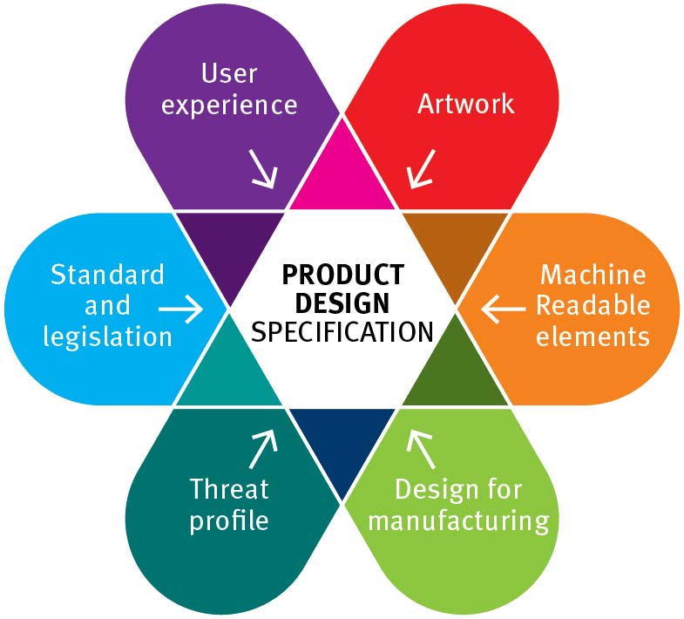
Representing Specifications
Augment the requirements document
  With specifications (what) information
  Commands, inputs, outputs
This is the simplest approach
  Provides links to requirements
  Provides a concrete understanding of the requirements
  Ensures that all requirements are considered
  Offers a basis for getting user feedback
Augment with ideas for the user interface

Slide 16
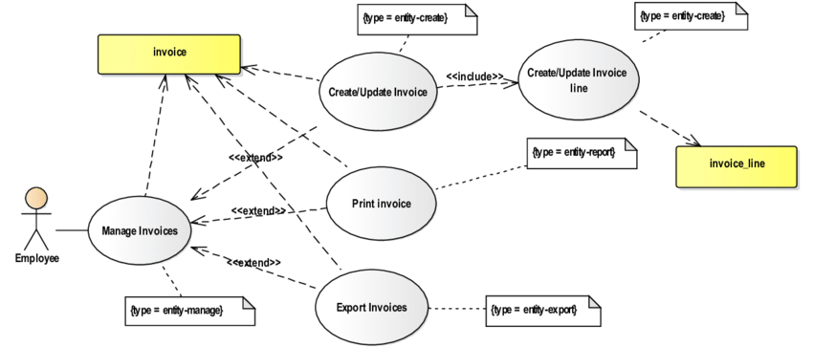
Specification Use Cases
Like requirements use cases
  But detailing system behavior
    Explicit commands, inputs, outputs
  What the user does to interact with the system
  What the system does in response to the user
  What the user interface might look like
Create a user interface story board for each use case/story
  Sequence of sketches showing the application
  Showing the sequence of interactions from the use case
  Annotations on what actions are taken from one to the next
This can be done as extensions of the original use cases

Slide 17
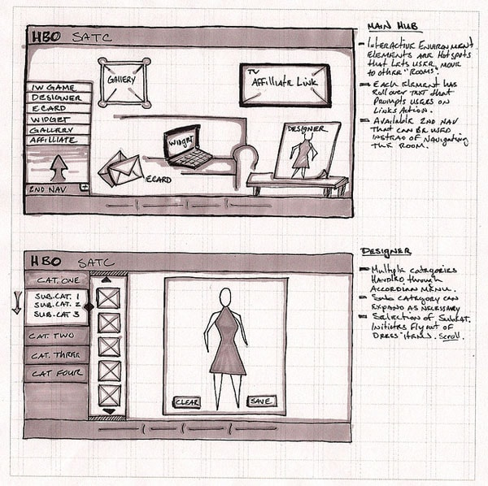
User Interface Sketches
Very quick sketch of what the interface might look like
  Not a user interface design
  More defining a set of components (menus, dialogs, drawings, …)
Multiple sketches or pop-outs from a sketch
  To show interactions
  Think of creating a story board or story book
These are not a design
  Not an image of the actual interface
  Show feasibility
  Just show the commands and how they might be implemented
  Give a basis for doing a full UI design

Slide 18
Specifications and Users
Specifications provide feedback to users
  Can ask would this solve your problem
  Can ask if the interactions, commands are sufficient
  Can ask if the interactions, commands are appropriate
Users will give you more concrete requirements
  Once they understand what you are thinking about
  Once they understand what can and can’t be done
  Once they understand what is easy and what is difficult
Don’t feel committed to your initial specifications
  Take user feedback into account
  Specifications are going to change

Slide 19
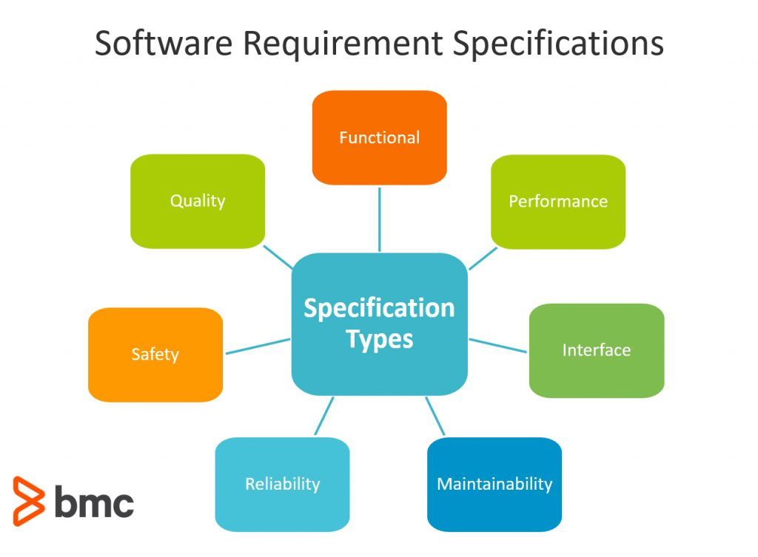
Non-Functional Specifications
Non-functional Requirements
Non-functional Specifications
  Performance
  Platforms
  Security
  Privacy
  Accessibility
External systems to interact with
Existing systems to build on
Notes:
Akin to non-functional requirements, but from the systems point of view

Slide 20
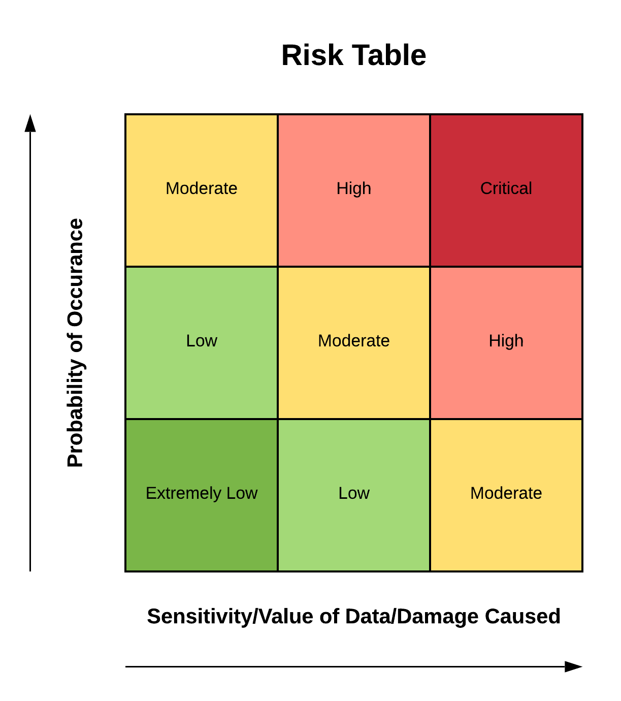
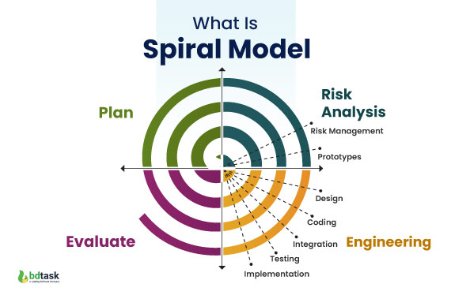
Risk Analysis
Understanding the risks in the project is part of specifications
Do a risk analysis
  What can go wrong
  What is going to be difficult
  What do you not understand
  How well understood is the user interface
  How well understood are the users
  How well understood are the algorithms …
This is information you will need for design
  Recall the spiral model of development
Include the risks in the specifications
  Enumerate and categorize them

Slide 21
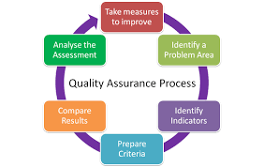
Maintaining Specifications
Specifications are going to change
  Requirements change
  Needs change
  Users change
  Competition changes
  Design & implementation provide opportunities and obstacles
You will need to know the current specifications
  To understand where you are, to direct design and coding
  To prioritize development
  To trace decisions back to requirements
Specifications are not throwaway
  You want to maintain the requirements-specifications thru development

Slide 22

Research in Software Specifications
Using specifications to detect API misuse
Formal specifications (e.g., temporal logic)
Using specifications to plan security mechanisms
Generating specifications from UI tests
Automatic documentation generation

Slide 23
Homework / Further Reading
Develop specifications for the programming assignment
  Feel free to discuss and exchange requirements
  Canvas assignment (due 9/17)
Further Reading
  Text book, chapter 4
  IBM Rational Description of Use-Case Diagrams
  IEEE Software Requirements Specifications

Slide 24
PROJECT
Initial team meeting
  We will break into project teams
Agenda
  Introduce yourselves
  Set up a weekly time to meet
  Start discussing requirements & specifications
    Start getting ideas for what specifically your system will do
    Create a shared requirements document if you haven’t done so
    Using the shared requirement specifications document
      Can separate or merge the two
    Determine what stakeholders to talk to (and assign people to do so)
  I’ll roam around, or you can just ask for me stop by

