Slide 1
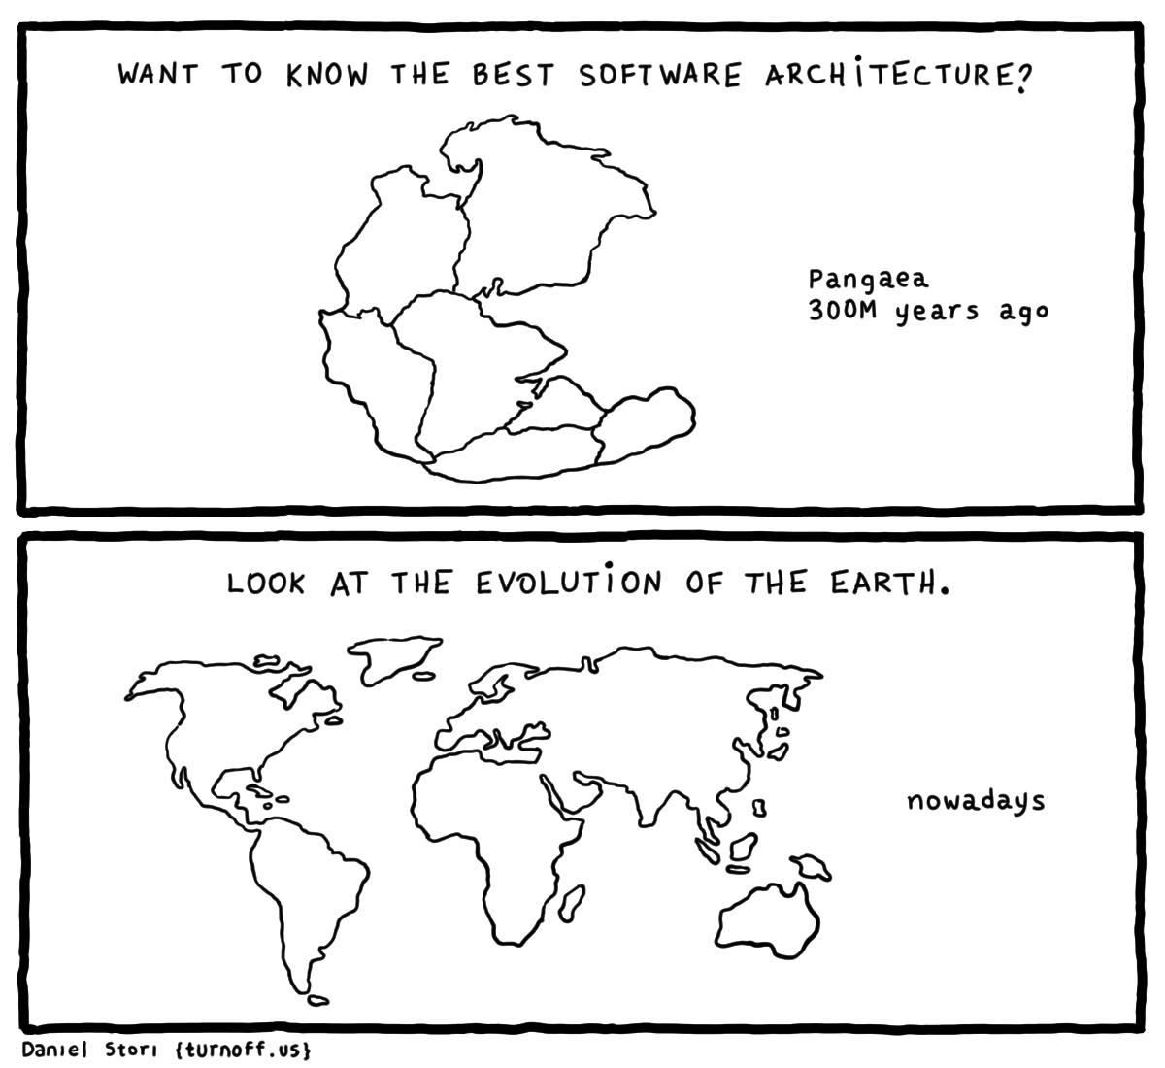
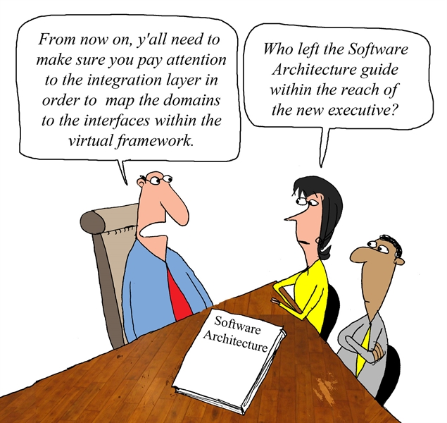
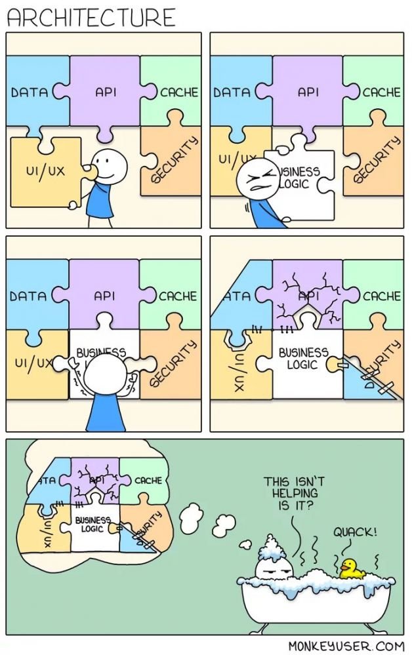
Software Architectures
CSCI2340: (Graduate) Software Engineering
Steven P. Reiss

Slide 2
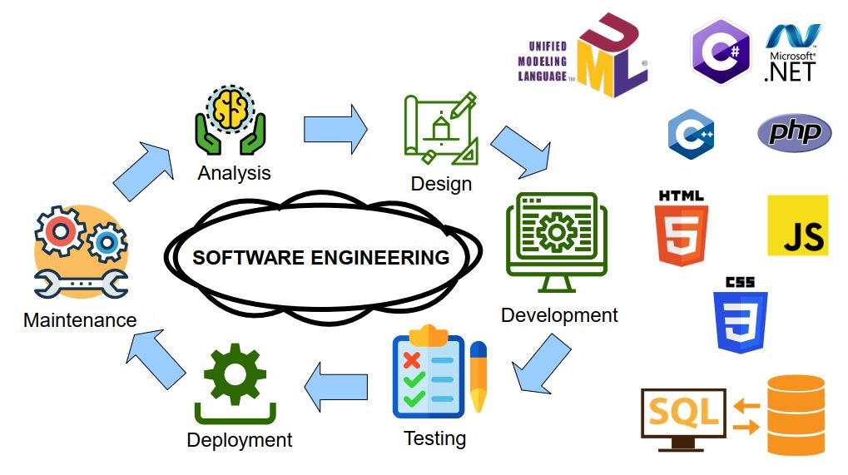
Design
Requirements tell us what users NEED built
Specifications tells us WHAT to build
Next, we need to decide HOW to build it
  This is DESIGN

Slide 3
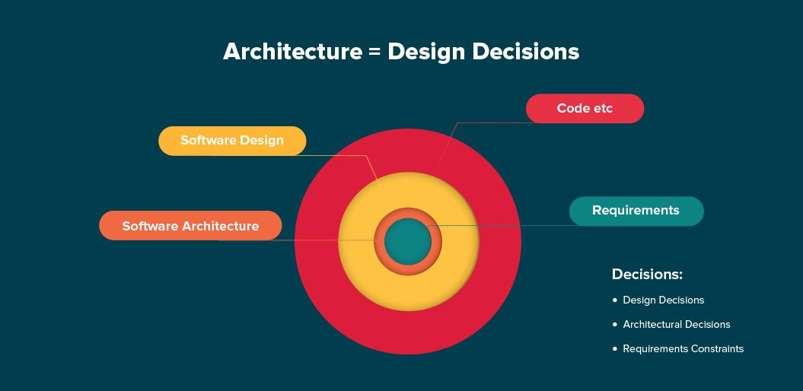
Design Decisions
Design involves lots of decisions
  Some are big (overall structure); Some are small (hash or tree map)
Most do not matter
  Anything can be made to work; anything can be redone
But each contributes to making the code better
  More maintainable
  Smaller and simpler
  Less subject to risk
  Easier to work on as a team
  Easier to understand

Slide 4
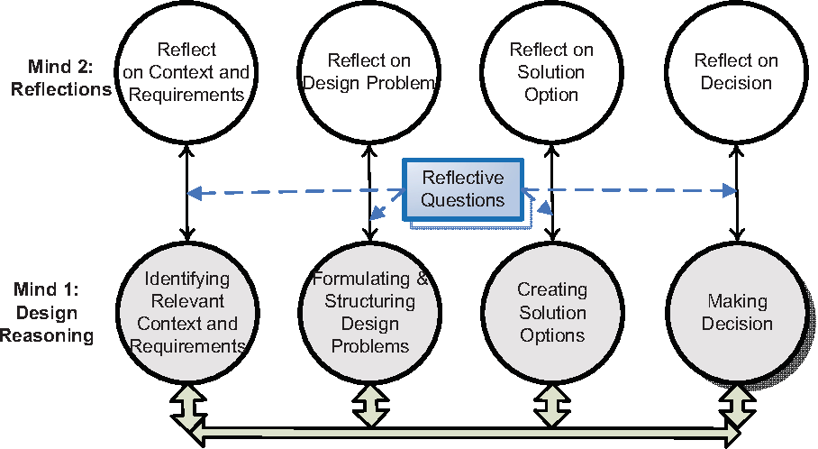
Making Design Decisions
What is the effect on the system
  Understand the consequences, implications, …
  How they fit with the solution, now and in the future
  Ease of implementation
  Simplicity of the result
    Size of the code
    Complexity of the code
    Complexity of interaction
  Ease of understanding
  Consistency
  Performance
  Risk Management

Slide 5
What Makes a Good Designer
Experience
  Read lots of designs, understand what others have done
  As you use a system, think about it might be designed
  Understand what works and what doesn’t
  Remember your past decisions (and their effects)
Understand Design Patterns
  Design patterns are a collection of standard working ways
  Need to understand when they should be used
  Need to understand when they should NOT be used

Slide 6
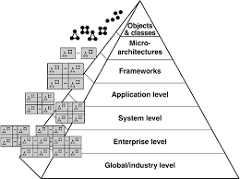
Decisions are Made at All Levels
What construct to use (for or while)
What data structure to use (HashMap or TreeMap)
How to split into methods
How to split into classes
How to split into packages
How to create and use APIs
The overall architecture of the system
  Software Architecture
Notes:
We’lll cover all of these eventually. We’ll start at the outer level

Slide 7

Software Architecture
Software architecture refers to the fundamental structures of a software system and the discipline of creating such structures and systems. Each structure comprises software elements, relations among them, and properties of both elements and relations.
Architecture is the fundamental organization of a system embodied in its components, their relationships to each other, and to the environment, and the principles guiding its design and evolution. -IEEE 1471

Slide 8
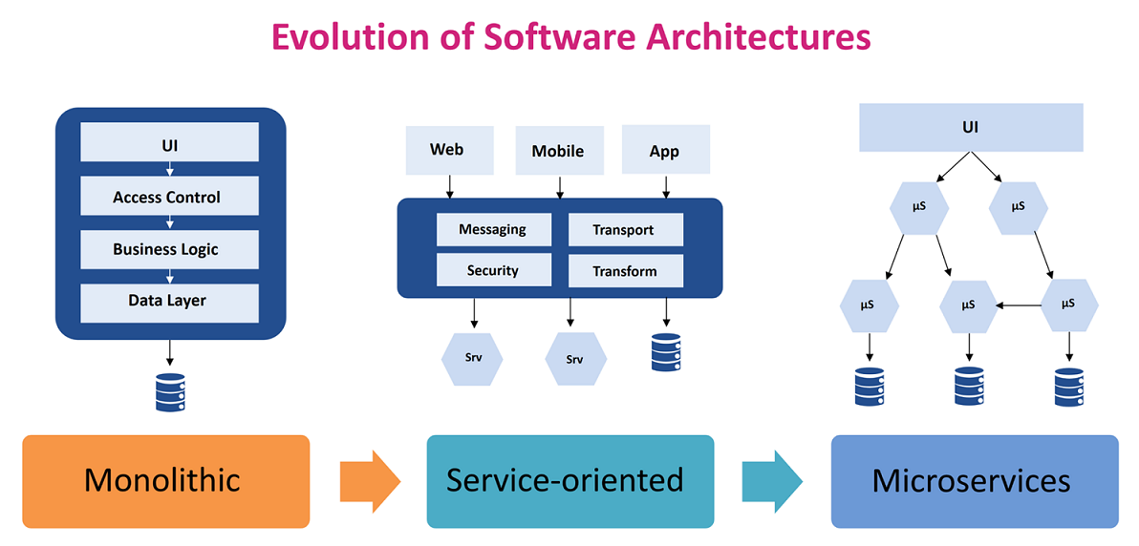
Software Architecture
An architecture is the set of significant decisions about the organization of a software system, the selection of structural elements and their interfaces by which the system is composed, together with their behavior as specified in the collaborations among those elements, the composition of these elements into progressively larger subsystems, and the architectural style that guides this organization -- these elements and their interfaces, their collaborations, and their composition. –Kruchten (2003) The Rational Unified Process: An Introduction

Slide 9
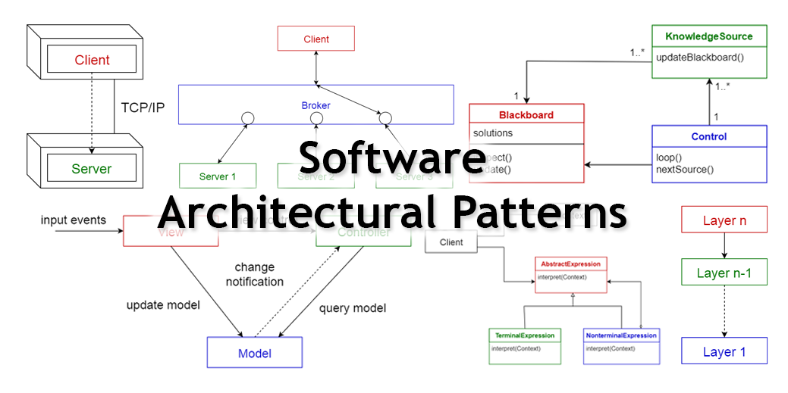
Software Architecture
The overall view of how the system works
  When the system is complex enough to warrant
Typically expressed as boxes and arrows
  Boxes represent system components
  Arrows represent communication between components
    Can be interpreted in various ways
    Can involve processing as well as pure communication
  Both are important and central to the architecture

Slide 10

Consider a Web Browser
Specifications
  Display a web page
    Download the contents (w/ CSS, JS, images, …)
    Layout the contents
    Display the contents
  Handle interactions (built-in and JS)
  Manage downloads and bandwidth
  Manage tabs & multiple browser windows
  Manage cookies and local storage

Slide 11
EXERCISE
Consider your favorite browser
  How does it work internally?
  What are the basic components?
  How are they connected?
  What are the key technical problems?
  How to take advantage of multiple cores?
How might the components be organized?
How would you build a new web browser?
Discuss this with your neighbors

Slide 12
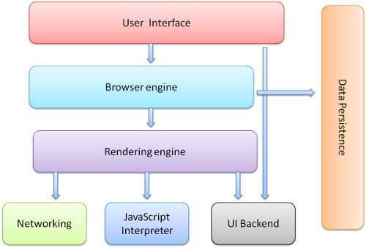
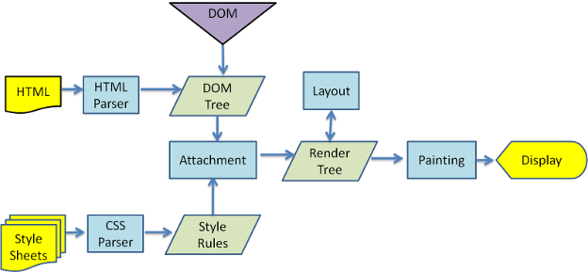
EXERCISE Discussion
What are the components
What are the key parts
What are the difficult parts

Slide 13
Browser Architecture
DOM
Storage
Networking
Render Engine
JS Engine
Display
Controller
Interactions

Slide 14
Architectural Patterns
There is a relatively small set of basic architectures
  Architectural design patterns
  Like house architectures (ranch, split-level, cape, colonial, …)
  Most actual systems are a combination of these
A good system designer will understand the options
  What they are
  How they might be implemented
  When they are useful
  What are their strengths and weaknesses

Slide 15
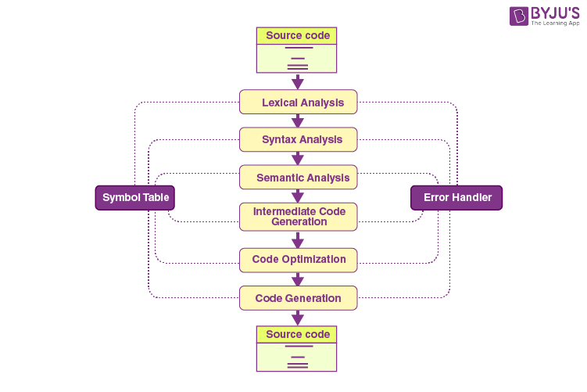
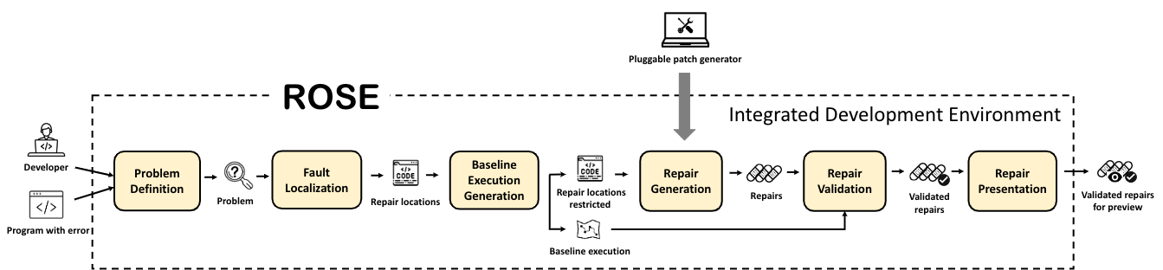
Pipe and Filter
UNIX shell pipes as a model
  Filters are processing units
  Pipes are connections between these
Classic example
  Compilers
Other examples
  Visualization Engine (BLOOM)
    Trace collection and processing
    Filtering and merge data sources
    Visualization
  ROSE (automatic program repair)

Slide 16
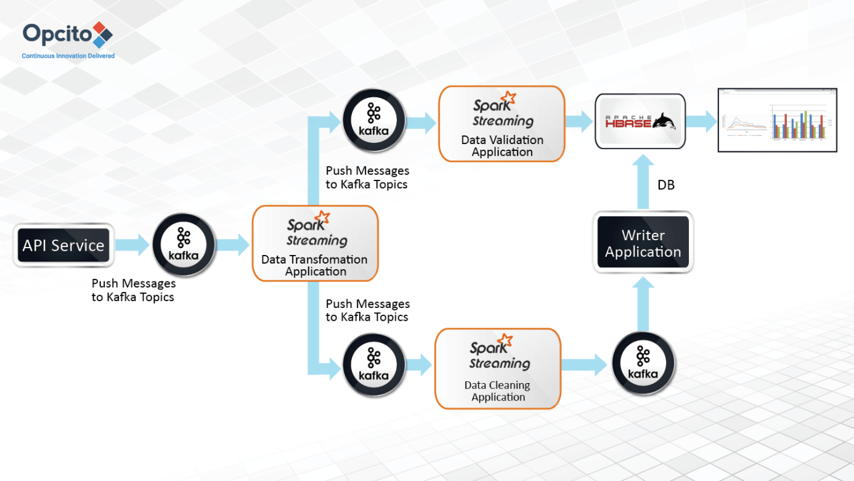
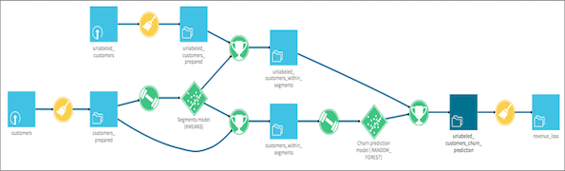
Generalized P&F: Streaming Architectures
Stream-based databases
Stellar Computer (graphics)
Data Visualization

Slide 17
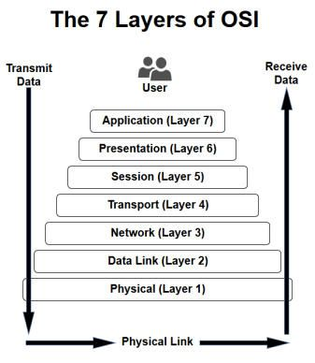
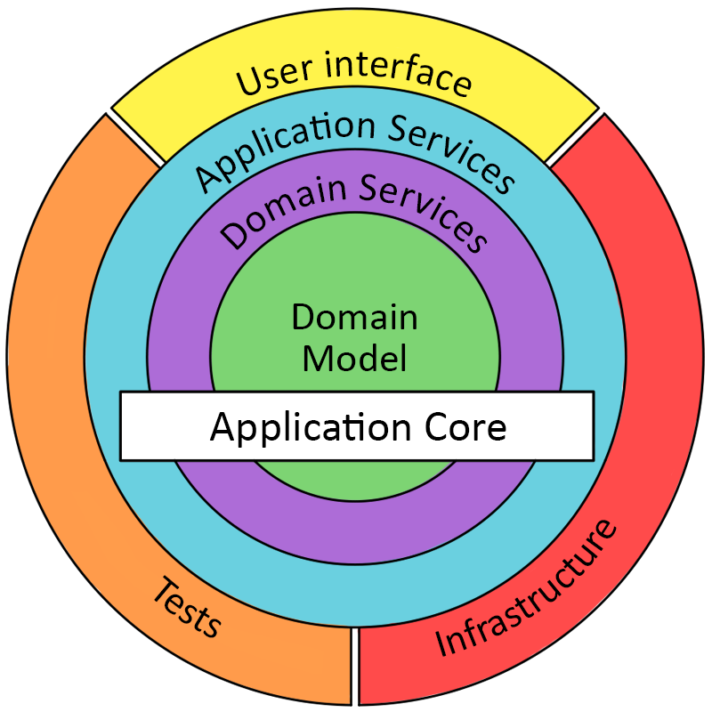
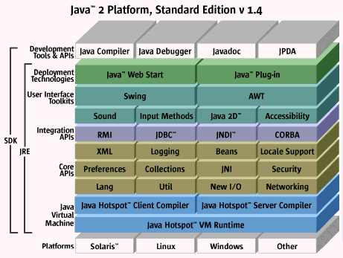
Layered System
Onion Model
Hub and Spokes Model
Classic Example
  Networking Protocols
Other Examples
  Garden
  Java
  Traditional Apps
Weed
Lily
Sage
Thyme
Violet
Humus
SOIL
Rue
Rose
Daisy
Utilities
Cosmos
Balm
Notes:
SOIL: Core framework: object model
HUMUS: Basic data types ad operations, execution model
SAGE: UI interface
ROSE: OS interface
COSMOS: Compiler
RUE: Trace and log module
LILY: Textual programming language
THYME: Graphical language support
DAISY: Documentation support
BALM: Browsing support (Smalltalk like browser) – written in LILY
VIOLET: Graphical object viewer support – written in LILY
WEED: Graphic object editor.

Slide 18
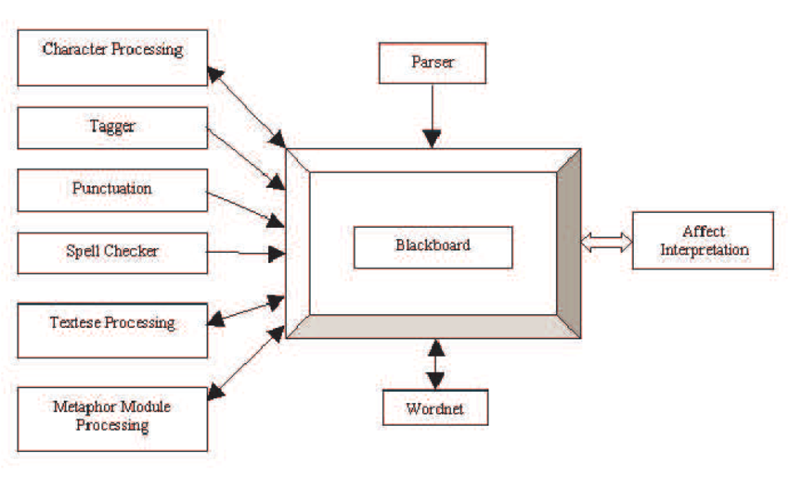
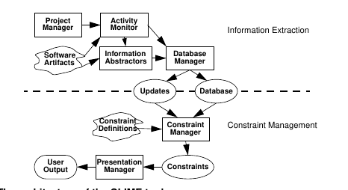
Repository Architectures
Shared data structure
  Blackboard, data store, database
  Various components access and update that structure
  Often with notifications on change
    Communication done via the central structure
Classic Example
  Programming Environment – commonality is the source code
    PECAN – AST-based
    Eclipse and Idea are similar if not expanded
  AI blackboard systems
Other Examples
  Clime with central database
  MVC-based web applications

Slide 19
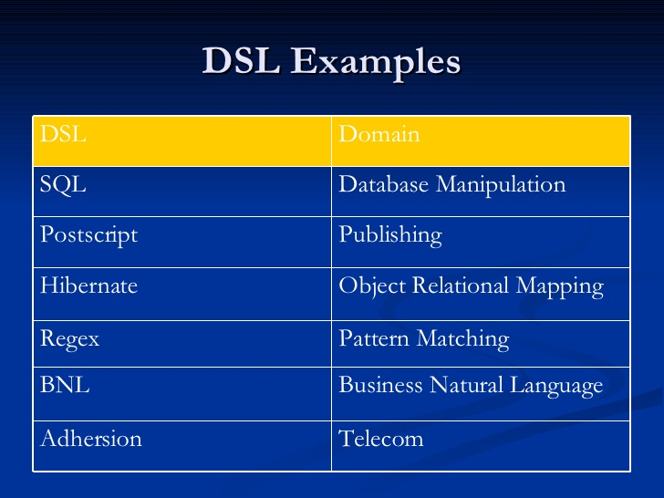
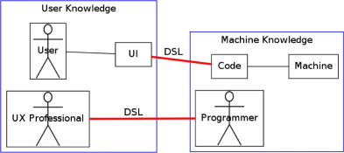
Interpreters
Domain-Specific Languages
  Define a language for writing the implementation
  Write the actual system in that language
  Interpret (compile) to run the system
  Language often is just a library
Classic Examples
  Scientific Computing Libraries and DSLs
  Systems for processing big data
    Python-based scripting
    Also computer vision, machine learning
  Rule-based systems
Other Examples
  UPOD: smartsign, smarthab, smartthings, smarthome

Slide 20
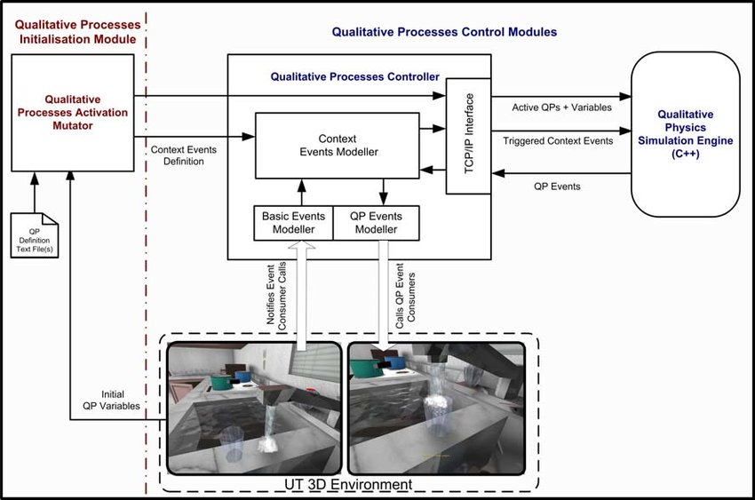
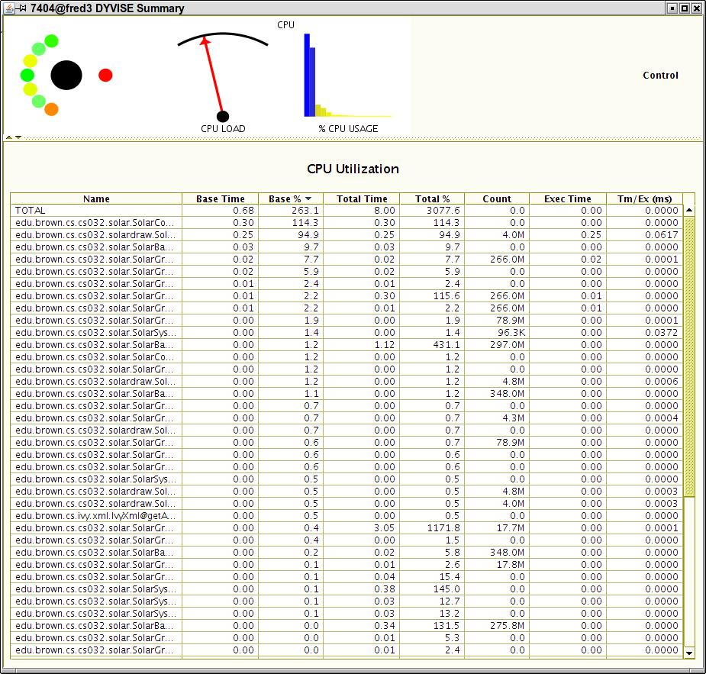
Process Control Architectures
Mostly used in IoT (RT/Embedded)
Control loop with feedback
Classic Example
  Thermostat
Other Examples
  Self-driving cars
  Many real-time systems
  DYVISE tuning

Slide 21
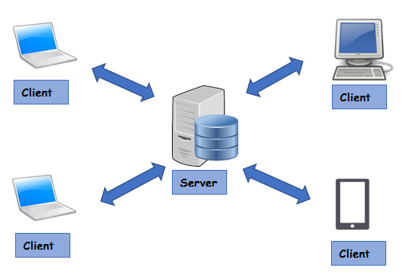
Client-Server Distributed Processing
Server acts as a master
  Clients talk to the master (not to each other)
  Message-based communication
  State can be global or distributed
Classic Example
  Computer Games
Other Examples
  Web-based applications
Peer-to-Peer systems
  TAIGA

Slide 22
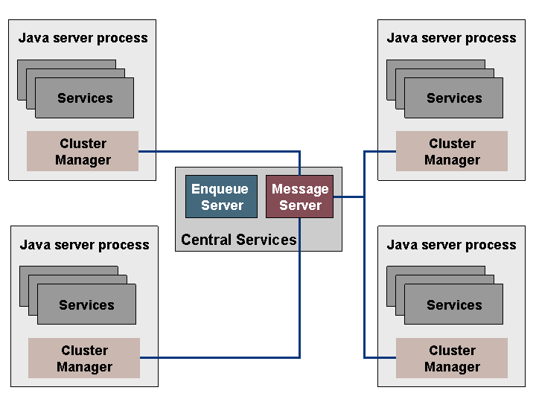
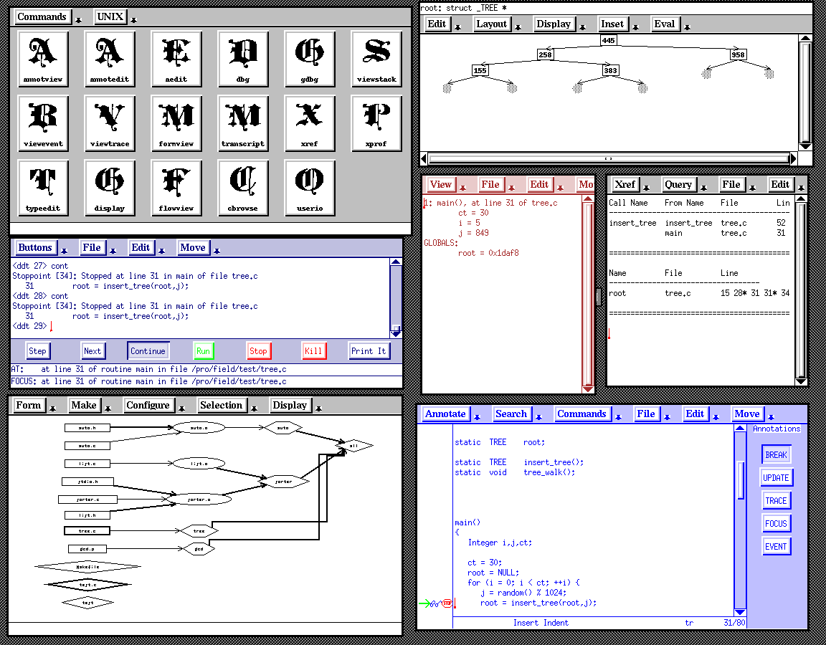
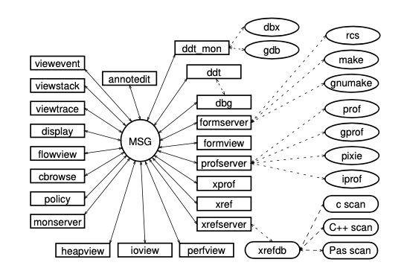
Message-Based Distributed Processing
Set of Processes communicating via messages
  Messages can be process-to-process
  More general is a central message server and broadcast messages
Classic Example
  FIELD environment
Other Examples
  CORBA-based computing
  Agent-based systems

Slide 23
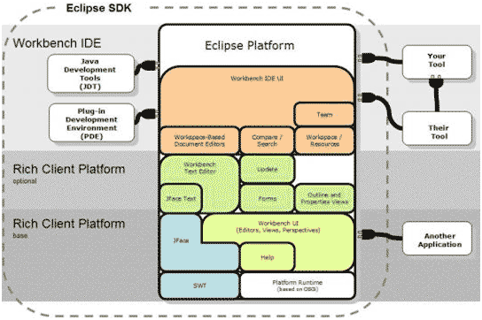
Plug-in Architectures
Weed
Lily
Sage
Thyme
Violet
Humus
SOIL
Rue
Rose
Daisy
Utilities
Cosmos
Balm
Core + Extensions with dynamic plug-ins
  Facilities to dynamically load and integrate plug-in code
    Done at run time, not compile time
  Extension points
    Allow plug-ins to augment the UI, other capabilities of core
    Allow core to provide notifications to the plug-ins
  Plug-ins can invoke the core system
    Register callbacks, do operations
Examples
  Eclipse
  VS Code

Slide 24
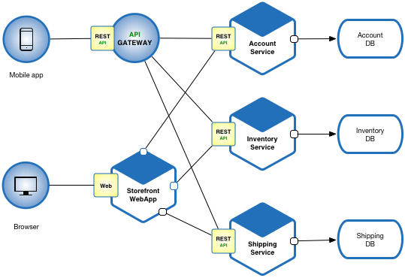
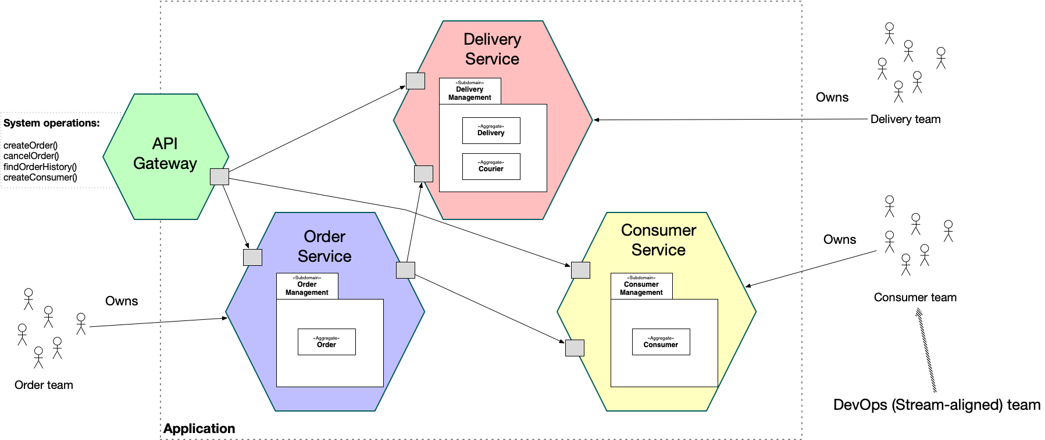
Microservice Architectures
Application built as a collection of services
  Services can be implemented independently
  Services can be reused by multiple applications
  Services are loosely coupled
  Database-oriented
Flexible, scalable, team-oriented
Examples
  Modern web applications

Slide 25
Browser Architecture
DOM
Storage
Networking
Render Engine
JS Engine
Display
Pipe & Filter
Layered System
Repository
Plug-in
Controller
Interactions

Slide 26
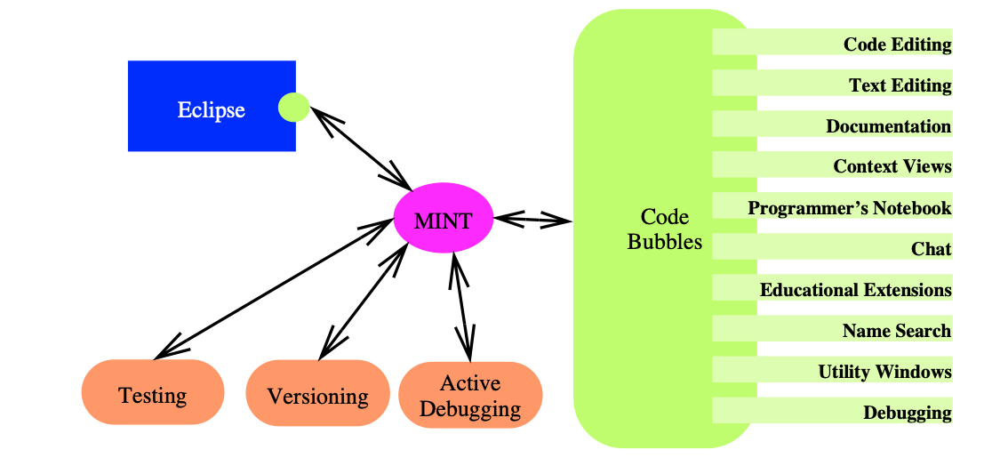
Heterogeneous Architectures
SEEDE
Most complex systems employ multiple architectures
  Combinations of the above
Example: Code Bubbles
  Message-based with communicating processes
  Layered architecture for main system
  Plug-in capability for extensions
  Repository based on source code and file system
FAIT

Slide 27

Software Architecture
Understanding these (and other) high-level models
Understanding when they are (and are not) appropriate
  These are essentially high-level design patterns
  Design patterns always tell WHEN they are appropriate
  Should also indicate when NOT appropriate
    When they make the system more complex
    When they make the system harder to maintain
Understanding what best applies to your problem
  What will make your life simpler

Slide 28
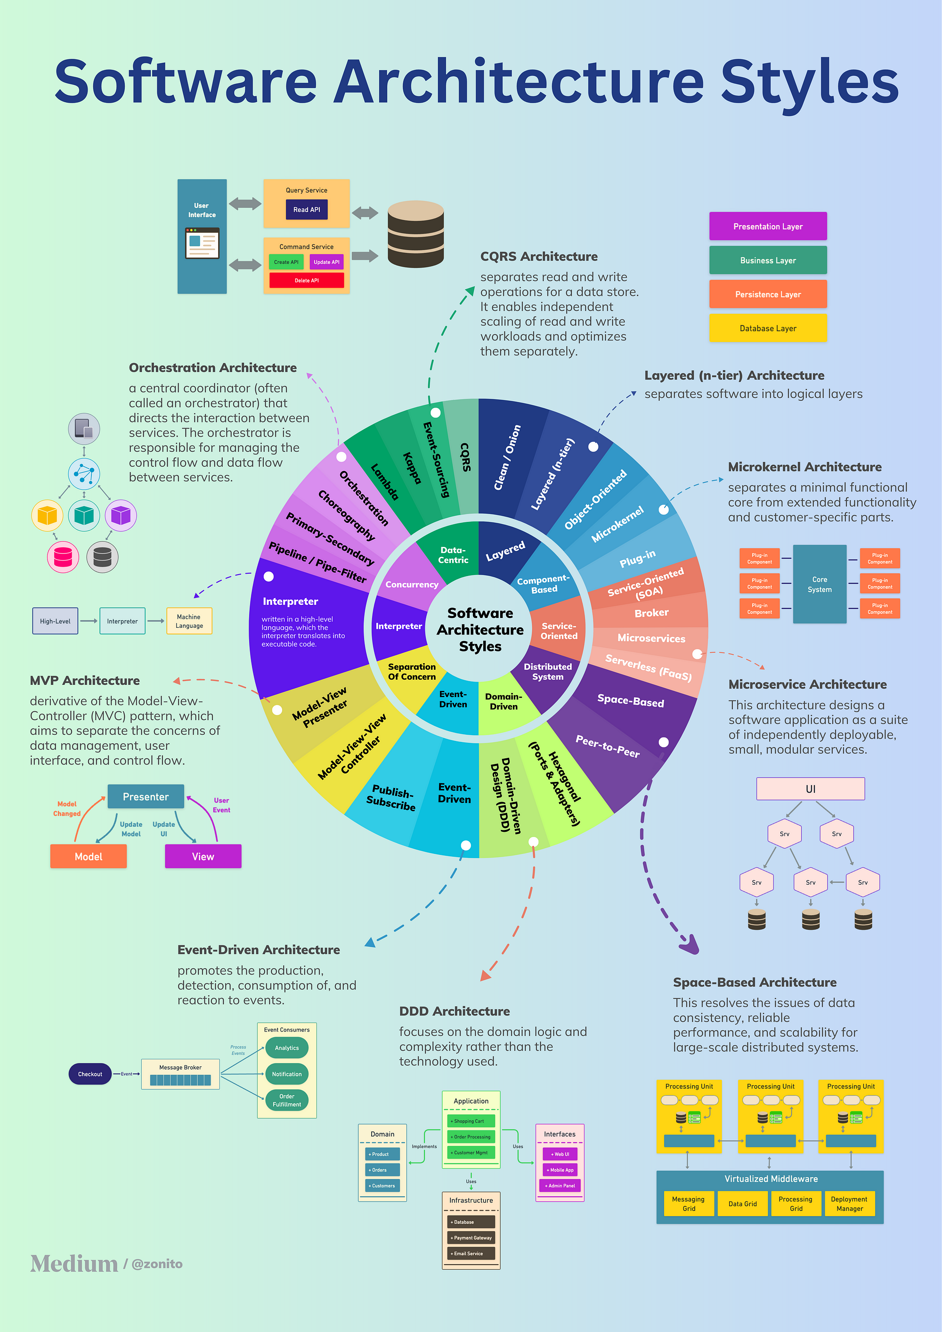
Choosing a Software Architecture
Decide on a set of basic high-level components
  What is the basic functionality
  Emphasize data over computation
  Handling the specifications
Determine which architectures are appropriate
  Based on the components & their interactions
Account for constraints
  Building a small system first
  Risks, security, performance, …

Slide 29

Other Things to Consider
Team-based Designs
  An architecture that allows an easy split among team members
  Having people work on individual components is easier
    Each person should have a well-defined component (or set thereof)
    Number of component correlates with team size
Risk-based Designs
  Understanding what is difficult, unknown, etc.
  Isolating and addressing risks
Overall architecture is generally the charge of main designer
  Having group discussions helps

Slide 30
Research in Software Architectures
Automatic redesign based on environmental deviations
Neural-net based architectures (using LLMs)
Understanding design decisions

Slide 31
HOMEWORK
If you don’t have a personal GitHub account
  Create one
Start thinking about coding the assignment
  Use Code Bubbles for Java/node/dart if desired
  Initial implementation due 9/26
  We will discuss coding next time

Slide 32
PROJECT
Decide on a project name
Discuss architectures at your next project meeting
  Develop a proposal
Continue working on specifications
  Should have a good high-level idea of what the team will be doing
  Should have a complete high-level view
  Details can be filled in later

Slide 33
Further Reading
Introduction to Software Architecture
  Classic paper introducing the field
Textbook – Chapter 5

