Slide 1
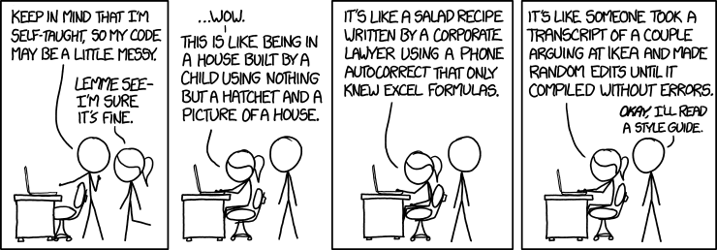
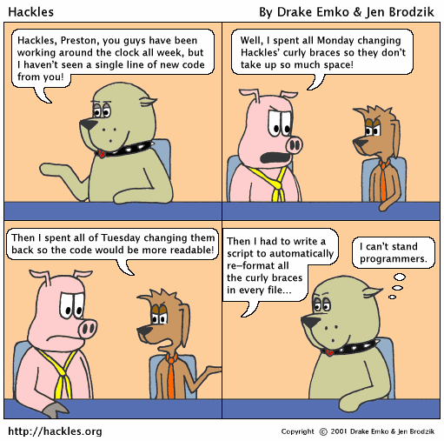
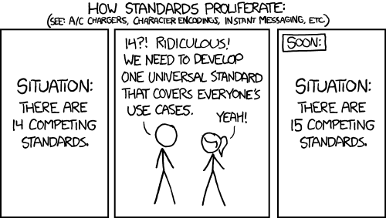
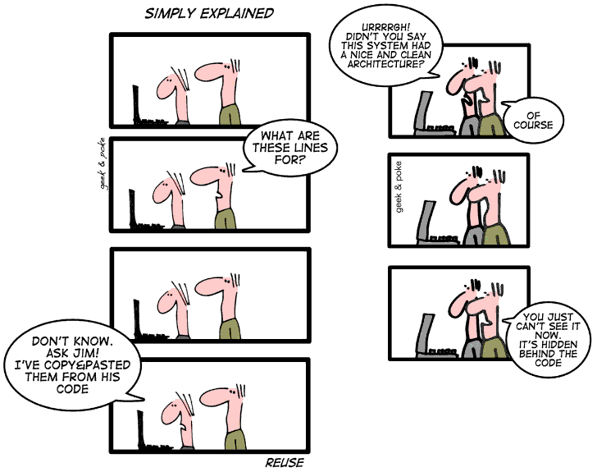
Basic Coding Techniques
CSCI2340: (Graduate) Software Engineering
Steven P. Reiss

Slide 2

Getting Ready To Code
We’re going to be doing design for a while
  But will eventually start coding
  And you should be coding the homework assignment
  And you are starting to work on the project
    If you need to do any prototyping
This lecture is preparation for that

Slide 3

GIT
We need support for joint projects
  Source code control, version management
  GIT is today’s standard (sccs, rcs, svn, perforce, …)
GIT provides a flexible, adaptable platform
  Distributed framework
    Even for one person development
  Allows lots of collaboration
  Supports complex branch and merge operations
  Provides the safety of older versions and going back
    Use if even for one person development

Slide 4
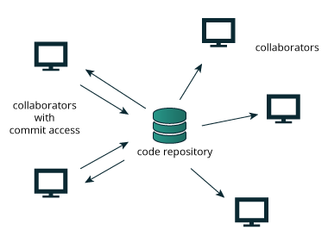
GIT Basic Concepts
Repository
  Central location for all files
  Can be GitHub, local, or anywhere accessible
  GIT supports multiple repositories
    Each user has their own repository
  One is designated the master or head
    Can be changed if needed
Individuals clone (check out) the repository
  They get their own copy of all the files
  Comes with a link back to the cloned repository
  But it is a repository in its own right

Slide 5
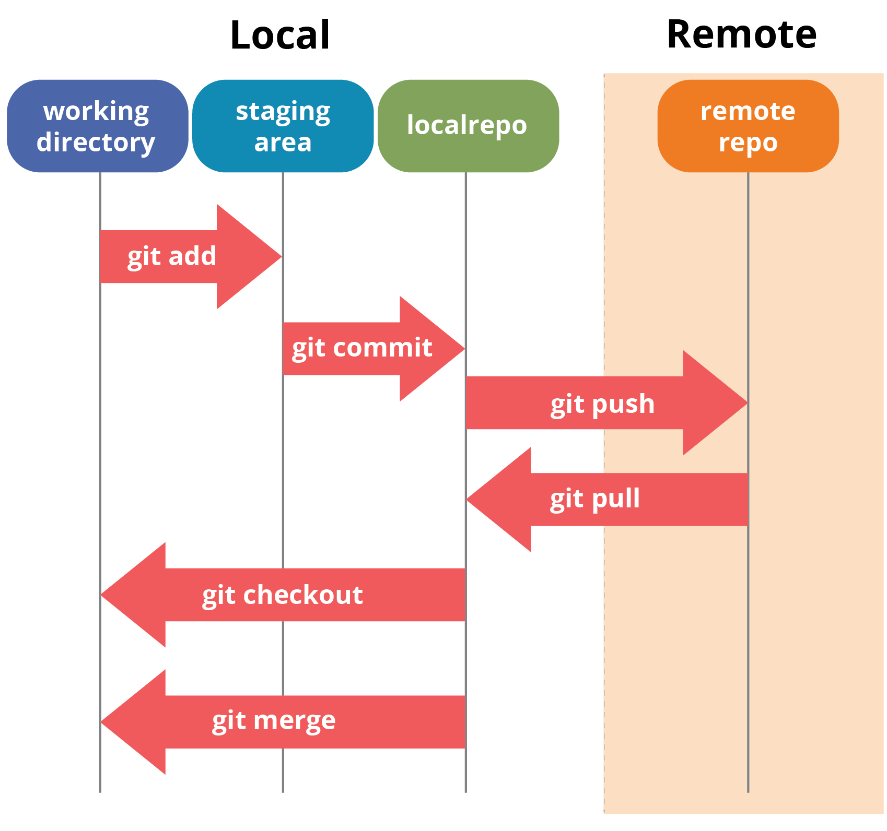
GIT Basic Concepts
Individuals can edit their copies
  Edit individual files
  Create private files & directories
    .gitignore file describes what is private
  Create new public files & directories
    But you must tell git using git add
  Remove files & directories
    But you should tell git using git rm
  Status operation to check what has changed
  Commit operation to commit changes locally
    Puts the changes into the local repository
    This allows going back, but doesn’t change the global repo

Slide 6
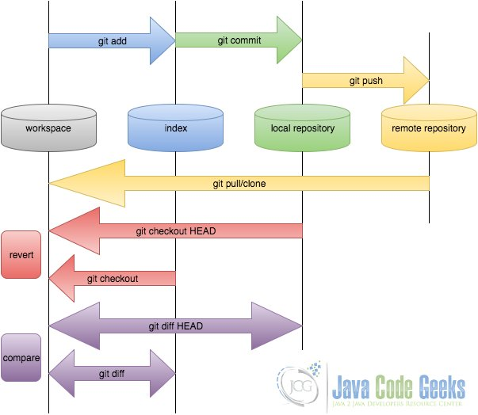
GIT Basic Concepts: Push and Pull
Push a committed local repo to the global repo
  Updates the global repo with changes
  Creates new version of the global repo
  Makes changes visible to others
Pull global repo into local repo
  Updates local files with global changes
What happens if there are conflicts
  Merge changes – doesn’t always work
  Can require manual intervention
  Commit the merge code

Slide 7
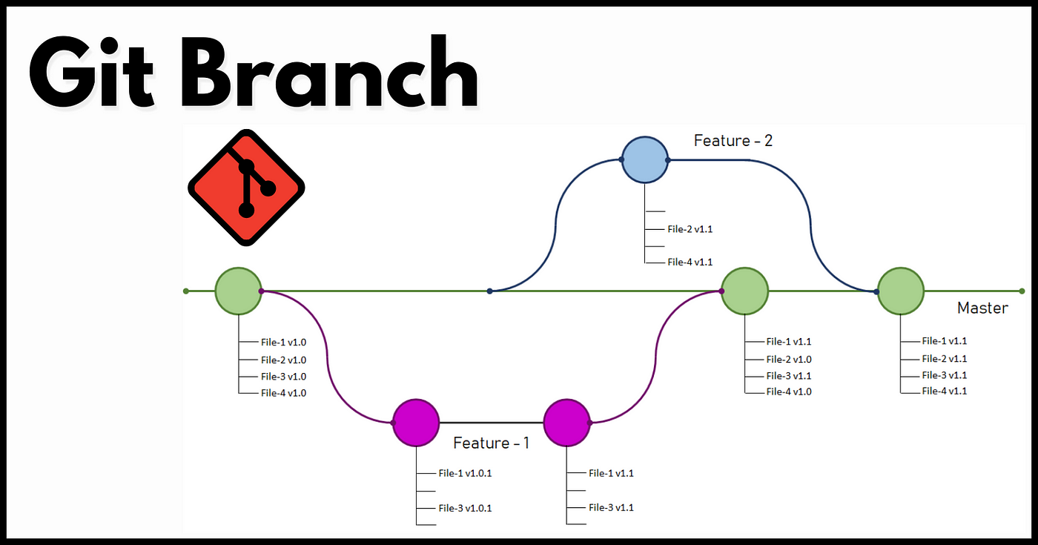
GIT Basic Concepts: Branches
Sometimes you need to work independently
  Don’t want all others to see your changes
  Don’t want to see changes of others (temporarily)
  But still want to save things globally
Branches provide such a means
  Branches are separate versions of the system
    Independently developed from the main repository
    But store in the repository
  Branches can then be merged
    With each other or with the main branch
  We’ll cover these in more detail later
  Today, continuous integration with a single branch is often used

Slide 8
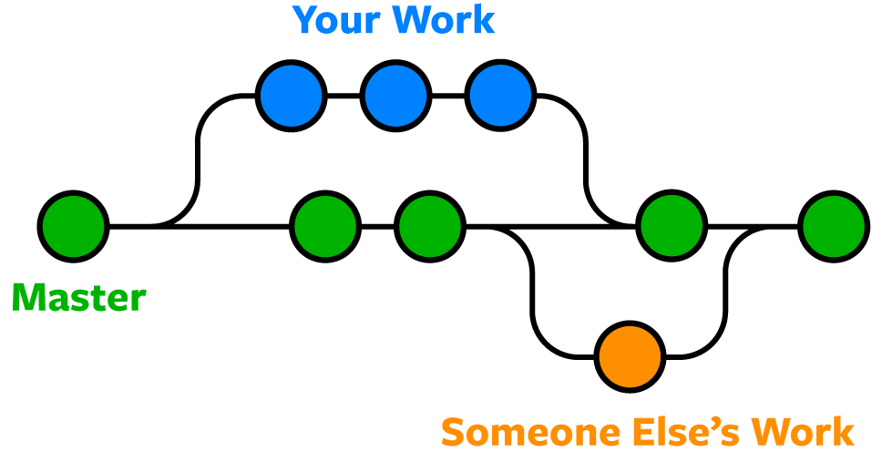
GIT Complexities
Editing and merge conflicts
  What if two people make changes to the same file
  What if one person deletes a file someone else uses
  You want to avoid this where possible – requires additional work
This can happen with or without branching
Repositories can be combined in various ways
  Merge – merge the code from the two branches (safest; recommended)
    But can require manual intervention and create corrupted files
  Rebase – apply your changes to current version if possible
  Stash and replace (removes all local changes) (git restore)
  We’ll get into these in more detail later
You should read up on these and decide what to use
  As a project team
Time at end of class to set up GIT for your project

Slide 9
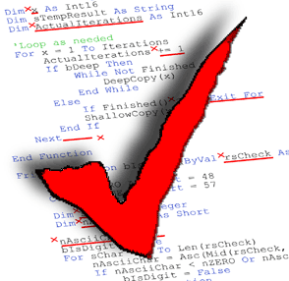
Coding Style
Most frustrating part of collaboration & using open-source software
Coding style is essential
  Helps with maintenance
  Helps with understanding
  Helps to make the code readable to everyone
  Open source should be open
  Consistency in a large project
    Much easier to work on code with known conventions
WRITE CODE SO IT CAN BE READ BY PEOPLE
  Not so it can be executed
  For yourself, you team, and posterity
  Be proud of your code

Slide 10
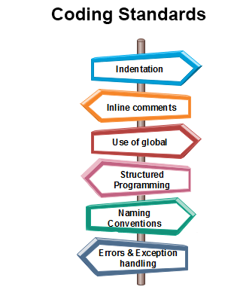
Coding Style Goals
Readability
  Looks nice; easy to read; spaced appropriately
  Easy to skim to get an overview of the code
  Easy to find things (non-linear readability)
Looking at an identifier
  Easy to know what it is
  Easy to know where it is defined
Looking at code
  One should understand its structure
  Without having to read in detail
Simplify debugging & maintenance
  Avoiding name conflicts
  Being able to find name in source
  Make changes easier
  Keep things local

Slide 11
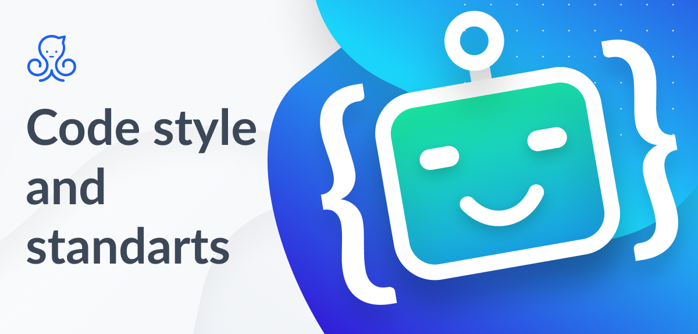
Code Style Components
Naming Conventions
Ordering Conventions
Coding Conventions
Formatting Conventions
File Organization

Slide 12
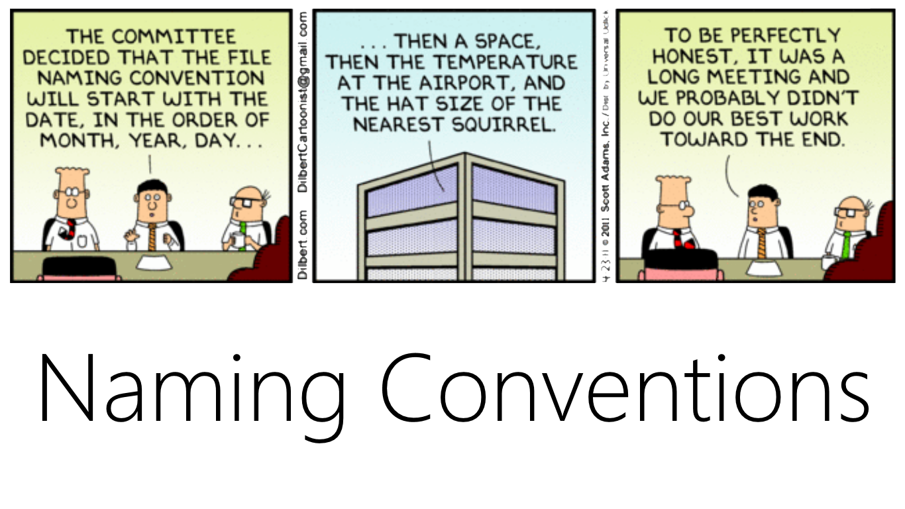
Naming Conventions
Goal:
  Distinguish different types of names
  Understand what the name means directly
  Understand where to look for the definition
  Understanding the scope of a name
My coding style (not what you need to use)
  Mainly for Java, adapted for other languages
Fields (static variables)
  All lowercase, contain an underscore, meaningful
  Always private (or protected) to avoid naming conflicts
Local Variables (and parameters)
  All lowercase, no underscore
  Short names okay if used within a few lines
  Otherwise use meaningful names

Slide 13
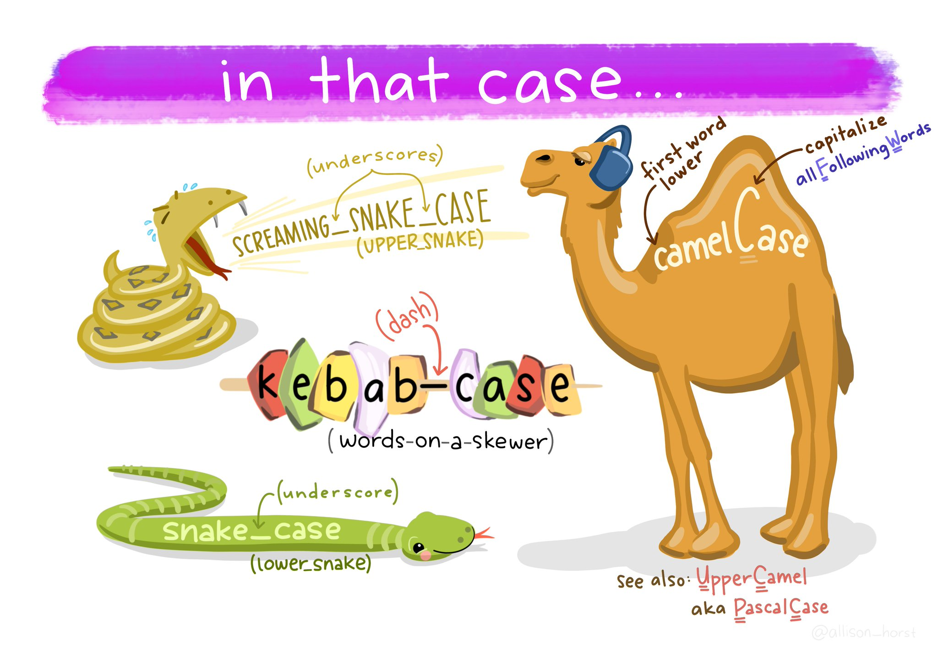
Naming Conventions
Constants (final static fields)
  All uppercase, underscores separate words
  Meaningful names
  Start with package name if external
Methods
  Camel case names starting with lowercase
    Can be single word (e.g., process), but this is unusual
  Meaningful names
  Access methods start with get, set, or is
  Factory methods start with create or new

Slide 14
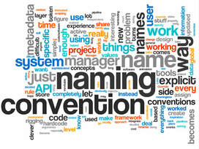
Naming Conventions
Types (classes, interfaces, enums,…)
  Camel case starting with uppercase (UpperCamel)
  Outer types should start with package name
  External (visible) inner types should start with package name
  Single outer type per file
Packages
  edu.brown.cs.user.project.<package>
  edu.brown.cs.project.<package>
  Should always be there
Imports
  Use single class imports (not on-demand) [fix imports command]
  Use static imports only where names will remain unambiguous

Slide 15
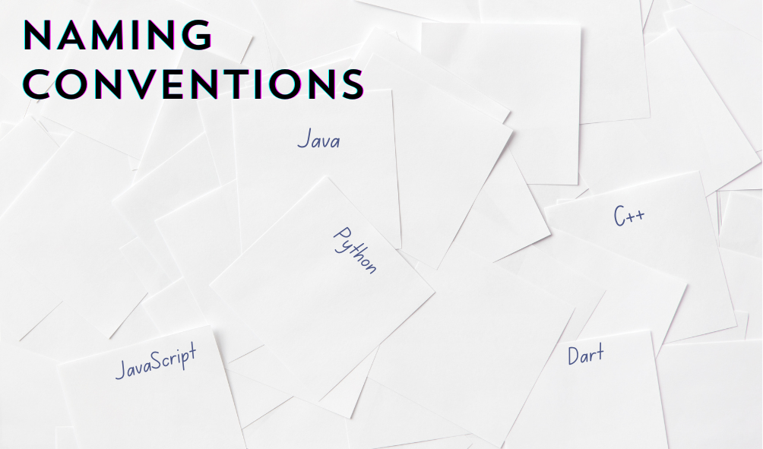
Naming Conventions
Different language can require different conventions
  May be recommended by the language
  May be required by the language (dart _xx for private)
  Adapt your coding conventions to the language as needed
  Compromise on multi-lingual projects
When modifying existing code, use its conventions
  Augmenting, adding a feature
  Patching, bug-fixing
  You first should learn the existing code conventions
When importing external code
  Change to your conventions
  But add citation to the original (copyright)
Project should have a common set of naming conventions
  Decide on these before you start coding (can use or adapt existing standards)
  Write them down so all members of team are consistent
  Put this in your repo

Slide 16
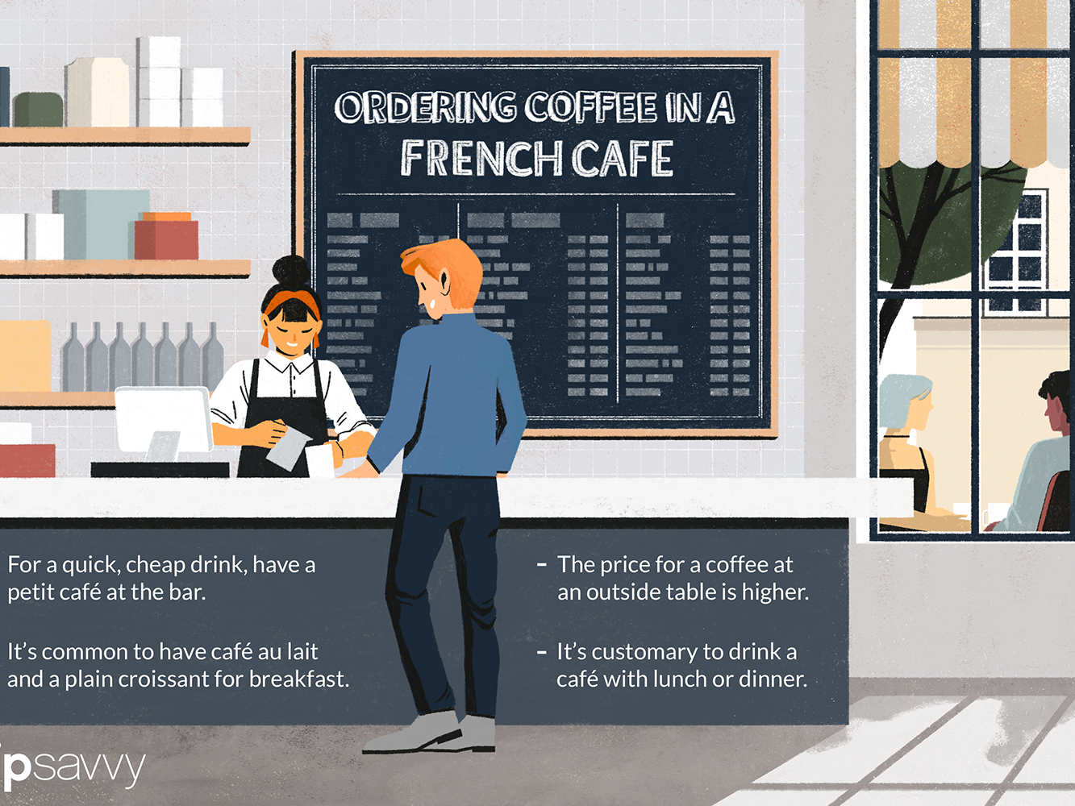
Ordering Conventions
Goal: Make it easy to find things in a file
Within a file (my Java conventions as an example)
  Header comments – name, purpose, author(s), copyright(s)
    Should only have a single purpose (we’ll get to that in class design)
    Include names of all authors (add as needed)
    Always include a copyright statement (even if simple or a reference)
  Main method if present
  Other top-level static factory methods
  Field definitions (private and then static private)
  Constructors and self-factory methods
  Access methods
  Public methods
  Private methods
  Inner classes (comment at end of class)
  Tail comment -- note the end of the file

Slide 17
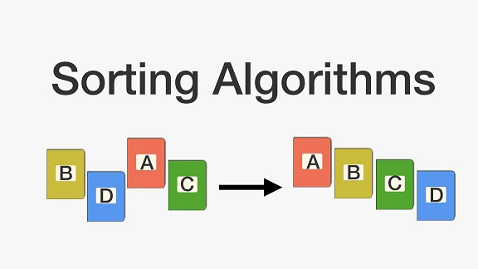
Ordering Conventions
Not as strict as naming conventions
Some slack allowed
  Private methods related only to a public method
  Inner classes related only to a single method
  Factory methods for inner classes might be treated as constructors
  Static methods might come earlier

Slide 18
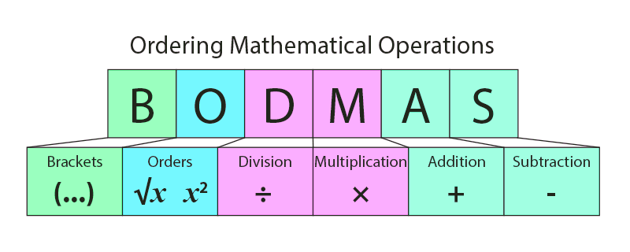
Ordering Conventions
Different languages can use different conventions
  Some might recommend them
  Some might require them (define before use)
When modifying existing code, use its conventions
  Augmenting, adding a feature
  Patching, bug-fixing
  You should learn the existing code conventions
When adapting existing code, convert to your conventions
Project should use a common set of ordering conventions
  Decide on these before you start coding
  Write them down & put into your repo

Slide 19

Coding Conventions
Principle of least privilege (keep things local)
  Make things private if possible
  Make things public only if necessary
  Fields should be private; protected at worst
    Never accessed outside of a class (or subclass) directly
  Javadoc (or equivalent) for all public and protected items
    Non-trivial descriptions
  Minimize public interfaces (keep small and few)
Protected versus package-protected
Methods should fit on one “page”
Inner classes, static inner classes, and outer classes
Hierarchies as inner classes versus outer classes
Coding conventions depend a lot on the language
We’ll cover coding conventions in more detail later

Slide 20
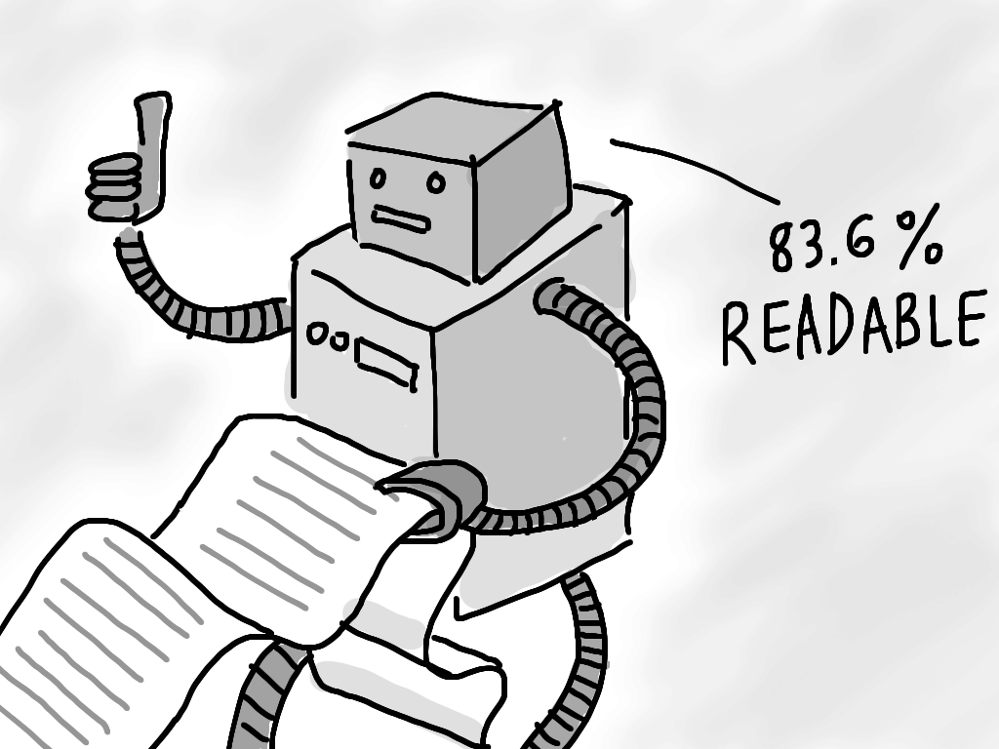
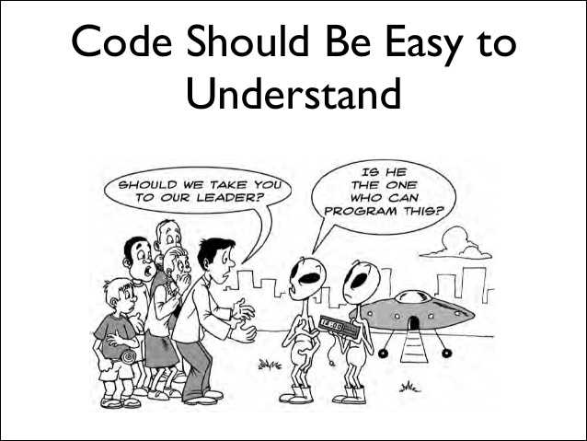
Formatting
Avoid complex conditions and constructs
  Code should be obvious
  Break up complex conditions into logical units
  Parenthesize appropriately (X and Y or Z)
Code should fit on the line
  Maximum line length 80-100 characters
  Split lines, or better yet, rewrite to avoid
Use spaces, blank lines, and comments to enhance readability
  And do so liberally
  Sentences and paragraphs
Consistent indentation
  3 or 4 spaces, not 2 or 8
Consistent formatting (e.g., { ... })
  And consistent spacing
Consistent constructs (e.g., while(true) vs. for( ; ; ) )

Slide 21

Comments
Block comments between logically separate components
  Separate sections
  Separate distinct functions
  Make it easier to find the components
  Make it easier to find things in the file without looking at all the code
  I prefer enclosed comments that stand out
    But some editors can make this hard (mine don’t)
Javadoc comments for external methods & fields
  Or language-equivalent where appropriate
In-line (//) comments where the code is non-obvious
Use blank lines liberally but meaningfully (paragraphs, sentences)

Slide 22

Formatting Conventions
Supported by IDEs
  Eclipse, IntelliJ, various VS-Code plugins
  Supported by checkstyle tool
Environment can reformat code to set specifications
  BUT not all conventions supported
  Usually, will not change line spacing
  Can handle initial indentation as you type
  Can re-indent quickly
You should set this up for your project
  Write it down; include in repo
  Define settings for the environments you are going to use

Slide 23
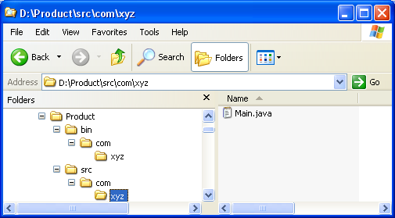
My File System Organization
root (project name)
  lib
  resources
  javasrc
    edu …
  java (compiler output)
  bin
    scripts and executables
  <package>
    src: link to ../javasrc/…/package
    bin.java: link to ../java/…/package

Slide 24
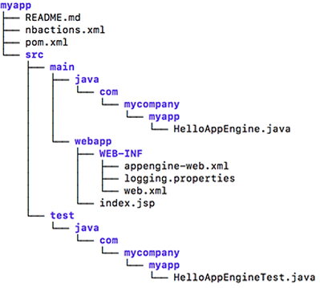
Maven File System Organization

Slide 25
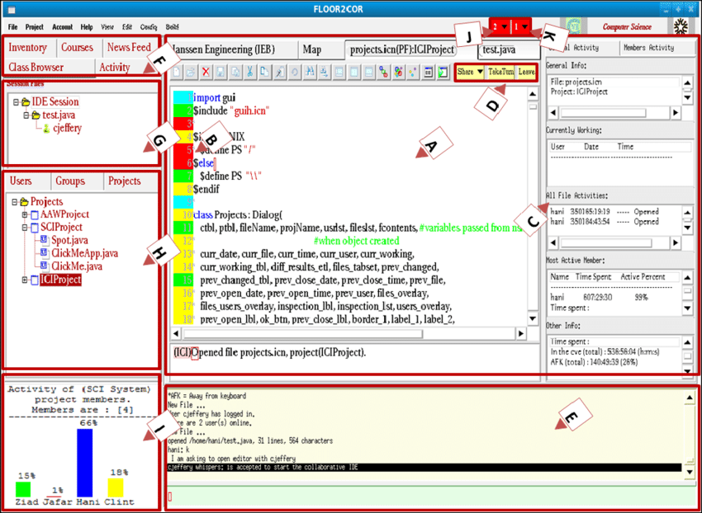
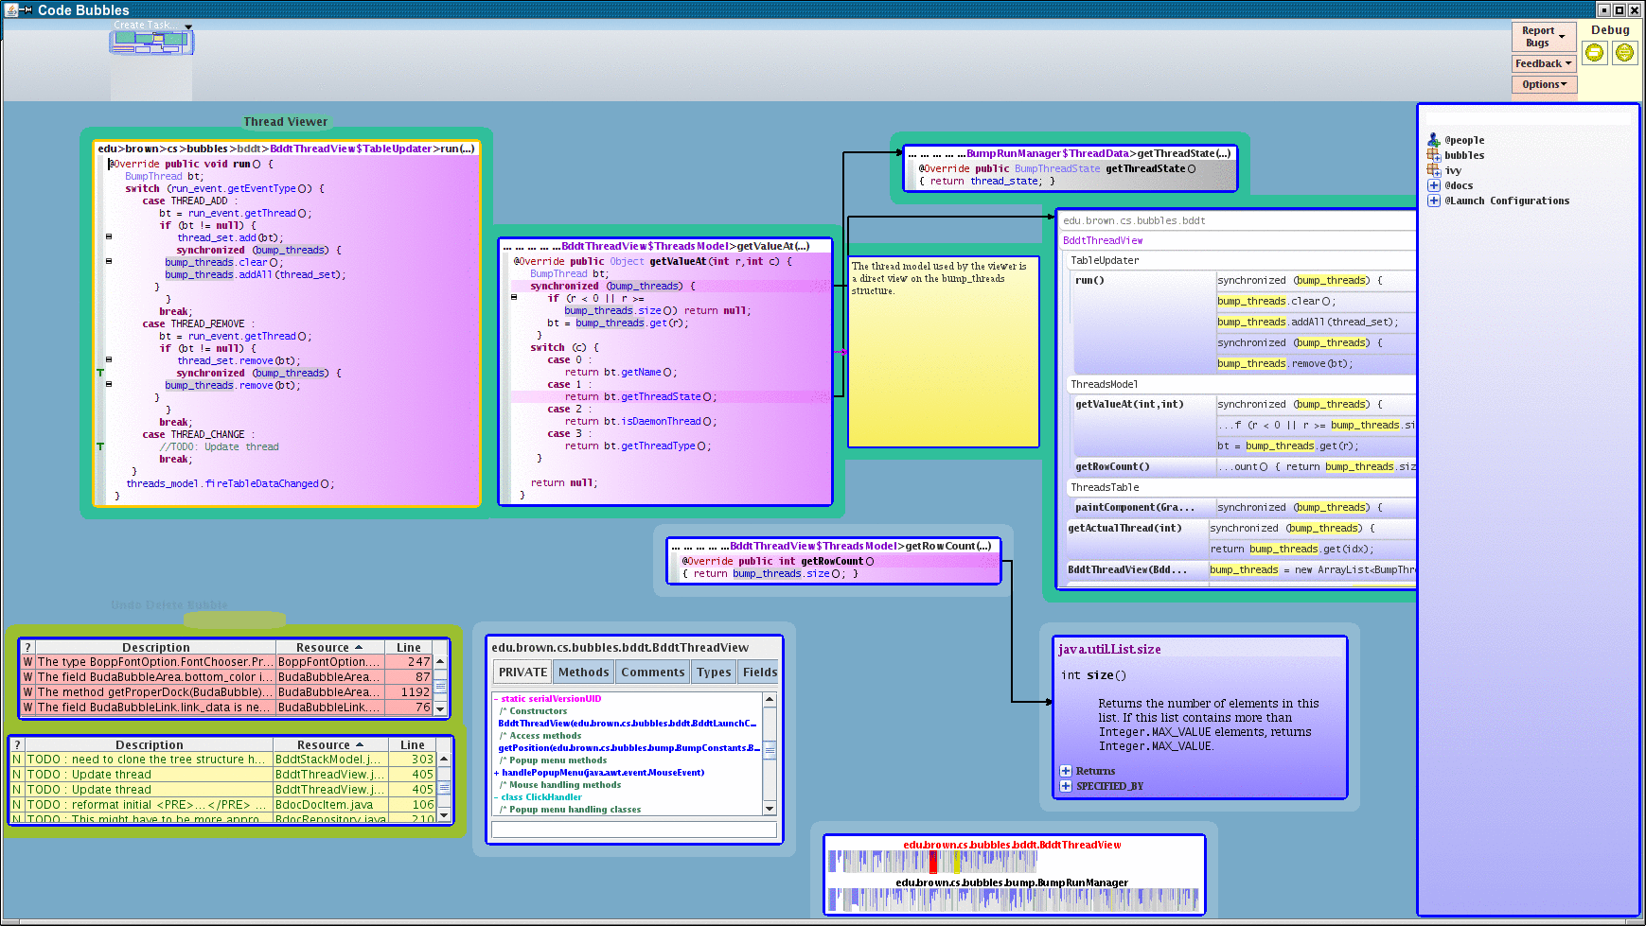
Integrated Development Environments
Help a lot, but take a bit of getting used to
  Immediate feedback on syntax errors
    Quick feedback on semantic errors
  Good integrated debugging facilities
  Tool integration (git, junit, ant, …)
  Formatting, import organization
I would like you to try Code Bubbles
  If you are using Java
  I need the feedback
  Based on first assignment
  But not required
You should all be using IDEs

Slide 26
Research in Coding Techniques
Automatic Style Inference and Application
Evaluating readability based on style

Slide 27
PROJECT HOMEWORK
Set up a GIT repo for your project
  Instructions for project meeting to follow
You should have a good sense of what to implement
  Put a goal statement describing this in your repo
    And hand-in via canvas
  When you have a software architecture
    Create a document describing it in your repo
    This should be done by 9/26 if possible
Agree on a coding standard for your project
  Write it down (and save in your git repo)
  Create an Eclipse / Idea / VSCode style file for it
  Possibly create a CHECKSTYLE description for it

Slide 28
HOMEWORK /Further Reading
Homework: Get an initial version of Bounce running
  Use the coding style agreed upon for your project
    Adapted for language differences
  Convert to that style if necessary
  Due 9/26 (hand in via canvas)
Further reading
  https://git-scm.com/docs
  https://google.github.io/styleguide/javaguide.html
  https://www.oracle.com/technetwork/java/codeconventions-150003.pdf
  https://medium.com/@rhamedy/a-short-summary-of-java-coding-best-practices-31283d0167d3

Slide 29
Project Meeting Exercise
You should have a GitHub account (prior homework)
Meet as a project group
  Decide on a project name (should have been done)
One person create a GitHub repo for your project
  Can be public or private
  If private, add the other members of the group
    Add me as well (github Id: stevenreiss)
  Add a README.md file
  Add a status directory
Everyone in group clone the repository
  Create a file tasks-<name>.md in status
  Git add it to the repo
  Git push
When everyone is done
  Git pull the repo so that everyone has the latest copy

