Slide 1
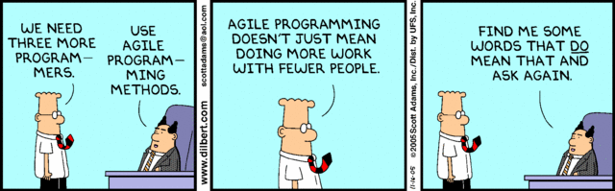
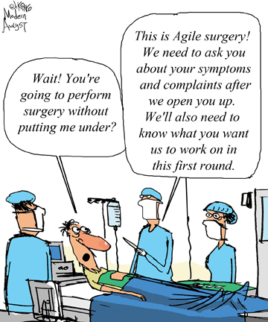
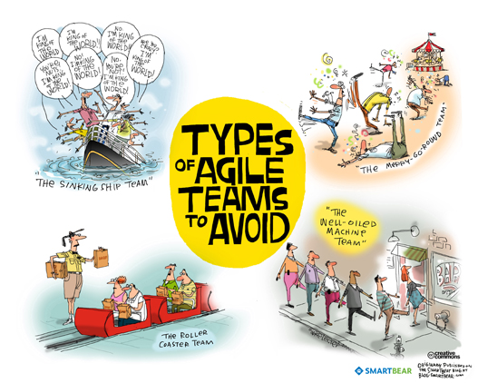
Team Management
CSCI2340: Software Engineering of Large Systems
Steven P. Reiss

Slide 2
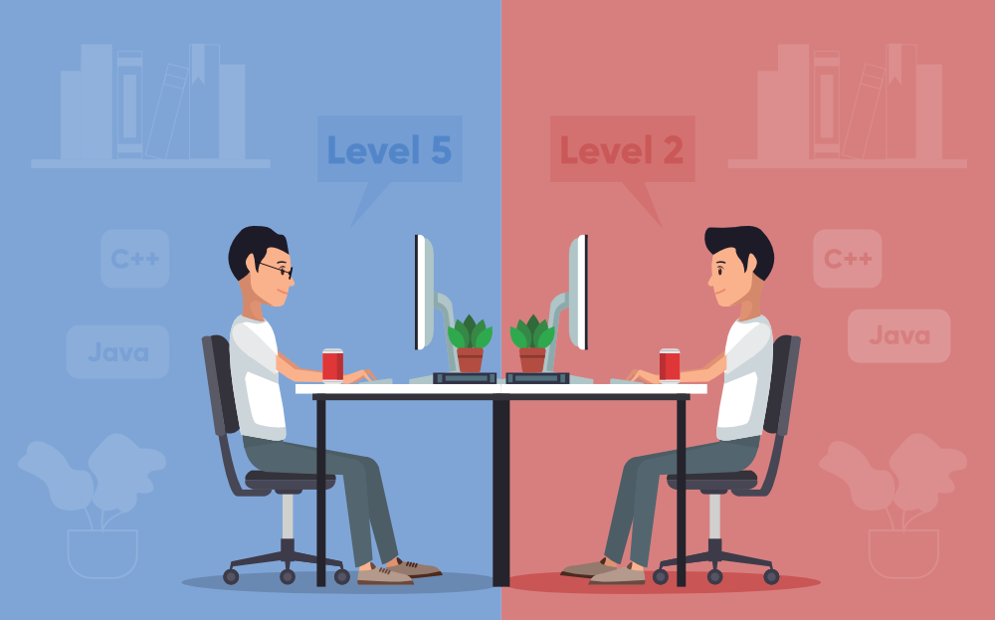
Continuing Preparation for Programming
Working in teams
Collaborative software development
Workflows and actions
Cost Estimation
Test-Driven Development

Slide 3
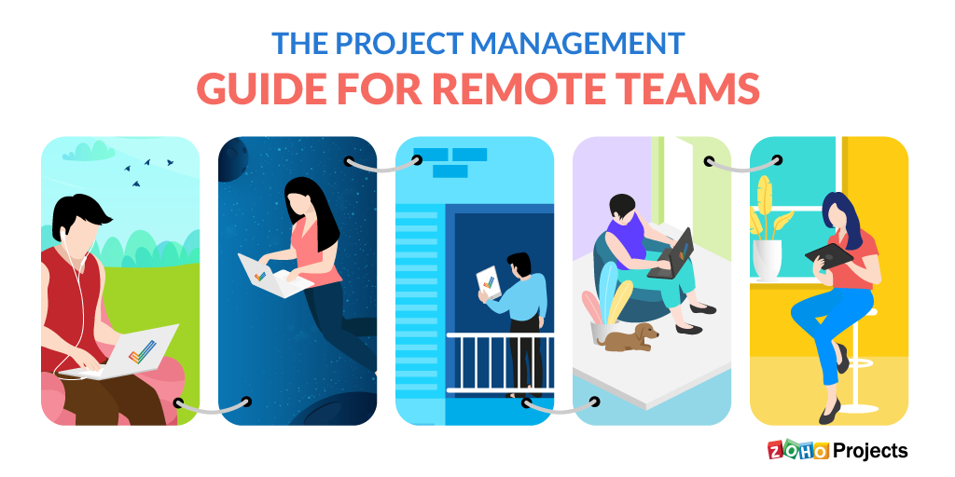
Working in Teams
Required for large projects
  Too big to do on ones own
  Multiple people can work in parallel
Requires Effort
  Coordination, organization, management
Difficult to make productive
  Mythical Man Month (Fred Brooks)
Tools can help
  Software process programming
  Modern team management tools

Slide 4
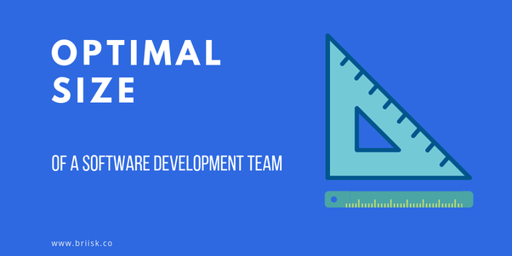

Team Size Matters
Small teams (<= 4)
  Can get everyone together
  Number of communication paths is small
  Meetings can be productive, even if not organized
  Easier to move people around
  People can learn the whole system
  Easy to divide project into logical pieces
    Front end, back end, database, business logic, …
    People can work independently

Slide 5
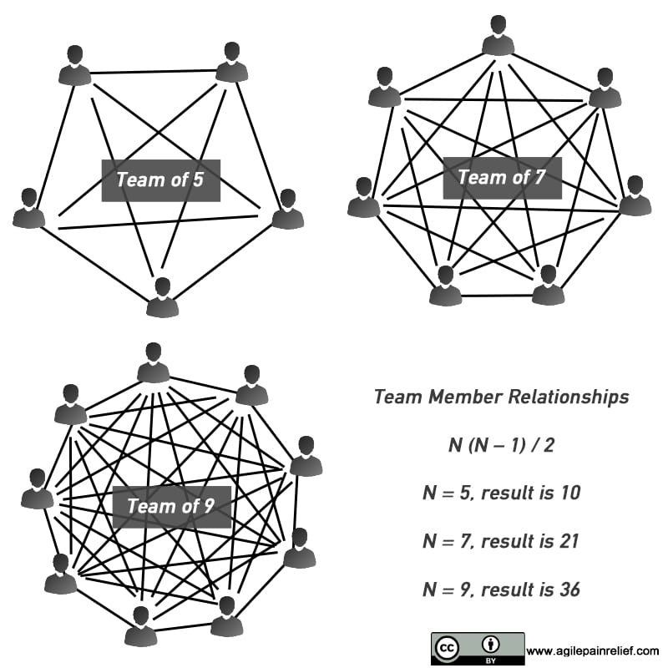
Team Size Matters
Moderate Teams (~6-12)
  Assume at least one person will be absent from any meeting
  Assume at least one person will flake out (get sick, …)
  Can’t communicate with everyone
  Meetings take longer & get less done
  Need better coordination
  Project needs to be managed
  More difficult to divide into independent pieces
  More critical paths (things that can go wrong)
  Difficult to understand the whole system

Slide 6
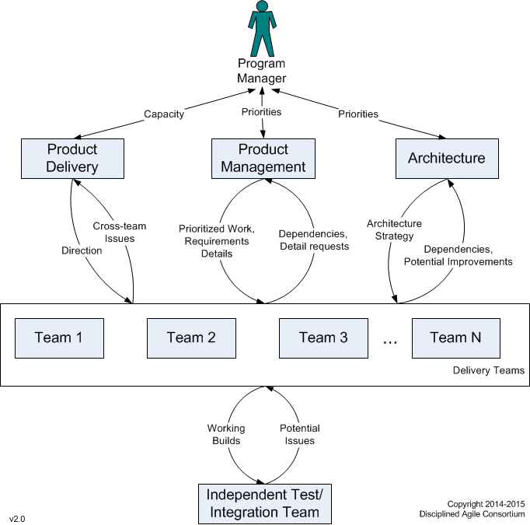
Team Size Matters
Large Teams (15+)
  Require a hierarchy
  Target system generally quite large
    No one knows all the details
    Most members don’t know the complete system
      Concentrate on your piece and how it fits in, not everything else
  Different strategies are used
    These are out of favor except for very large systems
    Divide the system into separable components
      Build these independently using smaller teams
      With common libraries or frameworks (separate teams)

Slide 7

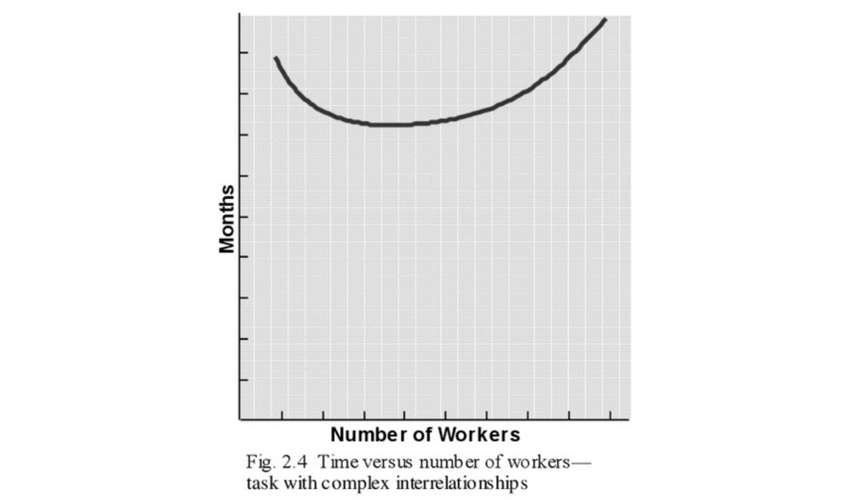
Mythical Man-Month
Adding people to a project can delay it further
  Can’t measure effort in terms of man-months

Slide 8

Team Management
Software teams need to be managed
  Ensure equality of workload
  Ensure consistency of decisions
Democracy doesn’t work
  Someone must make hard decisions
  Someone must ensure consistency
  Someone must make sure everyone is pulling their weight
    People aren’t getting in over their head
    People work on things they are best at

Slide 9

Team Leader
Need a team leader or manager
  Break project into tasks
  Assign people to tasks
  Keep track of what everyone is doing
  Coordinate where needed
  Reassign people as needed
  Make critical decisions
  Ensure consistency
  In charge of presentations

Slide 10
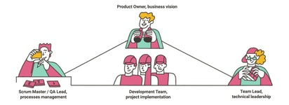
Team Management: Other Roles
Assistant Manager or Leader
  Manager not available 24/7, might get ill, might need help
Product Managers
  In charge of a portion of the software (e.g., front end or back end)
Documentation Manager
  Organize files, documents, requirements, repository, versions & branches …
    This is what I see to grade you on
Quality Assurance (QA, Testing) Manager
  Create system test cases, supervise testing, …
  Approve code for release
User Interface Guru
  Ensure a consistent, easy-to-use, nice-to-look at user interface
  Designing look and feel, icons, logos, etc.
Provisionary
  Handles setting up or provisioning AWS, VMs, Containers, databases, ...

Slide 11
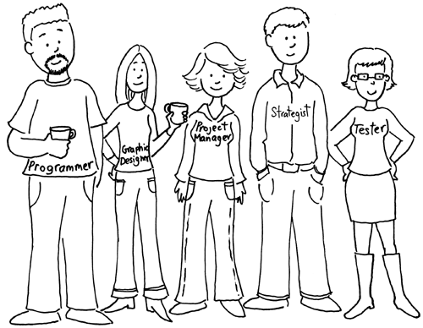
Team Management: Other Roles
Security, Privacy and Ethics Czar
  Ensure system is secure & fair
  Security testing, fairness testing
  Set privacy policy, enforce privacy policy
Performance Analyst
  Determine where and when there are performance problems
  Performance testing
Scribe
  Take notes at meetings; ensure information is current
Domain Experts & Users
  Provide essential information about the problem being solved
Skeptic
  Question everything. Avoid risks and failure.

Slide 12
PROJECT
Let's have a short project meeting
  Discuss roles
  Tentative role assignments
  Check status
  What should be done by whom this week
    Requirements, specifications and software architecture
  10 minutes
Then we’ll get into tools & other topics

Slide 13

Team Communication
Regular communication is key to a successful team
  Knowing how your part fits with others
  Getting things done in a time fashion
  Negotiating who does what
  Negotiating interfaces between components
Physical meetings can be difficult
  Team members might be distributed around the world
  People have other commitments
Tools for communication
  SLACK
  Discord
  JIRA
  GITHUB (wiki, issues)

Slide 14
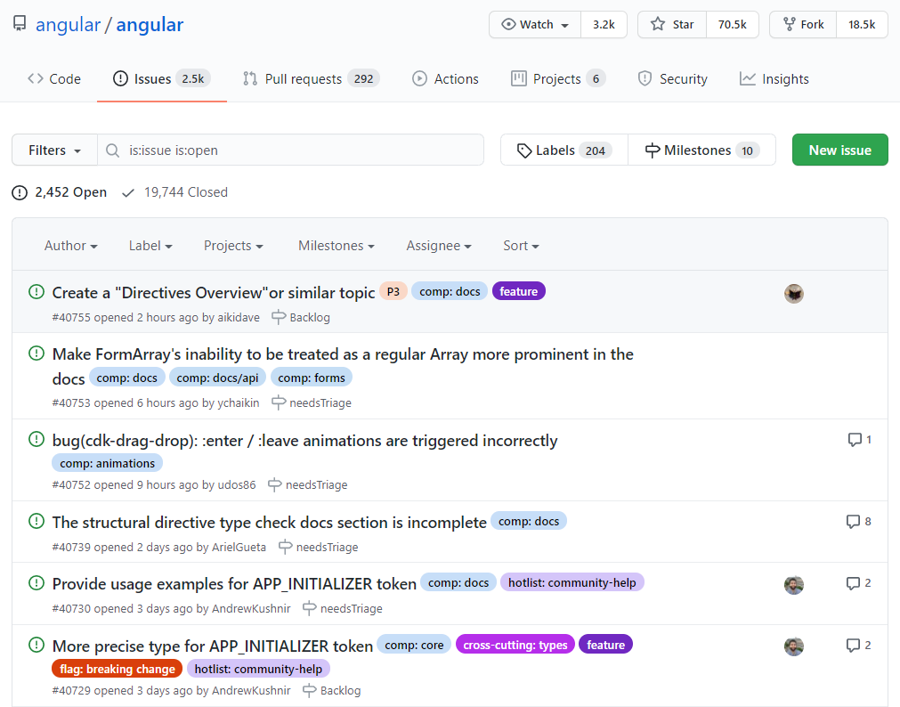
GitHub Communication Tools
GitHub Wikis
  Good for documentation, notes, comments
    Internal as well as external documentation
  Let others provide feedback
GitHub Issues
  Items in repo to plan, discuss and track work
  Bug tracking
  Combines slack-like messaging with project planning

Slide 15
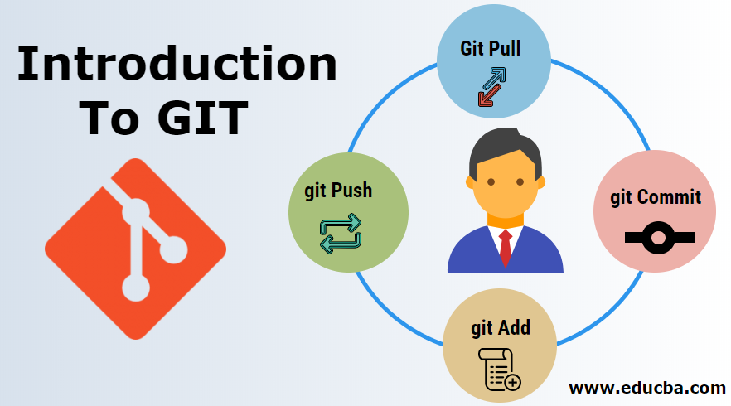
Version Management: GIT
Designed for modern software development
  Flexible repositories
  Ease of creating branches
Designed for agile development
  Good for all development

Slide 16
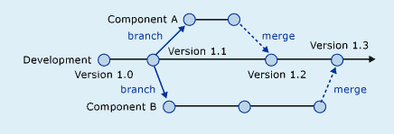
Software Branching
Individuals (or smaller teams) work on an extension or feature
  Interim system might not be usable
  Extension might not work or be desirable at the end
  Multiple such extensions developed at once
Want to allow these teams to work productively
  Without interfering with one another
This can be accomplished with branches
  Different, independent versions of the software
  Developers (or small teams) work on their own branch
But branches aren’t necessary
  Can develop a substitute method or class
  And make using that class conditioned on a flag or environment variable
  A bit more work as the status quo has to be maintained

Slide 17

Avoiding Branches
Branches can create confusion
  Coding for the past, not the future
Eventually branches need to be merged
  With each other
  With the main system
Problems arise when there are conflicting changes
  Ideally these are avoided
  Selecting features to avoid conflicts
  In practice, they are common
  Branching makes these worse
Need a team strategy for handling merge problems
  Team manager, negotiation, code ownership, …

Slide 18
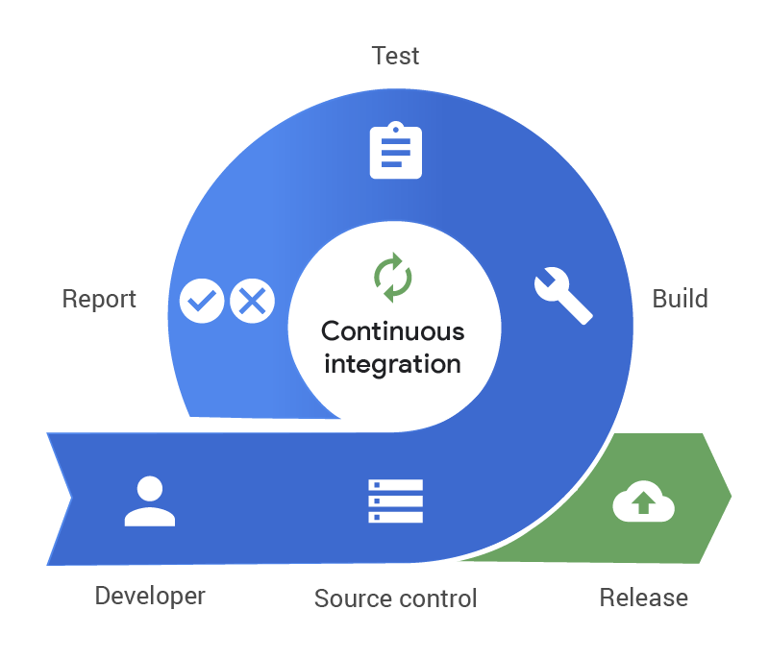
Continuous Integration
Always have a working version of the system
  Minimize branching for everyday development
  Merge all code changes regularly (daily/weekly/…)
  Build and test the system on merge
  Automate this process as much as possible
Pros
  Simplifies merging
  Helps find bugs faster (continuous testing)
  Improves productivity
  Supports dogfooding
Cons
  Requires development that can be merged
  What to do when tests fail

Slide 19
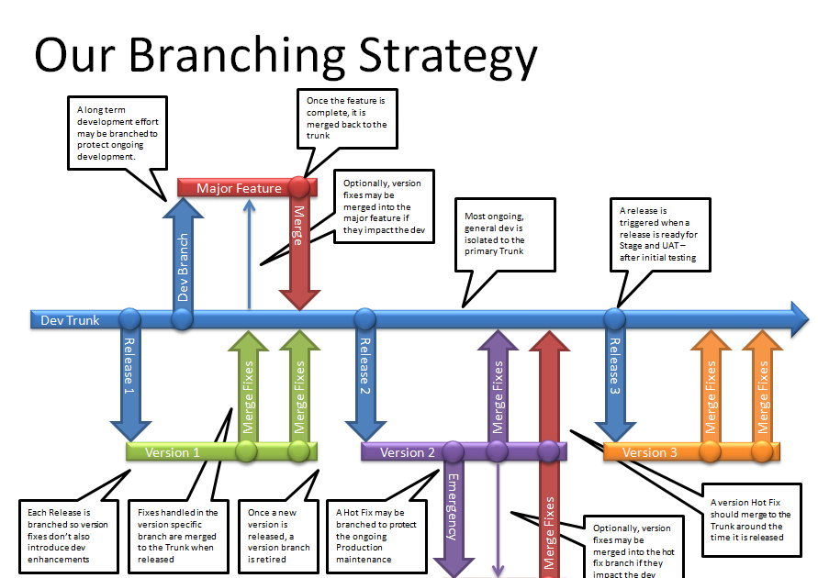
Branching and Maintenance
Continuous integration obviates branching
  Everything done in the main branch
  Everyone works in the main branch
  Generally fewer and less severe merge conflicts
  Requires more thought while coding
Branching might still be needed for maintenance
  Current stable version of the system for users
  Current development version of the system
  Previous user versions of the system
Security patches need to be made in all of these

Slide 20
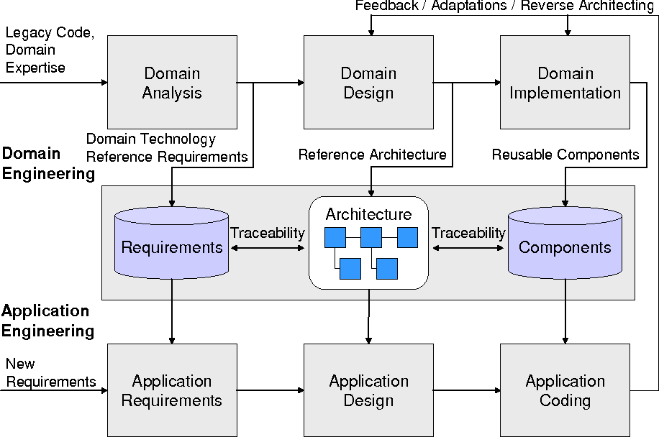
Families of Software Systems
Set of applications with common set of features
  All developed at once as one system
  System can be configured in multiple ways
Might be related versions of the same system
  State & Federal tax programs
  IntelliJ enterprise versus community
  Different versions of an operating system
Might be separate systems with a common framework
This is another approach that is used
  But should be considered in architecture & design
  Generally, for larger systems

Slide 21

Workflows and Automation
Continuous Integration requires automation
  Building, testing, deploying the system
  Useful in general
Workflows are a way of doing this automation
  Triggering event
  Actions to be run at that point
Workflows are more general
  Can be used for lots of different things
  On check out; on push; on pull; on reviews
  Supported by tools

Slide 22
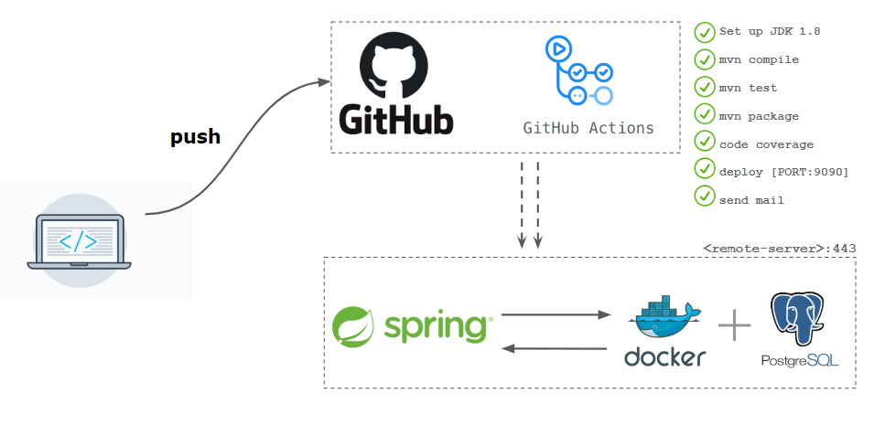
GitHub Actions
A general approach to automation
  Implementation of workflows
  For continuous integration or otherwise
Actions have a trigger event
  Push, pull most common
  Lots of others available
Actions have one or more jobs
  Common jobs (e.g., git actions, email, build & test)
  Scripts
  Actions can be conditional, run locally or globally, …

Slide 23
Using GitHub Actions
Defined in a yaml file in .github/workflows in project directory
  Useful for team projects
  But these run in GitHub
AWS CodePipeline and other alternatives exist
Git provides a local alternative: hooks
  Executable scripts in .git/hooks directory
  pre-commit, prepare-commit-msg, commit-msg, post-commit
  post-checkout, post-merge (pull), pre-push
Can also just create your own shell scripts
  Or ant tasks or make tasks
You should think about how these could be used in project
  To simplify your work

Slide 24
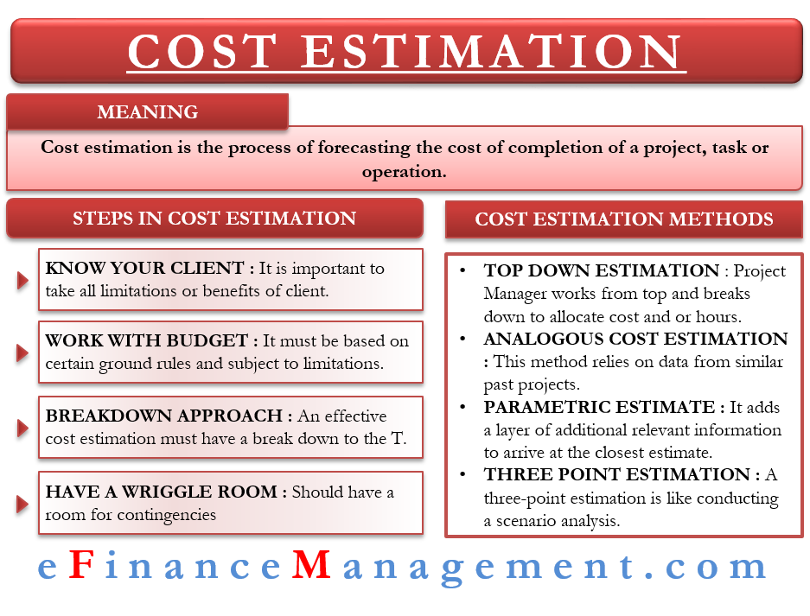
Estimating Time and Effort
Required for Team Organization
  Divide the project up fairly
  Get critical pieces working early
    Especially when others are dependent on them
  Determine what will be done when
  Determine who will do what
  You need to know how long it will take to build the software
Based on
  Complexity and size of code involved
  Complexity of interaction with other components
  Knowledge & abilities of programmer assigned

Slide 25

Estimating Time and Effort
Known systems – take various factors into account
  COCOMO model is the best known
  Expert experience is most widely used
My Approach
  Expert estimate based on similar code, size, complexity
  Multiply by 4 (for myself; different factor if others coding)
Easier to do for smaller pieces of code
  Rather than the whole system at once
  Agile sprints – only estimate the week’s work, not the project

Slide 26
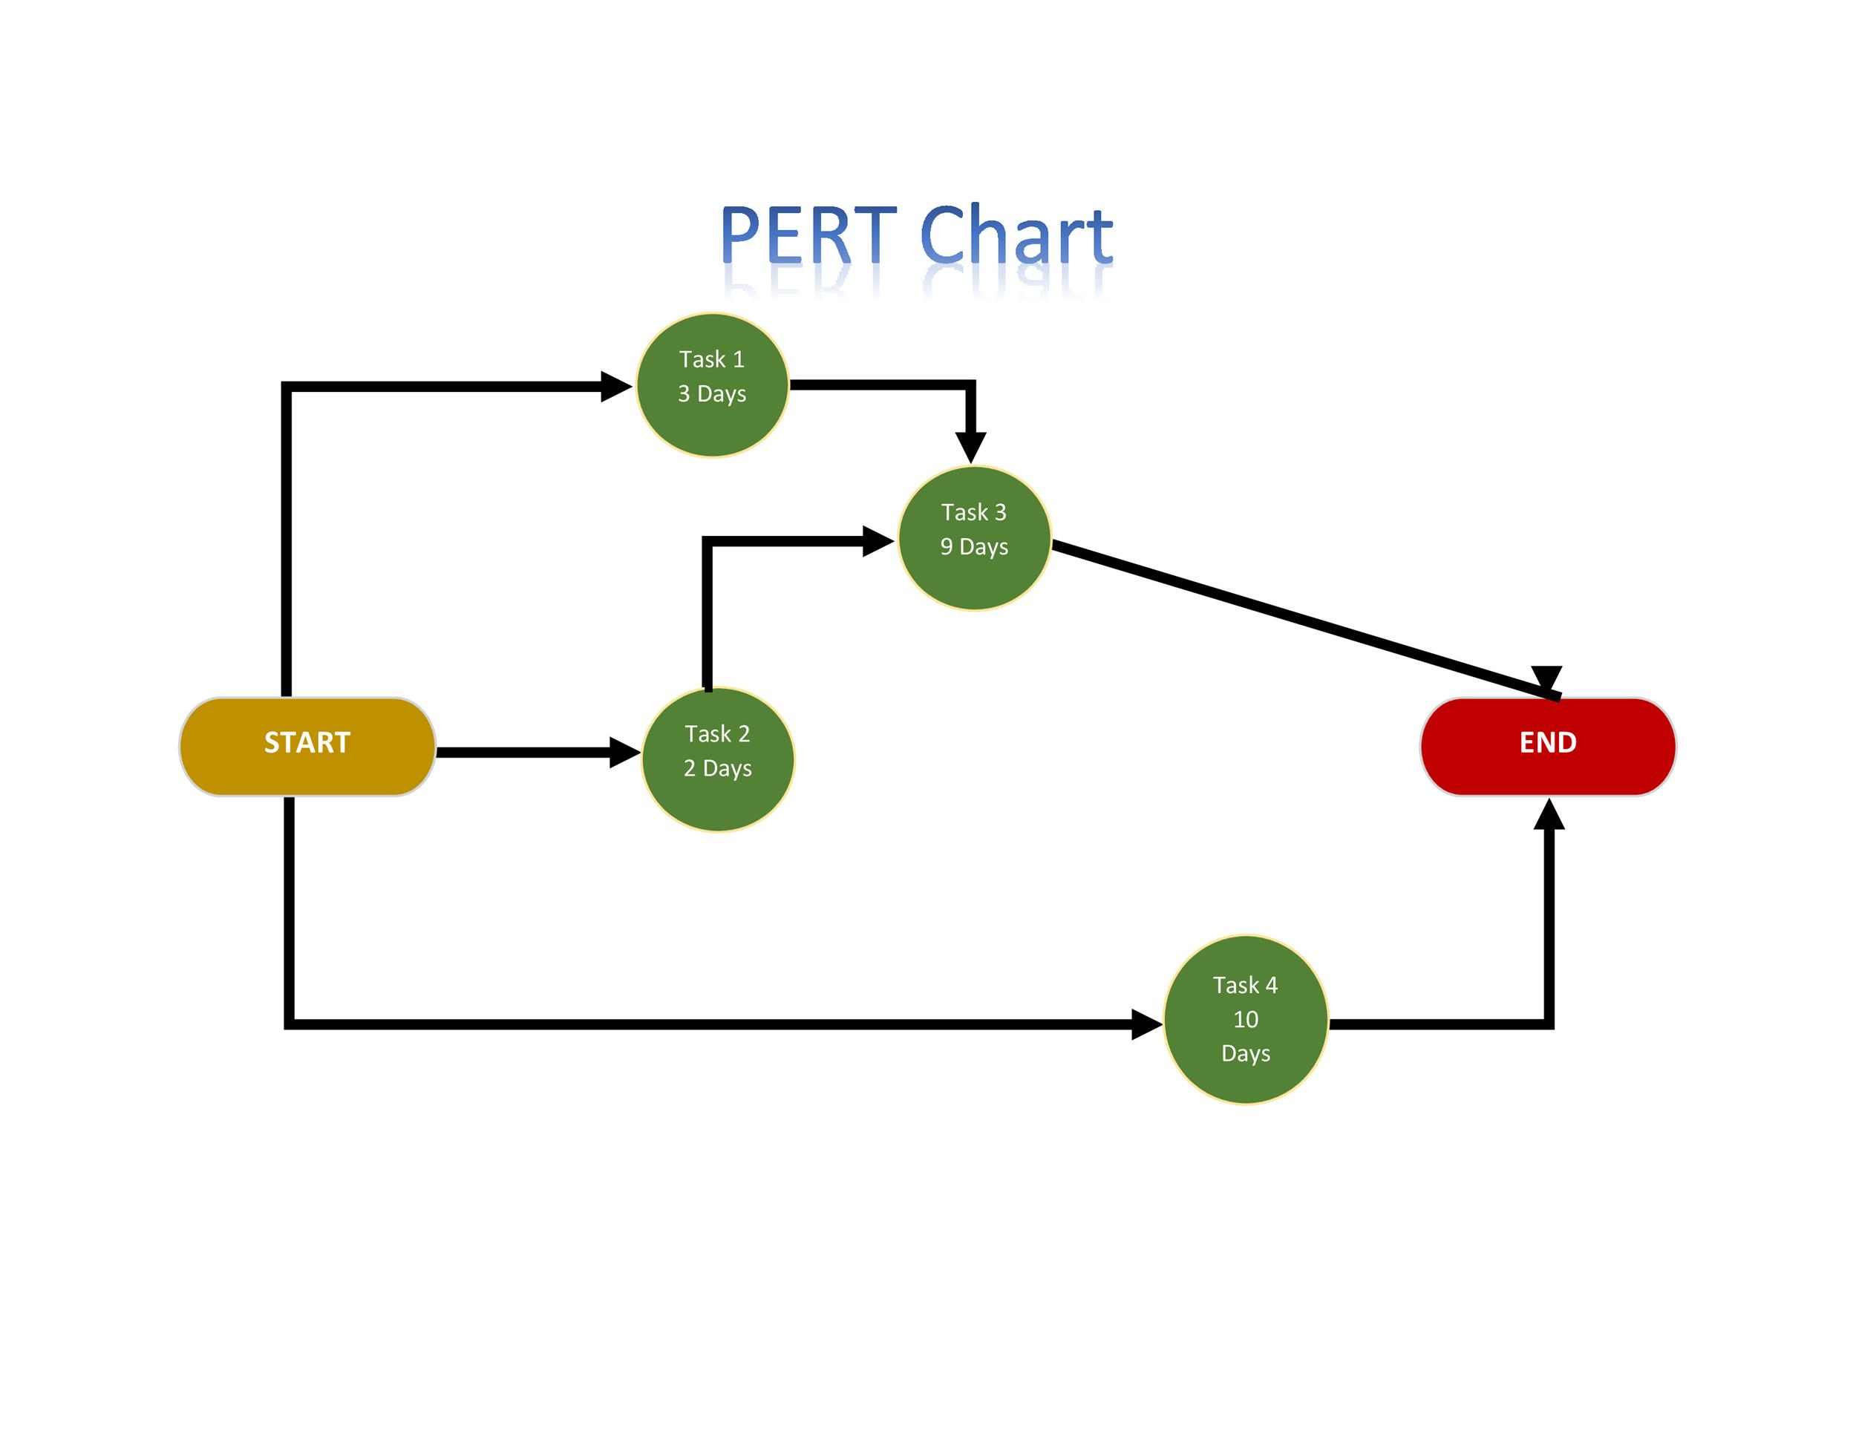
Project Management
Some pieces of the project are more important than others
  Required before other pieces can be tested (or even written)
  Required as a framework for building other pieces
Project management tries to identify these dependencies
  Project dependency graph (PERT & GANTT Charts)
Add time estimates to this graph
  Identify critical path (what takes the longest)
  When to start each piece so it gets done in time
  Who to assign to each piece

Slide 27
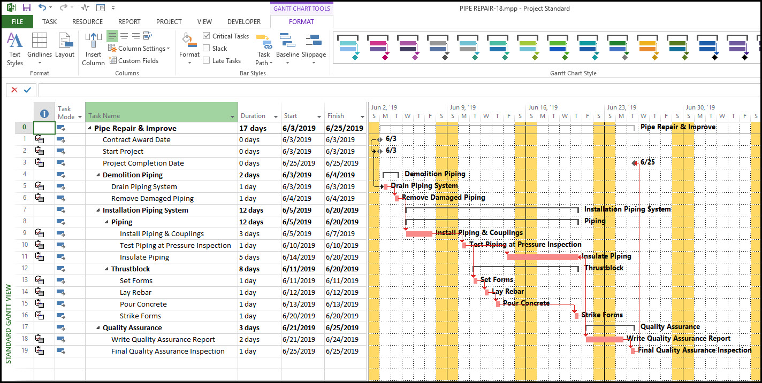
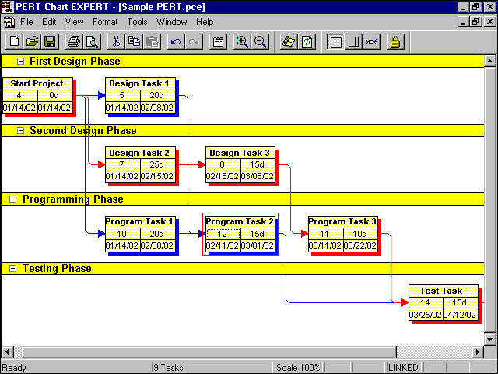
PERT and GANTT Charts

Slide 28
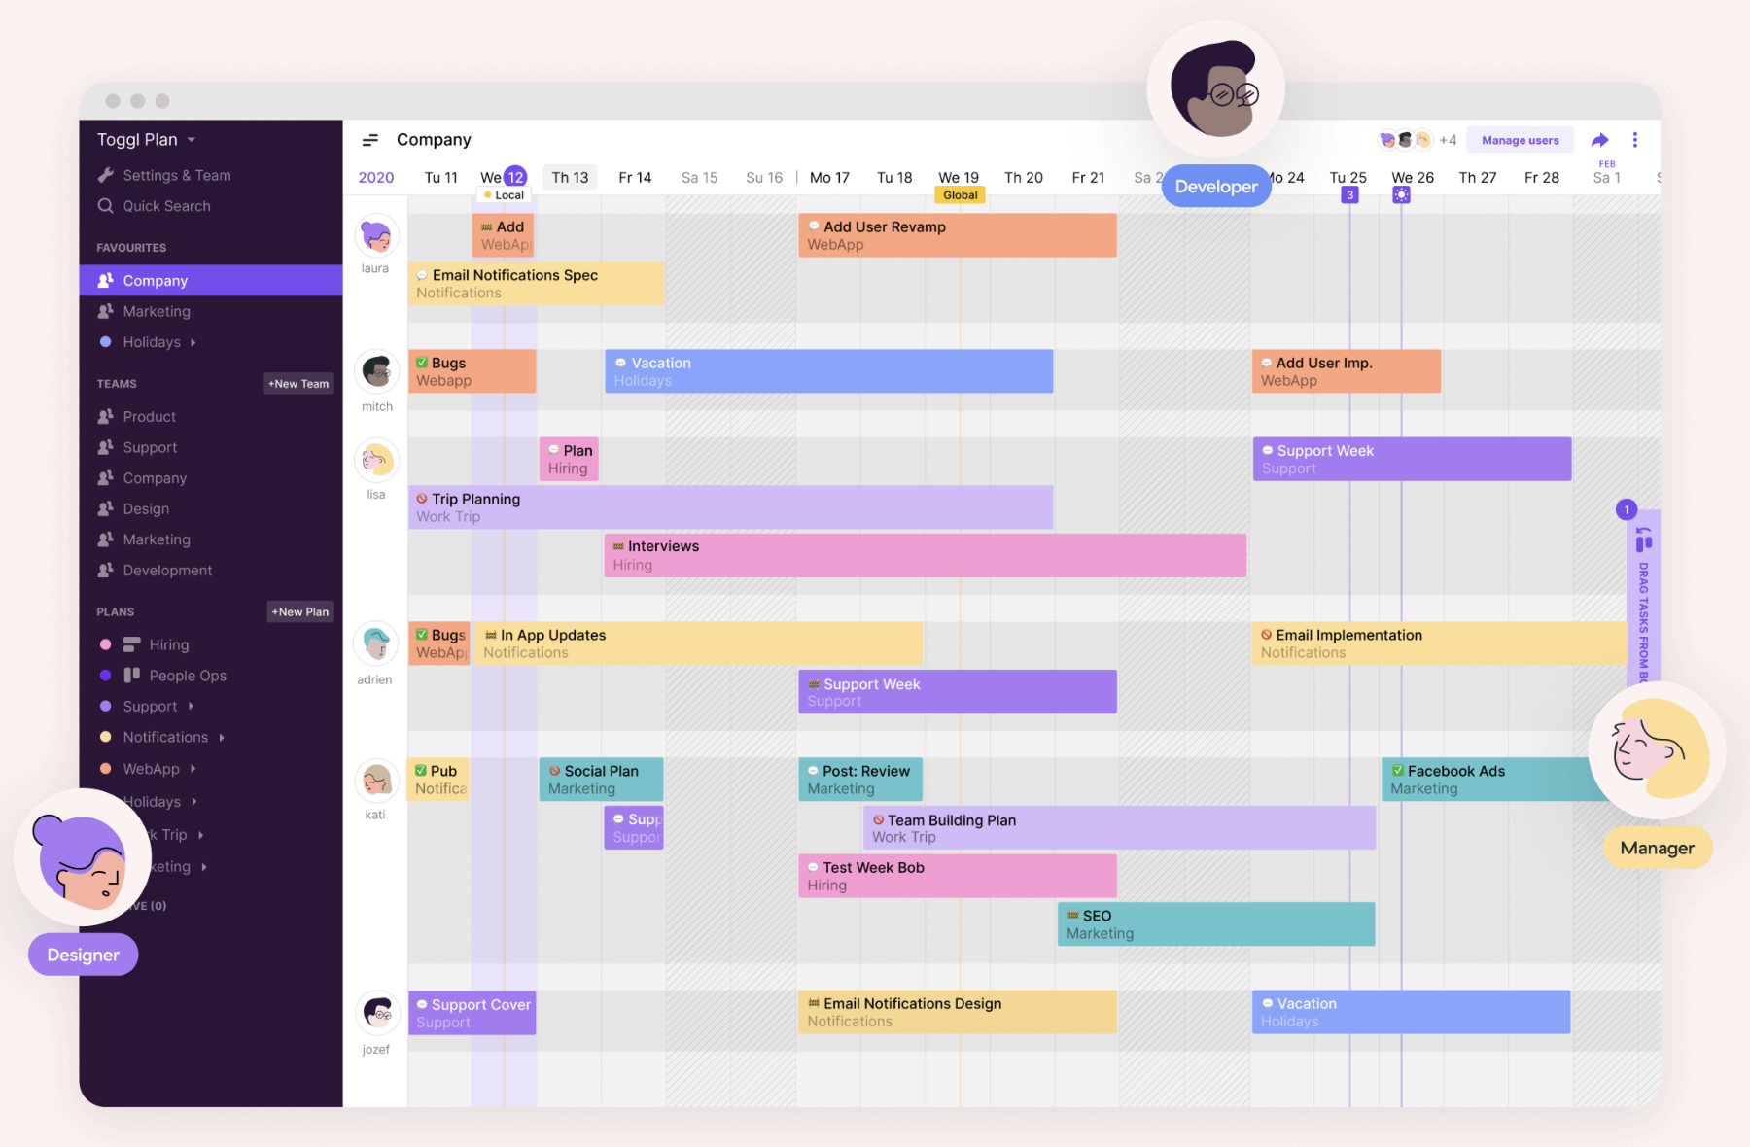
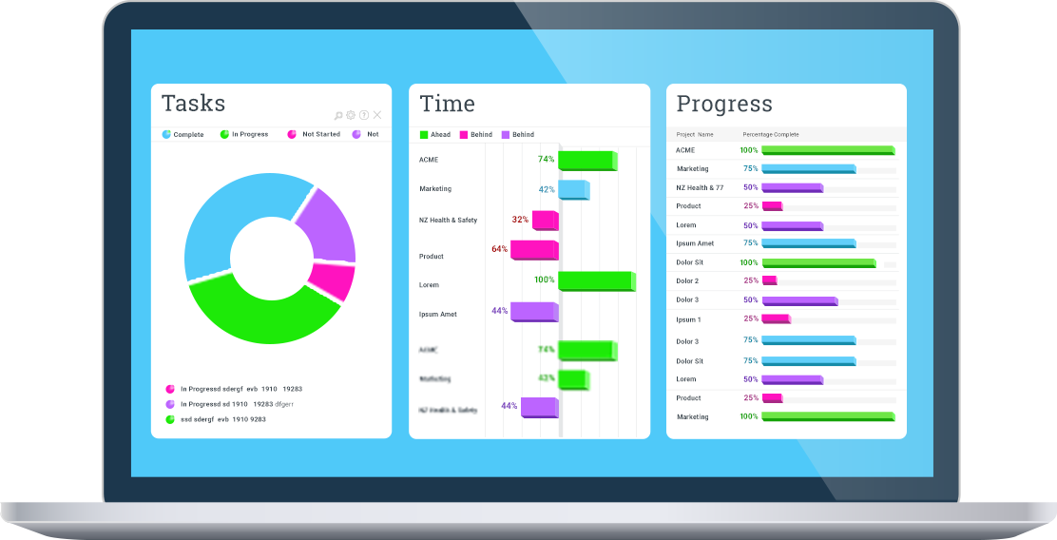
Project Management Software
Microsoft Project Manager
JIRA
GitHub issues (gantt chart generator)

Slide 29
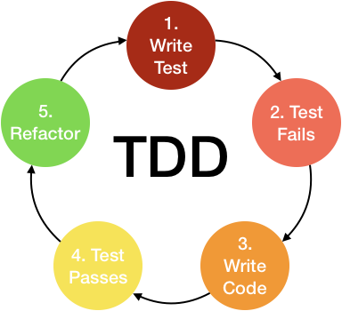
Test-Driven Development
This is emphasized in agile development
  Used in earlier courses
Write the test cases first
  Develop the code to pass the test cases
Design the code & system so it can be tested
  This is not as easy as it sounds
  Especially for UI-based, interactive systems
Write the user interface first
  Develop code to handle user interactions one-by-one
  Simulate the user interactions with test cases
  Good alternative or addition for UI-heavy applications

Slide 30
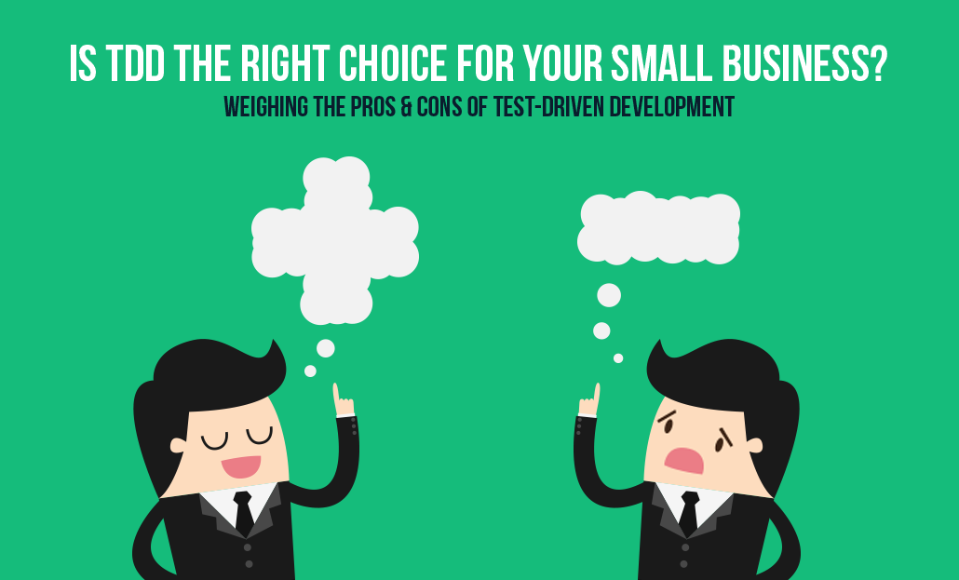
Test-Driven Development Pros/Cons
Advantages
  You can see how well you are doing
  Provides a focus for code development
  Better understanding of what needs to be written
  Ensures code works as it is written
Disadvantages
  Test cases can be difficult to write, especially interactive/graphical
    Can be as much work as actually writing the code
  Might need to write mocking (dummy) libraries, etc.
  Test cases and testing code can be buggy
  Evolving code means evolving the test cases as well
  Can overfit code to test cases, not look forward
  Files, external systems, etc. get in the way

Slide 31
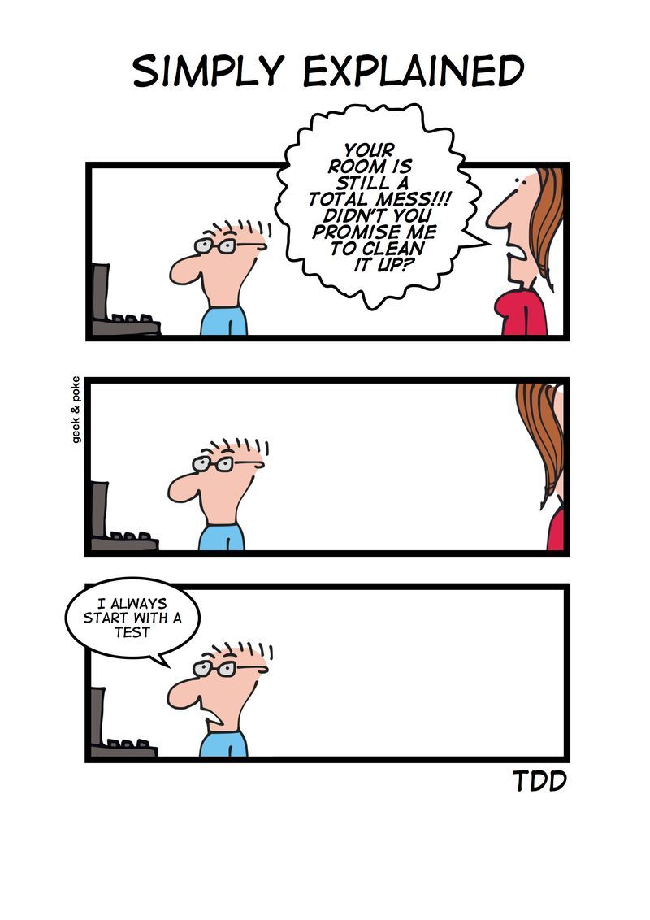
Test Cases
Are an essential part of the system
  Whether written before, during or after coding
  Needed to avoid regression errors
  Needed to approve code before general use
Can clarify design before coding
Can need as much effort as the code
  Typically, with more bugs
  Often not maintained as well
Alternatives
  Dogfooding
  Automated bug reporting
  Alpha and beta testing

Slide 32
Research in Programming Teams
Continuous Integration and workflows
User interface testing
Design for software families

Slide 33
PROJECT HOMEWORK
Check out various communication tools
  SLACK, GitHub Issues, …
  Choose one or more for your team
    Set it up, start using it
Finalize project roles
  Ensure absent people agree to their role
  Ensure everyone is “happy”
Set up an initial PERT/GANTT chart for your project
  Possibly using GitHub issues
  Little to put in there now since we haven’t done design
In addition to deciding on an overall software architecture
  Based on requirements and specifications
  Software architecture hand-in due Thursday (one per team)

Slide 34
HOMEWORK / Further Reading
Code up the bouncing balls assignment
Make your programming assignment code match the coding style for your project
  With a personal package name or equivalent
  With personal class names matching package
  Modified for different programming language if needed
Programming assignment should be working by class Thursday

Slide 35
Further Reading
https://github.com/minhloc2011/books/blob/master/Peopleware%2C%203rd%20Edition.pdf
https://martinfowler.com/articles/continuousIntegration.html

