Slide 1
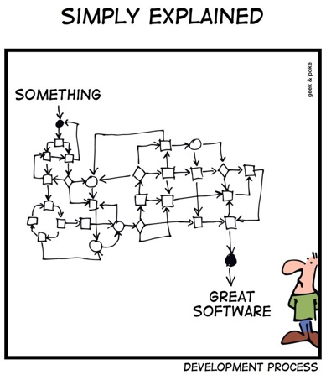
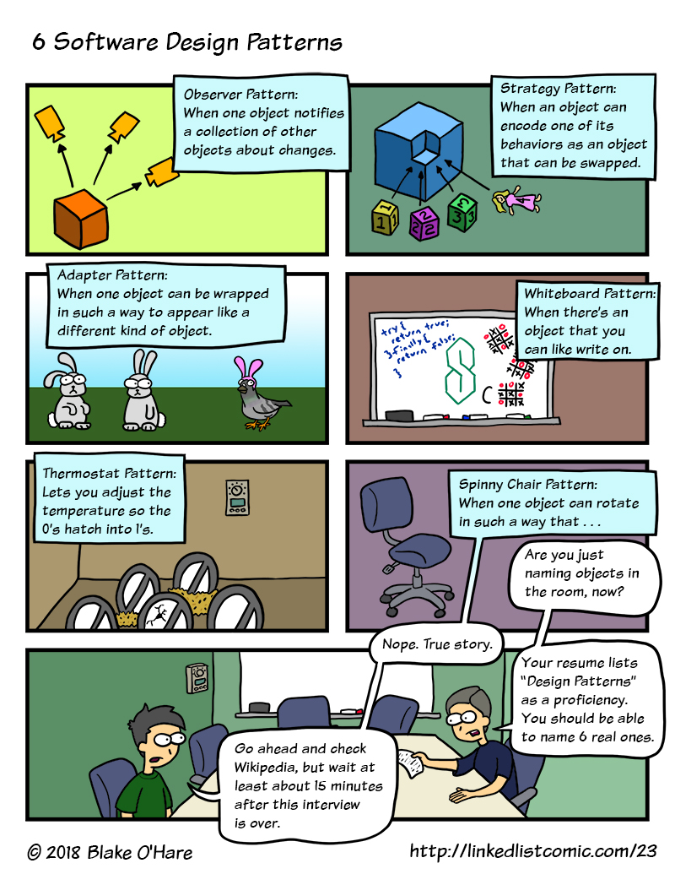
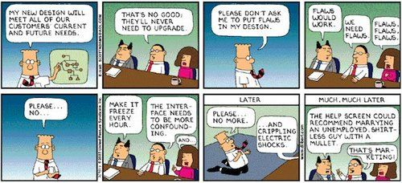
High Level Design
CSCI2340: Software Engineering of Large Systems
Steven P. Reiss

Slide 2
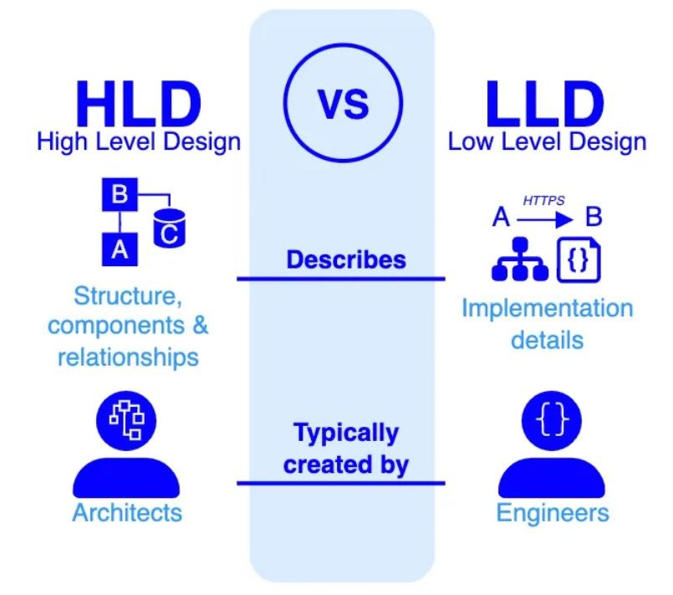
High Level Design
Suppose you know your software architecture
  You next must design its software constituents
  Both its components and communications
To do this you need to consider:
  What are the goals of your design
  What are the actual software components
  How to represent the design
This is what we cover next
  Today and next time

Slide 3
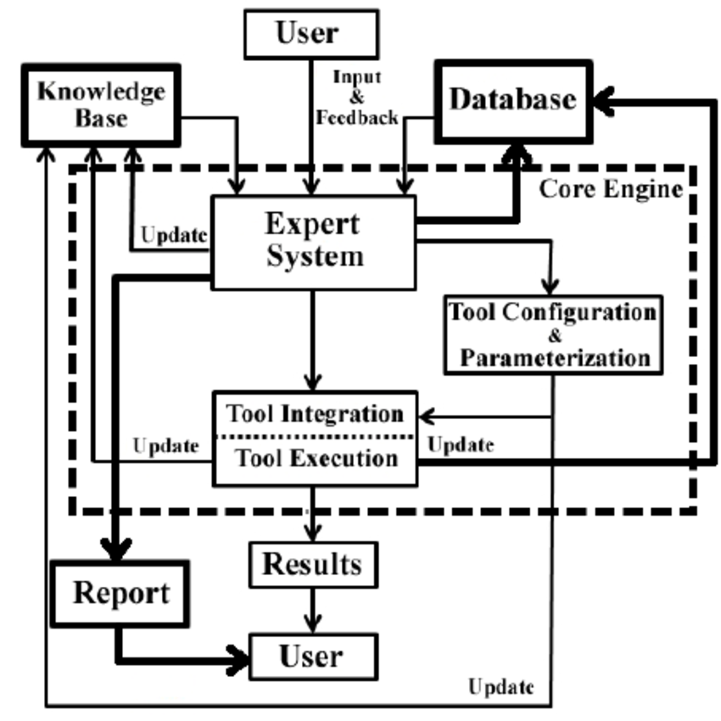
What is High-Level Design
Bridge between software architecture and detailed design
  Overlaps with software architecture
    Elucidation of the software architecture
  Overlaps with detailed design
    Starting point for low-level design
Typically based on software architecture
  Determine how the nodes and links might be implemented
  Develop a consistent, implementable structure
Each architectural component can be
  Single process in a multiple process system
    Might need to be broken down more
  Single subsystem (sets of packages)
    These will need to be broken down more
  Single package (set of classes)
  Single module (set of functions/classes/…)
Design components can combine or split these

Slide 4
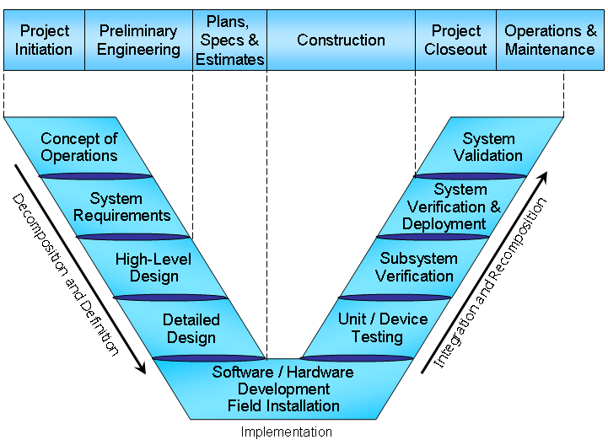
Goals for High-Level Design
Working system with minimal effort
  But initial system is a small part of development
Maintainability
  The resultant system must be maintainable over time
  The design must accommodate changes
Evolution
  Easy to add new features, handle changing needs, handle changing environments
  Without degeneration (code deteriorates and convolutes over time)
Risk
  Need to minimize immediate and future risks
Security, Privacy, & Ethics
  These should be considered as part of the design
Team Development
  Design should allow independent work by team members
  Design should build on the strengths of the team

Slide 5
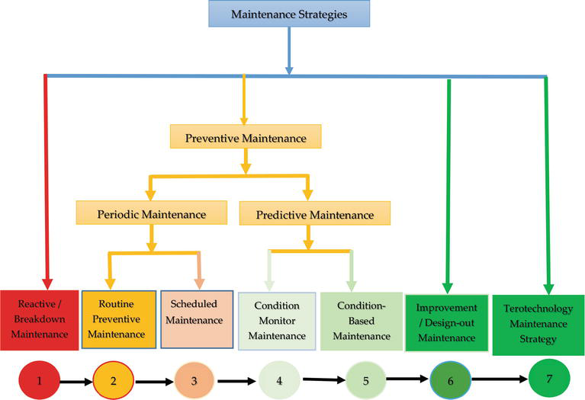
Design for Maintenance
Determine what outside things might change
  OS interface, DBMS interface, User interface
  Algorithms (e.g., LLM to use)
  Ensure these are isolated as much as possible
  Make these easy to change without affecting whole system
Make it easy to find and isolate problems (bugs)
  Defensive design
    Error handling, exceptions, …
  Logging
  Testability
  Incorporate these into initial design (high-level and detailed)
Notes:
Database module if twitter program.

Slide 6
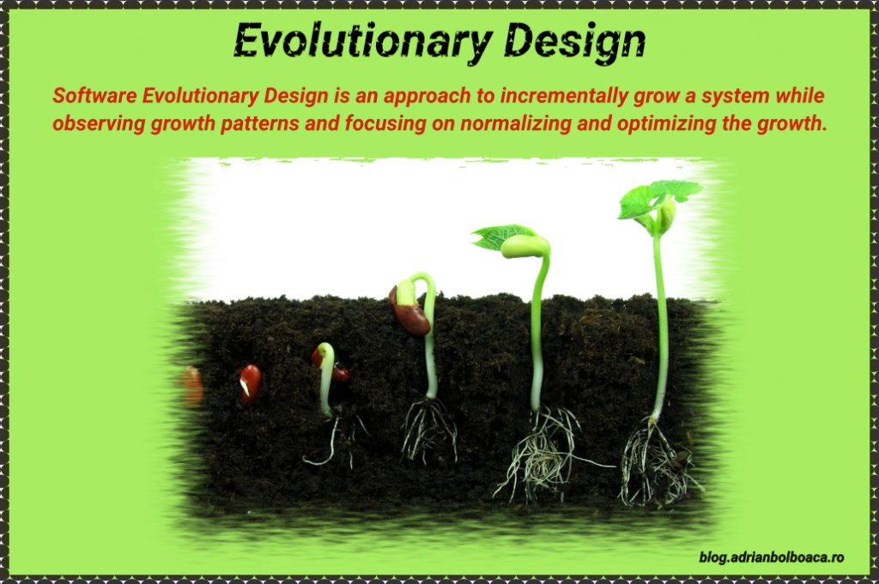
Design for Evolution
Determine what parts of the system are likely to change
  Ensure these are isolated (single component if possible)
  Changes should be local where possible
Determine what features might be added
  Required, higher-priority, short-term requirements (beyond Core)
  Optional, lower-priority, long-term requirements
  Design the system so that adding these is possible
    Without changing too much of the system
    Higher priority -> easier to add
    Things requiring a major rewrite won’t be added
  This is why I suggest full requirement specifications
Support agile development
  Make it easy to add new features
  Features should be in a small number of components
Notes:
Plug-in interface; ease of adding to menus in bubbles; bridges in catre

Slide 7
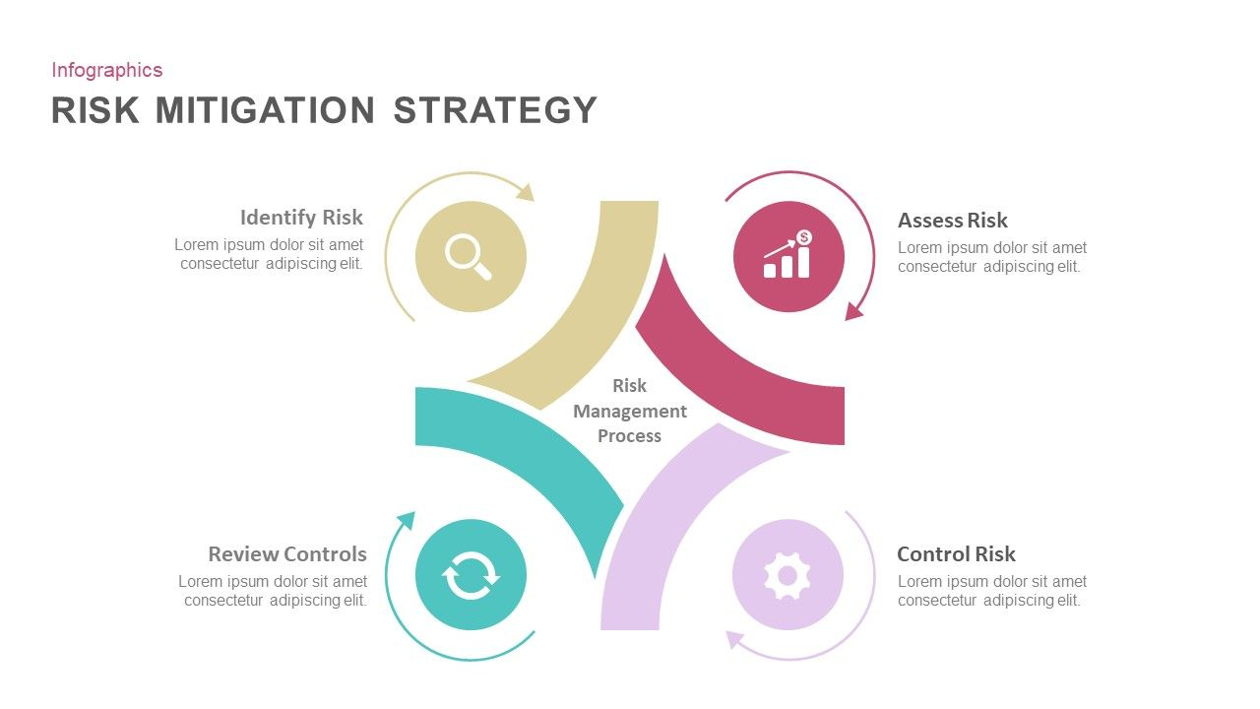
Design for Risk
Identify potential risks
  Requirements, specifications, skeptic
Address these risks
  Either isolate them
    Make it easy to try alternatives
    Make it easy to change solutions in the future as needed
  Or design the system around a solution for them
    Concentrate the design on the risk
Prototyping to check out potential solutions
  Ensure design will work with test system
Notes:
Using various ML algorithms to learn code style

Slide 8
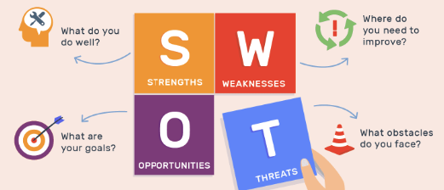
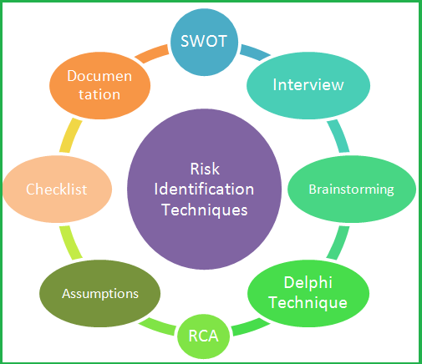
Identifying Risks
What can go wrong (skeptic)
  Always be skeptical of your own code (and others)
What do you not understand
  How to implement something
  How complex some code is
    How long something it will take to implement
  How long code will take to run
  How large data might be
  Whether something will work or not
External assumptions that might change
User interface risks
  The user interface is going to change
Competitive risks
Personnel risks
Notes:
Repair suggesters in ROSE

Slide 9
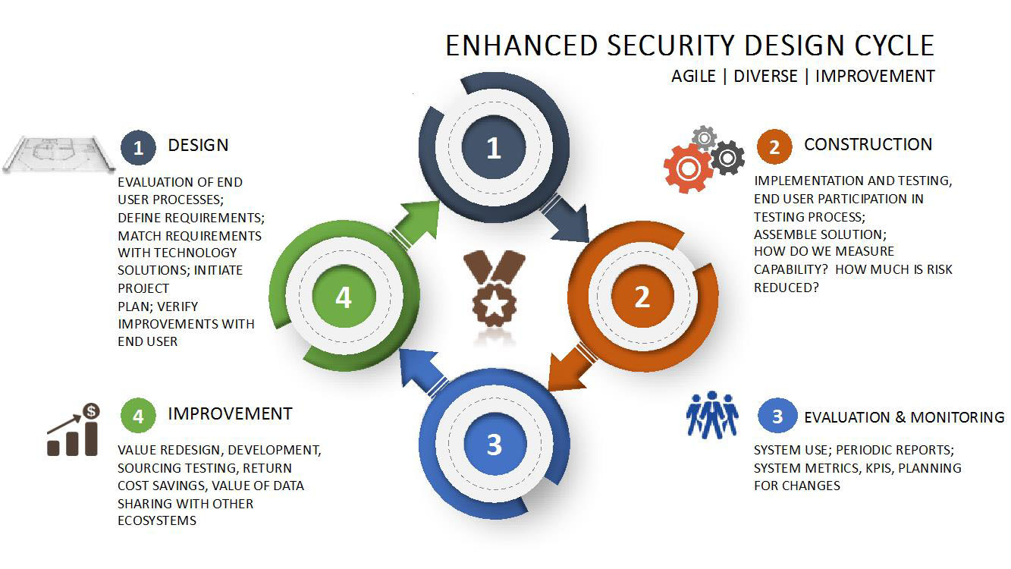
Design for Security, Privacy & Ethics
What data needs to be secured
  Or kept private
  Or is legally restricted in some way
  Or is company confidential
Isolate that data in one component
  Even if it’s a separate component just for the data
  Then securing the data involves a single component
  Keep it in a single component as you break down the design
What are the ethical risks of your system
  Difficult to determine how the system will eventually be used
  But you can take a first step
  Appropriate checking and feedback mechanisms in the initial design
  Can these be avoided
Notes:
Data module in sphere-E

Slide 10
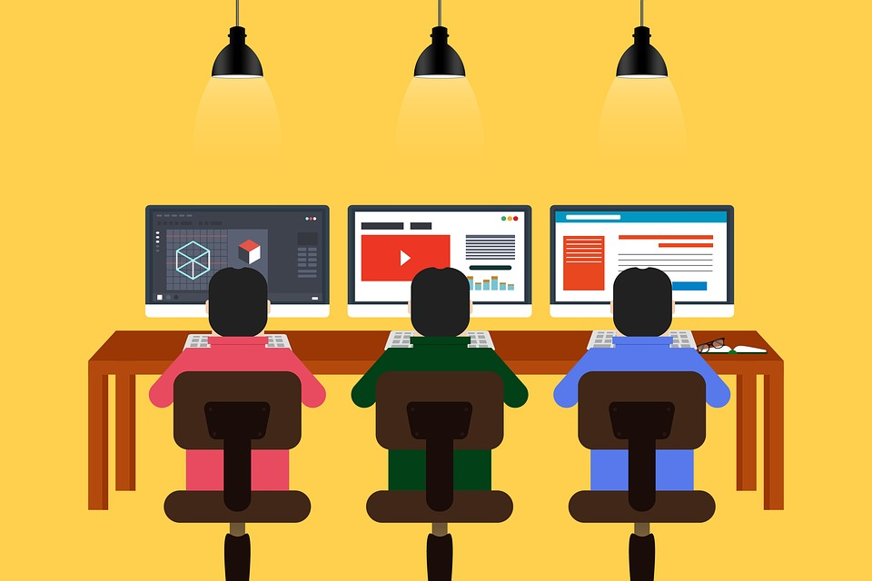
Design for Team Development
Each team member should have their own code / components
  Independence improves programmer efficiency
  Independence allows asynchronous development
  Allow individual testing, debugging
  Addressing the strengths of the team
Well-defined interfaces between people
  You know precisely what to code
  Know how to use other’s code
  Others know how to use what you code
  But you should not need to know the others actual code
Number of components vs team size
  Ensure there is a components for each team member
  Can have additional components
  If fewer, ensure the components are separable
    Multiple team members on one component -> component can be split
Notes:
BARNIE and the UTRAS – scripting module, LLM interface, Code bubbles interface

Slide 11
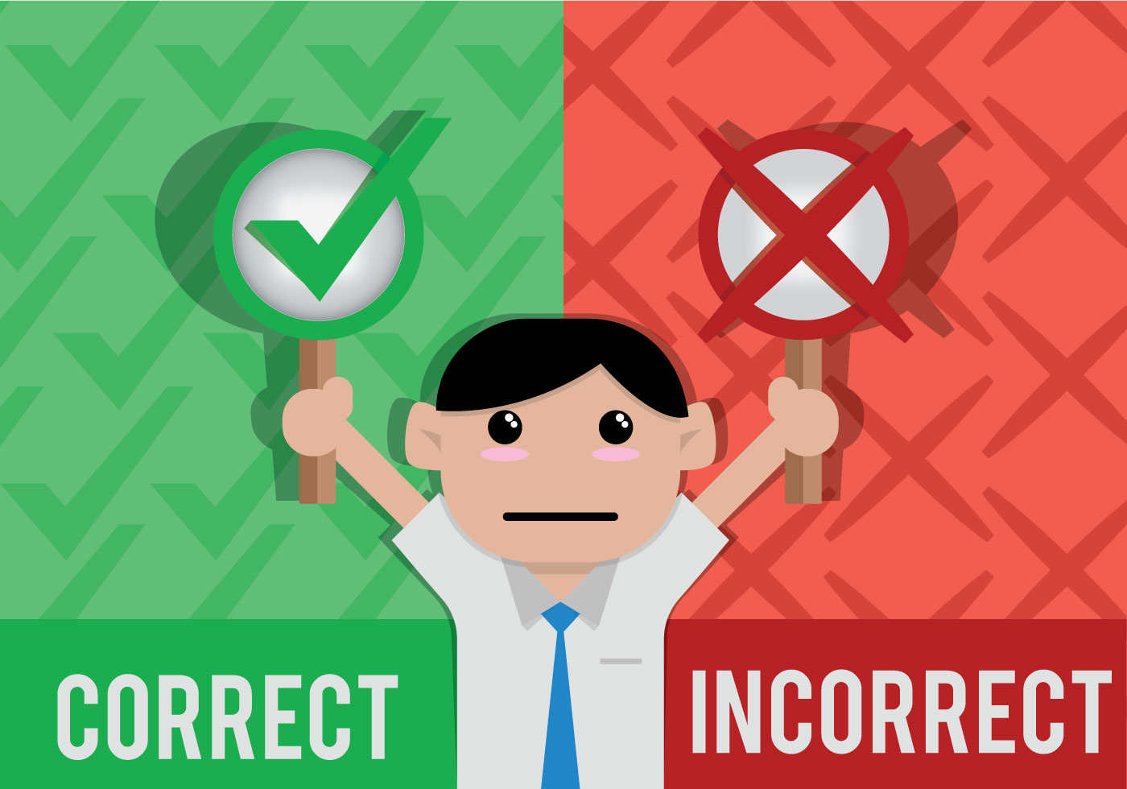
Correct vs Incorrect Designs
Almost any design can be made to work
  That doesn’t make it correct however
Addressing these design goals makes life easier
  Initially (creating the system)
  More importantly as the system evolves & is extended and maintained
A good design can cut the workload significantly
  Half the amount of code
  Less refactoring and rewriting needed
  Less time adding new features (easier to evolve)
  Easier to debug (finding and isolating problems)
  Easier to maintain and evolve
  Easier to test and deploy

Slide 12
EXERCISE
Let’s assess our initial programming efforts
We will split into small groups (<4). Within each group show each other the initial version of your programming assignment and provide feedback to the others.
  Feedback should be constructive
  Get ideas from others for your own program
  Give others ideas on how theirs might be improved
10 minutes

Slide 13
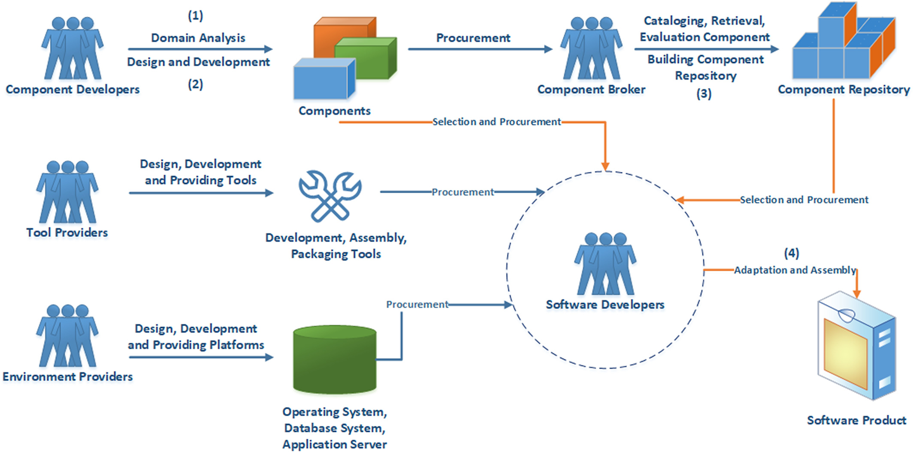
Approaches to High-Level Design
First step: Identify components
  Architectural components are a starting point
  Break down components into subcomponents
  Identify necessary components based on goals
  Think in terms of packages or modules or processes
Keep breaking down components until
  Component can be handled by an individual or two
  Component implementation does not affect the rest of the system
  Component implementation not affected by rest of system
  Component is a single package or module or service
  Component is well understood
  The overall design is understood

Slide 14
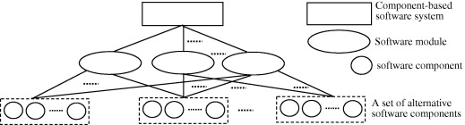
Component Selection
Top-level components reflect the software architecture
  Reflect the process structure
  Separate architectural components are separate
  Break these components down into subcomponents as needed
  Top-down approach to finding components
  Find commonalities (DAG, not a tree)
Isolated elements should be in a single component
  Add these as components
  Isolated for maintenance (OS, UI, DBMS dependencies)
  Isolated for evolution (interface for new features)
  Isolated for risk (unknown algorithms)
  Bottom-up approach to finding components
Shared data structures should be in a single component
  But it should be represented as functionality (not directly accessible)
Notes:
Test data in code bubbles: name, class, method, status, state, fail message & trace, count data, annotations

Slide 15
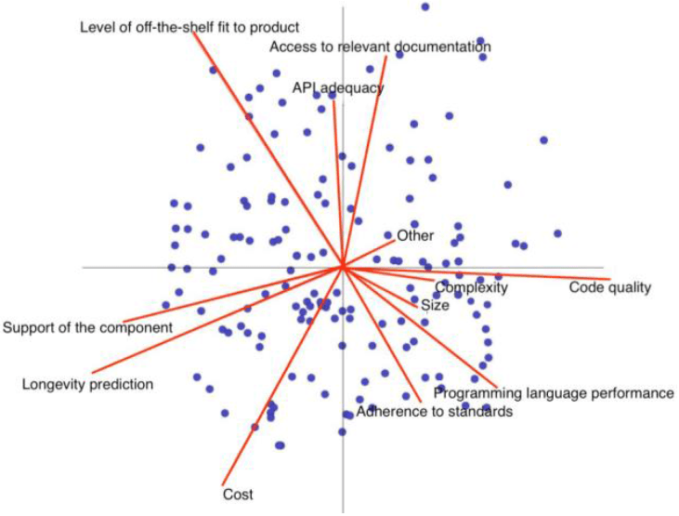
Component Selection (cont.)
Complex functionality should be in a single component
  Complex algorithms as well
  These are likely to change over time
New features should be easy to add
  Adding the feature changes only one component
  The feature might be added as its own component
    That should fit into the overall design
  If not a single component, then a small set of components
    Front end + back end on web application
    No potential feature should affect a large set of components
Components can be assignable to team members
  Either individually or in small groups
  Inner workings do not affect the rest of the system

Slide 16
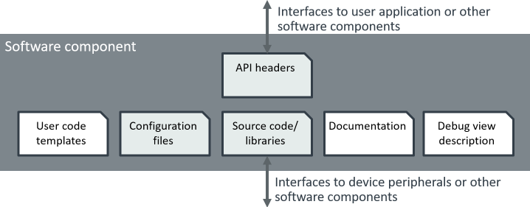
Component Description
Goal and purpose of each component
  Name
  Single short phrase or sentence
    Clear, meaningful
    Avoid ANDs (two components), etc.
Once you know the components you can define them in detail
What is important is the component interface
  How the component interacts with other components
    What it provides; what it requires
  High level design means defining interfaces
    As well as identifying the components
  The component implementations are mere details
    As long as we are satisfied that the implementation can be done
  The interfaces are the design

Slide 17
Interfaces
High Level Design is the design of Interfaces
Each component needs an interface
  How it is used by other components
  What it can and cannot do
The set of component interfaces is the high-level design
Concentrate on the interfaces before implementation
  Both in what is provided
  And in what is needed by others
  Have a complete set of interfaces before doing coding
Notes:
This slide is for emphasis

Slide 18
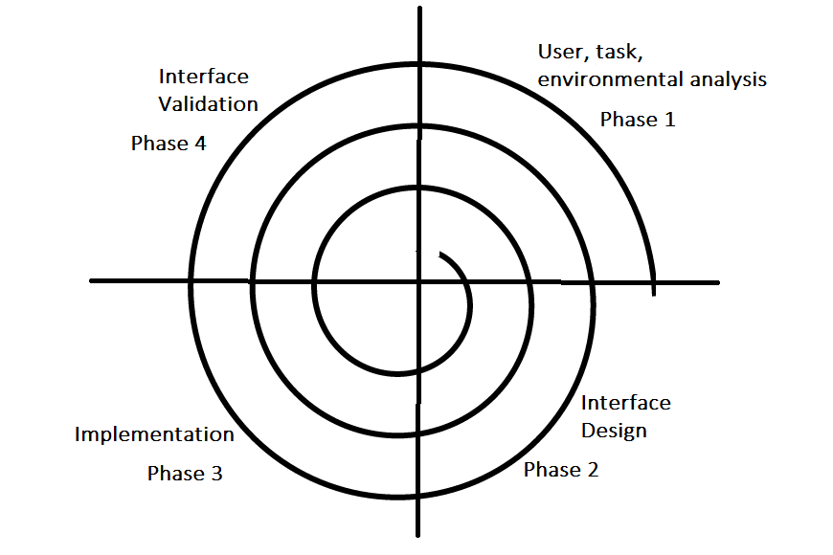
Interface Goals
Provide a concrete definition of the component
  Understanding of what is needed and what is provided
Enable others to use the component
  Without knowing its internals
  Develop code even before component is available
  Develop test cases
  Write a mocking library to emulate component
Ensure the design is correct
  Ensure you can implement each interface function
  Easy to change an interface while doing design
  Finish the interfaces before coding
  Check that all specifications can be met
  Ensure that other components have all they need

Slide 19
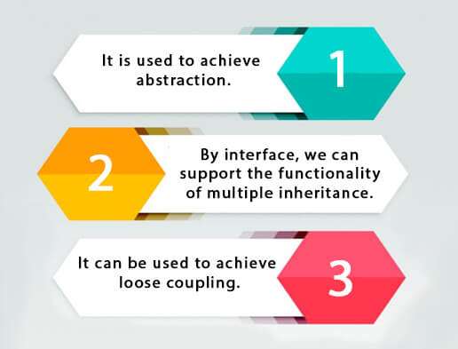
Interface Goals
“Interface” is defined loosely
  Can be interface class, set of calls, a set of messages, command line options, RESTful urls, …
  Can be bi-directional
    Often includes callbacks to offer functionality
Interface Definitions
  Signatures with meaningful names and types
    For each method, function, message
  Includes descriptions of functionality
  Includes error handling
    Exceptions, what happens if …

Slide 20
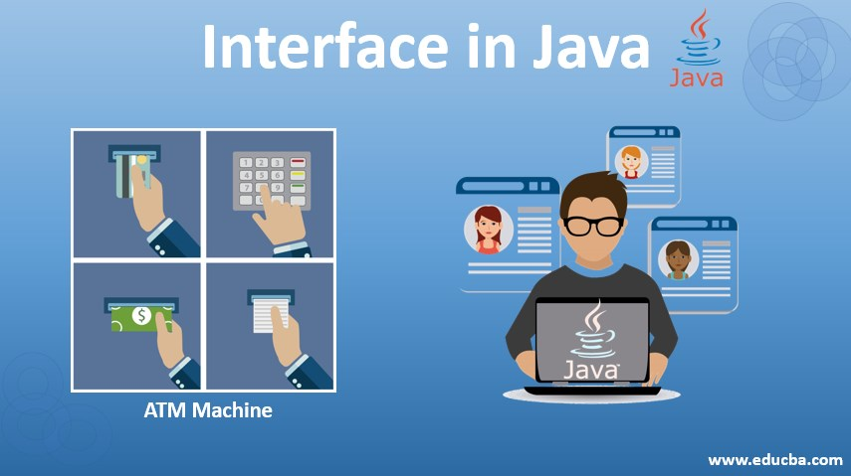
Interface Design
Provide the needed functionality
Keep it as simple as possible
  Single interface class, possibly with inner interfaces
    Shouldn’t be a large set of classes
    Shouldn’t be a hierarchy (these are represented by the root)
  Small set of methods or functions or messages
    Minimum parameters, simple types
    Not fields or variables
    Minimize constraints on ordering, call sequences, etc.
Provide room for expansion
  Identify possible future classes/methods/messages
    What is going to be needed for evolution and maintenance
  Its okay to define interfaces that won't be implemented right away
  Its okay to include low priority functions that won’t be implemented right away

Slide 21
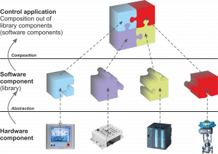
Interface Design
Document the interface
  Provide a description of each element
    Parameters, results, what it does
  Provide constraints
    What is expected of the inputs
    What must be done before the element is invoked
    What outputs are given under what circumstances
  Include error handling
    What happens if inputs don’t match constraints
    What exceptions can be thrown
    What happens if remote server fails
The interface will change
  Implementation will require changes, additions, deletions
    Negotiations between implementers and clients
  Needs of both can change over time
  Interfaces will get more complex over time
  Changes may require work in other components (avoid)

Slide 22
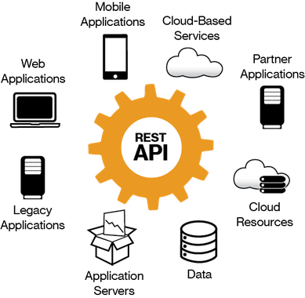
Representing a High-Level Design
Goals
  Define the components and their interfaces
  Represent these without doing the implementation
  Provide a basis for detailed design and coding
API-based Design (for each component)
  Application Program Interface
    Defines calls and requests
    Defines data formats
    Defines conventions, call orders, ..
    Defines callbacks
  This is what we need: how to represent it?

Slide 23
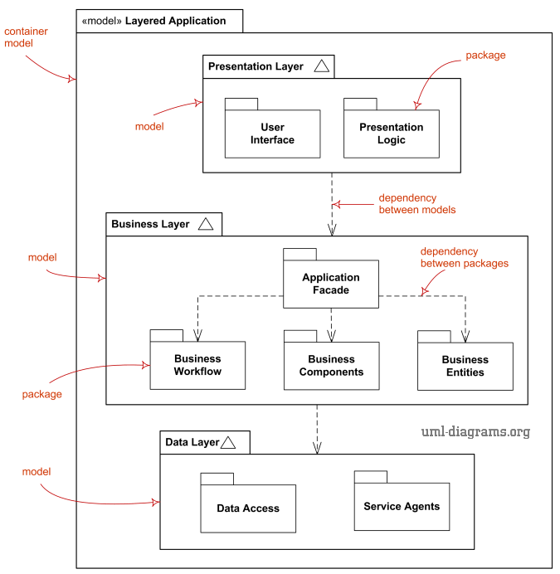
UML-Based Design Representation
UML class diagrams can be used to represent a design
  Components can be represented as classes
  Components can be represented as packages
  Methods in the classes represent the interface
    Might not actually be methods
  Links represent potential component interactions
These are language independent
  UML does not commit to a language

Slide 24
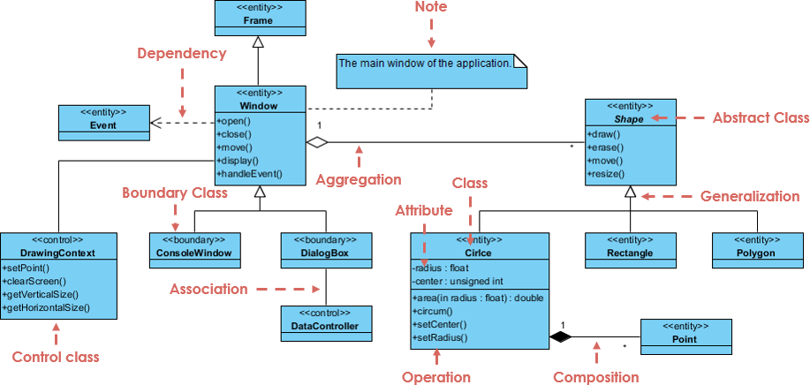
UML Class Diagram Basics
Classes
  Name, attributes, operations
Inheritance links
  Generalization
Dependency links
  Associations
  Aggregations
  Dependencies

Slide 25
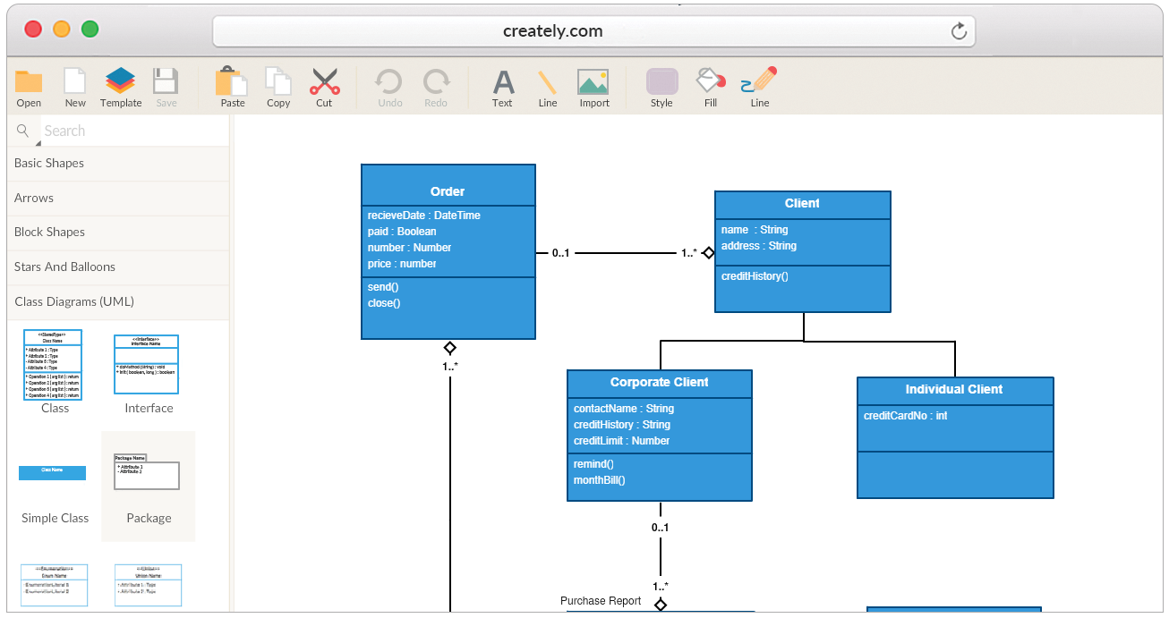
UML for High-Level Design
Meaningful information
  Fields can give a sense of the class (but won’t be used)
  Links imply usage connections, not contained data
  Basic methods provide the interface definition
Diagram in levels
  Keep size of each level small (5-10 classes)
    Then use a separate level to define those classes
    Facades, interfaces represent a level
  Keep the diagrams simple
  Gives a better sense of the design than 100 interfaces
    Easier to implement as well

Slide 26
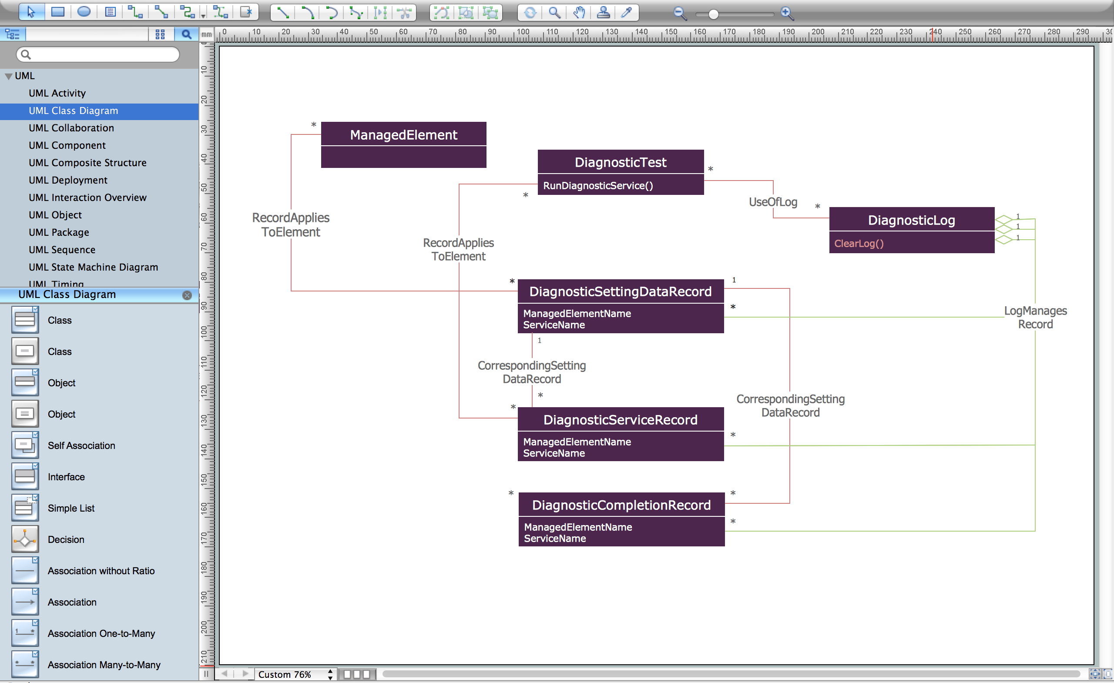
UML For High-Level Design
UML diagram can be used to sketch out the design
  Easier to change then a text or code file
  Easier to move things around for grouping, organization
Start with all possible component candidates
  Group these in a logical fashion & eliminate overlaps
    Hierarchies represented by their root or interface
    Choose one set where things overlap
    Common elements merged using a façade
    Internal components removed
  Continue until you have a small number left

Slide 27
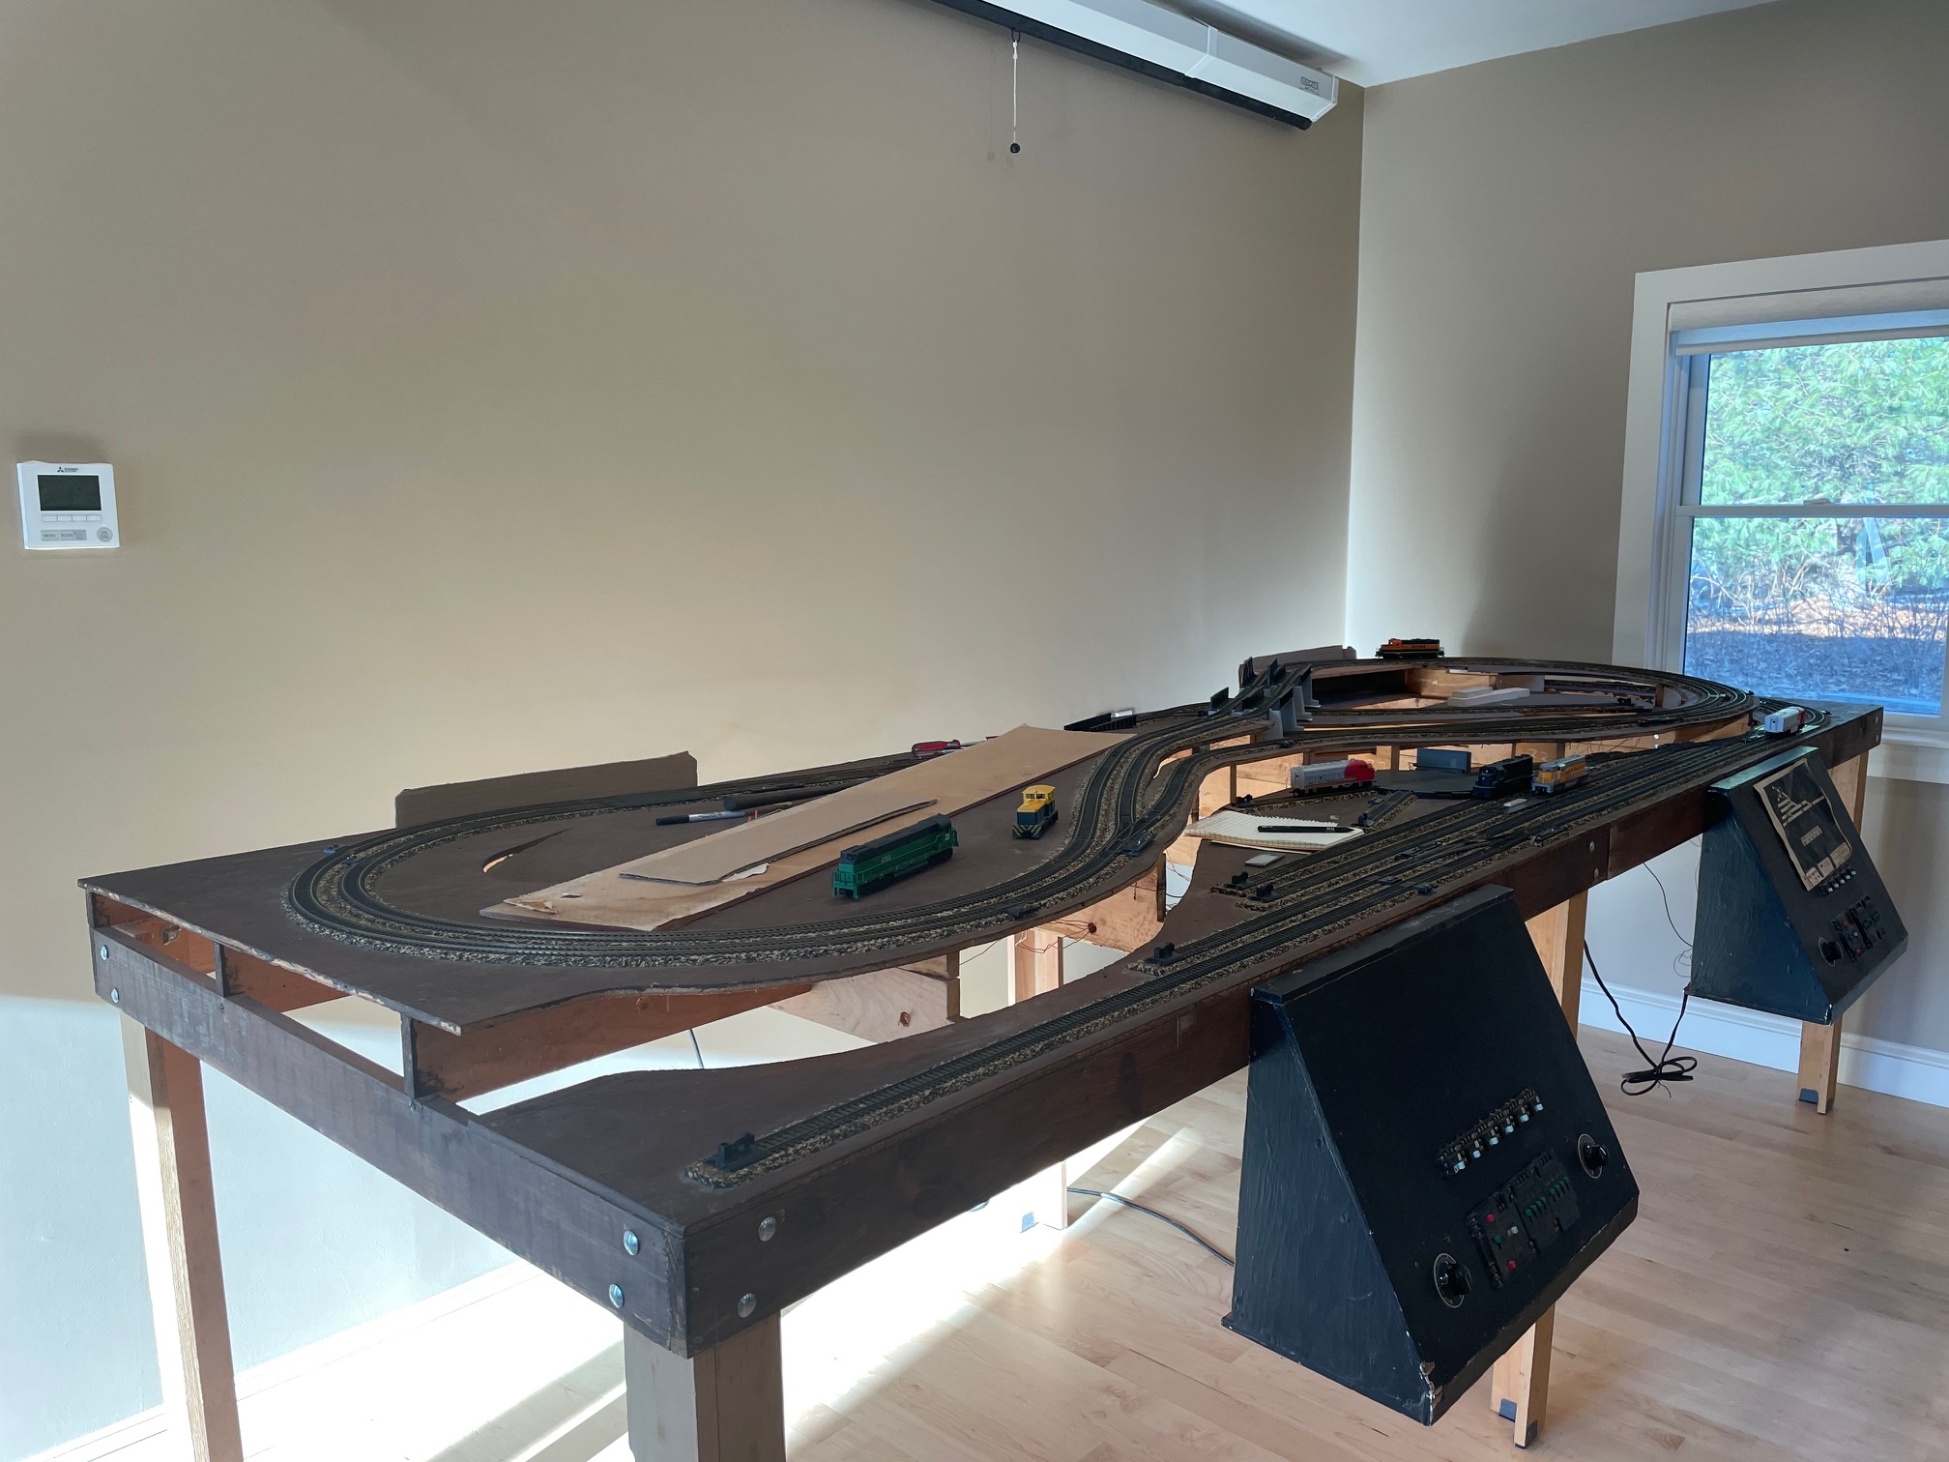
System to Design
I want to control my HO trains from my computer
  Creating hardware
    Embedded sensors in tracks
    WIFI control of switches, signals
  Using hardware
    WIFI control of engines
Want to direct trains to follow defined path
Want to ensure safety
  Avoid collisions, derailments
Want a current display of everything
  Want detailed control from the computer
Smart HO Railroad Environment (SHORE)

Slide 28
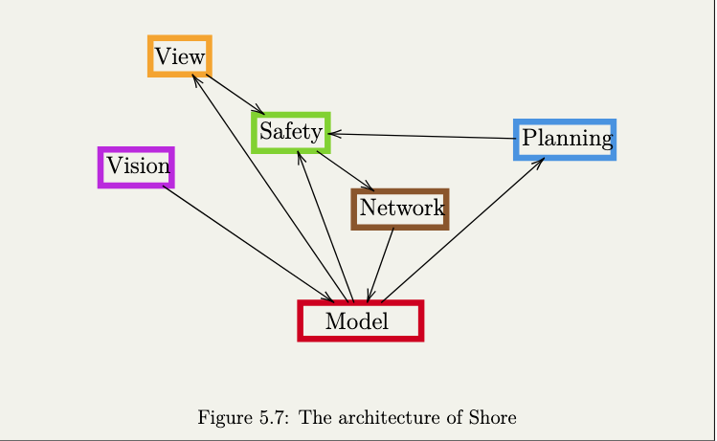
Software Architecture for SHORE

Slide 29
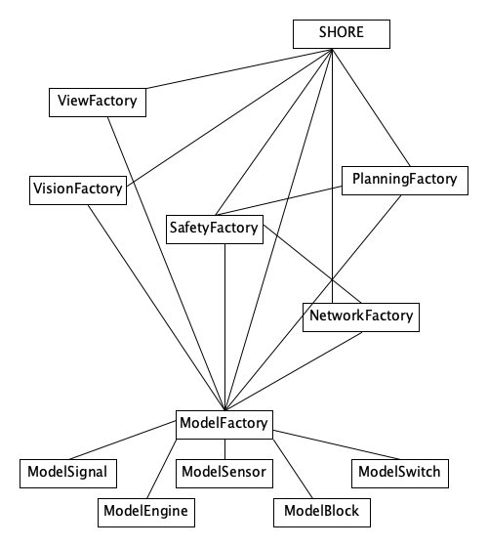
UML Design Diagram for SHORE
Added Control component SHORE
Create Façade Components
  View, Vision, Safety, Planning, Network, Model
Added classes for model data needed by others
  Signal, Engine, Sensor, Block, Switch
Note this doesn’t include interfaces
  But these could be added

Slide 30
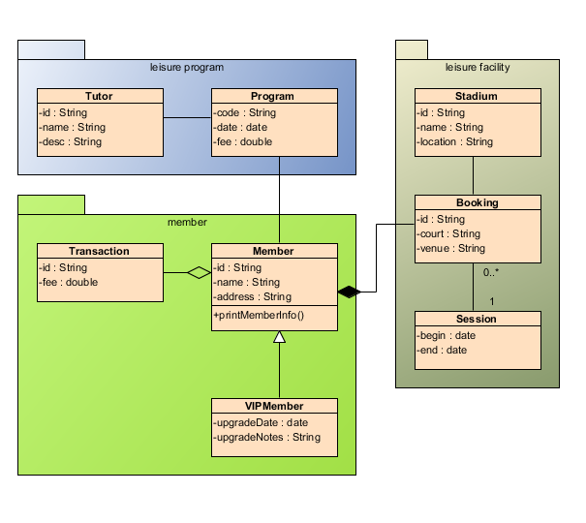
UML-Based Design Representation
Advantages
  Useful for initial exploration
  Can use graphic editor to explore possibilities
  Result is a nice visual representation of the system
  Can be done on paper or using UML editors
Disadvantages
  Adding methods/fields is messy
    Editors; syntax
  Probably won’t have a complete interface
  Not something one can compile against or work with
  Won’t be part of the actual system
    Will get out of date as system evolves
    Won’t represent the current design

Slide 31
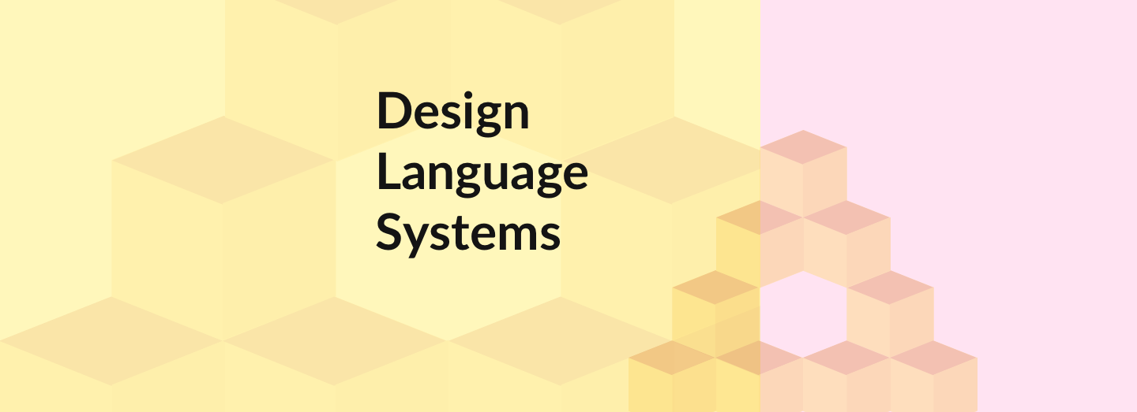
Language-Based Design
I prefer to work in a programming language
  Probably the implementation language (not necessary)
  Editors available
  Syntax well understood
Create a design that can be used in the implementation
  Starting point for the implementation
  Code against the interfaces
  Design evolves with implementation – always up to date
But still simple enough to be easy to change as part of design
  Adding, removing, changing components
  Adding, removing, changing methods
  Can ”play” with it as we do with UML diagrams
Multiple approaches to this
  We’ll cover these in the next class

Slide 32
Language-Based Design
Pros
  You can use it as the start of the implementation
    It in the target language
    When it is complete and ready
  Code against the design directly
    Becomes part of the system
    Evolves with the system
  Done using known editors, syntax, …
Cons
  You need to know the target language
    We’ll cover choice of language next time
  Not all languages support clean interfaces
  Not all interfaces are language oriented (e.g., messages, RESTful)

Slide 33
PROJECT HOMEWORK
Start thinking about the high-level design for your project
  How would you break it up: what are the components
  Try allocating specification items to components
  Possibly use a UML diagram to play with possibilities
    Install UMLet, argouml, umbrello
    Web-based UML tool (visual paradigm, creately)
GitHub repo should include
  Requirements, specifications, architecture, code style
  Simple use of GitHub Issues
Project Presentations on Tuesday 10/8
  10 minute presentations (not too detailed)

Slide 34
Programming Assignment Homework
Update your programming assignment hand in
  Using feedback from today’s breakout session
  Ensure it uses project code style
  Ensure there is a header comment, meaningful names
  Ensure naming conventions work
    Name implies its kind and definition location
    Easy to locate items in the file
You might try creating a UML diagram for the assignment

Slide 35
Further Reading
UML: IBM UML Introduction
Textbook, chapter 6

