Slide 1
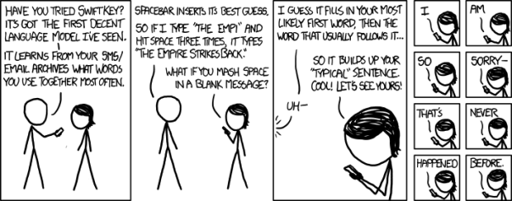
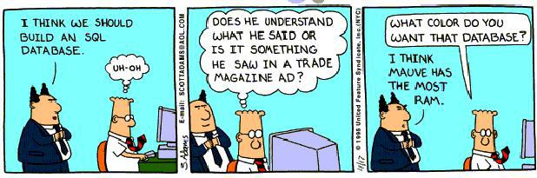
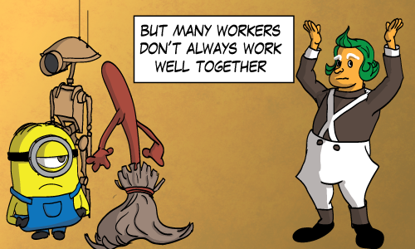
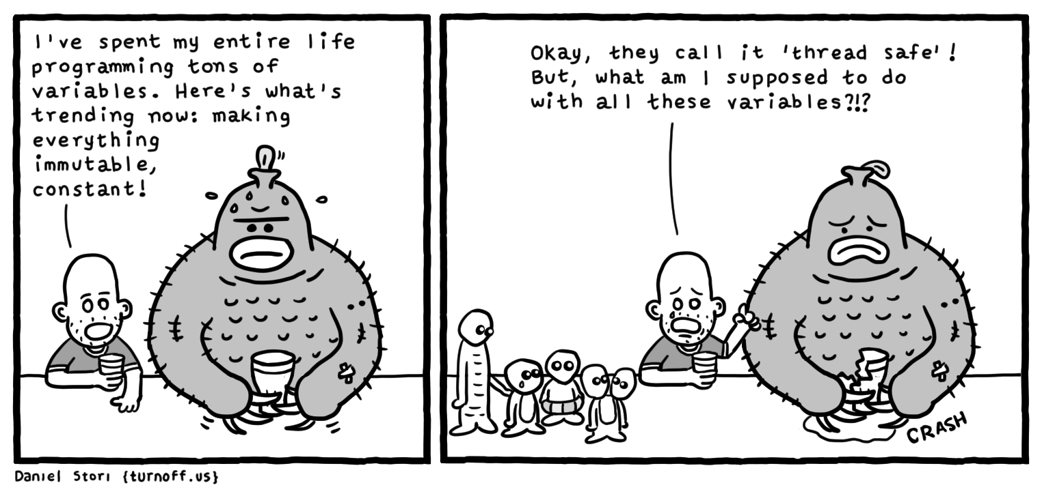
High-Level Design Issues
CSCI2340: Software Engineering of Large Systems
Steven P. Reiss

Slide 2

High-Level Design
Last time we talked about high level design
  Things to look for
  Thinking about components
  Noted that the component INTERFACES were the design
We talked about selecting component
  For the components
Next, we need to define their interfaces
  Messy to do in UML; easier to do in a language
This is a continuation
  More things to consider in the design
  Looking ahead to using the design
Topics
  Language-based representations for defining component interfaces
  Message-based interfaces
  Choice of language (for implementation, but we use it in the design)
  Using external (open-source and other) code, packages and systems
  Designing for concurrency

Slide 3
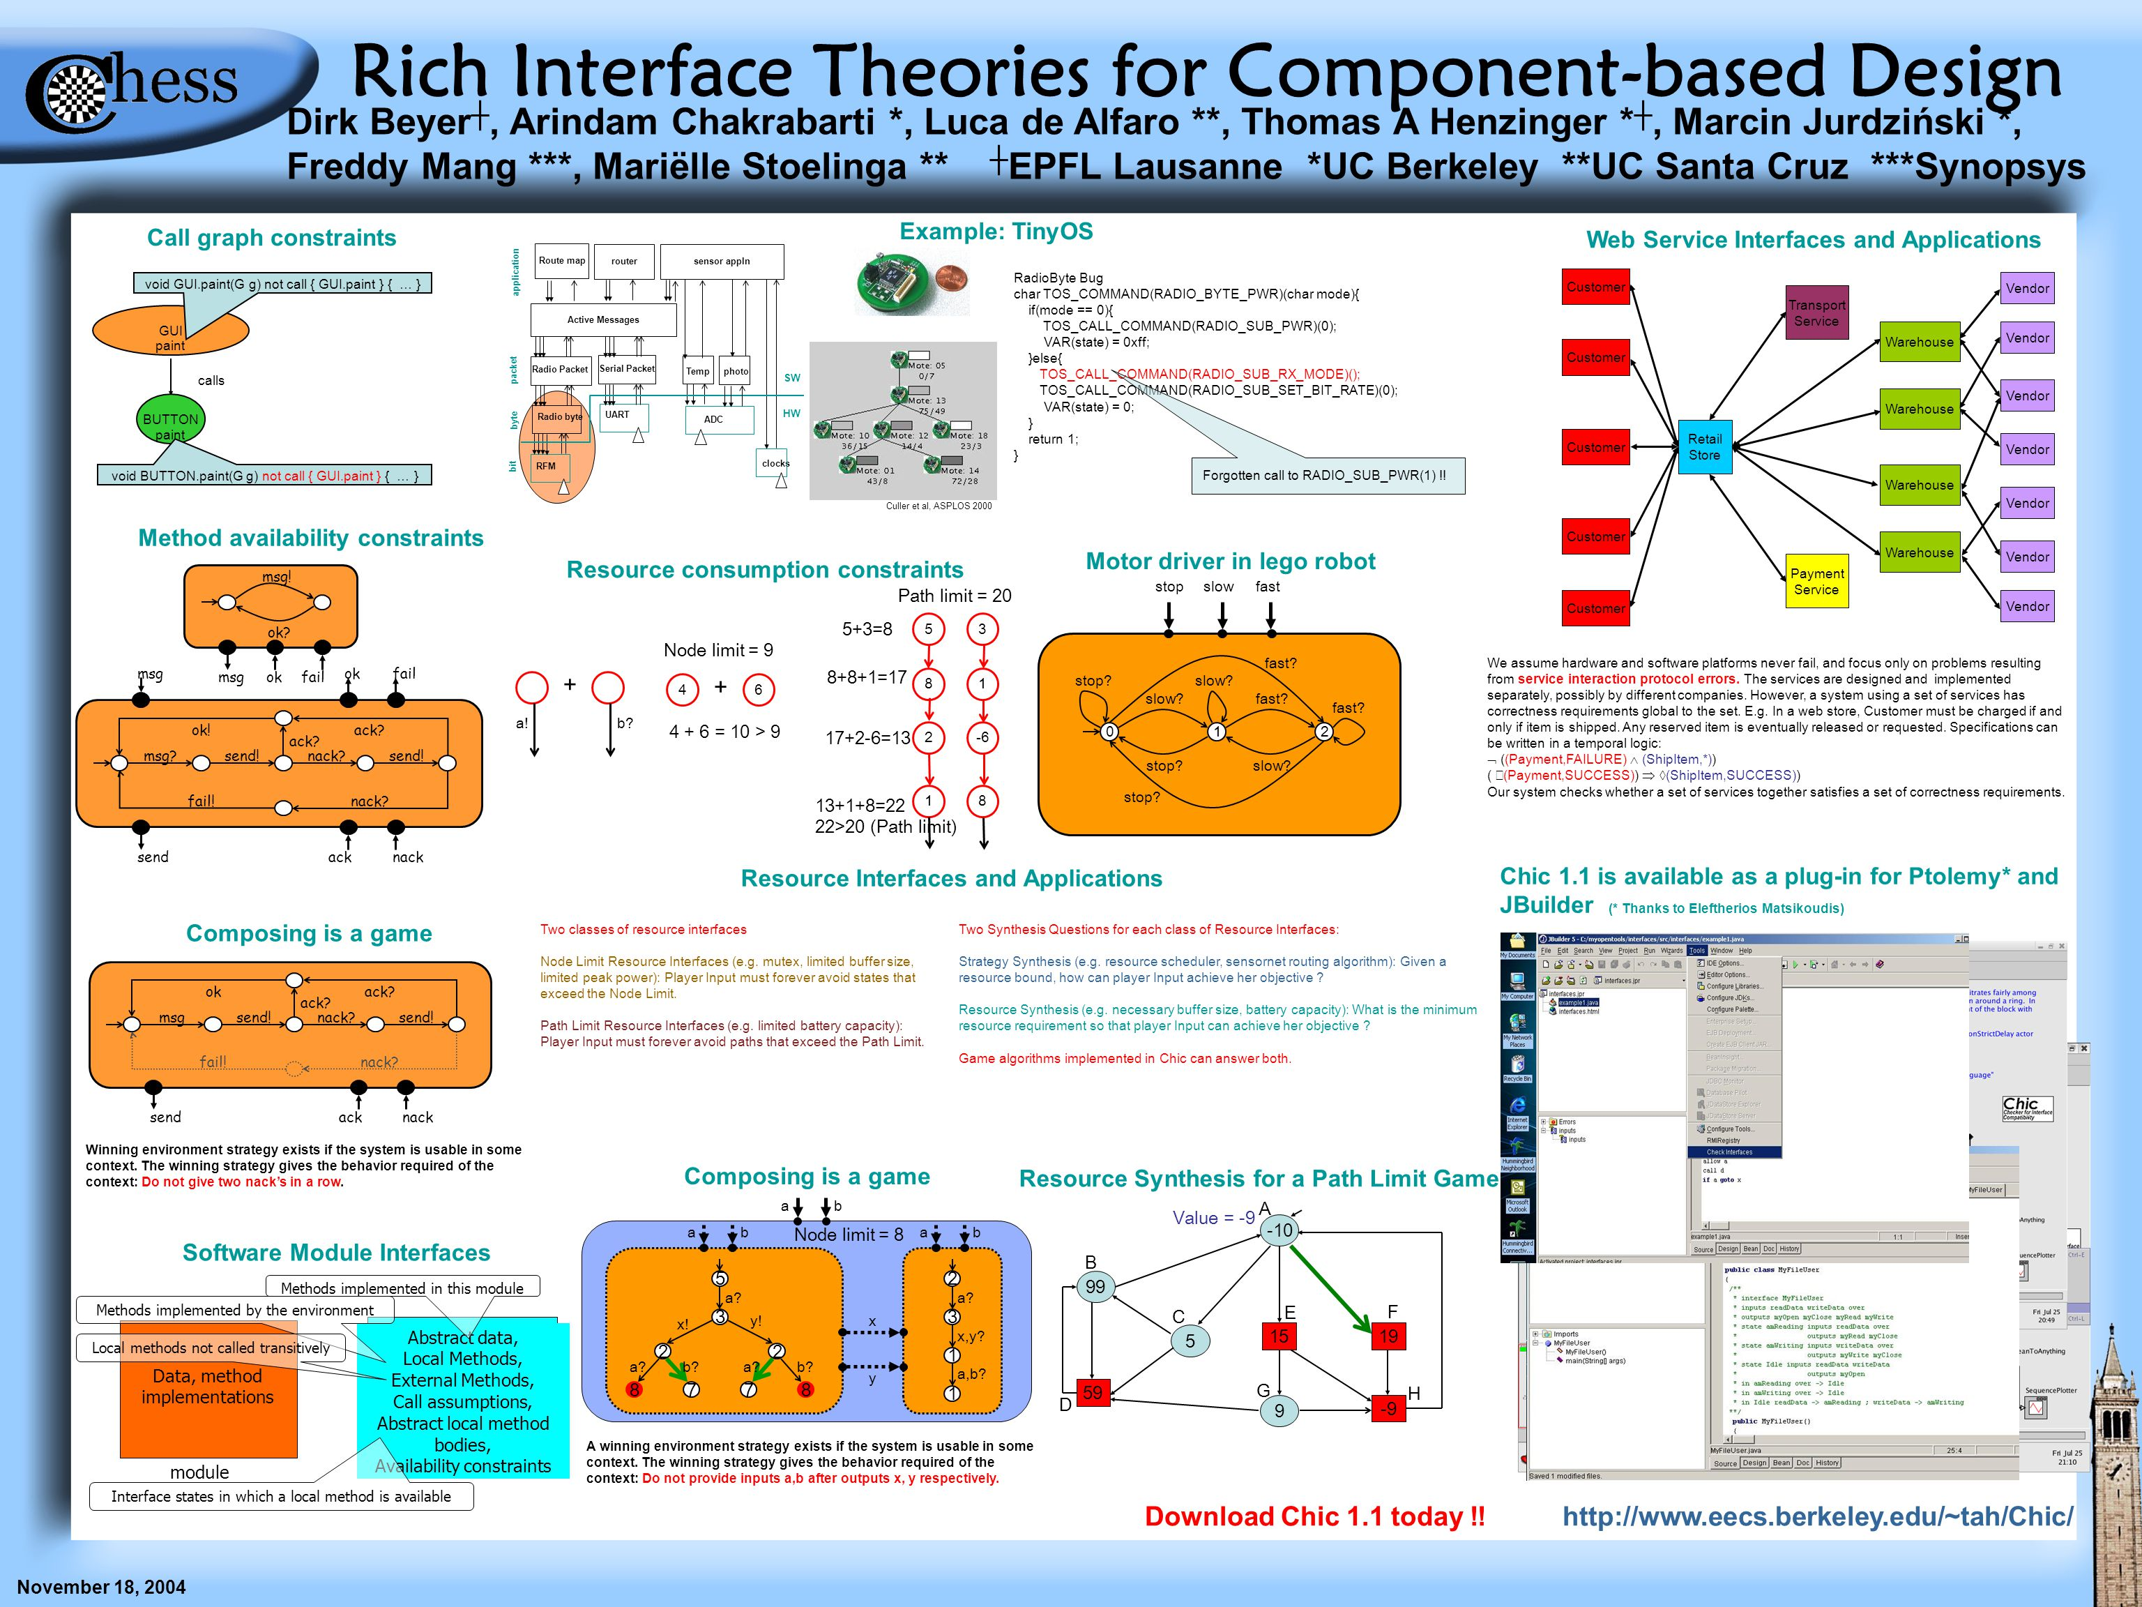
Language-Based Interface-Based Design
Each component is represented by a (Java) interface
  Component represents a class
  Single interface file for a component
  The whole design is represented as interfaces in Java
Data passed between components is defined with an interface
  Possibly defined as inner interface to component
  Possibly with its own component / interface
  Everything shared only through these interfaces
Each call-back from a component is an interface
  Defined as inner interface to component
  More consistent than using function pointers, easier to extend
Interfaces defined in a common package
  Separate from implementation packages
  Might later be augmented with common code (e.g., logging)
Examples
  S6/common, Catre/catre, Rose/root, Eclipse (IClassFile, …), SHORE

Slide 4
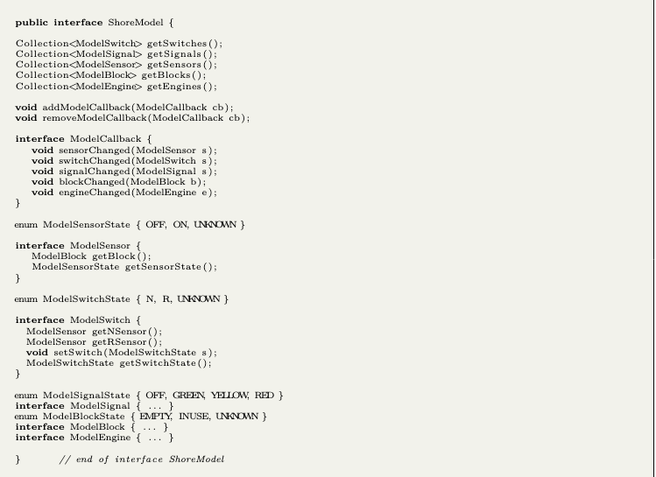
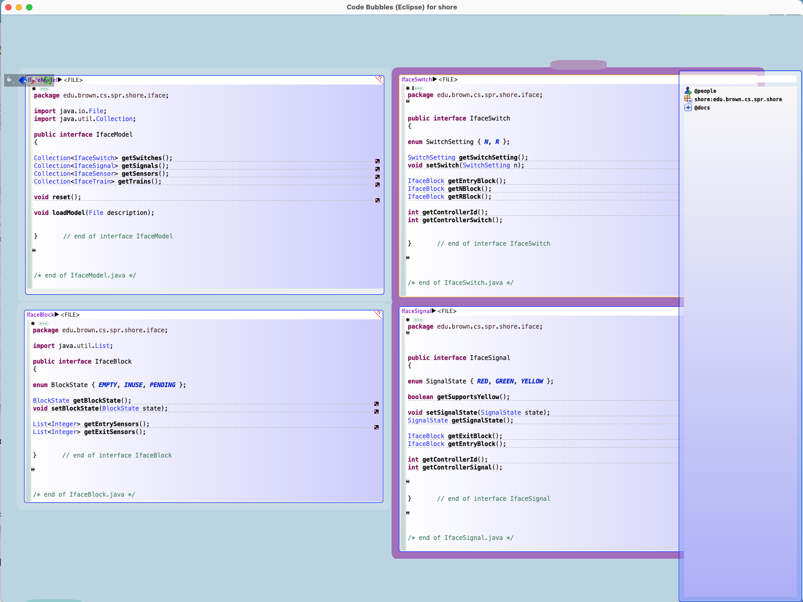
Interface-Based Design for SHORE

Slide 5
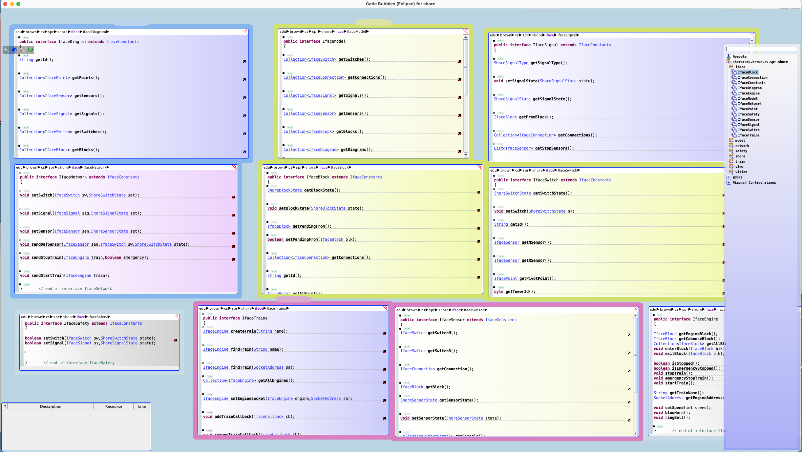
Interface-Based Design for SHORE

Slide 6
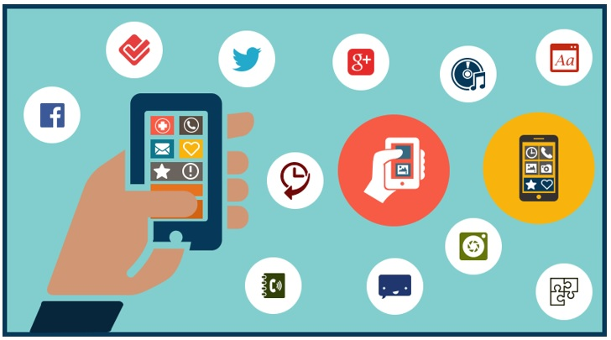
Advantages of Interface-Based Design
Provide a solid understanding of the components
  And their interactions before they are written
  In the target language, in a single location (package)
Can explore interface possibilities
  Experiment with different alternatives, methods, interfaces
  Easy to edit, change: no real commitment at this point
  More familiar than working in UML
Provide a basis for implementation of the components
  Result becomes part of the system
  Maintained as the system evolves
Provide a clean separation between components in the implementation
  All interactions between components are through the interfaces
  Can compile the rest in almost any order
Provide a location for documenting the design
  Javadoc of the interface
Can provide dummy / stub implementations (implementing the interface)
Can write test cases (against the interfaces)
Consistent approach to design (all object-oriented interfaces)

Slide 7

Disadvantages of Interface-Based Design
Commits the choice of language
  Not all interfaces are language-based
  Can rewrite the interface in actual target language (not that much to do)
Can make implementation a bit messier
  Trivial classes, public methods
  Need factory methods which might require reflection
  Need to cast interface to implementation class internally
  Returning collection of interfaces from collection of implementations is non-trivial in Java
  Interface for messages requires corresponding code
Might require a hierarchy of interfaces
  To add functionality without changing existing code
    JcompFile, JcompExtendedFile
Changing an interface can affect many components
  Especially call-back interfaces
  Default methods in Java now make this a little easier
Changing the implementation might need to change some interfaces
  Even if backward compatible
Interfaces will grow over time
  Can become overly complex with time – design will no longer be as clean

Slide 8
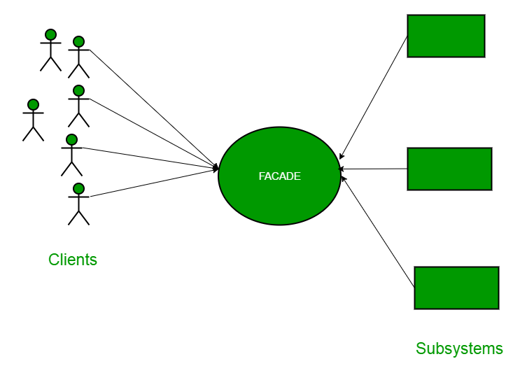
Façade-Based Design
A component is represented by a small set of public classes and interfaces
  Ideally a single class that delegates most of the work
    This represents the interface to the component
  And a set of interfaces or abstract classes exposing passed data and callbacks
  All other classes in the package are non-public
    The bulk of the work of the component is done in these classes
  Component implemented in a single package or module
Example: Code Bubbles
  Core (3 packages) includes a small set of public classes (< 20)
  Each component outside core has Constants interface and Factory class
    Constants defines interfaces for shared data, enumerations, callbacks, …
  All access is through these, not implementation classes
  Other interfaces can be defined if needed (generally in Constants)
  Standard interface to factory (setup/initialize)

Slide 9
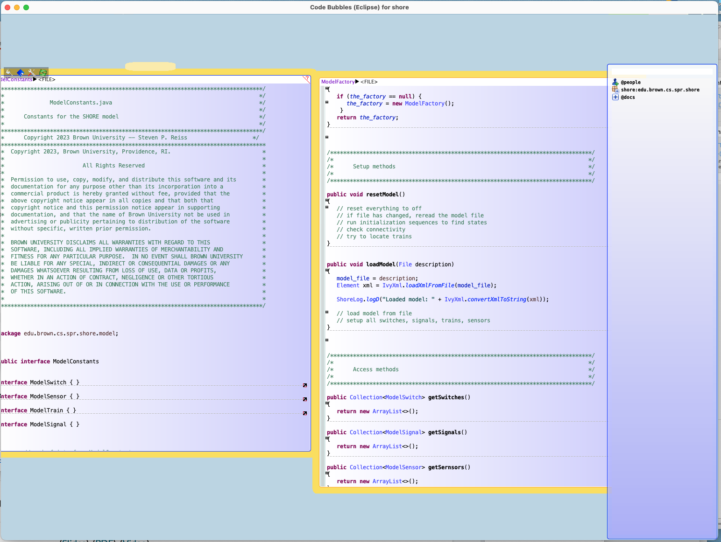
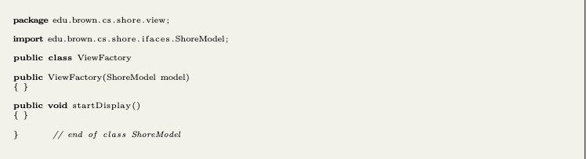
Façade-Based Design for SHORE

Slide 10
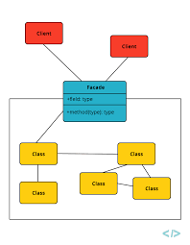
Advantages of Façade-Based Design
Good match to layered systems
  A façade can represent a layer
Good match to extensible-component systems
  Components implemented directly
No need for odd factory methods, easier to change
  Components are the implementation
Easier to extend by adding new components
  Not as restricted as interface-based design

Slide 11
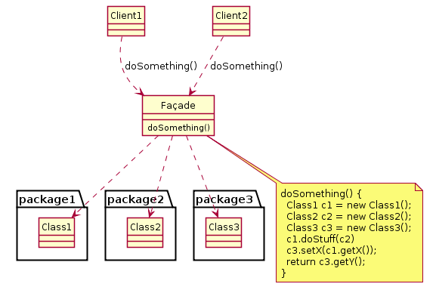
Disadvantages of Façade-Based Design
Harder to implement components in parallel
  Need inner layers defined to compile & write the outer ones
Not as clean a separation as interface-based design
Can be tricky to achieve an implementation ordering
  Linear order for compilation, dependencies
No central description of the system
More difficult to understand each component
Interface mixed with implementation
  Too easy to expose the implementation
  Through the public methods of a component
  Too easy to add new public methods & complicate the interface
Tendency to avoid documentation

Slide 12
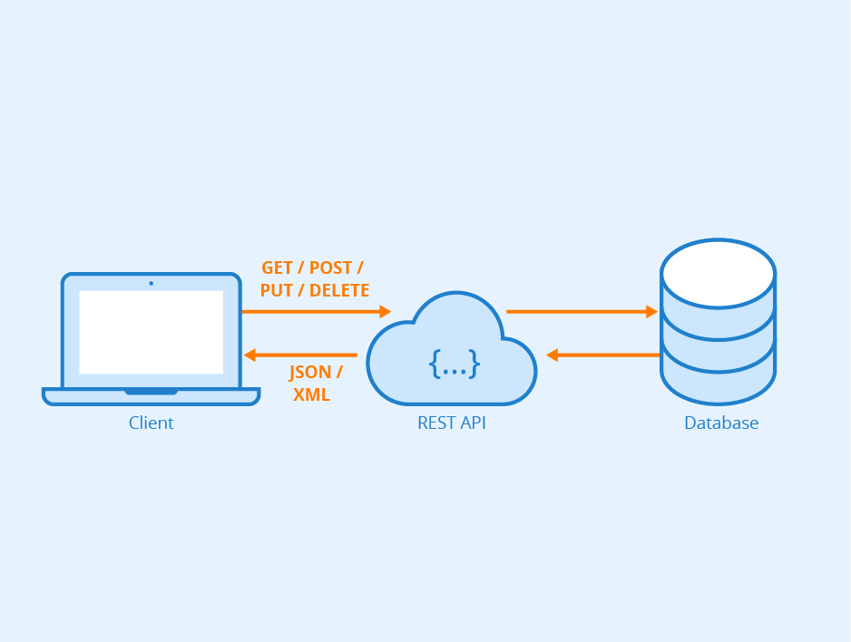
Message-Based Interfaces
Choose a messaging framework
  Preferably use an existing one (JMF, Ros, …)
  HTTP: RESTful interfaces
  Code Bubbles: mint
Define a set of messages (and responses)
  This is the interface
  Akin to defining function or method calls (documentation)
  Definition should include expected behavior
  Definition should include error behavior
  Definitions should be explicit (formats, options, etc.)
Easy to allow optional parameters on messages
Must be documented
  Can be a set of constants in an interface file
  Can be represented by a class that handles the messaging (BumpClient)

Slide 13
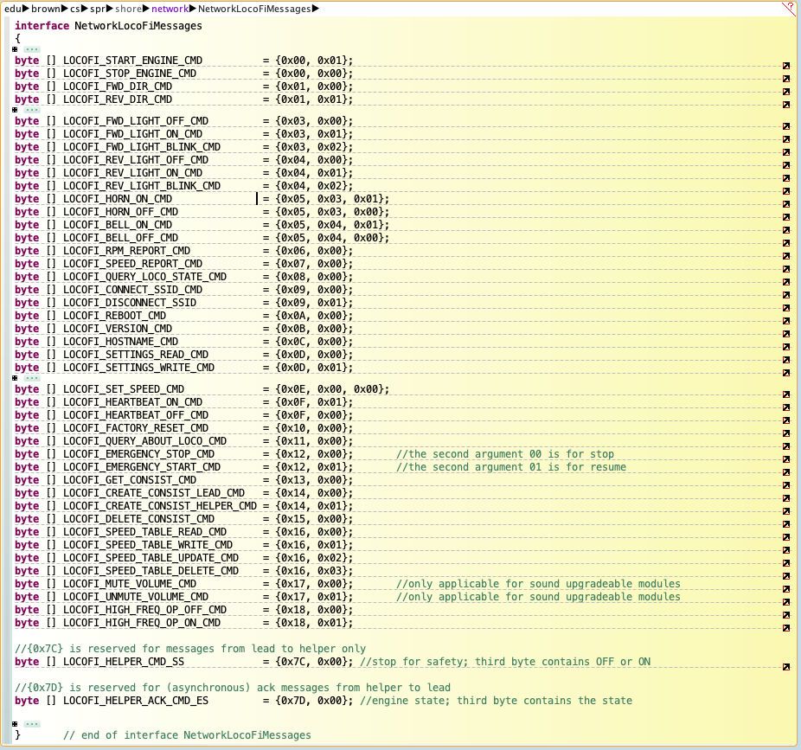
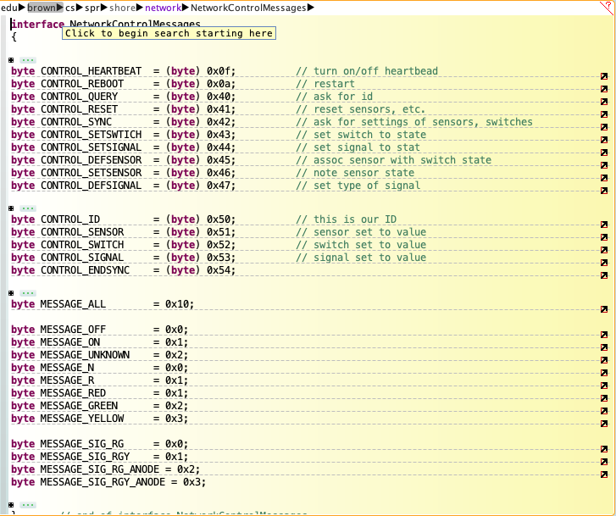
Message Interface in SHORE

Slide 14
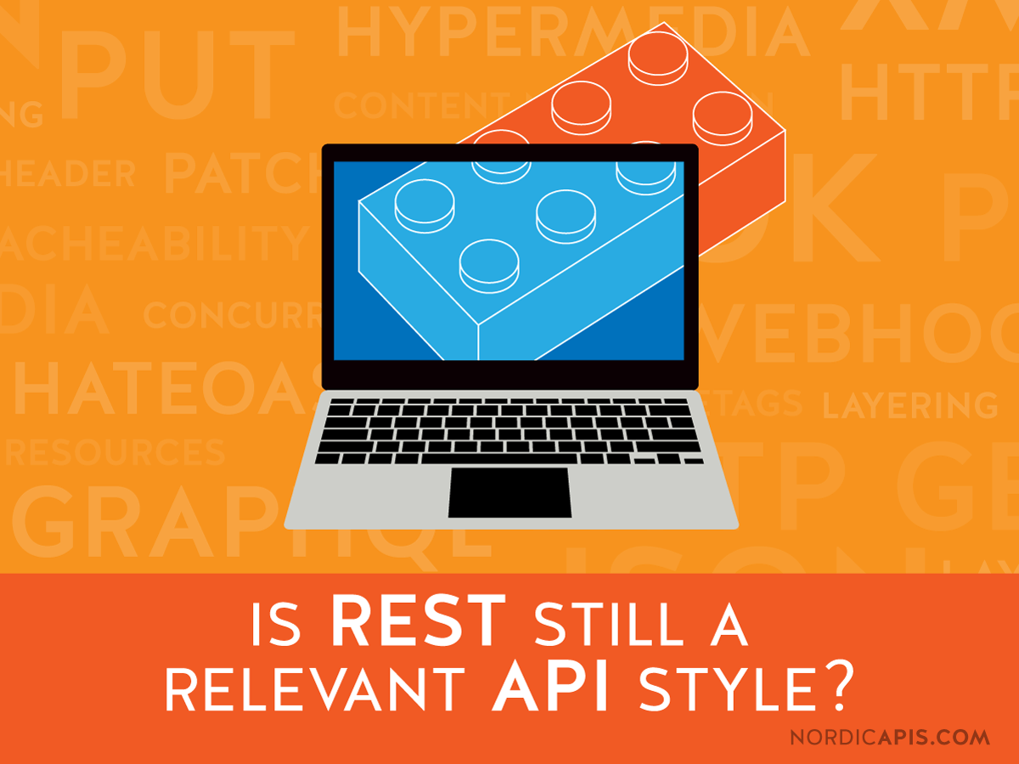
Pros and Cons of Message Interfaces
Easy to change, augment, add new
Limited applicability
  Between-process, more difficult within a process
    Use callbacks within a process
  Handles front-back end in web/mobile applications
Handling concurrent messages and replies can be messy
  Replies tend to be asynchronous
  Replies can always fail
  Can/should component process multiple messages at once
    For separate users
    For the same user
Tendency to avoid documentation
Requires a messaging architecture

Slide 15
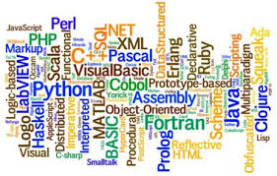
Languages for Large Systems
I’ve used Java for my examples
  Right now for language-based design, later for coding
  Object-oriented languages work for large systems
    Provide nice localized information hiding
    Much cleaner than procedural or functional representations: C with ADTs (Classes)
    A good way of thinking about components (interface vs implementation)
    Consistent approach (everything is done with objects)
  Interfaces are a natural part of the language
  Packages provide a convenient way of representing a component
  Common interface package provides a representation of the design
Other languages can be used as well (but often not quite as nicely)
  C# is roughly equivalent to Java
  C++ can be used if careful (effectively define interfaces; use safe pointers)
  Other modern languages (Go, Rust)
  Web & mobile languages (Dart, Swift, Android Java, JavaScript, TypeScript)
  Façades & interfaces can be created in any language
    But can be more difficult to hide the implementation
    Need control of visibility, import and export (as part of the language)
Need to understand what you want from the programming language
  To choose the most appropriate language for your application
Notes:
Message-based?

Slide 16

Large-Scale PL Requirements
Language must be supported over time
  Relatively stable and upward compatible
  Language evolves to match current programming style and issues
    Can be good or bad – language can get too complex
  Libraries and other components are rich, stable, and supported
  IDEs and debugging are well-supported
    Coding, navigating, discovery, debugging, compiler feedback
  Avoid extensions, especially non-standard ones
Language must be compiled (catch bugs early)
  With immediate error feedback from the IDE
Language must be strongly typed
  Types are a form of documentation and checking
  Types ensure interfaces are used correctly
  Typing moves error to compile time rather than run time
Language must be modular (avoid name conflicts)
Language must support objects, classes, and interfaces
  Object-oriented design supports the needed abstractions
  Objects provide information hiding
  Large systems are best modeled in an object-oriented fashion

Slide 17
Large-Scale PL Requirements Continued
Language should be easy to read
Language must support information hiding
  Private or local data & code
  Individual modules with import/export
  Different levels of access
Language should support concurrency
  Explicitly or implicitly
  Preferably in the language, not in a library
Language should support documentation
Language should be compatible with external libraries and systems
  That you will or might need for your application
  Most common libraries have APIs for a variety of languages, but not all
Language must support your system
  Messaging
  Where it can run (bare hardware, browser, OS, mobile platforms, …)

Slide 18
Large-Scale PL Requirements Continued
Language should be one your team is comfortable with
  Learning to use a language effectively can take from 1 month to a year
Language should make it easy to write safe programs
  Safe memory [garbage collection] (Java, C#)
  Help check for null pointers (dart)
  Help check for memory ownership (rust)
What doesn’t matter
  Brevity (this can get in the way of readability)
  Ease of writing initial code
  Efficiency of implementation
What language should you use on your project???
  It should meet these constraints
    Choice of language is important in long-lived, large systems
  Put the decision off as long as possible to better understand your needs
  Different languages might be used in different components

Slide 19

Multilingual Systems
Common for large software systems today
  Each process can be in its own language
    Message systems usually support multiple languages
    HTTP messaging works everywhere
  Can mix multiple languages within a process
    Trickier, not recommended, but can be done
  Web applications generally imply different languages
    Front end versus back end
  Native phone apps generally imply different languages
    Different operating systems; front end versus back end
Choose most appropriate language for each component
  But try to be consistent
  Mixing has costs and risks
  Develop consistent naming conventions across the project

Slide 20
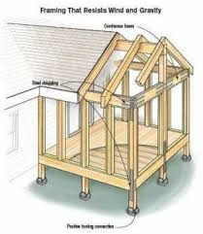
Designing Around What Exists
Don’t build everything from scratch
  Too much work, room for error, maintenance, risk
  Keep things simple
Reuse the work of others where practical
  Where it simplifies your efforts
    Now and in the future
  Where the benefits outweigh the costs and risks
    There are always costs
    There are always risks

Slide 21
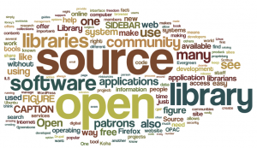
Standardized Code
Lots of “standardized” code exists
  Libraries that have evolved over time
  Common subsystems that are widely used
  Subsystems and libraries that are actively maintained
  Interfaces to existing frameworks
    OpenCV, SmartThings, ChatGPT, MongoDB, SQL, …
These are typically (but not always)
  Well-debugged and tested
  Documented
  Maintained by others (less work for you)
  Generally, with a well-thought-out interface (API)

Slide 22
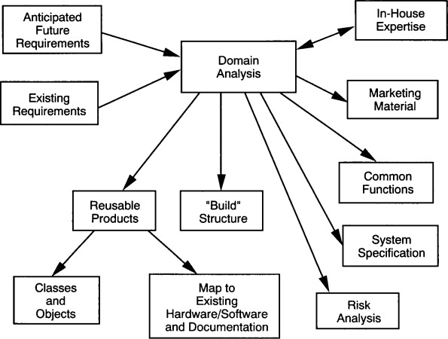
Common Domains
Some aspects of programming occur over and over
  Low level: Data structures, Algorithms, Properties
  High level: Databases, Machine learning
  Lots of others that aren’t as common, but still exist
In these domains, it is generally better to use existing code
  Complex, tricky implementations
  Existing tools allow for evolution, increasing complexity
  Well-understood
  Standard interfaces

Slide 23
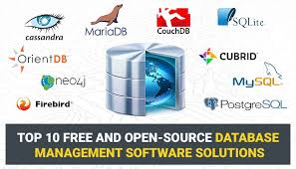
Databases
Anytime you need reliable, permanent data storage
  Long or short term, simple or complex
Use a database system
  Difficult to corrupt
  Might need to be shared or distributed
Not difficult to use
  After you’ve done it once
Not slower than doing something specific for your system
  Separate process, optimized, good error checking and handling
  Extensible to handle evolution, maintenance
  Writing to socket as fast or faster than writing to disk
Easy to migrate to more robust solutions as needed
  [SQLite] => MySQL => Commercial system (Oracle, DB2, SQL Server)
  MongoDB => Distributed MongoDB
But
  Another point of failure, porting, and distributing software, …

Slide 24
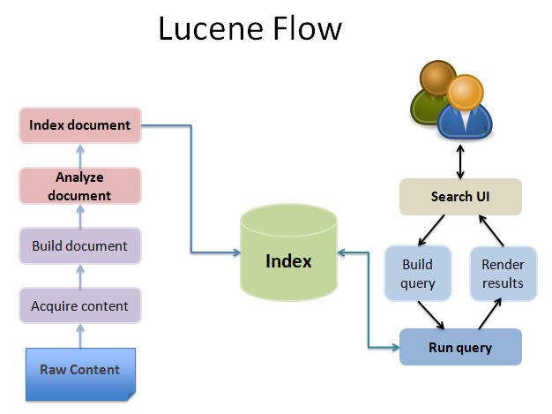
Search Tools
Search capabilities
  Search over multiple documents
    Indexed by keyword or other features (e.g., code patterns)
    Intelligent handling of multiple keywords, occurrences, logic, …
  Building and maintaining an index
Libraries exist for this purpose
  Lucene as a general (open-source, extensible) library
  Google search licensed for a particular domain or application

Slide 25
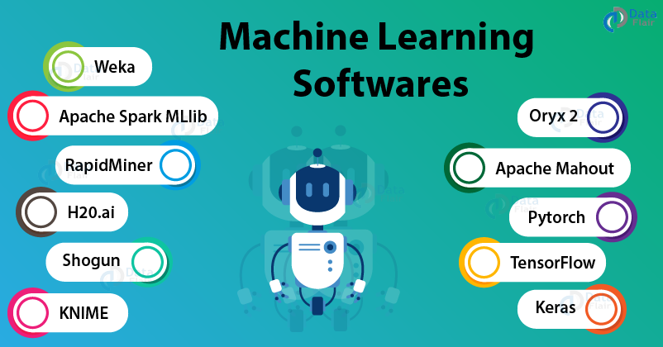
Machine Learning
Lots of machine learning algorithms
  Different domains require different approaches
  Standard, tested implementations available
Use a standard ML library if your application uses ML
  Unless you are researching ML
  WEKA, SPARK, and others
  Often want to run this as a separate process
  API interfaces to LLMs (ChatGPT, Bard, …)
Similar domains
  Computer Vision (OpenCV)
  Speech Generation and Recognition

Slide 26
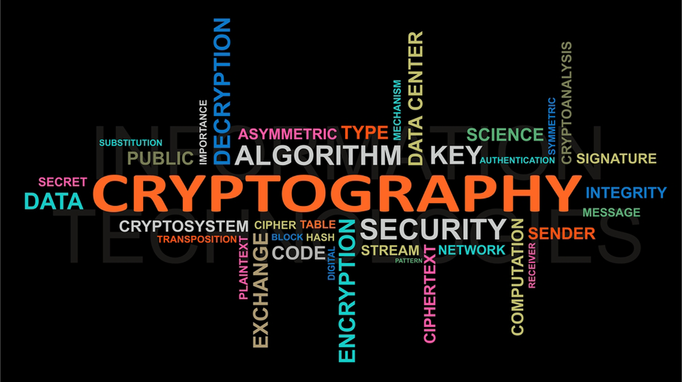
Other Common Applications
Math Packages
  LinPack, Array manipulation, Differential Equations
Cryptography
  Very hard to write safe code here – let someone else do it
Web Scraping
  Jsoup, Beautiful soup, …
Java Editor framework
Node packages (express,…)
Html plugins (jQuery,…)

Slide 27

High-Level Design
Reuse as much as possible
  Within a company, often reuse frameworks, libraries, code
  Develop an internal library (Ivy)
  But balance benefits, costs, and risks
Benefits
  Cost to implement yourself
  Cost to maintain and evolve
Costs
  Cost to learn (which can be high)
  Cost to adapt the external code to your code
  Cost to distribute (different licensing models)
  Cost to license
  Might skew or disrupt an otherwise clean design
    Might not fit into your design

Slide 28

Risks with External Code
Might need to commit the whole application
  Apache collections
Might have other dependencies
  Use Apache logger
  Lots of other libraries might be pulled in
  Different versions of other libraries, Java, JUnit, …
Might evolve in a way incompatible with your application
Might have bugs or security flaws
Might not be maintained (lose support)
Might not be well documented (difficult to use) [this is typical]
Might not be a good fit for your needs
IP rights might become problematic
Might make distribution (both source and binary) difficult

Slide 29
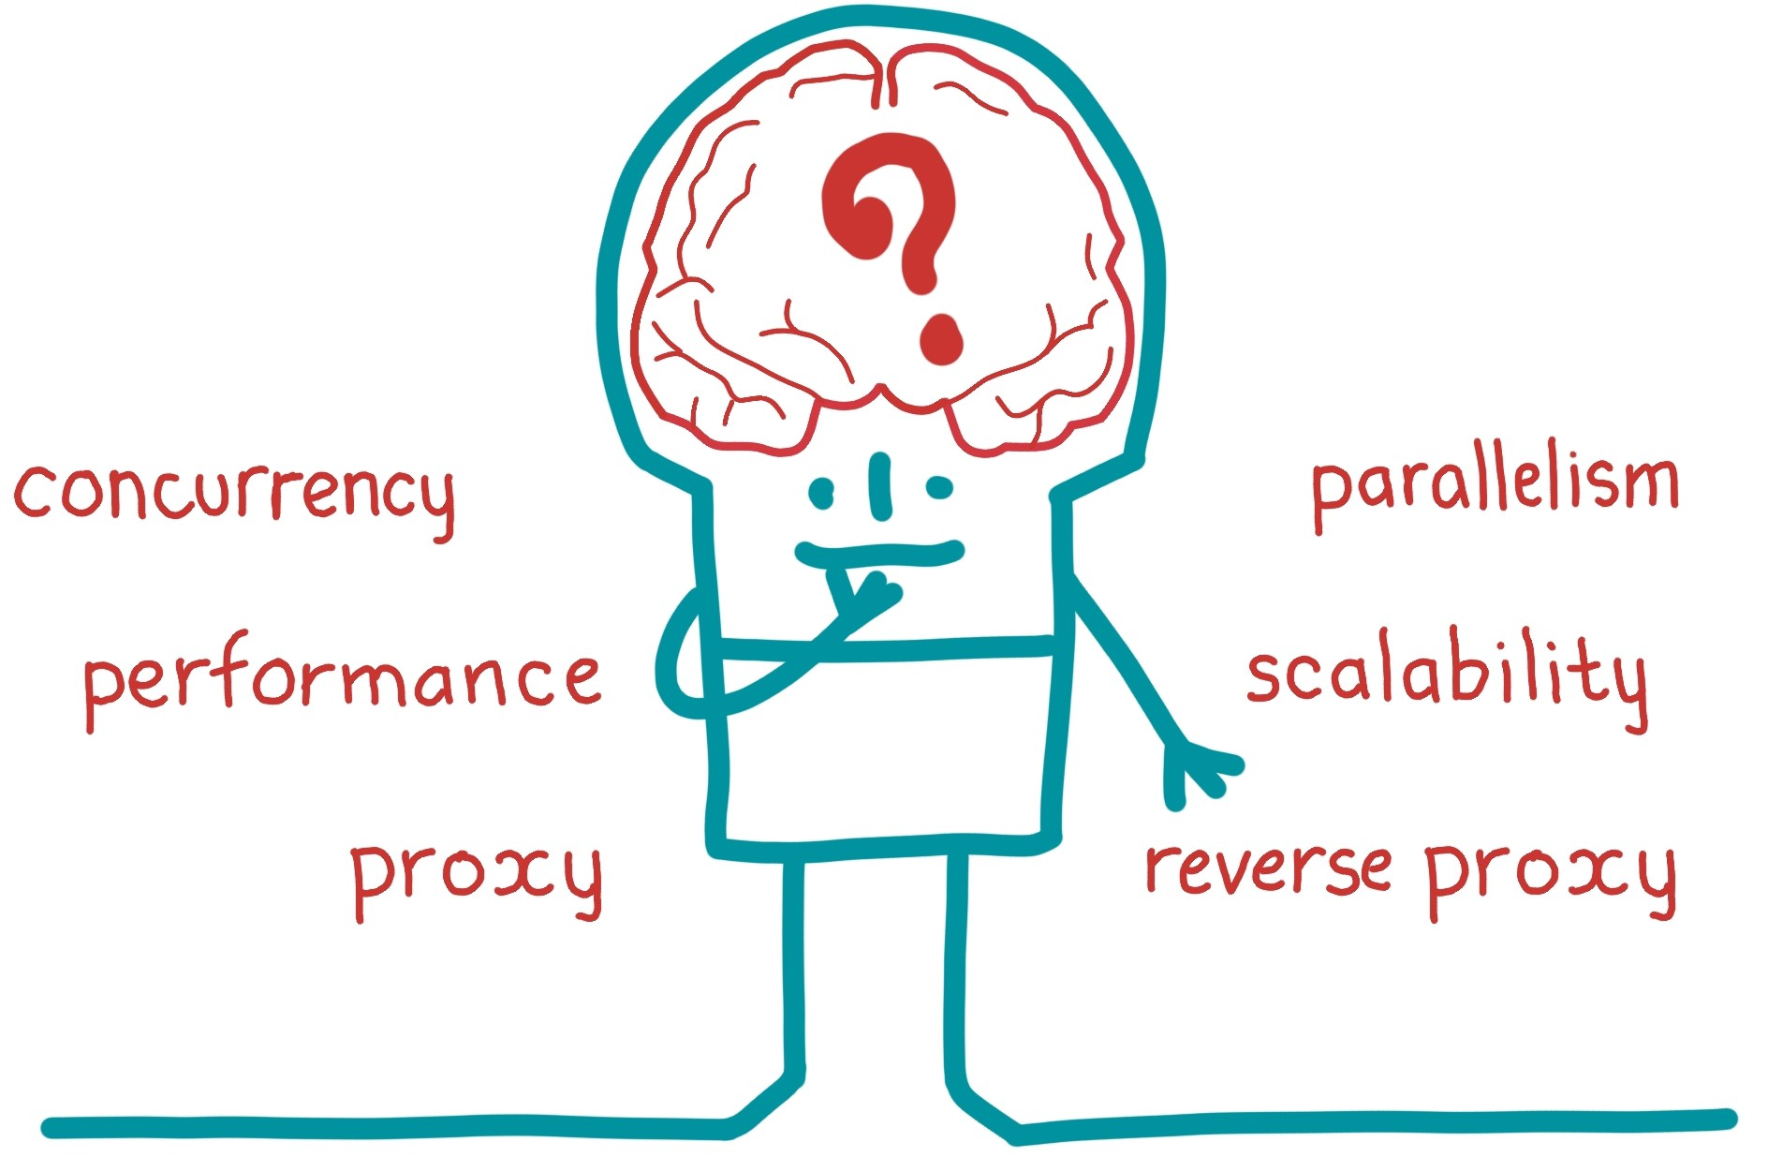
Designing for Concurrency
Goals
  Make best use of today’s hardware
    Multiple cores
    Networks of computers (cloud)
  Covering idle time
    Most time is spent waiting (UI, I/O operations)
  Simplicity
    Independent things can be independent: processes, sockets
A lot of this is implementation and comes later
  But several factors affect high-level design as well

Slide 30
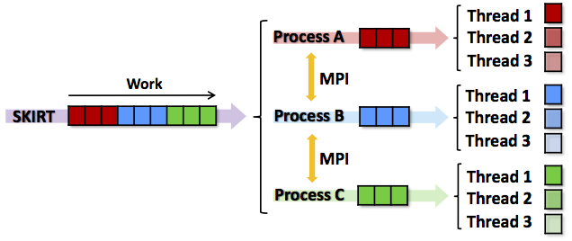
Concurrency: Multiple Processes
Independent processes that communicate
  Might run and read the result
  Might be message send and response
This is the easiest to design and code
  Each process is self contained
  Limited interaction => limited chance for concurrency problems
    But not non-zero (all the problems still exist)
  Well-defined interactions
  cpp, asm and the C compiler, Code Bubbles, weka in hump, sort

Slide 31
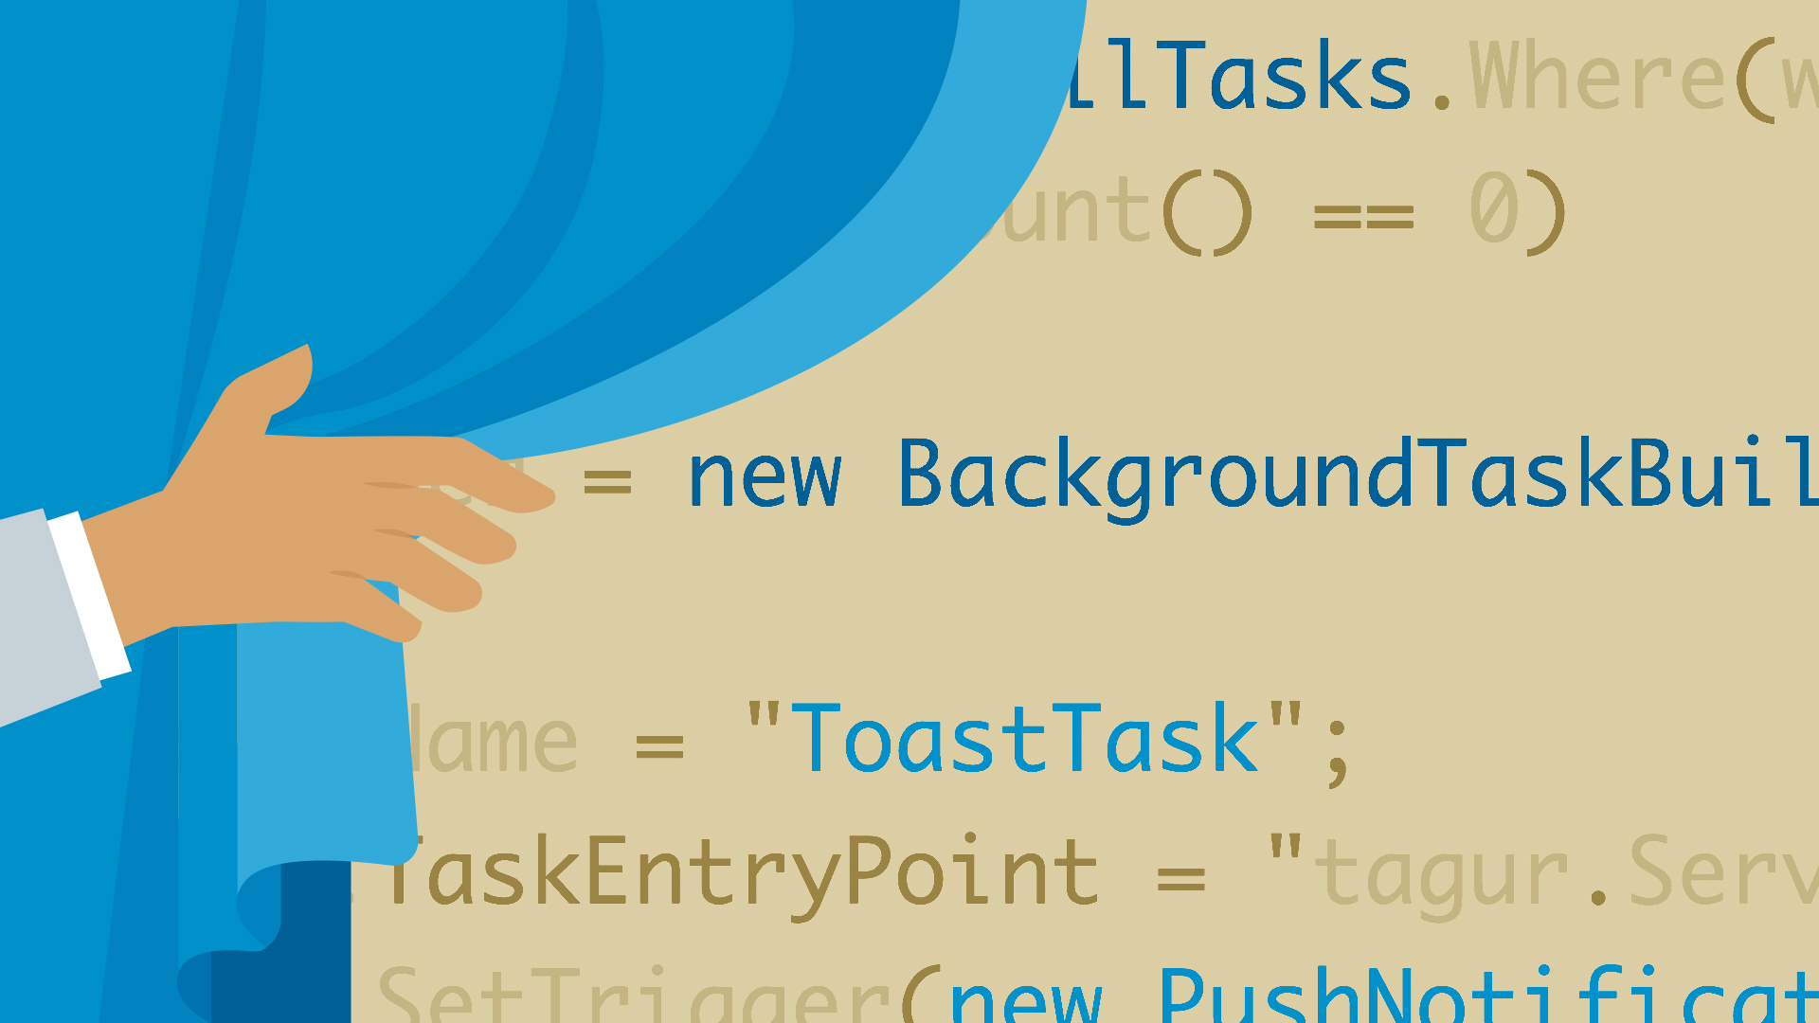
Concurrency: Background Tasks
Use threads to support long-term work
  Don’t access the result until it is ready (futures)
  Threads are independent
  Use futures if they are available and work well in the language
  Use thread pools to handle disparate work within a system; not separate threads
  Examples: eclipse indexing; bubbles syntax fixing, search, …
Use threads to support long-term I/O
  Sockets:
    Thread to monitor server socket
    Thread to monitor each client socket
  Other I/O (COSE search, crawler)
Most of this is in the implementation, not the design
Non-threaded models (e.g., JavaScript, Dart)
  Hide the threads & pools with asynchronous calls & futures
  But they are still there

Slide 32
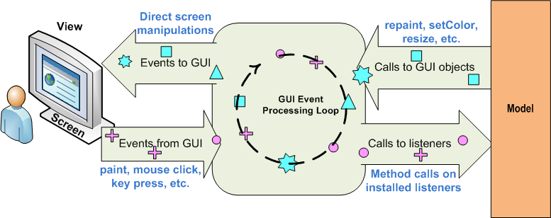
Concurrency: User Interface
Swing/AWT thread handles all the UI issues (implementation)
  Same for most UI packages
Most of a user-centric program is reactive
  User interface callbacks invoked in UI thread
  But your callback code then will delay the UI thread
  Don’t want to do anything complex in response to the user
View non-trivial actions as background tasks
  Start up a new task for each action
  Actions should be independent
  Using thread pools or futures
Actions affecting the UI
  Should be done in the UI thread
  Need to forward the actions to that thread

Slide 33
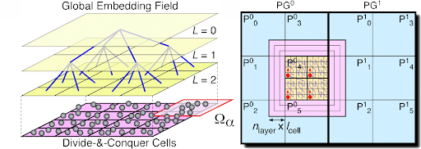
Concurrency: Algorithmic
Concurrent Algorithms & Data Structures
When a particular task is expensive
  And the algorithm can be made concurrent
Split a task into separate threads
  Run those concurrently
  Generally, need synchronization and sharing
Think of this as implementation, not design
  For design: if the task requires significant sharing
    Think of it as one thread or process
  Data structures provided by standard libraries

Slide 34
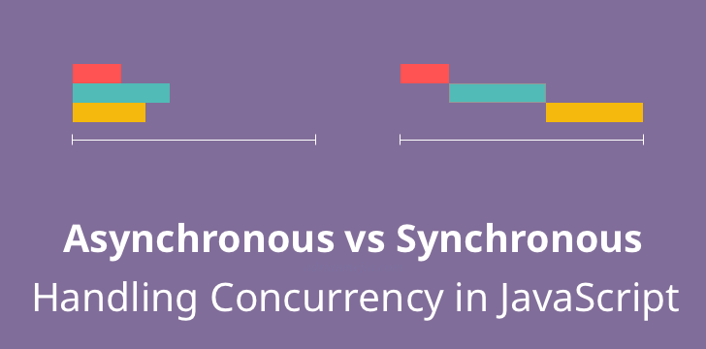
Concurrency in High-Level Design
Start with a synchronous design
  Easier to reason about, design at a high level
Identify opportunities & needs for concurrency
  What level of concurrency is appropriate
  Concentrate first on separating processes
    Other decisions are really implementation details
Identify shared data structures
  These complicate concurrency coding
  Much easier to code if known in advance than to retrofit
  Identify interfaces/classes that might be shared
    Document these as thread safe or not thread safe
  Isolate these in their own component
  Identify other commonalities: database relations, etc.

Slide 35
Programming Homework
Consider how you would modify your program to:
  Rather that having properties on the screen determined either randomly or by user input, tie them to process properties.
    On Linux you can look at /proc
    On mac or Linux you can run ps and parse the input
    On windows you can run tasklist
  Examples of what can be done:
    Ball size relates to log(memory size); Ball speed relates to CPU usage; Ball color relates to # files
    Update every 1-10 seconds, adding/removing balls as needed
  Issues
    Number of balls (400-900 processes); asynchronous running of ps
Consider also how to modify your program so that:
  It runs in a circular window rather than a rectangular one
Consider also how to modify your program to use multiple threads
  Compute each ball’s next position separately
Write and submit a description of what would be changed for these cases
  Don’t do the changes – just describe what you would have to do to your current application
  How modular was your original design
  How much could you reuse
Due Thursday (canvas hand-in)

Slide 36
PROJECT Homework
Work on the high-level design
  Choose appropriate target language(s) (based on criteria in lecture)
  Think about interfaces in those languages
Initial high-level design due Tuesday 10/8
  Something that can be reviewed
    Can be just a set of components
  Hand in through canvas (one per team)
  Not a final design
Next Tuesday 10/8 we’ll have initial project presentations
  Describe what you are building
  Describe the high-level design
  10 minutes (7 + 3 for questions)

Slide 37
Research in High-Level Design
Creating high-level designs using LLMs or code search

