Slide 1
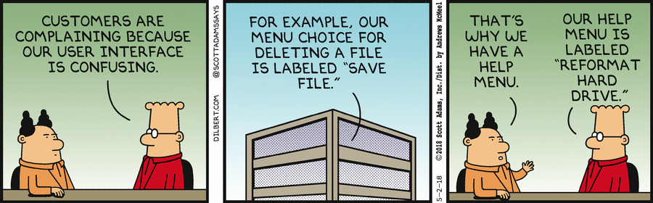
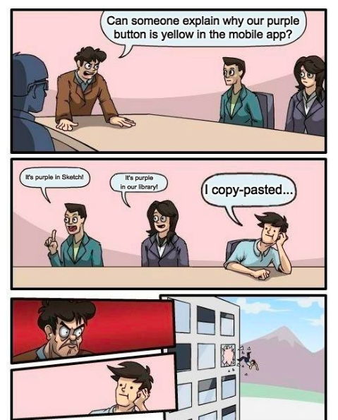
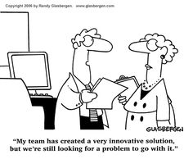
Design and the User Interface
CSCI2340: Software Engineering of Large Systems
Steven P. Reiss
Notes:
This lecture needs better organization to make it more appealing.
One possibility is to look at the 3 ways of developing an interface (first, as a driver, last) as the focus. Then for each, indicate what types of interfaces it is relevant to what types of design and design methodologies work in the case. The slides that do not address these concerns can then be dropped (callbacks, …). Other slides are integrated with the appropriate type.

Slide 2

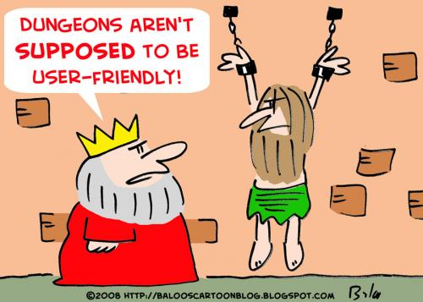
User Interfaces
Are an essential part of modern applications
Can make or break the application
HCI is its own field of study
  Understanding how people interact with computers
  Understanding how to evaluate and assess interfaces
  Understanding what works, what people like
  Visual design
Having a design background helps
  Computer scientists typically design poor user interfaces

Slide 3
Homework Discussion
I gave you 3 possible features to be added to bouncing balls
  Were any of them easy with your current design?
  Were any of them impossible with your current design?
  What approach do you think you would take for each?
Let’s see what happened

Slide 4
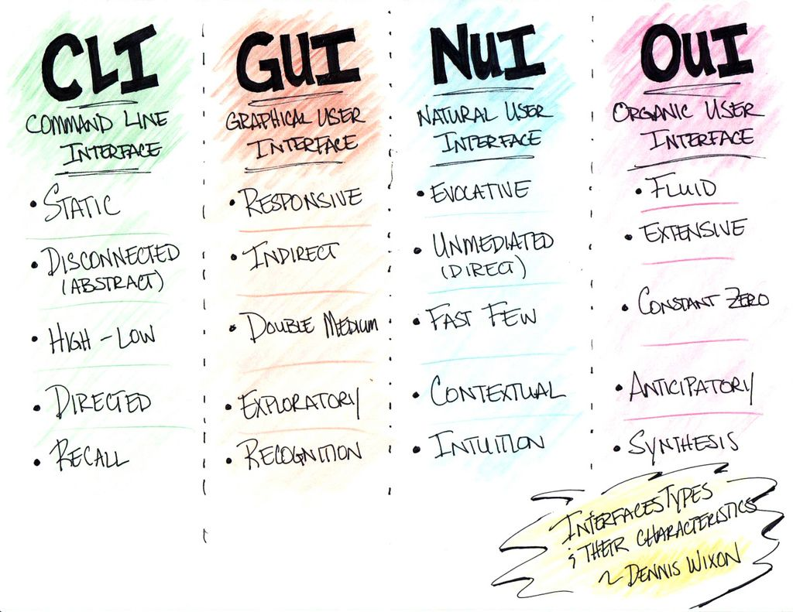
User Interface Types
Command-line interfaces
  Relatively easy to deal with, but limited (git, …)
GUIs: Workstation & phone interfaces
  Widget-based, callback-based interaction, direct manipulation
  AWT/Swing, JavaFX, Motif, Qt, WPF, Android, Swift, Dart, …
Web interfaces
  Original model: Reload a new page each time
  Today: Update page in browser; RESTful connection to server
Natural Language Interfaces
  Search, ChatGPT, phone bots
VR interfaces
  OpenGL (WebGL), augmented reality, 3D headsets

Slide 5
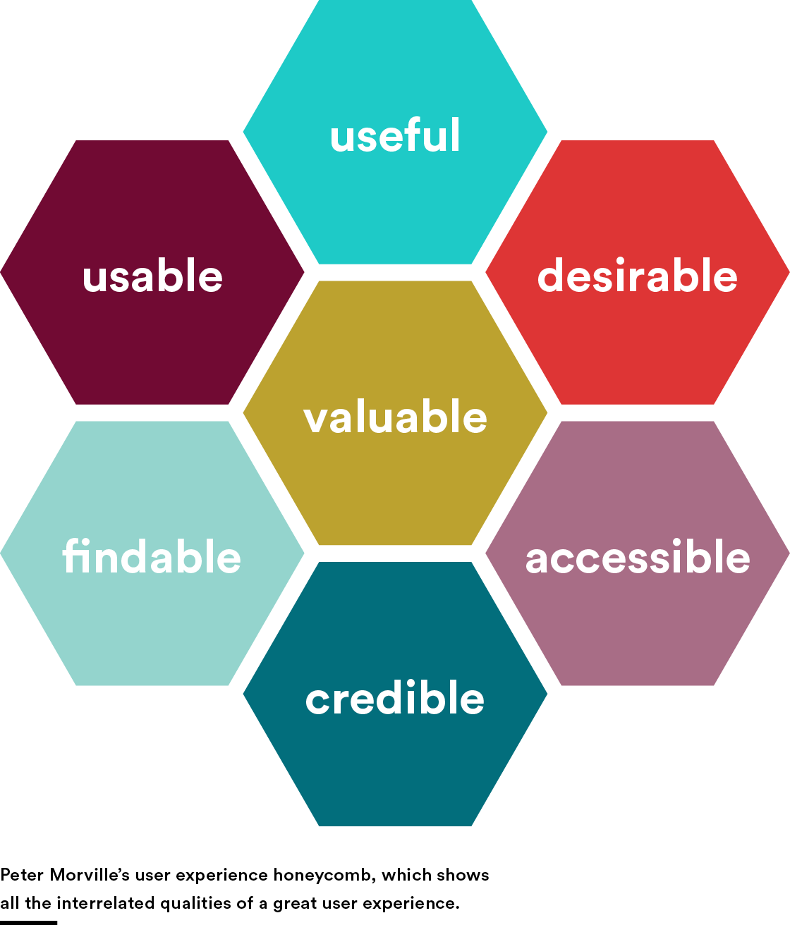
User Interfaces
The user interface is often critical to success
  Difficult to get right a priori
  Often needs a prototype
  Often needs multiple prototypes
The interface affects the rest of the application
  How it works, what it needs to do,
  What data it needs, what the user can do
  Often at the design level
The user interface is a risk to the system and to the design
  We’ve discussed how to handle risk

Slide 6
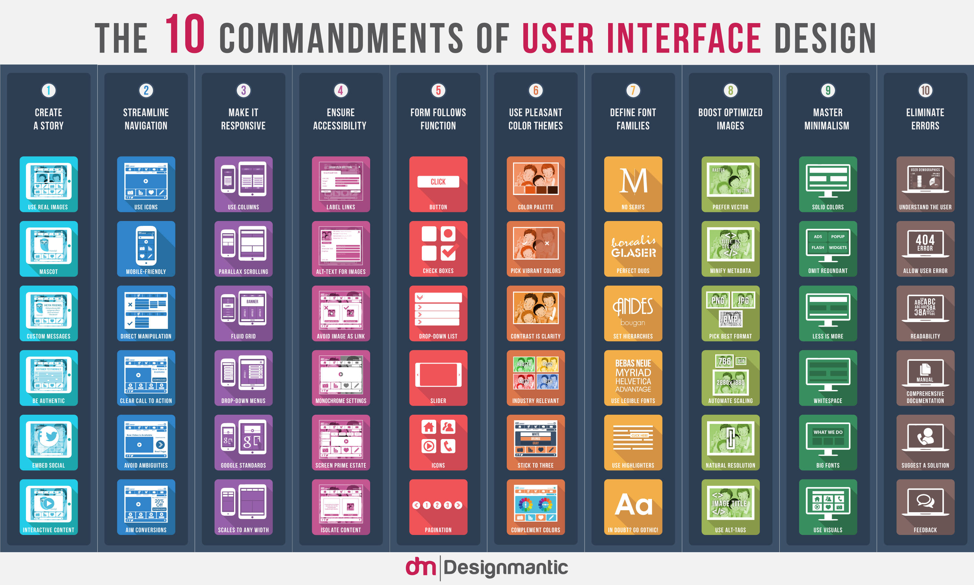
User Interface and High-Level Design
How these interact varies with the application
Where does the UI fit into the design
  Can be done later (treat as low-level design)
  Can be the driving factor for the design
  Can be in between
It depends
  How critical the user interface is to the application
    How much the design of the UI affects the design of the application
    With a completely different interface, how much of the application would persist
  How well defined the user interface is from specifications
    How sure are you of that interface
  How separable is the user interface from the rest of the system
Different approaches are used

Slide 7

Deferred User Interface Design
The UI might be important, but not central to the design
  Then the user interface is not critical at this stage
  A variety of interfaces will probably work
  You don’t need to know the best from the start
    Can prototype different interfaces later on
Isolate the UI from the rest of the design
  Determine what information might be needed by the UI
  Determine what commands are needed by the system
  Create a component with an interface or façade for the UI
  Design of the UI is now a lower-level design problem
  Don’t even need to build a full UI initially
Examples: SHORE, UPOD/Sherpa, S⁶, FAIT

Slide 8
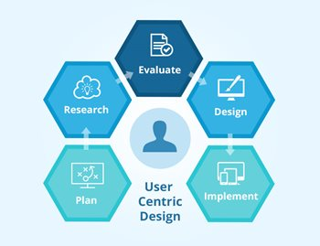
UI-Centric Design
Sometimes the UI drives the application
  Then the user interface is more important
  The system should exist to support the interface
Specifications
  Give a sketch of the user interface
  Identify the commands and operations needed
Build the user interface first
  Rebuild it until you get it right
  Fill in the rest of the system as needed
  Even if the rest of the system is complex
Often combined with UI-first implementation
Examples: ROSE, DYMON

Slide 9
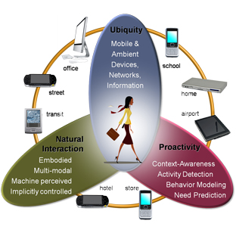
UI-Pervasive Design
Sometimes the user interface is the application
  Makes it more difficult to change
  UI tightly coupled with the rest of the code
Designing the user interface is designing the application
  The rest of the application is secondary
  Most system components interact directly with the UI
  The rest of the application fits into the UI rather than vice versa
Prototype ideas to get the overall UI structure correct
  Then implement a real UI and fill in the details as needed
  Still try to keep many changes local
Examples: Code Bubbles, FREDIT

Slide 10
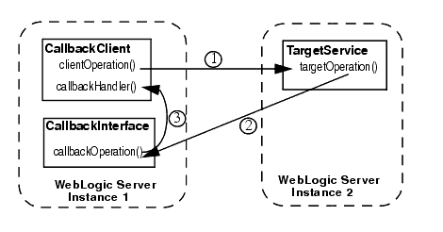
Interactive Interfaces Use Callbacks
A callback is a routine/object registered with a component
  Invoked when something changes
  Example: UI buttons, drag and drop, file monitors
  Example: Debugging events in Code Bubbles
Useful for monitoring data structures that can change
  UI registers callbacks with from the non-UI part of the application
  SHORE: monitoring state of HO trains, sensors, etc.
    In the UI to update the display when anything changes
    Internally to continually checking safety
    Updating the planning process when that happens
Widely used in interactive UIs
  Register callbacks with the view to handle user interactions
  Done with widgets, HTML/JavaScript, …
  Most modern applications are reactive: driven by these callbacks
Need to add appropriate callback interfaces and methods to the design

Slide 11
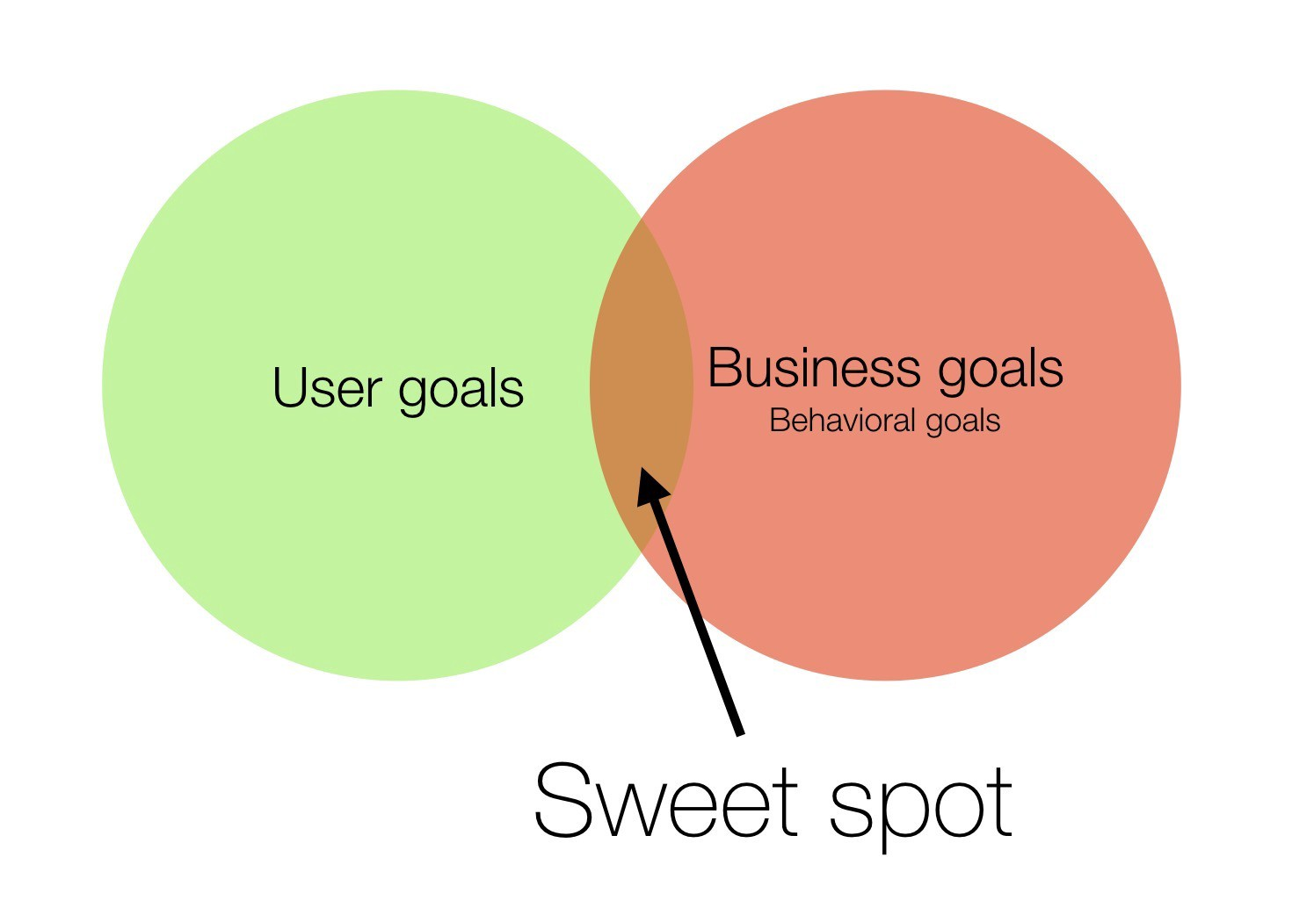
User Interface Design Goals
Separate the user interface from the rest of the application
  UI will change (a lot)
  Want to minimize the changes on the rest of the system
  At least isolate what might change
  Even if the user interface is the application
    Freezing a bubble to rearrange the screen
Allow experimentation with the user interface
  Prototyping in whole or in part
  Before, during and after implementation
Allow for future expansion and changes
  In the system and the user interface
Different strategies for UI integration
  But all can be viewed as Model-View-Controller (MVC)

Slide 12
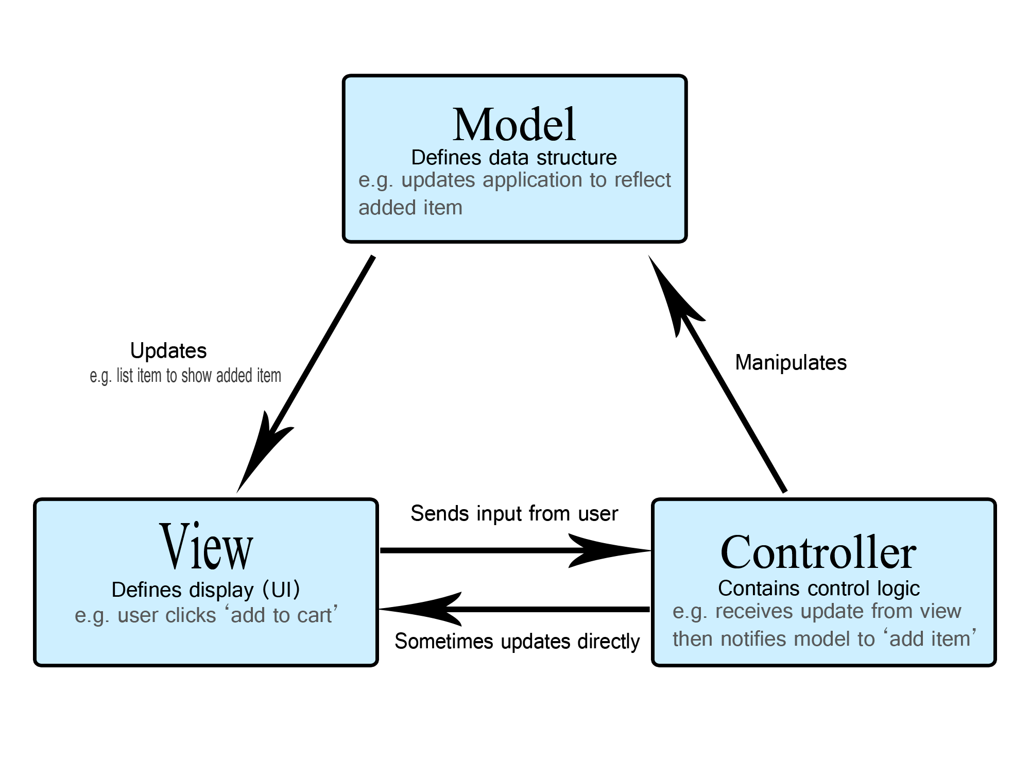
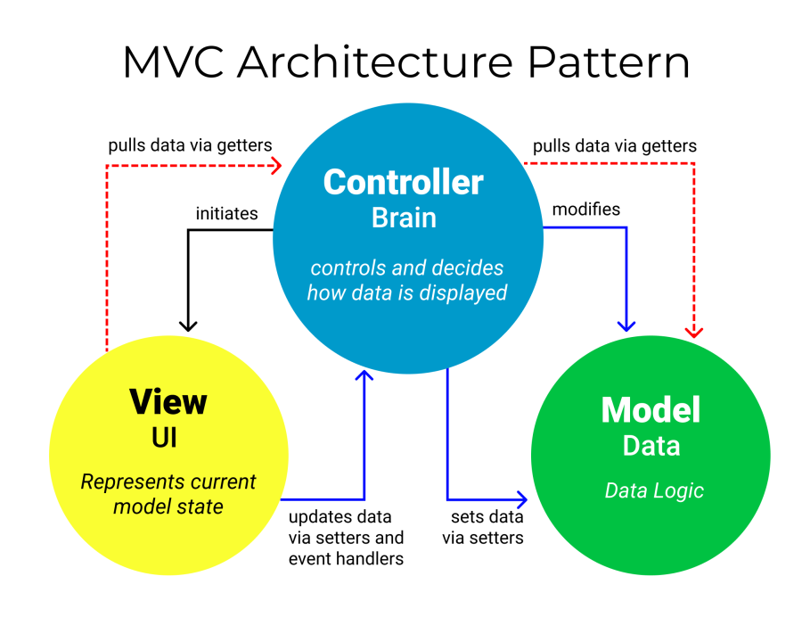
Model-View-Controller Architecture

Slide 13
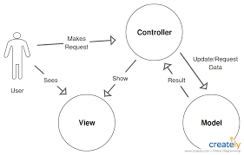
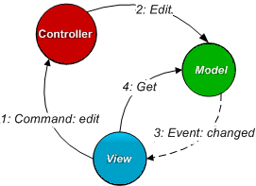
MVC Can Mean Almost Anything
Many ways to implement MVC
  Many very different implementations call themselves MVC designs
  Varying degrees of independence of model, view, and controller
  Varying degrees of communication between model, view, and controller
  Varying size and complexity of view, model, and controller
MVC means different things to different people
The components are often entangled
  Model includes Controller
  View includes Controller
  Model includes View

Slide 14
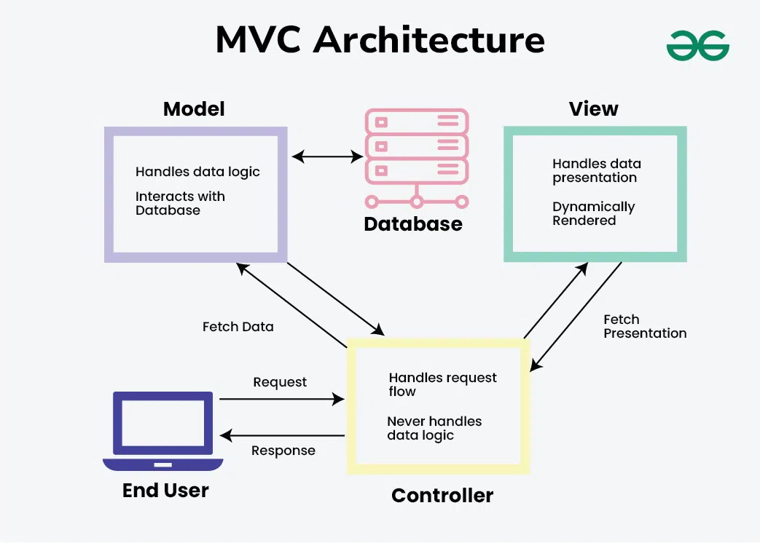
MVC Issues: Size of Components
Model can be a complex component or can be trivial
  Complex: SEEDE, SHERPA, DYMON
  Trivial: ROSE (all commands, very little retained)
  In Between: SHORE, TWITTER DISPLAY, FREDIT, Code Bubbles Editor
Controller can be a complex component or combined
  Complex: TWITTER DISPLAY
  Part of view: RESTful interfaces to microservices
  Part of Model: Code Bubbles
View depends on user interface
  Simple set of commands (git)
  Complex interactions (TWITTER DISPLAY)
  Complex graphics (DYMON)
  VR model of the world

Slide 15
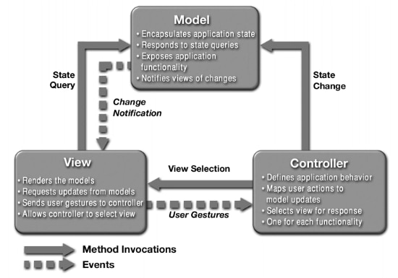
MVC Issues : Who Talks to Whom
Communication patterns in MVC also vary
Can model communicate directly with view and vice versa
  View can generate model update commands directly
    RESTful applications changing the database directly
  Model generates view updates directly
    Callbacks, live data
Or must all communication go thru the controller
  View generates commands
    Controller translates these into model updates
  Model tells the controller what has changed
    Controller translates these into view updates

Slide 16
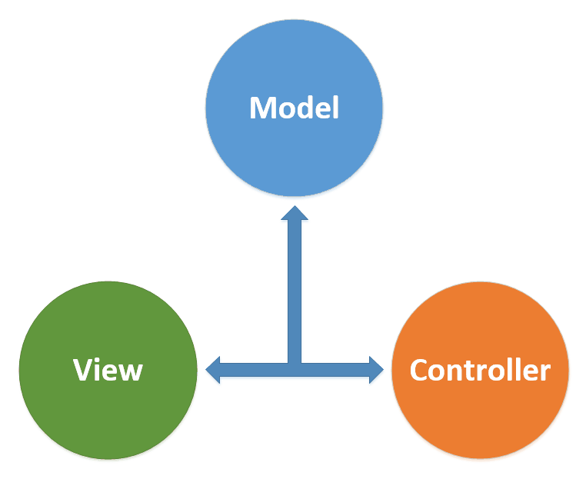
MVC Issues: Representation
The view needs to understand the model in the abstract
  View shouldn’t know the (implementation) details of the model
  But needs to know what the contents are enough to display them
  Also needs to know enough to query or update
  Don’t want to duplicate the model implementation in the view
    Especially with a separate front end (web/mobile applications)
    Don’t want the view to depend on model implementation
    But this is sometimes done
Representing the view in the abstract can be tricky
  What commands are allowed or implied?
  What does direct manipulation mean?
  How much does the controller need to know
  Does the controller need a view of the model?

Slide 17
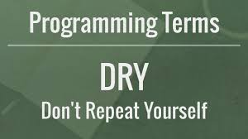
MVC Issues: Duplication
The model might be duplicated
  Actual model data structures in memory
  View concept of the model (for display & editing)
  Database concept of the model (for permanent storage)
  Controller concept of the model (for update commands)
  SHERPA: user’s universe as JSON, data structures
This means that evolving the model can be complex
  Changes required in several places of the program
  Leads to more code, errors, complexity, inefficiency
This has led to various alternate solutions
  Accessible (public) model, ORM, embed controller in model, …

Slide 18
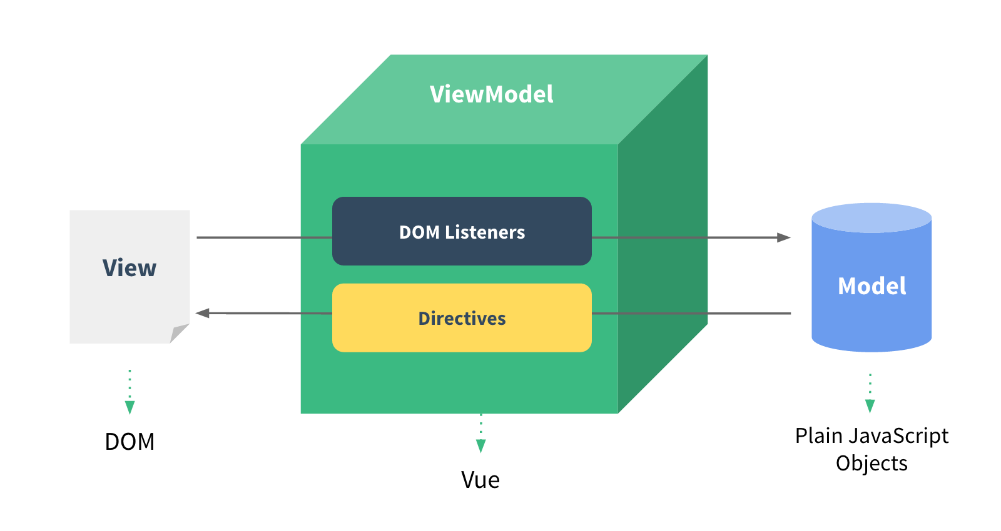
MVVM Architectures
ViewModel translates between view and model
  Acts as simple controller
  Makes model objects easy to manage and present
  Handles most of views display logic
  VUE

Slide 19
MVC Design Example: SHORE
View
Controller
Safety
Network
Model

Slide 20
MVC Architecture Example: SHERPA
Universe Storage
DART User Interface
Embedded Web Server Commands
Programs
Devices
RESTful
Sensors
Conditions
Model Universe
Execution Engine
MONGODB
Notes:
Update for CATRE

Slide 21
Exercise
How does your programming assignment fit MVC
  All these versions of MVC; which (or none) is yours?
  Breakout into small groups
  Say hello
  Sketch out your MVC model quickly
  Discuss how your programming assignment fits the MVC model
    Do you have a model?
    Do you have a controller?
    Do you have a separate view?
    How do these interact?
5-10 minutes

Slide 22
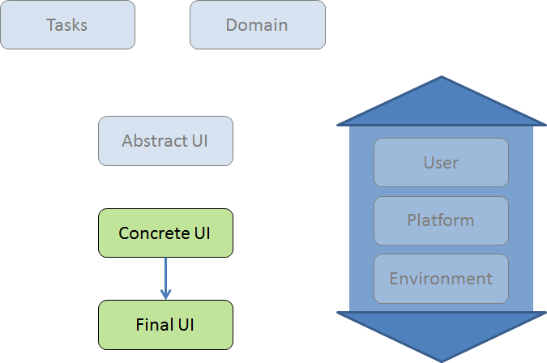
User Interface and High-Level Design
Determine what MVC approach is appropriate
  Based on complexity of model, control, user interface
  Based on software architecture & specifications
  Based on whether UI is separate process or not
  Based on the needs of the system (importance of UI)
  Determine responsible design components
Separate the different MVC components
  As much as possible and practical
Avoid duplication
  Avoid implementation dependencies
Ensure high level design reflects your approach

Slide 23

UI-Development Alternatives
How the UI fits into the application affects development
  It affects how one designs the application
  It affects how one designs the user interface
  It affects how one approaches the implementation as well
Alternatives
  UI-First development
  UI-Centric development
  UI-Last development

Slide 24
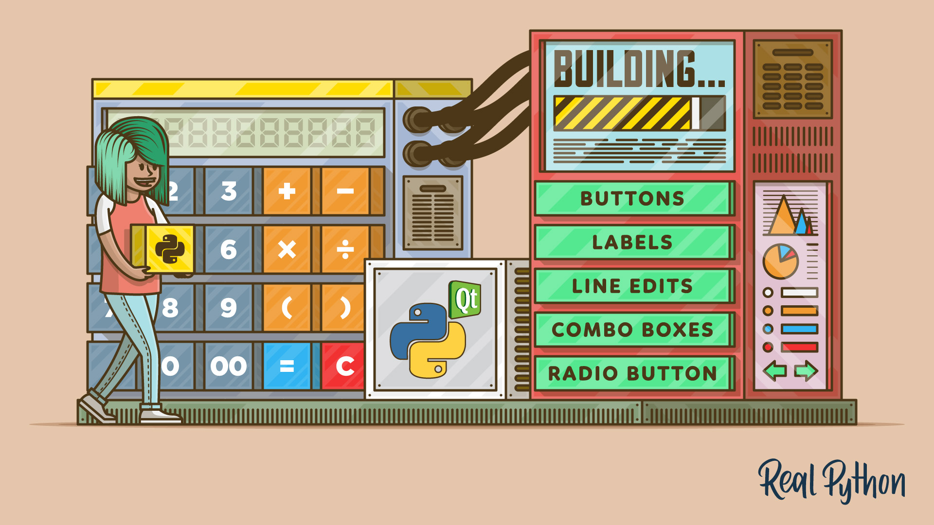
UI-First Development
Build and test a user interface first
  Prototype
  Multiple prototypes if needed
  Relatively complete user interface
Design the rest of the application around it
  Implement UI commands one at a time
    As needed for your scenarios
  Continually test the interface
    Executing commands
  Can build the essential pieces in parallel
    But might need to revise their interfaces to accommodate the UI
Web apps (SphereE, Twitter Data), Code Bubbles

Slide 25
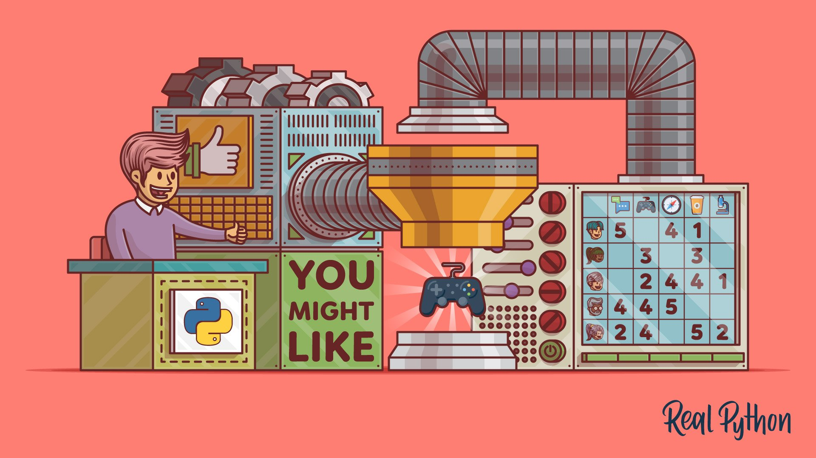
UI-First Development Pros and Cons
Good chance of getting the interface right
  Multiple prototypes
  Lots of experience using the interface
Provides a framework for the application
Provides criteria for measuring performance, usability, etc.
Slows down application development
More difficult for multiple-person teams
Akin to test cases first
  User interface acts as the test framework

Slide 26
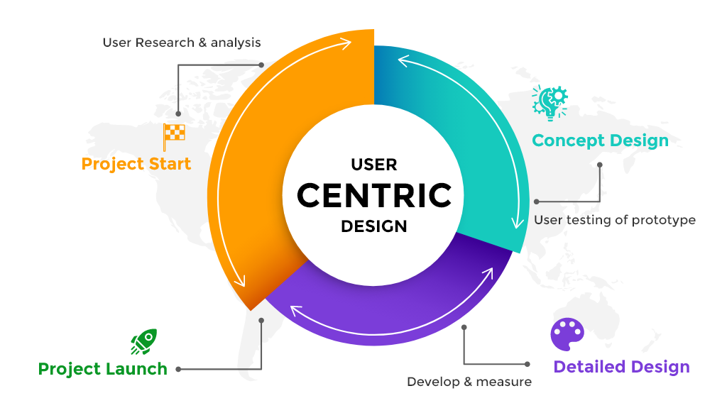
UI-Centric Development
Many features are tied to the UI
Build the application based on features
Start with a very simple user interface
Add the UI buttons and interactive capabilities one by one
  Then add the implementations
  Add the UI for the button, then add callback, then the implementation
  Do this for each button/capability/dialog/panel/…
  Can rearrange or modify the interface once buttons work
Choose important parts of the applications based on UI & scenarios
Can develop much of back end in parallel
Fits in with agile development
Examples: DYMON, SEEDE
Notes:
Fix this slide

Slide 27
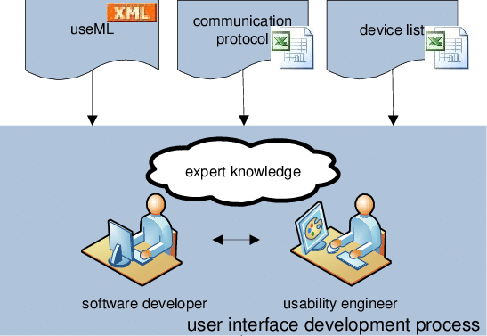
UI-Last Development
Get an understanding of what will be needed for the UI
Create a component (interface/façade) for the UI
  As part of the high-level design
  Can have a dummy implementation (or none)
Get the main implementation working
  Use the UI façade or just print statements to test it
Then work on one or more user interfaces
  Might require minor changes to the design, but not much
Examples: SHORE (swing/javafx), SHERPA

Slide 28
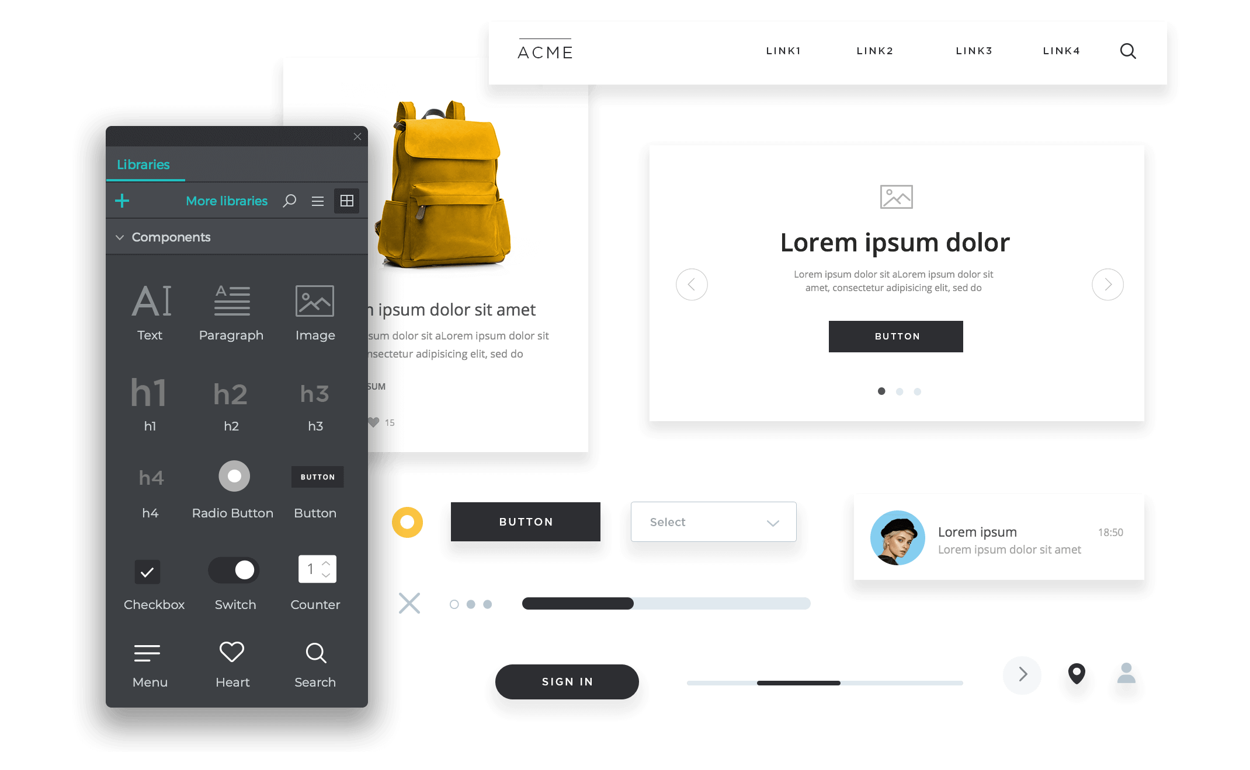
Prototyping the User Interface
Design methods suggest designing 3+ different user interfaces
  User can choose one or create one with ideas from all 3
Development methods talk about building multiple UIs
Need a concrete way of evaluating the UI
  Having the wrong UI is a risk
  Its difficult to know what is the correct UI
Building multiple examples can be helpful
  Can be shown to user to get feedback
  Can play with it to get experience
    By yourself (too tolerant)
    By others

Slide 29
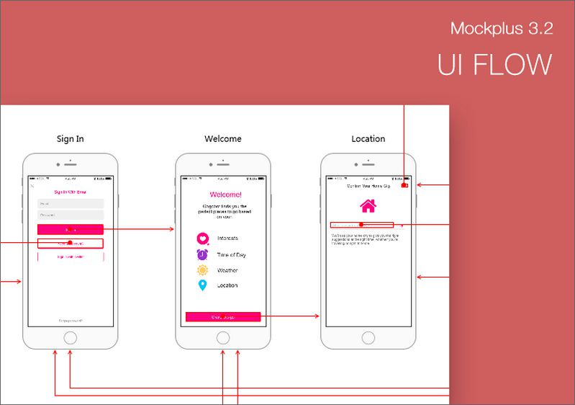
Types of Prototypes
Low-fidelity: paper sketches
  Akin to what is provided with specifications
  Simple and cheap to create
Medium-fidelity: clickable prototypes
  Something the user can play with
  Not necessarily detailed or pretty, just give a sense of design
  Give a sense of flow with dummy results, etc.
  Static web pages and links for a web application
  Front-end only mobile applications
  InVision is an example of a tool for this

Slide 30
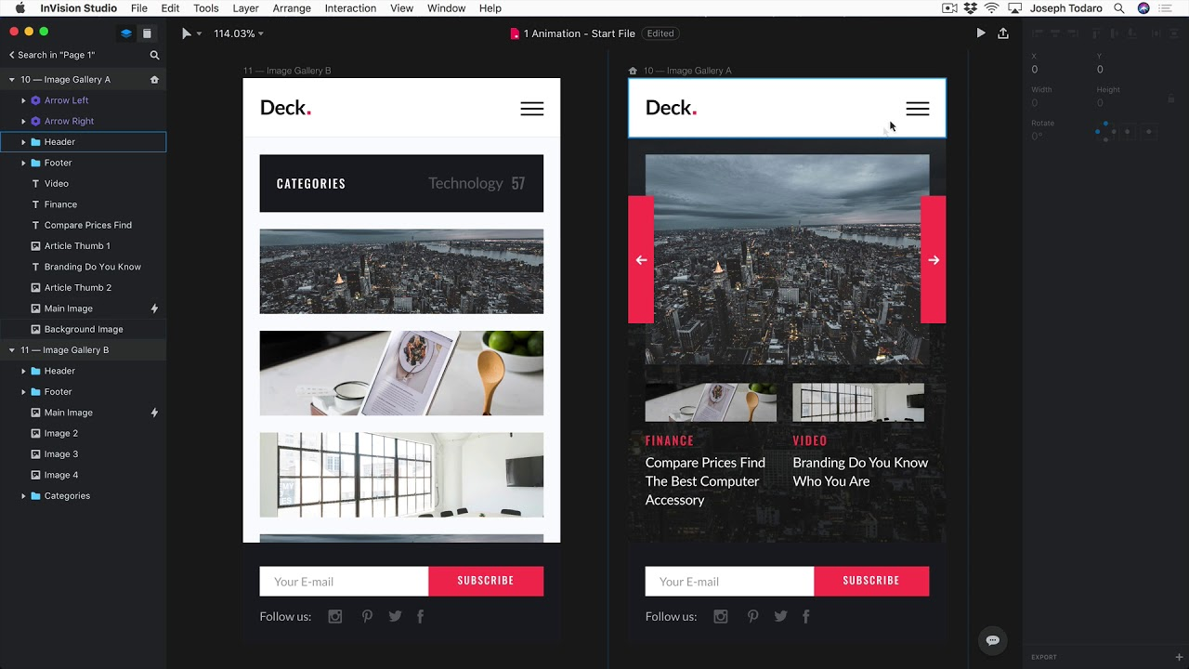
High-Fidelity Prototypes
What looks like a complete application
  Includes interactions and transitions
  Coding the user interface portion of the system
Tools let you do this without the code
  InVision, Principle, Framer, UXPin, Figma, HTML w/o JavaScript
Mocking code to replace a real back end
  Implement the calls with static (or almost static) data
    Easy to do with HTML, can be done with other models
  Usable but non-functional implementation
  User can evaluate the interface

Slide 31
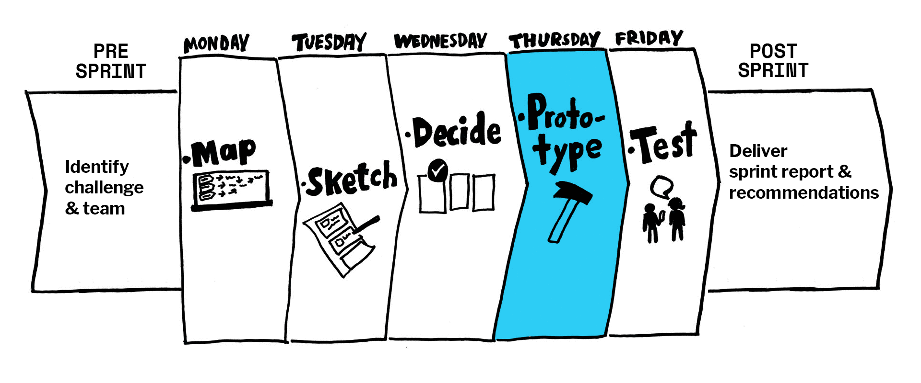
What is a Prototype
Quick and dirty implementation to try something out
Designed to be thrown-away, not kept
  No commitment on the developer’s part
  Not perfect, just an approximation
  Might not be performant, look the best, …
  Code is not “production quality”
Designed to be easy to change
Designed to be reimplemented if used

Slide 32
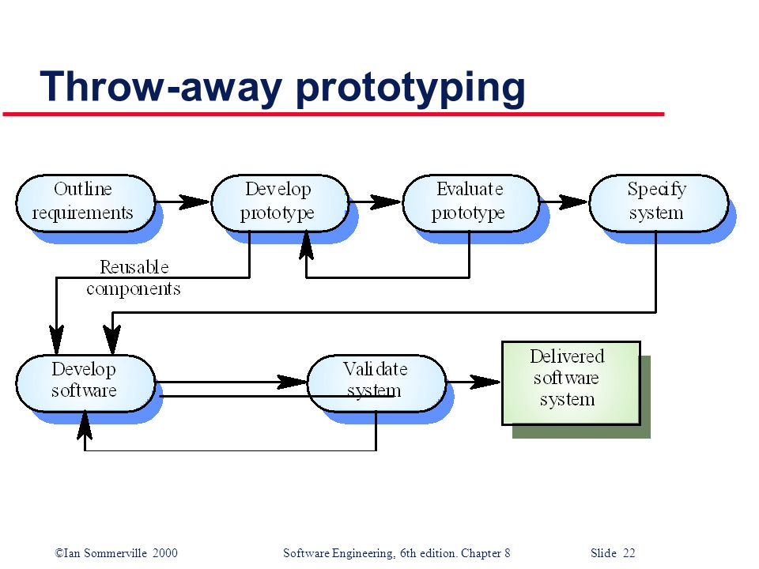
Do Developers Throw Away Prototypes
Not really
  They might refactor to clean them up
  But they typically find their way into the final code
What’s wrong with this
  Care that goes into design and code not there
  Code is messy and difficult to maintain
If you code a prototype, code it as if it were final
  Or code in a different language (to force throwaway)

Slide 33
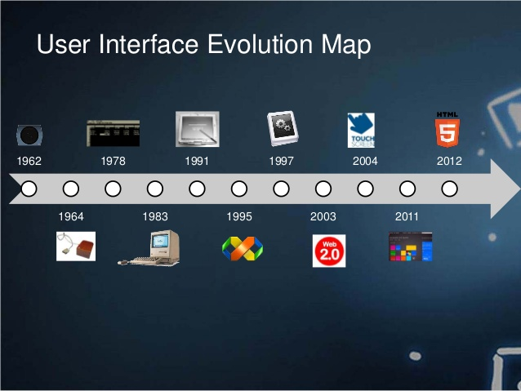
User Interface Evolution
The user interface is going to change
  As the application evolves
  As users want more or different features
  As the environment changes
  Because users expect it to be “modern”
Try to make this easy (or at least possible)
A plug-in style design requires a plug-in style user interface
  Core provides hooks for adding buttons, menus, etc.
  The user interface isn’t designed as much as accumulated
  Might need to be redesigned after a while

Slide 34
Homework Assignment
We want to add a graphic notes to Code Bubbles
  Bubble where the user could draw, image saved for the future
Requirements
  Should be small (sticky note sized) (minimal screen space)
  Drawing interface shouldn’t get in the way
    Only mouse button 1, pull down menus (button 3) & keys are available
    Interface not used frequently
      Must be simple & obvious or self-documenting
Develop a possible user interface
Submit a sketch and discussion in Canvas by Thursday 10/10

Slide 35
PROJECT Homework
Tuesday 10/8: Initial Project Presentations
Tuesday 10/8: Initial High-Level Design (canvas)
Following Tuesday (10/15):
  User interface prototype for the project
    Low-fidelity is fine for now
  Statement of how the UI fits into the application
    How it fits into the design
    Approach to be used
  Would be good to have it done earlier

