Slide 1
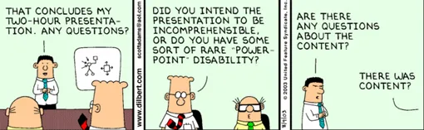
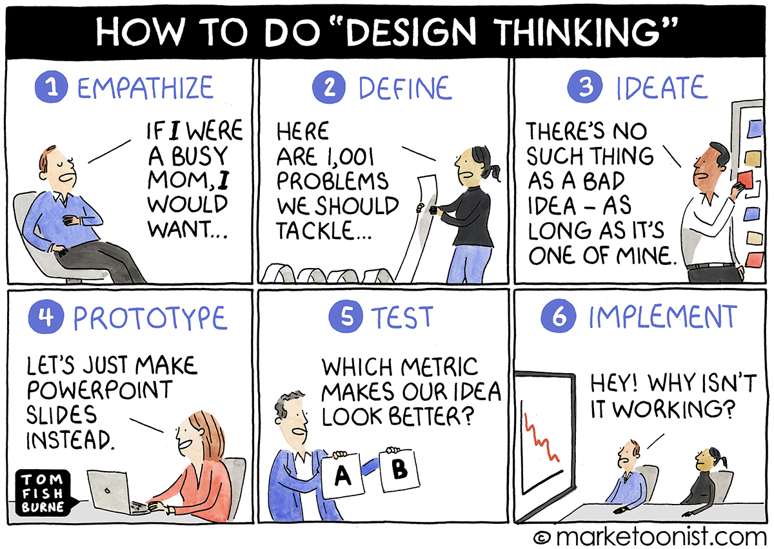
Initial Design Presentations
CSCI2340: Software Engineering of Large Systems
Steven P. Reiss
Notes:
Randomize order on slide 2.

Slide 2
Presentations
DJ
Speech
LLAMA
UI Gen
IoT
Accessibility
Agentic

Slide 3
Programming Homework
User interface for adding graphic notes to Code Bubbles
  Due Thursday 10/10 (canvas)

Slide 4
PROJECT Homework
Initial High-Level design (due today)
  Should fill in details – define the interfaces
  Preparation for individual design and coding
User interface prototype for the project (10/15)
  Low-fidelity is fine for now
  Try to get it done earlier
Statement of how the UI fits into the application
  How it fits into the design
  Approach to be used
  Put this into your repository
Should have time for a project meeting on Thursday

