Slide 1
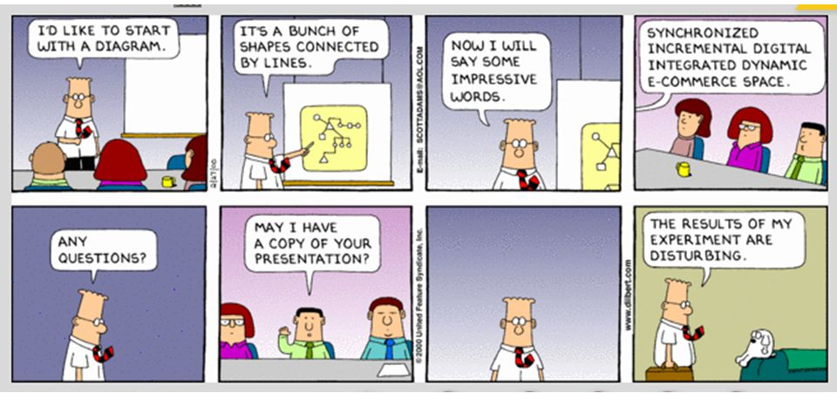
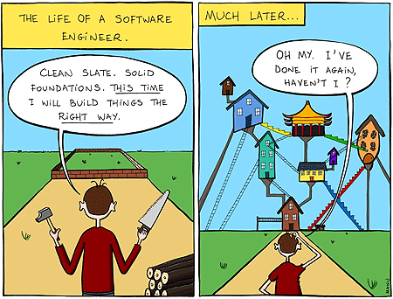
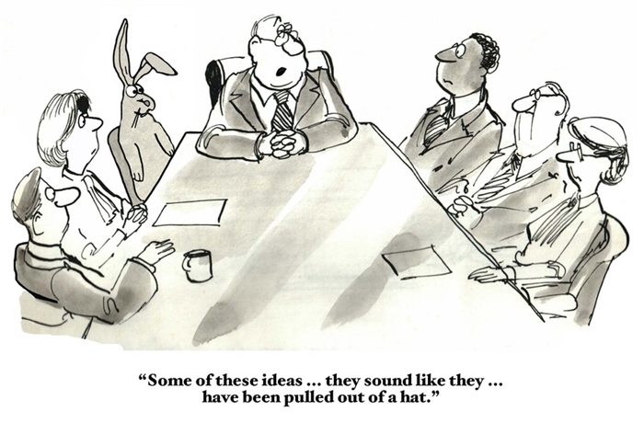
Detailed Design
CSCI2340: Software Engineering of Large Systems
Steven P. Reiss

Slide 2
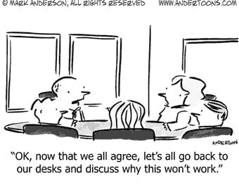
Comments on Presentations
Projects seem to have well organized project teams
Projects seem to have a plan for proceeding toward the implementation
Projects provided a nice overview of what they intend to do
  Enjoyable presentations
  Real specifications and requirements
Several projects seem overly ambitious for a semester course
  This is good – planning for the future
  However, you need to be realistic about the course
    Have a good definition of what you expect to get done this semester
  You want to use LLMs
    Don’t really understand what the inputs/outputs are going to be
    Prompt engineering and output interpretation
  Integrating with VS Code or other IDE might be future plans
Need to really understand what you are building
  UI generation – react is for interactive pages; how to specify and define interaction
  Accessibility -- both while creating (intro to talk) and after the fact (based on a URL)
  Speech -- what edits are allowed and how are these supported

Slide 3
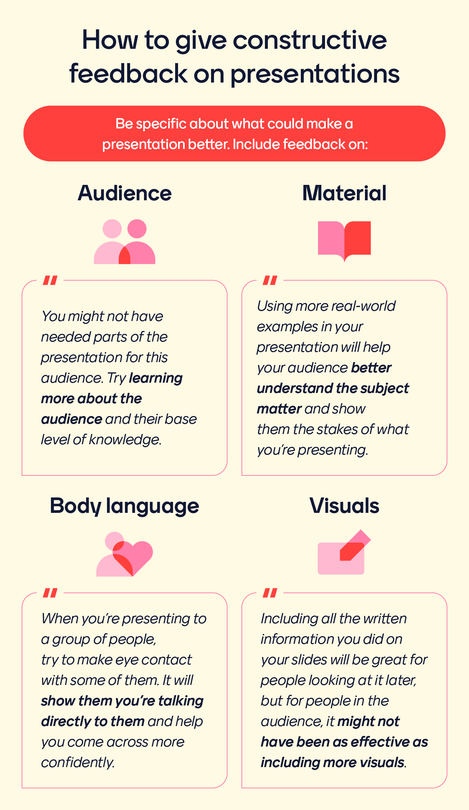
Comments on Presentations
General Problem: deciding on technologies to use before understanding the design
  This commits the design rather than vice versa
  Choice of language
    Untyped (Python; JavaScript vs TypeScript)
  Choice of database
    This is an implementation decision, not a design decision (e.g., songs might be better stored in NoSQL)
    Possibly specify what needs to be stored, not the schema
      Definition of database schema is implementation – that is not part of the interface between components
      Shouldn’t need to be known by all members of the team
  Choice of framework
    This is generally an implementation decision, not a design decision
    Front-end shouldn’t care what is responding to their RESTful requests
Need actual users to provide feedback on specifications, UI, …
  Some projects did this nicely
  Others planned to – these are needed before as well as after design

Slide 4
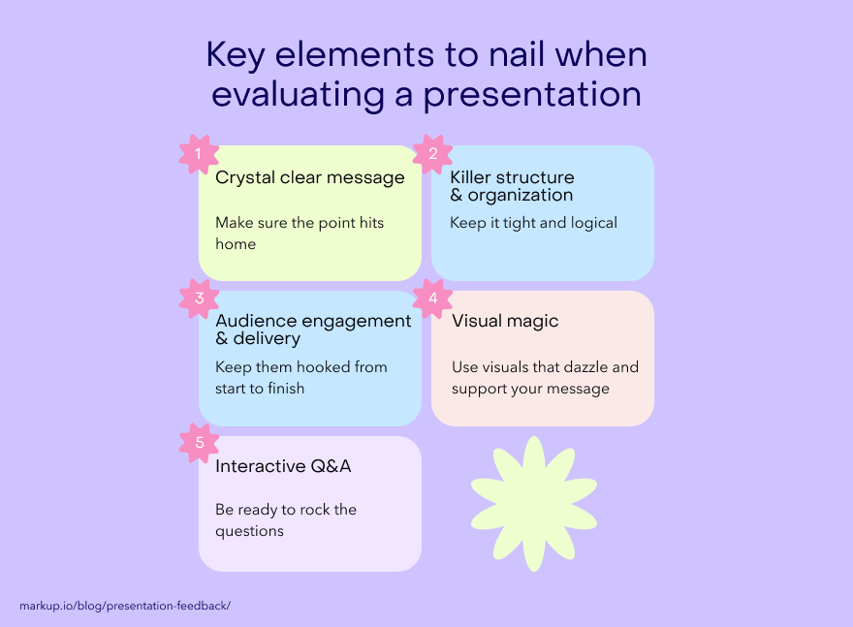
Comments on Presentations
Need to identify and account for risks
  No project listed the risks, but they are there (e.g., LLM usage)
Need to define the interfaces
  No one talked about the component interfaces, the set of RESTful messages, etc.
  This is what should be defined in terms of high-level design, not implementation details
Document as you write, not afterwards
Need to think about how app could be self-supporting
  How could you monetize it to support AWS, maintenance
Remember that the goal of the project in the course
  Is to learn how to write large, long-lived software
  Not just to get something working this semester
Project Meeting at the end of class
  I’ll be available for questions

Slide 5
User Interface Homework
What approach did you take to graphic note bubbles
  Do you think your solution will work
  How to minimize the interface
  What ideas did you have
Notes:
Type anywhere and then have the option of putting a box around it (and filling the box) – possibly assume a box with clear border and background. Handles to resize a box. Pull down to change font, size, etc. for text; pull down to change shape from box to circle. Pull down in background to set defaults. Use mouse to draw arrows and pull down on arrow to set size, ends, etc.
Alternative – sketch and have the system detect a circle, box, ellipse, arrow, etc. and draw it there.
Alternative -- ask DALL-E or LLAMA or GEMINI

Slide 6

High-Level Design
Breaks the system into components
Each component to be coded by individual (or a small team)
Each component has well-defined interfaces
  Note that these may change
Next step is to design the components
  And choose appropriate technologies
  Then build the implementation
You should have some experience at this level
  From CS32, CS134 or equivalent
  I want to highlight what I think you should have learned

Slide 7
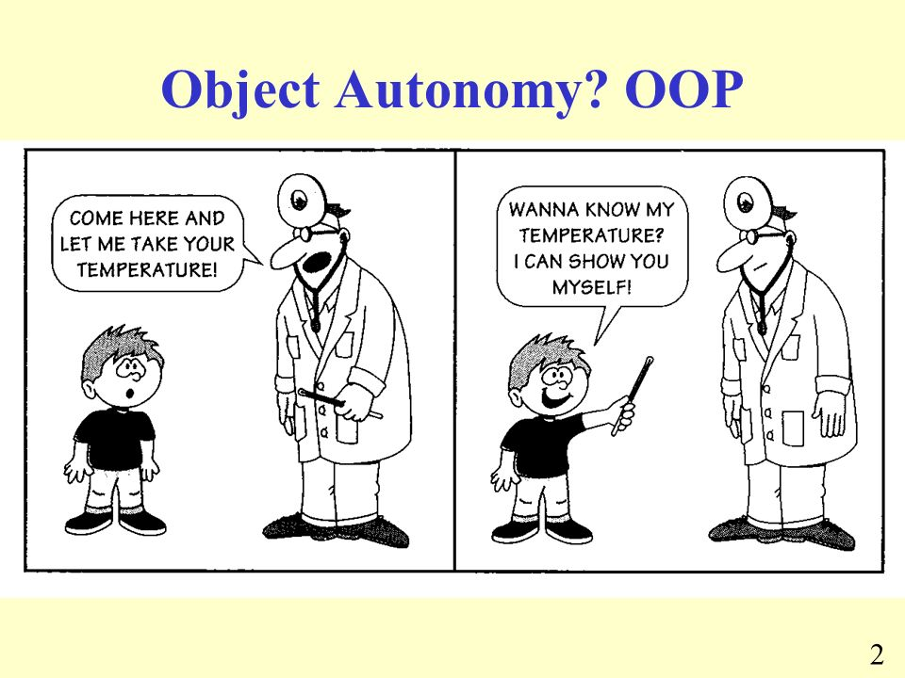
Object-Oriented Design
Object-oriented design fits most applications
  Objects provide information hiding
  Objects are a natural way of representing things
  Objects can be singletons or sets of items
Objects are supported by most languages
  Modules in some languages represent singleton objects
  But mixing modules and objects can get confusing
Objects are flexible
  Naturally represent many aspects of programming
  Not just physical entities

Slide 8
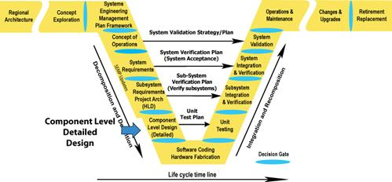
Detailed Design
For a single high-level design component
  Repeating high level design at a more detailed level
Designing classes (modules, files)
  Determine the set of top-level classes needed
  What are the methods/functions and fields/local variables of those classes
  Determine how these classes are organized (inheritance)
Designing methods
  What do the methods do
  High-level specification (not code)
    Signature (data types, return value, exceptions)
    Statement as to what the method does (JavaDoc? Pseudo code?)
  Don’t be afraid of exceptions
Designing private methods and fields comes later
  Part of implementation, not design

Slide 9
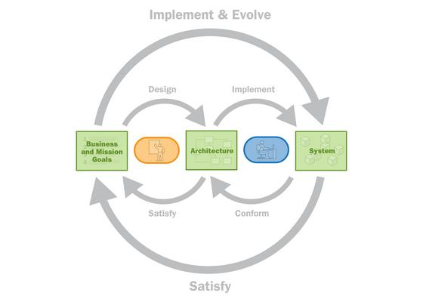
Goals of Detailed Design
Compact, coherent implementation
  Before you commit to code
Changes, new features, etc. are contained in a single class
Top-level classes aren’t too big or too small
  Inner or support classes should be small
  File sizes are reasonable
Number of files & classes is reasonable
Methods have reasonable (small) number of parameters
The interfaces between classes are SIMPLE
  Simpler means easy to code, maintain, evolve
You should feel comfortable coding it from specification

Slide 10
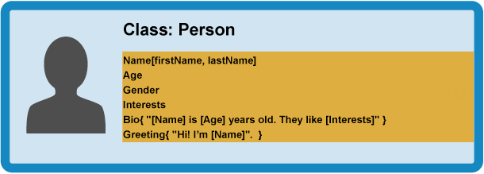
What do Classes Represent
Objects (physical or virtual) in the solution
  Data with operations
  Anthropomorphic
  Example: switches, sensors,
Algorithms (functional classes)
  Example: safety controller (switches, signals)
Reactive Elements (callback classes)
  Function pointers, completions
  Sets of these
Control (Thread/Runnable)
Controllers
  Phases of a run
Data types (e.g., lists and maps)
  Complex combinations of these

Slide 11

Choosing a Set of Classes
You should have done this in the top-level design
  Set of interfaces or façades for the design
  Here the components are packages/modules
    If very complex, use multiple or nested
    Additional packages developed for supporting or common code
You need to do it again for each package or module
  Start with classes representing the top-level design components
    Façades – probably on one class for this package
    Interfaces – a public class for each interface this package implements
  Then add whatever is needed to support these

Slide 12

Choosing Classes
Goal: set of coherent classes
Start with the set of all possible classes
Organize this
  Cluster classes that are similar (e.g., hierarchies)
  Find representatives of clusters (or create)
  Find dominant classes (this controls or owns that)
  Find redundant classes
  Find common functionality
  Can use UML again, interfaces, paper, …
Choose a subset of these
  That cover the original set
  That is “good” : what does this mean?

Slide 13
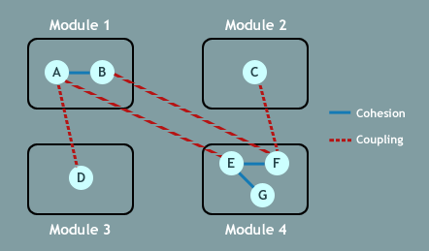
Coupling and Cohesion
Coupling
  How much one class needs to understand or use another
  Generally, communication should be 1-way, not 2-way
  Avoid implementation dependencies
  Want to minimize coupling
Cohesion
  How unitarian (sole-purpose) one class is
  Should be able to describe a class with a simple phrase
  Want to maximize cohesion

Slide 14
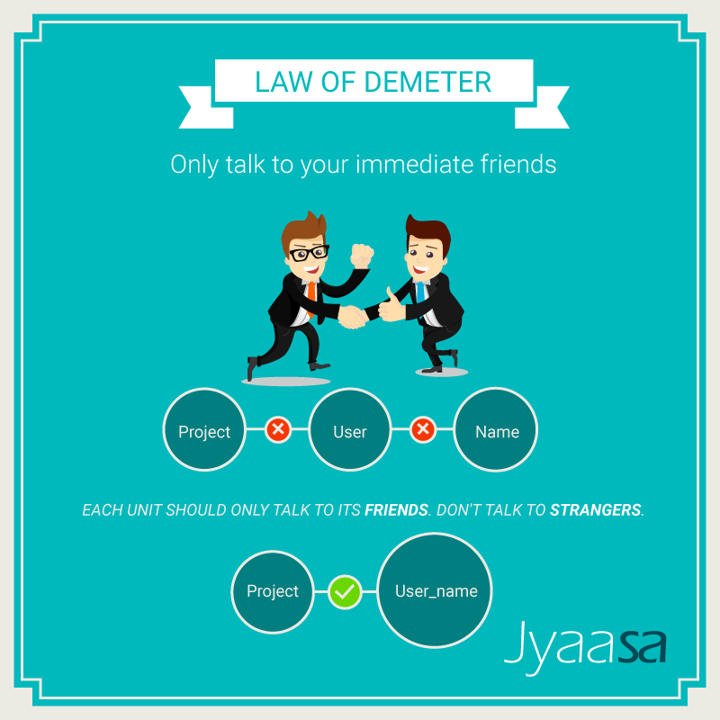
Law of Demeter
Principle of least knowledge
A unit should have limited knowledge of others
  Only units “closely” related to the current unit
  These are the unit’s friends
  Should only have a small circle of friends
Each unit should only talk to its friends, not to strangers
  Only talk to immediate friends
  Very limited communication to things outside the package/module
  Limited communication to other classes even in the package
Principle of least privilege
  Restrict and annotate who can access what

Slide 15
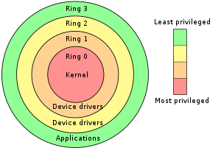
Principle of Least Privilege
Fields should always be private
  Except for constants defined in an interface
  Possibly protected for use in subclasses, but this is discouraged
    You need to look at the superclass when fixing the subclass
  Implementations should depend on another class’s fields – they are low-level details
Methods should only be public where necessary
  Implementing an interface, part of a façade – defined in high level design
Methods should only be package-protected where necessary
  When needed by other classes of the package
  But the package-protected set of methods for a class should be small (its local interface)
Methods should only be protected where necessary
  When needed by subclasses, no-one else (don’t use as package-protected too)
Methods should be private by default
Inner classes should be private
  And static where possible
Pure constants (strings, numbers) should be avoided in code
  These tend to change, and you need to find them and keep them consistent
  Strings might change with internationalization

Slide 16

Design Patterns
Early on we noted design is the application of patterns
We talked about architectural patterns
  And noted that patterns exists at all levels
  It is your job as a software engineer to know lots of patterns
  That is what makes a good designer
What is an object-oriented design pattern
  Set of classes and methods to serve a particular purpose
Description of a design pattern
  Purpose
  When it should be used
  When it should not be used
  The actual classes and methods
  Alternative implementations

Slide 17
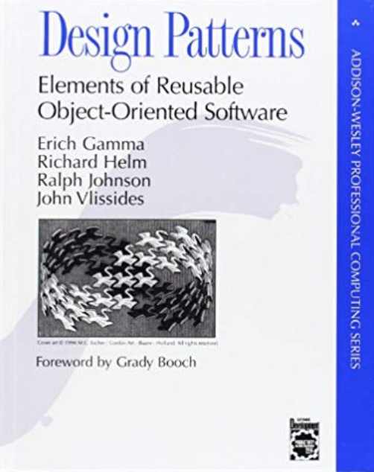
Design Patterns
Are useful
  Handle common situations in a standard way
  Provide a common vocabulary for understanding design
  Provide a starting point for doing design
Can be overused
  Or underused
Gang of four (GoF) book
  20 some common patterns (sequential)
  You should know these by name
    Some are more common than others
    Your design vocabulary

Slide 18
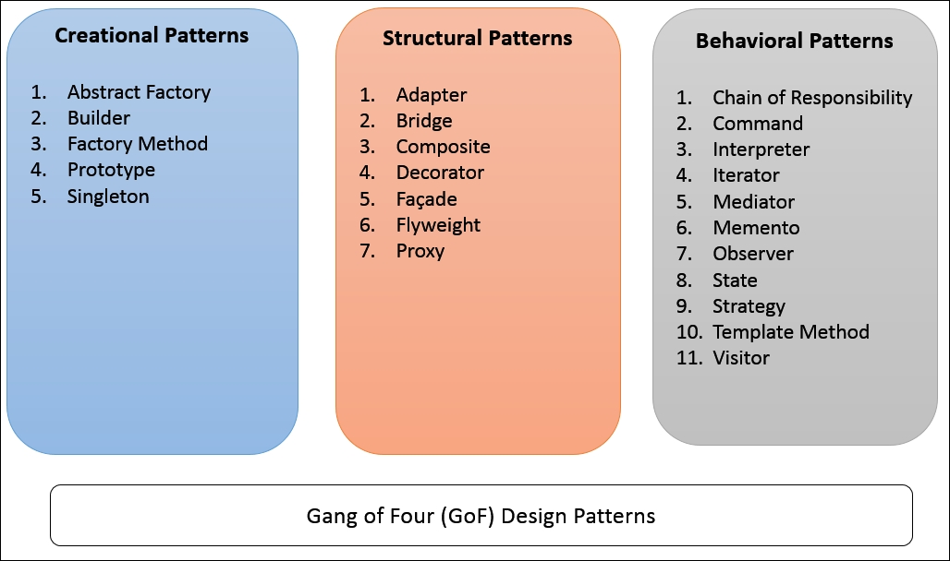
Categories of Design Patterns
Factory patterns
  Builder, Abstract Factory, Flyweight, Singleton, Factory Method, Prototype
Delegating responsibility patterns
  Adaptor, Bridge, Decorator, Façade, Proxy
Control patterns
  Composite, Interpreter, Command, Iterator, Strategy, Template, Visitor
Algorithmic patterns
  Mediator, Memento, Observer

Slide 19
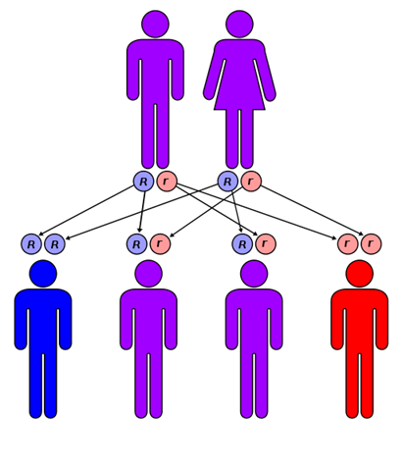
Inheritance
What object-orientation is all about
  Not really, sort of a side issue
    OO is about abstraction and information hiding
  Inheritance offers OOP lots of functionality
Forms of inheritance
  Interface inheritance
  Class inheritance
  Multiple inheritance
  Prototype inheritance (Self, early JavaScript)
  Mix-ins
Uses of inheritance
  The different functionalities they provide

Slide 20
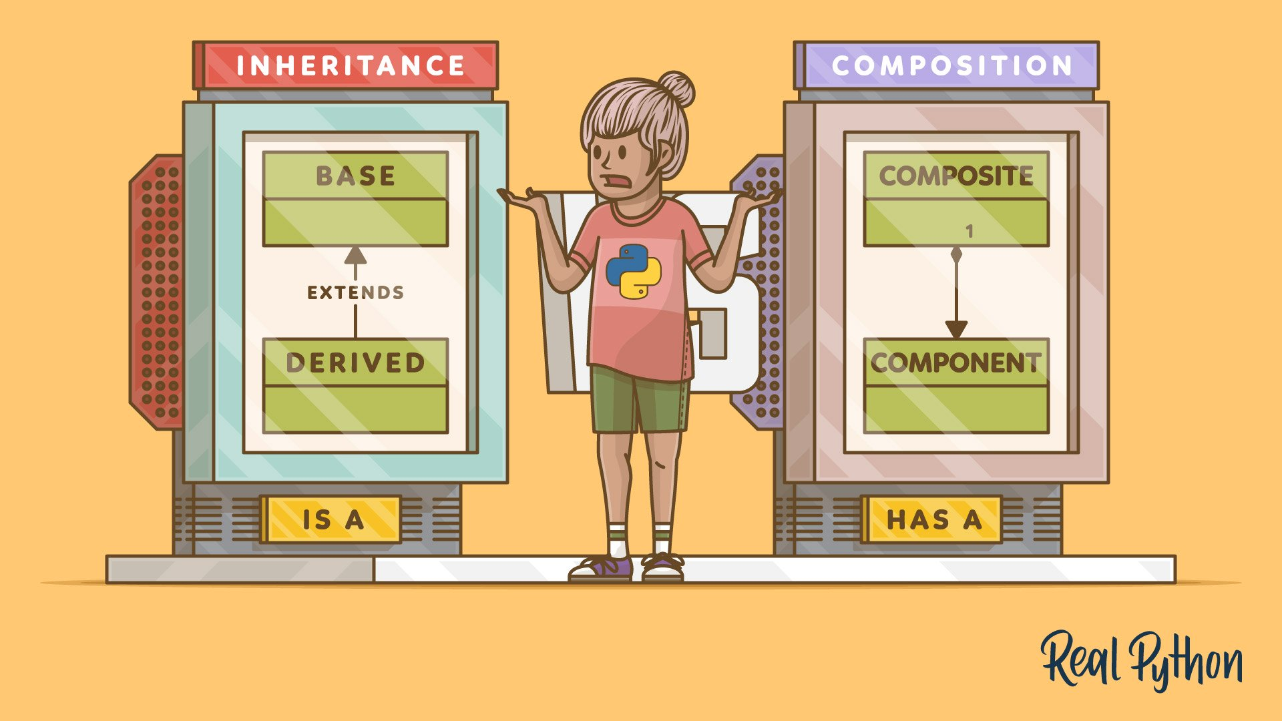
Natural Inheritance
Representing a hierarchy of object types
  Obvious example (animal/mammal/rodent/…)
  Not that frequently used
Most natural hierarchies are shallow
  AST nodes, symbol types, device types
Intermediate classes should be abstract
  Used to group lower-level classes, not used as objects
  Used to define or specify particular functionalities
All external references should be to the root class
  Or abstract classes (internally)
  Don’t not want to expose the implementation or hierarchy
    Because it is going to change and is an implementation detail
    Others shouldn’t be dependent on it
  Generally, don’t want to expose intermediate classes
  Generally, don’t want to expose leaf classes either

Slide 21
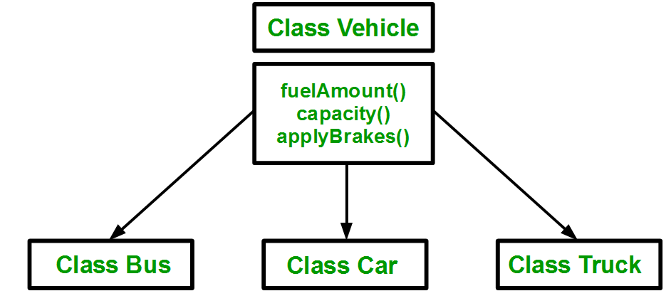
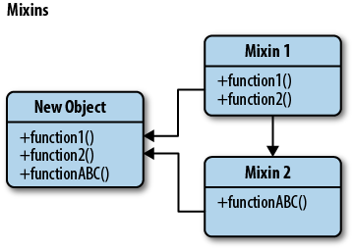
Inheritance for Shared Functionality
Providing shared functionality
  Common methods go into super class
    Which should be abstract
    Without a public constructor
    Only used to represent any of its implementors
  Subclasses are directly visible
    Can be created, etc.
  Example: CATRE saved objects, BudaBubble
Provide Additional functionality
  Mix-Ins are designed for this
    Multiple inheritance can provide this
    Java: interfaces with default methods
  How these work can be confusing and messy
    Conflicting names, DAG-like inheritance

Slide 22

Other Uses of Inheritance
Providing common definitions
  Constants interface
    Fields defining global constants
    Enumerations
    Can also define inner interfaces and classes
  Implementing this provides access to names, not functionality
Providing annotations
  Indicate a class has certain properties
  Serializable, Cloneable
  Code Bubbles: Zoomable

Slide 23
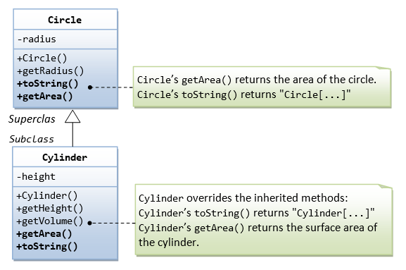
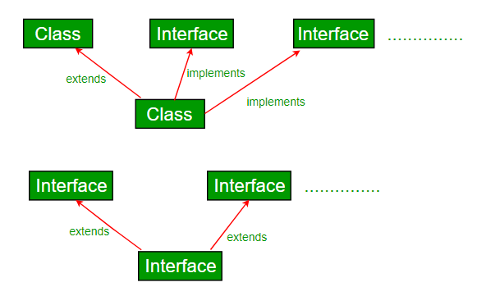
Other Uses of Inheritance
Modifying the behavior of a class
  Inheriting from a Swing class
    Set properties in the constructor
    Modifying the paint method
Providing alternative implementations
  Interface or abstract class as the root
  Subclasses implement the actual algorithm
  Jcomp (compiler)
    Internal implementation to read byte codes using ASM
    Jcode implementation that tracks all the information in a project
Interface inheritance
  Supporting high-level design interfaces
  Defining abstract functionality
  Requires factory classes or static methods to create the actual objects
  This is the only safe instance of multiple inheritance
    Assuming there are no default methods
  ActionHandler, Runable, CatreSavable

Slide 24
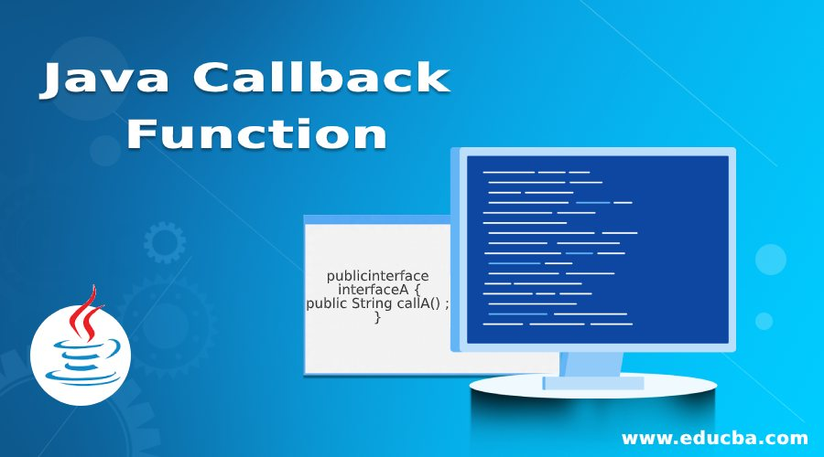
Other Uses of Inheritance
Defining callbacks
  Server defines a callback interface
    Use default methods to allow simple use (if > 1)
    Or provide an implementation class with empty callbacks that can be inherited from
  Client defines an implementation of the callback
    Registers it with the server
  Server invokes the callback when an event occurs
  Akin to callback functions, but more general
  MouseListener, ActionListener, …
Behavior inheritance
  Defining the default behavior (Thread, AbstractAction)
  Adding behaviors to a class or interface (JcompExtendedFile)
  Identifying the availability of a behavior (Scalable in Bubbles)

Slide 25
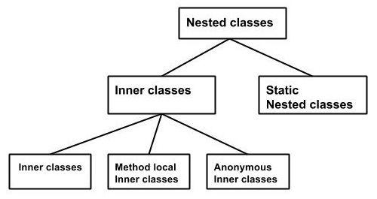
Inner (Nested) Classes
Any class used only by a single class should be a private inner class if possible
  When allowed by the language (Java)
  Or a private class defined inside a module (JavaScript, Dart)
  Can also use private class defined in the same file (C++)
  Unless it is too complex (> k lines, m methods, one page) – then it becomes its own outer class
A local hierarchy can be implemented as inner classes
  Outer class is the root of the hierarchy
  Internal classes are private Inner classes and not exposed directly
  Inner classes are static (why?)
  Example: JcompSymbol => various types of symbols
Inner classes should always be private (& static if possible)
  Inner classes are implementation details
  Never refer to inner classes of another class
    Exception: Inner interfaces of a top-level interface are okay
  Don’t export inner classes
Inner classes will often evolve to outer classes
  When they get to large or complex

Slide 26
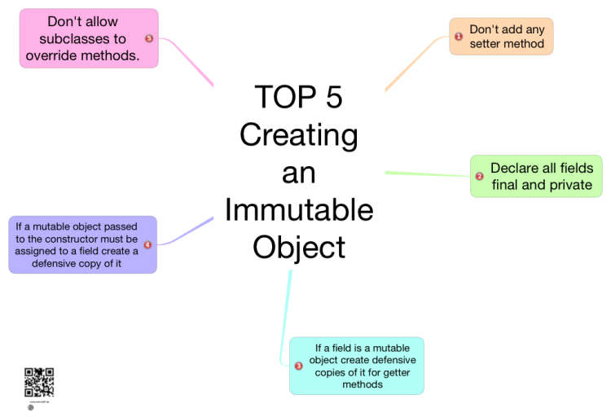
Immutable Objects
Objects that are never changed once created
  String in Java; Java Records
Immutable objects might change internally
  But the changes are not visible to anyone
  And the changes are thread safe (or duplicable)
  String in Java computes and stores its hash code the first time it is needed
These are much simpler to reason about
  And generally safe for concurrency
Can be tricky to code
  Should be final, everything done in the constructor, no internal fields for computations, …
Can be more difficult to code with
  Less efficient (lots of new objects)
  Need to remember to use correctly ( String.replace(…) )
  Must be careful to keep it immutable as the implementation evolves
    Document immutability and concurrency

Slide 27
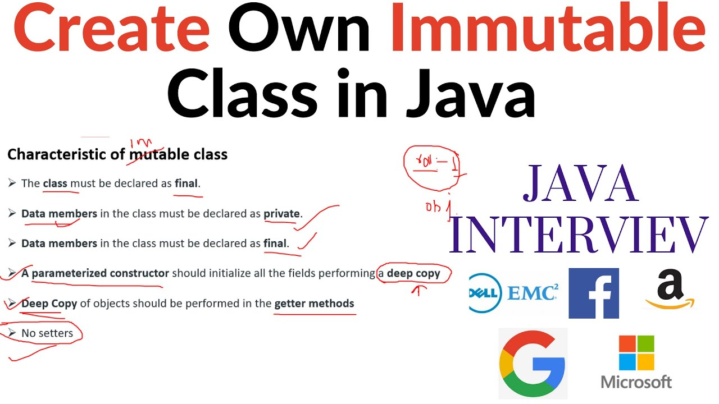
Unique Immutable Objects
If you create many instances of an object
  And they are essentially the same
  Create only one instance of that object
Have a factory method that checks if object exists
  That calls a private constructor if it doesn’t
  Returns original if so
  Returns a new instance if not
  String.intern()
Generally, implies object is considered immutable
This has advantages
  Saves memory
  Can use == rather than .equals (fast comparison, hashing, …)
Disadvantages
  Need to define fast lookup
  Factory method must be synchronized in a multithreaded environment
  Can be tricky to code and use: must be immutable

Slide 28
PROJECT Status
Make sure you know what you are building
Should have ideas for your user interface (10/15)
Should have broken project into components
  Separate the various components
  High-level design: façades and interfaces
  Components assigned to individuals (or small teams)
Should have interfaces for the components (part due)
Ensure components are separated for implementation
  For example, in Java, use different packages
  In other languages, use different directories
Individuals should start developing a set of top-level classes for each package
  Or modules or components or files (depending on language)
We will have project status reports in a few weeks

Slide 29
Further Reading
https://w3sdesign.com/GoF_Design_Patterns_Reference0100.pdf

Slide 30
Project Meeting Time

