Slide 1
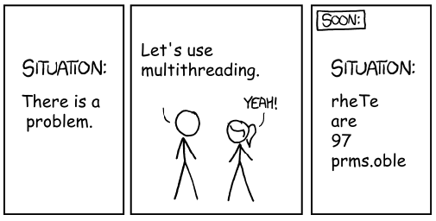
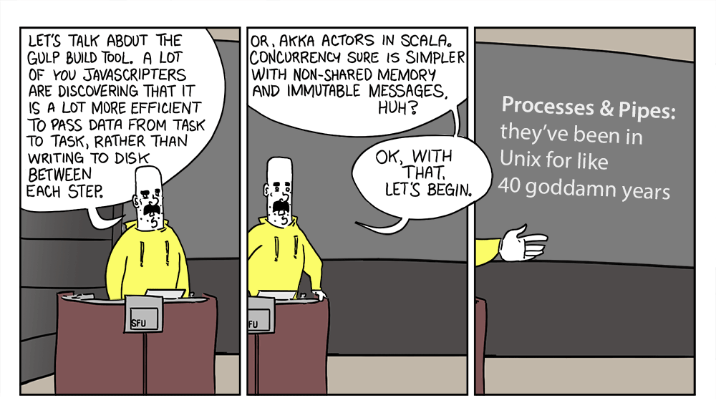

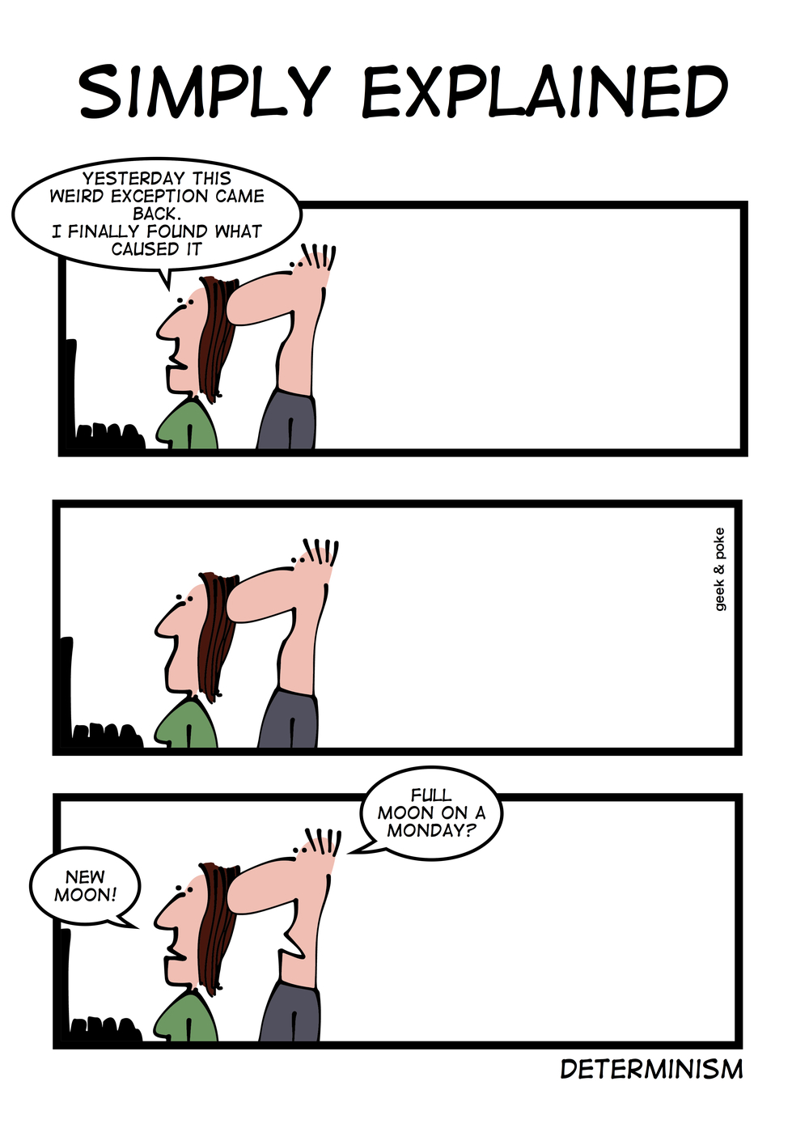
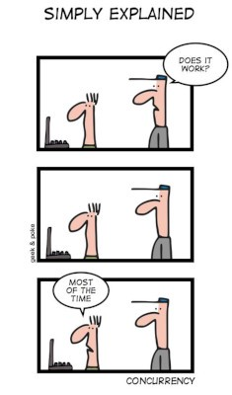
Concurrency and Synchronization
CSCI2340: Software Engineering of Large Systems
Steven P. Reiss

Slide 2
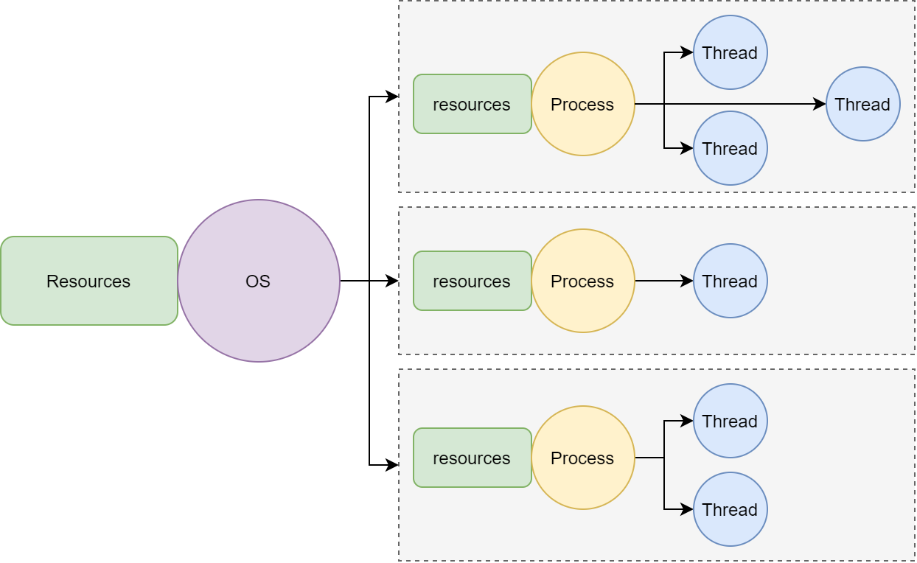
Using Concurrency
Today’s CPUs have multiple cores
  Can easily run multiple things at once
  You want your program to take advantage of this
Doing things in parallel should speed up your program
  Handle more users, larger data sets, …
Modern environments require concurrency
  User interfaces and reactive programming
  I/O on slow devices such as the web
  Need to handle large number of simultaneous users
Most systems today are concurrent
  All for I/O, many for processing

Slide 3
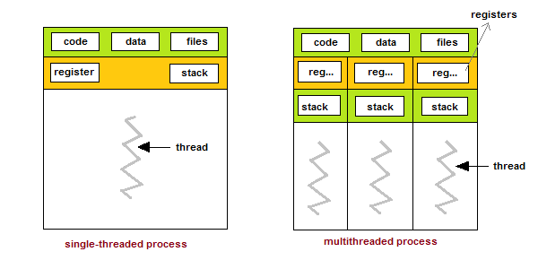
Basic Concepts: Threads
Threads are schedulable entities that execute code
  Flow of control
  Basic way of doing concurrent operations within a process
Contain:
  Stack (local variables)
  Registers (temporary variables)
  Locks that are held
  Thread-specific data
Can be built into the language
  Java Threads
  Dart isolates (limited threading – no shared memory)
  Or built on top (Posix Threads in C; threads in Python)
  Life is easier if the language knows about threads
Can be hidden by the language
  futures; async/await – but these might only provide limited concurrency

Slide 4
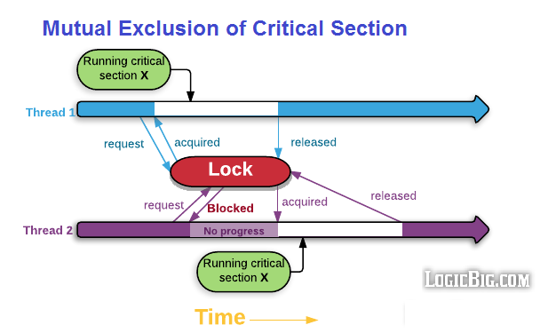
Basic Concepts: Locks
Locks provide synchronization between threads
  Ensure that a thread has exclusive use of a resource
  Access to a shared variable, file, socket, processor
Different types of locks
  Mutex, semaphore, monitors, read/write, fork/join
  Locks on a file; files as a lock
  Waiting for message replies
  Java synchronized regions are monitors
    Wait/notify allows for arbitrary lock definitions
  Database transactions
  Hardware locks: Compare and swap
Concurrent data structures & atomic variables
  Work without locking; no sequential guarantees
Locks are needed to make concurrency work
  Even concurrent data structures use primitive atomic operations

Slide 5

Concurrency and Design
Techniques discussed earlier
  Separate processes
  Within a component
    Identify potential background tasks
    Identify what can be done in parallel
    Identify potential shared data structures
  User interface concurrency
  Database concurrency
Now we need to discuss
  Concurrency in the detailed design and in the implementation

Slide 6
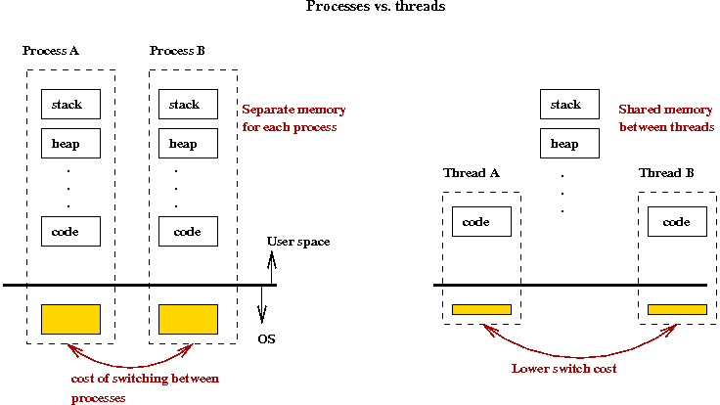
Separate Processes
Relatively easy to implement
  Should provide simple concurrency
Need to handle communication
  Sharing via messages (HTTP)
  Sharing via run/exit (waitFor)
  Sharing via databases, files
Still need to synchronize
  Message-based synchronization (wait for a reply)
  File locks and semaphores (Linux, not Java)
  Database transactions
Synchronization problems still exist

Slide 7
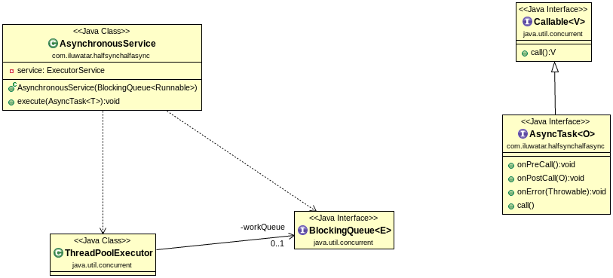
Threads and Parallel (Background) Tasks
Implement Thread, Runnable or Callable
  Run method is the background task
  Runs in its own thread
  Use Java synchronization to provide a waitFor method
    Or use java.util.concurrent.Future
Threads can be run directly
  Create (new X where X : Thread)
  x.start()
Threads are expensive
  Stack; start-up time; memory

Slide 8
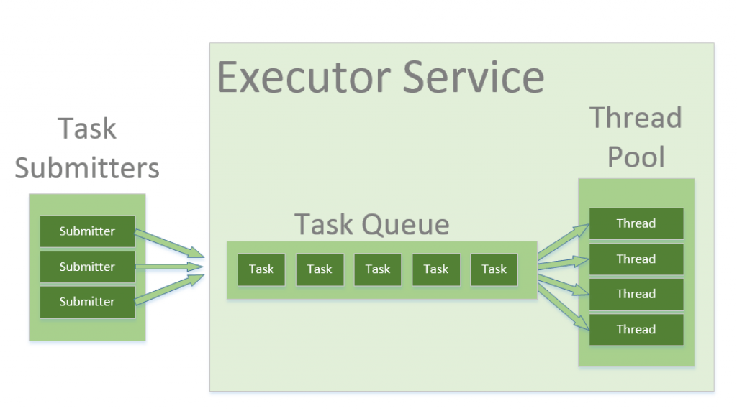
Thread Pools
Reuse threads for multiple tasks
  Pool of threads that handle queued tasks
  Can vary and control the number of threads
  Can control the queue (e.g., priority queue)
  Pool can expand and contract dynamically
Better approach than individual threads
  But slightly more complex
  Might need to ensure adequate pool size
  Can be a little tricky to implement
    Implementation depends on queue type and size
But Java thread pools can be tricky to set up
  Synchronization can become an issue
    Wait for a task in the queue can fail

Slide 9
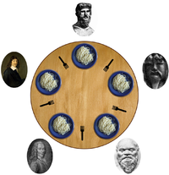
Problems with Concurrency
Concurrency makes programming considerably more difficult
Synchronization problems: Race Conditions
  A needs output from B, but doesn’t wait for it
  A and B both want to update a variable at the same time
  A shouldn’t proceed until all Bs are done
Locking problems
  Deadlocks: A waits for B, B waits for A
  Cycles of locks in general
  Might go beyond explicit locks
Performance problems
  You don’t get the expected performance boost
  Parallel programs can even run slower
Debugging problems

Slide 10
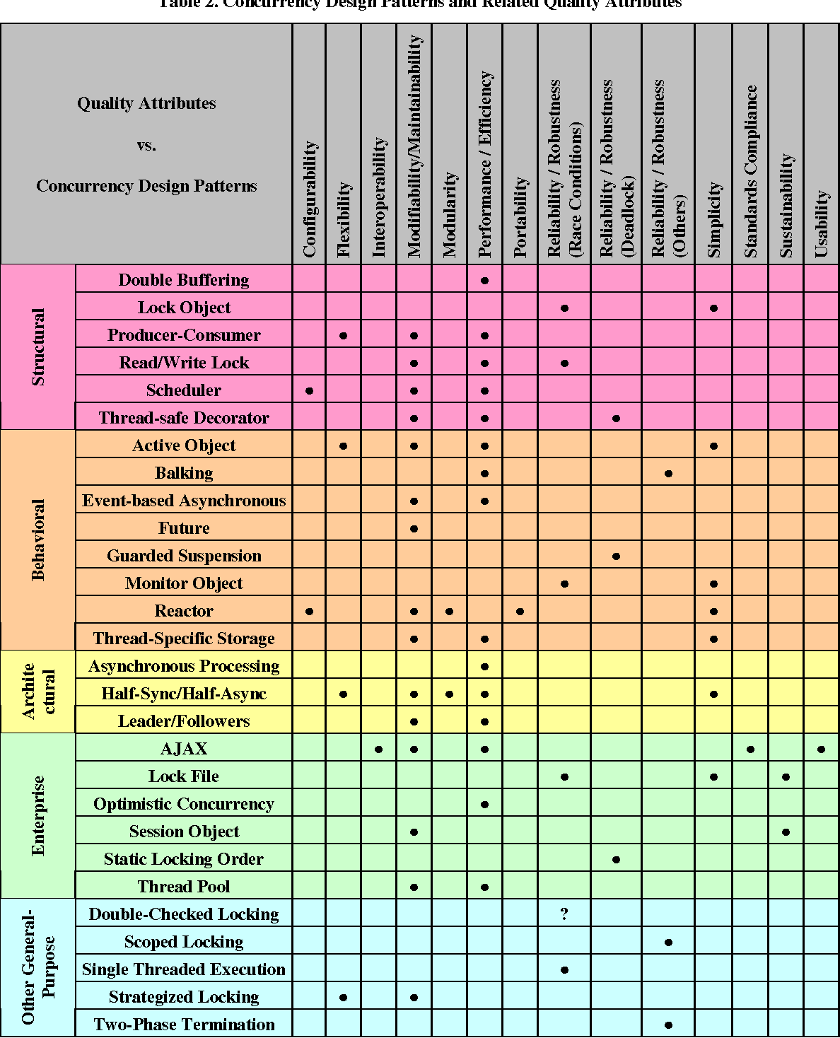

Concurrency Patterns
Design is all about patterns
  Standard ways of implementing things
Patterns for handling concurrency
  To avoid race conditions
  To avoid deadlocks
  To get the maximum performance
You should be aware of these
  And use them as appropriate

Slide 11
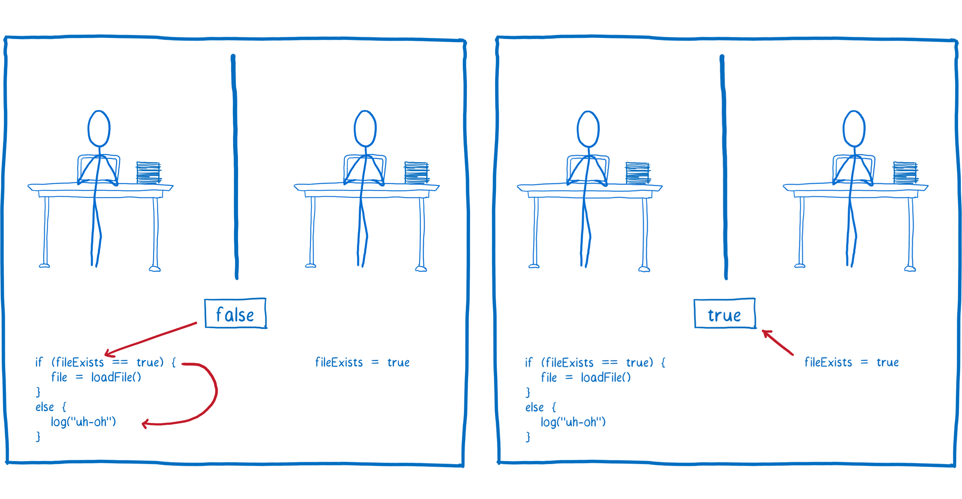
Race Conditions
Two threads, A and B, both write to the same location
  What will another thread see at that location
  Will it be the value of A or the value of B
    Or something different
More typical race conditions
  Parallel computations
    A accesses v, computes v’, saves v’ into v
    B accesses v, computes v”, saves v” into v
  Thread depends on a variable set in another thread
    But doesn’t wait for that thread to set it

Slide 12
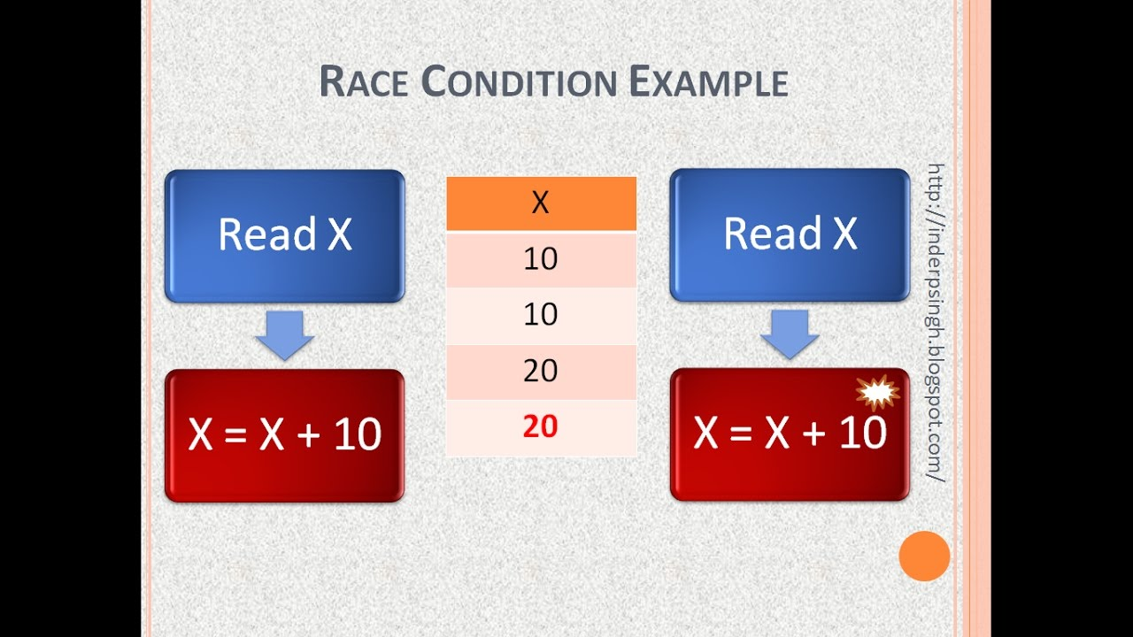
Race Conditions
Counter Program
  void count() { ++shared_counter; }
    Called from multiple threads
  4 threads each calling count 100,000,000 times
    What will the resultant value be
      Will it be exactly 400,000,000?
      Can it be over 400,000,000?
      Can it be under 400,000,000?
Make a guess

Slide 13
Experiment
Tried the counter program as above
Also tried:
  Making the count method synchronized
  Using an atomic integer rather than a simple variable
  Having each thread maintain its own counter, add these at end
  Making the shared counter variable volatile
  Having only one of the threads to the counting
What results do you expect?
  Which of these is guaranteed to yield 400,000,000?

Slide 14
Counter Program Results
What | Count | Fred4: clock (cpu) | New Fred4 | Mac Mini (intel)
Simple Counter | 112,836,399 | 2.57 (4.25) | 0.14 (0.245) | 0.16 (0.191)
Synchronized method | 400,000,000 | 19.62 (53.71) | 23.06 (80.535) | 28.24 (90.31)
Atomic Integer | 400,000,000 | 8.06 (7.22) | 3.28 (11.956) | 8.36 (32.06)
Separate counter per thread | 400,000,000 | 11.16 (10.96) | 2.68 (6.608) | 4.08 (8.751)
Simple Counter, volatile | 186,035,542 | 52.80 (14.16) | 3.41 (13.449) | 9.91 (38.13)
Single Threaded | 400,000,000 |  | 0.07 (0.073) | 0.15 (0.141)

Slide 15
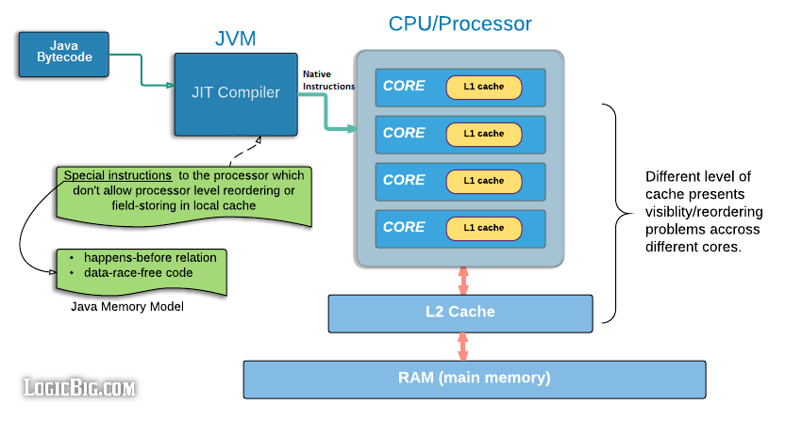
Volatile Variables
What does volatile mean and why is it used?

Slide 16
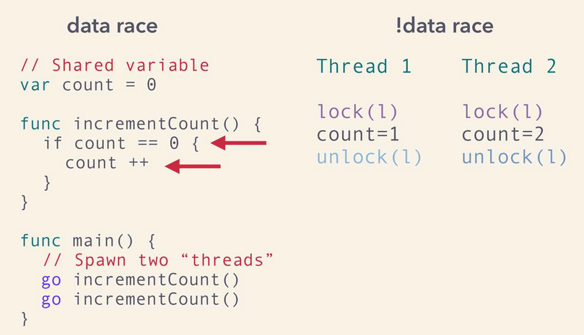
Race Conditions
Show up as random results
  Different results from different runs (with same inputs)
  Unexpected results
  Accessing null pointers or undefined values
Are often difficult to find and understand
  Debugging these can take months
Need to avoid these while coding
  These arise from shared data
  Identify what classes might be used by multiple threads
    Or assume that a class is used by multiple threads
  Identify what data structures might be shared by multiple threads
    Or assume that a data structure is shared

Slide 17
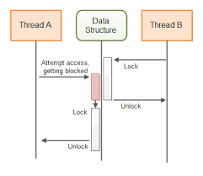
Design Patterns for Shared Data
Synchronized data structures in the language
Concurrent data structures in the language
Synchronized access to a data structure
Use immutable objects
Minimize shared data
Handling the shared user interface
  Operations on user interface in the user interface thread

Slide 18
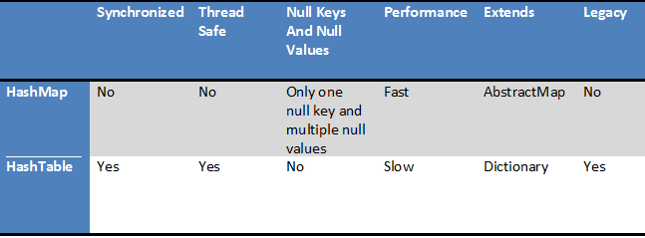
Synchronized Data Structures
Some Java classes automatically synchronize all access
  Every method is synchronized
  Hashtable, Vector, StringBuffer
  Synchronized collections [ Collections.synchronizedSet(…) ]
These don’t always work
  Common case: add new element if old not present
  Synchronized requires creating the new element in any case
    Or synchronized lookup, create, synchronized putIfAbsent, check

Slide 19
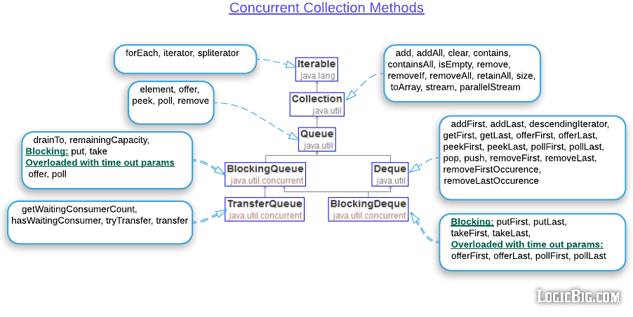
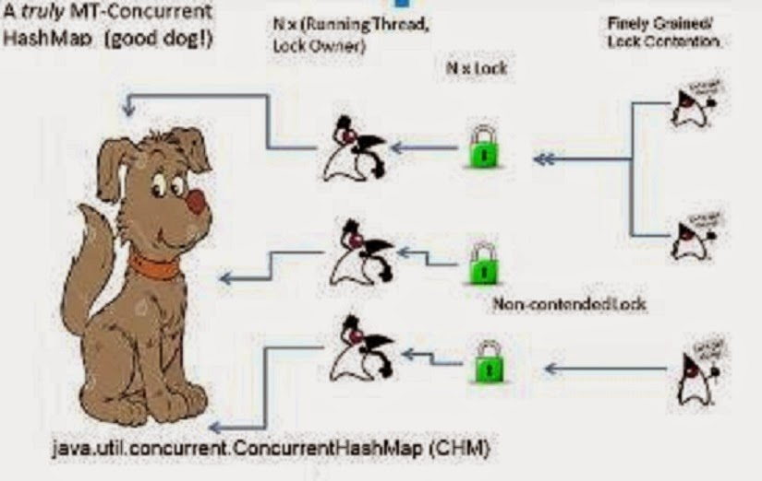
Concurrent Data Structures
Java provides atomic primitives
Java provides explicitly concurrent data structures
  ConcurrentHashMap, ConcurrentSkipListSet, ConcurrentSkipListMap, …
  No guarantee on simultaneous updates and reads
    May or may not see the updates immediately
    Simultaneous updates might be in any order
Encouraged if serializability not needed
  Can safely iterate over the data
    But may or may not see newer values
  Can safely access the data
    But may or may not see concurrent updates

Slide 20
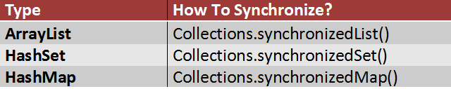
Synchronized Access to Data Structure
Use synchronized (collection) { … } for all accesses
  Other than initialization
  Multiple operations can be combined
  More general than synchronized data structures
  Might need to use it for reads as well as writes
  Will need to use for iterations
Caveats
  All updates to a data structure should be in a single class
    Generally, return a read-only copy of the collection if others want to scan it
  Updates should be localized (few update methods)
  Be careful of creating potential deadlocks
  Easy to miss one or more locations

Slide 21
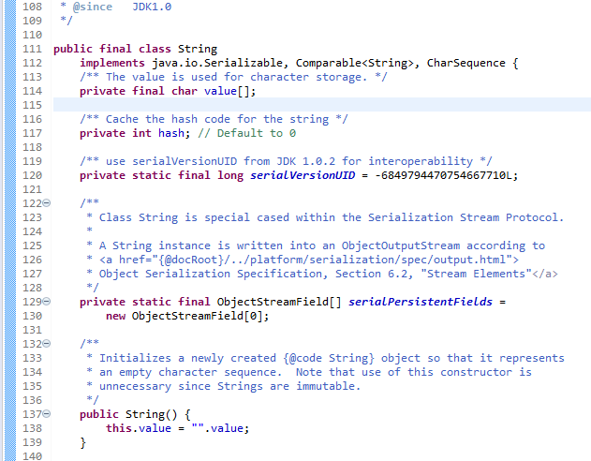
Immutable Objects
Immutable Objects
  Created once, never modified
These are inherently thread-safe
Might want unique immutable objects
  Requires synchronization on creation, not on use

Slide 22
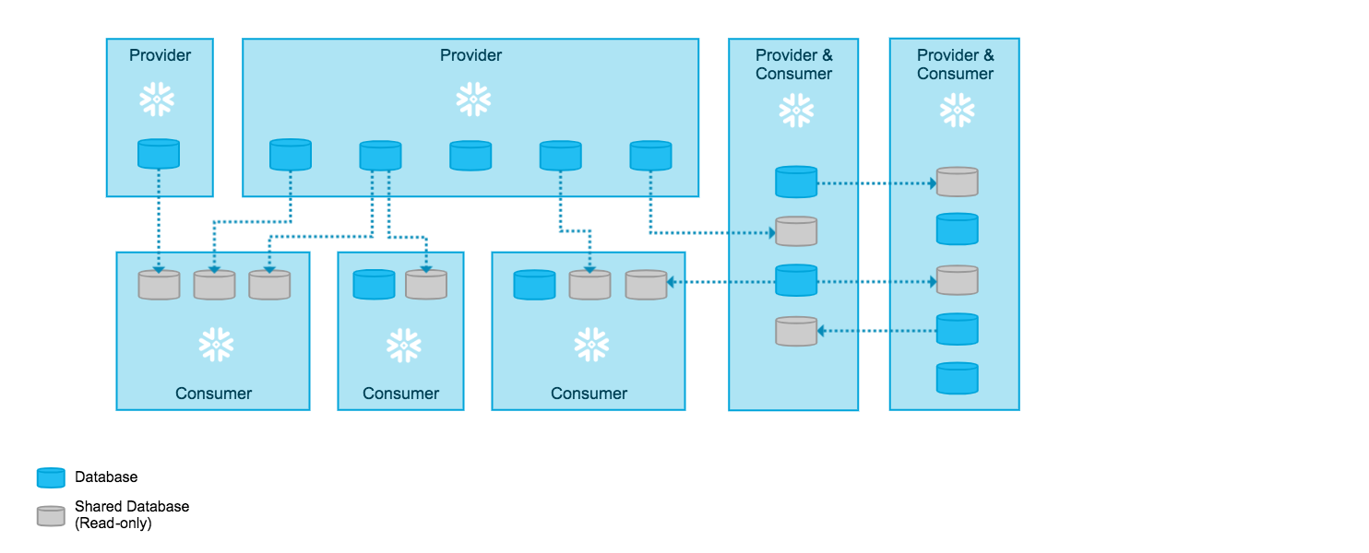
Minimize Shared Writable Data
Read-only data is easily shared
  Constructors don’t need synchronization
  Or when you don’t worry about updates
    Ball position for example
Identify what needs to be shared
  Now and possibly in the future
If you don’t know about a class
  Assume it will be eventually shared and code accordingly
  If not coded for multiple threads, document as not thread safe

Slide 23
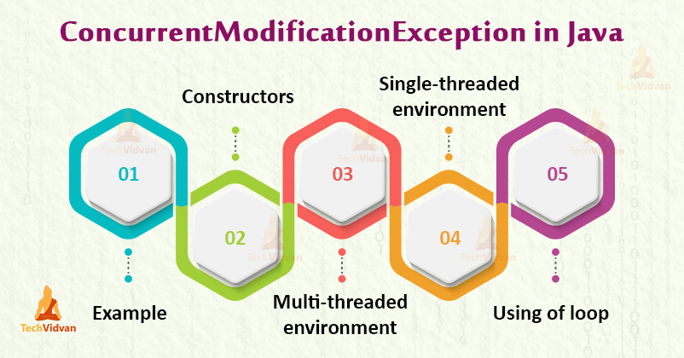
ConcurrentModificationException
Another form of race condition
  But it can happen even without threading
Looping over a structure that is changed
  foreach loops
  Even non-loops [ e.g., new ArrayList<>(structure) ]
Patterns to avoid this
  Create copy to iterate over
    Synchronize the creation if needed
  Use iterators & their operators
    If single threaded
  Use concurrent data structures
  Synchronize the loop (NO)

Slide 24
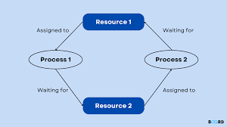
Deadlocks
Threads waiting on each other
  No thread can make any progress
    Thread A locks X, tries to lock Y
    Thread B locks Y, tries to lock X
  Can be arbitrary cycles (more than 2 locks)
  Can involve different types of locks
  Can involve system locks as well as user locks (User Interface)
  Can involve waiting for messages between processes
  Can involve waiting for your turn in a thread pool
Evolution and Maintenance
  Tends to add locks to avoid race conditions
  Adding locks tends to create dead locks

Slide 25
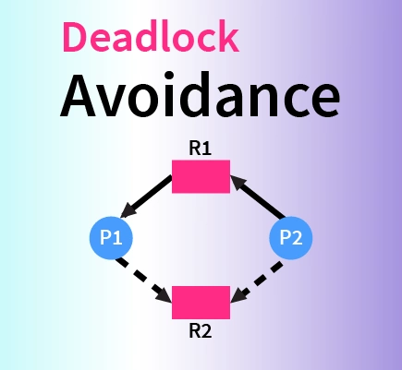
Patterns to Avoid Deadlocks
Locks should be as local as possible
  Use synchronized statements rather than methods
  Avoid calling other routines from within a locked region
    Especially routines that might lock something else
  Include locking in documentation for method
  Avoid executing long-running or non-trivial code in a locked region
Avoid waiting indefinitely for a remote process or message
  These are effectively locks & remote process might fail
  Also avoid waiting on message before producing a response
Avoid having lots of threads waiting on a single lock
  This can cause problems with thread pools
  Can be difficult with hidden locks

Slide 26
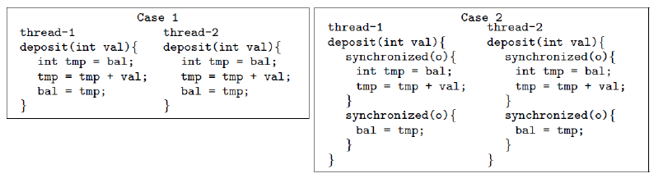
More Patterns to Avoid Deadlocks
Use synchronized statements rather than methods
  To minimize the code that is synchronized
Use java.util.concurrent locks
  More control (e.g., read-write locks, semaphores, trylock)
  More difficult to code with (use try…finally)
  Avoids bad code inside a monitor
  This doesn’t avoid deadlocks
Split locked regions into smaller regions
  Synchronized check
    Can this be unsynchronized?
  Unsynchronized work
  Synchronized recheck and save
Avoid nested locks
  Or document and use a fixed lock ordering
Avoid locking where possible: use concurrent data structures

Slide 27
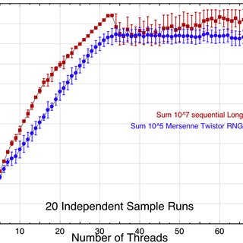
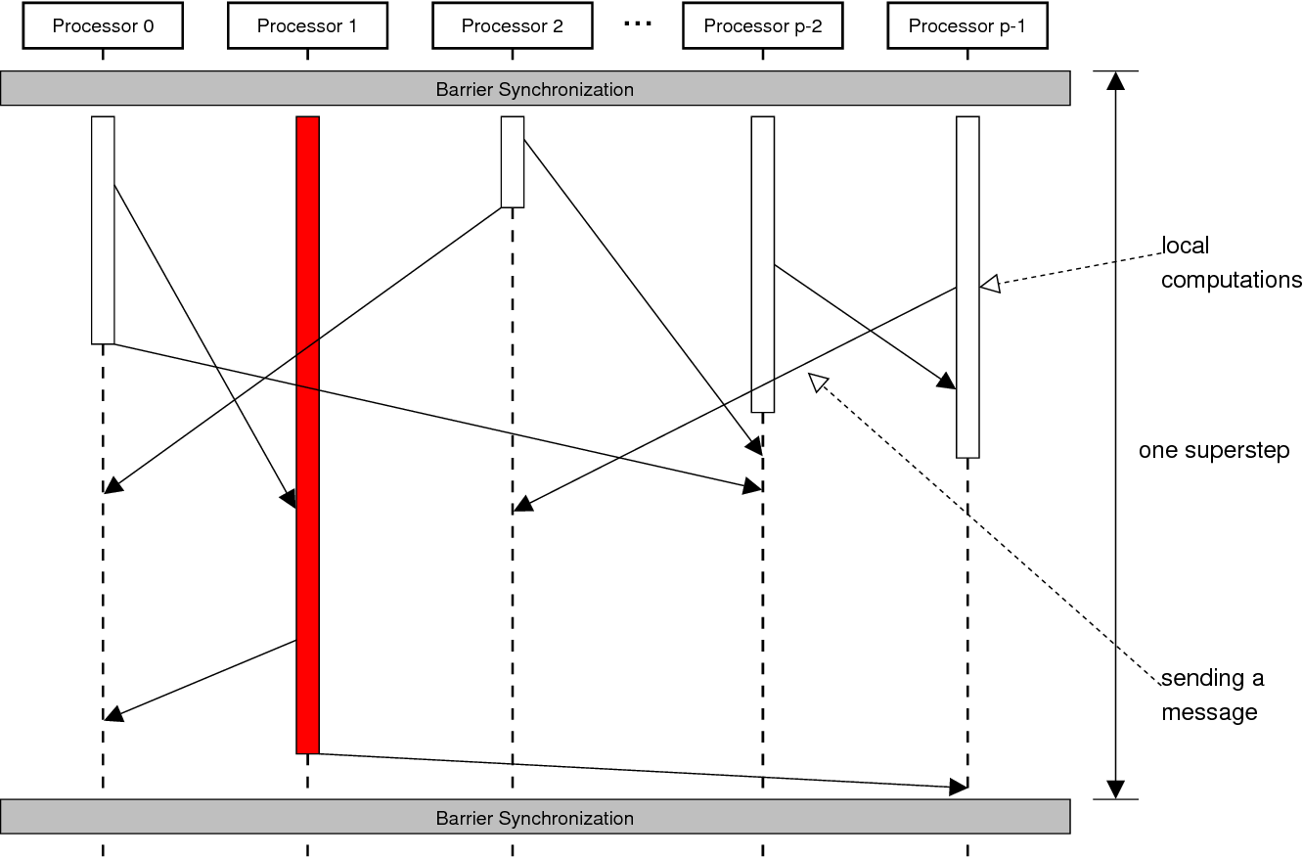
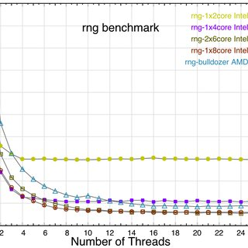
Performance Problems
Synchronization can be expensive
  Counter program with & without synchronization
  Cost of locking even when not needed
  Cost of volatile variables
You never get as much as you expect
  Can be slower with multiple threads than single thread
  Speed up degrades with # of threads
  Speed up depends on the problem involved
  Speed up depends on hardware involved

Slide 28
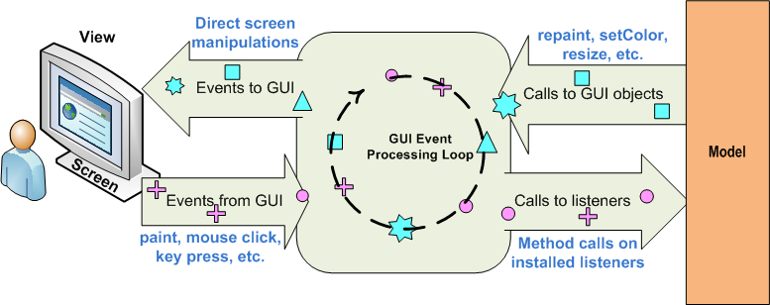
User Interface Threads
The user interface runs in its own thread
  Can access all widgets, definitions, etc.
  These are effectively shared
All changes to the UI should be done in UI thread
  After initialization
  Creating new windows, updating widget properties
  Updating tree, list, table contents
    This is why there are table models independent of the display
  Updating selection, cursor, …
Use SwingUtilities.invokeLater(…) or invokeAndWait

Slide 29
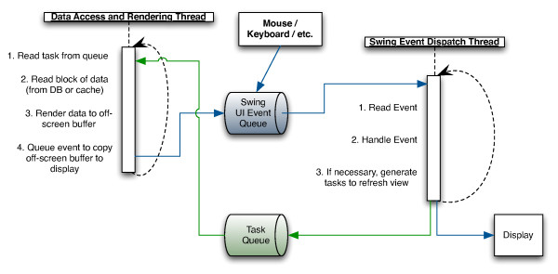
User Interface Thread
User interface callbacks are in UI thread
  User interface invokes user routine in that thread
  Anything done in the callback blocks the UI
All non-trivial UI actions should be runnable tasks (> 10ms)
  Done in a separate thread (with a thread pool)
  Using SwingUtilities.invokeLater to update UI if needed
The complexity of callbacks will grow over time
  What is simple now might be time consuming in the future
JavaScript, Dart
  All futures, async calls are done in the UI thread
    But I/O and external processes are done in parallel with it
  Long-running computations
    Either need to be put in a separate process
    Or need to be split up into small steps

Slide 30
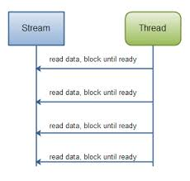
Input / Output Concurrency
I/O is slow with respect to computation
  Don’t want to slow program down while doing I/O
Threads provide a convenient way to handle overlap
  I/O often needs to wait
  Threads provide a simple mechanism to allow this
    Make non-blocking I/O easy to program
    Thread waits for the I/O operation
    The rest of the program continues (in other threads)
  Thread overhead is small compared to I/O

Slide 31
Sockets and Threads
Server Socket Thread
  Implemented as a thread that opens server socket
  Loops forever doing accepts
  Creates new client thread for each accept
Client Socket Thread
  Given socket for client
  Loops reading from client
    When a full message is read, process the message
    Send the reply
  Exits when socket is closed
  If two-way, provide call to send a message
    Need to handle replies – gets more complex

Slide 32
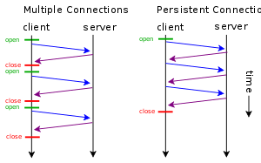
I/O Threads for Other Uses
Connecting to external server
  HTTP connection
  Stdin, stdout, stderr from the subprocess
  Separate thread that reads and reacts
  Separate thread with futures
Large disk I/O operations
  Can also be done in background
Waiting for a message
Waiting for external process to terminate

Slide 33
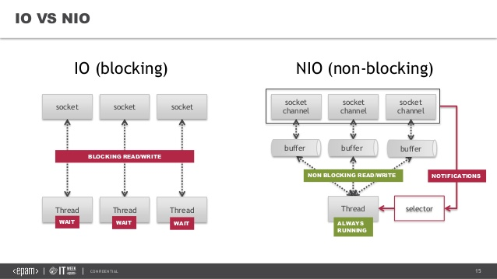
Threaded I/O Alternatives
Use non-blocking I/O operations
  C/C++ use interrupts or exceptions on completion
  Java: (java.nio) implemented using futures
These can be a bit more complex to understand
  And to get proper overlap
  Non-threaded languages use these internally
    Providing futures or async calls for I/O

Slide 34
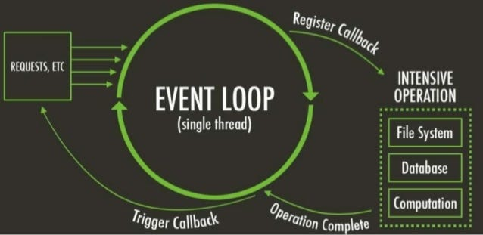
Implicit Concurrency
JavaScript, Dart, and other languages
  async - await, futures
Concurrency for external actions
  I/O and external actions done in background (HTTP requests, Database requests)
  Libraries provided to do complex actions in background
    Either as language extensions or as plug-ins
  Running your own server programs
  Assumption made that these are where your program is spending its time
    This is true for most web servers, web pages mobile apps
But your code in JavaScript or Dart is still single-threaded
  One event loop that runs one thing at a time
  Need to move intense computations to a separate process
    Or do low-level coding to handle these in the language
  Dart has isolates, but these can be tricky to use (no shared memory)
    Good for handling separate users in separate threads

Slide 35
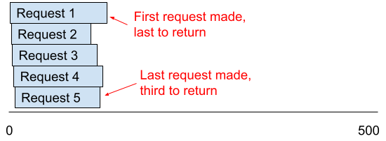
Implicit Concurrency Problems
There can still be concurrency problems (but not as many)
  Race conditions with database operations (use transactions)
    Handling failed transactions
  Race conditions on read – await – compute based on read – write
  Deadlocks with external processes and messages
    Handling failed messages
    Ensuring external failures are noticed by the program
Performance
  Don’t want to block the main event loop with computation
  Anything complex or time consuming needs to be external
  Or requires low-level coding or server processes

Slide 36
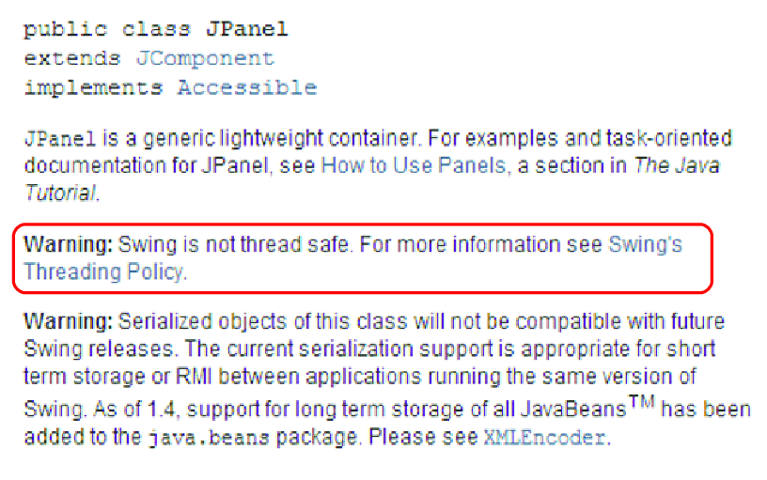
Documentation for Concurrency
Document each class or module
  Immutable
  Thread-safe
  Not thread safe
Document methods
  What they lock

Slide 37
HOMEWORK
Its time to recode your programming assignment
  It turns out that compiling on my new Linux machine takes < 10 seconds
Various alternatives:
  Use your bouncing balls for data visualization
    Show information about all processes or your processes as you thought about earlier
    Show information about weather in 100+ cities (specify in a file)
    Show information about 100+ stocks (specify in a file)
    Show information about some other time-changing values
  If your program has a goal the user should achieve
    Then create an AI agent that tries to achieve the same goal
    AI agent should run independently from the ball computations
  If your program does complex computations (e.g., collisions or inter-ball gravity)
    Then code the program to do these in separate threads (using a thread pool?)
    And experiment to see how many threads provide the best performance
    Provide graphs and discussion of how the number of balls and number of threads affects performance
Also consider updating the program
  Recode your assignment to use concurrency (needed with any of the above options)
  Run in an elliptical or polygonal window
Due 10/24 (can get it done earlier to provide time on project)

Slide 38
PROJECT HOMEWORK
Continue detailed design of your project piece
  You should have a sense of the top-level classes
    Of your component
Hand in individual top-level designs next Tuesday (10/22)
Should have time for a project meeting on Thursday

