Slide 1
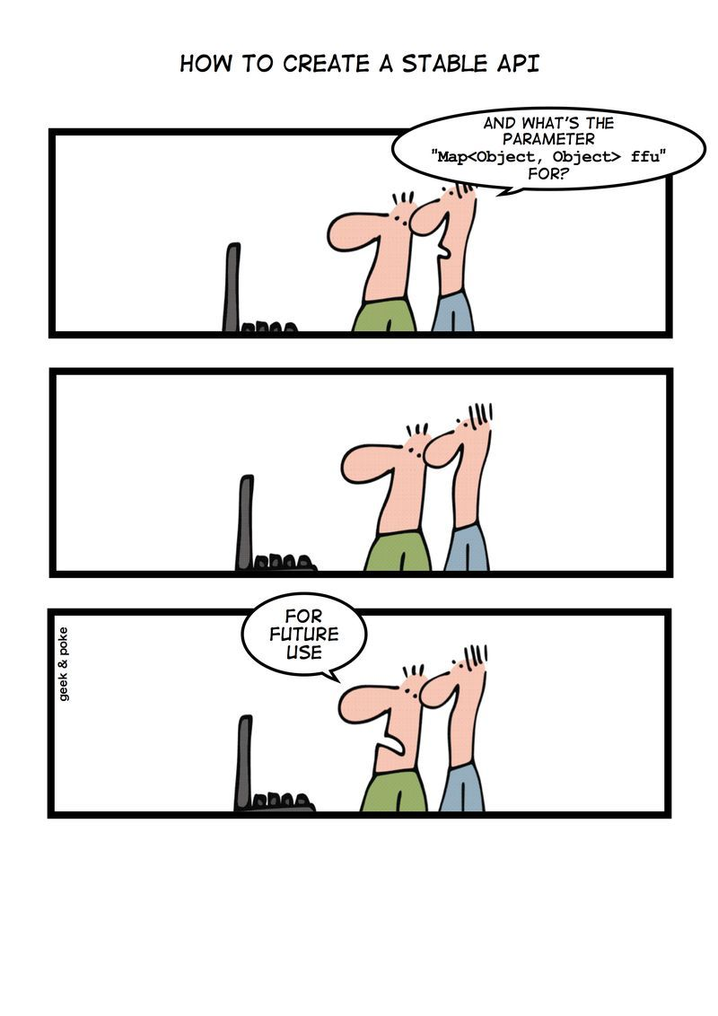
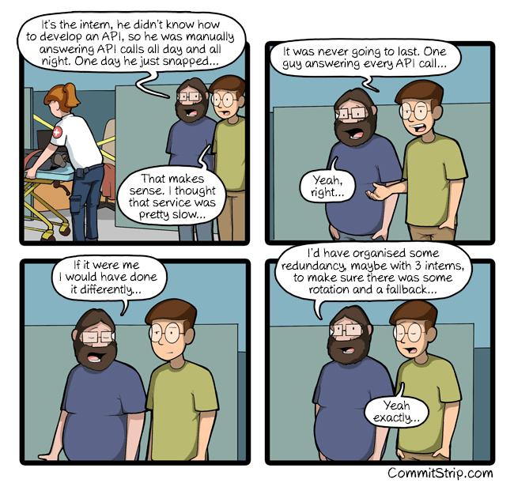
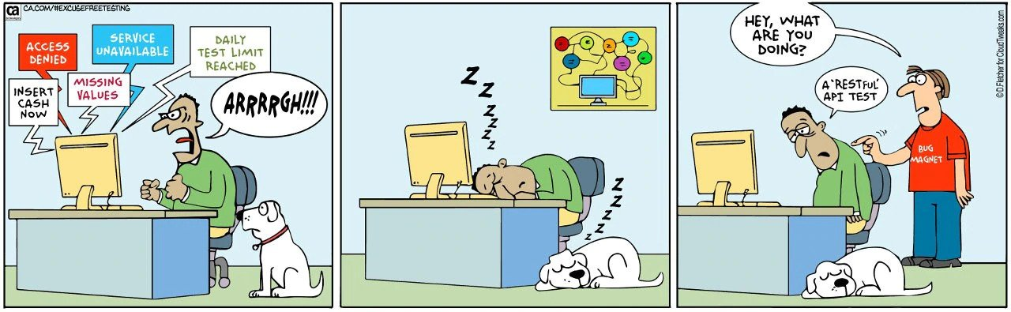
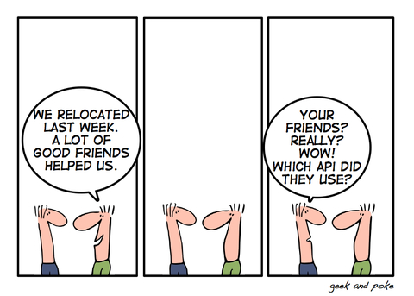
Creating and Using APIs
CSCI2340: Software Engineering of Large Systems
Steven P. Reiss

Slide 2
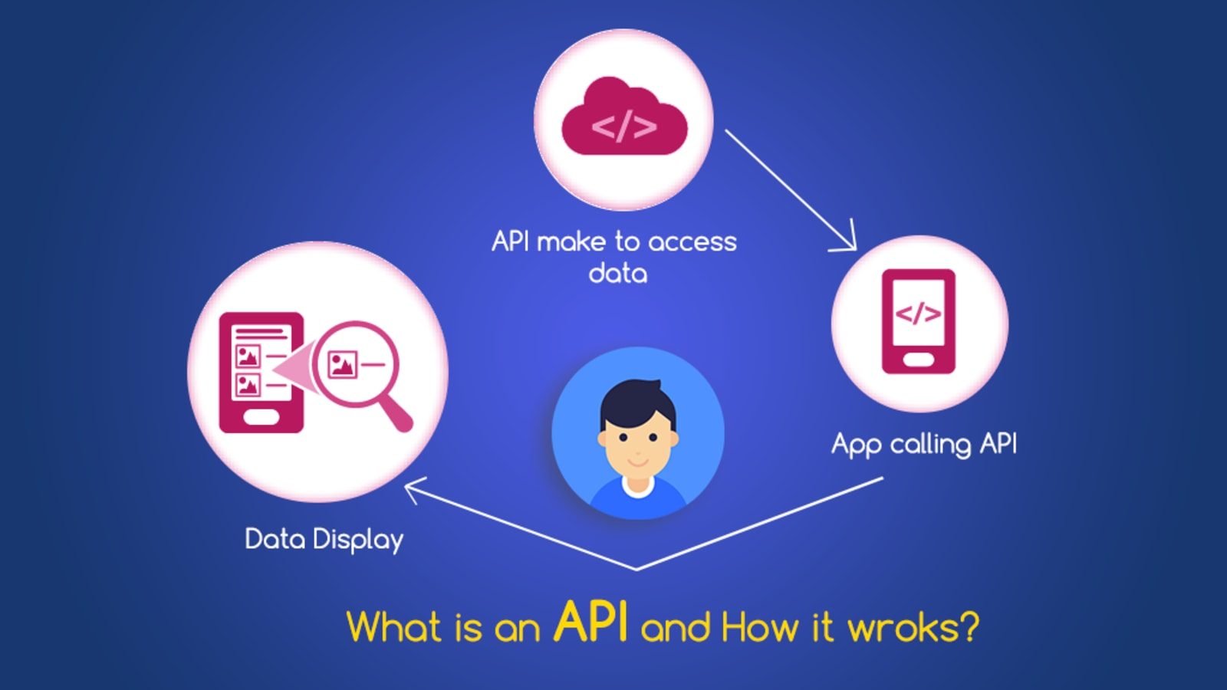
What is an API
Application Program Interface
Front end to a library or equivalent
  Set of top-level calls
  With OOP: Set of public classes and methods
  With Modules: Set of (importable) functions and classes
  With the web: Set of messages or HTTP requests
The API is also the documentation on how to use these
Designed to be shared
  By multiple portions of the same application (different developers)
  My multiple applications
Designed to be reused
  APIs are a clean way of achieving reuse

Slide 3
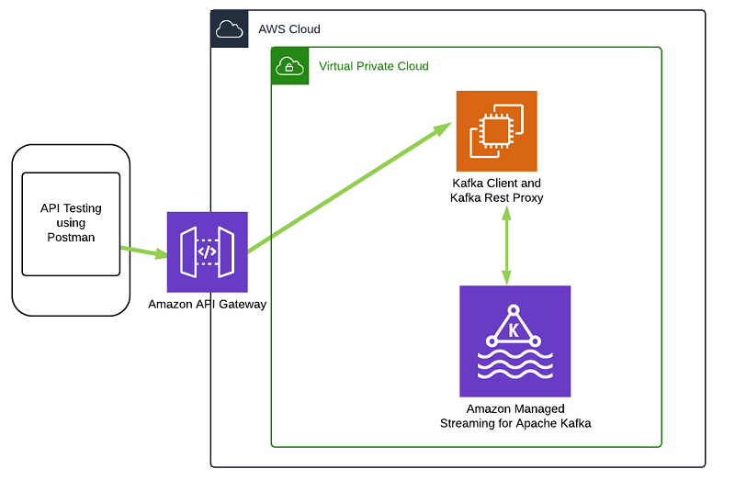
Using an API
This is easier than creating one
  And existing APIs will give you ideas for designing your own
Lots of external (open source) code exists
  Risks and benefits covered previously
  Considerations
    How well it fits your needs
      Does it fit with your implementation
    How easy is it to understand
    Is it being maintained
    IP, security, performance, …

Slide 4
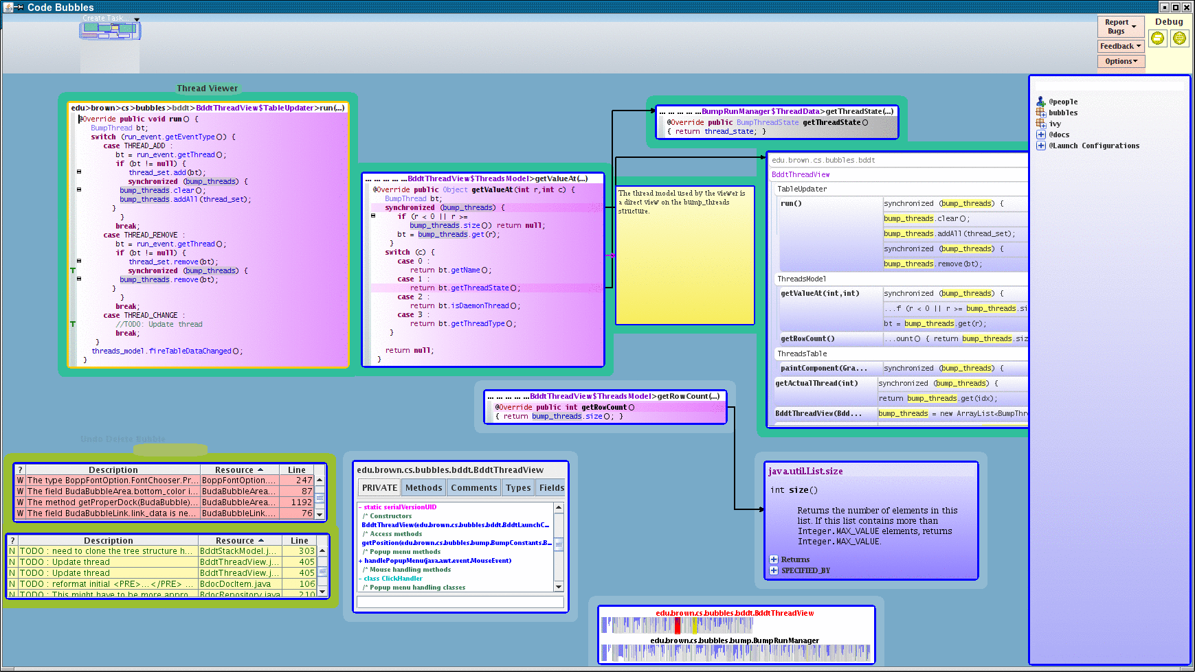
Example: External APIs used in Bubbles
Eclipse JDT and support for abstract syntax trees
  To use the JDT in our plugin we needed 36 jar files
Marytts for text to speech (was freetts)
Apache commons compression
Gnujpdf for generating pdfs from screen images
Joscar, Smack for chat services
Jsoup for html scraping (documentation access)
Json
Jsyntaxpane for editing various forms of text files
Jtar for reading tar files
Junit for testing
Websocket (node.js debugger interface)
Commonmark for markup parsing (programmer’s notebook)

Slide 5
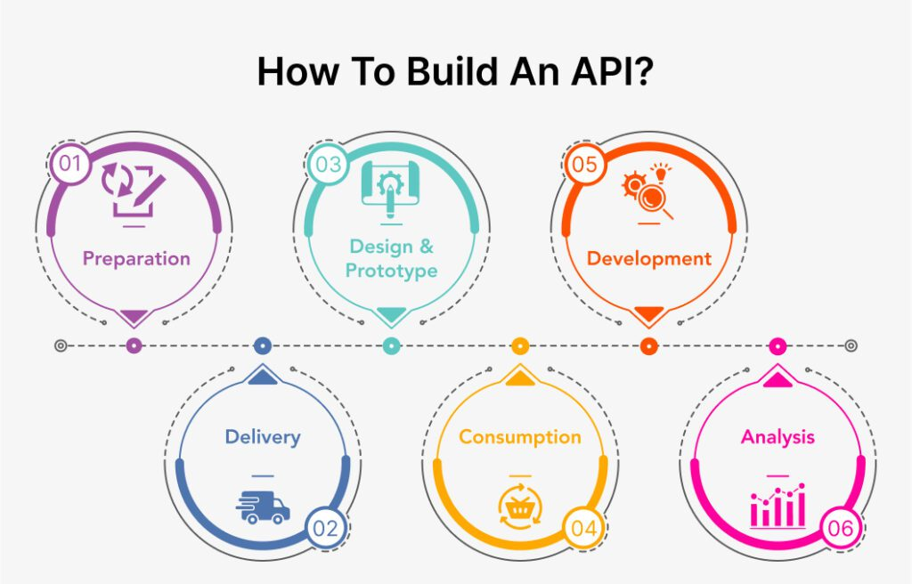
Creating an API
You should create an API for your future development
  Common code you will use over and over
  Within a project, within a company, for an individual
Alternative to copy & paste
  This create code clones which can be problematic
  Provides reuse
You should do this for your project
  Common code across multiple developers
You should do this for your own coding
  Common code for single developer
You need to understand the programming language and your needs
But this is not as easy as it seems
  This lecture goes over some of the complications

Slide 6

Experience with Creating APIs -- IVY
Ivy has evolved over 40+ years
  Started as BWE in the early 1980s (mostly for UI)
  Evolved from C to handle C++, Java
  Thinking about a Dart equivalent once we understand how it is used
Almost everything developed in IVY has changed
  Some changes are easy – additional calls & packages
  Other changes are more difficult
    Moving away from jikesbt to asm
    Handling prefixes in XML
    Handling templated versions of Swing classes
More has been retired than has been maintained
  Or will be when the one piece of software still needing it dies
  Pieces basically no longer work (CINDER, JFLOW) – compilation only

Slide 7

Experience with APIs -- IVY
Several pieces are only used by one application
  Weren’t useful for more than one (PEBBLE FSA editor)
  Too specialized or too complex (JFLOW -> FAIT (outside IVY))
  JANNOT – annotation processor
  Probably remove these from API (but consider current & future uses)
Other pieces are widely used and seem correct
  MINT for message passing (and MINCE for C/C++)
  SWING: a set of classes to simplify the use of Java Swing
  FILE: a set of file and formatting utilities
  XML: a set of XML input, output, and manipulation utilities
  EXEC: process running and query methods
  JCOMP: fast internal Java compiler
  PETAL: embeddable, extensible structured graphics editor
  STDLIB: C++ extensions and standardization (.H files)
  JCODE – byte code interface using ASM

Slide 8

Experience with APIs -- IVY
Other pieces have seen limited use (but > 1)
  LIMBO – tracking lines between versions
  LEASH – interface to Cocker code search
Other pieces have become outdated
  CINDER -- jikesbt byte code manipulation
Other pieces are under development
  BOWER – Express-like embeddable web server for Java

Slide 9
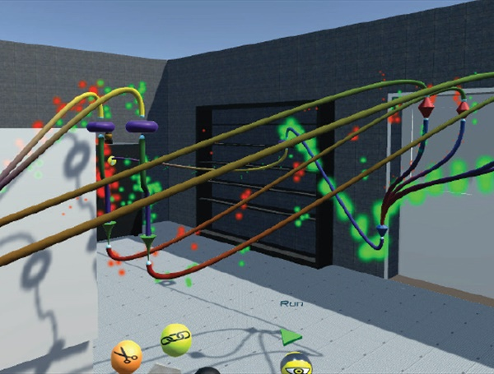
Interfaces Types Used in IVY
Sets of static methods
  FILE, XML
Extensions to existing classes
  IvyXmlWriter, SwingGridPanel, SwingNumericField, …
Public class or façade
  IvyExec
Sets of related classes (façade with interfaces)
  MINT (control, message, handler)
  JCOMP (type, symbol, scope, …)

Slide 10

Single Jar Packaging
IVY is packaged as a single jar file
  Which requires several other libraries
  These can be included in the jar (ivyall.jar)
  These can be picked up from the IVY’s lib directory
Single jar packaging is good for individual use
  Essentially provides an extended common code base
Not ideal for outside users

Slide 11
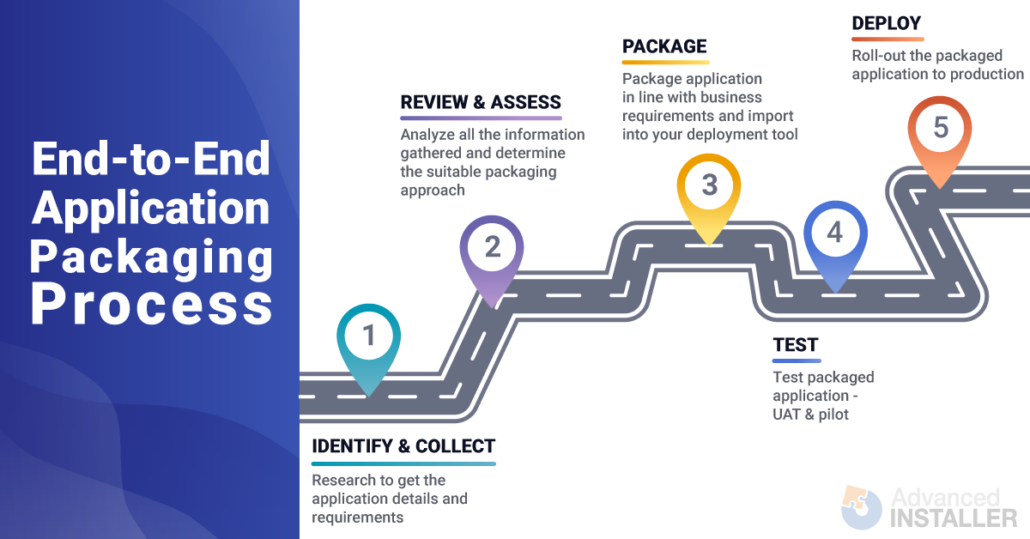
Single Package Packaging
Outside users probably don’t want all of IVY
  Want to use a single package (e.g., MSG, JCOMP, or PETAL)
Packaging IVY as a set of jars would make sense here
  Users could pick and choose just what they want
Pros and Cons
  Saves memory
  Avoids naming and library conflicts
  However, these packages depend on other parts of IVY

Slide 12
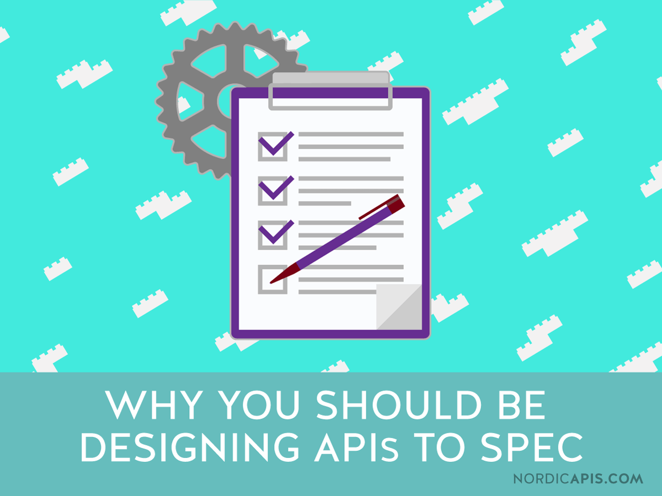
APIs are Difficult to Design and Build
What you need to know to build your own API / library
  Because you should be thinking of and doing this
Need to anticipate future uses
  But no one knows what these are or will be
Try to be general
  Generalize from the special case of your application
  This can make things easier (or more difficult)
  But keep it simple
Need to be easy to use
  Easy to learn, especially if for others
  Few dependencies (internal or external)
  No large commitment
  Easy to incorporate into another project

Slide 13
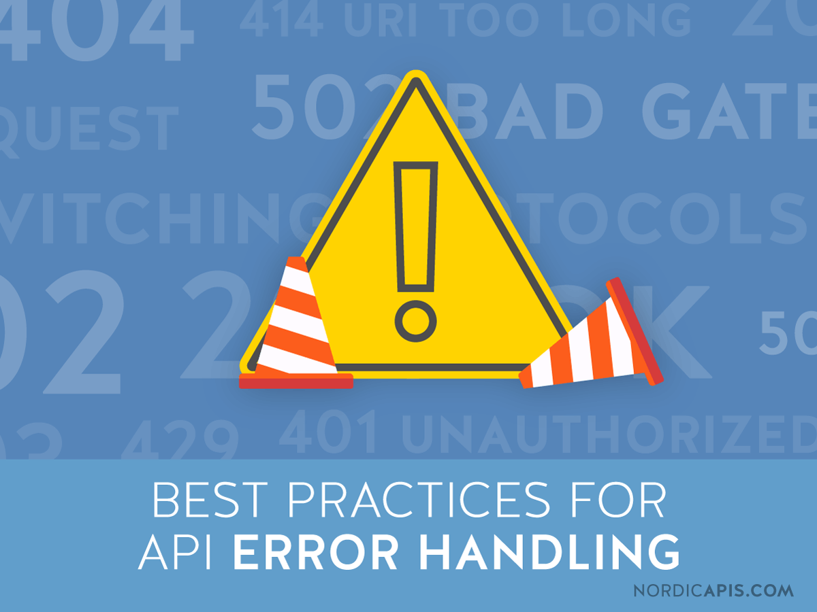
APIs are Difficult to Design and Build
Error handling is important
  Don’t want to be blamed for others' problems
    Programmers trust their own code more than yours
  The API is a black box
    Don’t you won't want to debug it if you are working on other things
Needs to be standalone
  Shouldn’t depend on too many (any?) outside libraries
    Version inconsistencies
    Incompatibility with other libraries used in an application
    Libraries you depend upon will change and evolve
  Should avoid language dependence (e.g., which version of Java or C++)
  Packageable in one or two files (.jar, .so + .H, npm module)

Slide 14
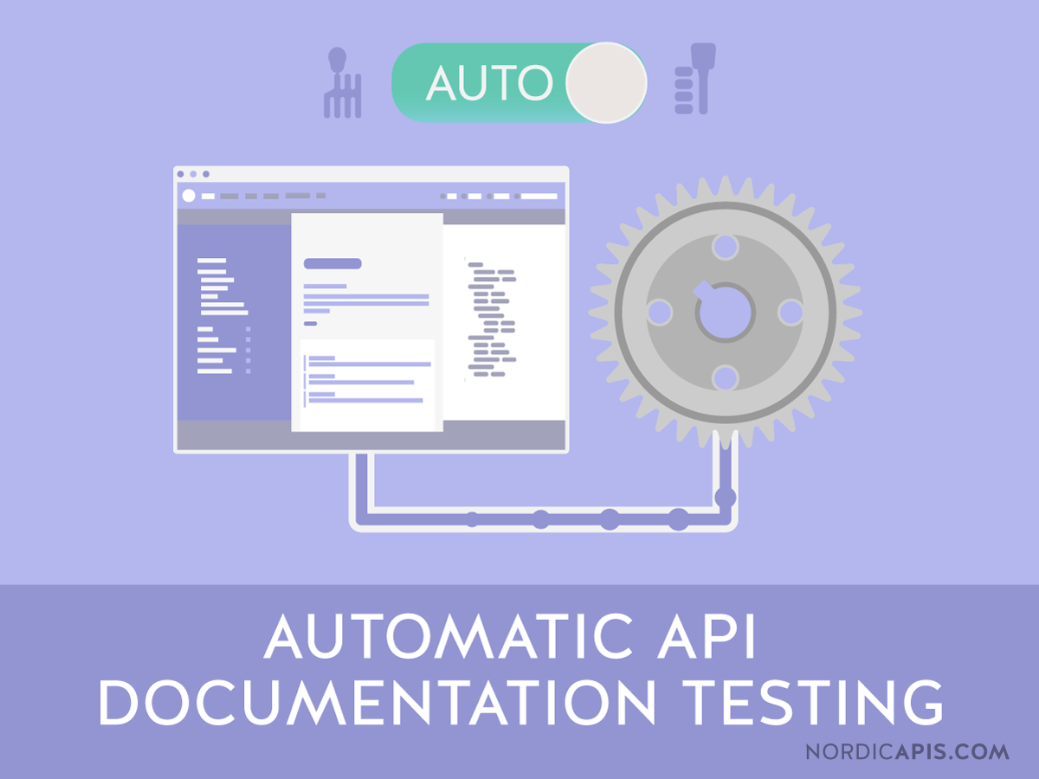
APIs are Difficult to Design and Build
Need to be (well) documented
  Javadoc (or equivalent) describing each public function and field
    Expected inputs, exceptions
    Non-trivial
  Usage examples (php manual)
Need to be well tested
  Test suite just for the API
  Keep adding to this as bugs are found
Performance can become an issue
  Might not be in your application
  But will be in the next one

Slide 15
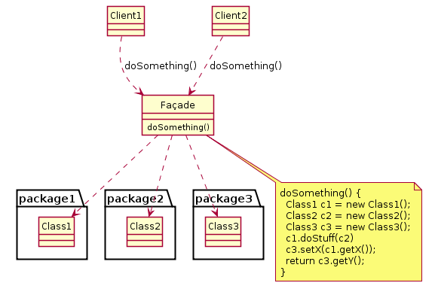
High Level Interfaces are a Form Of API
Designed to be used by other parts of the application
Much of what went into the design of an interface
  Is the same as the design of an API
  Anticipate potential uses
  Anticipate future needs
Except uses of a generic API are not well known
  You have thought out your application
  Don’t really know any others
  Need 3-5 different applications to get the API almost right

Slide 16
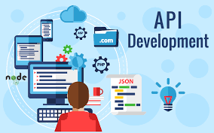
API Development
Identify potentially shared code
Start with the simplest API you need first
  What you would write for the first application
  Routines that might be useful in other circumstances
  If you have 2 or more initial applications, this is easier
  Multiple people can be thought of as multiple applications
Generalize where possible
  Use templated classes rather than fixed components
    Don’t use Object or dynamic if you can avoid it
  Use templated methods to allow generic arguments
  Leave room for expansion and evolution
    Probably more than you normally would
  Extend standard interfaces where appropriate
  But keep the interface simple

Slide 17
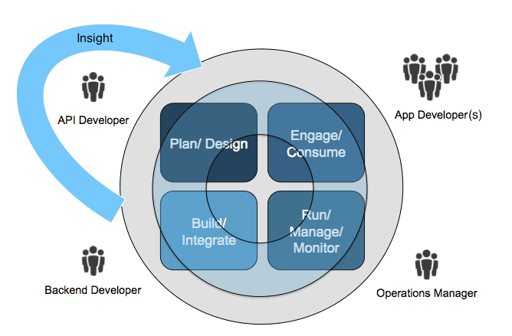
API Development
Each time you have a new application
  Refactor the API to accommodate it
    Add a few new calls or classes
    Add new methods with additional parameters
    Remove or merge unneeded methods
    Maintain upward compatibility
  If major restructuring is needed
    Decide if it will help both applications (probably will)
    Preserve the original API as well (mark as deprecated)
    Don’t be afraid to refactor early on and as needed
After enough (5) uses
  You’re probably close to having the right API
  Publish it

Slide 18
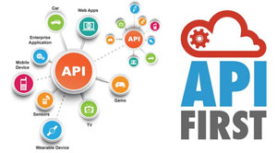
API Coding Principles
Handle errors
  Well defined behavior on bad or invalid inputs
    Either in terms of unique output or exceptions
  Code defensively: error check all inputs explicitly
    Check for null, 0, empty collections, …
    Explicitly document what is returned on bad inputs
  Don’t be afraid to throw exceptions
    Either standard exceptions or one defined explicitly for the library
    Understand Exception versus Error
Document as you go
  Javadoc or other standard form
  Include input assumptions
  Include output under different circumstances
  Include exceptions

Slide 19
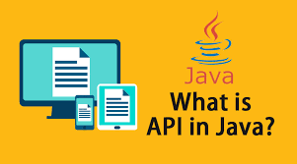
API Coding Principles
Collections are more useful than arrays in Java
  Dynamic, easier to create, easier to add to, more flexible
Use enums for options, not integer or object constants
  These are type-checked
  Define these as part of the library
Use interfaces if multiple implementations are possible
  Or if you want to hide the implementation
  With an appropriate static factory method
  Use reflection here if needed to choose the implementation
Define callback interfaces for events
  Use EventListenerList
  Add methods to add and remove callsbacks
  Provide a default listener implementation class (or default methods on interface)

Slide 20
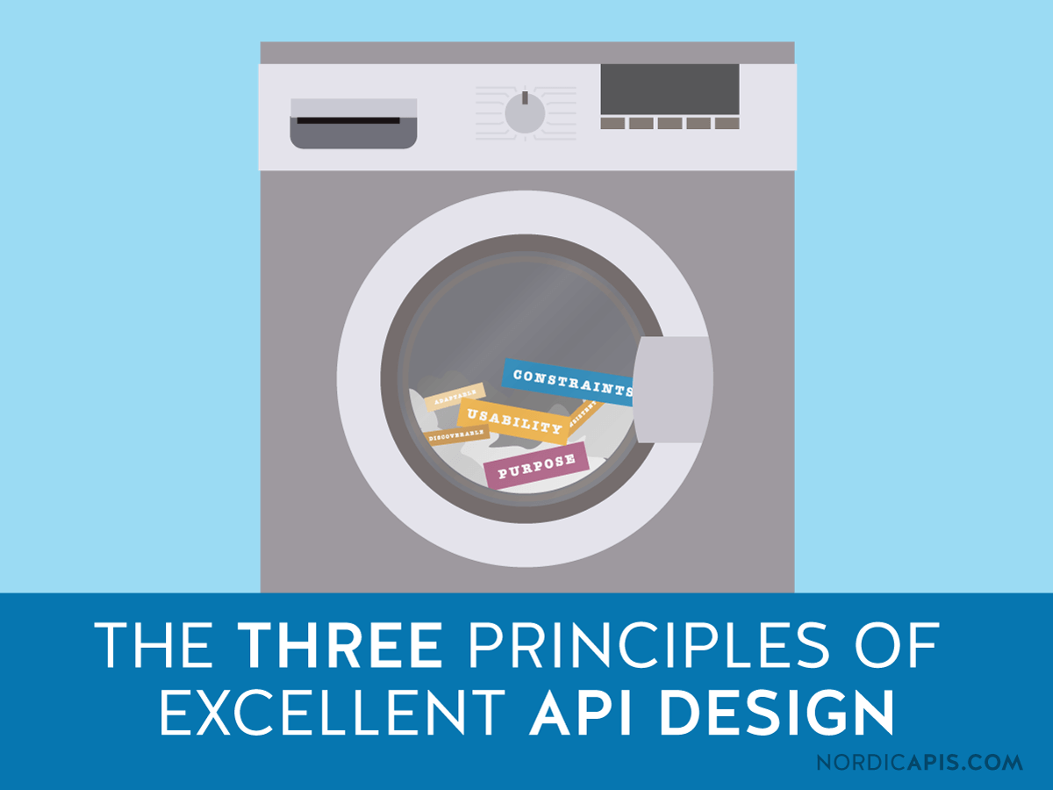
API Coding Principles
Generalize
  Use Collection, not List, Set, or Vector
  Use CharSequence not String
  Use Comparators rather than implicit comparison
    But provide a method to use implicit comparison
  Algorithm classes where appropriate
    But provide a method to use the standard algorithm
Use templated classes and methods
  Understand templated classes
  Learn how to define a templated method
  Avoid using Object if it isn’t multiple types at once
  Define interfaces as needed to represent input data

Slide 21
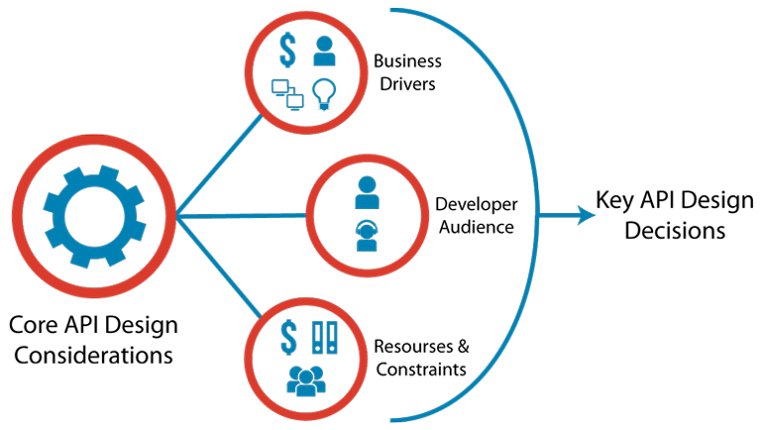
API Coding Principles
Minimize the size: keep it simple
  Number of public classes, interfaces, methods, fields
  But providing functionality
  Ensure it is easy to use
Provide debugging hooks
  toString, output methods, logging?
  Informative error messages or exceptions with messages
Avoid using outside libraries that might be used separately
  To avoid version conflicts
  To make it easier to include in your application

Slide 22
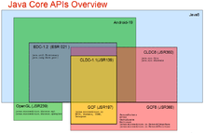
API Coding Principles
Implementing structures or hierarchies in an API
  Provide an abstract top-level class for common functionality
  Only expose the subclasses if necessary
    Defining a set of interfaces is often more appropriate
  Provide iteration for use in the language if appropriate
  Provide navigation (up, down, children, …)
Define a visitor for each external data structure
  So that users don’t have to understand explicit navigation
  Even if it isn’t a tree
    Signature visitor, UML visitor

Slide 23

Library Management
Need to manage the set of APIs an application needs
  To avoid duplication
  To avoid version conflicts
  To easily include all the needed libraries in the binary
I’ve been doing this manually
  Maintaining a lib directory with the explicit requirements
  Maintaining the classpath, librarypath, or command script
Tools have been developed for this
  These are commonly used today
  These depend on the language
  And its compilation and sharing models

Slide 24
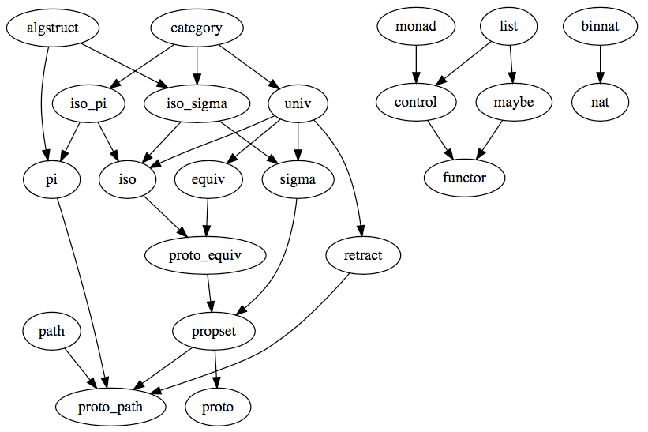
Library Management Tool Goals
Each API specifies its dependencies
  Which other APIs it uses
  Including minimum, maximum version numbers
Application specifies its dependencies
Tool finds the proper version to meet all the dependencies
Versions are automatically downloaded
Versions are automatically included when running the binary
Tool can build a complete binary (with dependencies)
Tool can build a directory with all the libraries

Slide 25
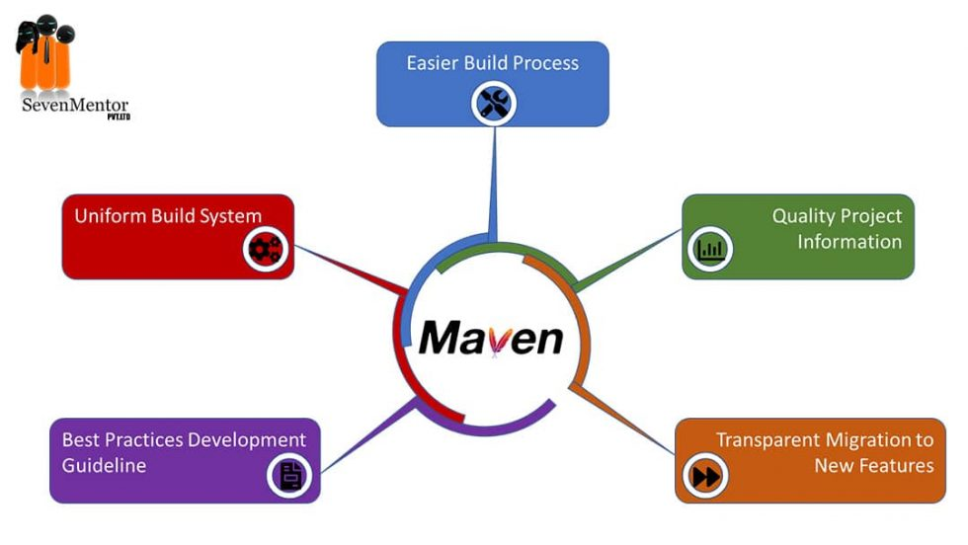

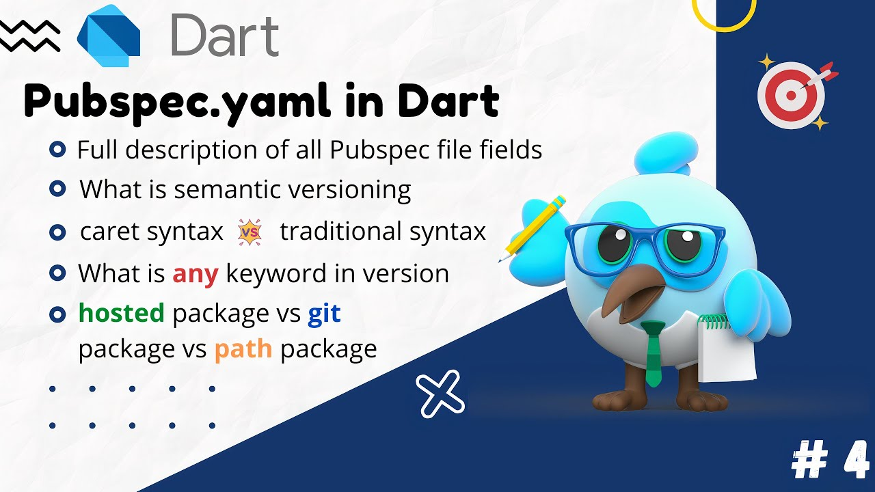
Library Management Tools
Maven (MVN)
  For compiled languages (Java, C/C+, …)
  XML file (pom.xml) defining the dependencies
  Global repository of libraries and their dependencies
  Maven also handles building, packaging, testing, …
  Can fail if conflicting dependencies
Node Package Manager (NPM)
  For Node, JavaScript, TypeScript
  Uses json file (package.json) to define the dependencies
  Allows multiple versions of a library (since language does)
Dart/Flutter use YAML (pubspec.yaml)
  To do maven-like analysis
  And provide other capabilities ala maven
You probably should be using one of these for your project

Slide 26
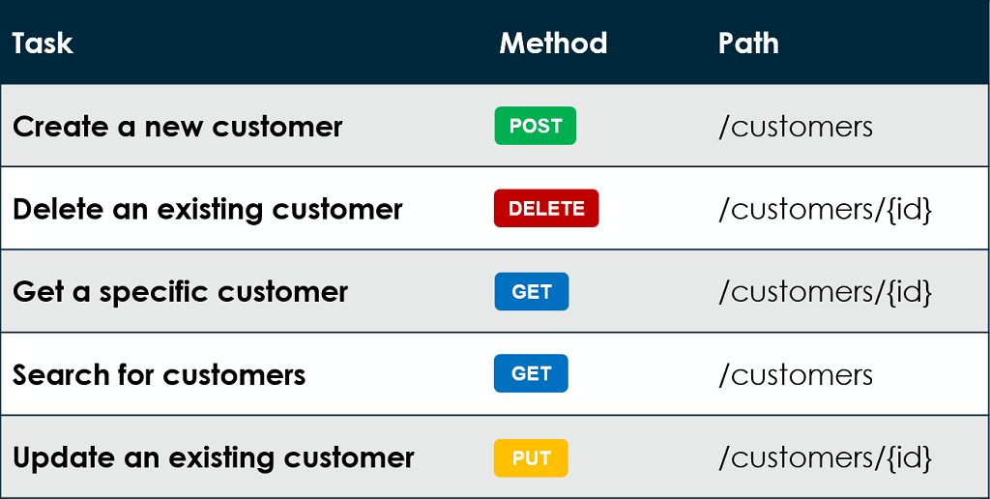
Other Types of APIs
Just as there are multiple ways of representing interfaces
  There are multiple API possibilities
HTTP-based APIs
  SOAP-based protocols
  RESTful (AJAX-based) protocols
    Google location service
  Microservices
Message-based APIs
  FIELD and Code Bubbles use several of these

Slide 27
Programming Homework
Modified programming assignment due 10/24
  Use the balls for data visualization
  Provide an AI for your bouncing balls game
  Experiment and report on using multiple threads
Create a video of the assignment once it works
  Can have sound (not mandatory)
  Prepare to hand in (due 10/29)
  Prepare to show in class Tuesday 10/29

Slide 28
Project Meeting
Meet again as a project group
  Think about whether you need an API to support your team
    Code that each person would need to write separately
    Identify any such portions and list their requirements
Then have a project meeting

