Slide 1
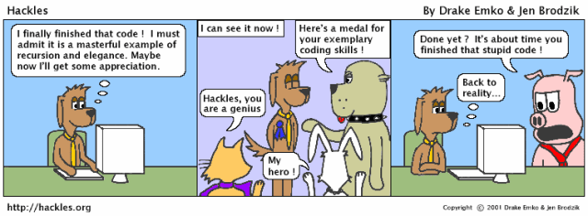
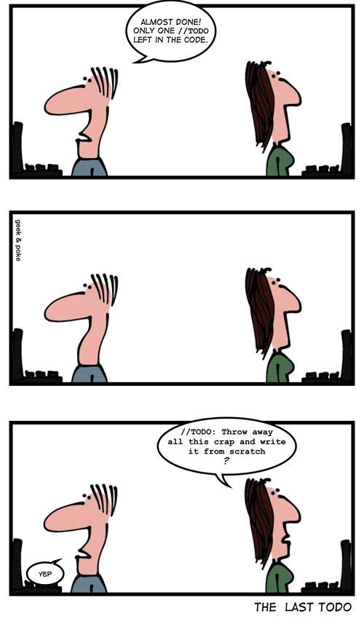
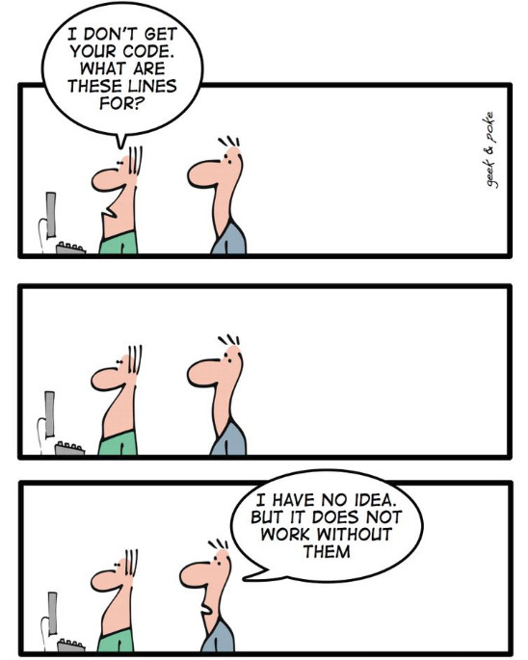
Coding
CSCI2340: Software Engineering of Large Systems
Steven P. Reiss

Slide 2
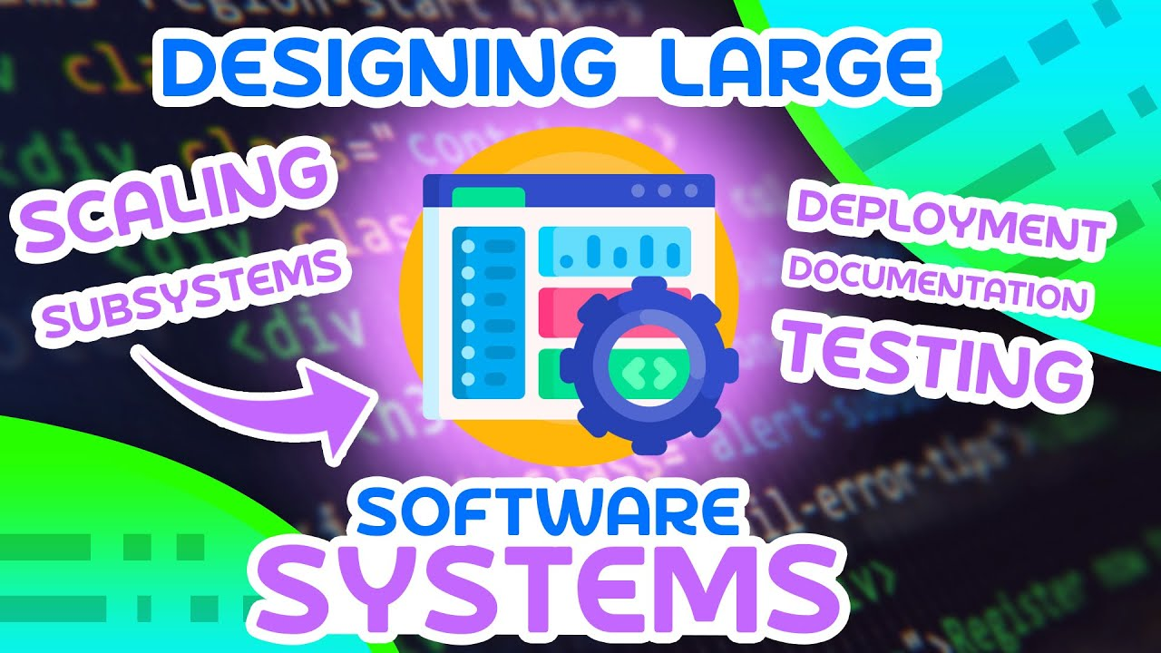
So You Think You Know How to Code
You already know how to code
  Or you wouldn’t be here
  You’ve been coding for a while
This course should teach you to code better
  Coding not for the moment
  Coding for large, long-lived systems
  Coding that will last
I want you to use what you learned
  In your project
  In your programming assignment
  In your future work

Slide 3
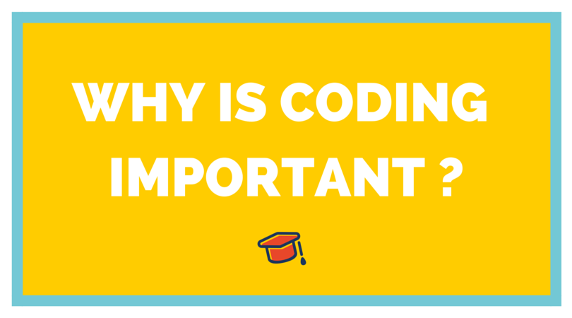
Coding is Important
You will spend considerable time writing the code
  Or it will seem that way
You will spend a lot more time reading that code
  Maybe not in this course, but in the real world
  Also reading code that others wrote
  For debugging, maintenance, evolution, understanding …
This lecture tries to provide some general principles
  Beyond the naming and ordering conventions we previously covered
And example rules or suggestions for coding in Java and JavaScript
  Other languages have similar rule sets
  Find them on-line, or invent them yourselves
  But make sure they are meaningful for you

Slide 4
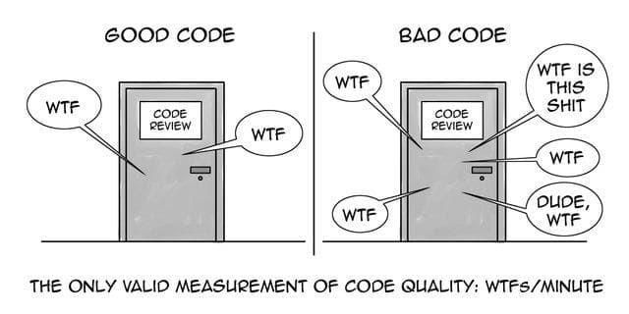

Basic Principles
Write code to be read by humans
  Names should be meaningful
  Code shouldn’t be overly complex
  Code should be documented where needed
  Code should be organized
    Finding things in the code should be easy
  Conventions should be followed
    Naming, ordering, style
  Code should be easy to understand
    Simpler is better

Slide 5

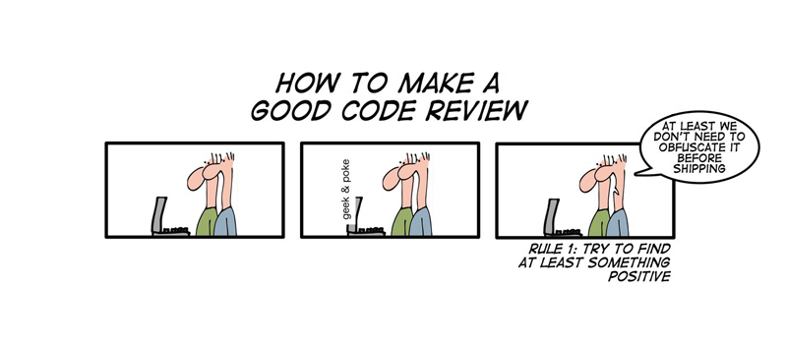
Basic Principles
Take pride in your code
  You should want to show it off
  You should want others to read it
  You should want others to emulate it
  You should want others to use it

Slide 6
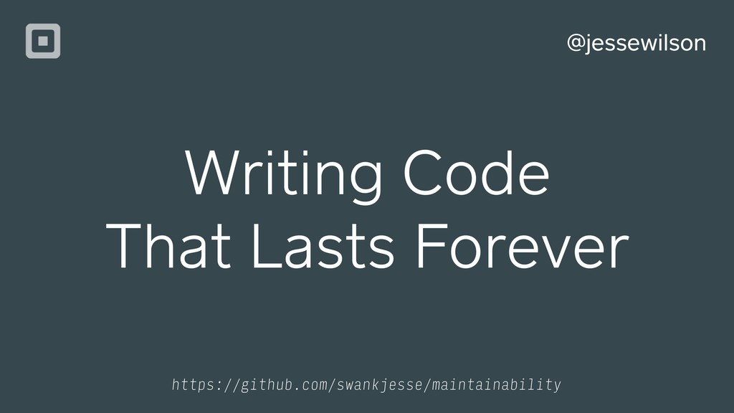
Basic Principles
Write code meant to be permanent
  Assume it will be around for 20 years
  Even if you anticipate doing so, you won’t throw it away
Write code so it can be extended in the future
  Code rarely shrinks
  Classes will get additional methods/functions and fields
  Classes will be used in different ways
  Methods will get longer and more complex
  Fields and variables will be added

Slide 7
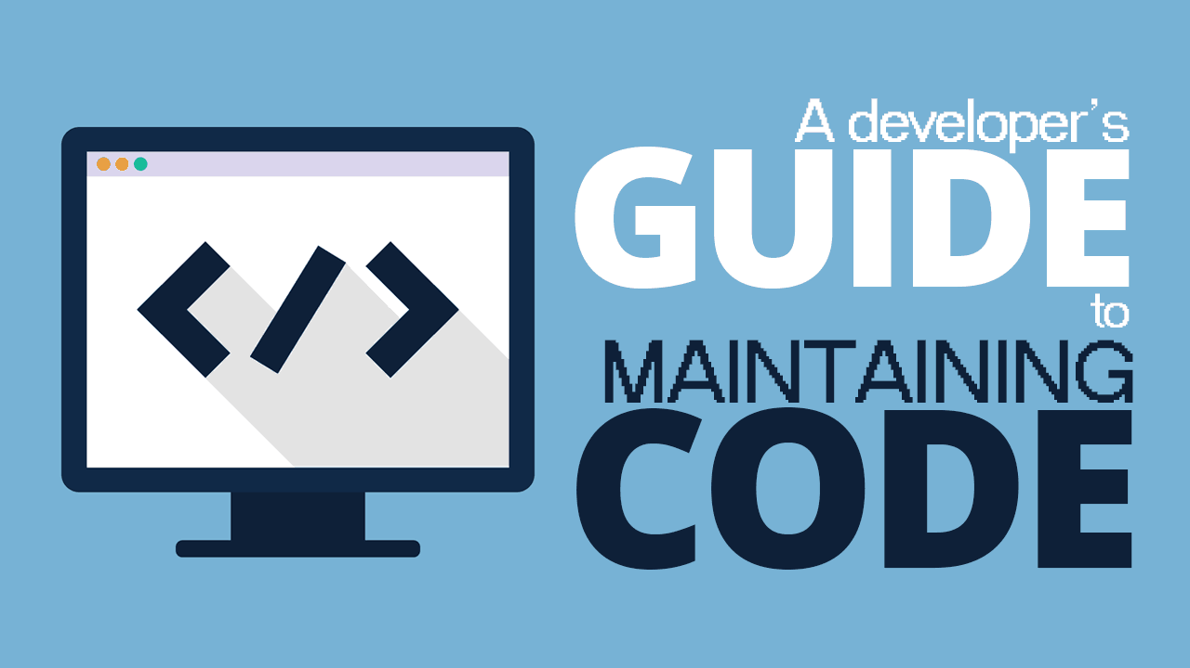
Basic Principles
Write code to be maintained
  Ease of debugging is more important than ease of writing
    Code defensively: it really helps
    Ability to find a location given class/method name
      This might be all you get from a stack trace or bug report
    Avoid constructs that are difficult to debug and test
  Ease of changing the code is more important than ease of writing
    Easy to add new items
    Easy to adapt, refactor
    Localize as much as possible (principle of least privilege)
    Minimize coupling, maximize cohesion
    Document as needed

Slide 8

Making this Concrete: Classes
Files and Classes should be reasonably sized
  Not too long or too short: think about reading it
    200-1000 lines is best
Keep the number of top-level classes in a package reasonable
  Number of files in a directory
  5-20 would be a good target: think about finding something
  Use inner classes, separate packages, or subpackages
Inner classes should be small
  If it is > 100 lines (1 page/screen), should probably be an outer class
Make inner classes static, non-extendible classes final
Classes and files shouldn’t have too many public methods
  Interfaces should be kept simple

Slide 9
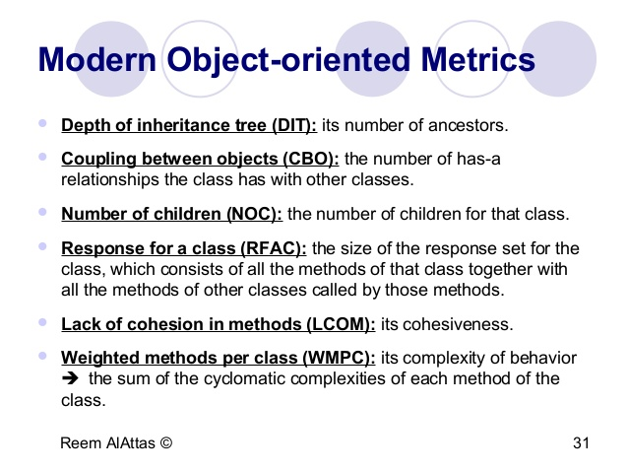
Making this Concrete: Methods
Methods / Functions should be reasonably sized
  Should fit on one page or screen
  If more complex, split into multiple methods or use helpers
  Or encapsulate in an inner class to provide common local variables
Methods shouldn’t have too many parameters
  Especially accessible methods (public, protected, …)
  Parameters should be necessary and logical
Parameter types should be primitive where possible
  Easier to understand, simpler to use
Use a consistent parameter order throughout project
  (width, height) versus (height, width)

Slide 10

Making this Concrete: Logging
Use logging to track execution throughout coding
  You’ll eventually have to debug
  Have the system capable of explaining what is happening
  Logging finds bugs that you don’t otherwise see
  Add logging calls as you code as you write it
Logging libraries exist
  Java has one built in
  Apache Commons Logging
  Slf4j is another widely used one for Java
  Easy to write your own as well
  Be wary of bugs introduced in logging

Slide 11
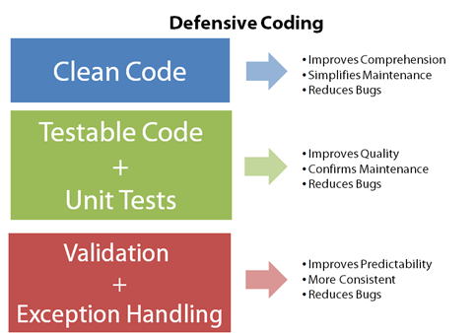
Making this Concrete: Defensive Coding
Add defensive checks liberally as you write the code
Fields should be private (prevent others from changing)
  Keeps change effects local
Public methods shouldn’t trust their arguments
  Check that parameters have reasonable values
  Before using them
Check output is reasonable and expected
  When testing, debugging, using the system
  After calling external methods
  Catch errors early
  Always look at log output
Make all assumptions explicit
  Either in the code or in comments
  Or both

Slide 12
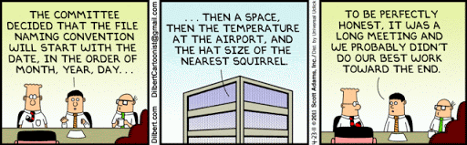
Making this Concrete: Conventions
Use a consistent and complete set of conventions
  Standard conventions (e.g., Sun, Google)
    Quite extensive, but still don’t cover everything
    Might be overly restrictive for your purposes
  Use naming conventions to your advantage
    Class name should identify the package and where to find it
    Looking at an identifier, you should be able to find its definition
    Avoid the possibility of name conflicts (internal and external)
  Use file ordering conventions to your advantage
    Know where in a file to look for things (fields, private methods, …)
    Formatting should be consistent throughout the project
    Split files into sections with blocks

Slide 13
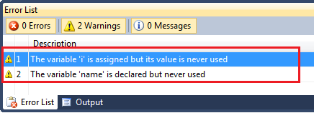
Making this Concrete: Compilation
Choose a reasonable set of compiler warnings
  IDE-based compilers make this easy
  Warnings are there for a reason – better code
Ensure code compiles without any warnings
  You can use @SuppressWarnings if needed
  But you should justify its use

Slide 14
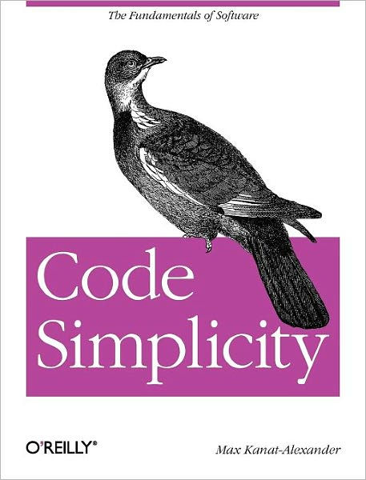
Making this Concrete: Simplicity
Keep the code simple
  Efficiency probably isn’t the primary concern
  Nor is conciseness or minimizing initial typing
  Target ease of reading, understanding & debugging
Comment anything that might not be obvious
  To a programmer unfamiliar with the details
  To yourself 5 years hence
Ensure code can be understood from the comments
  And the method and variable names
  Without having to read unnecessary details
  Be able to quickly find the relevant portion of a function or method

Slide 15

Use a Style Checker
For Java: use checkstyle
  Either start with Sun or Google standards
    Change these to meet your needs and conventions
  Or go through the various checks and set up or ignore each
    Justify your decision
  Should have no checkstyle warnings when done
    Use @SuppressWarnings when needed and justified
For other languages
  C/C++: lint (original style checker)
  Dart: language enforces some style conventions
  TypeScript/JavaScript: ESLint
  Checkers exist for most languages

Slide 16
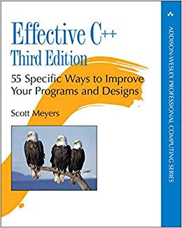
Making this Concrete: Language
Every language has its quirks
  Some aspects are for ease of coding, not ease of reading
  Other aspects might be hard to understand
    What happens at run time needs to be obvious to the reader
  Other aspects might make debugging difficult
  Other aspects might make evolution difficult
I generally develop a set of rules for using a language
  That emphasizes readability, maintenance, debugging, evolution
  Features not to use in the language
  Features to use that might otherwise be overlooked
  Based on experience
You can generally find language usage guidelines
  For most languages, either in books or on the web

Slide 17
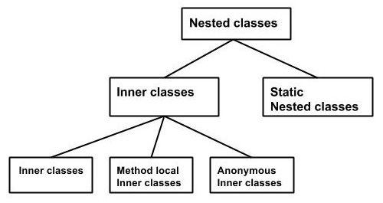
Java Guidelines: Inner classes
Use inner classes
Use inner classes to hide implementation details
  Inner classes should not be exposed directly
  Inner interfaces in a common interface might be exposed
  Can enclose an algorithm with its own set of global variables
  But can implement global interfaces
Inner classes are likely to become outer classes
  Name and code accordingly
Avoid nesting inner classes
Inner classes should be static if possible
Inner classes should be private

Slide 18
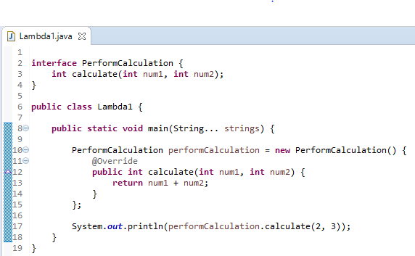
Java Guidelines: Anonymous Classes
Do not use anonymous or method-local classes
  Class outername$10 tells you nothing while debugging
    Finding the code is difficult
  Anonymous classes will often grow and become cumbersome
    Will need to become inner or outer classes eventually
    Why not make it an inner class initially
    This gives a reasonable name, file location
    Makes it easier to extend
  Understanding variable references is difficult
    Changing variables can have unintended effects

Slide 19
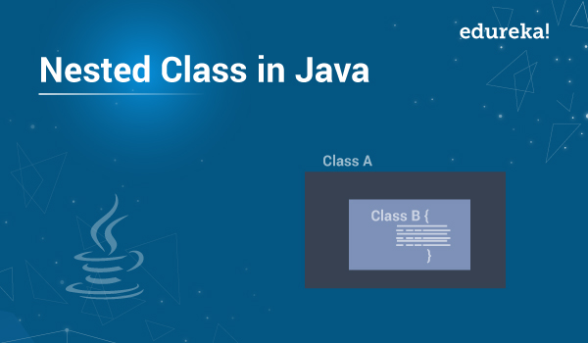
Java Guidelines: Hierarchies
Embed simple hierarchies as inner classes
  Inside the exposed (abstract) (root) class of the hierarchy
  Assumes hierarchy itself is not exposed
    This is an implementation detail
  Inner classes must be static in this case
Only expose a hierarchy if necessary
  Prefer interface-based hierarchies
  Allows hierarchy to evolve and change
  Only the root should be a visible external type
Provide a visitor for hierarchical structures
Notes:
This is a bit complex – need a better introduction or use case

Slide 20
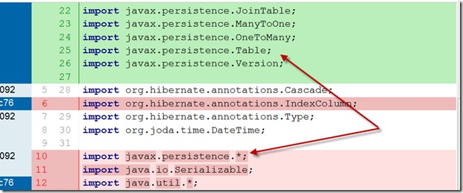
Java Guidelines: Imports
Don’t use on-demand imports
  IDEs will add necessary imports, fix up import lists, etc.
Use static imports only when names will be unambiguous
  With your code, external libraries, other imports, etc.
Use imports to access inner components of an interface
  When those components are named appropriately
  To avoid name conflicts
  Otherwise use Outer.Inner notation

Slide 21
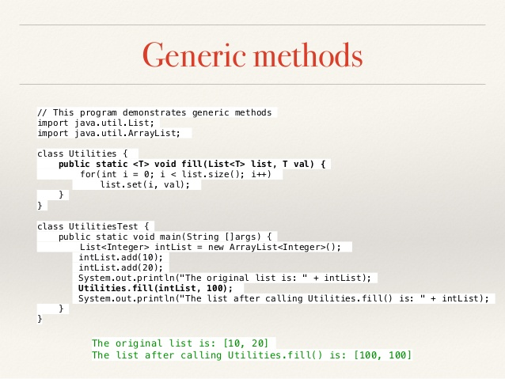
Java Guidelines: Generics
Get as strong typing as you can
Use generics for all collections, etc.
Don’t use Object
  As a method parameter
  Unless you really mean an object with multiple simultaneous types
Learn how to create your own generic classes
  Template rather than cast
Learn how to create your own generic methods
  Where the output type and maybe input types depends on parameters
  But ensure these are easy to understand and use

Slide 22
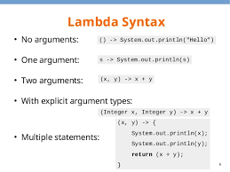
Java Guidelines: Lambdas
Use lambdas sparingly if at all
  Never use untyped lambdas
  Difficult to debug – where is lambda$5 in the code?
  Environment is unclear at run time
  Problems similar to anonymous classes (and more)
Implicit typing can be complex and confusing
  Make sure it is all explicit
  Prevents future problems
Be wary of method references
  Impossible to debug

Slide 23
Annotations in Java -- Definitions
Understand the use of annotations in the language
  Built-in Annotations (e.g., @Override, @SuppressWarnings)
  Checking annotations (e.g., @Nullable, @NonNull)
  User defined annotations
Compile-time annotation Processing
  Augment or convert the code
  But not in the way you would expect
Dynamic annotation processing
  Effectively augment the code using reflection at run time
  Used by Spring and other frameworks
  This means what you read is not what you execute

Slide 24

Java Guidelines: Annotations
Use built-in annotations (@Overrides)
Use checking annotations if available and enforced
  Otherwise, they can be misleading
Don’t use an annotation processor or dynamic annotations
  Seem convenient, but more of a hinderance than a help in the long run
  Difficult to understand what is going on
    Unless you are intimately familiar with the annotation library
    And you won’t be in 5 years
  Dynamics have no source for debugging, extending
  Can violate principle of least privilege (@Getter)
  Don’t work well with static analysis tools
  Note these are part of the Spring & other frameworks

Slide 25
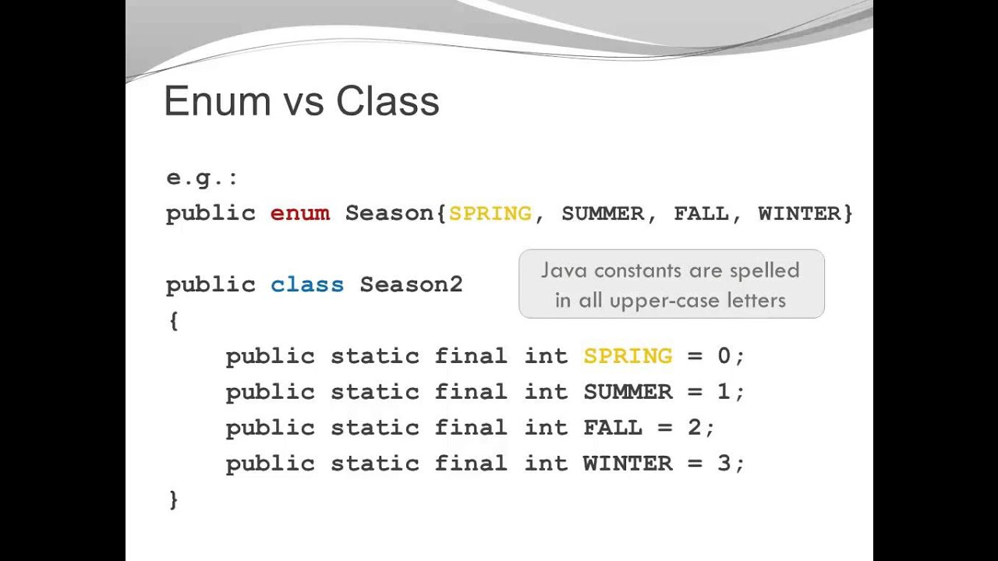
Java Guidelines: Other
Use enumerations rather than integer constants
Avoid using records (implicitly make things public)
Only this ‘this.’ where necessary
Initialize in the constructor
  Not in non-static field declarations
  Initialize all fields
Don’t depend on default initializations
Don’t get ”cute”
  if (x*y == 0) { } versus if (x == 0 || y == 0) { }

Slide 26
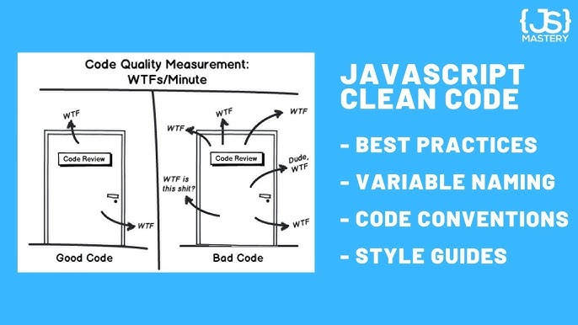
JavaScript/TypeScript Guidelines
Avoid nested function definitions
  Especially those > 1 line (a simple call)
  Preferred: use async/await
    Code looks sequential, understandable
  Alternative: use futures
    But arguments are odd & not as clear to read
  Alternative: use separate functions
Avoid lambdas (use named functions)
Use separate routings with Express
  One for each component that handles URLs
  Rather than a master router with all routing in it
Google JavaScript style guide (overkill)

Slide 27

Dart Guidelines
Avoid nested function definitions
Avoid lambdas
Avoid complex nested widget definitions
  Define the components first, then the widget
Separate the system into logical directories
  Treat directories as packages

Slide 28
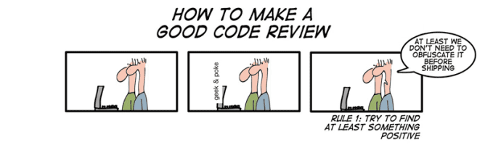
Code Reviews
Looking at code off-line
Have several uses
  Code style checking for project consistency
  As a debugging tool
  As a testing tool
Take a piece of code (method, class, …)
  Have a panel of reviewers
    Can be individuals working separately or a group meeting
  Pass the code out to the panel (possibly in advance)
  Panel goes over the code line-by-line
Goal is to find and eliminate all potential problems
  Make sure the code conforms to various guidelines
  Find potential bugs
  Ask about what-if questions to ensure al possibilities considered

Slide 29
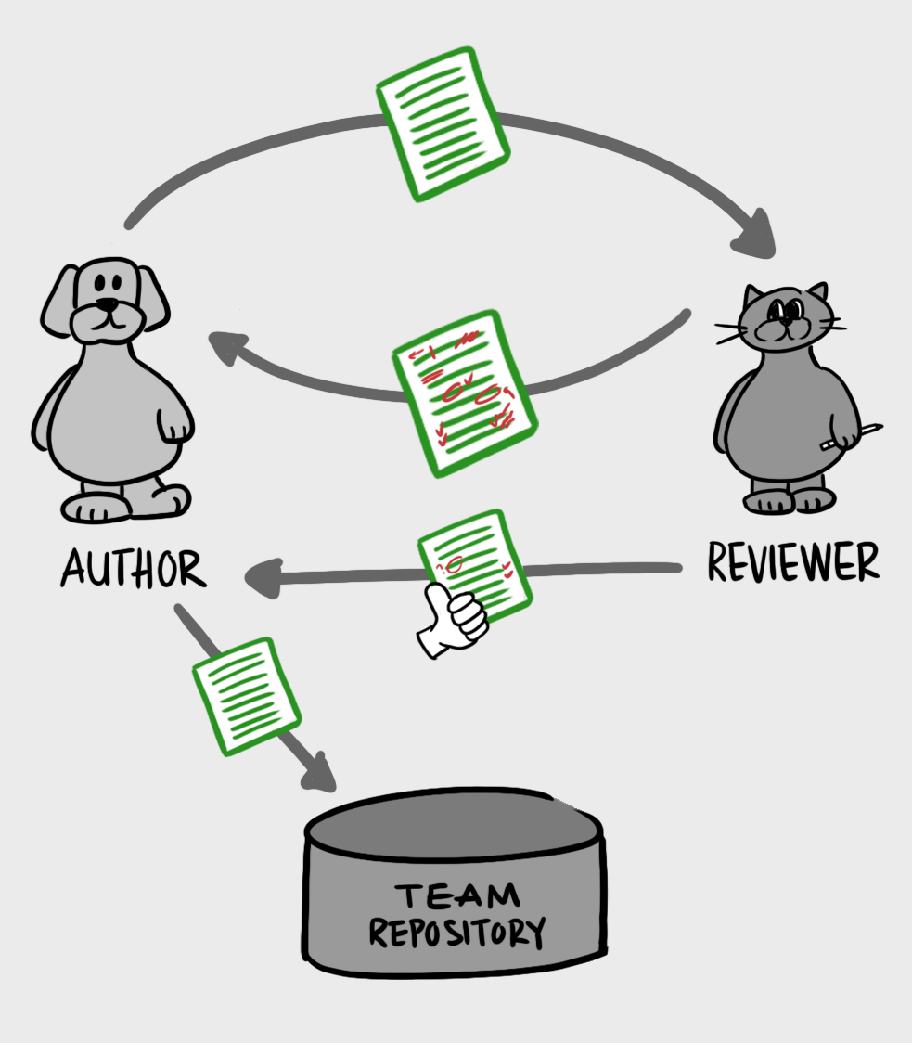
Code Reviews
Look For
  Style violations
  Language usage violations
  How readable and understandable is the code
Simulating the execution to see if it works
  Find possible inputs and conditions that might cause problems
  Ask what-if questions
You can do code reviews on your own
  Read over your own code critically (like proofreading)
    This is a good idea in general
    Read it as you write; read it after it is written; read it as you type it
  Not as effective as having others do it

Slide 30
EXERCISE
Code base (handout)
Go through the code and note what you think should be changed
  To make it follow conventions
  To make it more readable
  To make it the way you might code it
  To make it easier to maintain/evolve/debug/…
  To make it better (you can always improve your code)
  You should be able to find at least one thing to correct, possibly several
Note what changes you would make
  And then we will go over them as a class
We’ll do this again for debugging next time (different code)
We’ll do this with your project code later on

Slide 31
HOMEWORK
Added feature due Thursday; Video of your program due next Tuesday
Explicitly state coding standards for you project (as a team)
  Add this to your GitHub repo (coding styles should be there already)
  Ensure the code meets these standards
  Set up eslint, checkstyle or similar tool for your project
Explicitly state the coding standards
  For the language you use for your assignment
  Can be the same as above if the same language
Make sure your programming assignment conforms
  To these standards
  And meets the other coding criteria mentioned today
  Clean it up if not
Optional
  Pair up and do a code review of your programming assignment

Slide 32
PROJECT
Ensure that each person can go off and code their portion of the system on their own.
Project status reports in class next Tuesday (after or interspersed with program videos)
Project meeting?

