Slide 1
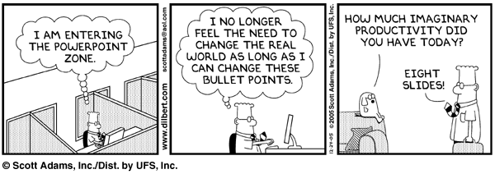
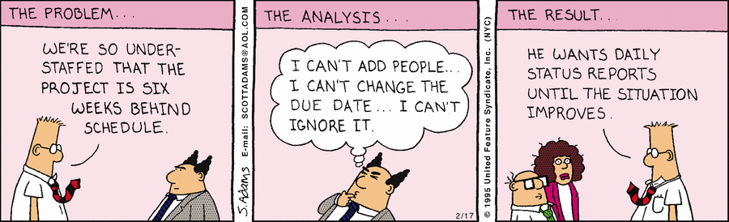
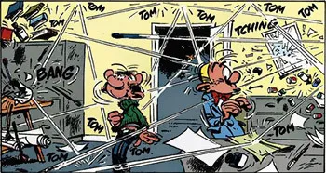
Status Reports
CSCI2340: Software Engineering of Large Systems
Steven P. Reiss

Slide 2
Bouncing Ball Videos

Slide 3
Project Status Reports

Slide 4
Project Meeting

