Slide 1
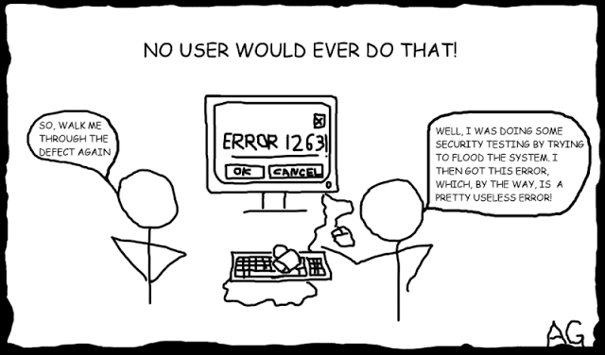
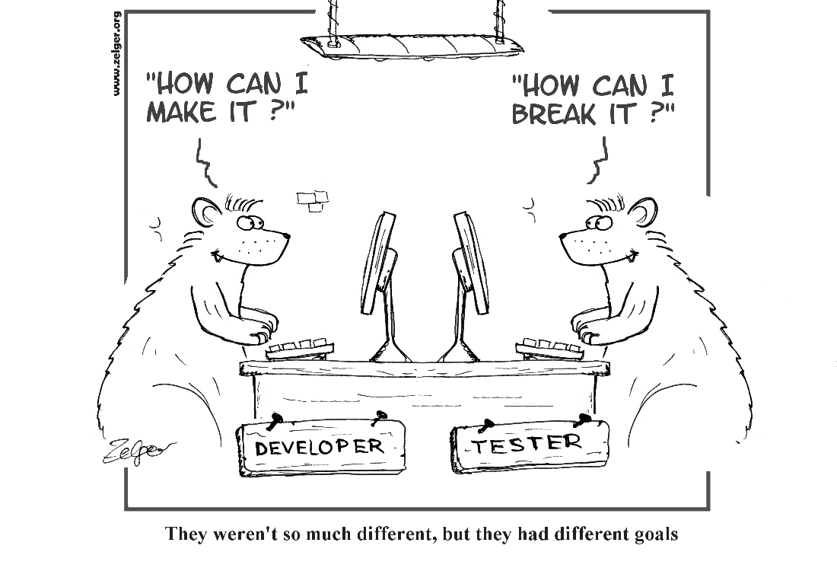
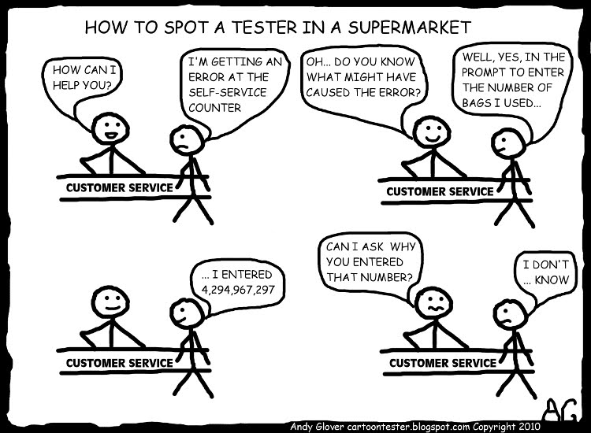
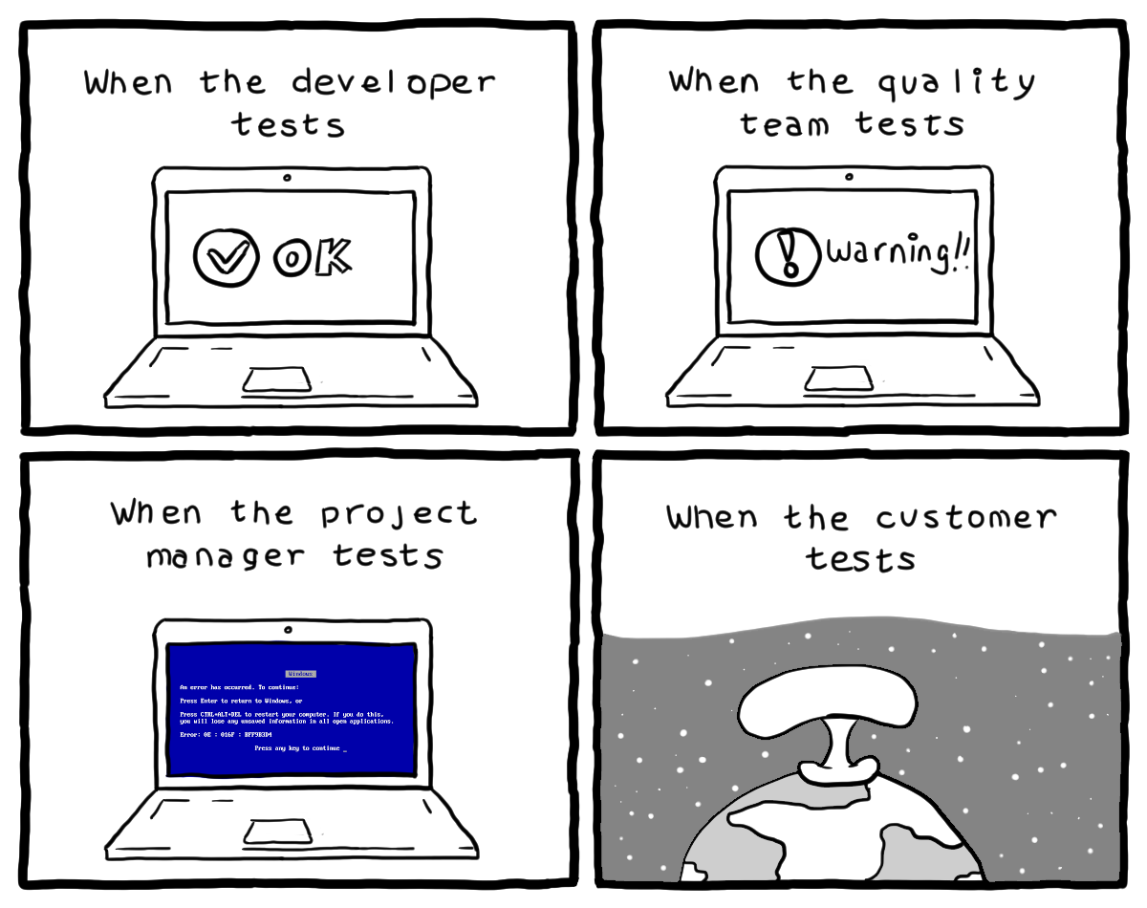
Testing I
CSCI2340: Software Engineering of Large Systems
Steven P. Reiss

Slide 2

Grading
Project Grading
  Based on the various presentations
  Based on reading code in the repositories
    Code should meet the criteria specified in the course
    Code should be designed to be usable many years in the future
    Code should be designed for maintenance and evolution
  Based on other items that should be in the repo
Program Grading
  Based on handing in all portions in in a timely fashion
  Possibly on reading code as well

Slide 3
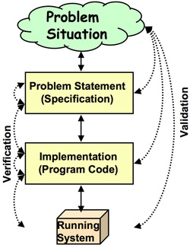
Verification versus Validation
Formal verification
  Proving that the program is correct
    Proof checkers are getting much better
  Requires a formal definition of correctness
    This is often harder to write than the program itself
Proving correctness of the code
  Requires modeling the program (finite state)
    Model might be in error or too abstract
  Can be very difficult
    Much can be automated, but not all
One practical solution is testing
  Another is partial correctness (covered after testing)

Slide 4
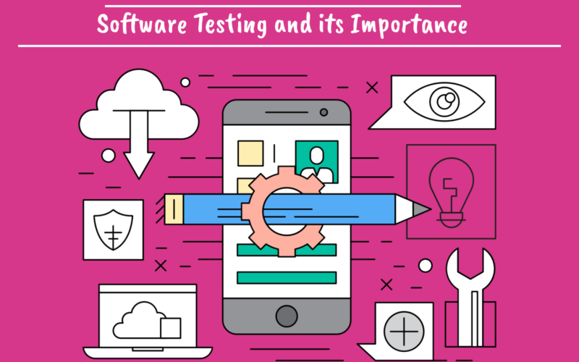
Importance of Testing
Software Testing could be a course by itself
  Terminology, tools, techniques
Who should find the bugs
  Programmer
  Company (QA team)
  End User
Testing can help tell if your program works
  What does “work” mean
    Does the program do what it should?
    Can the tester “break” the program?
    Will users “break” the program?
  Not whether it is correct
Being your own tester
  You should test all code before committing it
  Force yourself (and your team) to use the system (a lot)
    Dogfooding if appropriate
Notes:
Different companies take different approaches

Slide 5
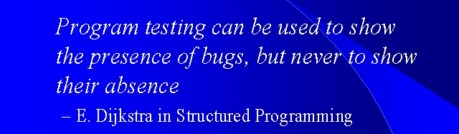
Limitations of Testing
Testing does not define the program behavior
  Doesn’t provide a semantics for the program
  Doesn’t provide specifications (formal or otherwise) for the program
  Doesn’t consider everything involved in correctness
  Doesn’t consider all possible inputs
Testing will tell you what is broken, not what works
  Give you confidence in the program, not guarantees
  Dijkstra: Testing can only show the presence of bugs, not their absence
A successful test case is one that fails
  Good testing tries to break the program, not validate it
  Good testers are devious and good at breaking things
  Assumption is that if it can’t be broken, it mainly works
Notes:
Steve Jobs and NeXT

Slide 6
EXERCISE
Consider the following program. It takes three input data values representing the three lengths of the sides of a triangle as parameters. The method returns a string indicating whether the triangle is scalene (i.e., no two sides are equal), isosceles (two sides equal) or equilateral (all sides equal).
Create a test set for this method
Write down your tests

Slide 7
What Test Cases Did You Develop?

Slide 8
Discussion
Do your tests include both the inputs and the expected output
How many tests did you create?
How many tests are needed to validate this program
  4 ... 165 depending on who you ask
  Depends on what you want to check, how much confidence you need
Did you test for …
  Valid cases (all three outputs)
  All combinations of 2 sides being equal
  Non-triangles (1,2,5)
  Invalid inputs (0 or negative values, non-numbers (NaN), large numbers, …)
  Approximate results (5.00000000000000001 vs. 5)
And this is a trivial program …

Slide 9
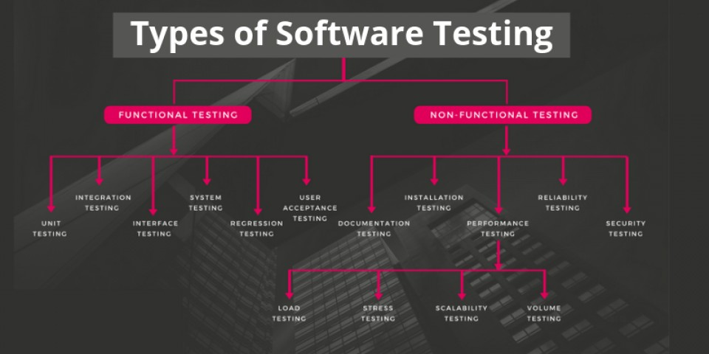
Different Types of Testing
Testing can be done at various levels
  From individual function or method to system
Testing can be done for different software aspects
  Functionality
  Security
  Performance
  Useability
  Installation
  Compatibility

Slide 10
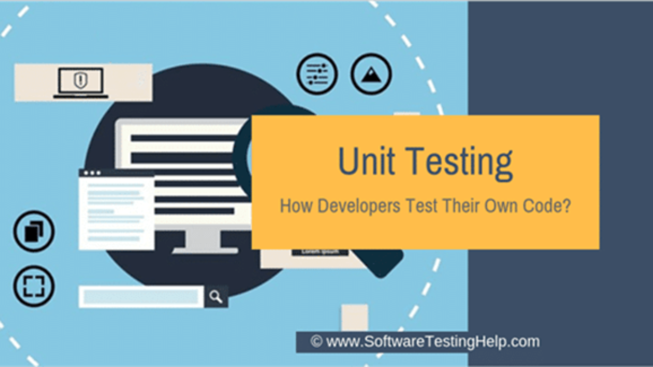
Unit Testing
Unit testing: methods or functions
  Checking individual methods or functions
  Junit for Java, similar systems for other languages
  Sometimes worth doing for complex standalone methods
  Worth doing for libraries and common code
  Worth doing to prevent regressions (error history)
  Difficult to do for much of an integrated system
Unit testing: classes
  Methods generally don’t function outside of their class
    Functions often don’t function outside their file
    Need to set up the class to test a method
  Probably want to test multiple methods or functions at once
    Add and remove from a structure…
  Still can be difficult in an integrated system (classes rarely operate in a vacuum)

Slide 11
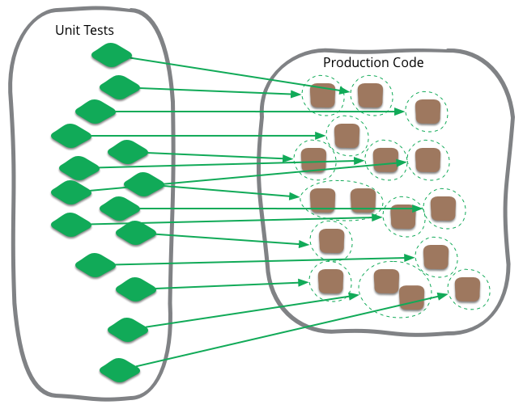
Unit Testing: Packages
Classes generally don’t operate in isolation
  They require other classes in the package and system
Need to set up a whole environment to test them
  Multiple objects of multiple types
  Then you can test individual classes and methods
Junit provides some hooks for this
  @Before, @BeforeClass
  @After, @AfterClass
Provide a set of tests for a particular package or directory
  Including package, class, and method tests
  Early on you need to test functionality without other packages
    Mocking, stub implementations, tracing interactions
    This is where an interface-based design is helpful
  Should be done within the package (so methods don’t have to be public)
    Test class or set of test classes either in same directory or in parallel directory (maven)
Useful for testing your individual components

Slide 12
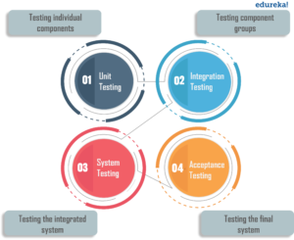
Integration Testing
Multiple people and packages need to work together
  Lots of potential errors
    Wrong interface assumptions
    Different interface assumptions
  Always takes longer than anticipated
Testing the interactions between packages
More focused on functionality than problems
  Can be higher-level package tests with actual packages
  But should include error conditions as well
    Note that these should be handled by defensive coding
Different from interface testing
  Testing all the calls in an interface
  Especially with RESTful interfaces
  This can focus on finding problems
  Generally included in package testing

Slide 13
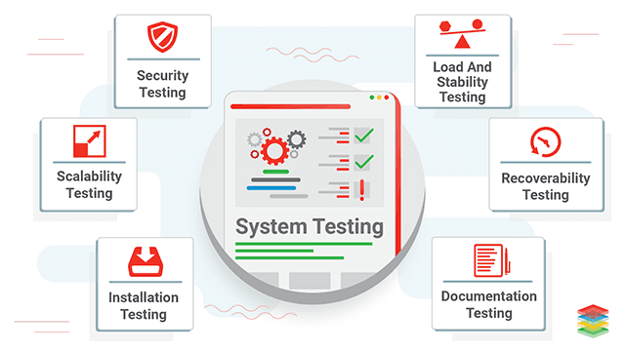
System Testing
Testing the whole system in operation
Involves running through your scenarios
  This is the minimum you need to do
  Should include all scenarios, with their variations
  Include error-handling with the scenarios
  Automated if possible
Additional tests based on
  User reported problems
    Often these can be view as unit tests (with some work)
  Problems found during debugging
    Again, these are often viewed as unit tests
  Additional scenarios
    Based on user experiences

Slide 14

Dogfooding
Using what you are writing is a good habit to get into
  Especially if you use it to assist in its development
  Force yourself to use it even when it is a bit buggy
  Provides testing without formal test cases
  Provides experience
    User experience (UX), performance, bugs, missing features, …
  Provides tests of latest version of the system (prerelease)
  Run your program from a debugger to catch bugs as they occur
  Your projects can do this
    Speech, IoT, Accessibility, LLAMA
    UI Gen, DJ, Agentic
Note that you won't be as critical as real users
  You are too tolerant of your own mistakes
  You know how difficult it might be to fix something
  But you can use it when others cannot
  Note potential problems even if you don’t fix them
    Write them down so you remember them

Slide 15
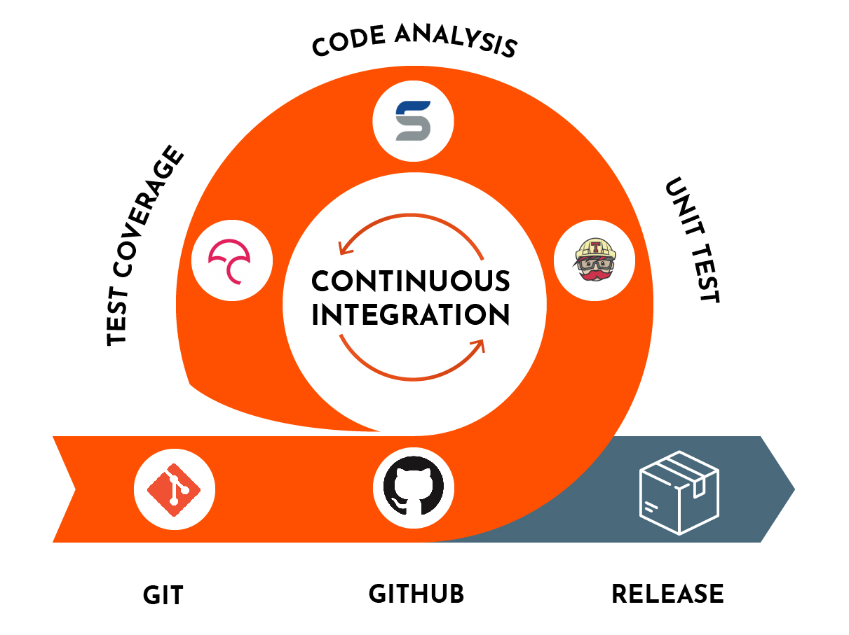
Continuous Integration and Testing
We’ve talked about this before
  Using a single branch
  Merging on a regular (daily) basis
  Running the experimental version of the system
It also involves testing
  Run all the test cases with each merge
  Running tests is part of the merge process
  Having an adequate set of tests is part of the process
We’ll look at this in more detail next time

Slide 16
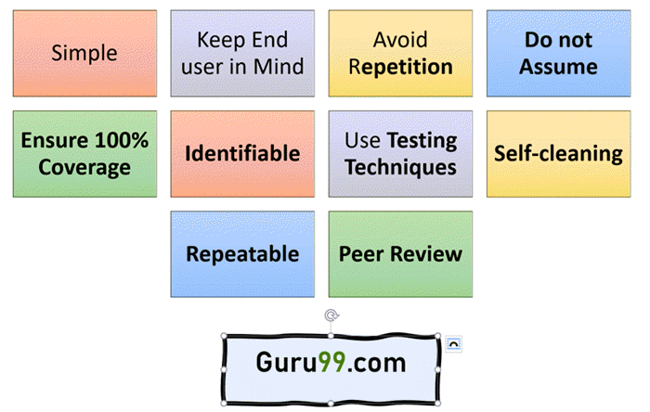
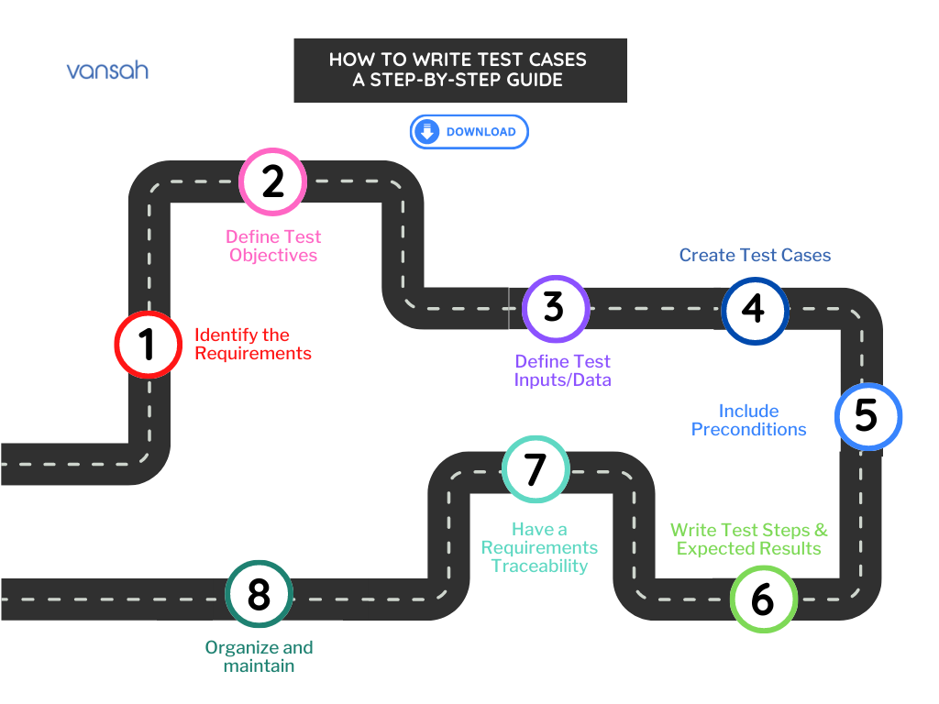
Creating Test Cases
Creating good tests is difficult
  Can be as much work as writing the original code
  Difficult to think of all possible tests
  Difficult to ensure that the tests cover all possible cases
  Difficult to check the results accurately
Good test cases are designed to break the program
  This is puzzle solving again
  How can I break this program
  What can I do that is unexpected
  What are the cases that will cause problems
Black box versus white box testing
Tools are being developed to automate this
  And best practices
  Covered next time
Problem: What is a GOOD set of tests?

Slide 17
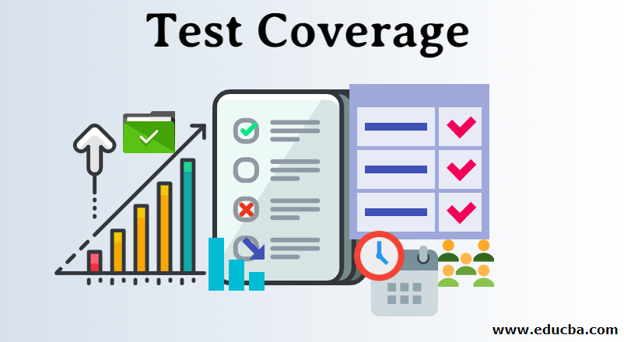
Coverage
How to measure the effectiveness of a test suite
  Has it found all the bugs
  Has it missed any obvious bugs
  How confident in the program are you if it passes the tests
A concrete measure of this is coverage
  What part of the program is covered by the test set
    Covered means executed by some test in the set
    Any code not covered hasn’t been tested
  But what does coverage mean
Other measures are also used
  Coverage is only as helpful with quality tests
  Mutation testing (next time)

Slide 18
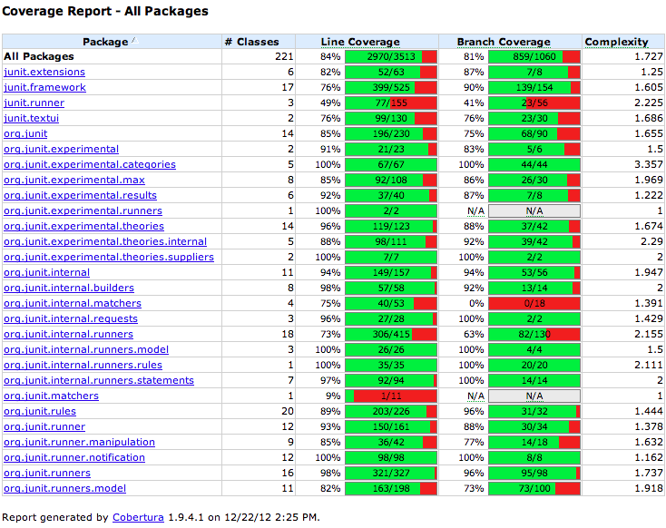
Types of Coverage
Method coverage
  Every method is executed by some test
  Is this sufficient?
Call coverage
  Every method call is executed by some test
Line coverage
  Every line of code is executed by some test
  Better than method coverage
  Not always achievable (defensive coding)
  Typically, this is what is thought of as coverage
    What the coverage user interfaces show

Slide 19
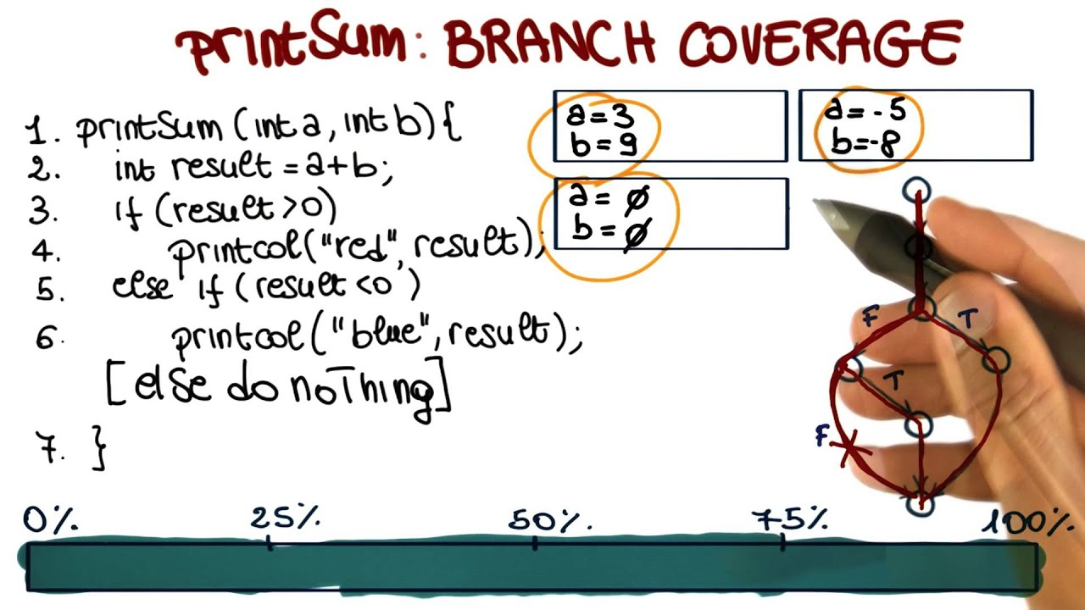
Types of Coverage
Statement coverage
  Every statement in the code is executed by some test
  Handles cases of multiple statements on a line
    if (<condition>) <statement>
      condition false implies line coverage, not statement coverage
Branch coverage
  Every alternative in each branch is executed by some test
    if (<condition>) <statement>
      condition true implies statement coverage
      Branch coverage implies a test with true and a test with false

Slide 20
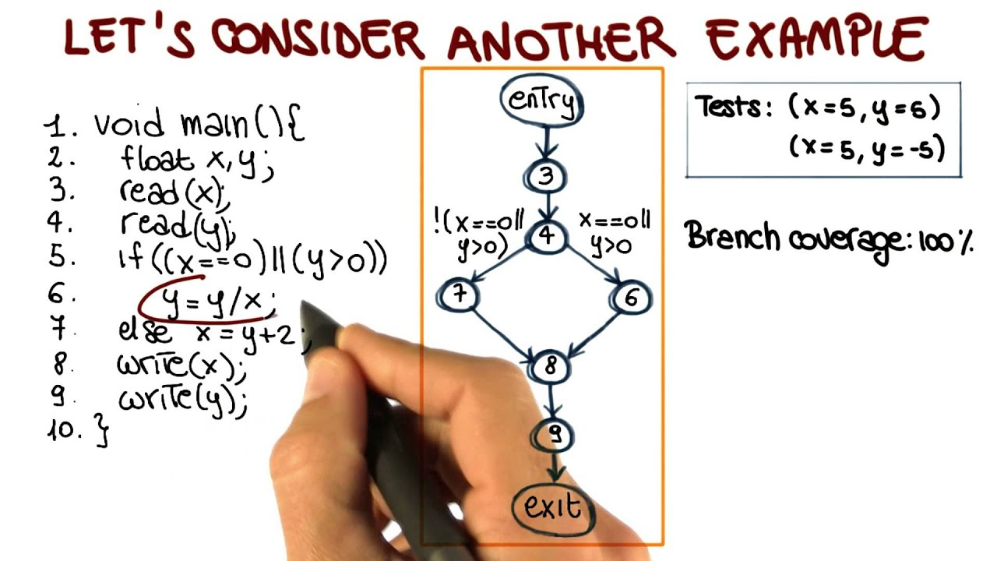
Types of Coverage
Condition coverage
  Every condition in a branch is covered with true and false
  Handling && and || conditions
    if (x && y && z)
      Four cases: x false; x true, y false; x,y true, z false; x,y,z true
  Statement coverage at the assembly level
Path coverage
  Every path through the program covered by some test
  Sequences of conditions
    Ten sequential independent if statements might yield 1024 paths
  Talked about, but rarely used

Slide 21
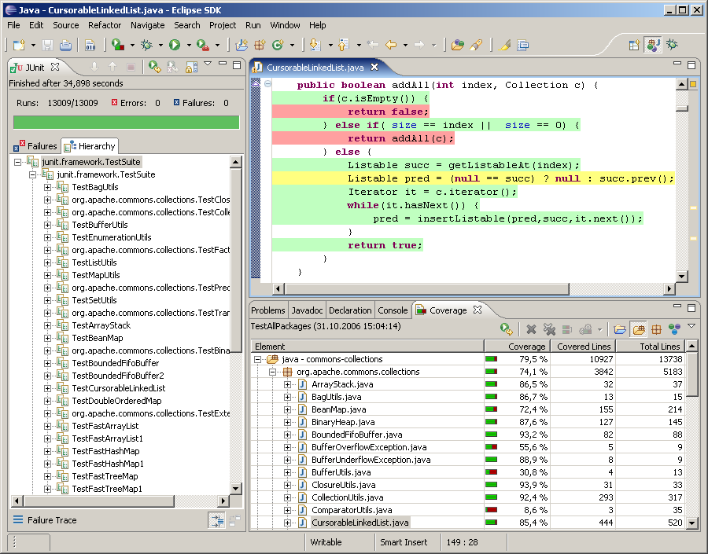
Getting Coverage Information
Most IDEs can provide coverage information while testing
  Eclipse, IntelliJ collect coverage data (line, branch/condition)
    You must run for profiling, not for debugging
    VS Code has plugins that can do this
  Provide a user interface to show covered lines
  prof and gprof for C/C++ programs (outside of IDE)
Code Bubbles automatically provides coverage for tests
  Computes line, branch, call coverage
  Uses line coverage for fault localization
  Uses coverage to note when tests should be rerun
  No current user interface otherwise
Code Bubbles Test management

Slide 22
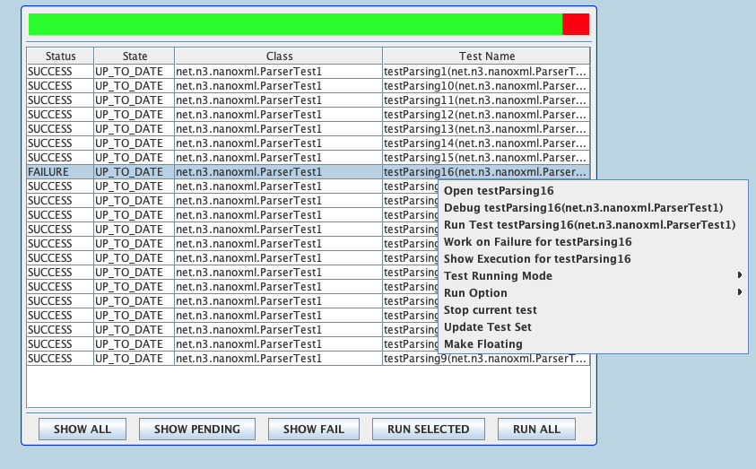
Code Bubbles Test Management

Slide 23

User Interface Testing
Testing the user interface
  Testing if the functionality works
  Testing the appearance of the interface
  Testing usability of the interface
Testing with actual users
  Dogfooding
  Alpha and beta testing
  A-B testing
Testing functionality with simulated interaction
  Test case runs an Input script
  Tool support: Selenium and similar packages
Testing different platforms (browsers, mobile platforms, window sizes, …)
Testing accessibility and internationalization
Testing installation and platform compatibility

Slide 24
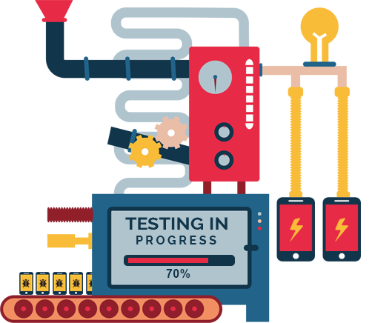
Classic User Interface Testing
Lab-based testing
  Recruit (and pay) potential users
  Train them on the system
  Have them use it in a lab setting
Record what they do
  Have them talk through what they are doing
  Save video and transcript
  Analyze behavior (errors, confusion, # clicks, timings, …)
Survey the users after
  To understand what they did and why
  To get other’s opinions on the user interface

Slide 25
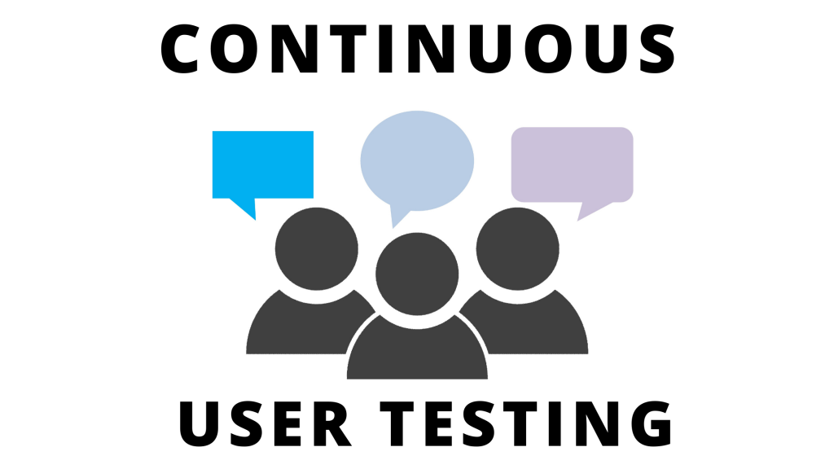
Continuous User Testing
Gather information from a running system
  Example: command sequences, # errors, # undos, …
  Example: faults that are hidden from the user
  Example: timings and performance
Can be augmented with questionnaires
  Simple: do you like/dislike the system
  More advanced: full questionnaire with feedback
Dogfooding as a form of continuous testing
  But you need to note and report errors
A-B testing
  Some users run version A, some run version B (chosen at random)
  Get feedback, monitor errors, timings, etc.
  Need a significant user base

Slide 26

Test Maintenance
Tests need to be kept up-to-date
  Need to evolve as the code evolves
  Need to be augmented as new problems are found
If you don’t run tests all the time
  The tests eventually become useless
  Or require more work than they are worth
Maintaining tests can be a lot of work
  If you have lots of tests
  If the tests weren’t written well and documented
  If you haven’t checked the tests for a long time
Evolve tests as you evolve code
  This is implied by continuous integration

Slide 27
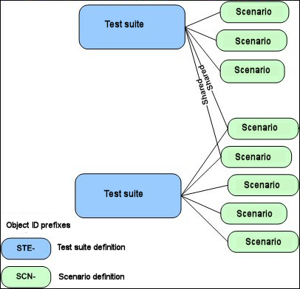
Test Suites
A test suite is a set of tests
  All the tests for all components of the system
  Junit : run all tests, all tests in a class, a single test
Problems with test suites
  Serious testing can yield large test suites: 1000’s of tests
  Running all of these can take hours or days
  Check the results of all the tests can be difficult

Slide 28
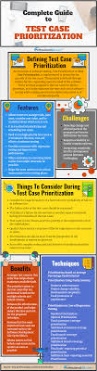
Test Prioritization
Problem: Running a test suite can take hours or longer
  Lots of tests, some tests can be time consuming
One approach is to order or prioritize the tests
  Test that are likely to fail are done first
  Can be based on what code has changed
    Tests that cover that code should be tried first
    For some changes, this might be large
  Can be based on other criteria
    E.g., tests that failed recently should be tried first
Only run tests affected by changes
This has been an area of active research

Slide 29

Test Minimization
Minimize the size of the test suite
  Coverage provided by multiple tests can overlap
  Doesn’t mean the tests are identical
    But often means the tests are redundant (not always)
Find a minimal set of tests that achieve the same coverage
  Same as the original set
  Based on type of coverage one is trying to achieve
This is NP-complete; but good approximations exist
This has been an area of active research

Slide 30
Programming Assignment
I want to do a code review next class
  If you might like your program reviewed
    Please send it to me (pointer to a repo is good enough)
  I will select one submission
    Make sure it is anonymous
    And provide feedback on it
  Do this today at some point (or before the weekend)
If I don’t get anything suitable, I will pick one at random

Slide 31
PROJECT
Should have individual components working next week
  Want to have a minimal system running fairly soon
  Status reports were encouraging in this line
Make sure you have the framework for testing
  Include a script to run all the tests
    (ant or maven or gradle); inside or outside IDE
Add information on how to compile and test
  Should be noted in README files in your repository

