Slide 1
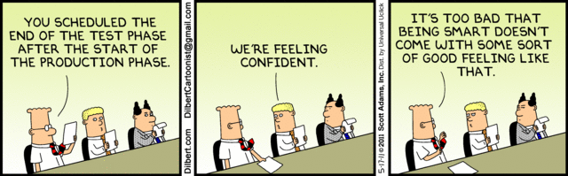
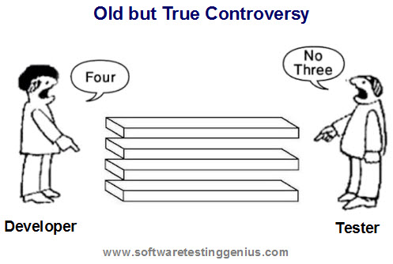
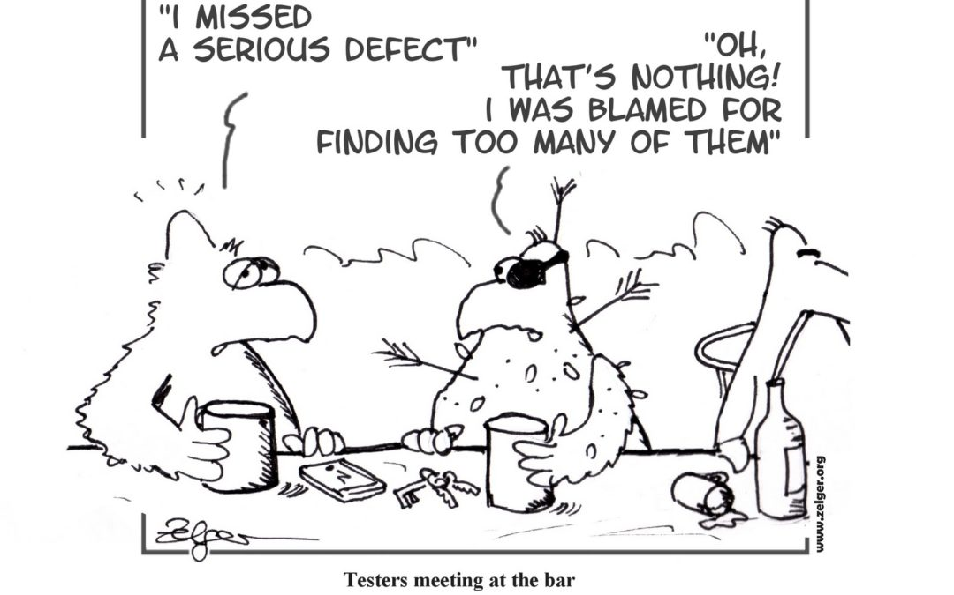
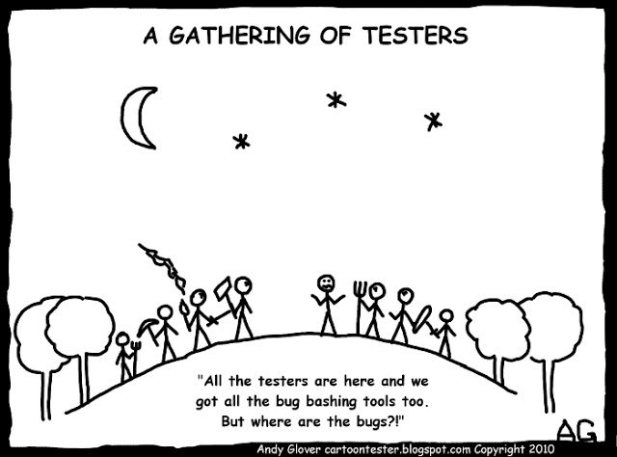
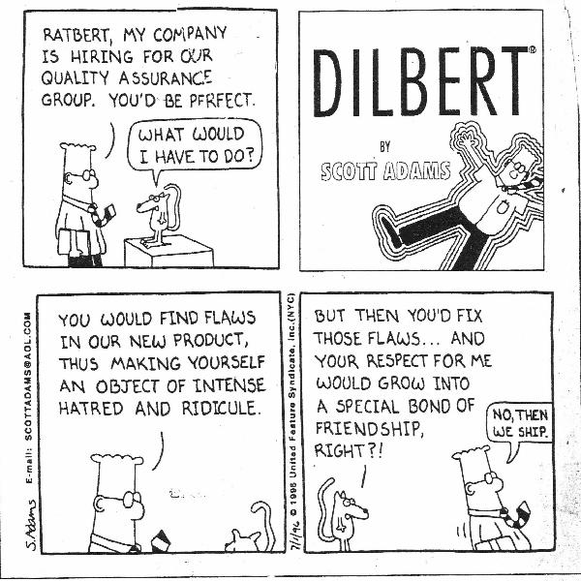
Testing II
CSCI2340: Software Engineering of Large Systems
Steven P. Reiss

Slide 2
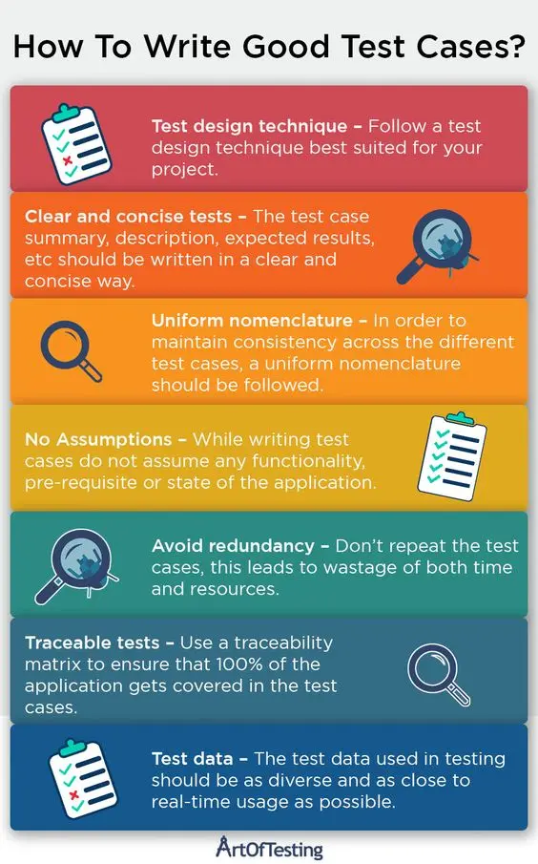
Creating Test Cases
White box vs Black box testing
  Black box: only the interface is known
    Tester must assume something about the code
  White box: code is available
    Tester can read the code to find potential problems
    Much easier and more practical
Basic Test Cases (programmer created)
  Test basic functionality to see if program works
    Needed to assist development
    Can run through typical scenarios
    Test extended functionality as it is added
    Make these permanent
  Tests to ensure the program can handle bad inputs
  Tests to catch possible errors
    A successful test case finds a bug
  These are only a small fraction of a test suite

Slide 3
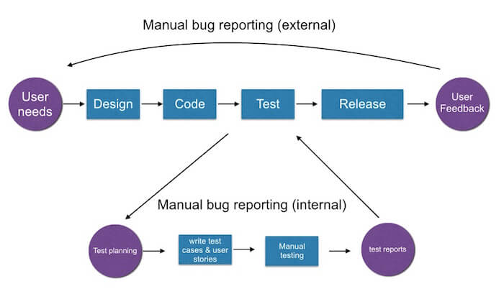
Creating Test Cases
Each user reported bug should have a test case
  Unless the bug and fix are trivial
  To duplicate & fix the bug (and check the fix works)
  To prevent regression
  Most tests in a suite are of this type
  These can be from actual bug reports
  Or from automatically recorded stack traces
Creating test cases to ensure complete coverage
  You want to ensure all code is tested
  Based on type of coverage desired
  Additional tests are generally needed to achieve this

Slide 4
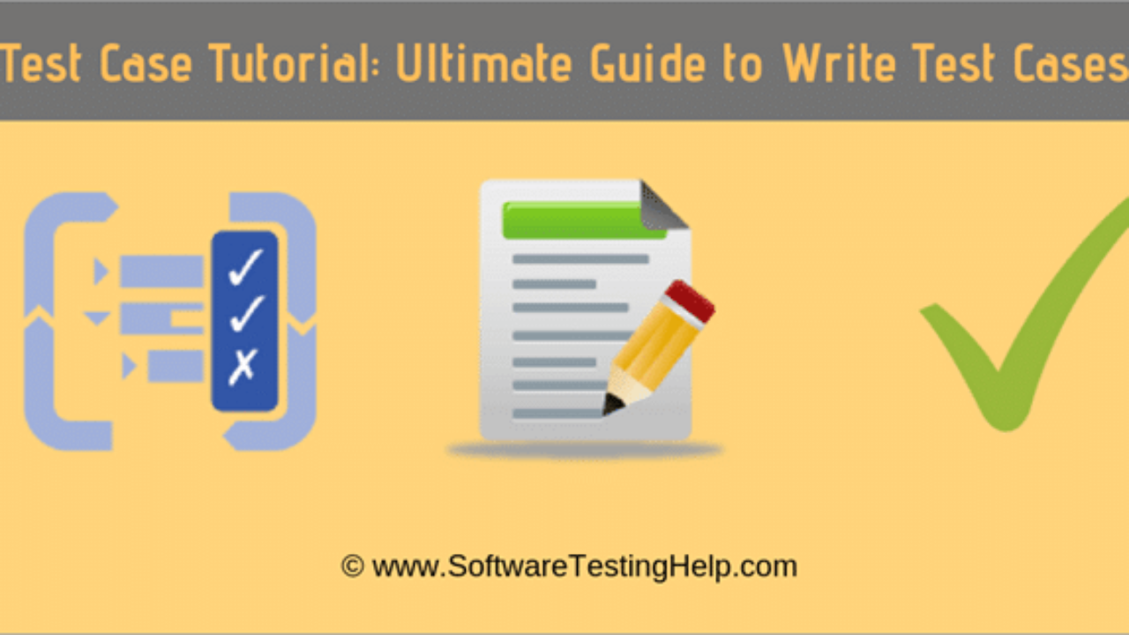
Creating Test Cases
Creating test cases is a lot of work
  Finding appropriate arguments to get coverage
  Finding arguments that might cause the system to fail
  Finding arguments that duplicate a bug report or stack trace
  Setting up the appropriate environments
  Checking the results
  Programmers get sloppy (tests are buggy, not the code)
This leads to work on automatic test generation
  With a variety of different approaches
  Commercial and research-based systems exist
  LLMs (e.g., Claude, ChatGPT) can do some of this (but not all)

Slide 5
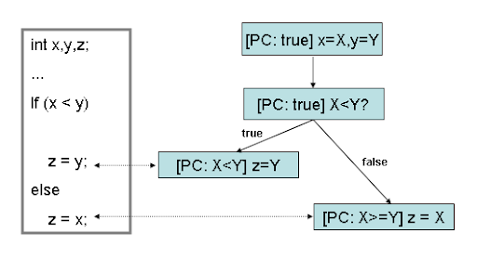
Symbolic Execution
For each coverage point (line/branch/condition)
  Determine constraints on variables needed to get there
  Trace constraints back to the start of the function
  This gives you constraints on the test inputs
Construct new inputs based on these constraints
Often difficult to do
  The problem in general is unsolvable (halting problem)
  Works best with numerical routines and inputs
  Can use shape analysis for objects
  Often fails

Slide 6
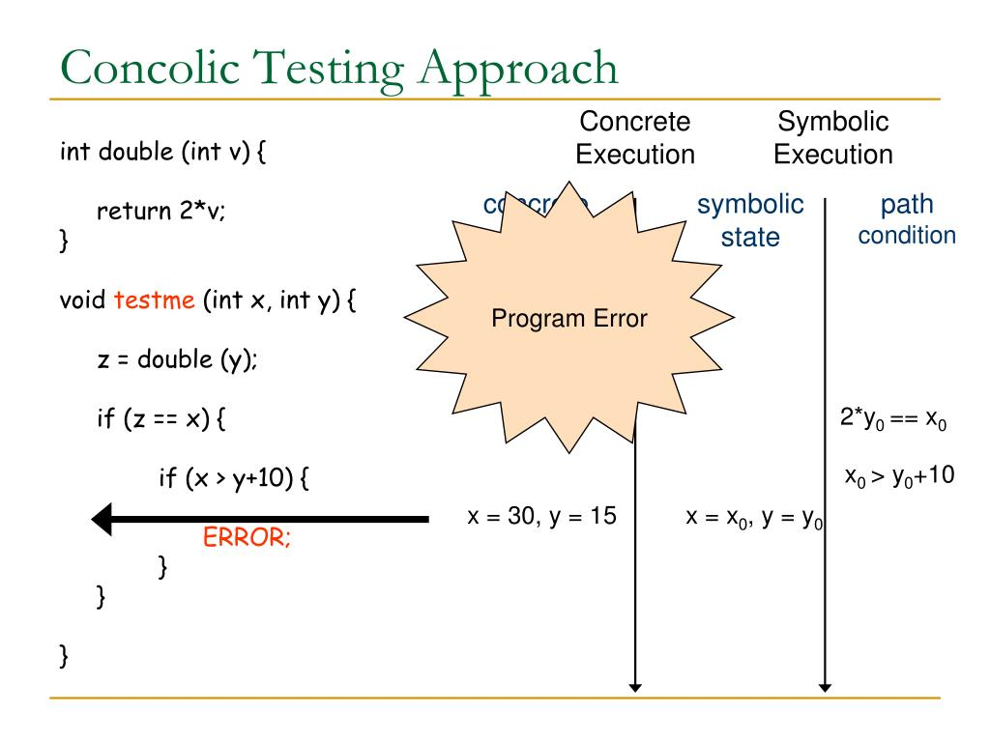
Concolic Testing
Combination of concrete testing and symbolic execution
Do symbolic execution along a concrete execution path
  Easiest when starting with a failed execution
    Given values at that point: compute values at the start of the function
  Forward analysis
  Maintaining constraint expressions for each variable
More practical than pure symbol execution
  But not as complete
  And not necessarily more useful
Test generation tools
  EvoSuite, qodo, …
    Work okay, but not great
  But is this what you want?
    What is the test output; what is successful?
    Is the test an important one?

Slide 7
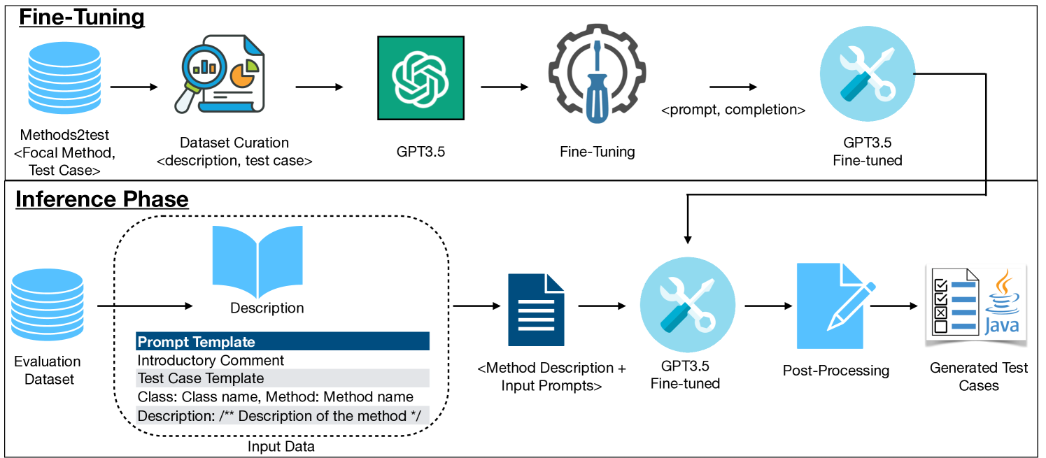
Using LLMs to Create Test Cases
You can ask a LLM to create test cases for a method
  It can do a reasonable job of creating basic tests
    Normal functionality
    Edge cases
  BUT
    It can not achieve strong coverage
    It can provide the wrong outputs
    It is more geared to method rather than system testing
This will improve in the future
  But still probably won’t be complete

Slide 8
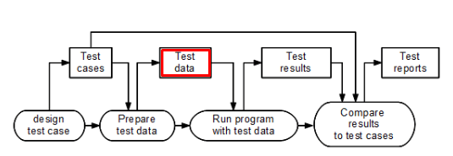
Creating Tests for a Bug
This is a standard part of debugging
  Much of a test suites is developed this way
Research: how to automate this
  If a bug report has a stack trace
  If the bug report has enough information
  Using concolic testing techniques
  From a debugger situation
ROSE test generation (using debugger & input)
  ROSE is our automatic program repair tool
  ROSE knows the failure symptom and the environment
    Identifies what portions of the environment are needed for the test
    Environment can be queried via the debugger at the time
  Should be able to generate a test case based on this
  Difficulty is recreating the environment using only accessible methods
  Might not know the correct result (other than no exception)

Slide 9
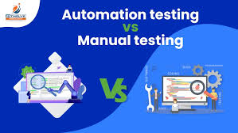
Testing Interactive Programs
Problem
  The test is a sequence of interactions
  You don’t want to have a user do the interactions
    Although this is done
  You don’t want to redo the test if the UI is rearranged
    Different window sizes, visual updates, …
Various solutions exist
  Generating RESTful calls without a UI (curl)
  Tracking and repeating user interactions
  Writing code to emulate a user using widget accessors

Slide 10
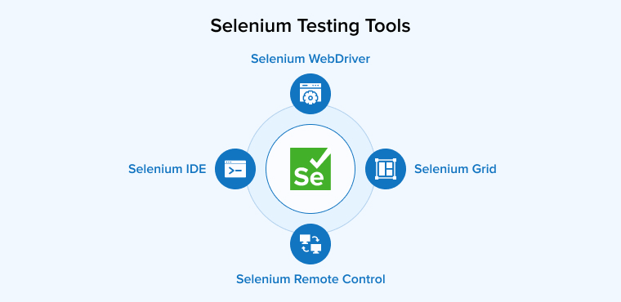
Tools for Interactive Testing
Tools exist to help with interactive testing
Selenium is the one I’ve seen used the most
  Designed for web pages and the browser
    Appium/Selendroid extend it for mobile devices
    Similar tools exist for desktop applications
  Can record a sequence of user interactions
    Generates a program that identifies widgets by CSS accessor
  User can write programs to emulate the interactions
    Starting with recorded or separately
    Separate functions for common interactions
  Result is a testing framework for the application
Flutter/Dart: built in tool + several alternatives
Other tools: Squish, Sikuli, …
Research: generating tests for RESTful calls based on front end

Slide 11
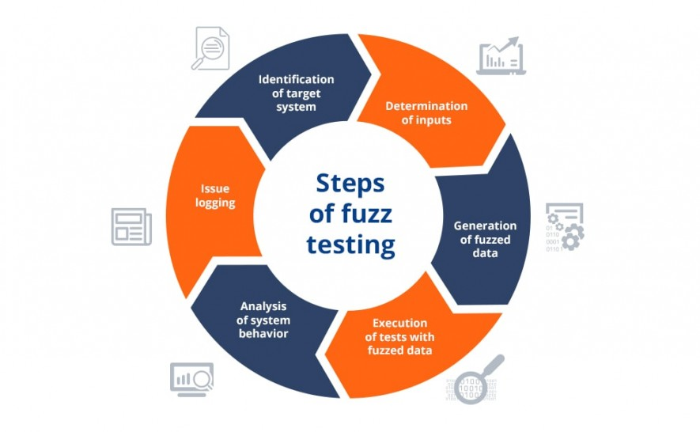
Fuzz Testing
Another approach to automatic test generation
Generate invalid, unexpected or random inputs to a routine
  Try out lots of values to get a function to fail
  Generate tests where the function fails
Like letting naïve users try the software
  Cat on the keyboard
  Freshmen attacking FIELD
  5-year-old at the keyboard

Slide 12
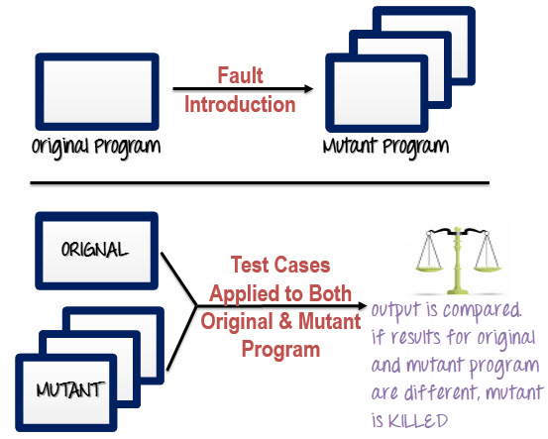
Mutation Testing
Change the code slightly (semi-random mutations)
  Standard set of possible mutations
    E.g., invert a conditional
  Check if the test cases can detect the change
    This helps evaluate the test suite
    Note that many obvious errors are not detected
Find test cases that can detect the change
  This broadens the test suite

Slide 13
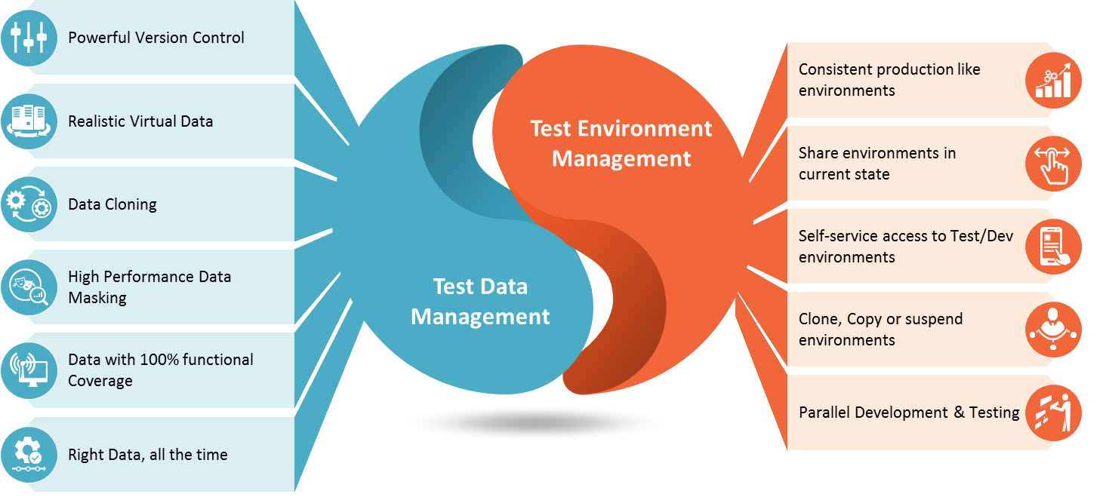
Test Environments
How are you going to run your tests?
Testing and production can be quite different
  Production database with real people, data
  Has external effects
    Charging credit cards, sending data to warehouse, causes things to be shipped
  Accumulating usage data for business purposes
  Requiring external web browser or talks to real hardware
  Changing files in the file system
All these might not work in a test environment
  And you don’t want to test new code in production
  Production code needs to be tested and robust
  Can’t afford to break hardware while testing

Slide 14
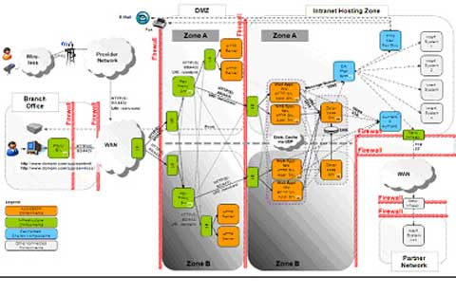
Test Environment Contents
Separate git branch from the production system
  Or just don’t pull onto production host until version is stable
    And test from current version on another host
  Or create the branch when production is ready (it will still change)
    This is what is typically done in active systems
  Or run/compile time flags
  Or detect what machine it is running on (or who is running it)
Separate database
  Preferred over special items in production database
Separate hooks for external features
  Payments, real-world consequences
  Simulation of outside hardware
  Simulation of the real world (outside, real-time events)
Might want to cache outside queries
Separate machine to run on

Slide 15
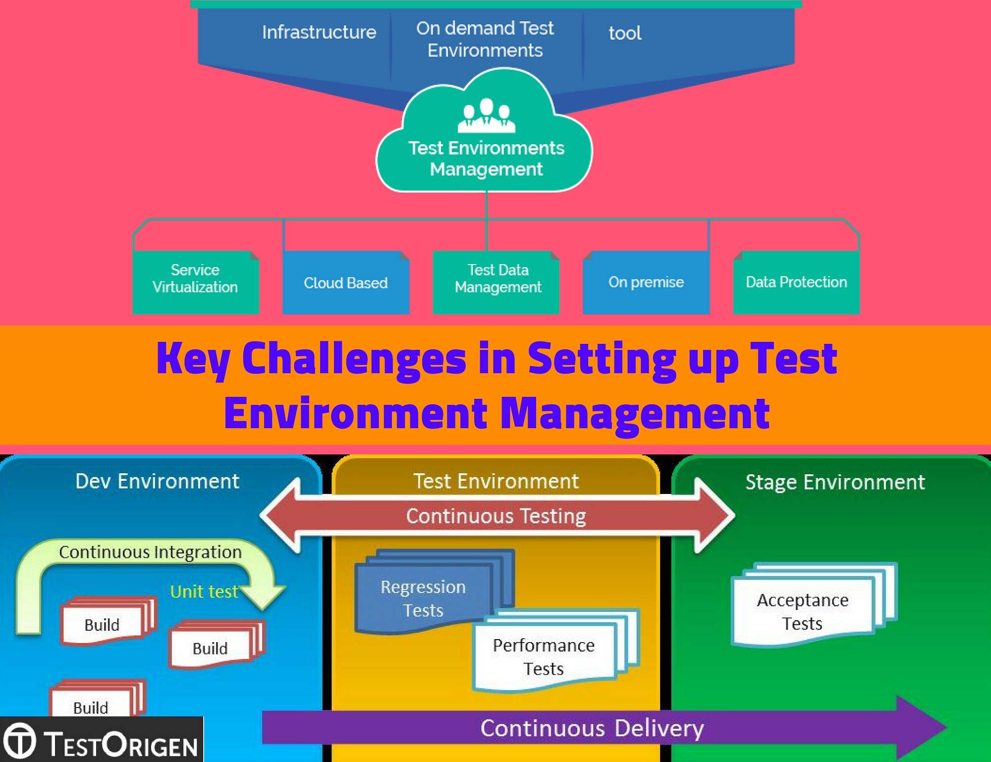
Setting up a Test Environment
Should have a script to do this
  Restore the test file system to a known state
  Restore test database to a known state
  Set up any other environmental data
  Even if you only use it for running a test suite
Some can be done with the individual tests
  Using @Before, @After, @BeforeClass, @AfterClass
  Not ideal for file system, database setup
Handling multiple machines and processes
  Might require test harness or coordinator

Slide 16
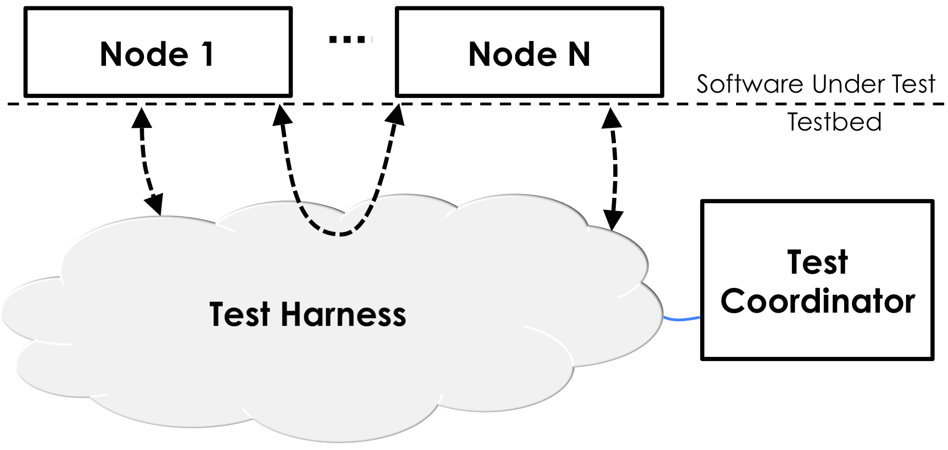
Testing System Components
Want to check calls to other components are right, but not have a real effect
  Want to test a web back end without using a browser
  Want to test web front end without using the back end
  Want to test payment without paying, shopping without buying
  Want to test SHORE without trains
  Want to test Pinball without the pinball machine
Rather than trying to use actual code
  Create code that mimics the actual code
  Might be simple (accept a particular card number, reject others)
  Might check that behavior of the system is correct
  This is called MOCKING
  Same issue when system pieces are missing
  Some external libraries do this for you already (Stripe, for example)
Simulation is another alternative
  Especially for hardware systems and real-world interaction
  Simulated pinball machine; simulated smart house

Slide 17
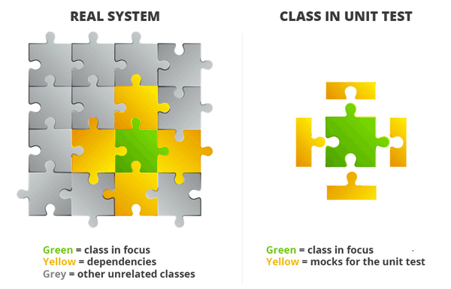
Mocking
Mock component is generally much simpler than actual one
Provide reasonable returns, but generally fixed return values
Provide hooks to handle the whole interface
  With minimal responses unless needed for testing
  Provide minimum functionality needed to support tests
Methods that take inputs should check their values
  This is part of testing
Providing logging for additional test validation
Frameworks exist to help create mocking code
  Mockito is the standard for Java
  Easier, but not necessarily recommended in the long term

Slide 18
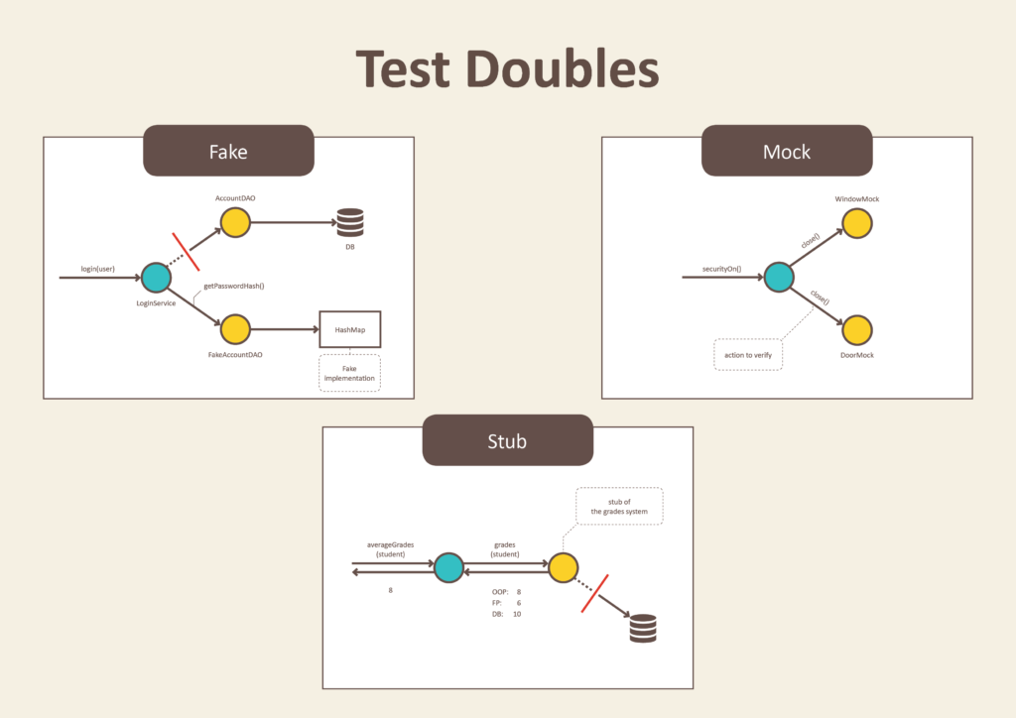
Mocking
Mocking code is not throw-away
  Especially mocking for testing
  Take care in writing it as you would system code
  Buggy mocking code will cause bad testing
    And it is likely to be buggy
  Use established coding practices
Might want to create mocking code for development
  For portions of the system not yet implemented

Slide 19
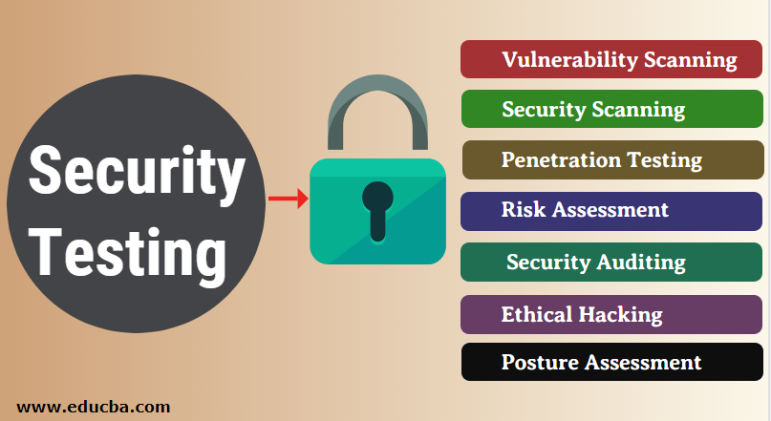
Security Testing
No system is totally secure
  Need to test for potential security problems
Checking for known security problems
  C/C++: checking for buffer overflow possibilities
  Web Apps: SQL injection, XSS, DoS and other attacks
Dynamic security checking tools exist (usually web-oriented)
  Machine vulnerabilities
  SQL injection attacks, Cross-site scripting, Denial of Service, server configuration
You should think about applying these to your system
  Ethical hacking
Static security checking tools exist (verification) is often done in addition to testing
  Partial correctness formal methods
    Checking buffer overflows
    Checking tainted data
    Checking program states
  Since you want to check ALL inputs

Slide 20
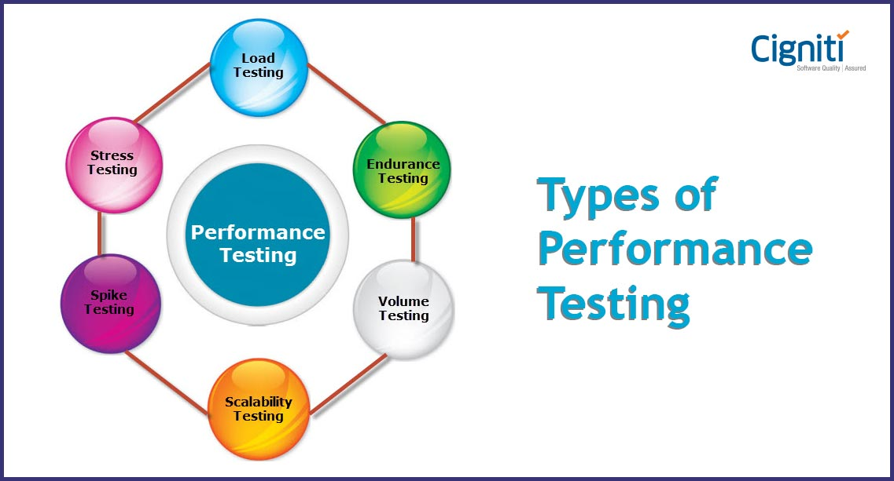
Performance Testing
Performance can be important
  Resource utilization (CPU and memory)
  User perception
    100ms makes a noticeable difference in usability
  Ability to handle large data, large loads, complex cases, …
Stress testing
  What happens if files are large (user uploads 100G file)
  What happens if you have 100,000 users
  How does the system degrade (or does it crash)
Notes:
Start 2nd lecture here?

Slide 21
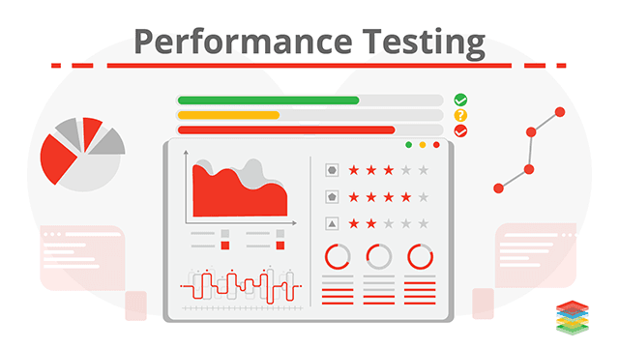
Performance Testing
Typically, performance doesn’t matter
  10% of the code uses 90% of the time (5/95)
  Most of that 10% is outside of your control
    Necessary functionality
    Inherent to the application
Performance only matters if there is a problem
  User interface is too slow
  Using too many resources (memory, CPU, disk, …)
  Otherwise, simplicity and ease of coding reign

Slide 22
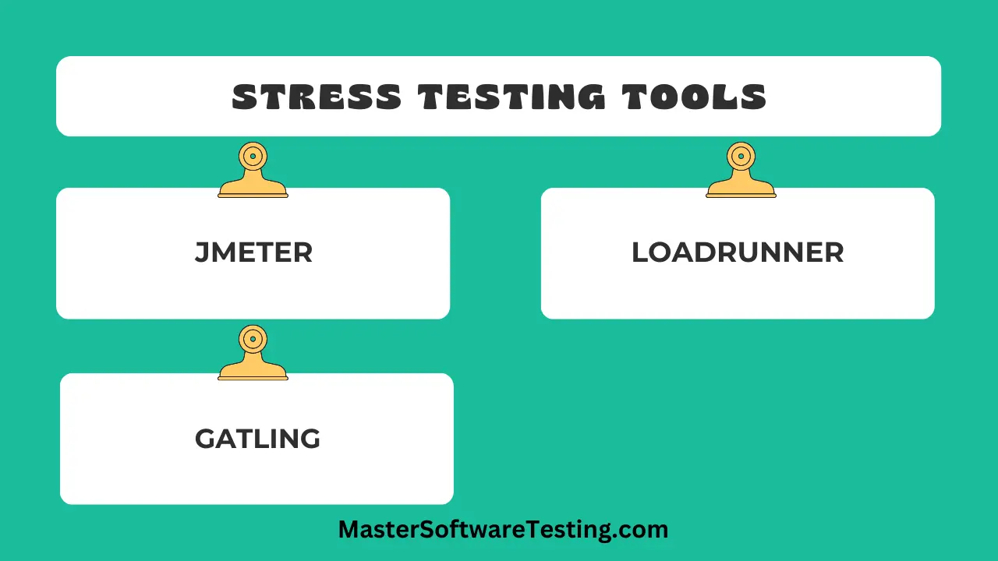
Detecting Performance Problems
User interaction performance
  What users perceive (what you perceive)
  You can get timings (video and look at frames)
    Browser timings for web applications
Application performance
  Time for specific operations
  System view of CPU, memory, disk I/O
Multithreaded performance
  % CPU used vs expected (improvement from multiple threads)
  Tools to understand behavior: locking, bottlenecks, …
Stress testing
  Simulate the load: jmeter and similar tools

Slide 23
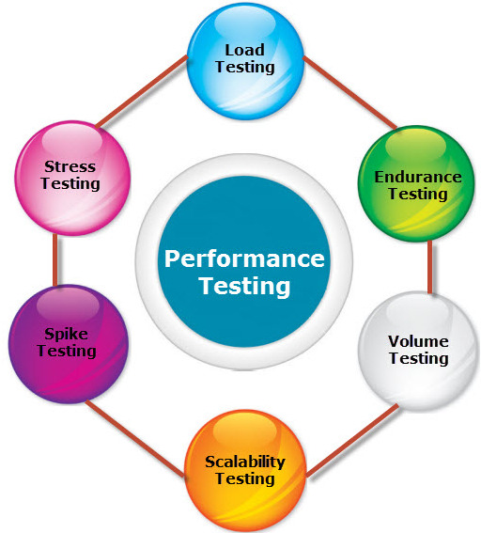
Creating Performance Test Cases
Normal test case that takes too long
Typically, not done as part of test suite
  Can be done to debug the performance problem
    Create a test for this purpose
    Might not be considered part of test suite
  Can have a test case that times out to fail
    But running on a different machine …
  Might be non-deterministic
    You might need to run it a lot of times

Slide 24
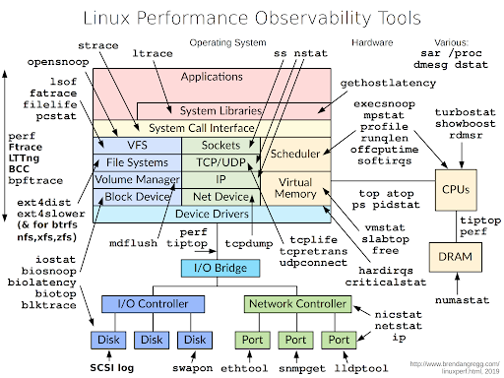
Performance Analysis Tools
UNIX / LINUX: prof, gprof
  For C/C++ and native code
  prof gives time & count for each function
  gprof gives these for each function + caller-callee pair
    Get an approximation to why a routine spends its time
TypeScript
  Chrome DevTools
Standalone Java tools
  Jprofiler, VisualVM, jconsole
  Dymon
These provide limited information
  Especially about multithreaded problems

Slide 25
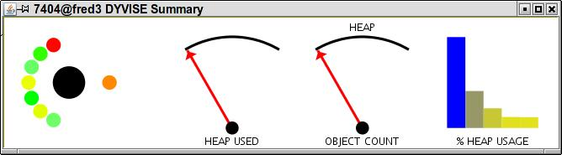
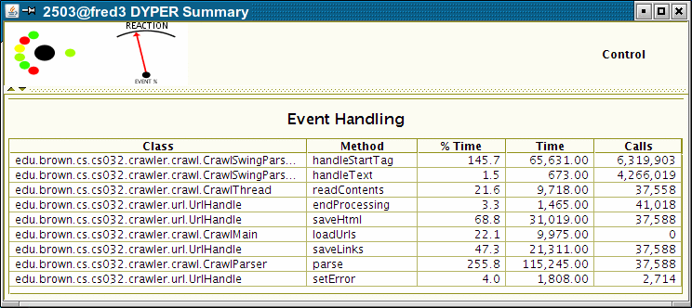
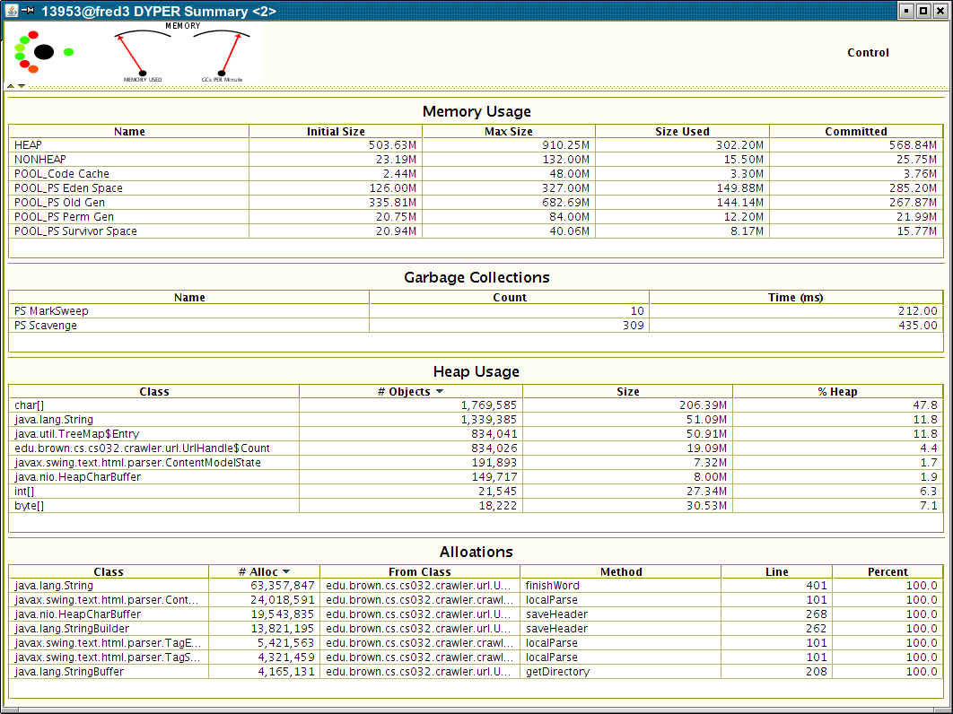
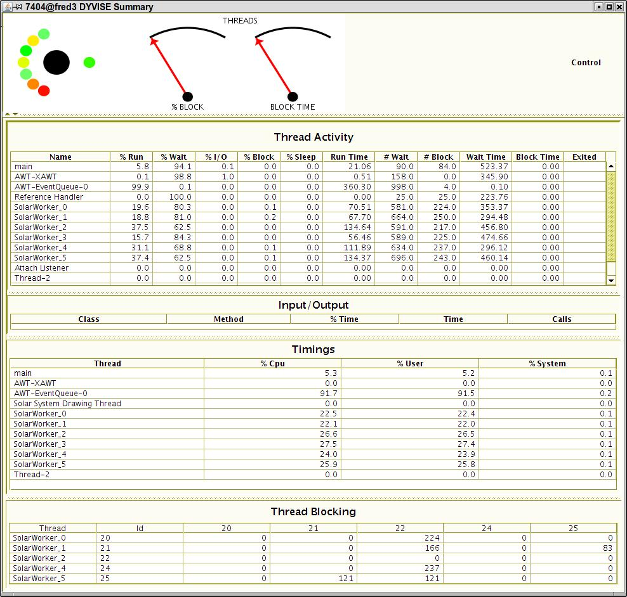
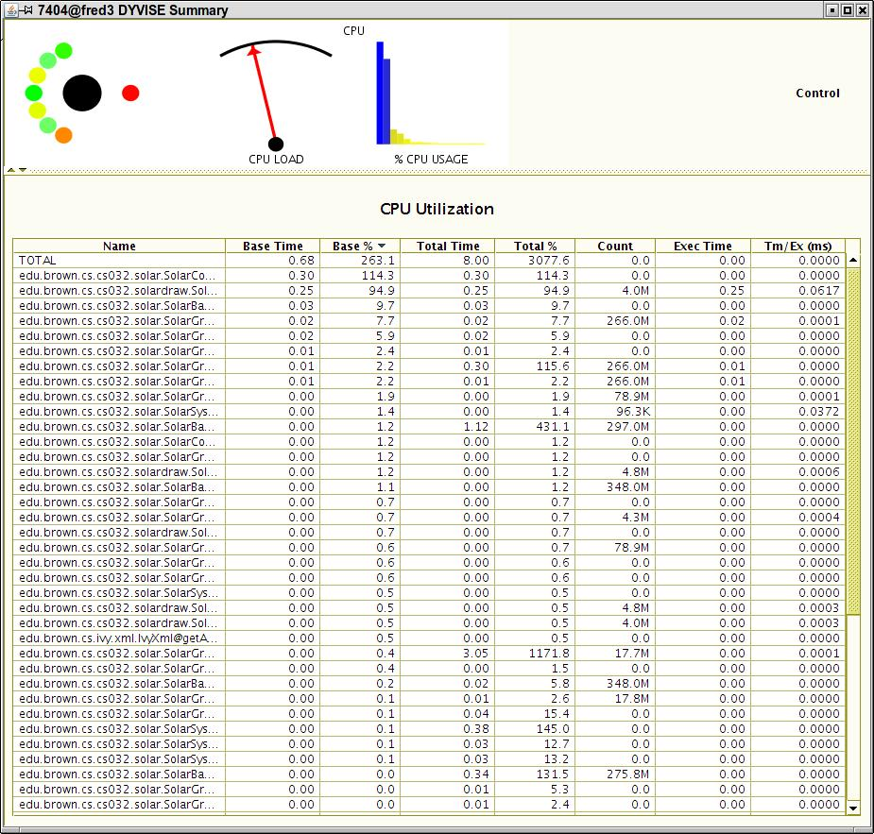
DYMON

Slide 26
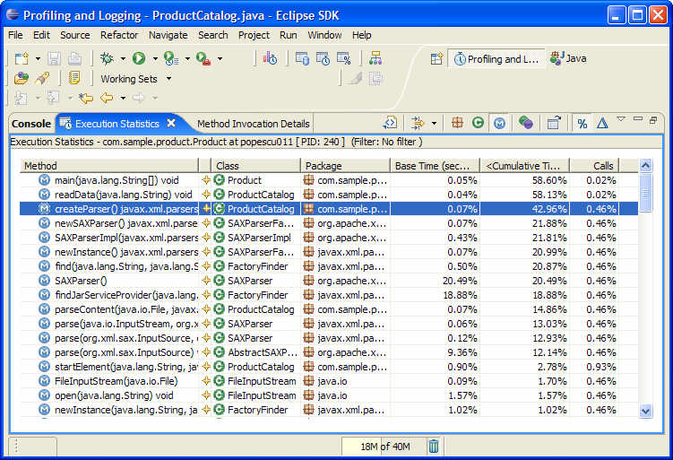
Performance Analysis in IDEs
Environments typically include one
  VS Code, IntelliJ, (Eclipse TPTP)
Code Bubbles
  Automatic as part of debugging
    Collects more information than displayed
Again, these provide limited data
  Especially for multithreaded cases

Slide 27
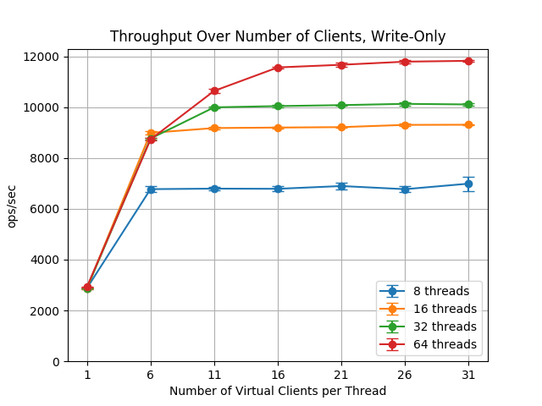
Multithreaded Performance Analysis
Detecting the state of all the threads
  Running, busy, waiting, I/O
Detecting what threads are blocking on
  Shared locks, bottlenecks, other threads
Detecting what threads are doing
  In terms of the program
  Why they are blocked, waiting, or doing I/O
Problem: multithreaded web crawler would work well for a while, but then it would essentially halt for a time before continuing

Slide 28
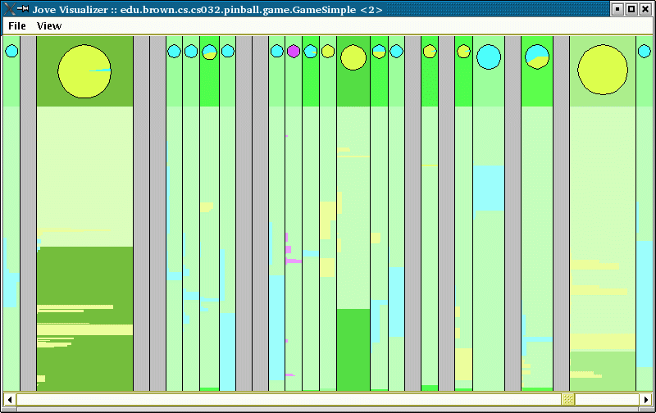
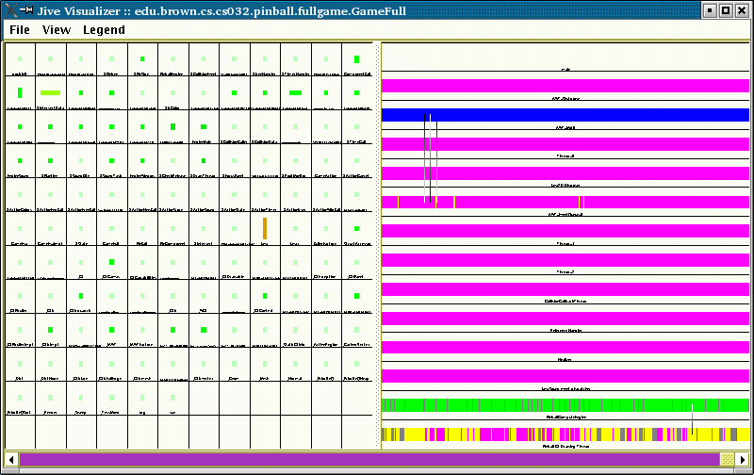
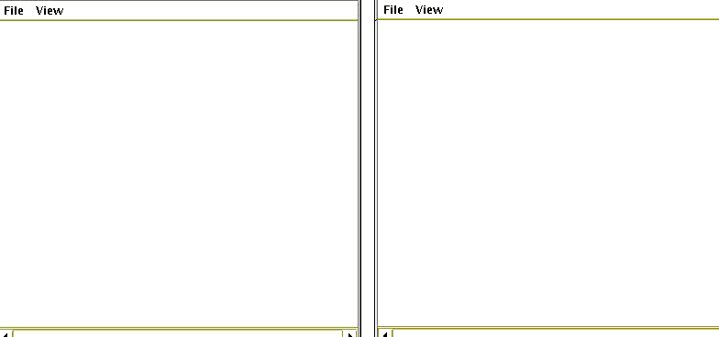
Jive, Jove and Veld

Slide 29
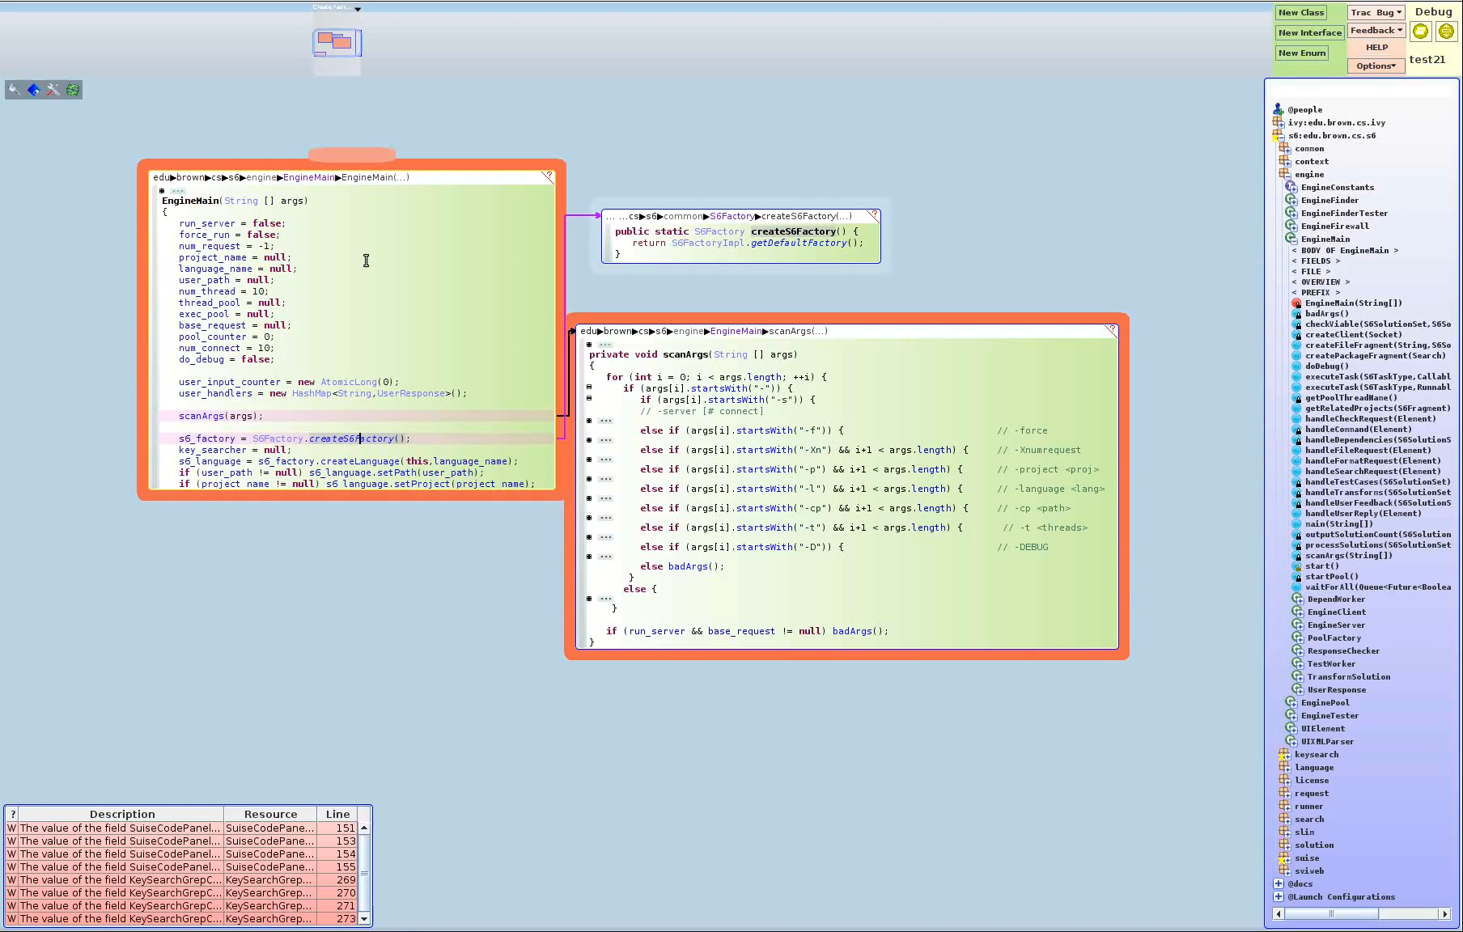
Dynamic Visualization in Code Bubbles

Slide 30
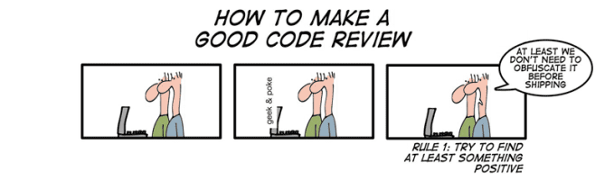
Code Reviews
A form of manual testing
Take a piece of code (method, class, …)
  Have a panel of reviewers
  Pass the code out to the panel (possibly in advance)
  Panel goes over the code line-by-line
Goal is to find and eliminate all potential bugs
  And make sure the code conforms to various guidelines

Slide 31
EXERCISE
Example code review (codereview.java)

Slide 32
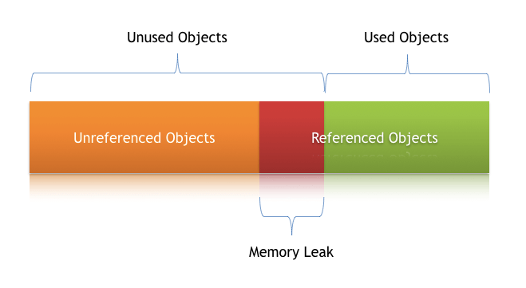
Memory Problems
Memory Leaks occur in Java
  Despite garbage collection
  But are more subtle than in C/C++
Tools for detecting leaks
  jmap –dump; jhat are standard java tools
  Eclipse memory analysis extensions
    Summary
    Browse through memory
  Dyvise memory data
Test cases for memory problems
  Especially for recreating them

Slide 33

Memory Ownership
Who is in charge of a particular piece of memory (object)
  Creating it, holding a pointer to it, freeing it
  Making this clear reduces memory problems
    Especially in C/C++ but also in Java and other systems
    In addition to garbage collection
Ideally this should be clear
  Non-owners shouldn’t save pointers (or should use weak ones in Java)
  Generally handled via documentation & manual techniques
  Requires strong programmer discipline to get right
    Especially with multithreading
  RUST makes it explicit

Slide 34
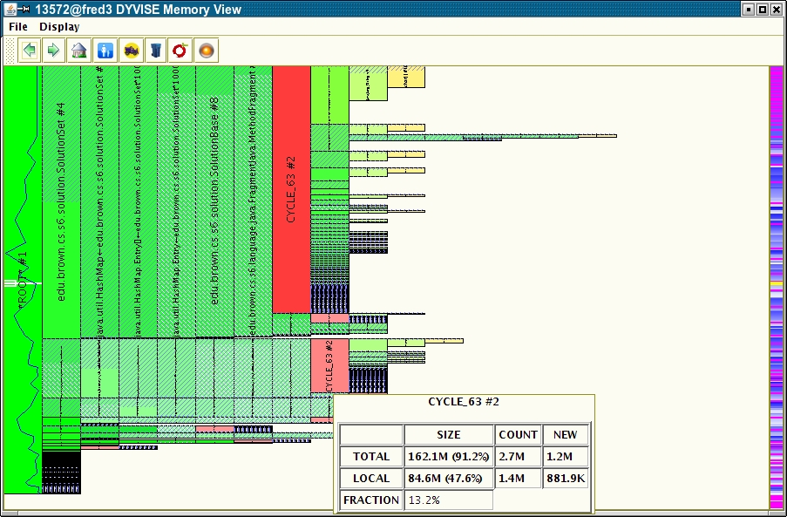
DYMEM

Slide 35
PROJECT
Ensure you have a testing strategy for your project
  Test environment
  Test version
  Include documentation of the strategy in your repository
Do a code review within your project team
  Choose a complex module within the project
  Point everyone to the code in advance
  Then go over the code line by line to ensure it works
  Submit a summary of your findings in Canvas
Does any group want to present on 11/26?
  Tell me by next Tuesday

