Slide 1
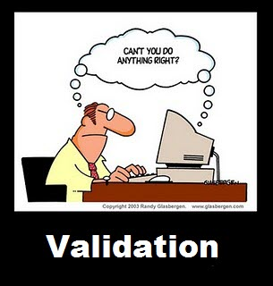
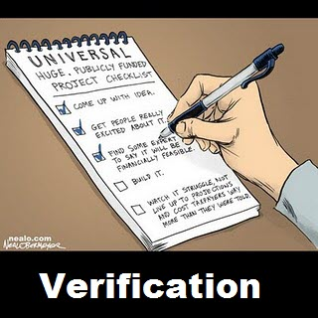

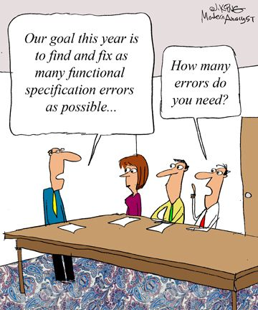
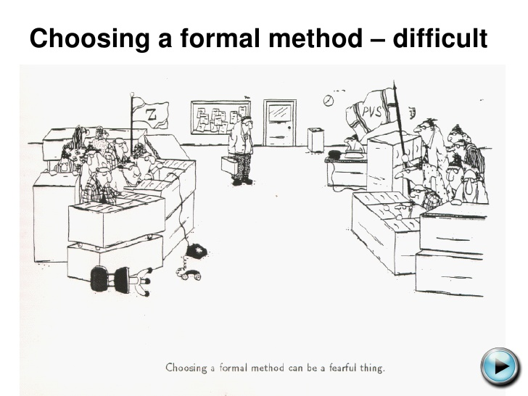
Static Analysis I
CSCI2340: Software Engineering of Large Systems
Steven P. Reiss
Notes:
Talk about copyrights

Slide 2
Programming Assignment
It should follow naming conventions
It should follow style conventions
  Formatting, size of methods, …
It should be readable (block comments, etc.)
It should include copyright, file headers
If what you handed in doesn’t do all this
  Revise it and resubmit within the next week.

Slide 3
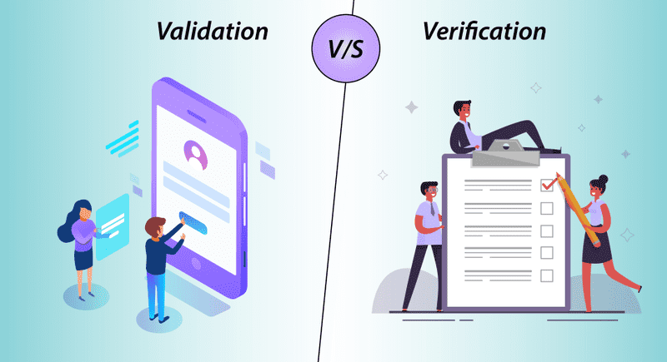
Validation versus Verification
Validation checks the program
  Testing, code reviews, user experience, …
  Confirmation by examination of objective evidence
    That the program meets its requirements
Verification
  Proves the program meets its requirements
  Showing it works for all possible inputs
  Showing it works under all possible conditions
  This is what static analysis tries to do
Verification is needed in safety-critical systems
  Verification is useful in security-critical systems
  Verification is useful in general

Slide 4
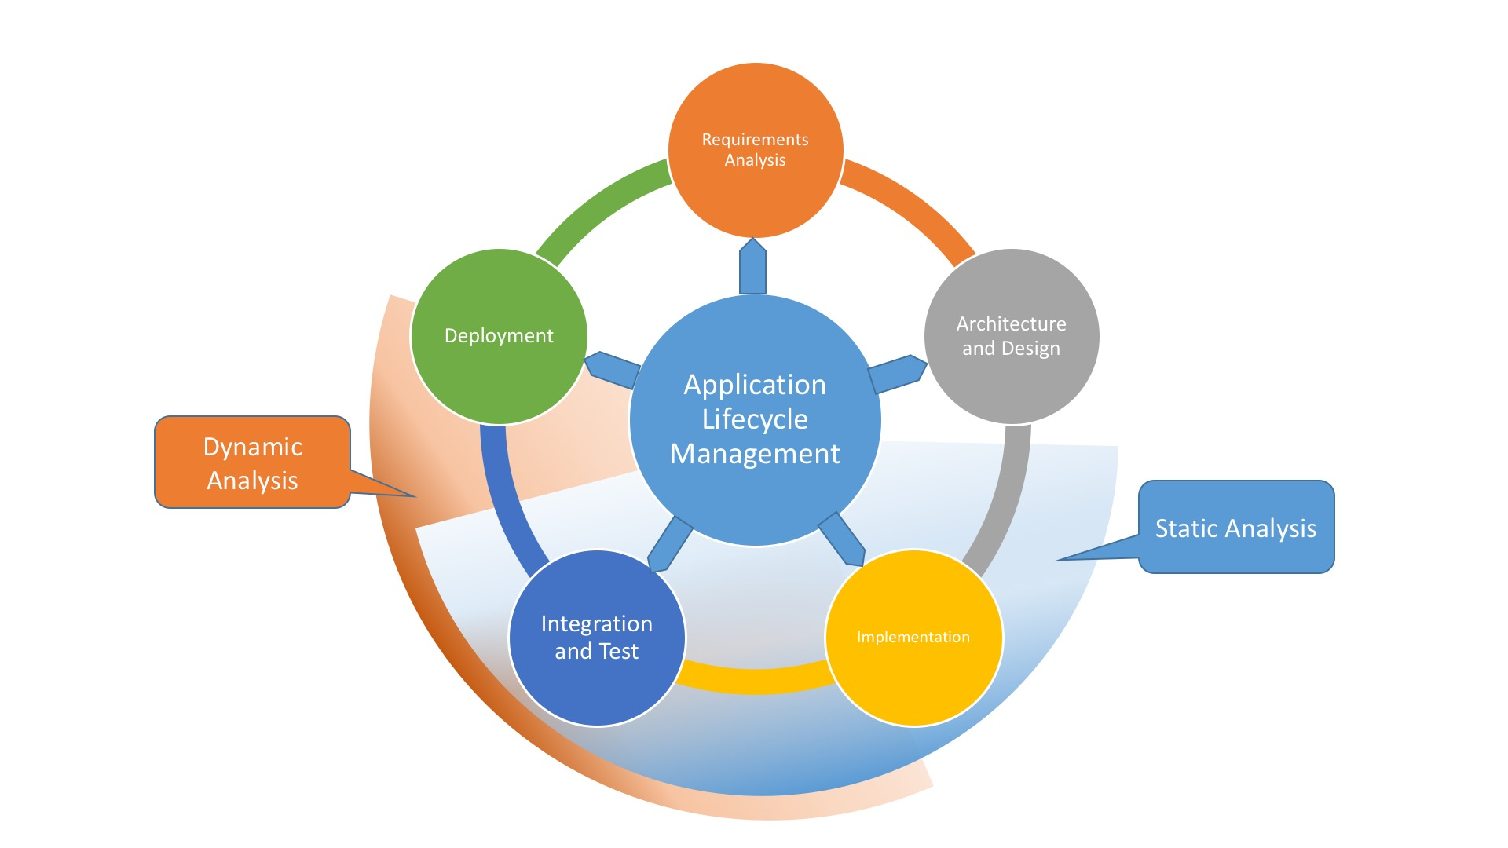
Goals of Static Analysis
Demonstrate that the system will work under all conditions
  Can work on a model of the system rather than actual code
    As long as working on model implies working on the system
    Note: not working in the model does not imply not working in the system
  Need to define what ”work” means in a formal sense
Find potential bugs without running the software
  Considering all possible inputs rather than just samples
  Considering all possible executions
Checking for potential problems
  Looking at specific problems
    Either general or program-specific
  Seeing if they are present in the code

Slide 5
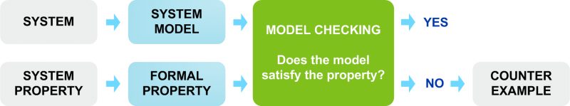
Partial Correctness
Complete program correctness is difficult
  Would need a complete specification of the program
  For a large, complex system, especially an interactive one
    Writing the specification is more difficult than writing the code
    The specification is as or more error prone than the code
Solution is partial correctness
  Identify key properties the code should have
    For safety, for security, for operation
  Prove these properties hold in the program
    Under all possible inputs and all possible executions
Differs from partial correction in program theorem proving

Slide 6
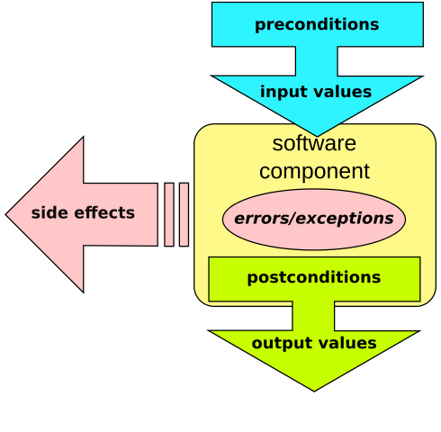
Contracts: The Traditional Approach
Contracts are local formal specifications of program behavior
  Several forms and levels
  Partial specifications (not necessarily complete)
  Developed by Bertrand Meyer in the language Eiffel
    Based on formalisms developed by Dijkstra
  Can be safety conditions or just program conditions
Three types: Preconditions, Postconditions, Class Contracts
Precondition contracts
  Specify constraints on the inputs to a method or function
    Argument can’t be null; 0 < value <= 10; …
  These are the assumptions a method makes
    What you might check using defensive coding & documentation
  Preconditions make these assumptions explicit

Slide 7
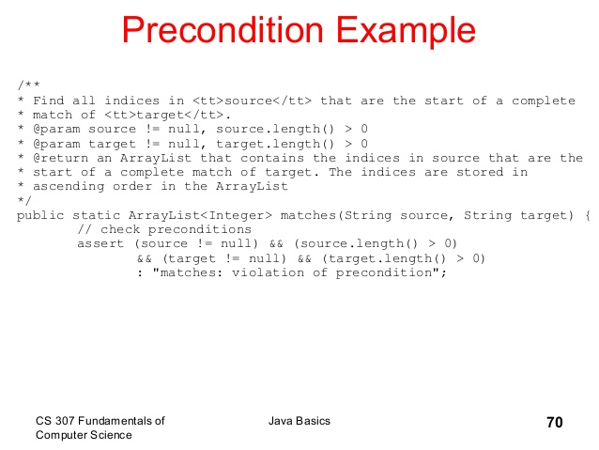
Specifying Preconditions in Java
Can be done using assert statements
  Placed at the start of a method
  These generate an exception if condition is violated
  But can be ignored (compiler or execution option)
Can be done using annotations
  com.google.java.contract.* is one example
  @Requires(<boolean expression>) annotation on a method
    Expression has access to the various arguments
    And any other accessible values
  A bit messy since Java annotations apply to types, not methods
  Needs to be checked outside the language
Similar facilities exist for other languages

Slide 8
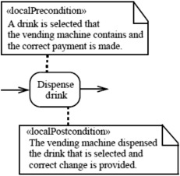
Postcondition Contracts
Specify constraints on the outputs of a method or function
  In terms of the inputs and the return value or exception
    Can use its own local variables if needed
  result >= 0; set.contains(input)
These can be a definition of what the method does
  But generally, are only constraints, not full specifications
Can be specified using assert
  With assert (…) inserted before any return statement
Can be specified with annotations
  @Ensures(<condition>)
  @ThrowEnsures(<condition>)

Slide 9

Class Contracts
Specify properties of a class
  Define relationships among fields of the class
    Constraints on the class
  Hold whenever a public or package-protected method returns
    Also, when a constructor returns
    This allows inconsistent states while computing, but that are not exposed
    Requires accurate specification of protection levels
  Can specify usage rules for methods
    But this is non-trivial (need to create automata as part of the check)
    Can introduce contract variables for this purpose
Can be defined using assert statements
  assert balanced(); assert field != null
  Add this at the end of each appropriate method and constructor
    Call a method to do the check rather than check in place

Slide 10
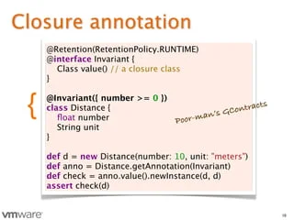
Class Contracts
Easier to define using annotations
  @Invariant(<condition>) specified once for a class
  But this needs to be checked

Slide 11
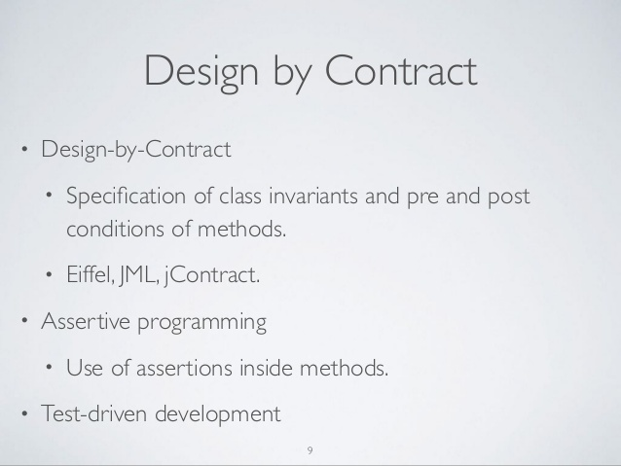
Checking Class Contracts
Annotations can be used to generate internal code
  Checked at run time using annotation processing (cofoja: defunct)
  Checked at run time using aspect-oriented programming (Oval; defunct)
  Check at run time using class loader patching (Jass; defunct)
Can be checked statically with proper framework
  Proving the contract holds under all executions
    Post condition holds given precondition
    Class condition holds whenever a public method returns (assuming pre & post conditions)
    Using theorem proving technology
  Java Modeling Language (JML) did this (defunct)
  C-spec for C# (Microsoft) does this
Ideally contracts would be compiled in as run time checks by the language
  But annotation processing in Java doesn’t allow this
  Compilers are starting to support some of more useful annotations

Slide 12
Discussion
Contracts seem to be a way of ensuring program behavior
  Relatively easy to specify, non-obtrusive
Yet they are not widely used.
WHY?
  Do any of you use them?
  Would you use them if they were available?
  Would you use them for documentation?
  Would you use them if they were checked
  Would you use them if they didn’t cause performance problems?
  Would you prefer them to defensive coding?
  How difficult to you think they are to create?
  How complete do you think they generally are?
  Can they express global properties, safety, security?

Slide 13
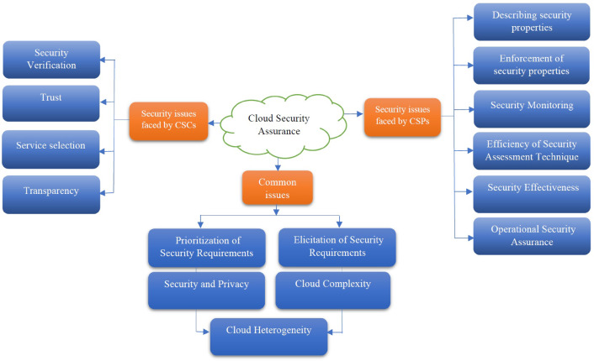
Safety Condition
We want to prove the whole system is secure
  With respect to a given condition or property
Actually, we try to prove the system is not secure
  Define a condition that should not occur
    A violation of safety or security
    The program can cause two trains to crash
    User input can flow to a SQL query
    A user can gain super-user access without authentication
  Prove the program can cause this condition to occur
The proof then lets you see why the program fails
  Proof effectively creates an example that fails
    Shows how and why the program is unsafe
    Tells you what to fix (can be the program or how the proof was done)
  Failing to prove the system is not safe means the system is safe
A condition that we use to show the system is not safe
  Is called a SAFETY CONDTION

Slide 14
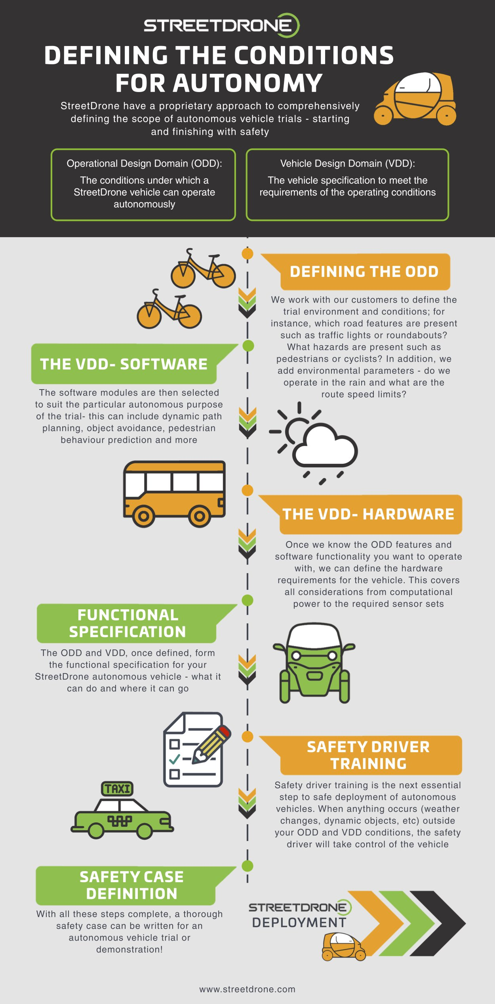
Safety Conditions
These are used to define the possible problems
Defining things the program shouldn’t do
  SHORE: allowing two trains to crash
  Writing sensitive data out
  Invoking a SQL query with tainted data
  Executing privileged command without privilege
  Overflowing a buffer
Ensuring that the system doesn’t do these
  Under any conditions
  Under any possible sequence of inputs
  Under any possible sequence of actions
    Including thread schedules

Slide 15
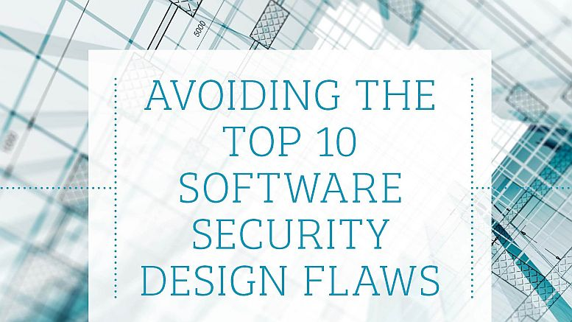
Security Problems as Safety Conditions
Checking that tainted data doesn’t go to the wrong place
  SQL injection attacks
  XSS attacks
  Credit card numbers not saved
  Secure data remains at the proper security level
Checking there are no buffer overflow errors
Checking that assumptions are met
  User authorized as admin to execute admin functionality

Slide 16
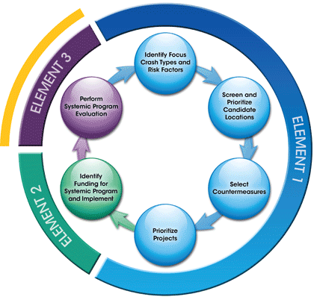
System Problems as Safety Conditions
Many correctness properties of a system
  Can be expressed as safety conditions
  Example: transfer of money from one account to another
  Example: hasNext called before next
Can express the critical system issues
Can show the system does what it should
But you need to state the conditions
  These are application specific

Slide 17
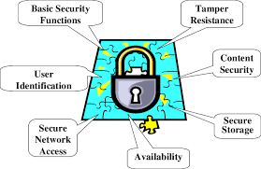
Safety Conditions in Embedded Systems
Used extensively in embedded systems
  Often these are critical systems
    With real-world consequences
Examples:
  SHORE: two trains shouldn’t be in the same block
  PINBALL: the program shouldn’t blow a fuse
  A self-driving car should not crash into a person
NASA is a big proponent

Slide 18
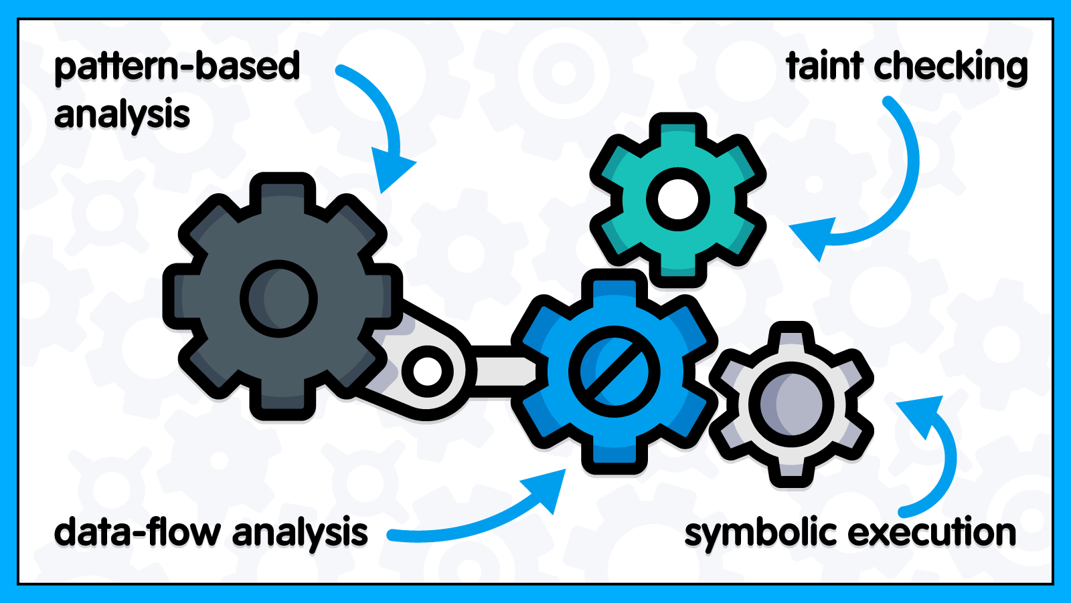
Static Analysis Checks Safety Conditions
Shows how a safety condition can fail (the program is bad)
  Or shows it can’t and thus can’t be triggered by the program
  When it does fail, it shows how the failure can occur
To do static analysis effectively we need to simplify
  The condition needs to be stated in formal finite terms
  The program needs to be stated in finite terms
    And tractable (problems solvable)
    This means finite state and small finite variables bounds
Then we can do a proof
  Either in terms of finite automata
  Or in terms of Boolean formula

Slide 19
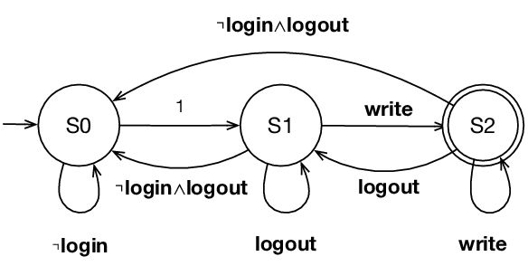
Büchi Automata
Safety conditions can be specified using automata
  Over infinite inputs
  Transitions indicated by program events
    Calling or returning from a method
    Variable having a certain value at a given point
    Execution reaching a given point
    Creation of an object
  Transitions indicated by predicates
    Based on program variables
  Safety condition expressed in terms of different states
  Start state indicates initial state of the system
  Error states define states that should not be reached
Goal: Find a valid series of program events or variable settings
  That puts the system into an error state when started in the start state
  Again, trying to get the system to fail (not show success)

Slide 20
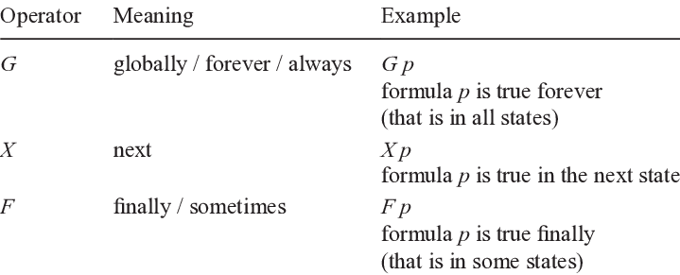
Temporal Logical Formulas
Can also be represented using temporal logic
Boolean logic
  With additional operators for time
    X eventually occurs
    X always occurs
    X occurs after Y
  Using properties of the program as a base
    Program events, variable values, …
Roughly equivalent to automata
  Can map back and forth
Other representations are also used for special cases
  Contracts for local behaviors
  Special structures for escape analysis

Slide 21
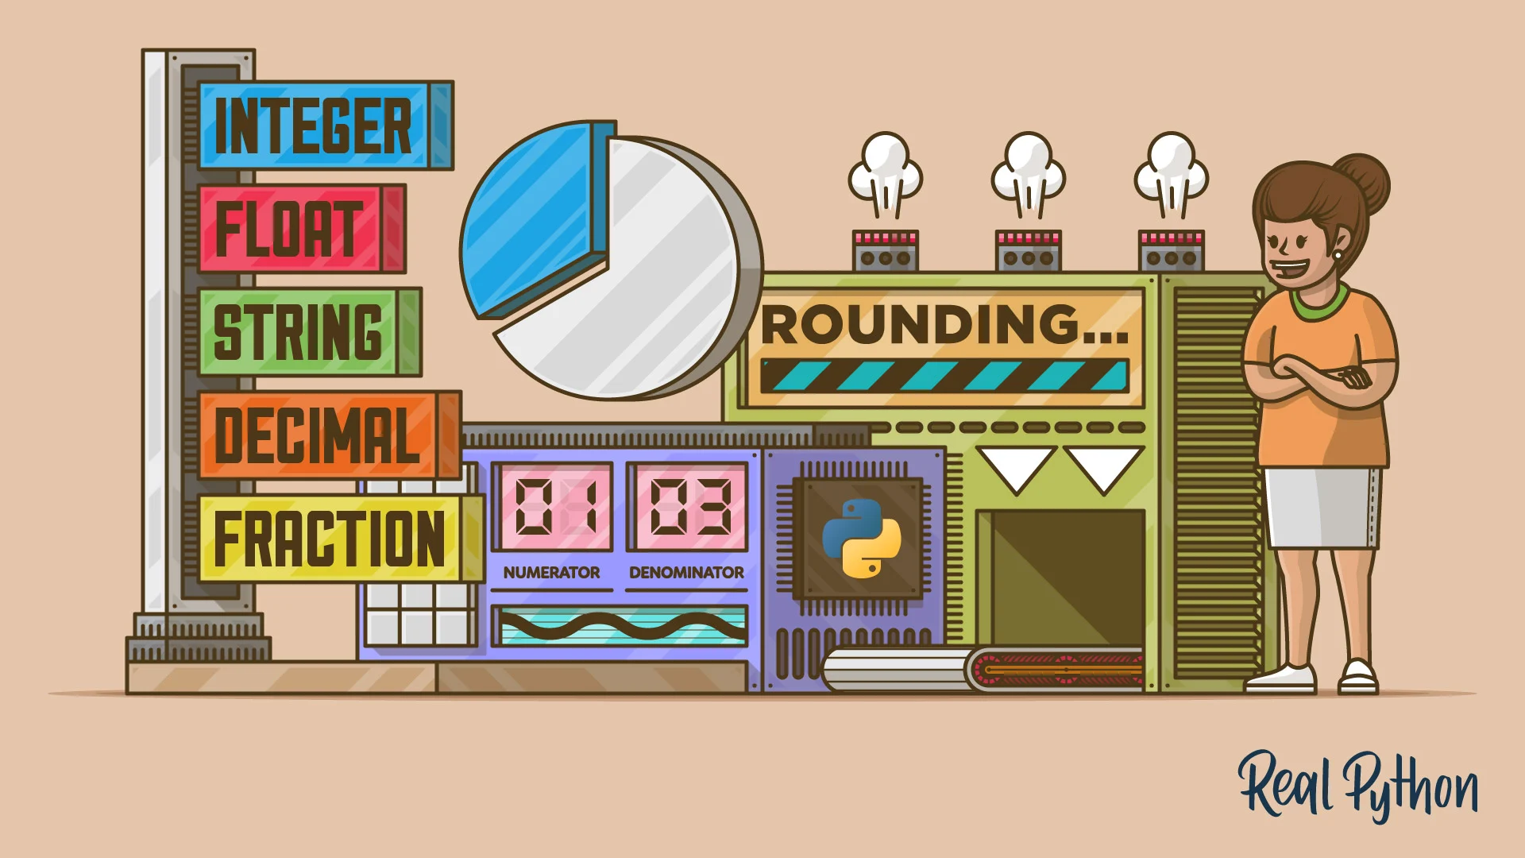
Representing the Program’s Data
To check these properties, the program needs to be abstracted out of the code
  Program must be finite state (to allow decidability)
  Essentially an extended finite automata (conditions on transitions)
  Minor extensions (e.g., call-return) are possible, but not simple
  Fixed number of threads if threads are considered
The program’s data must also be finite
  Integers, doubles, etc. need to be restricted to finite sets
    A few significant values or ranges; then combine all the others (0,1,2, >2)
    Need to do arithmetic with the combined values
    Operations might yield multiple results
  Structures
    Represent as finite graphs (of links)
    Again, with nodes representing an arbitrary graph
    Fixed maximum size for arrays, lists, etc.
Note these are approximations (generally include all possible cases)
  Up to a point (max size, max threads)
A lot of this can be automated

Slide 22
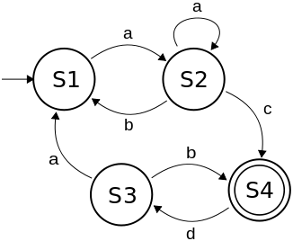
Representing the Program
Need to map code to an augmented finite state automata
  States represent program locations
  Can have a set of (finite) values for variables at each location
  Arcs can be conditional on the values
Generally, just use the control flow graph directly
  Without considering most conditionals
  Program can go either way at a conditional
Can consider threads and thread interleavings
  State is cross-product of states of individual threads
  This makes the problem more difficult
Try to make this a conservative approximation
  It includes all possible cases
  If problem doesn’t occur in model, it can’t occur in program
Most of these mappings can be automated

Slide 23
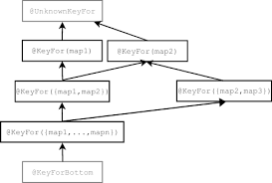
Data-Based Safety Conditions
Some safety conditions relate to specific data items
  Need to be checked for each logical instance of item
  Separate automata defined for each item
    States relate to states of the data item
    These are equivalent to subtypes
  Subtypes are type qualifiers
    Specify the automata state for the type
    Can be arranged in a lattice
  Changes relate to actions on the data item
    Creation, operations, …
Examples
  Iterators: Initialized, hasNext available, hasNext none, next Called, error
  SQL Data: SQLuntainted, SQLtainted, SQLfullytainted, Unknown

Slide 24
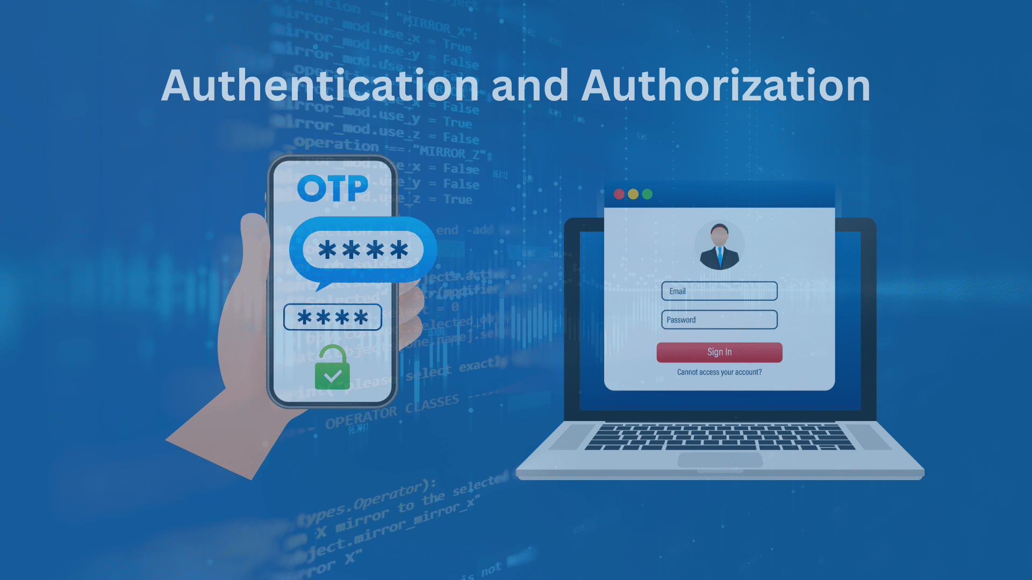
Program-State-Based Safety Conditions
Other conditions depend on the program overall
Has the user been authenticated
  Anywhere that authentication is needed
Is a user authorized for this action
  Authorized at the right level
Security Level
  Is the users access level >= that of the data

Slide 25

Testing Safety Conditions
You want to ensure safety conditions are never violated
  Actually you want to find a violation of the safety condition
  In the program now or in the future
  Under any possible conditions
  Under all possible executions
You could add code to check this
  But that code might be buggy or incomplete
    Still might be a good idea: defensive coding
  So even with code, you can’t be sure there are not holes
Static Analysis tries to be the answer
  Can check a specific property
  Can check it practically for all possible executions and inputs

Slide 26
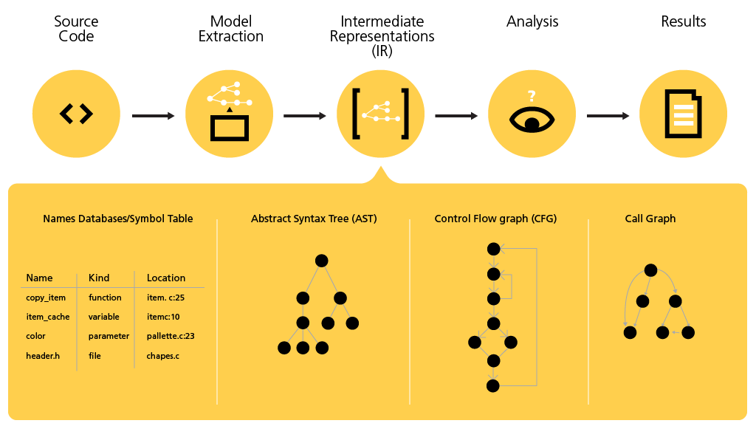
Static Analysis
Defining the condition(s) to check
  Different approaches are used
    Subtyping (Finite state data models)
    Finite state models (Büchi automata; temporal logic)
    Bounds checking (variable ranges for buffer overflow)
    Condition-specialized structures (e.g., for escape analysis)
  Chosen mainly for convenience
    Based on the safety condition to check
    Based on means for checking that problem
Static analysis then checks these for all possible
  Inputs and valid program executions
  Possibly assuming a simplified version of the program
    That is a generalization
One approach that is used here is subtype checking

Slide 27
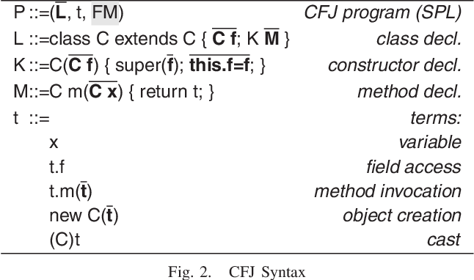
Subtype Checking
Type checking can catch potential errors
  This is why I encourage using strong typing
  Finer type checking can catch more
    Knowing X is in inches rather than centimeters
    Knowing X may or may not be null
    Knowing X can be tainted
This can be done by adding subtypes to existing Java types
  Subtype of double-inches
  Subtype of String-nonnull or String-nullable
  Subtype of String-tainted

Slide 28
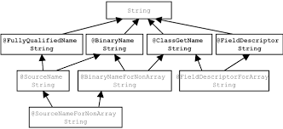
Defining Subtypes
Subtypes in Java can be defined using type annotations
  @NonNull, @Tainted, @Unit(“inches”)
  Can be applied to the types of fields, arguments, local variables, returns
    Any place a type is specified, can annotate that type with appropriate subtypes
Need rules for checking and propagating subtypes
  Assigning null to a @NonNull variable is an error
  Passing inches to a method wanting centimeters is an error
  Concatenating tainted data with untainted data yields tainted data
  Inches * inches = inches²; inches*scaler = inches
  Writing tainted data to a file is an error
These must be defined for each subtype and operator
  But in general, the rules follow a hierarchy for the subtype
    Thus, the specification can be simplified and practical

Slide 29

Subtypes for Security Checking
@SqlTainted
  Whether data is tainted with respect to SQL injection
@HtmlTainted
  Whether data is tainted with respect to XSS
@FileTainted
  Is the file name tainted to give outside access
@Initialized
  Has this data been initialized

Slide 30

Subtype Checking Tools
Tools exist for checking these subtypes
  Using type-checking technology
Checker system
  Available as a plug-in for IDEs or standalone
  Runs in batch mode
Checking is done statically
  Check all assignments (explicit and implicit)
  Types are propagated inside a method
    Checking defines the target subtype at each program point
  Types are not propagated between methods, but are checked at each boundary
    Method call, return value
Errors
  No errors detected says program is correct with respect to annotations
  Errors detected says program might be wrong
    And type checking yields the execution sequence yielding the error
  Again, this is an approximation since type combinations might not be possible

Slide 31
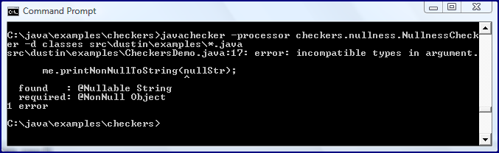
Using Checker
More difficult than it looks
  All intermediate values need to be subtyped correctly
    Types must be defined at each boundary (method definition and call)
    Can require a lot of annotations
    Will miss some things (e.g., common routines)
  Requires understanding and annotating collections
    Saying that no value in a collection is null
    Saying that access to a map will return something non-null
      That this variable holds a valid key – there’s an annotation for that
      But this requires adding a lot more annotations
  Requires annotating third-party libraries
    Java standard library is annotated by Checker
    But systems often use other libraries as well
  Only checks source code, not binaries
Nice framework, not that widely used

Slide 32
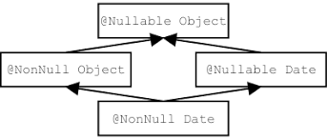
Null Checking
Checking for nulls is an important instance
  Prevents potential NullPointerExceptions
  Can be quite useful
Today’s compilers try to do this
  But there are usually too many false positives
    In constructors and routines called by constructors
    When using collections
    Based on library routines
  Also, tools like FindBugs try to do this
    Again, with lots of potential false positives
  Can also be done using Checker with lots of annotations

Slide 33
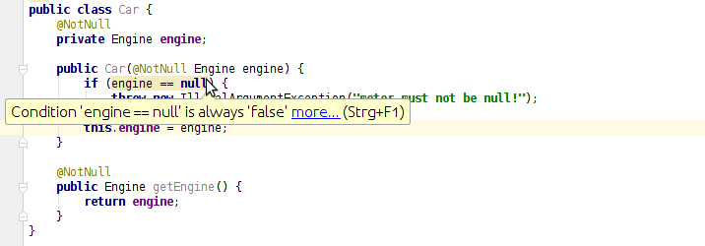
Null Checking in the Compiler & FindBugs
Rather than checking everywhere
  Only check where it can implicitly be null
    After the user has checked for null
    After the value has been set to null and not reset on all paths
  This can have a lot of false negatives
This can be augmented with @NonNull, @Nullable
  To get more accurate results
  But these aren’t necessarily supported by the compiler
Or by building null checking into the language
  DART: type system includes nullable/non-null explicitly

Slide 34
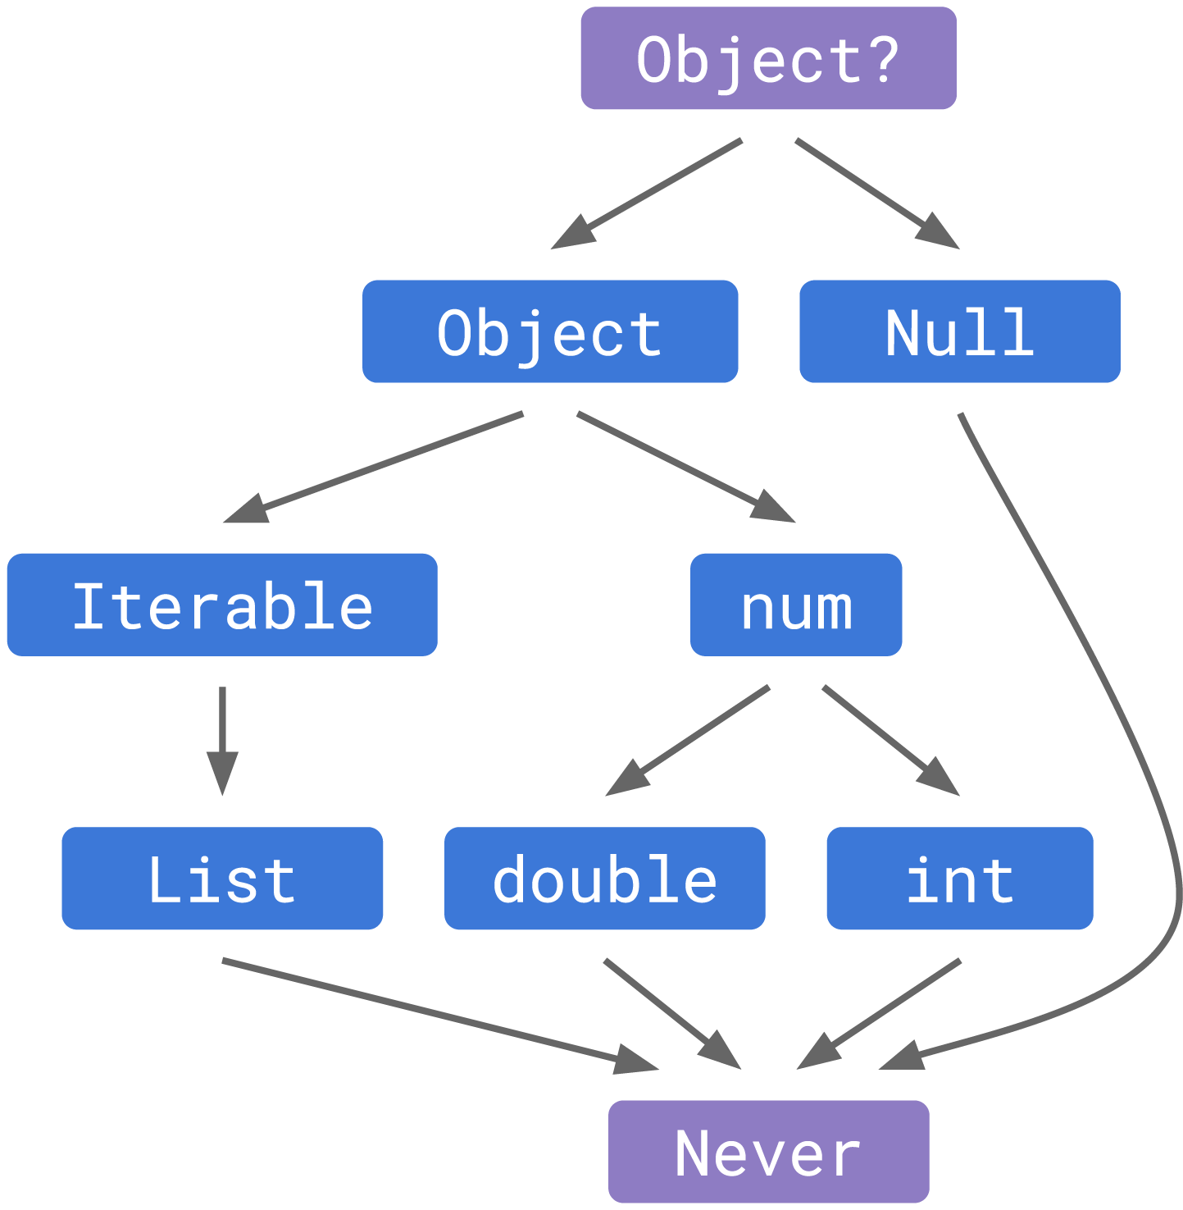
Null Safety in Dart
Dart includes nullability in types system
  Either absolute
  Or settable in the constructor
And operators that handle null values automatically
  With well-defined semantics
This solves many problems
  Catches potential errors
  Forces user to think about null values
But not all problems
  Delayed initializations can still cause problems
  Programmers get lazy and declare values as nullable
  Compiler check based on conditionals not perfect
  You should still except come errors

Slide 35

Next Time
Other approaches to safety checking
Abstract interpretation
  Using data flow analysis to simulate a high-level execution
  Looking at all possible inputs and executions
Model Checking
  Mapping the safety condition and the program to finite automata
  Developing a formula stating the safety condition fails
  Proving that this formula is true to find counterexample
    Or prove there is no counterexample

Slide 36
Homework
Think about what can go wrong with your project
  That you want to ensure the code doesn’t do
  What are the potential problems
    Safety, security, or operational
  What are the critical aspects of your software
  How would you show your software works
List one safety condition for you project
  Submit to canvas
  Due Thursday 11/14
Notes:
Move earlier

Slide 37
PROJECT
Did any project want to present on 11/26?
We will have 3½ classes devoted to project presentations
  (11/26), 12/3, 12/5, 12/10, (12/12)
  Each team gets <=40 minutes (half a class)
  Last class: 12/12 can be used for final demo (<=10 minutes)
Presentation
  Requirements, specifications, design, implementation
    Live demo or video (if possible; canned demo otherwise)
    This can be saved for the last class, but would be nice to see current state
  Possible plans for maintenance and evolution
    Where is the project going after the class is over
  Experience: What you learned, what you should have done better
  Questions from the audience

Slide 38
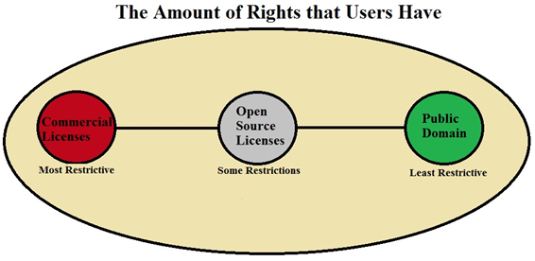
Copyright
You should have a copyright notice at the top of each file
  With an appropriate license
  Or “All Rights Reserved”
  Even for programming assignments
In addition to your name and year
Should be the same throughout the project
Be aware of copyright on anything you use
  Include in source if you borrowed code
  And copyleft (GPL)
Should be below block comment for the file

Slide 39
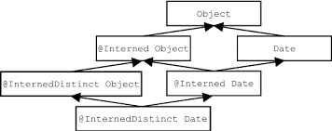
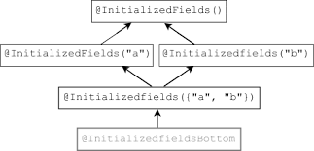
Subtypes for a Type Form a Lattice

