Slide 1
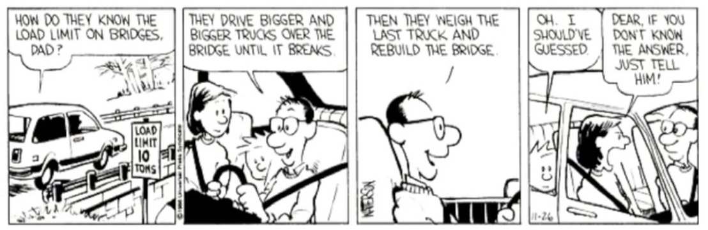
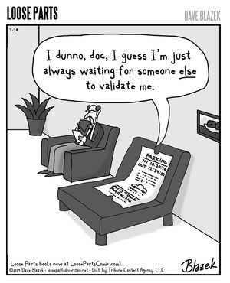
Static Analysis II
CSCI2340: Software Engineering of Large Systems
Steven P. Reiss

Slide 2
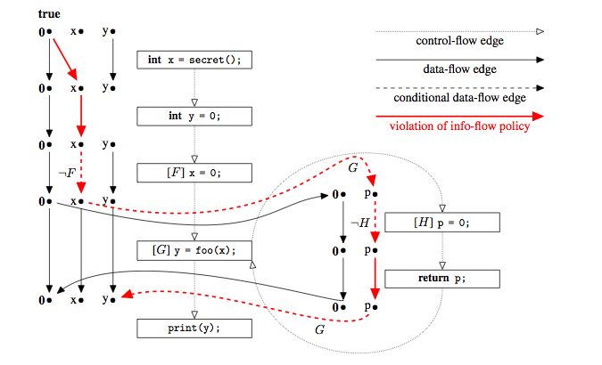
Type Checking Requires Work
Type checking doesn’t take flow of control into account
  Considers the declared type, not the actual types
    Routine without a declaration can return NULL, even if it wouldn’t
    Doesn’t know what actual types might occur a a given point
  Methods use their declared type, not what is effectively passed in
  Need to annotate all intermediate methods and local declarations to make it work
    And there can be a lot of them
Want to understand the actual types occurring in execution
  And the actual subtypes
  More precise than the declared types
  This provides more accurate analysis
  With many fewer annotations
Also want to track program states
  Properties that aren’t data-specific
  More general safety conditions

Slide 3
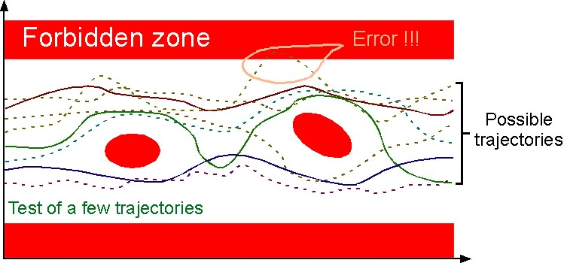
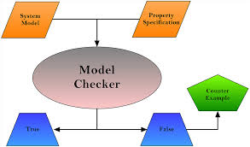
Beyond Type Checking
Check data-oriented properties without all the annotations
  Annotate only source and sink
Check program-oriented properties
  That aren’t related to a type
Approaches exist
  Using Data Flow Analysis to propagate the properties
    Running a model of the program with symbolic values
  Using Model Checking to validate a safety property
    Map program to an automata to a temporal logic predicate showing next state
    Map safety condition to an automata to a temporal logic formula
    Create a formula that says the program can enter an error state
    Prove that formula is correct
  Specialized approaches for specific properties (e.g., thread safety) also exist

Slide 4

Data Flow Analysis: A More General Solution
Determines what code can be reached
  And what code orderings are possible
  Considers different calling situations
Determines what values that can reach each point
  Value is an abstract representation of program data
    Specific type & subtype and finite value representation
  Tracked for all instances: stack, local variables, fields, globals
  Values can then represent types (since they are typed)
    Actual types, not declared types
Does implicit type checking
  Without having to specify the intermediate constraints

Slide 5
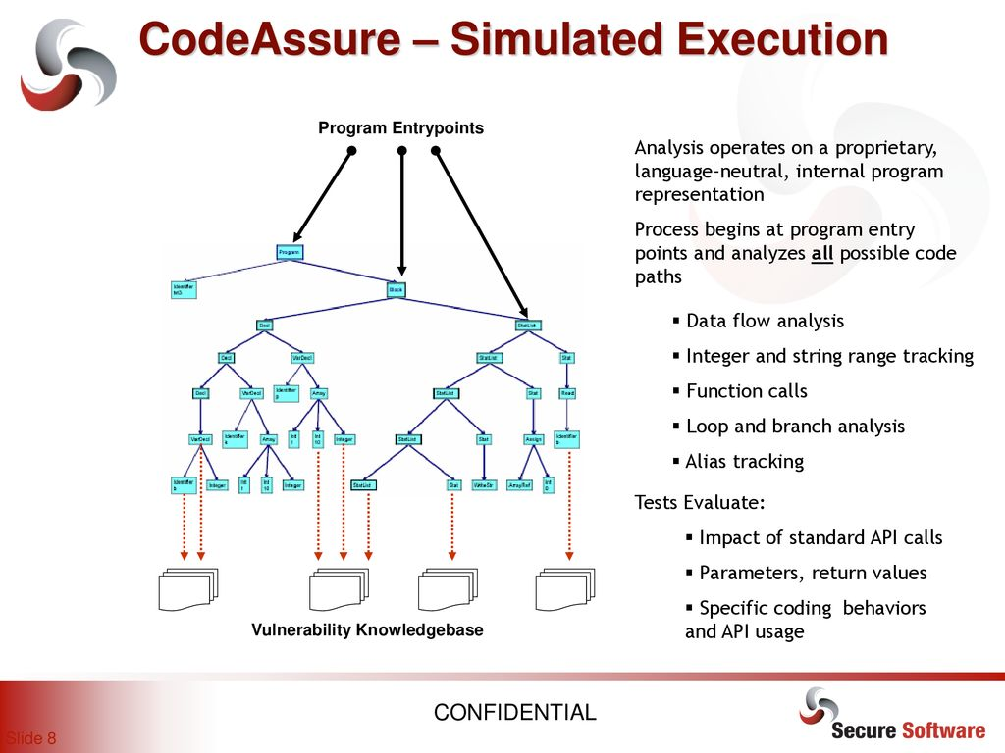
Data Flow Analysis
Can be used to check state-based safety conditions
  Associate set of safety condition states with each program point
  Propagate these through the execution
    Changing states based on potential program events
  Any point with an associated error state represents a potential error
Can be used to check data-based safety conditions
  Associate data states (subtypes) with each data element
    Extend the notion of type to include base type plus subtypes
  Propagate these through the execution
    Computing and adjusting types and subtypes appropriately
  Determine when data is used in an incorrect manner – subtypes conflict
Can be used for more sophisticated checks
  Tracking integer values (constraints), string lengths and contents
  Check for buffer overflows, possible exceptions, invalid URLs and regular expressions, …
Still limited
  It is an approximation – program and values are modeled, not exact
  Checking for null violations is still difficult
  Doesn’t handle thread interleaving or locking (but handles threading)

Slide 6
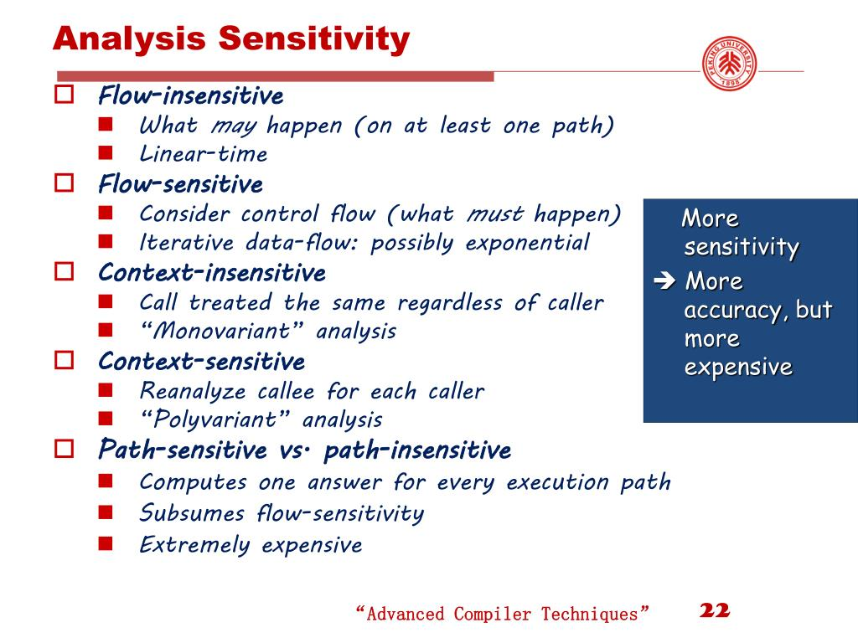
Sensitivity Levels of Data Flow Analysis
Path-sensitive
  Consider each different program path separately
    First time through a loop versus 2nd time, …
  More accurate, but can get very expensive (recall path coverage)
Flow-sensitive
  Consider control flow within a method
  But merge states when control flow comes together
Flow-insensitive
  Just look at all possible computations done in the method
    In any order and without considering conditions, etc.
    Much less expensive
  Useful for some analyses
  Too imprecise for safety condition checking
Context-sensitive
  Consider different call sites for methods as different methods
  Otherwise merge inputs to a method; pass merged outputs back to each call site
  Can also have partial context sensitivity

Slide 7
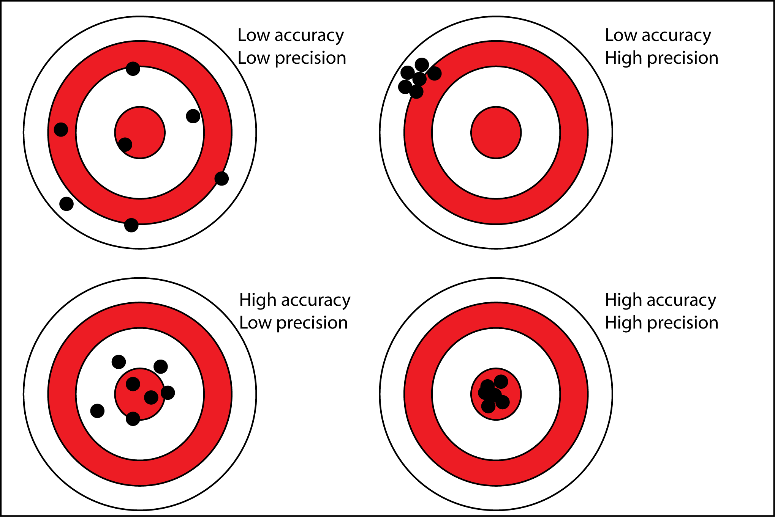
Precision & Accuracy
A flow analysis is precise if
  Every possible execution is included in the flow analysis
  The analysis covers all executions and then some
A precise analysis guarantees
  If it shows there is no problem, the program is safe
  If it shows a problem, the program MAY not be safe
A flow analysis is accurate if
  An error found in the analysis indicates an error in the program
  But no errors in the analysis does not indicate the program is safe
  Much more difficult to achieve, much less useful
You want both accuracy and precision
  Precision is probably more important
  But there are tradeoffs between them
  And both tradeoff with efficiency

Slide 8
Compiler Data Flow Analysis
Data flow analysis is used for compiler optimization
  For specific properties
    What variables are alive (will be used) at a program point
    What definitions reach a given program point
    What expressions are available
    What values are constants
  Fix set of bits indicating yes or no
Bit sets are propagated and computed over the flow graph
  Over a graph of basic blocks and their connections
  Using relatively simple Boolean formulas (union, intersection)
Very efficient computation of information needed
  In terms of both time and space
But this doesn’t help with types & subtypes & program properties

Slide 9
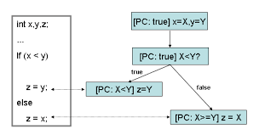
Abstract Interpretation
Abstract interpretation based flow analysis
  Simulate program execution
  Using a finite state version of the program
  Starting at all possible starting points
    Main programs; test cases; …
Using abstract values rather than actual ones
  Abstract value: data type with subtypes, source, constraints, subvalues
  Simplified (finite) versions of data as discussed in prior lecture
    With type and subtype information
Keeping track of program states for general safety properties

Slide 10

Abstract Execution Uses a Finite Program
Calls are not call-return
  Each method/function has its own execution model
  Call merges call arguments into parameter values for called model
  Called models are handled independently
  Return value of called routine used at call site
Conditionals can take multiple branches
  Based on what is known about values
  Nondeterministic finite state automata
Associate values with each instruction
  Values are finite but are always increasing
  Control flow meeting points merge values
  Need to reevaluate instructions when values change
The result is effectively a finite state automata
  With a finite set of values, evaluation will terminate

Slide 11
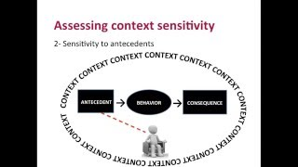
Execution and Sensitivity
How to interpret code depends on flow sensitivity
  Multiple instances of a function -> context sensitive
    Generally, a separate instance for each call site
  Single instance of a function -> context insensitive
  Consider flow inside a function -> flow sensitive
    Otherwise, assume all statements are executed in any order
    Flow insensitive is useful for some analyses, not in general
  Multiple instances of a statement -> path sensitive
Note that all of these keep the process finite
  And hence all ensure the analysis will terminate

Slide 12
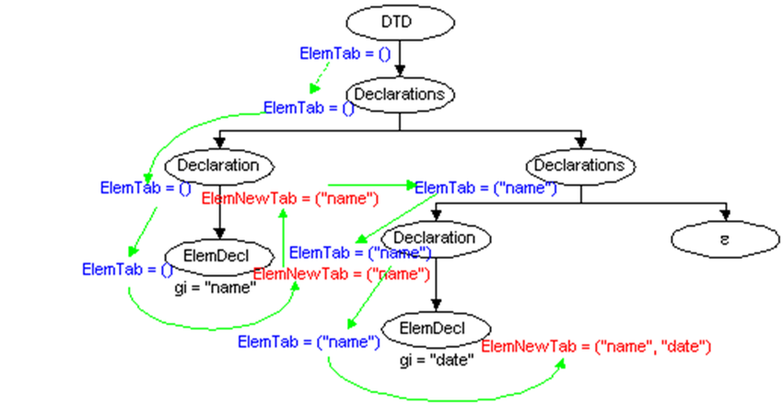
Program Points
Abstract interpretation effectively executes the program
  Looking at the effect of each instruction if assembler/byte code
  Interpreting source code at the instruction level
    This can be done using the abstract syntax tree
    Think of an ordered AST visitation as program instructions
      Enter a node
      Return to a node after each individual child
    Dotted AST node (Node plus location in the visitation)
These are program points
  Exact set determined by sensitivity
  But the set is finite
Associate values with each program point
  Finite set of finite values

Slide 13
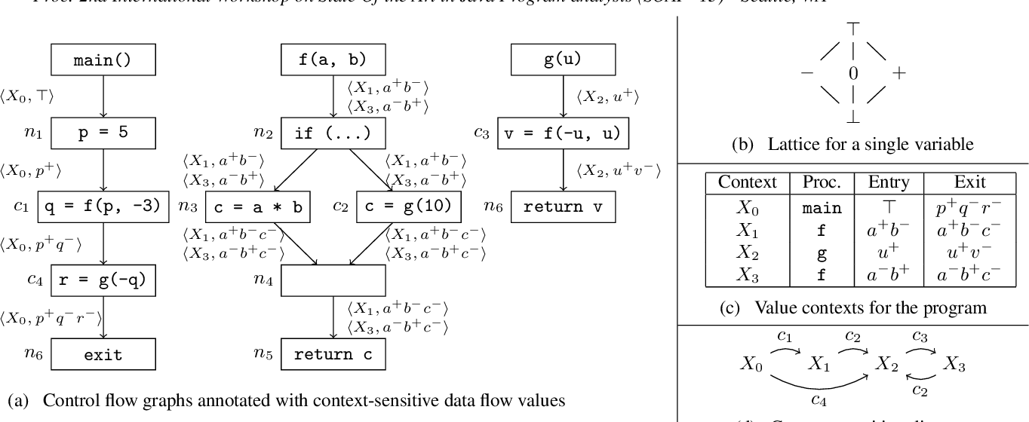
Values in Flow Analysis
Typed Data: finite representations of data
  With type and subtype information
  For numbers, can indicate a particular value, value set, range, range set, ANY
    Kept to a small number of items for each value
  For strings, a particular value, value set, length range, ANY
  For objects, keep a set of entities representing possible objects
    Each creation site (new for example) has its own entity (finite number of these)
    Generic entity for unknown sources
    Each entity can have field values (which are typed data)
    And array entities can have indexed values (which are typed data)
  ANY values let flow analysis consider all possible inputs
Each program point has a collection of possible values
  Values accessible at that point (local variables, stack)
  Global values are kept globally but can be accessed at any program point
  Can keep track of fields that are set locally and then accessed (not necessarily accurate)
  Overall precision of the flow analysis depends on value representations
Need to define how values are changed by program operations
  This is the nitty-gritty of abstract interpretation

Slide 14
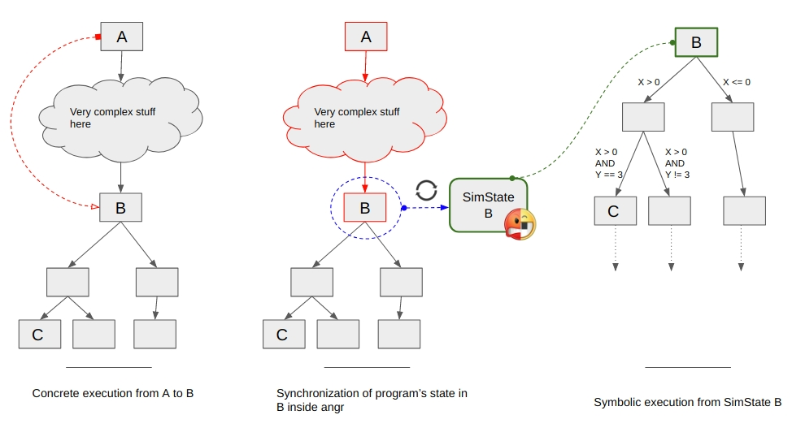
Values Stored for Program Points
Start of a Method:
  Value of parameters
  Return value (merged)
  Avoid reinterpretiation if no changes
Program point:
  Instruction, Dotted AST node
  Contents of local variables, stack
  (Contents of fields stored locally)
Objects:
  Contents of various fields
  Contents of array elements (by index and globally)
Global:
  Contents of global (static) variables: single value

Slide 15
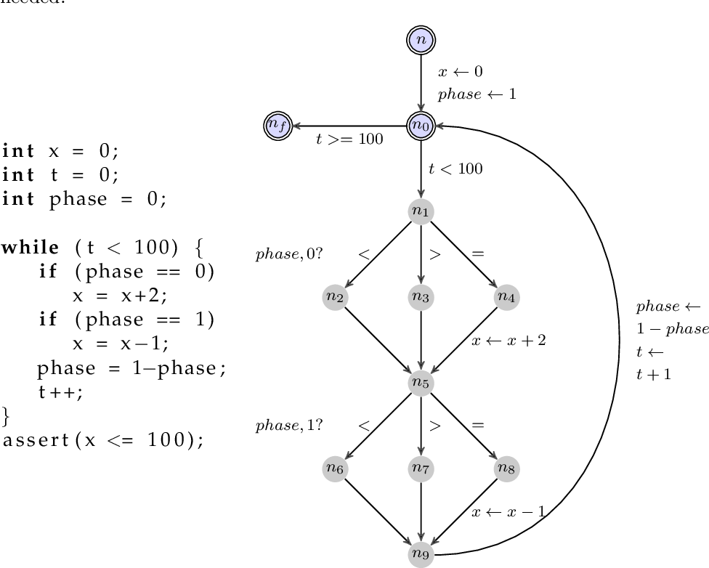
Operations on Values
Merging two values
  This is the most common operation
  Needed at all flow merge points
  Needed for global & field assignments
  Needed for merging call arguments
  Needed for merging return values
Based on operators in the language
  Assignments
  Integer operations
  String operations
  Stack operations
  Accessors (field & index)
  Casts (implicit and explicit)
Individual methods might be special
  Sanitize, MD5 hashing can change subtype states

Slide 16

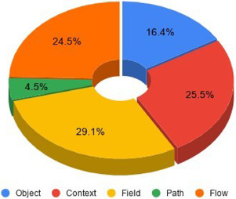
Practical Abstract Interpretation
Need an efficient representation of values
  Tradeoff between precision and performance
  Since representation needs to be small and finite
Need an effective way of doing the interpretation
  Knowing when to create a new instance of a routine (context sensitive)
  Minimizing the reinterpretation of states
    If merge doesn’t change values, then no need to reinterpret
  Tradeoff between precision and performance
Need to handle the quirks of the language
  Exceptions, callbacks from system methods
  Reflection, native methods
Need to make things efficient
  To make this practical

Slide 17
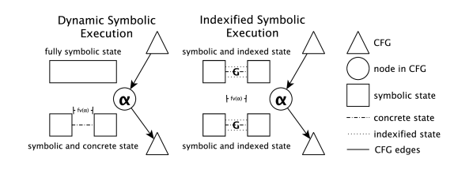
Efficient Abstract Interpretation
Use a work queue algorithm
  Start with program starting points (main, tests, …)
  Create dummy code to execute tests, static initializers, …
Given a program point with its values
  Determine the set of next possible program points
  And the possible values there
    Stack, local variables
Merge values as appropriate
  From original values saved for that program point
    Or just use the new values if the point was never executed
  If anything changes or a new point, queue that program point
  Try to queue alternatives in a logical order to minimize reevaluation
Continue until nothing changes
  Everything is finite; values only grow; this is guaranteed to terminate

Slide 18
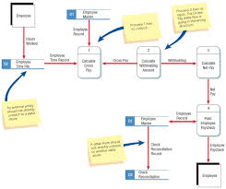
Flow Analysis Errors
Detected error indicates a possible program error
  Conflict between expected and actual subtypes
    Using annotations to define expected subtypes
  Error program state reached
    After some program state event-based transition
  Can be wrong (like lint) since it is an approximation
    The abstract execution might not be possible in the real program
  Saved state information can provide program path leading to error
    This is the counter-example we desire
    It produces a graph of possible counter-examples
    User can go through and determine which if any of these is really possible
No errors found show the program is safe
  Assuming the analysis is accurate
  But false positives can be reasonably common (depends on property)
Accuracy
  Lack of accuracy can yield false negatives (safe when program isn’t)
  One tries to avoid inaccuracy for safety conditions
  But a little inaccuracy is probably okay for immediate feedback

Slide 19

Abstract Interpretation Difficulties
This sounds straightforward, but:
  Real programming languages and real programs are not that simple
  Need to handle real programs and their complications
Java: handling reflection, native methods, initializations, etc.
Handling call backs from system routines
  Swing/AWT event loop itself is hidden
Handling exceptions (especially run time exceptions)
  Thrown exceptions are relatively easy
  Considering all potential run time exceptions is expensive & not very helpful
Handling test cases (in addition to the main program)
  With the various @Before ... annotations
Handling implicit calls
  Static initializers, boxing and unboxing, lambdas
  Calls to Thread.start imply invoking Thread.run()
Tracking program state & subtype changes
Making it efficient enough to work as the user types

Slide 20
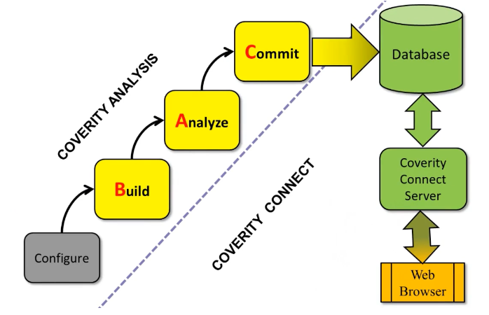
Flow Analysis Tools
Quite a few exist
  Mainly for fixed sets of properties
    Optimized for those properties
  Generally, these run in batch mode
  And can take hours or days to run on something complex
Examples
  Amandroid for android checking
  Commercial tools (C++): coverty, parasoft, understand, veracode, …
  Often run with major check-ins, before releases
Our Goal: Immediate feedback on safety errors

Slide 21

Immediate Feedback
A lot of things are still done in batch
  Compilation
  Testing
  Checker type checking
  Checkstyle
  Automatic bug repair
I believe they would all be more effective if done immediately
  Provide feedback as the developer types
  Compiler feedback in todays IDEs shows this
My research goal continues to be to find ways to achieve this
  Continuous testing: not that useful since tests take too long and interact
  ROSE for automatic bug repair while you debug
  Code Bubbles checkstyle plugin to check as you edit
  And abstract interpretation for checking safety properties as you edit
    Fast data flow analysis has other applications as well

Slide 22

Safety Checking as you Program
Goal: Show the state of safety conditions in real time
  As the programmer writes or edits the code
  Show problems to the programmer in the IDE
This is the goal of our FAIT project
  Runs in conjunction with Code Bubbles
  Provides error indications at safety violations
  Provides information on why this is a safety violation
    Graph of paths leading to the violation
  Provides other information
    Backwards slice of a variable
  Useful for other tools
    ROSE uses it to do fault localization

Slide 23

FAIT: Efficient Flow Analysis in an IDE
Making it efficient and complete
  Handle all the Java complexities such as reflection with some user input (via a resource file)
  Special handling collections, maps, string buffers
  Ignoring methods that do not matter with respect to the condition(s)
    Based on user input in a resource file
  Using unique immutable objects for efficient entity and value representations
Making it concurrent
  For much faster flow analysis
  Work queue of methods to work on; work queue of locations in the method
  Separate threads can work on separate methods simultaneously with little synchronization
Making it incremental
  To update as the user types
  Detect what might have changed, mark those as invalid, add to work queues
Handling both source and binary files simultaneously – parallel interpreters
  Source for files being edited (needed to avoid continual save and compile)
  Binary for everything else
Tries to be both accurate and precise while being efficient
  User input on what is important; what values to consider; what should be context sensitive

Slide 24
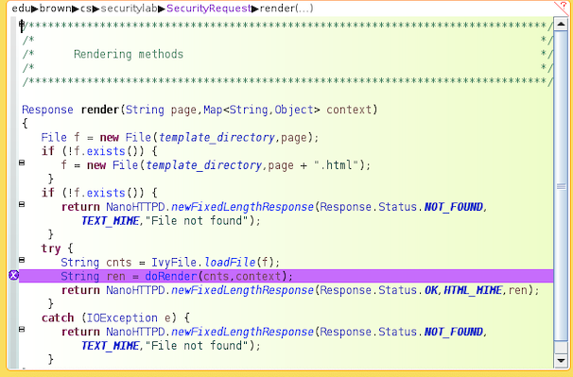
Code Bubbles FAIT Analyzer
Runs as part of the environment
  Updates anytime there are no compiler errors
    Can’t execute when there are errors
  Provides immediate feedback
    Typically, in under a second, with initial analysis in under a minute
Requires the user to define subtypes and safety conditions
  What they want to have checked
    This varies from one system to another
    Some basic ones predefined (Tainted data for SQL injection & XSS, for example)
  Subtypes
    Various states, rules for computation; again, some basic ones predefined
  Safety conditions
    Various states, program events, rules for changing state based on event

Slide 25
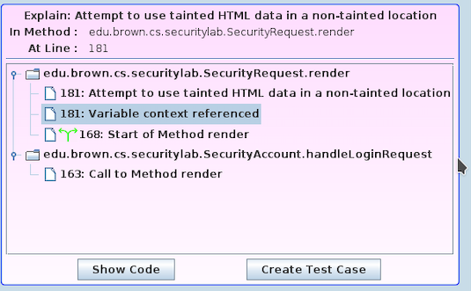
FAIT in Code Bubbles
Requires some annotation of the code
  Using Java type annotations
    Either direct or indirect (in resource file)
  Using preannotated library routines (from resource file)
  Source and sink annotations required for type checking
    But not the intermediate values as Checker would require
    Standard ones (e.g., Spring html server, Java html server) are predefined
    Or can call dummy function (e.g., KarmaUtils.taint(data))
  Calls to dummy function indicate state-based events
    KarmaUtils.event(“event”)
Requires additional information from a resource file
  How to handle reflection, native methods
    Reflection only in cases where the class is never instantiated otherwise
    Most standard library native methods are taken care of
  Note special case methods (e.g., those that never return)
  What methods can be ignored (for better performance)
    Or whole classes or whole packages
Current Research on user interface to define and edit the resource file
  This is a difficult user interface problem

Slide 26
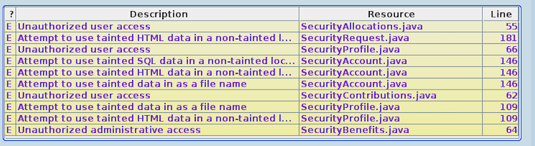
FAIT in Code Bubbles
Reasonably precise for most safety conditions
  But this varies with complexity of the code
  And how complex one allows values to become (ranges and constraints)
  Doesn’t detect multithreading errors (e.g., deadlocks and race conditions)
    Doesn’t consider locks in general
  Graphs let user explore output; resource files let user adjust program to achieve more precision
Mostly accurate, but accuracy not guaranteed
  Performance, reflection annotations, native code
    User descriptions of these in resource files might introduce errors
  Doesn’t consider all possible run time exceptions
Fast enough to be useful
  Updates whenever code is error free
  Presents current errors to user
  Can be queried in real time
    Provide a back slice of how a value might be set from the editor
    Provide information to ROSE on possible locations leading to a fault
    Provide a trace of how an error might have occurred

Slide 27
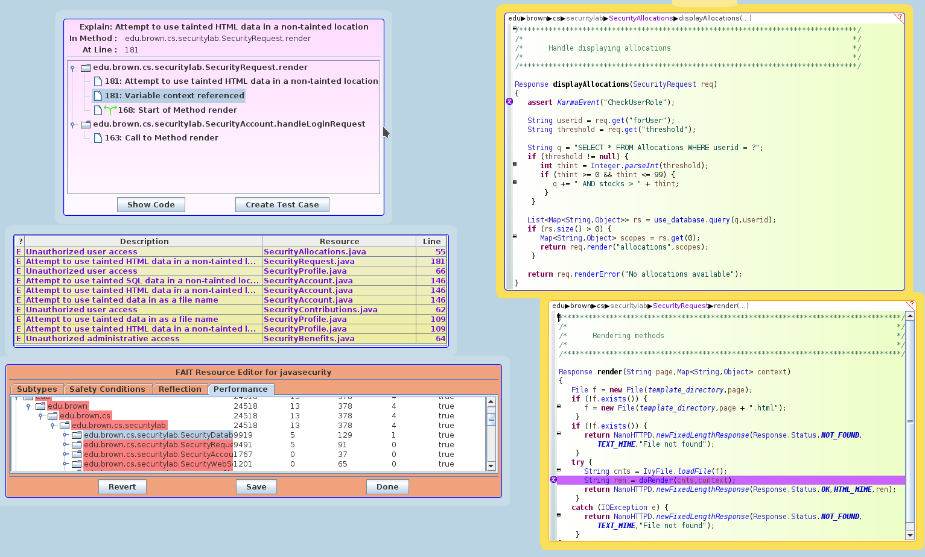
FAIT in Code Bubbles

Slide 28
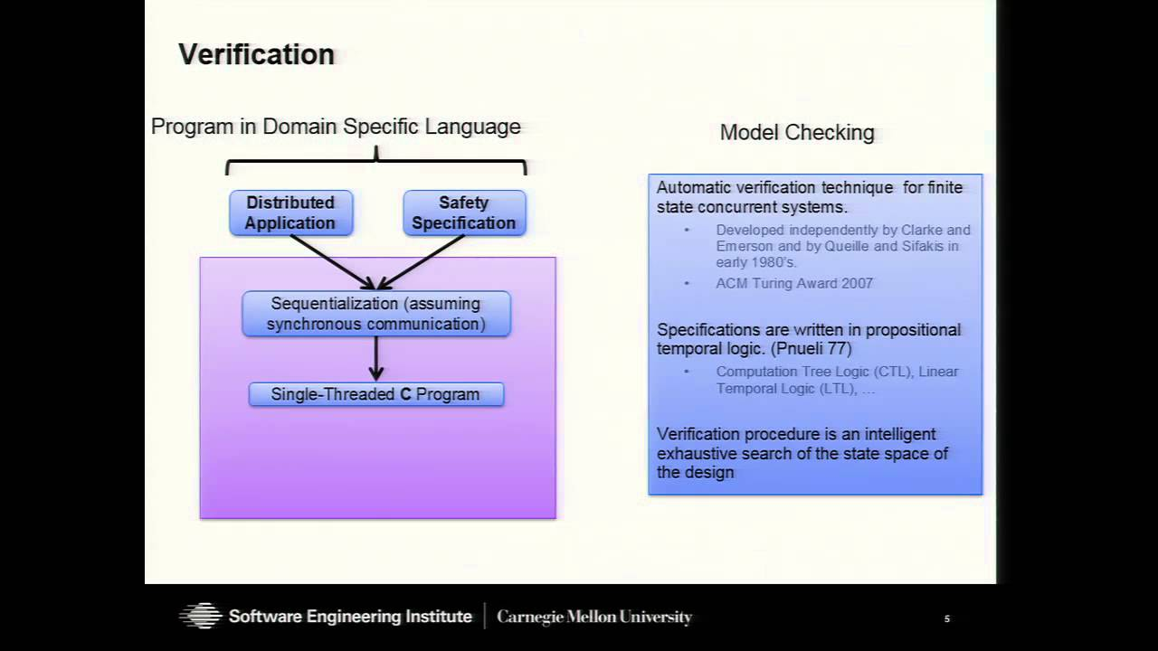
Model Checking
Abstract interpretation is limited
  Doesn’t consider interleaving executions
  Doesn’t consider external events
  Doesn’t consider locking
  Doesn’t consider the external world
Model Checking is a more general approach
  Designed to handle interactions with the external world
  Designed to handle thread-based interleaving
  Can handle locking
  Used extensively for embedded systems

Slide 29
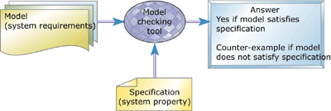
Model Checking
Originally created for checking hardware
  Small number of internal states
  Hardware is inherently finite
Then used for checking embedded systems
  Embedded code is usually relatively simple
    And usually modeled or written as a finite state automata
  Interactions with the real world are important
  These are often safety-critical (e.g., pinball fuses; train crashes)
Then use to check arbitrary software systems
  Checking individual safety conditions in a program

Slide 30
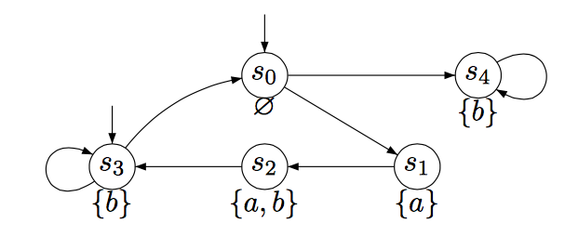
Model Checking
Can be done in terms of automata
  One automata for program, one for safety condition
  Find all possible pairs of states
    Run the two automata in step (cross-product)
    Events from program automata drive condition automata
    Outside events can also change the condition automata
  This is effectively what is done by abstract interpretation state checking
Usually done in terms of temporal logic formulas
  Boolean formulas
  With additional operators for time (different sets are used)
    X is true forever (X always occurs)
    X is true in the next state
    X is true in some future state (X eventually occurs)
    X is true in some state after Y is true

Slide 31
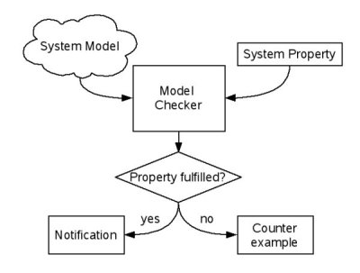
Model Checking
Create a single formula that is true if the program fails
  Represent a program state s as a Boolean vector
    Finite number of variables, each with a finite representation
    Includes the program counter (e.g., the program point)
    Assume a finite number of threads – each thread has its own state
      Program state is the concatenation of the thread states
  Define the starting state of the program s₀
  Create a logical relation representing program execution
    R(s1,s2) is true if program can transition from state s1 to state s2
    Basically, R is the OR of the effect of each instruction on the program state
  Create a temporal logic formula representing the condition C(s1)
    Over the program state – map from the FSA if needed
  Create a formula that says an execution from s₀ leads a state where C holds
    Temporal logic (repeatedly use program relation)
  This is large, but can be created mechanically
Prove that formula holds
  The proof provides a counter example and hence a potentially buggy execution
  Find a set of values that satisfies this formula
  Convert that into the appropriate execution

Slide 32
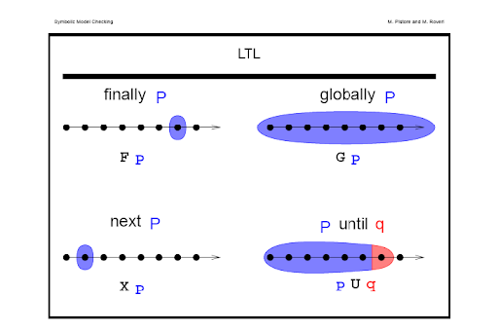
Model Checking
Various technique exist to do the checking efficiently
  Ordered binary decision diagrams
    Cute data structure that can greatly simplify the search
    Can handle program states space of size 2^100 or so
  Newer technologies for 3SAT and similar problems
    Can generally handle these as well
  These are all batch processes however
Both can yield a proof that shows how the program can fail
  Which can be translated into a counterexample
  Which can be translated back to the actual program
  To provide feedback to the user

Slide 33
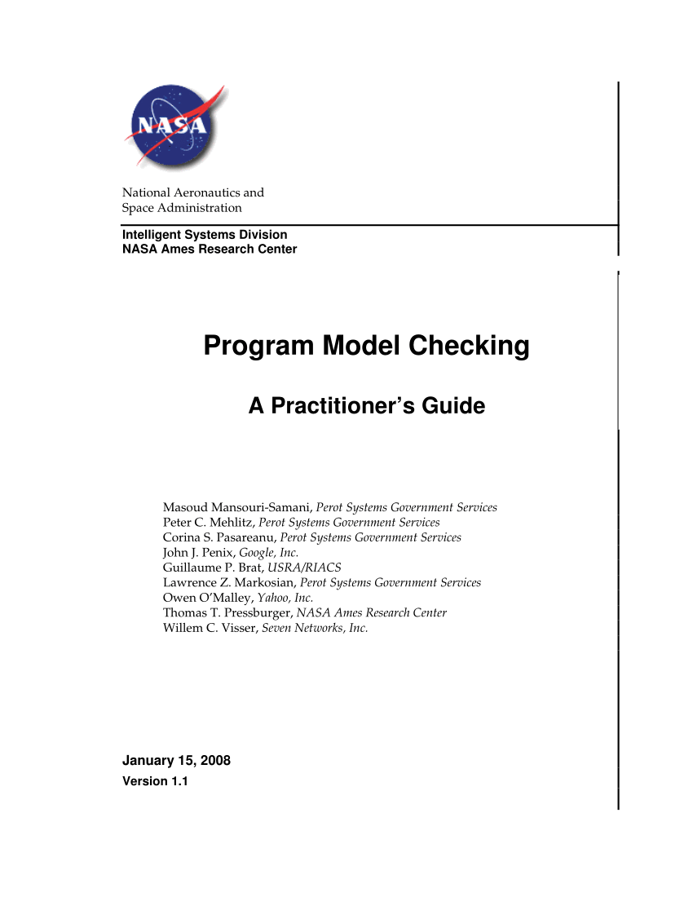
Practical Model Checking
The whole process can be semi-automated
JavaPathFinder is used by NASA for example
  Starts with annotated Java code
  And conditions to check
Either says the model is correct
  Or shows an execution leading to an error
    Counterexample
  If the reported execution isn’t possible
    The model can be made more robust
    Adding additional annotations or constraints
    Extending the way values or the program is modeled
  Often, a proof involves multiple such changes

Slide 34
PROJECT
You should have a working version of your project
  Not fully functional
  But demonstratable
  Something you can feel good about
Choose a date for project presentations
  One of 12/3, 12/5, 12/10 (2 presentations a day)
  Or I will choose one for you
  eMail me your options and priorities and I will assign dates

