Slide 1
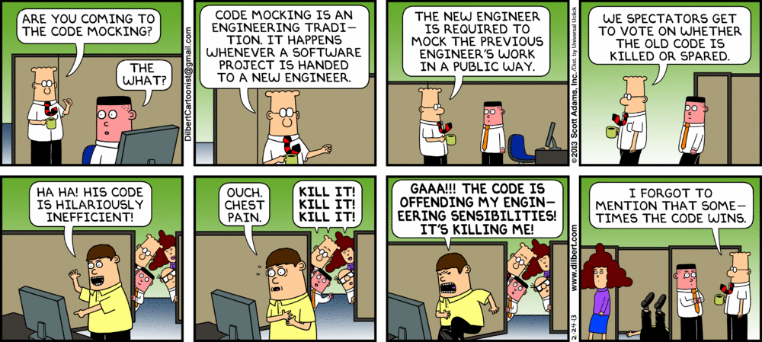
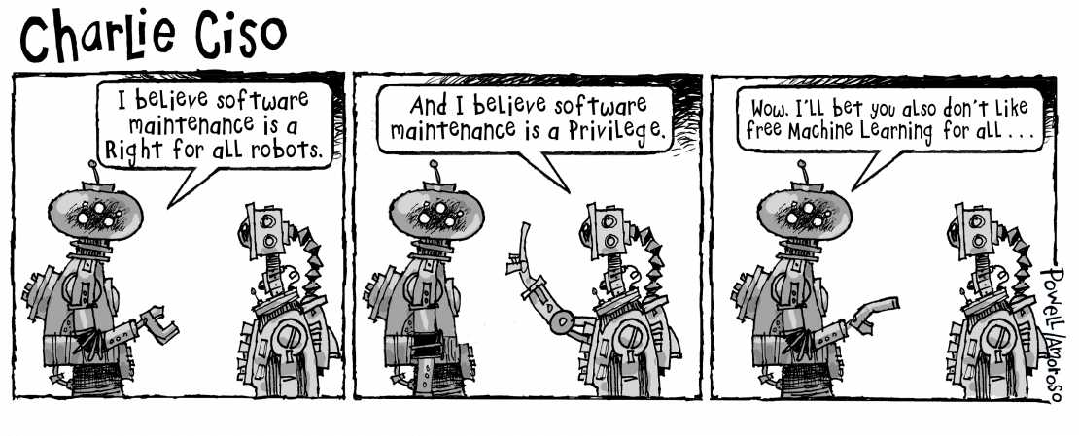
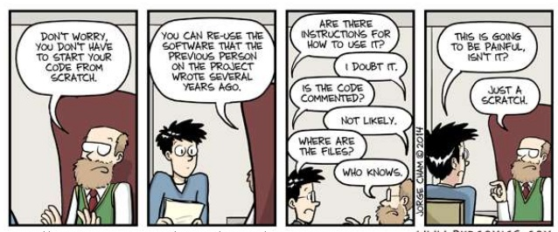
Maintenance I
CSCI2340: Software Engineering of Large Systems
Steven P. Reiss

Slide 2
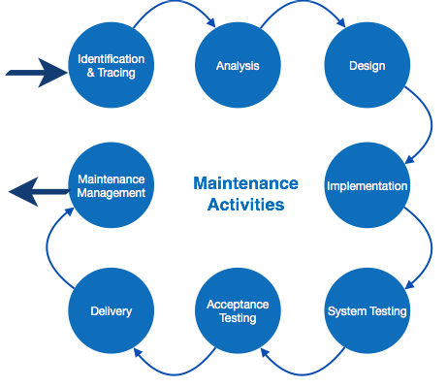

What does Maintenance Involve
Changes to the software
  New features, capabilities, uses
  Fix bugs, scale the system, …
  Adapting and staying ahead of the competition
  Attracting and keeping users
  Making the software self-supporting
Changes to the environment
  New versions of the language, libraries, OS
  New architectures
  New hardware to interact with
Changes to the user base
Changes to personnel

Slide 3
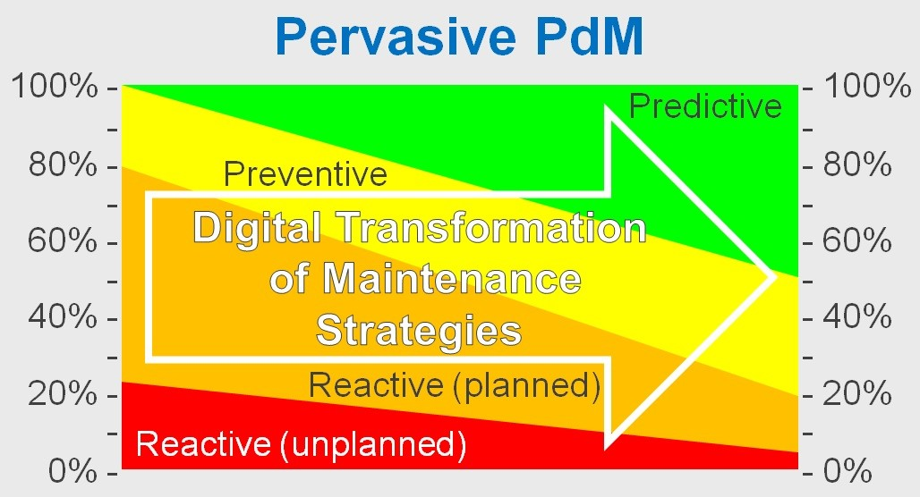
Maintenance is Pervasive
Throughout software development
  In requirements, specifications
  Design for maintenance
  Coding for maintenance
  All software development is maintenance
Much of maintenance involves coding and debugging
  As well as requirements, specifications, and design
  But we have covered these
Maintenance also involves some new issues
  That you and your system must deal with
  For the user, web-based applications, the backend, & in general

Slide 4
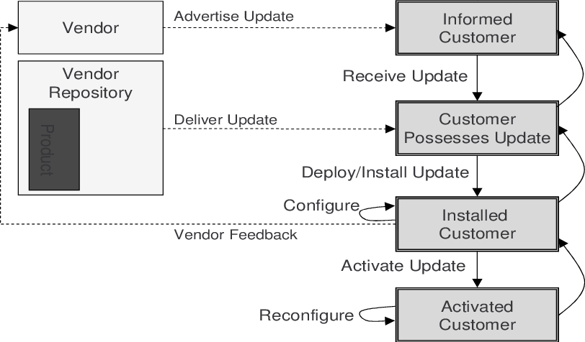
Maintenance Issues: User Facing
How to have the user install the software
  App stores
  Direct downloads
  Purchases
  On different systems
  No need: it’s a web page
How to have the user upgrade the software
  Automatic upgrades
  Manual upgrades
  No need: it’s a web page
How to get the user to understand the software
  How to use it effectively
  How to do what they want to do right now
  Documentation, help, tutorials
How users interact with the software
  Privacy and security policies
  Usage policies

Slide 5
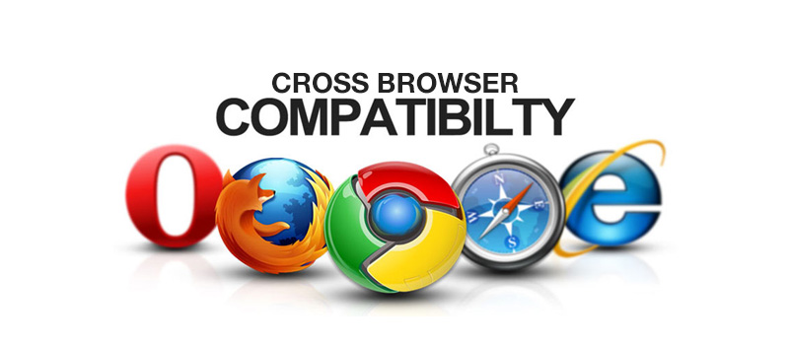
Maintenance Issues: Web-Based
How will it work with different browsers
  Older browsers, unusual browsers, new browsers
  Optional browser features (e.g., location, camera, audio, …)
How to have it work under different user conditions
  Lots of different hardware & software options
  Enable/disable cookies, ad blockers, …
  Operating system permissions
  Different networking capabilities
  Cached pages
How to have the user understand the software
How users interact with the software
  Privacy and security policies
  Usage policies

Slide 6
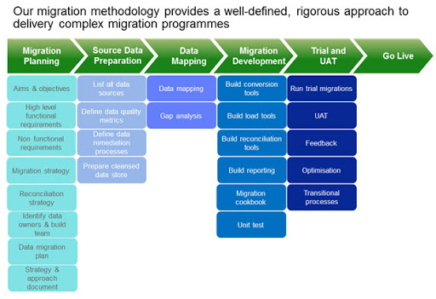
Maintenance Issues: Back End
How to upgrade the server as the software evolves
  Minimizing down time
  Without affecting current users
How to enable porting to a new platform
  New OS, language, libraries
  Changing back end
How to ensure stability of the platform
  You must upgrade (security, EOL)
  What happens when things changes
  What happens as needs changes
  What happens as resource usage changes
  Keeping it and the data secure
  Monitoring what is happening

Slide 7
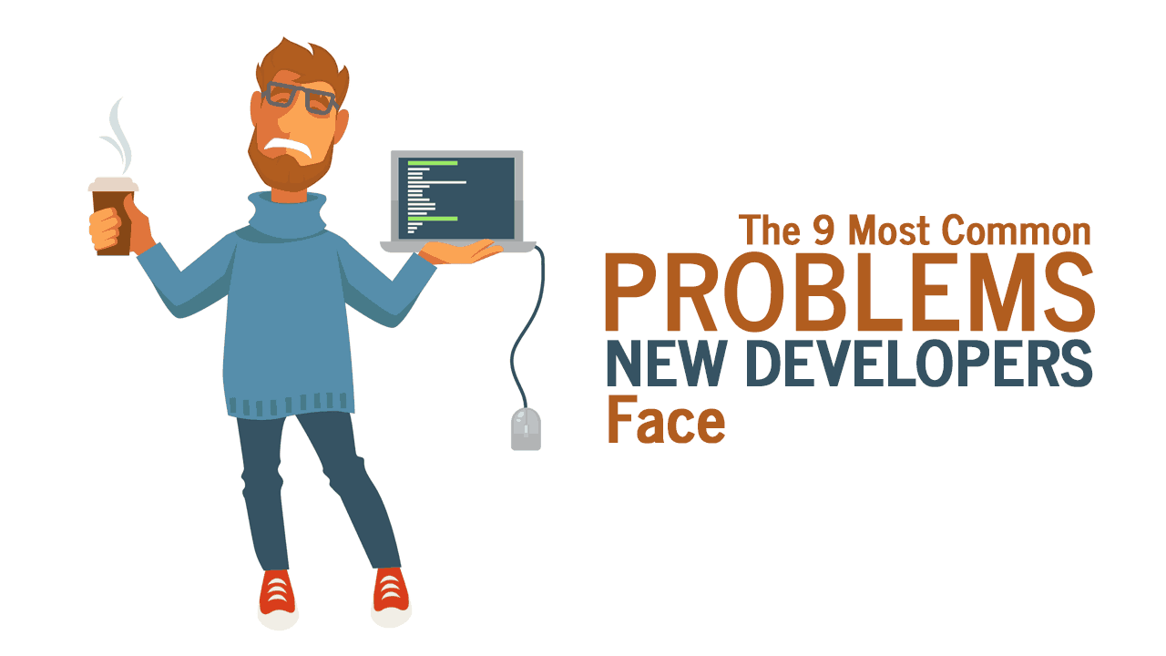
Maintenance Issues: General
How to bring new developers on board
How to maintain other programmer’s code
Ensuring you don’t break things
  When maintaining the code
  Adding new features
  Adapting to new environments

Slide 8
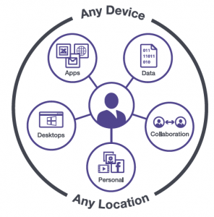
User-Facing Software Issues
User environment differs from debugging environment
  Jar file rather than class directories
    Binary rather than source
    Not running in the debugger
  Binary files need to be architecture specific
  Different compilers and shared libraries
  Different versions of JRE, JavaScript, python, Node, npm, …
  Different shells and system commands
  Different installation directory and paths
  Different file system (paths might not work) (/ vs \)
  Access to resource files can differ
You want the software to work in the user’s environment
  Running at arbitrary path, with different permissions
  For arbitrary user environments

Slide 9
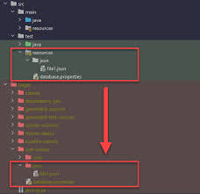
Resources on the User System
Resource files
  Images (icons), text (i18n), user-settings, libraries, …
  Options and user settings
  Program needs to read these
  Both while developing and in production
Accessing resource files in the user’s environment
  Self-discovery (location of binary can be found)
    If resources are kept in a jar
    Need to handle resources in development as well
  Java: Based on class path (using class loader) (works with jar as well)
  Setting an environment variable (and ensuring user sets it)
    Updating the user’s shell startup files
  Patching the binary on installation (or compiling from scratch)
  Part of the system (Mac applications are directories)
  Fixed location (/System/Library/<application>/…, Windows Registry)
  As part of installation (android, ios)

Slide 10
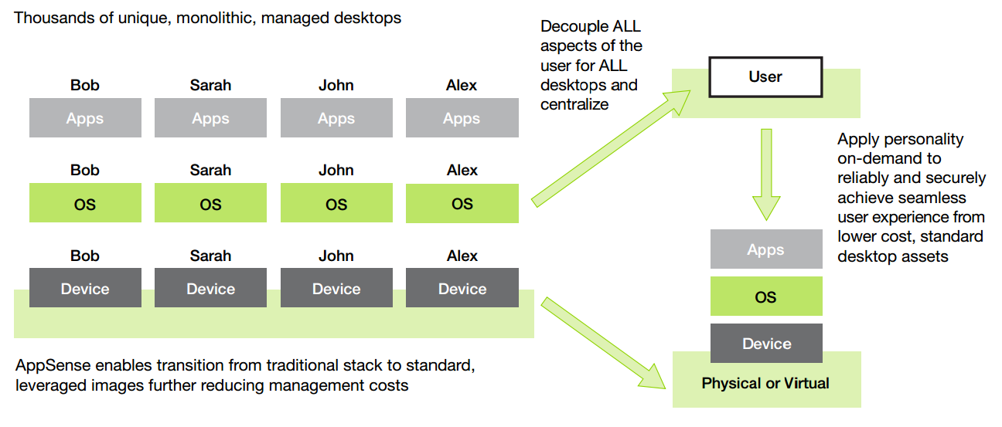
Handling the User Environment at Runtime
Need to run on what the user has
  Different versions of the OS, language, libraries, tools
  Different installation directories, permissions, packages
  Different environment variables, shells, …
  User might not have sudo or root permission
  User might not be a sophisticated user
Can check prior to installation
  Separate program to check if usable
  As part of build/initialization (linux configure)
  As part of app-store
  As part of preinstallation or installation
  But user can change this underneath you
Code for the least common denominator
  Don’t use new features
  Or use them only if available
  Or isolate in your own modules

Slide 11
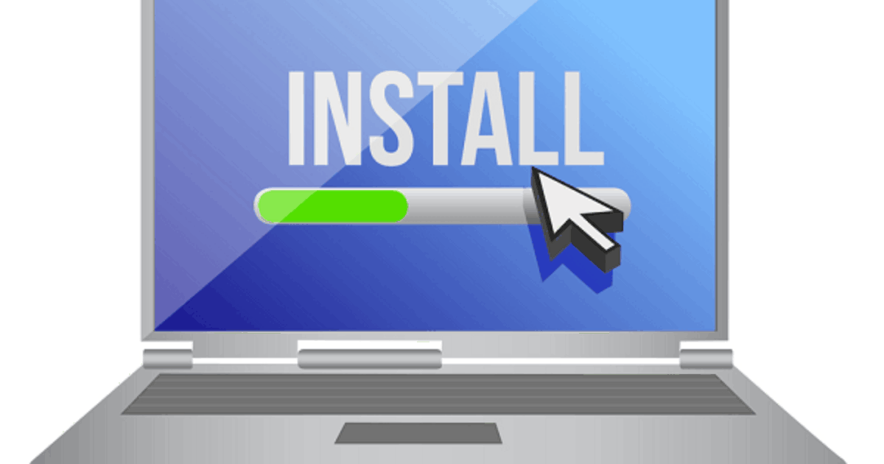
Installation & Upgrading
What do you need to do to facilitate installation?
  Need to have the user install the software on their machine
  Need to have the user install the software in their environment
Potential problems
  Detecting the environment and adapting to different ones
  Checking if the environment is suitable
  Removing inconsistent or older versions of the software
  Maintaining the user’s settings and work from older versions
Potential solutions
  Think about all the ways you have installed software

Slide 12
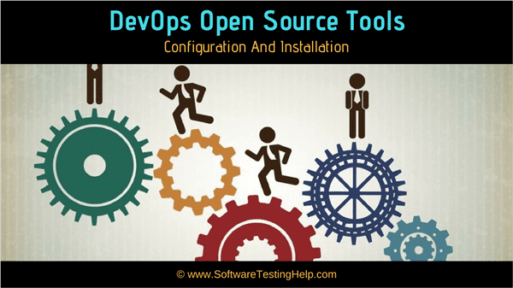
Installation Solutions
Download a package that includes and runs installation script
  app-get on Linux (fixed location install; needs sudo)
  auto-run on CDs
Download source, configure, compile, install
  homebrew on the Mac
Download and run a dedicated installer program
  Typically, a single disk image or file containing installer and data
    Can just be installer and do the installation from the network (Eclipse)
  Commercial installers exists
    You customize them by writing “scripts”
    These provide access to common operations
  Open-source installers exist
    Not as robust as the commercial ones; scripts are much more limited

Slide 13
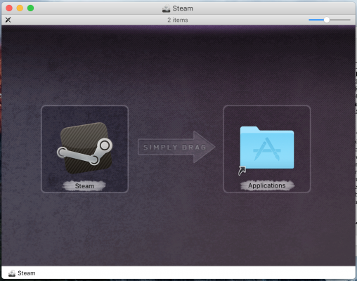
Installation Solutions
Mac OS/X
  Application is already bundled in a directory (*.app)
    User just moves it to the applications folder
    Directory includes binary(s), libraries, resources
    Single directory can work with different architectures
  Disk image contains app and link to applications and hint to move
Self-Installing
  Check and install as part of system initialization
    Can be done in conjunction with any of the above
  Code bubbles: download jar. First run does the installation
    Prompts user for any needed information
    Sets up install directory contents
    Restarts the application with proper libraries

Slide 14
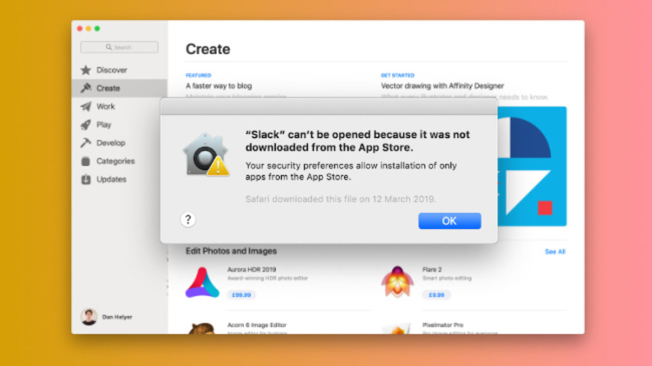
Installation Solutions
App Stores
  Provide a standard way of installing mobile apps
    You must adhere to the protocols, licenses, inspections, etc.
    Not convenient in early stages of development
    Include resources, compatibility, capabilities needed, …
  Being extended to desktops (mac, windows, chrome-OS)
    But here they typically use normal installers
Marketplaces
  Marketplaces provide the equivalent for single apps (e.g., Eclipse, Code)
  Useful where 3rd-party plug-ins are a way of extension
  Require considerable work to build, maintain on your own

Slide 15
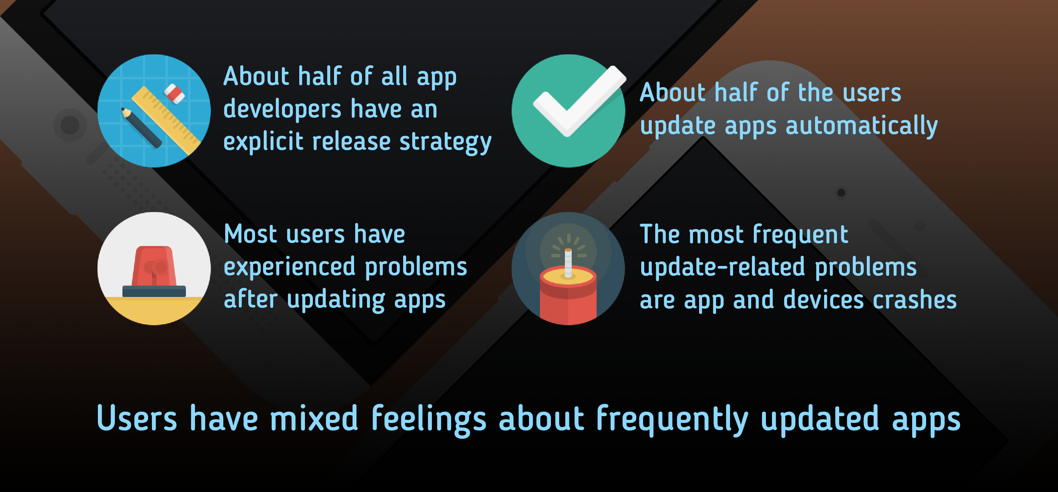
The Updating Problem
Software updates are going to be required
  Fixing bugs, adding new features, accommodating new OSs, etc.
  What do you require from the user
Detecting when updates are available
  Knowing when to update, integrating this into the application
  Not asking the user all the time
  Doing it automatically
  Detecting if update is appropriate

Slide 16
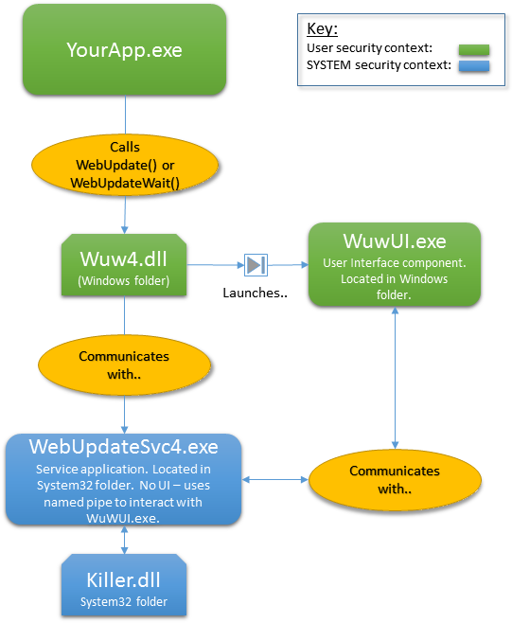
How to Update
Separate program that does the update
  Save state that needs to be saved
  Update the software (and saved state)
  Remove previous version
  Restart the software
  Need to ensure the update can be aborted
    Download; atomic replace; restart
    Separate file partitions used in IoT devices
Downloading and running the installer again
  Rather than a separate program
    But this is visible to user, not hidden
  Using user’s current settings
    Requires a smarter installer
  Installer probably needs to do this anyway

Slide 17
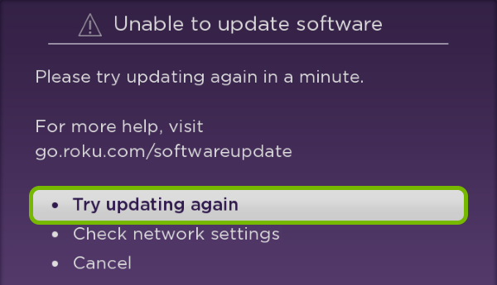
Update Issues to Consider
Matching the installation with the update
  Anything the user had to set up before
Updating personal resource files if they have changed
Permissions required
Checking for other required libraries, packages, systems, …
Updating libraries, resources, registry
Removing outdated resources
Handling errors
  Permissions, disk space, network issues, …
  Bad updates

Slide 18
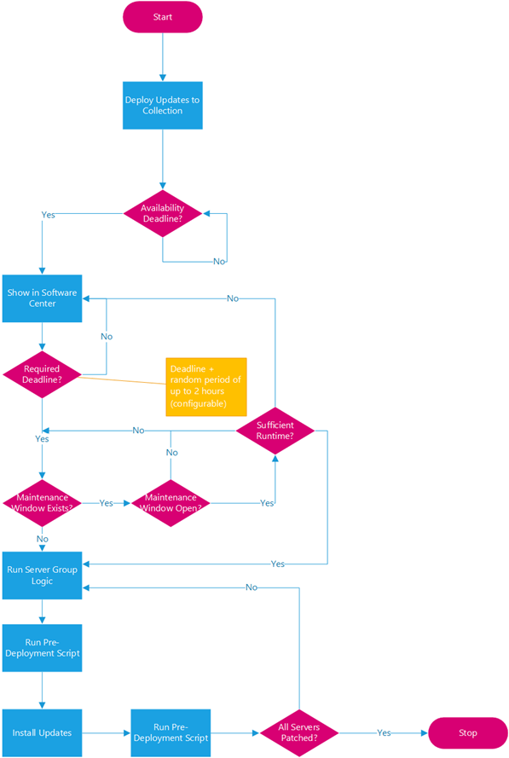
Back-End Systems
Back-end systems are a bit easier to maintain
  You have control of the environment
  You have control of when and how to update
Problems still exist
  Isolating users from potential changes
  Isolating from other applications and their needs
  Handling hardware/software errors
    Don’t crash or do an auto restart
  Updating
    With little or no downtime
    Without losing user connections/sessions
      Keep these in permanent storage
    Running multiple versions simultaneously

Slide 19
EXERCISE
What are your projects installation and update plans?
  Have you investigated this at all?
  Have you built it into your system?
For web applications, what are your compatibility plans?

Slide 20
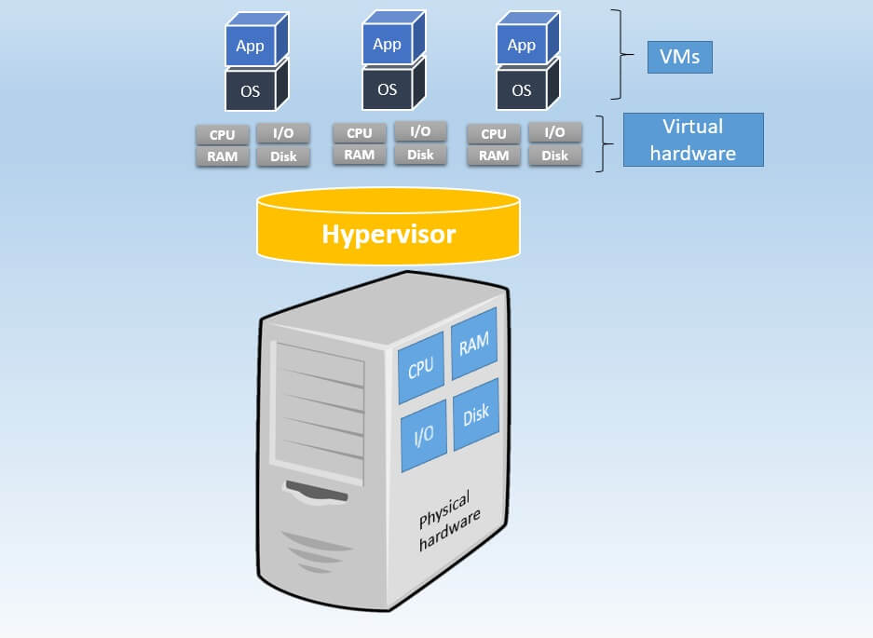
Virtual Machines
Today most server code is run on virtual machines
  Some of you are already doing this
  You can’t run in production from your local machine
Cheaper than owning specific hardware for each application
  Your application seems to have its own dedicated hardware
  But the physical hardware can be shared
  Someone else worries about hardware maintenance, etc.
  Can specialize the VM to the application
  Easy to migrate to a new VM
    If the hardware goes down
    As your requirements change
You have control of the environment
  Libraries, installed software, versions, etc.
  You control when things change

Slide 21
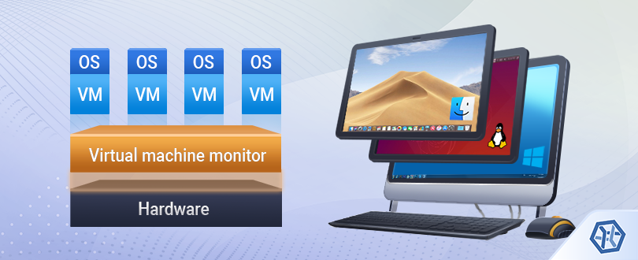
Virtual Machines
Easier to upgrade as needed
  To a larger server
  To multiple servers
  Can migrate from one VM to another
    Save and restore state
    Recovery
  Can just change IP address to point to a new VM to upgrade
    But then everything needs to be saved in a separate database
Virtual Machines provide a layer of security
  Isolate the software to a particular VM
  Compromise the VM, not the development platform
    Setting up a new VM should be relatively easy
  Can migrate on hardware failures

Slide 22
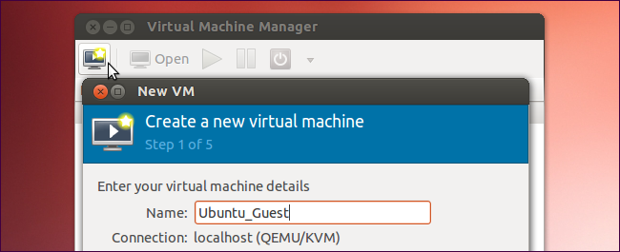
Most VMs run Linux
Standard configurations for most standard servers
  For most execution stacks
  Apache, MySQL, Php; Node, Mongo; Wordpress; dart/flutter; flask …
  Or instructions for setting up such a server for your stack
Different ecosystems provide different options
  Amazon (AWS): servers, disk space, SQL & NoSQL databases, firewall, credentials, …
  Brown CS: servers, disk space, PostgreSQL, firewall (staff maintained)
  Google cloud, Microsoft Azure, IBM …
You should learn how to manage the system
  Install and upgrade software (apt-get)
  Manage the database system
  Manage credentials, users, …
  Manage the firewall

Slide 23
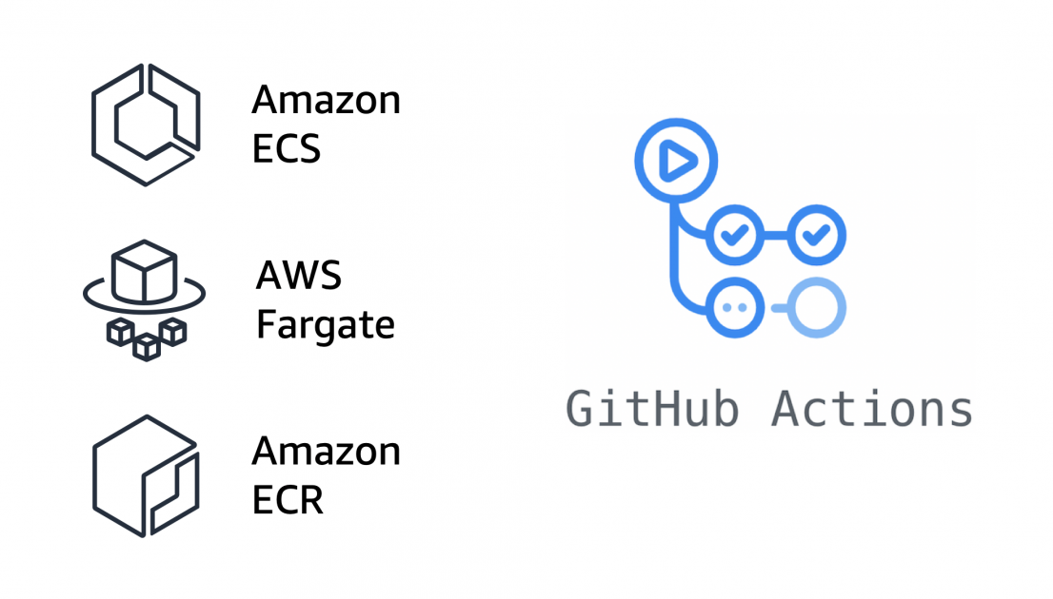
GIT and the VM Server
GIT can be useful for maintaining the virtual machine
  Ideally you have a development version of the software
  Can have a production branch as well
Installing on the server should be as easy as
  git pull (to get the proper version)
  Run installation or update script
    Set up anything that needs setting up
    Stop old server
    Start new server (pm2)
  Can be automatic with git/GitHub actions
    Actions also available from cloud service
  Update script for database
    If the database schema has changed

Slide 24
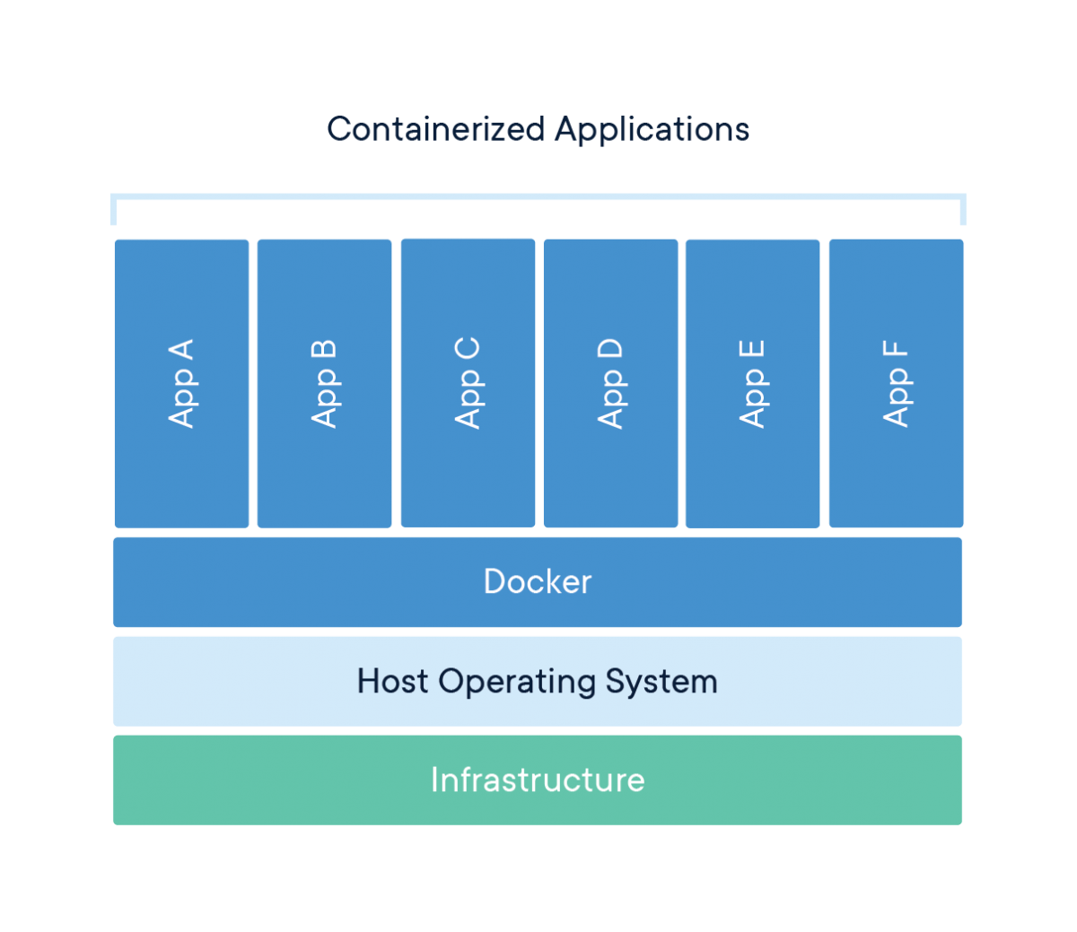
Virtual Machine Issues
Virtual machines have considerable overhead
  Pre-allocate memory, disk, …
  Startup, even from sleep, takes time
  Extra runtime overhead of a hypervisor
  Migration can take time (copying large files)
  Out of your control
But they provide a high degree of isolation
  One VM is unlikely to affect another
  Corrupting a VM doesn’t corrupt everything
  And they offer a lot of flexability
Would like the benefits without the costs

Slide 25
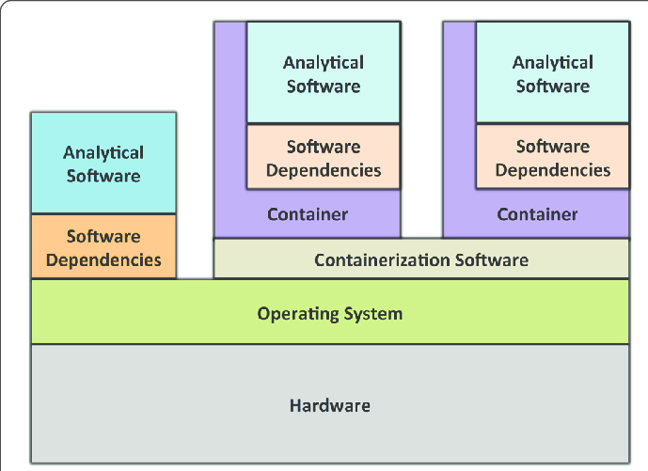
Containers
Containers are a lightweight solution
  Equivalent functionality to VMs
  But with much less overhead
Operating-system level virtualization
  Multiple isolated systems running using a single kernel
  Isolation
    Independent process trees
    Independent networking
    Independent user ids
    Independent file systems
    Container can crash or be corrupted without corrupting the system

Slide 26
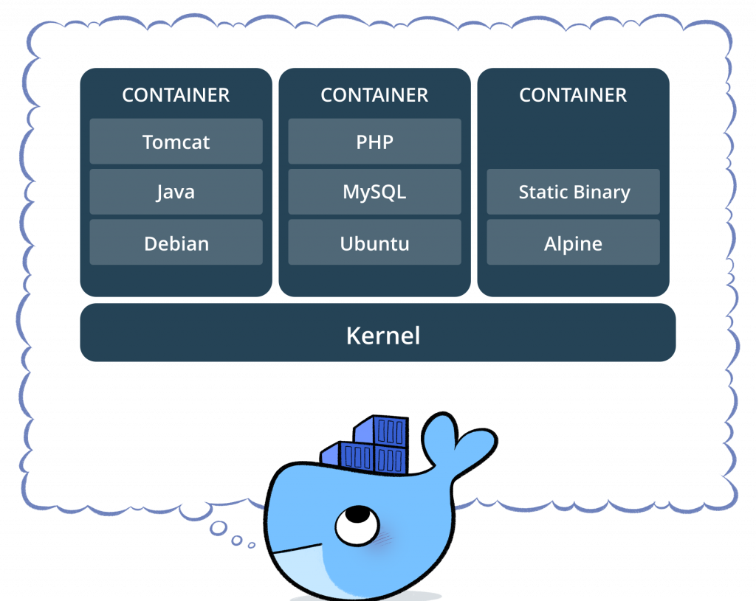
Container Pros and Cons
Isolation of file system, processes, network, users
Rollback
  Save and restore images, restart from image
  Fast to start a new container from image
Rapid deployment
Migrate from one container to another
Save and restore state
Difficult to use with user facing apps
  Need access to the shared display
Depend on host for networking

Slide 27
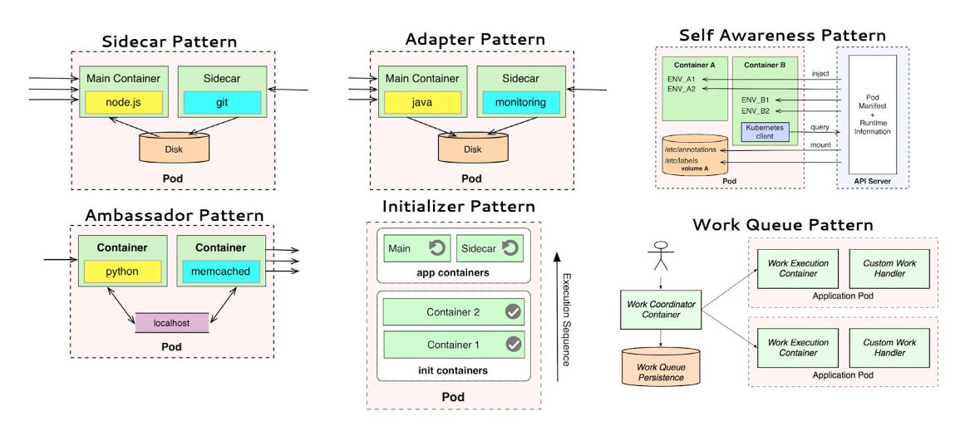
Containers and Microservices
Microservice architecture
  Divide the system in small, composable pieces
  Services can invoke other services
  Front end (web/mobile?) can invoke services as needed
  Services can be updated or replaced independently
  Good fit for some applications
Containers are a good match for microservices
  Each microservice can run in its own container
  Database can run in its own container or VM

Slide 28
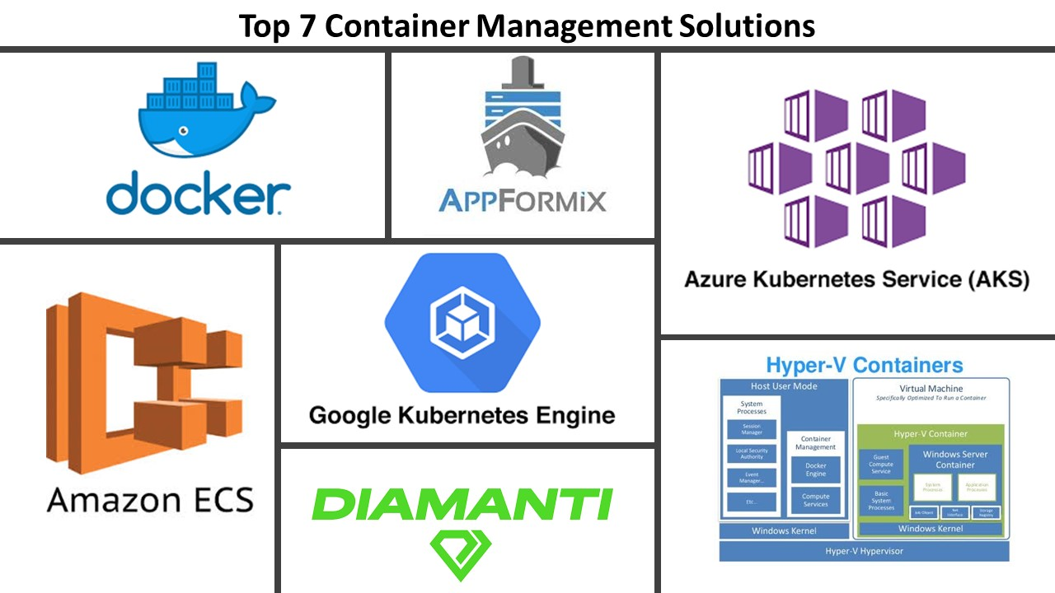
Managing Containers
Managing a lot of containers can get tricky
DOCKER provides facilities for this
  Based on kubernates

Slide 29
HOMEWORK
Sign up at DOCKER if you don’t already use it
Download and install DOCKER desktop
Do the tutorial that is there
No hand in

Slide 30
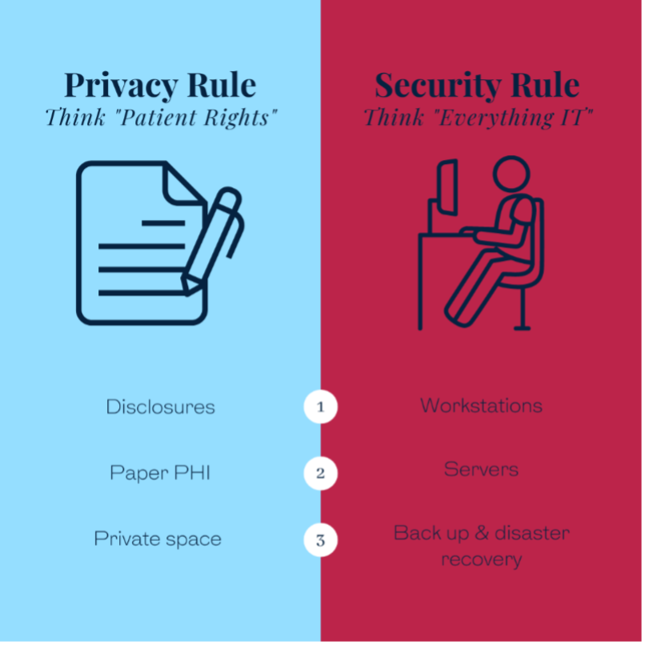
Privacy and Security Policies
Privacy and security were considered since requirements
  Pretty much in the abstract
  Once you have a user-facing system these become concrete
You need a privacy policy
  What data you are storing and why
  What permissions users retain on their data
  How to meet various legal requirements
    California and GDR (Europe) have specific requirements
  Might want to verify compliance with your policy
You need a security policy
  How to handle personally identifiable information
  Your responsibility for that information
  Keep track of what you are doing – security czar

Slide 31
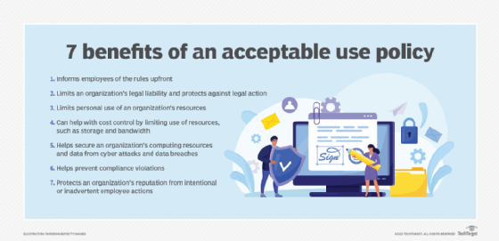
Usage Policies and other Legal Issues
You probably want a usage policy
  Can someone scrape your site
    To grab your data or functionality
  Can someone scrape your site for search
  Can someone scrape your site for building an AI model
  How much can one person use the site
    Can your site be accessed from a bot or application or must it be a real user
Other legal issues
  HIPAA (health), FERPA (students), COPPA (children)
  ADA compliance
  IP for code and data (copyrights, trade secrets, patents)
  Liability for accuracy of information presented

Slide 32
PROJECT
Presentation Schedule
  11/26: User Interface Generation
  12/03: Speech
  12/03: Sense IoT
  12/05: LLAMA
  12/05: DJ Mix
  12/10: Agentic
  12/10: Accessibility
  12/12: Final demos for all groups (optional)

