Slide 1
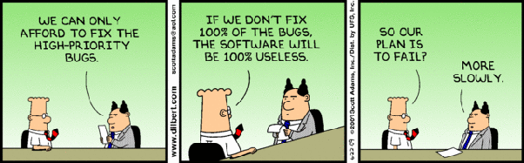
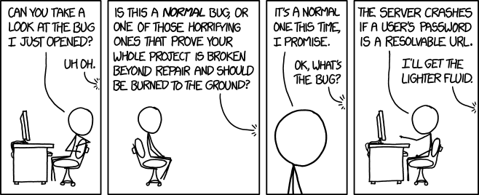
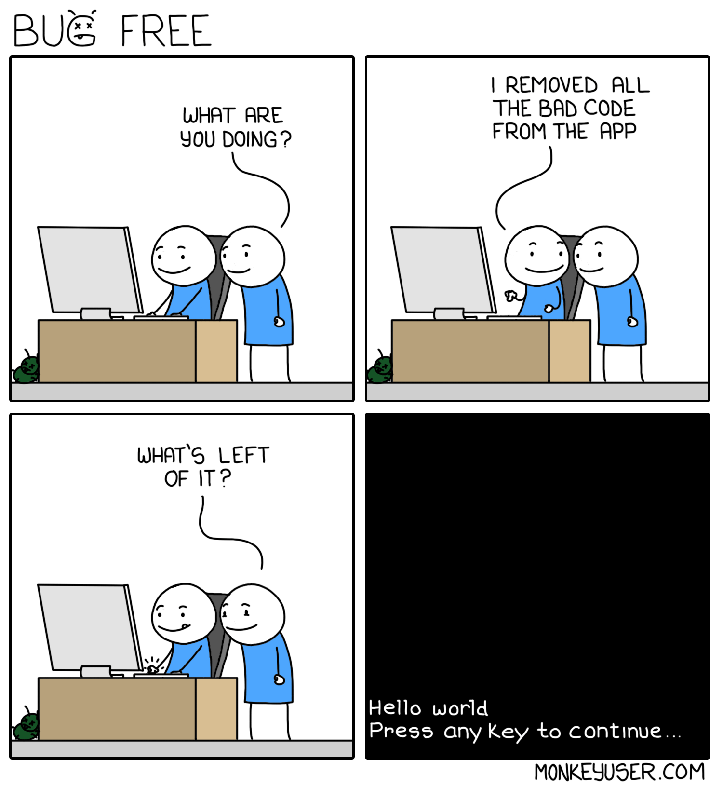
Maintenance II
CSCI2340: Software Engineering of Large Systems
Steven P. Reiss

Slide 2
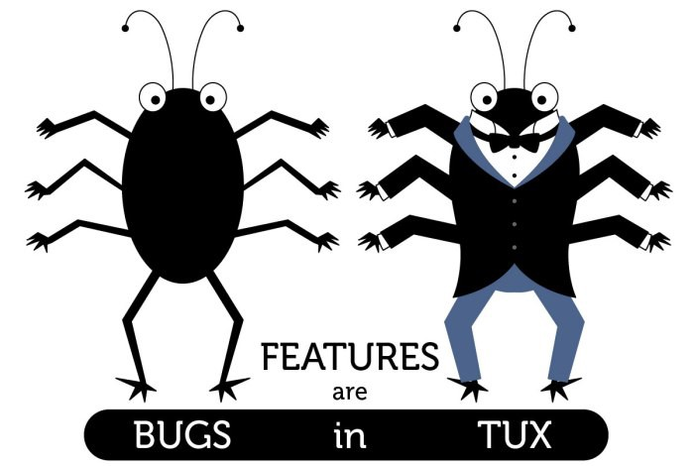
Bugs and Features
Much of maintenance is bug and feature driven
  You will find bugs
  Other programmers will find bugs
  Your QA team will find bugs
  Users will find bugs
  Your team want to add new features
  Your management will want new features
  Users will want new features
You will need to track, prioritize, and address these issues
  To know what to work on next
  To understand the state of the system

Slide 3
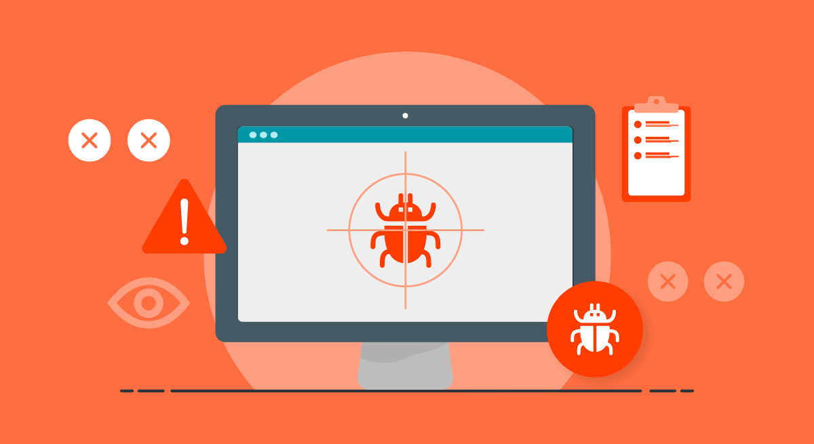
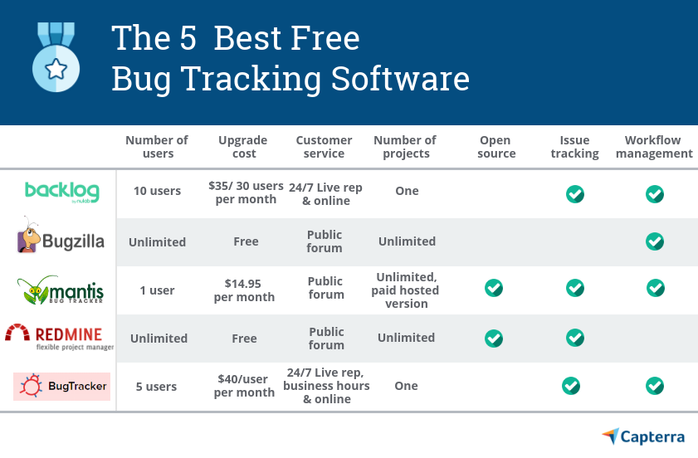
Bug Tracking
If there are a small number of issues (10s)
  You can do it by hand or on paper
  I use the Reminders app on the Mac for example
  But this lacks history, is not shared or prioritized, …
But a large system with a user base can have many more issues
  100s or 1000s outstanding is not unusual
  Need something more sophisticated
Tools exist for this purpose
  Bug tracking or problem tracking system
  JIRA, , YouTrack, GitHub Issues…
  Organized database of bugs & features

Slide 4
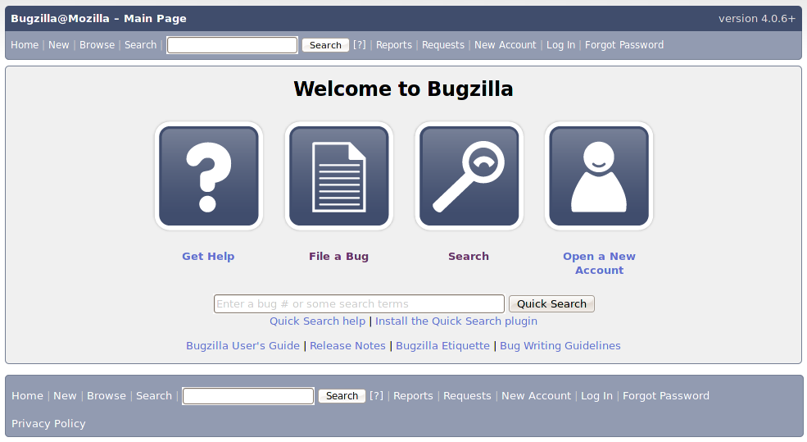
Bug Tracking System Features
Let you define bugs and feature requests
  Stored in a permanent repository
Assign these a unique id
  That can be used in the code and in commits
  That are permanent
Link bugs with associated bugs (avoid duplicates)
Give bugs a priority (critical, severe, … feature request)
Assign bugs to a developer to be fixed or implemented
Track status of entries (submitted, validated, fixing, done)
Search for bugs using various criteria and terms
View the history of a bug or feature request

Slide 5
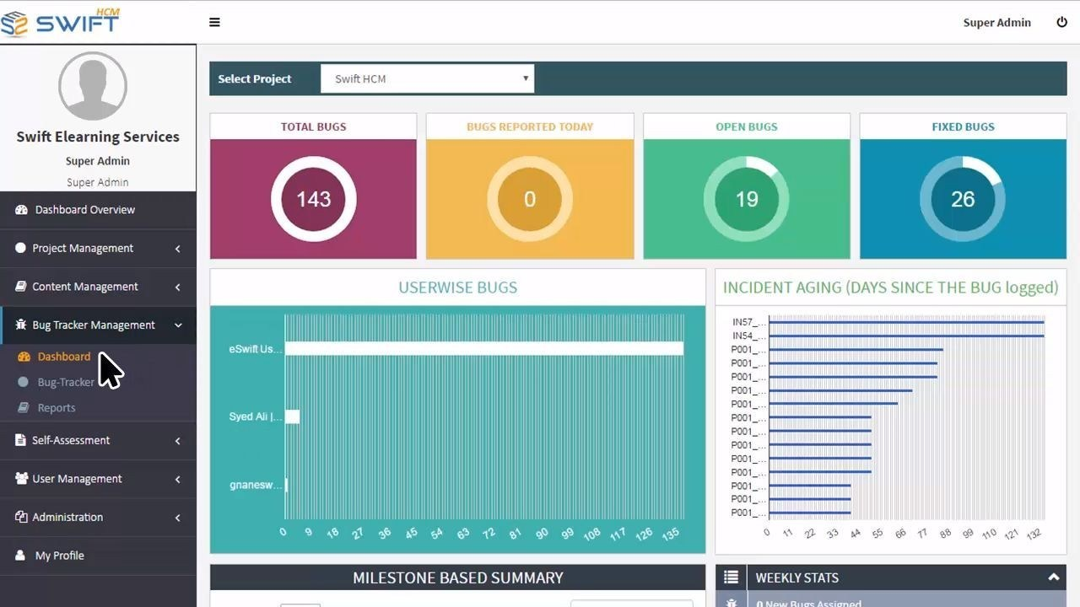
Bug Tracking System Features
Add comment, notes, etc. to entries
  Questions & answers as well
Sending email on status changes
Statistics (for management)
  Track the state of the system
  Track progress
User-accessible portal
  Users can comment on bugs
  Users can report bugs
  Users can vote bugs up or down

Slide 6
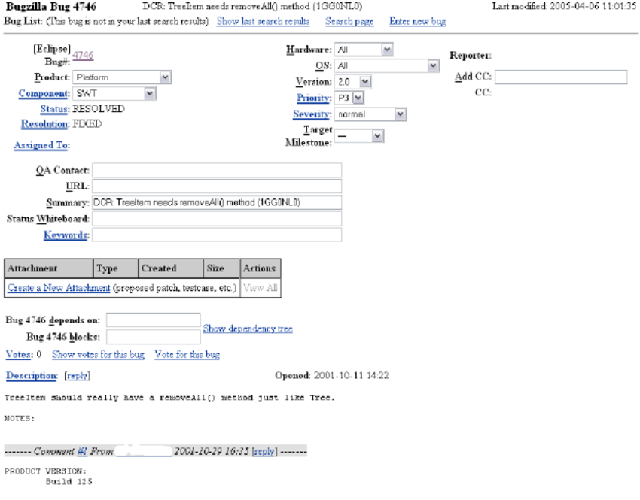
Bug Tracking System Problems
A bit of overhead is involved
  Can take 5-10 minutes to enter a new bug
    Or feature request
    Or more, depending on problem
    Entering all the necessary data
    Ensuring it is a new bug, not a duplicate
  Modern systems have made this easier
    By providing more flexibility
Geared toward larger organizations
  Seems like overkill for an individual or smaller project
Not that flexible or easy to adapt to your flow
  Difficult to customize the interface to your system

Slide 7
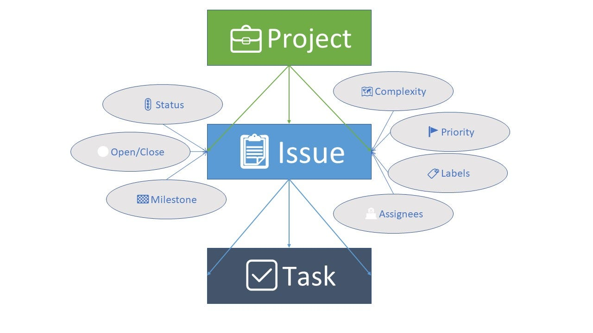
Modern Systems: GitHub Issues
Simple interface for a bug database
  Not structured like other systems, more freeform
  Wiki-like description, comments, feedback on bug
  Issues have a number
    Number only, starting at 1
  Issues have labels or tags
    Default is type of bug.
    Can be expanded to include priority
  Issues can be assigned to a developer
  Issues are associated with a project and a branch
  Issues have a state (open/closed)
Interface can be customized to project/team
  For example, the set of tags available
Notifications for status changes

Slide 8
Homework
If you don’t do so already, try using GitHub Issues to track bugs in your project.
  Ensure you have at least one issue (even if it is ”Start using GitHub Issues”)

Slide 9
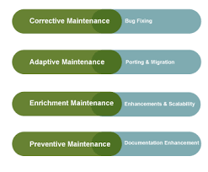
Maintenance Programming
Maintenance programmers work on other people’s code
  When assigned a bug or feature to address
  Possibly on the same project, possibly on a different one
  Possibly on open-source code
Maintenance programming is different from initial coding
  And from maintaining your own code
  In how you approach the code
  In how you write the code

Slide 10
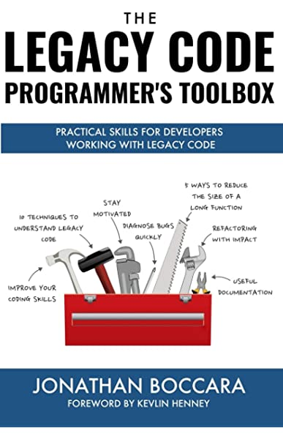
Approaching the Code
Determine where the change should be made
  This is fault localization
  Experimentation – find the code that causes the bug
    Easier if there is a test case you can use in the debugger
  By searching over the source
    Looking for error messages, names, stack traces
  By asking others or looking at (non-existent) documentation
  Like fixing your own bugs, BUT…
Don’t attempt to understand the whole system
  Concentrate on the problem at hand
    Only understand what the minimum needed to locate the problem
  Try to find pieces of the code that might be relevant
    Using names, coverage, …
    Using the IDE (name search, calls to a method, …)
    Using documentation
Fault localization is often the most difficult part of maintenance programming

Slide 11
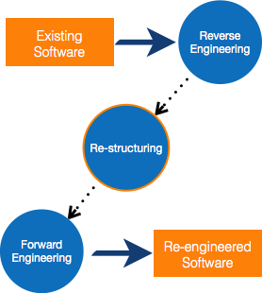
Fixing the Code
Develop a fix that addresses the problem
  Like fixing your own bugs, BUT …
  With a minimal effect on anything else
    Better not to try to fix the rest of the system
    Concentrate on the problem at hand
  But be general enough to handle related problems
    If you can prove such problems exist
  Understand the full effect of the code
    What it does to the local function
    If those changes flow out of the function, understand what it does to callers
    Propagate this to callers of these as well – but try to minimize the effects
Validate the fix manually
  Check anything else done in the local area
    Think about possible consequences of the fix
  Find a fix that causes minimal changes to the function and to its return values
  Check all call sites and assumptions
  Check what other conditions might apply
  Ask why it worked in general and failed in this case
  Satisfy (prove to) yourself that the fix works and doesn’t affect other cases

Slide 12
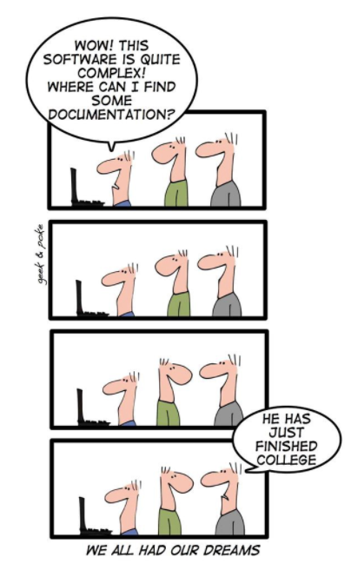
Writing the Code
Use the style of the existing code
  Not your personal style
  Not your project’s style if it is a library
Add a comment for the fix
  With your name, date
  With the bug id if there is one
  With information about the fix
Write good code
  Others will read it and judge you by it

Slide 13
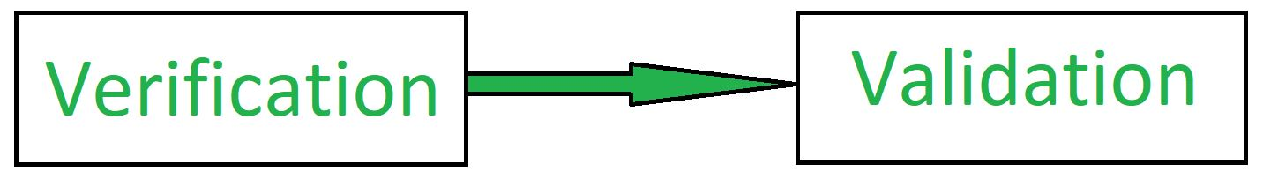
Validate the Code
On paper – manually check the actual code
  Prove to yourself that the code works
  Double check and triple check
With the original problem
  Create a test case if you didn’t start with one
  Add to your test suite if possible
With other test cases
  Using the existing test suite
  Adding other test cases that you see that might be at issue
    Based on your analysis of what other things might be affected
Maintenance program is fun and challenging
  What is the minimum you need to understand of the system to fix the bug

Slide 14
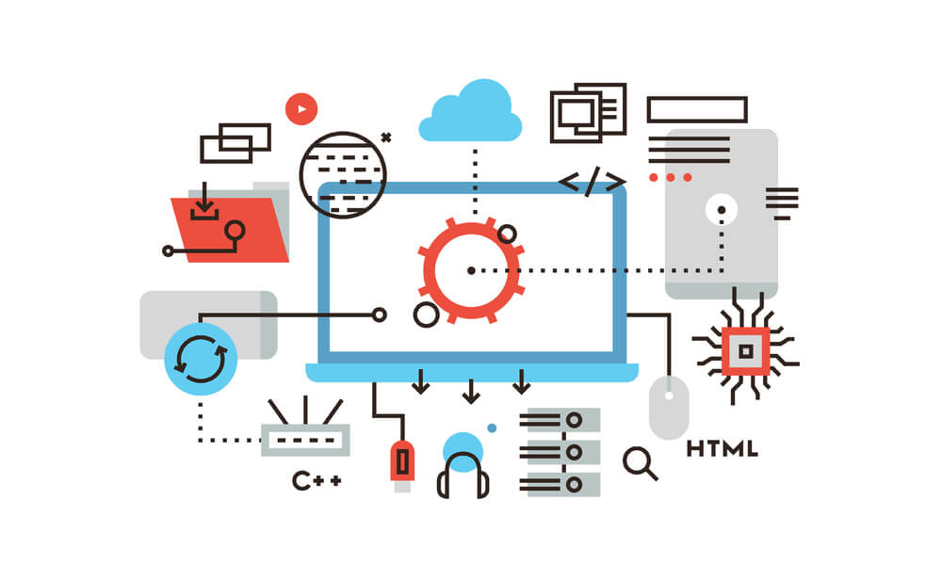
Monitoring Your System
You want to know about your system
  Is it being used
  How is it being used
  What are the problems users are having
  What are the problems the system is having
  Are there performance issues
  Are there security issues
  Has your data been compromised
  Where should you put your future efforts
How can this be done
  By asking your users
    Pop-ups, surveys, feedback requests
  Automatically
    In various ways

Slide 15
Automatic Monitoring: Analyzing Logs
Of URL requests to the server (RESTful and otherwise)
  Log analysis tools exist to help here
Of command sequences (without sensitive data)
  Operating system logs; self-generated logs
  Log analysis tools can help here if logs are structured
  Code Bubbles sends anonymized command info to server
    These can then be analyzed off-line
From your applications logging
  You are writing log files – make them easy to interpret
    Easy to find relevant information in
    Structured in some way
  Our loggers have <module>:<severity>:<thread>:<message>
  Other loggers have their own standard or structured format

Slide 16
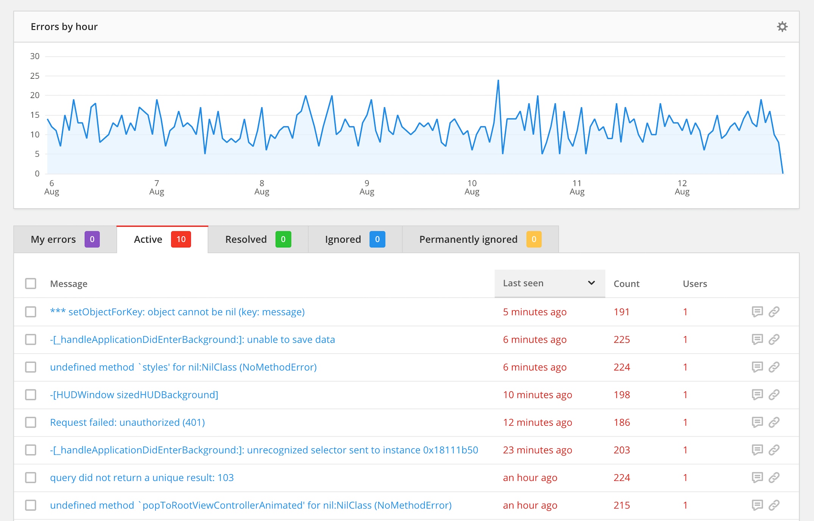
Automatic Monitoring: Bug Tracking
Crash reports sent automatically
  Many applications request permission to do so
  On force quit
  On internal error
  Tools exist to analyze these if they are structured
Even if the system can recover from the error
  You can send information about the problem
  Need to get user permission for this (at installation)
  Code Bubbles detects and sends problems to our server
    Which we check periodically

Slide 17
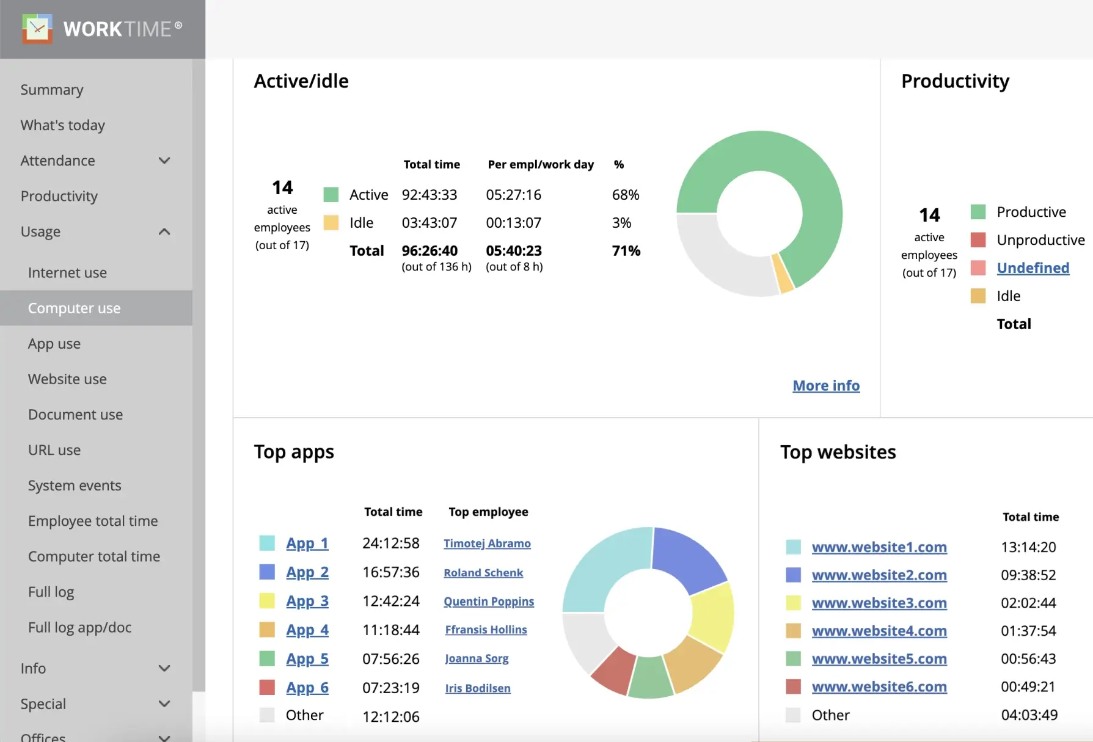
Automatic Monitoring: Usage
You can request permission to track usage
  To help improve your system
  From user at installation
Need to instrument the software
  To provide the necessary data
  Better to do it at random for short periods
    You can still get a good sample
    And the user shouldn’t notice the instrumentation
Output the information so it can be analyzed
  Standard (structured) format usable with log analysis tools
  Code Bubbles command logs

Slide 18
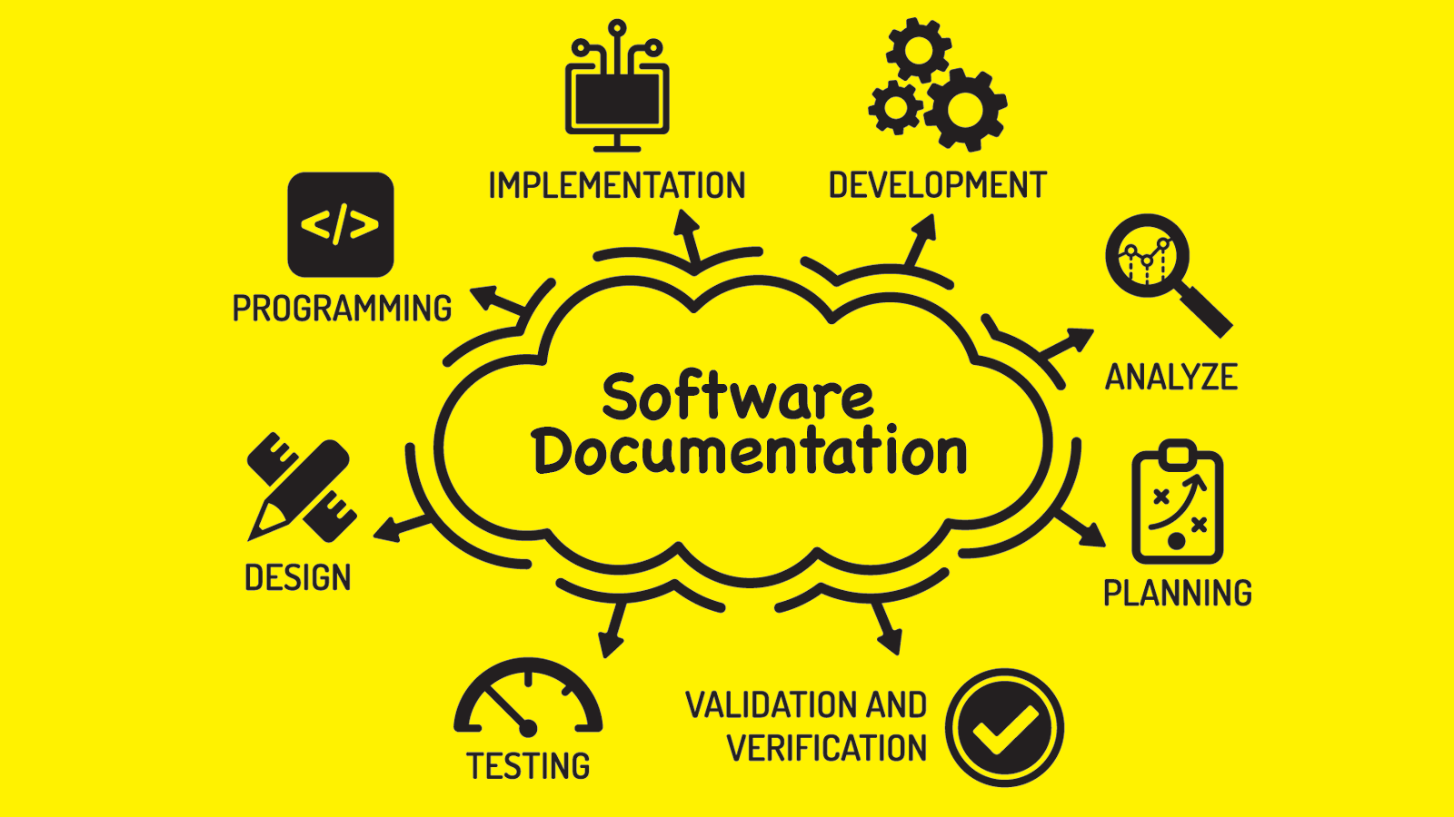
Documentation
Users expect documentation
  Even if they don’t use it
    A system that needs documentation is a faulty system (poor user interface)
    How often do you read documentation
  Actually, most people do read documentation
    But in subtle forms
Programmers hope for documentation
  When they must maintain the code
  When they want to understand or reuse the code
  And they hope the documentation is accurate and up-to-date
    But you should be skeptical

Slide 19
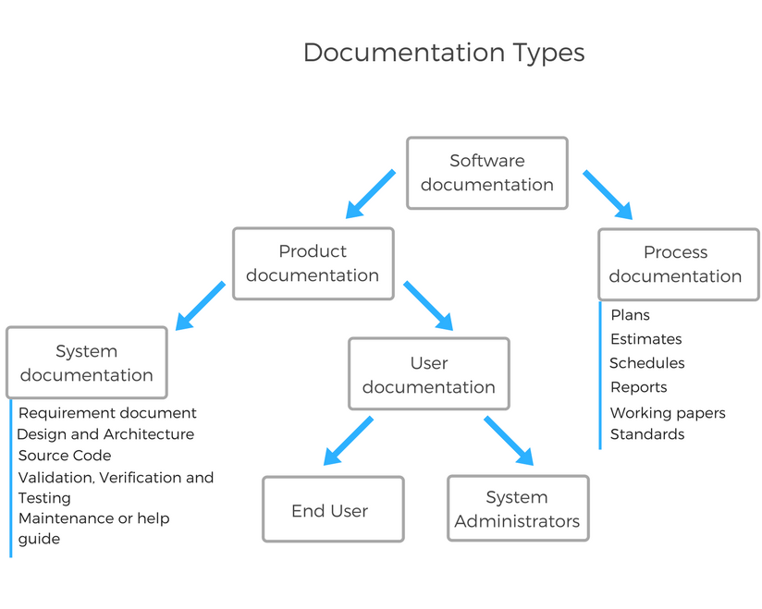
Forms of Documentation
User Documentation
  Manuals
  Tutorials
  Help systems (searchable manuals)
  Tool tips
Code Documentation
  API descriptions (JavaDoc)
  Usage examples
  In line and block comments
  Design documents, interfaces, facades, UML
  Get in the habit of documenting as you write and rewrite
Note that documentation tends to get out of date as code evolves

Slide 20
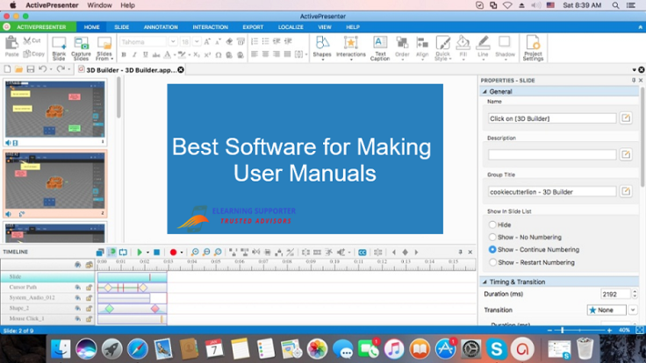
User Manuals
Written so they can be used interactively
  Small units, properly labeled
  Indexed
  Tools exist for this (EBT, FrameMaker)
  Many of the descriptions are too simplistic to be useful for difficult problems
    Manuals are not detailed enough to be helpful
Difficult (tedious) to write
  Most people only read a small portion
    Need to be concise but complete
  Determining what is relevant or important
  Documentation writers might not know software that well
    Programmers don’t have time/knowledge/ability to write manual well
  Indexing needs to handle different vocabularies
    User terminology and programmer terminology often differ

Slide 21
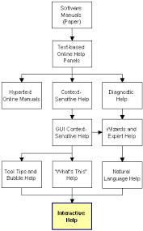
Interactive Help
Context-sensitive help systems
  F1 brings up help based on current location
Other forms of help
  Code Bubbles help (DEMO)

Slide 22
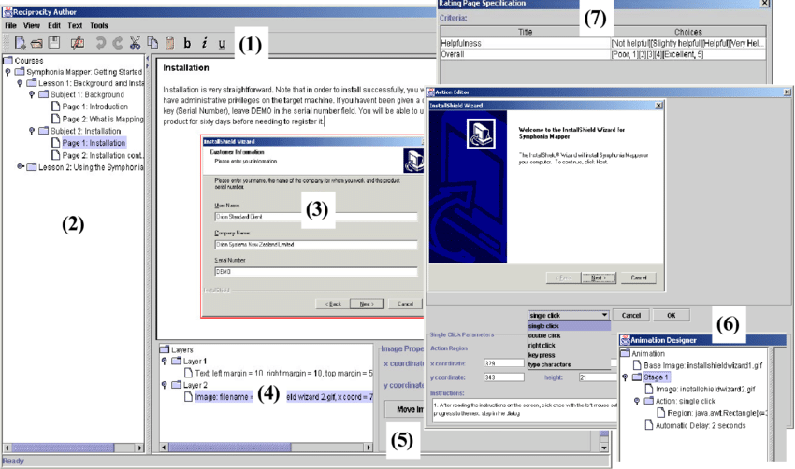
Tutorials
A tutorial is a good start for understanding
  Attempt to illustrate main features
  Show off the system capabilities
  Give users enough knowledge to start doing their own work
A video of the tutorial (or the system in action) can help
  To promote the system
  To help users understand how to use it
  To help understand the tutorial
  Necessary for research software
A hands-on tutorial (possibly with a video) is better
Tutorials should be easy for the user to install and use
  Consider the docker tutorial you did earlier

Slide 23
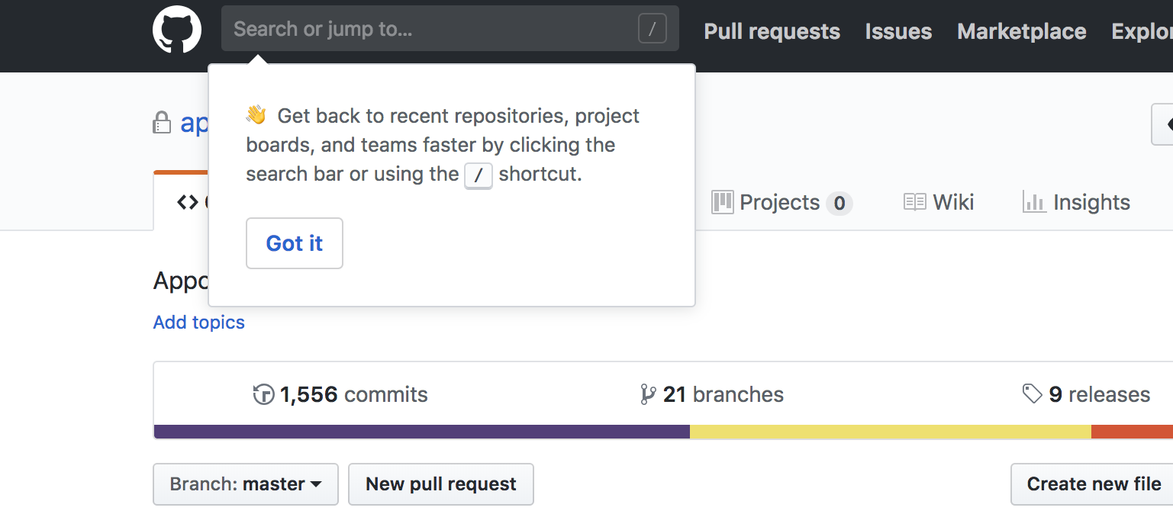
Tool Tips
These are the most convenient documentation tools
  Don’t require any effort on the user’s part
  Always available
  Users are used to them
  Available in most front-end and web tool kits
You should provide tool tips for all UI features
  Every button, icon, text field, …
  Any place else where additional information can be helpful
    Bubbles code editor – elision, line number, debugger context, variable values, …
Tool tips can be more than just pop-ups
  Consider hints in VS-Code
  Consider the help pop-ups in code bubbles
Be careful that tool tips don’t get in the user’s way

Slide 24

Monetizing Your Project
Software has costs to maintain
  VMs are not free
  Need hardware and software maintenance
  Need programmers
You need a business plan to support long-lived software
  Ads, contributions, subscriptions
  Selling data
  Supported by company
  These might need to be part of requirements/specifications
  Support does not mean profit (but it can)

Slide 25
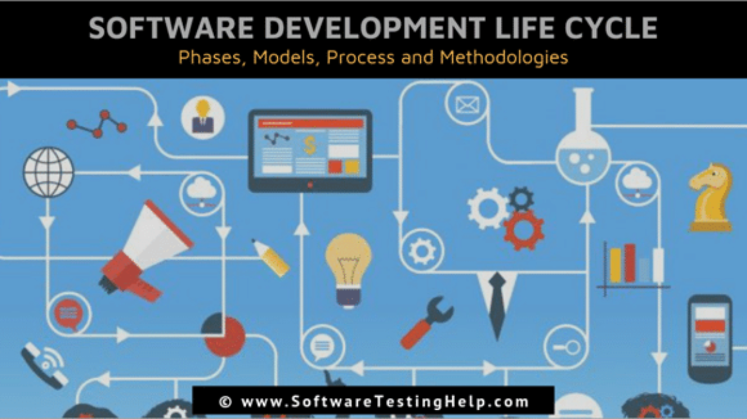
Course Review

Slide 26
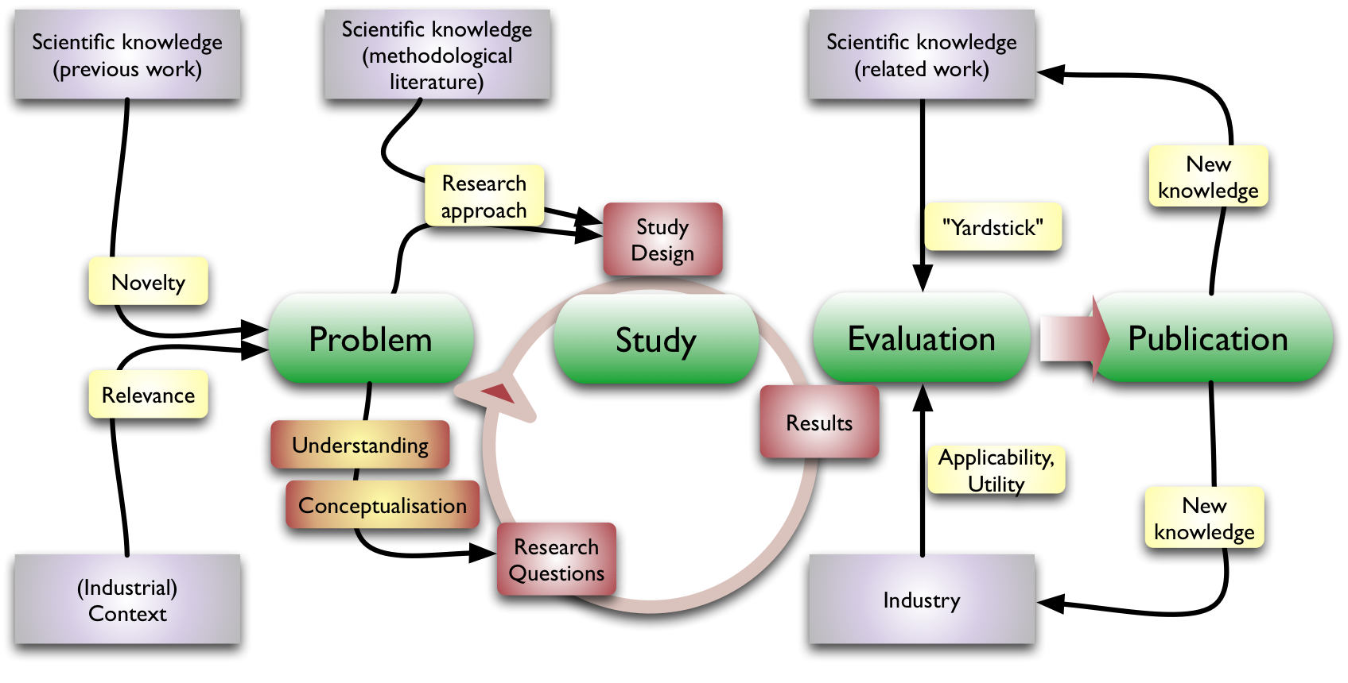
Software Engineering Research
If anyone is interested in research
  On any of the topics covered in the course
  Or related topics
Drop me an email
  Or we can schedule a meeting

Slide 27

THANK YOU!!!

Slide 28
PROJECT Presentations
Presentation Schedule
  11/26: User Interface Generation
  12/03: Speech
  12/03: Sense IoT
  12/05: DJ Mix
  12/05: LLAMA
  12/10: Agentic
  12/10: Accessibility
Final Demonstrations 12/12
  10 minutes each as needed (optional)
Each project gets up to 40 minutes (1/2 class)
  Present the problem (requirements, specifications)
  Present the solution (design)
  Present the system (implementation)
  Demo or video of the system in action (live preferred on the 12th)
  What you learned
  Future plans
  Questions
Feel free to invite your friends and sponsors and anyone interested in the project

